Slide 1
South Africa
Dr. Tamaryn Morris and Mrs Mardené de Villiers
South African Weather Service
tamaryn.morris@weathersa.co.za

Slide 2
About Organisation (Met-Ocean Structure)
VOS responsibilities:
Research and Cargo ships (mostly from Cape Town harbour)
SOOP responsibilities:
XBT transects along AX25 and CrossRoads lines
TSG, CPR and PCO2 opportunistically
ASAP responsibilities:
SA Agulhas II (Once a day at midday)
Institute/staff (PMOs):
Mardené de Villiers

Slide 3
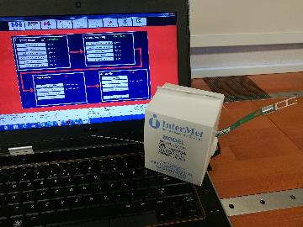
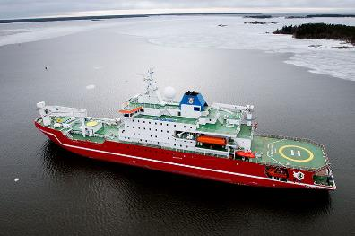
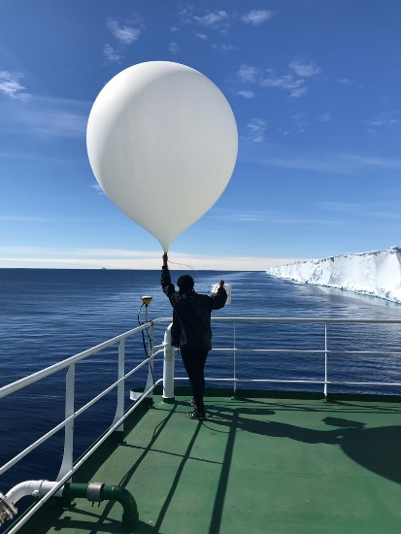
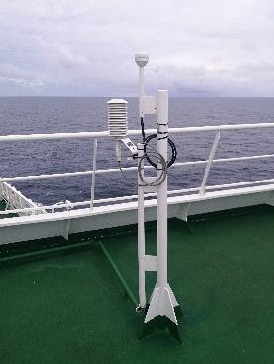
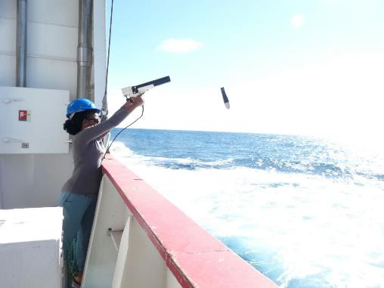
SOT Activities
Instrumentation
Automatic Weather Station
HMP155 (Temperature and Humidity)
Ultrasonic wind sensor
PTB110 (Pressure)
Upper Air
InterMet Radiosondes
Helium Gas (ship) and Hydrogen (Islands)
SOOP
XBT’s provided by NOAA
Seabird TSG system

Slide 4
Other initiatives/resources: Integration across OceanObs networks
OCG
OCG Capacity Development Task Team
Tamaryn Morris
OCG Boundary Current Workshop
Tamaryn Morris
OCG S+BP (assist)
Mardené de Villiers
and Tamaryn Morris
SOT Focal Point (SA) and PMO
Mardené de Villiers
SOT Task Team (CD)
Mardené de Villiers
SOOPIP Co-Chair
Tamaryn Morris
DBCP Focal Point (SA)
Tania Daniels
South Atlantic Panel Chair
Tania Daniels (tbc)
Indian Ocean Panel Chair
Tamaryn Morris (tbc)
Argo Focal Point (SA)
Tamaryn Morris

Slide 5
Gaps and Requirements, and Covid-19 Impact
Migration of data to BUFR format, timeously
Submission of historical data and metadata particularly for SOOP activities (TSG, PCO2, CPR)
COVID-19 impact – none. Relief cruises continued as before for bases as essential

Slide 6
Future Plans
Work with S+BP team to finalize documents for SOT (VOS, ASAP and SOOP)
Outreach to neighbouring African countries and other vessels for recruitment of vessels to VOS in particular
Work towards BUFR data migration
Work with other Ocean Observing networks (Argo, DBCP) to make best use of cruises and data acquisition possibilities

