Slide 1
Agenda Item 1: Opening Remarks
Darin Figurskey, SOT Chair

Slide 2
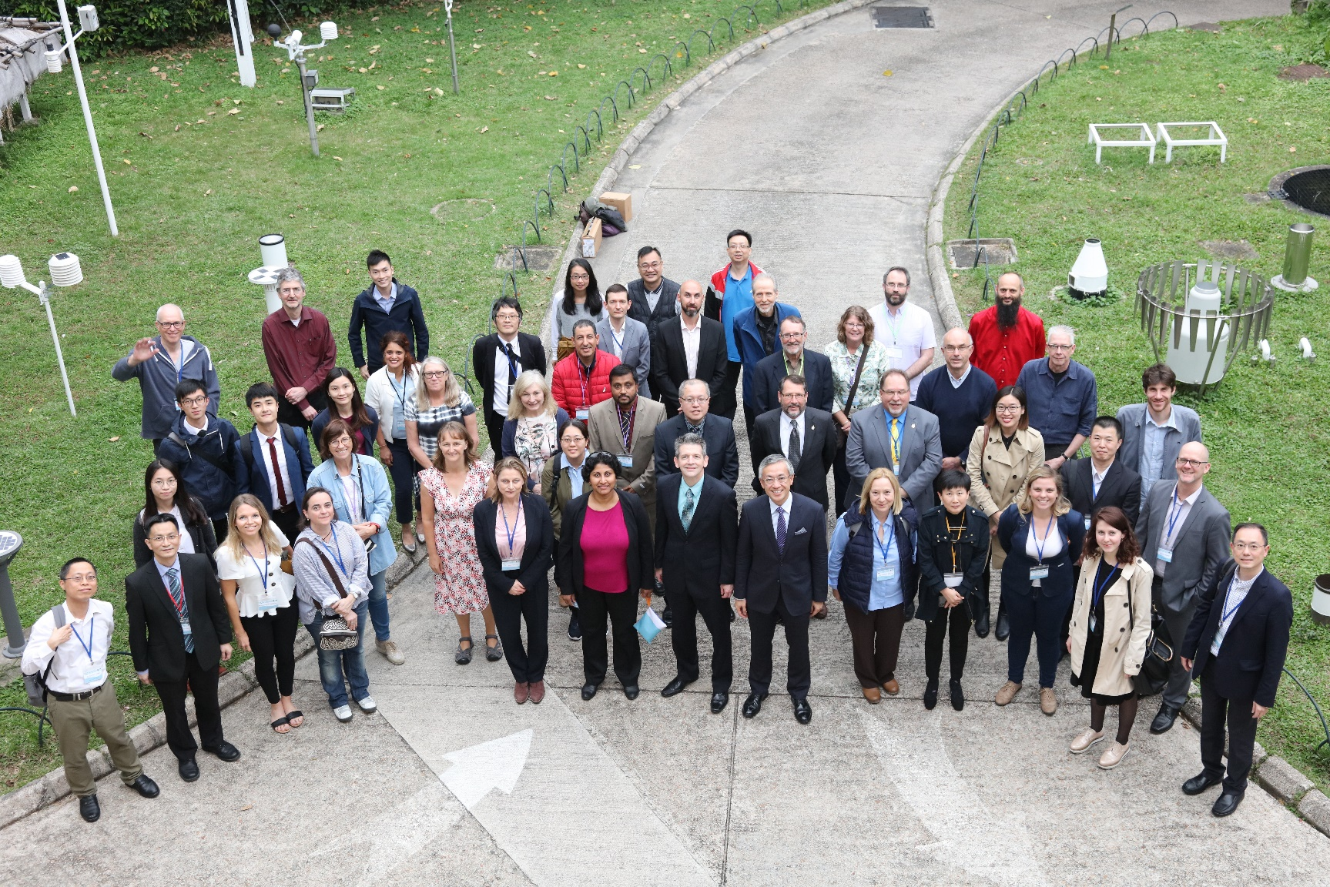
Thank You For Your Service!
We are grateful for their years of service, their commitment to science and observations, and their friendship.
SOT – 10, Hong Kong Observatory, April, 2019

Slide 3
Developments and Achievements
SOOPIP
Seamless leadership transition in progress with the SOT’s approval.
Very good progress on standards and best practices.
Recent cross-network workshop on boundary currents.
Developing closer relationships with Ferrybox and CPR/TSG/pCO2 communities.
VOS
Hosted PMO-6.
VOS contributions from Denmark and Thailand.
Validated the SOT metadata structure in cooperation with SOOPIP, including reference tables and definitions.
SOT-ID codified at recent INFCOM session.
Maersk coordination and developing closer relationships with other partners.
Working to trace Open-GTS observations from beginning to end through DWD and NOAA dataflows.
Coordination with Iridium on functions of its SafetyCast GMDSS service.
Coordination started with the Global Cryosphere Watch (GCW).
ASAP
Great coordination with Polarstern Arctic research expeditition.
1350 additional soundings overall in 2020 vs. 2019.
Possibly two new U.S. participants.

Slide 4
Intersessional Plans and Opportunities
Working through the UN Decade of Ocean Science.
Renewed attention to SOT-wide KPI(s).
Continued metadata transition activities.
Capacity development.
Best practices.
Task team support across the SOT.
WMO functional connections.
Periodic webinars.
Approximately 2X annually.
Keep networks informed of SOT-wide activities.
Recruitment.
Your thoughts?

Slide 5
Come Back Together (Mostly) by 2023

