Slide 1
The Netherlands KNMI
Arjan Kramer (PMO)
mail: kramer@knmi.nl

Slide 2
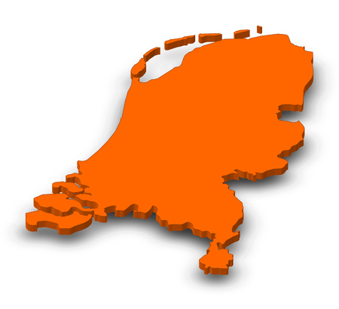
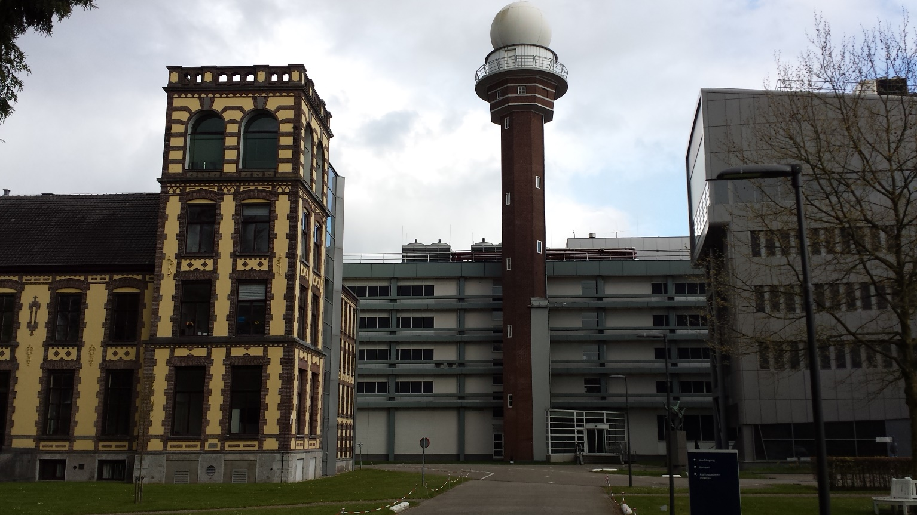
KNMI
Royal Dutch Meteorological Institute
established in De Bilt since 1854
www.knmi.nl
$$→$$

Slide 3
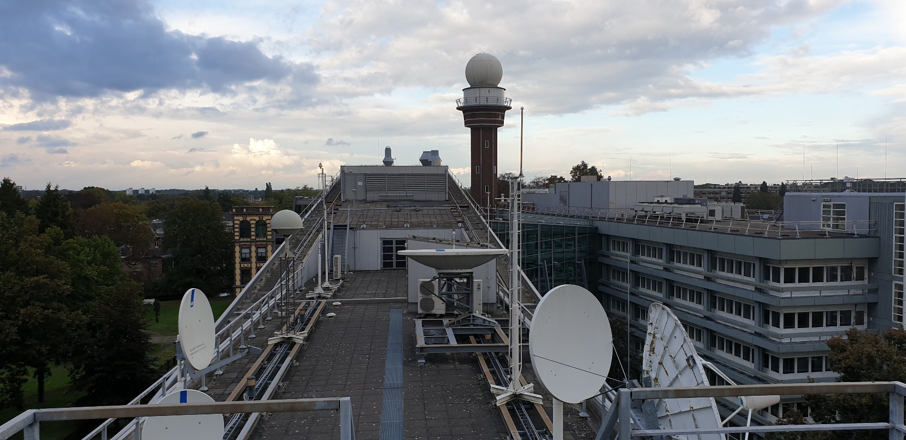
Our PMO team
Yvonne Schavemaker (team lead)
Martin Stam (TurboWin+)
Rene Rozeboom (PMO)
Arjan Kramer (PMO)
1 full time equivalent

Slide 4
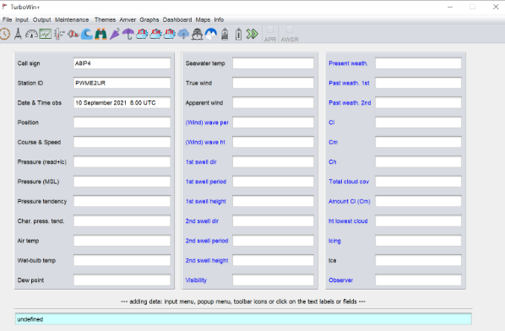
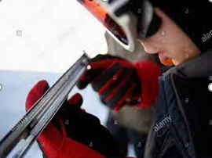
TurboWin+ (E-SURFMAR/KNMI)
Download of the lastest version and forum:
https://gitlab.com/KNMI-OSS/turbowin/turbowin

Slide 5
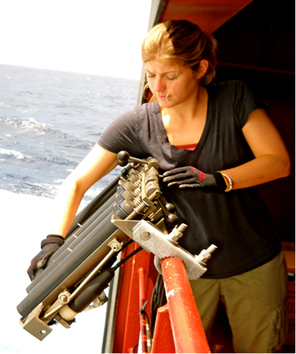
VOS responsibilities: 70 ships (conv)
2 EUCAWS SYSTEMS Lagarfoss/Atlantic Klipper
SOOP responsibilities: 3 inactive (corona related)
ASAP responsibilities: 0
BUOY deployment: 14 drifters a year (2 arctic)

Slide 6
Consequences corona virus
Shipping companies and seamen do not want you to visit them
Decrease of observations because of no supplies and visits
Installation of EUCAWS behind schedule
No commercial expedition tours (ships laid up)
Communication difficulties (processes are slower)

Slide 8
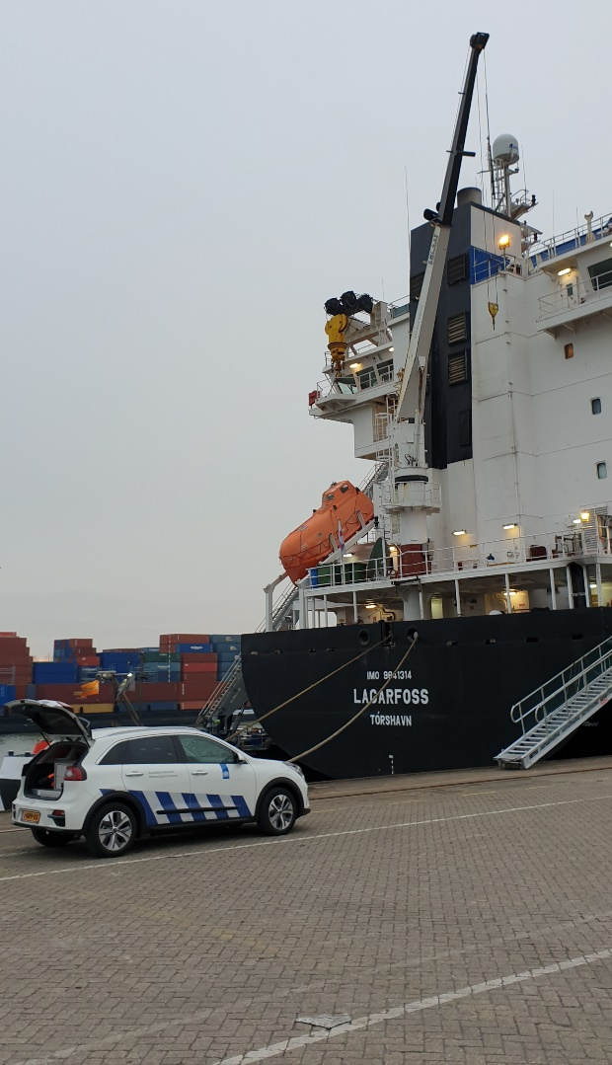
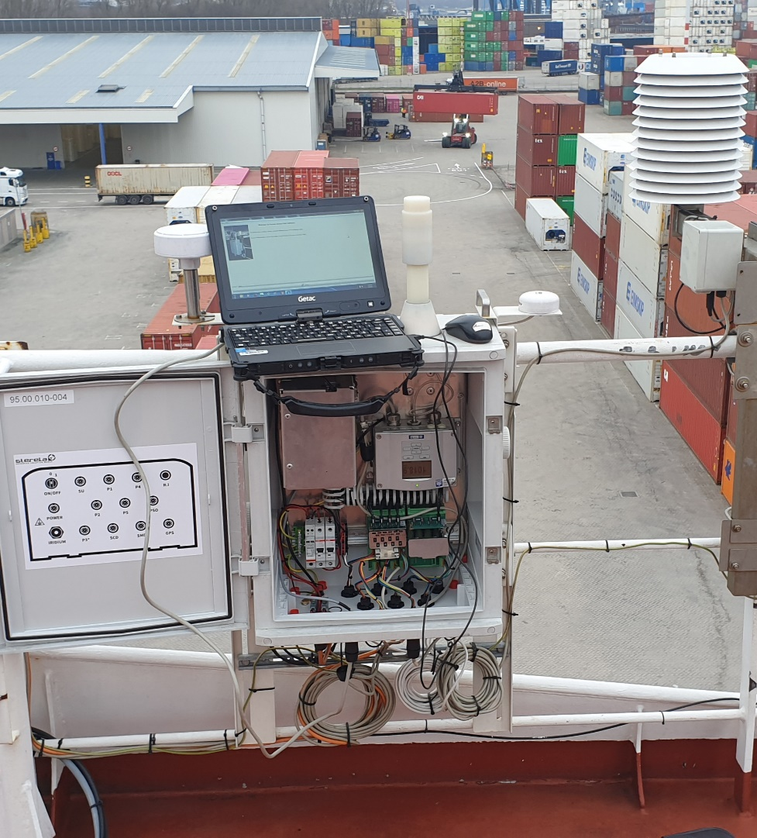
EUCAWS SYSTEM MOUNTED ON M/V LAGARFOSS

Slide 9
M/V Atlantic Klipper/Lagarfoss

Slide 10
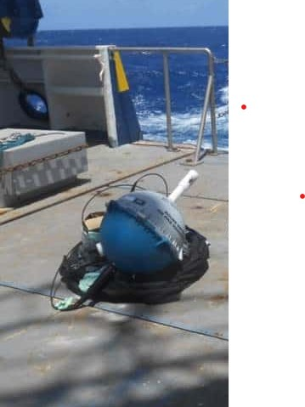
DRIFTERS (E-SURFMAR)

Slide 11
Trajectory of one of our drifters deployed in May.
Iceland

Slide 12
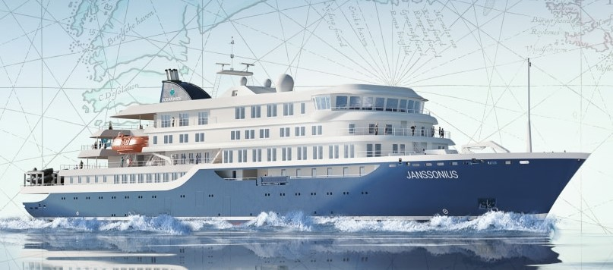
Planning this year 4 EUCAWS systems on
Ocean Wide Expeditionships in sparse areas
(North- and South Pole).

Slide 13
Future plans
Increasing visiting VOS ships
4 more EUCWAS this year
Planning 10 EUCWAS for 2022
Adding sonic windsensors and seawater temperature measurements (EUCAWS)

Slide 14
Thank you for your attention.
Any questions?

