Slide 1
Canada
Puneet Jaswal, Marine Standards Officer, Meteorological Service of Canada (MSC)
and
Alexander Zucconi, Marine Network Manager,
Meteorological Service of Canada (MSC)

Slide 2
About Organisation (Met-Ocean Structure)
VOS responsibilities:
Produce hourly observations via a network of Automatic VOS systems
Network is currently comprised of 42 active ships
MSC Marine Network staff comprises of a National coordination and standards team, Regional PMO’s, and several technicians

Slide 3
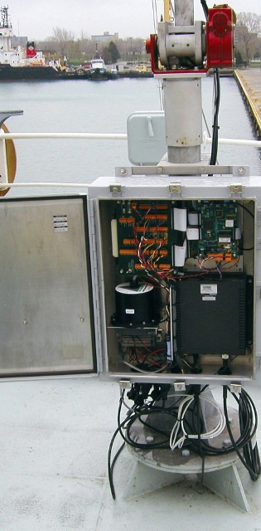
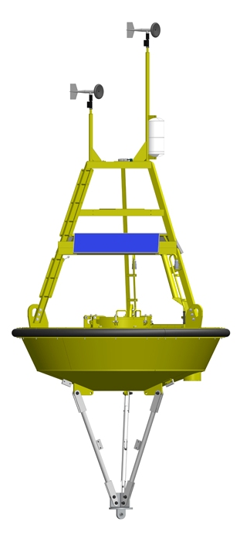
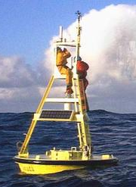
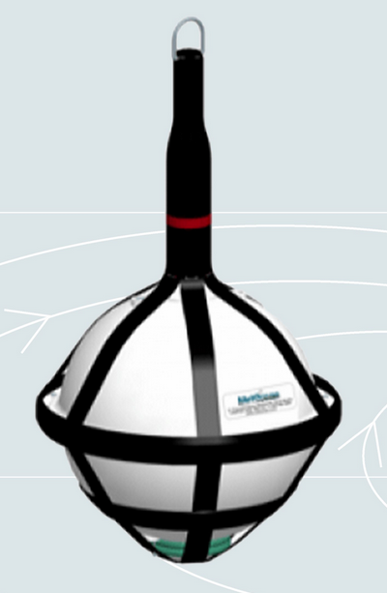
MSC Marine Network Structure
Marine Network
Moored Buoy Network
AVOS Network
Drifter Buoy
/METAREAS
OPP Network

Slide 4
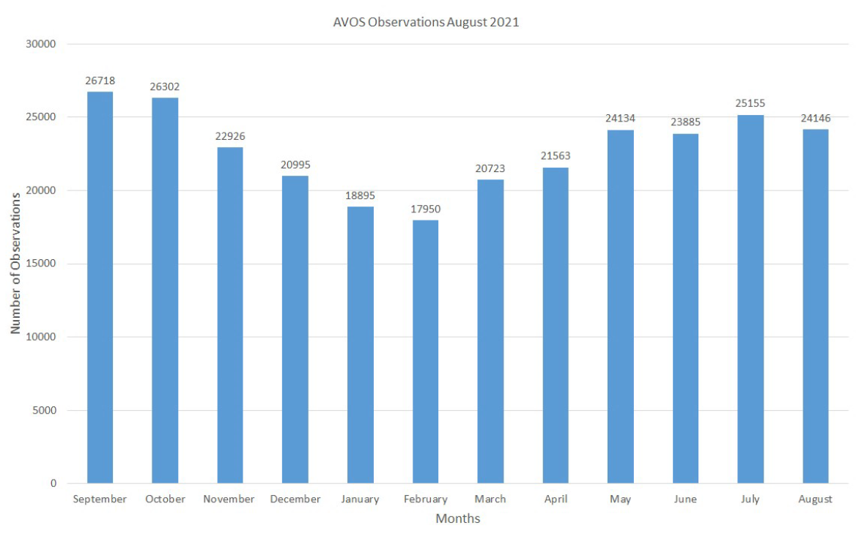
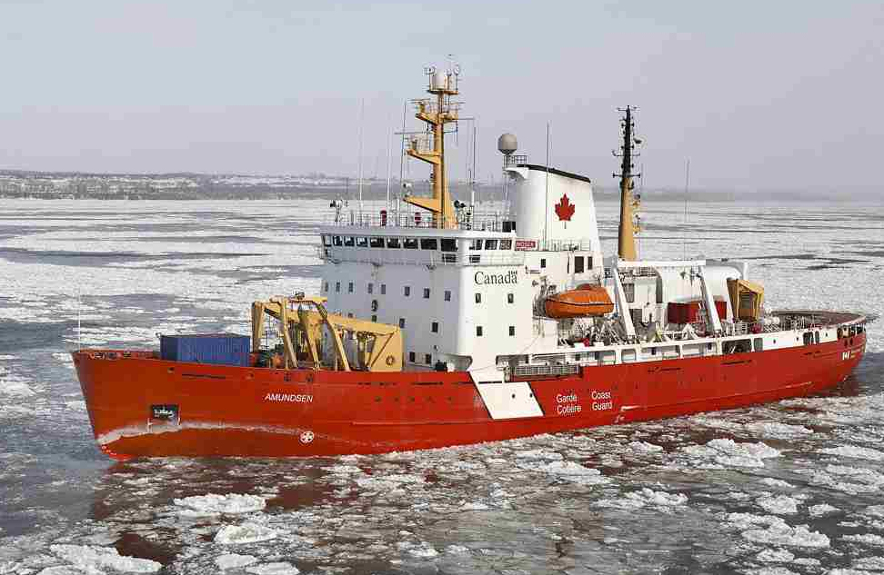
Performance during Pandemic
Observation count:
2020: 314371 (automatic), 1325 (manual)
2021 (thus far): 178922 (automatic), 8488 (manual)
Observations typically increase over summer time due to winterization of many ships

Slide 5
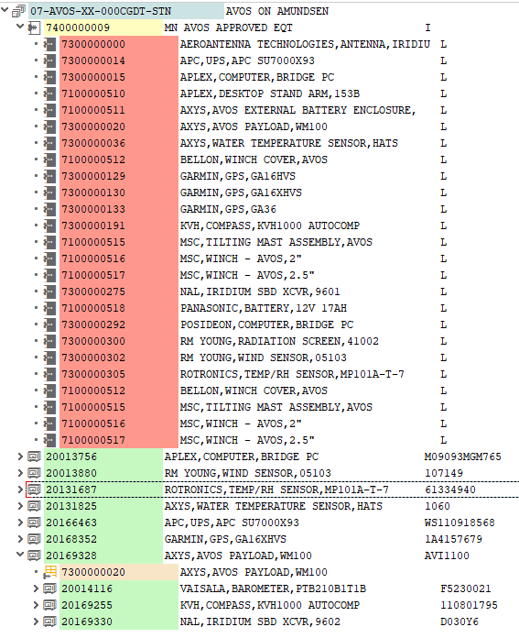
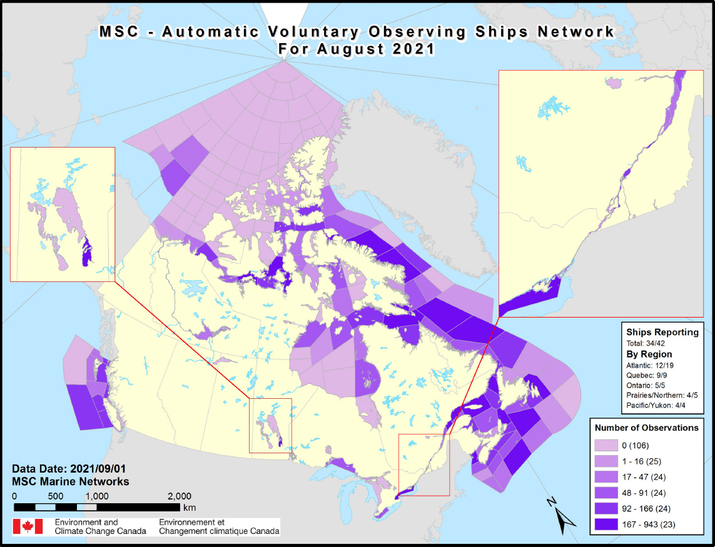
Performance in 2021
Official total fleet : 42 ships, mostly Canadian Coast Guard
4 currently suspended for repairs.
5 ships lost over the year due to retirement, looking to recruit more however candidates must pass selection process
Standard ship BOM slowly being upgraded

Slide 6
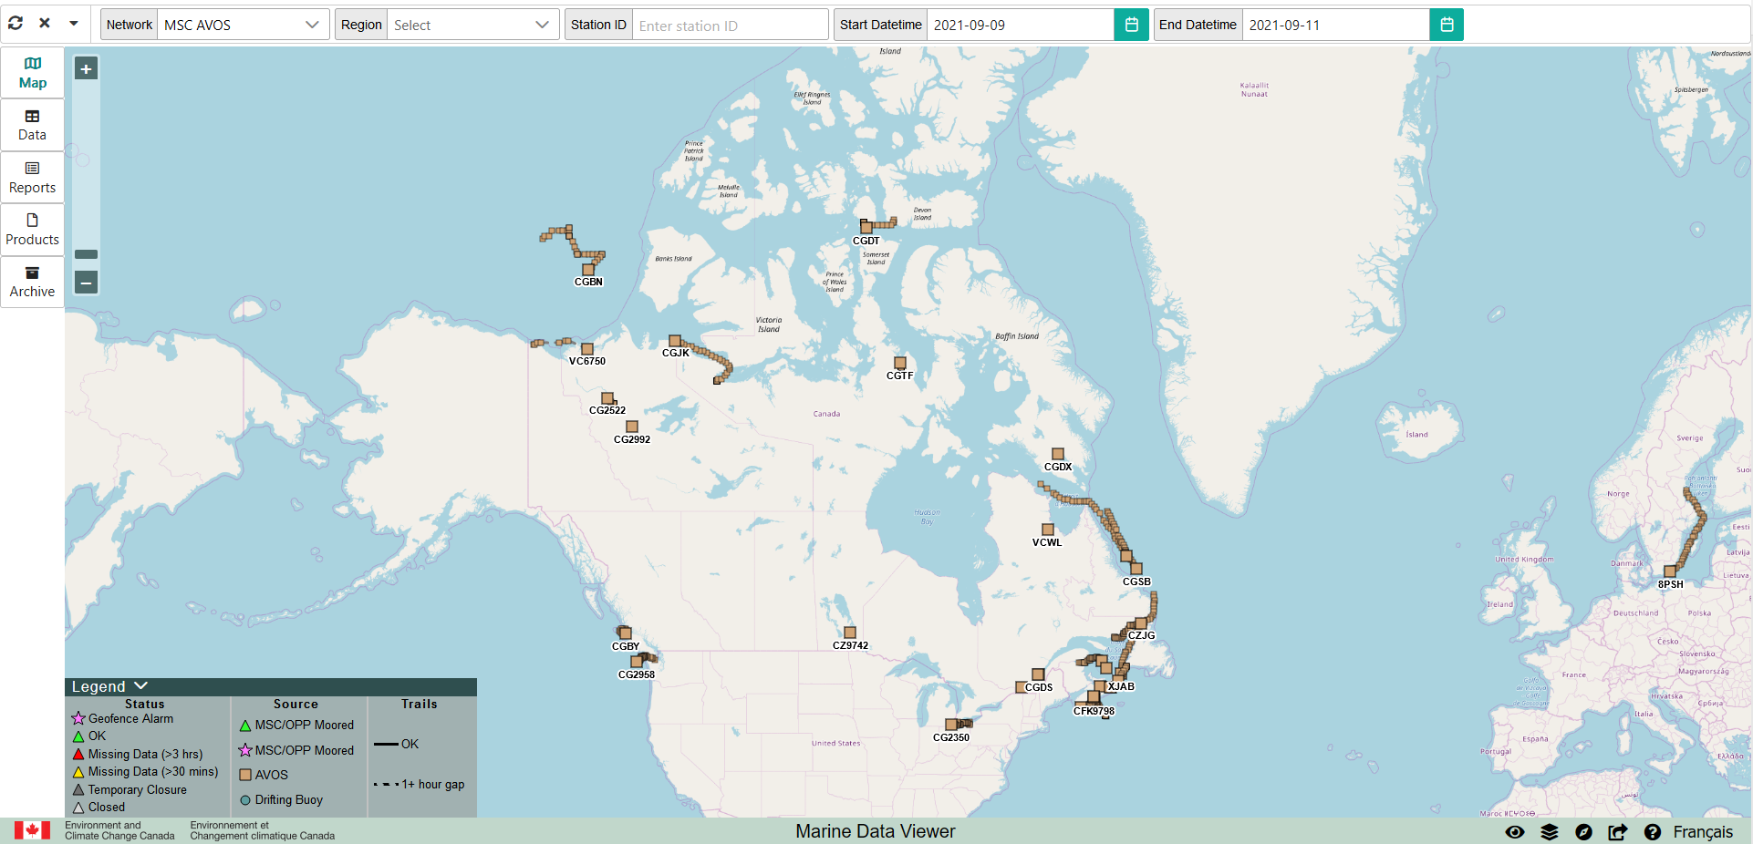
Marine Data Viewer
New marine network viewer to view location, data, and reports

Slide 7
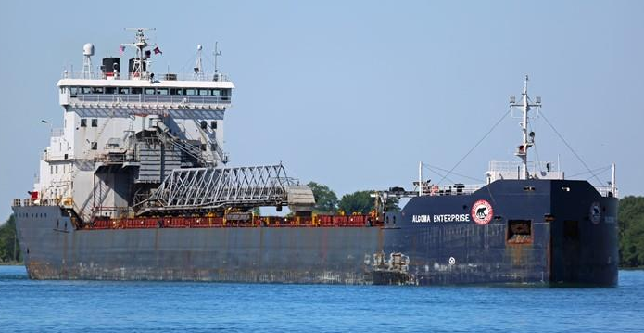
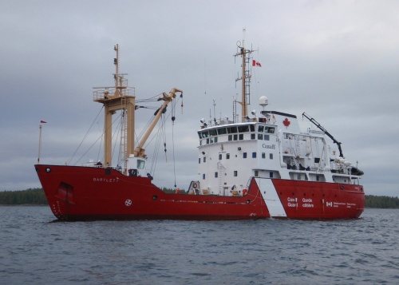
Gaps and Requirements, and Covid-19 Impact
COVID - missed scheduled maintenance
Result: issues such as time sync errors rampant
Still producing FM-13, hope to migrate to BUFR soon, but still far from implementation date
Ship loss due to age/attrition

Slide 8
Future Plans
Finally close to implementing SOT – ID
Slowly upgrading fleet to new generation payload
WM100 > WM500
Conducting a large analysis of AVOS network
Investigating where to optimize, identify monitoring gaps, and leverage new opportunities
Ship Recruitment – new CCG ships have AVOS infrastructure “roughed in”
Goal: 50 stations

