Slide 1
5.0: ad hoc Task Team – Key Performance Indicators
David Berry, ex Chair of ad hoc Task Team
Elizabeth Kent, UK National Oceanography Centre

Slide 2
Terms of Reference
The ad hoc Task Team on Key Performance Indicators shall:
Derive Key Performance Indicators for the various panels of the SOT, and for the SOT as a whole;
When developing these Key Performance indicators the Task Team shall consider:
the user requirements for observations (OSCAR/Requirements);
the existing leading programs in each panel of the SOT, with their existing Key Performance Indicators;
Note that such Key Performance Indicators shall inform about current situation and progress regarding
Implementation
Data Flow
Instrumentation
Operations
Data Uptake
International Cooperation (as relevant);
Follow-up the implementation of such Key Performance Indicators by JCOMMOPS on the JCOMMOPS website;
Review the list of static maps produced by JCOMMOPS and advise on potential changes.
Notes:
Note, need to change JCOMMOPS to OceanOPS

Slide 3
Members
David Berry (ex-lead)
Axel Andersson
Darin Figurskey (ex officio – SOT Chair)
Henry Kleta (ex officio – VOSP Chair)
Martin Kramp (ex officio – SOT TC)
Rudolf Krockauer
Shawn Smith
Janet Sprintall
Callum Stone
Rik Wanninkhof
Notes:
Members as of March last year but recognition that need to expand group. Climate requirements weakly captured, mostly operational

Slide 4
Actions / recommendations from SOT-10
Actions:
A6.9/1: The KPIs marked as priority 1 in the attached KPI list are to be implemented on the JCOMMOPS website. They are recommended for inclusion, as appropriate, in future editions of the JCOMM Ocean Observing System Report Card. (SOT-TC; SOT-11).
A6.9/2: Agreed to distribute KPIs presented above for review by the Team members during next two weeks. (TT-KPI; 30 April 2019)
A6.9/3: The KPI list is adopted as a living document, and the Ship TC is to report at SOT-11 on the progress of implementation of KPIs marked as priority 2. (SOT-TC; SOT-11).
Recommendations:
R6.9/1: The KPIs for spatio-temporal coverage proposed in by the TT-KPI should be discussed within JCOMM OPA, to cover all programs and activities. (OCG)
R6.9/2: Consider including surface marine data in the WIGOS pilot project on data quality monitoring, feeding it with data prepared by Météo-France QC tools and/or Met Office RTMC; once in place, consider basing the JCOMMOPS QC relay on these results. (WMO/TT-WMD)
Notes:
Actions mostly done (I think), for example KPIs integrated into report card.
SOT-TC updated on progress of implementation
As with UUID recommendations, unclear if communicate with respective parties.

Slide 5
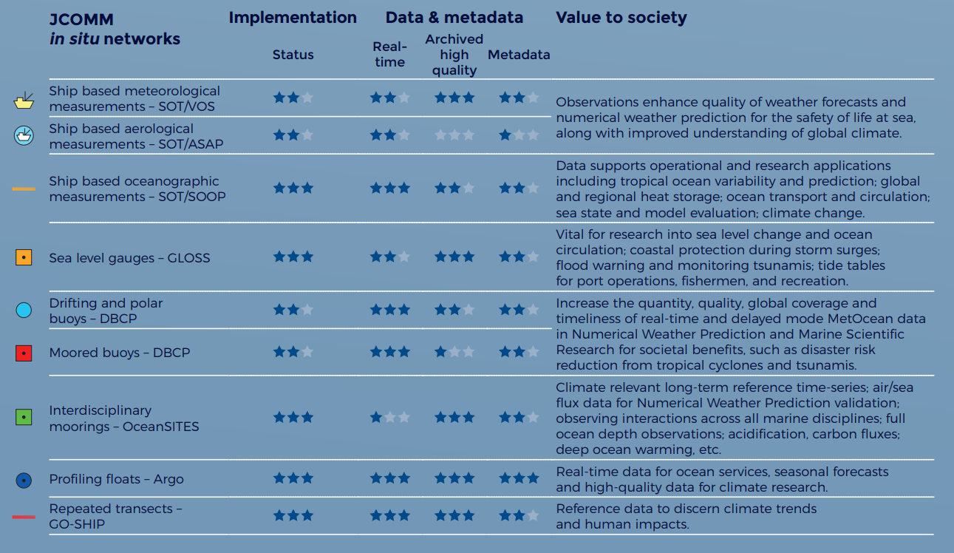
Example of KPIs included to Annual Report Card (example for 2019)

Slide 6
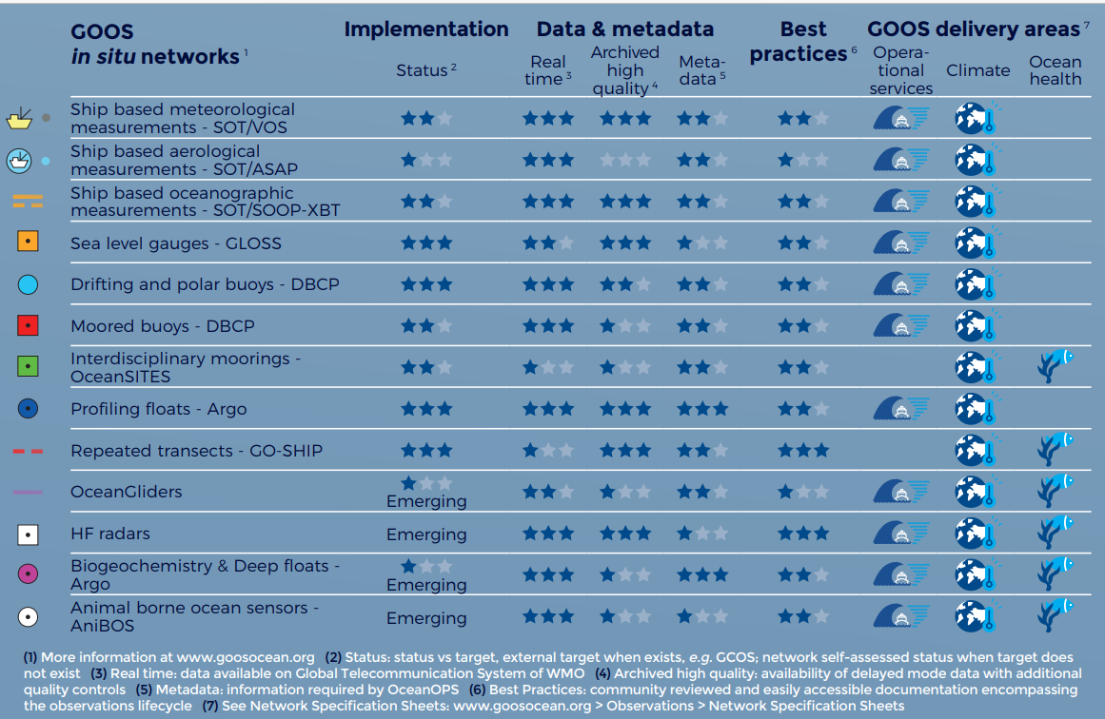
KPIs from 2020 annual report card

Slide 7
Activity over inter-sessional period
Change in leadership of task team during fall 2019 due to change in role and organization of previous lead / chair
Initial meeting spring 2020 to get activity moving again
Terms of reference and membership of the task team reviewed
Task team requested to review OceanOPS maps
Activity since stalled due to changing funding sources and over commitment of new chair

Slide 8
Review of KPIs (monitored by OceanOPS)
Notes:
Useful to review the existing requirements (in brief) as part of this meeting, only go over ones monitored via OceanOPS website, we can go through in detail at end.

Slide 9
Notes:
Example of KPI dashboard from OceanOPS website

Slide 10
Implementation
VOS
Coverage (monthly), number of ~2.5 degree grids cells meeting target # observations
Activity
VOSClim units, number and % of total fleet
Number of operational units
% unmasked
ASAP
Number of operational units
SOOP-XBT
Intensity, number of deployments
Number of reference lines
Activity
Number of ships
% of lines active
Notes:
Most of these are OK, exception is coverage for VOS. This KPI was selected as a first draft several years ago but only 4% of grid cells meet the target of 2 observations per day. KPI is for 75%.
More on this KPI later.
Other KPIs much better, either met or near to being met. Refer to OceanOPS monitoring site.
Missing SOOP-CO2 and BCG KPIs

Slide 11
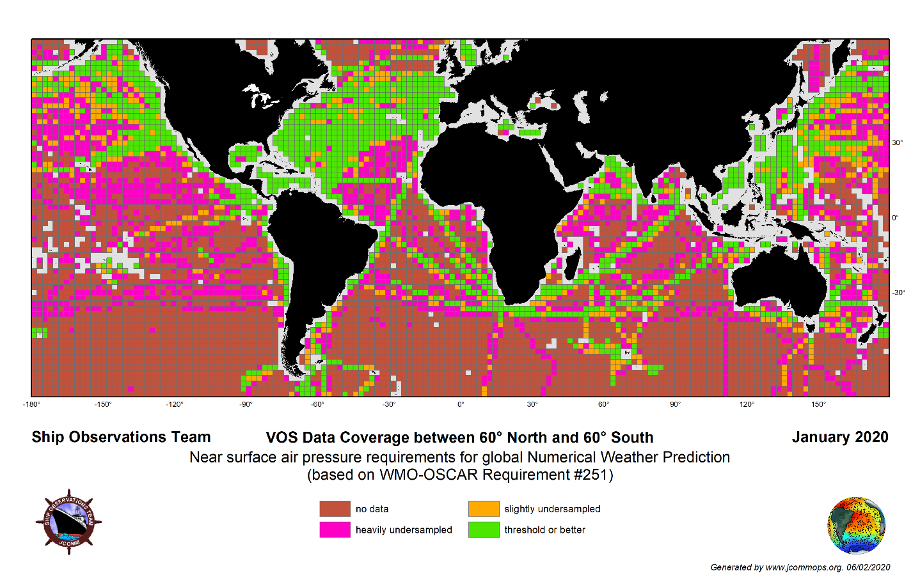
Coverage example
Notes:
Example of coverage for VOS, based on crude count of SLP obs. Need ECV based approach, taking error characteristics into account.

Slide 12
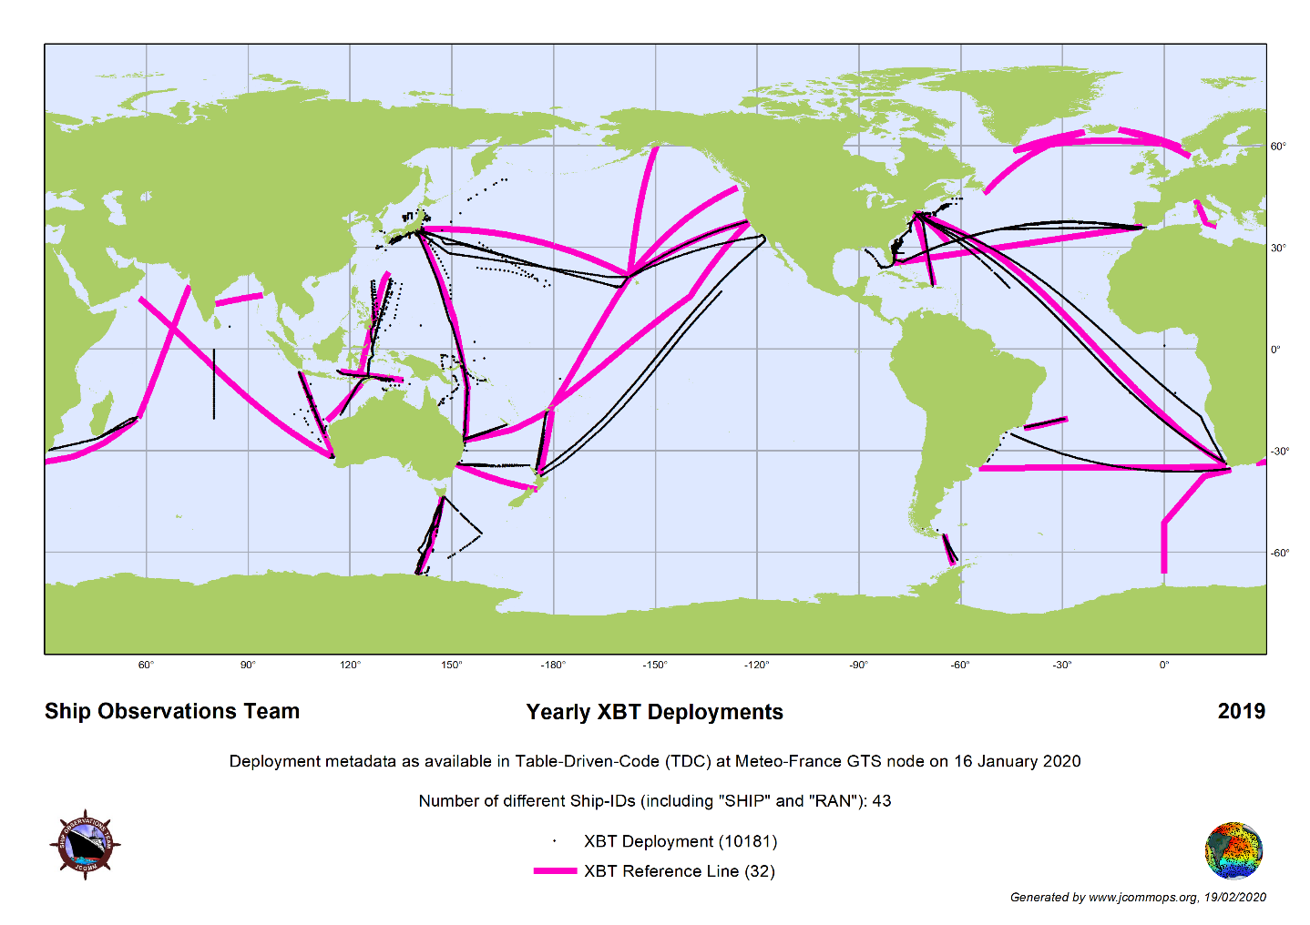
Coverage example
Notes:
Example of coverage for SOOP

Slide 13
Data flow
Metadata quality (SOOP-XBT, VOS)
At least one sensor recorded
Format (VOS)
TAC, TAC + BUFR, BUFR
Delivery (VOS)
Number of ships delivering at least 20 obs per month
Delivery (SOOP-XBT)
Proportion of observations submitted to GTS
Timeliness (VOS)
% of observations available within 120 minutes
Quantity (VOS, ASAP)
Number of monthly observations
Notes:
Most of these make sense, but with a few exceptions / contradictory KPIs, e.g.
100% target for TAC + BUFR and 100 % for BUFR only.
Need to include targets for delayed mode delivery.
Target for inclusion of metadata and use of latest BUFR template, incl. UUIDs
Availability of metadata through OSCAR

Slide 14
Instrumentation (VOS)
% of ships with AWS vs total number of ships
International (VOS, SOOP-XBT)
Diversity – number of contributing / participating countries

Slide 15
Related activities
AOPC
Ongoing activity defining requirements for climate monitoring to feed into RRR
OOPC
Similar process ongoing for near surface oceanographic data and air-sea fluxes
Difficulties
Land based targets not suitable for moving platforms, instead need to base on spatiotemporal statistics
Effort needed to convert requirements / uncertainty metrics to something usable for operators
e.g. uncertainty of 0.1degC over 100x100km areal average, how do we relate this to point observations and number required
Notes:
Note work by previous task team here as well.

Slide 16
Value of observations
Already clear that VOS observations are valuable to the global observing system by
Providing wide range of ECVs
Sampling along long transects, complementing other networks (e.g. drifters, moored buoy, etc)
Value increased by
Having extensive metadata on ship/platform characteristics, observing methods and protocols
Made with care, good data management
Sample frequently enough to be representative of diurnal cycle (e.g. hourly sampling)
Similar parallel statements can be made about the other panels (SOOP-XBT, ASAP)
Notes:
Always useful to reiterate value of observations, include how we can increase their value

Slide 17
Next steps
Evidence base on user requirements needs to be improved, especially at regional and local scales, including by application area (ongoing as part of the RRR process)
Uncertainty budget, relating sampling and observational errors to grid box mean values (at local, regional and global scales, annual to sub-annual)
Develop sampling requirements and map to network characteristics
This continues work begun previously by the task team

Slide 18
Recommendations / decisions
Convert to full task team (rather than ad-hoc)
Restart work of TT, following on from SOT-10 report (linked to from TT report)
Additional KPIs (to be developed)
Use of latest BUFR template, including metadata and UIDs (extends existing KPI)
Quality – blacklisting, mean error and RMSE
Percentage in each VOS class based on reported parameters (linked to existing KPI but more explicit)

Slide 19
(a) Adopt draft Decision 5.0/1 —Decision Continuation of TT-KPI: Recognising the importance of the work of the task team the SOT decided to promote the ad-hoc task team to a full task team.
(b) Adopt draft Action 5.0/2 —Action TT-KPI focus on spatiotemporal requirements: The SOT asked the TT-KPI to further develop metrics on spatiotemporal coverage, relating those metrics to the requirements as specified in the RRR (TT-KPI in coordination with the GOOS OCG/networks, GCOS AOPC and OOPC, and other relevant groups).
(c) Adopt draft Action 5.0/3 —Action TT-KPI enhance metrics on data flow, quality and VOS class: The SOT asked the TT-KPI to further enhance the metrics on: data flow to include monitoring the use of the latest BUFR sequences for marine data; quality of the observations, particularly linking to the MeteoFrance QC tools, black listing and error statistics (mean error and RMSE); and percentage of VOS in a particular class reporting the parameters required to meet that classification.

Slide 20
OceanOPS dashboard
https://www.ocean-ops.org/board?t=sot

Slide 21
Discussion

