Slide 1
INDIA
Dr. Balakrishnan Nair T. M
Scientist G & Group Director
Indian National Center for Ocean Information Services (INCOIS), Ministry of Earth Sciences
bala@incois.gov.in

Slide 2
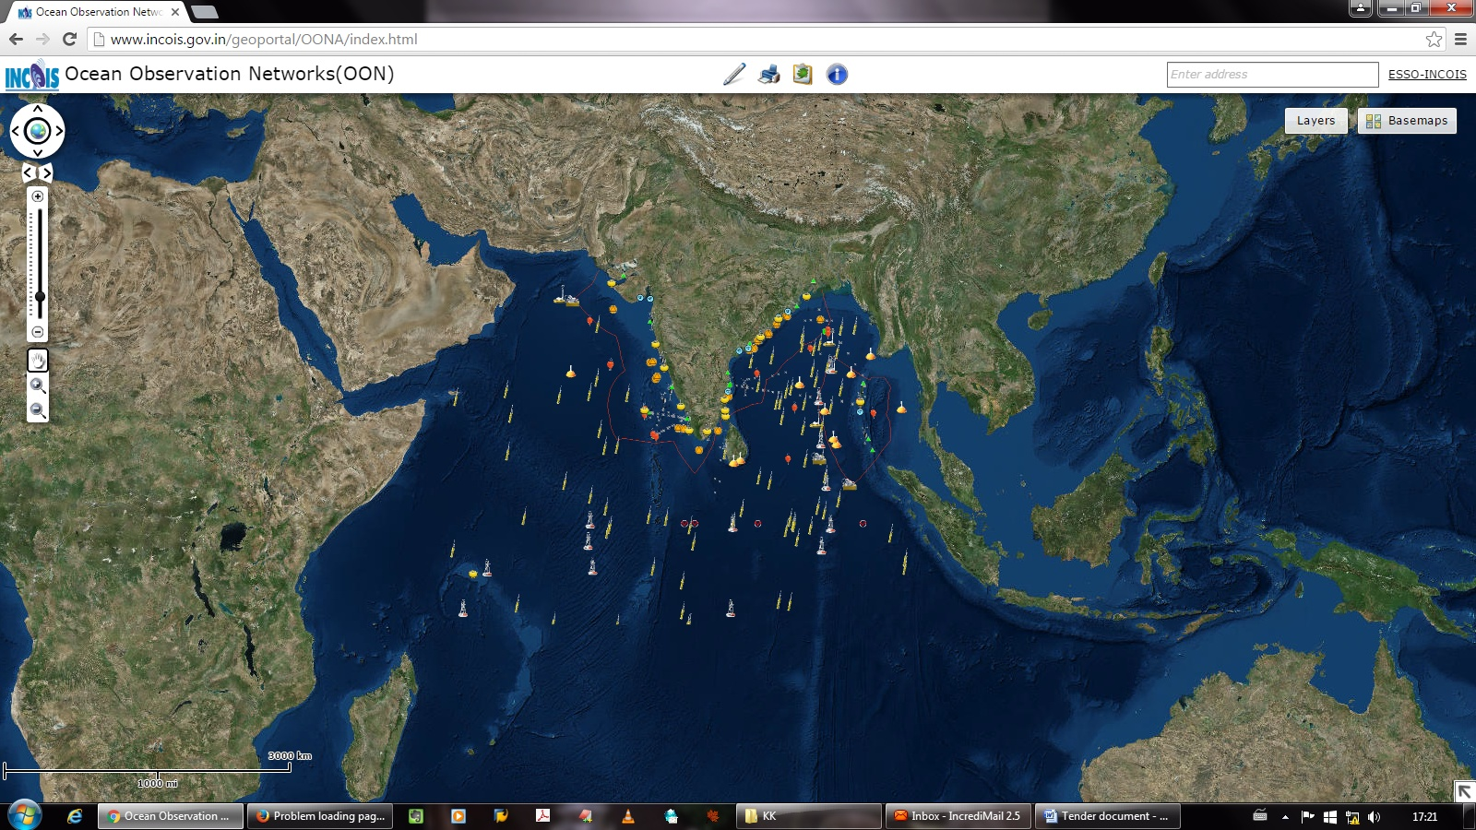
About Organisation
(Met-Ocean Structure)
Mission
“Provide the Ocean Information and Advisory Services to Society, Industry, Government Agencies and Scientific Community through Sustained Ocean Observations and Constant improvements through Systematic and Focussed Research”.
VOS responsibilities: (INCOIS)
  Research, Cargo and Passenger ships (All ports of India )
  Underway Biogeochemical & Wave observations
SOOP responsibilities: (NIO, Goa)
  XBT transects along 3 sectors
  Coastal time series salinity data
ASAP responsibilities:
(PMOs):India Meteorological Department
Our services to Indian Ocean Society
Potential Fishing Zones
Ocean State Forecast (Waves, Currents, SST, Tides, etc.)
Early Warnings (Tsunami, Storm Surge, High Wave Alerts)
Special Services for Blue economy stakeholders
Ocean Climate Services
2

Slide 3
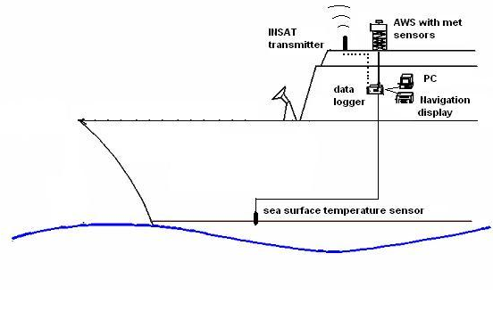
SOT Activities
VOS- INCOIS Real Time Automatic Weather Station (IRAWS)
Nowcast
Data Assimilation
Integrated Forecast System
Validation
Wind
Temperature
Baro.Pressure
RH
Chlorophyll
Turbidity
Radiation
IRAWS
3
Parameters | Sensor Make | Accuracy
Wind speed | S1510 –Ultrasonic Gill | 0.01 m/s
Wind Direction | S1510 –Ultrasonic Gill | 1°
Air Pressure | WEATHERPAK-2000, S1079W | 0.3 hPa
Air temperature | WEATHERPAK-2000, S1057W | 0.1° C
Relative humidity | WEATHERPAK-2000, S1057W | ±2%
Shortwave Radiation | WEATHERPAK-2000, S1092W Eppley | ±2%
Long wave radiation | WEATHERPAK-2000, S1425W, Eppley | ±2%
Sea surface Temperature (SST) | WEATHERPAK-2000, Thermister Type, S3338,RS-485 signal | 0.01° C
Rain gauge | WEATHERPAK-2000 S1111W | 2 mm
Chlorophyll +Turbidity | FLNTUS-ECO Chlorophyll fluorometer, Turbidity meter, Bio-wiper,Memory- Wetlab | 0-30ugChl/l
GPS | Trimble with marine grade antenna and enclosure
Gyro/Digital compass | WEATHERPAK-2000,S1085W
INSAT communication | INSAT-UHF transmitter

Slide 4
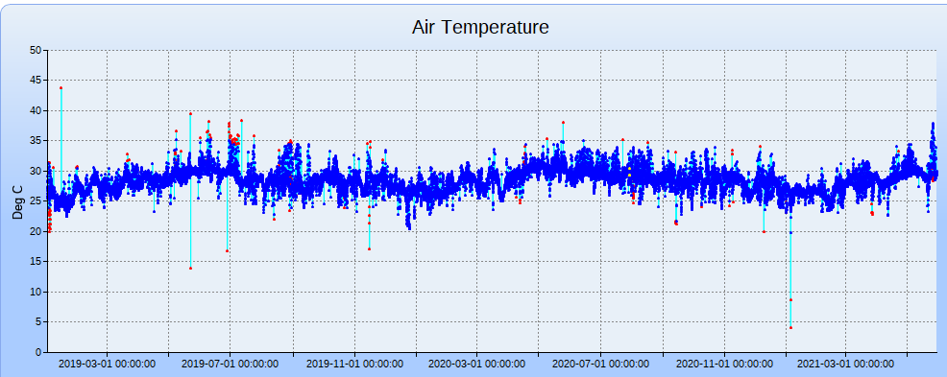
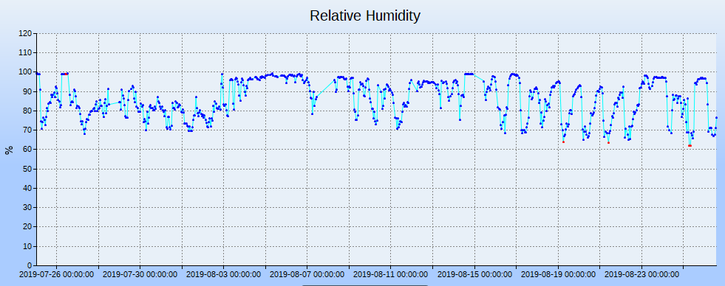
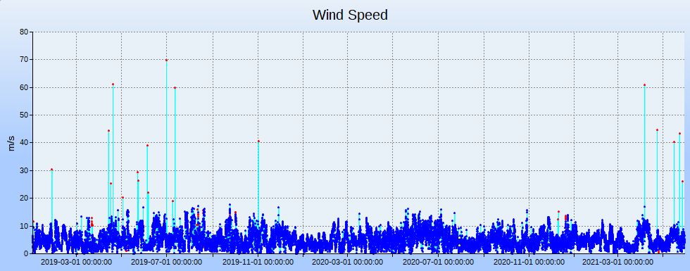
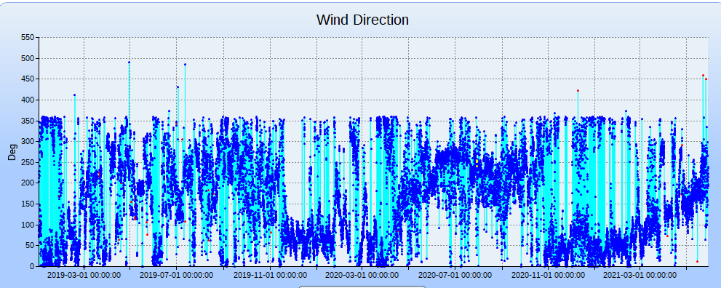
SOT Activities
Participating ships & Automation in Monitoring
 | Real time Repoting
 | GPS error Reporting
 | Drydock
 | Decommissioned
Header
SMVX02 DEMS
Ship Name | Deployment Date | Last Reported Time | Last Reported Latitude | Last Reported Longitude
ORV Sagar Kanya | 01.06.2010 | 29-05-2021 23:04 | 13.09111 | 80.33278
FORV Sagar Sampada | 26.07.2010 | 29-05-2021 23:10 | 9.93472 | 76.17333
CRV Sagar Purvi | 06.08.2010 | 23-05-2021 11:30 | 9.97556 | 76.24389
ORV Sagar Manjusha | 17.09.2010 | 29-05-2021 23:19 | 13.08083 | 80.32833
RV Sindhu Sankalp | 18.06.2011 | 02-02-2020 05:05 | 13.09028 | 80.3375
RV Samudra Saudikama | 07.07.2011 | 29-05-2021 23:50 | 9.97556 | 76.24389
RV Samudra Kaustubh | 21.08.2011 | 27-05-2021 11:12 | 17.69528 | 83.30333
SCI Nalanda | 25.05.2013 | 09-09-2021 00:09 | 18.93194 | 72.86889
FSI Mastya Vrushti | 05.06.2013 | 09-09-2021 07:19 | 20.06167 | 70.43917
ORV Sagar Nidhi | 11.06.2013 | 29-05-2021 23:59 | 13.08139 | 80.35056
FSI Mastya Drushti | 05.07.2013 | 29-01-2020 12:09 | 13.41889 | 80.36611
FSI Yellow Fin | 11.07.2013 | 06-06-2020 21:59 | 15.40444 | 73.82528
INS Sarvekshak | 30.07.2013 | 17-04-2021 04:09 | -8.153333333 | 64.50583333
FSI Sagarika | 29.08.2013 | 06-09-2021 09:59 | 15.40806 | 73.80472
FSI Mastya Varshini | 04.10.2013 | 29-05-2021 23:59 | 9.96194 | 76.28306
MV Nicobar | 28.05.2014 | 31-07-2021 08:10 | 22.53889 | 88.31472
FSI Blue Marlin | 17.07.2014 | 09-09-2021 06:59 | 11.66 | 92.72528
MV Swaraj Dweep | 30.04.2015 | 21-05-2020 05:59 | 22.53889 | 88.315
MV Nancowry | 10.06.2015 | 30-05-2021 00:00 | 11.68083 | 92.74694
SCI Yamuna | 03.07.2015 | 09-09-2021 07:19 | 18.92694 | 72.86278
MV Campbell Bay | 04.08.2015 | 09-09-2021 07:09 | 18.94444 | 72.84167
MV Sentinel | 08.09.2015 | 12-01-2021 09:59 | 11.65917 | 92.72472
MV Dering | 09.09.2015 | 29-05-2021 23:59 | 22.53694 | 88.29972
MV Chowra | 13.09.2015 | 12-02-2021 07:09 | 9.9575 | 76.28528
MV Kalighat | 14.09.2015 | 29-05-2021 23:59 | 11.68278 | 92.70944
INS Darshak | 05.10.2015 | 19-10-2020 15:11 | 15.4175 | 73.79166667
INS Sutlej | 06.10.2015 | 12-08-2019 05:16 | 9.950833333 | 76.28361111
INS Nirupak | 11.12.2015 | 20-06-2021 03:42 | 11.68083333 | 92.71722222
INS Sandhayak | 11.12.2015 | 19-03-2020 05:59 | 17.70083333 | 83.27361111
RV Ratnakar | 28.01.2016 | 17-02-2021 13:59 | 9.93639 | 94.79417
MFV Blue Fin | 26.11.2018 | 30-05-2021 00:00 | 10.57111 | 72.635
MV Lakshadweep Sea | 26.09.2020 | 06-09-2021 08:09 | 9.95139 | 76.26639
MV Arabian Sea | 28.12.2020 | 29-05-2021 23:59 | 10.58694 | 72.9925
Ship Name | Ship Call Sign
ORV Sagar Kanya | VTJR
FORV Sagar Sampada | VWXS
CRV Sagar Purvi | VWFQ
ORV Sagar Manjusha | AUKJ
RV Sindhu Sankalp | AUYB
RV Samudra Saudikama | VWSK
RV Samudra Kaustubh | VWSM
SCI Nalanda | AVFV
FSI Mastya Vrushti | 8TAO
ORV Sagar Nidhi | AUCE
FSI Mastya Drushti | 8TAP
FSI Yellow Fin | VTSJ
FSI Sagarika | VTLX
FSI Mastya Varshini | ATVK
MV Nicobar | VTWS
FSI Blue Marlin | 9HA2800
MV Swaraj Dweep | VTZJ
MV Nancowry | VTXB
SCI Yamuna | AVFX
MV Campbell Bay | AUXE
MV Sentinel | VTFG
MV Dering | VTVS
MV Chowra | VTGB
MV Kalighat | VWTI
RV Ratnakar | AVWP
MFV Blue Fin | 9HA2800
MV Lakshadweep Sea | AUVM
MV Arabian Sea | AUVL
4

Slide 5
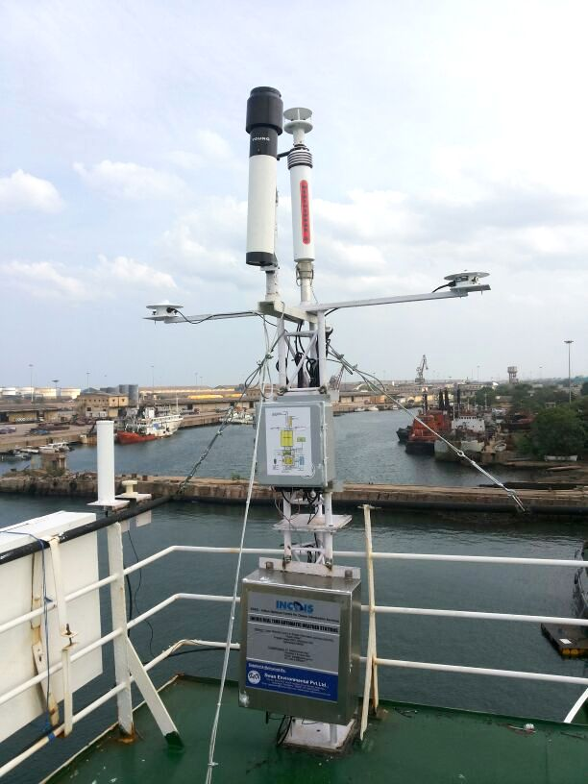
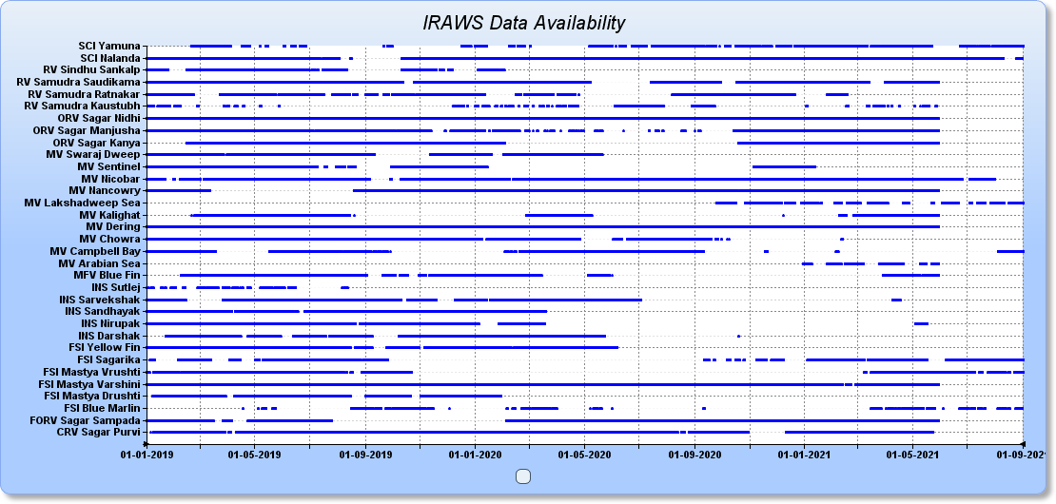
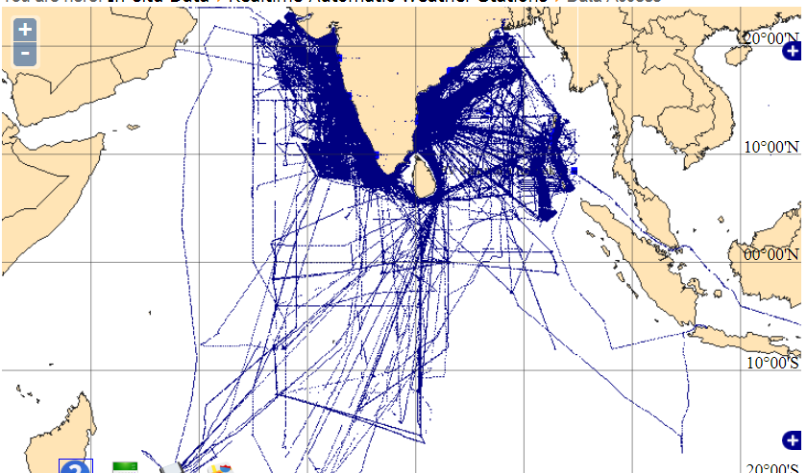
SOT Activities
VOS- (IRAWS)- Data and spatial coverage
Commissioned Stations :35 ,AWS in Operation :30 ,AWS lost: 01(2014) , AWS Re-installation :02(2020-21) ,
AWS Decommissioned :04(2020-21), Under Repair:01

Slide 6
2019
SOT Activities
VOS- (IRAWS)- Calibration & maintenance
Calibrations | Wind-11, AT-17, BP-08, LWR- 05, SWR-09, RG-05
Preventive Maintenance | 114
In Operation Dry-dock Repair Total
Calibrations | Wind-6, AT-10, BP-03, LWR-08, SWR-07, RG-07
Preventive Maintenance | 54
2020
No. AWS
2021 (May 2021)
Calibrations | Wind-2, BP-04, LWR-02, SWR-02, RG-02
Preventive Maintenance | 60
In Operation Dry-dock Repair Total
6

Slide 7
Covid-19 Impact
Maintenance & Calibration activities suffered due to
  constraints of transportation,
  non availability of electronic components,
  shut down of ship operations,
  port containment zone restrictions
  Quarantine measures etc.
However as a way forward, it is planned to operationalize 34 Weather Stations by October 2021.

Slide 8
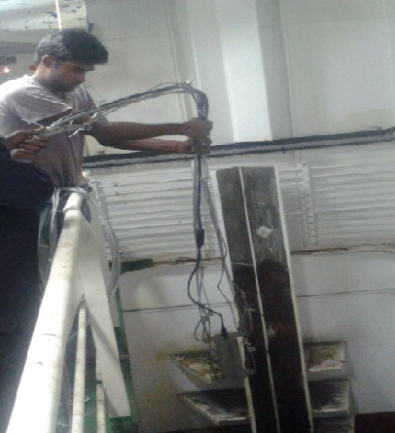
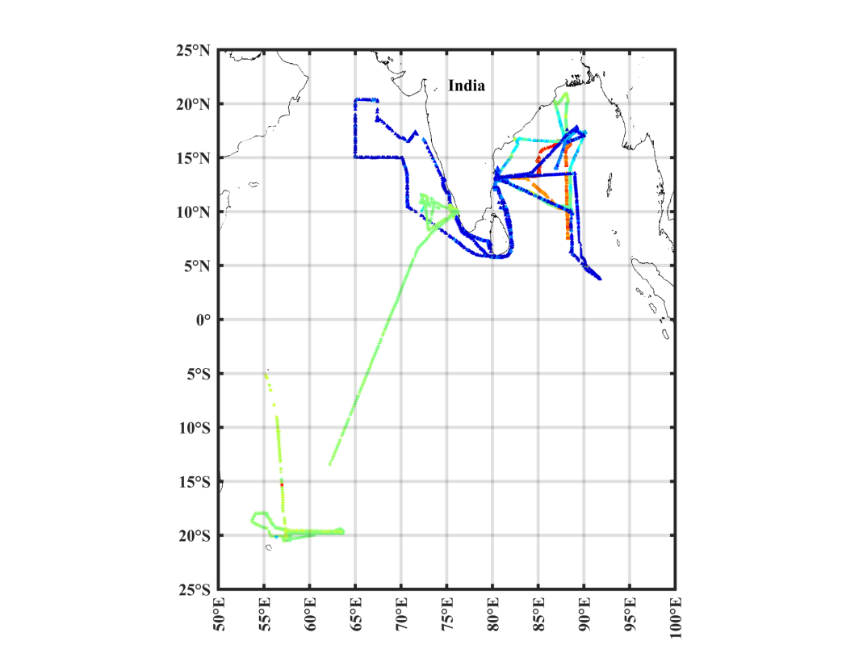
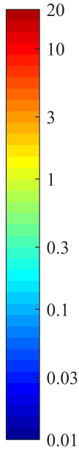
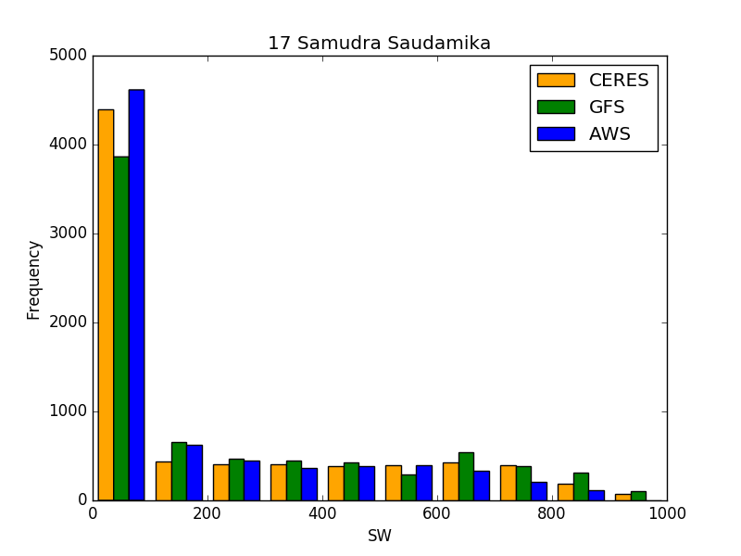
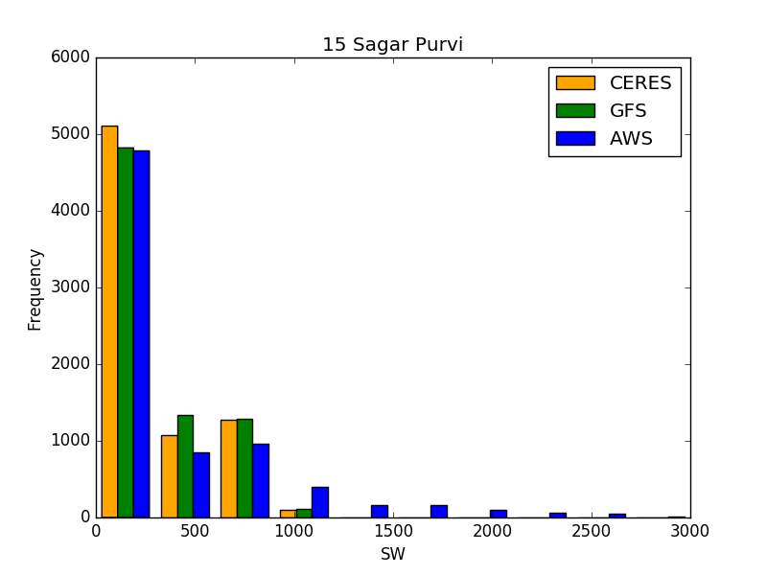
Other initiatives/resources: – Met and ocean network
Chlorophyll /Turbidity /SST Sensor Installation onboard ORV Sagar Nidhi
Chl-a Concentration (in mg-m⁻³)
Comparing the VOS Radiation data with GFS and CERES

Slide 9
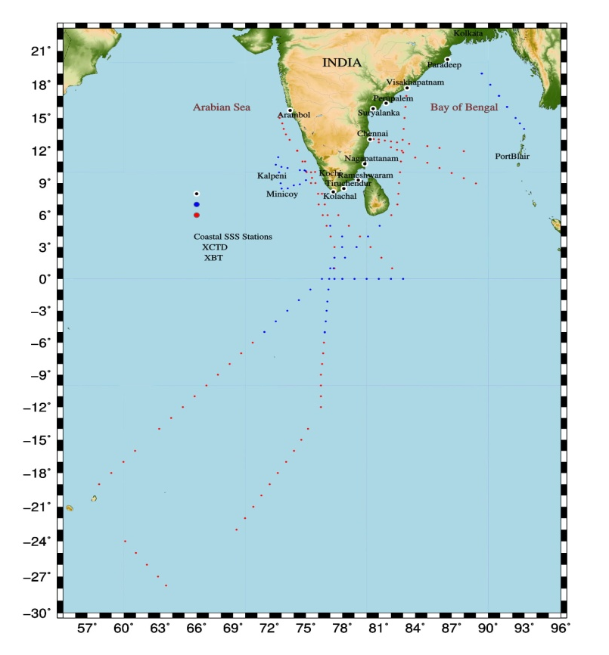
SOOP activities
Data acquisition (Apr-19 to Aug-21)
Transect | No. of voyages | No. of XBT | No. of XCTD | No. SSS/SST
Chennai-Port Blair | 5 | 54 | 6 | 143
Port Blair-Kolkata | 2 | 0 | 11 | 41
Kochi-Lakshadweep | 6 | 3 | 51 | 48
India-Mauritius | 1 | 28 | 12 | 76
Others (Research Vessel)
Sindhu Sankalp | 1 | 9 | 11 | 62
Sindhu Sadhana | 1 | 21 | 7 | 62
Data density (Apr-19 to Aug-21)
Station name | Total Samples
Paradeep | 92
Vizag | 88
Perupalem | 81
Suryalanka | 86
Chennai | 91
Nagapattinam | 66
Tiruchendur | 118
Rameshwaram | 98
Kolachal | 121
Arambol | 95
Coastal time series salinity data

Slide 10
Gaps and Requirements
Integrating water quality observation systems with existing network of AWS.
Real-time AWS observation System simulation experiments for optimization of AWS system.
MoU with shipping and oil industries.
Incorporate automated sampling devices for biological (e.g.. Fish larva) and pollutants (e.g. micro plastics) .

Slide 11
Future Plans
Increase the AWS network integrated with oceanographic parameters to 50.
Collaborate with Indian Ocean RIM countries for recruitment of vessels to VOS in particular
Utilize the Fishing Boat of Opportunity for Automatic met-ocean data collection.
PCO₂ sensor integration with present AWS in selected ships.
Better data utilization for Operational services and Research collaborating with SOT team.
Real time data transmission of SOOP data (is in progress).
Thank You

