Slide 1
SOOP-CO₂
Ocean Carbon Cycle – Sea-air CO₂ fluxes
Funded by NOAA Global Ocean Monitoring and Observing Program (GOMO)
Partnership of 5 institutions:
NOAA/AOML
NOAA/PMEL
NOAA/GML
Univ. of Miami/RSMAS (academic partner)
BIOS (Bermuda)(academic partner)
Goal: To constrain the flux of CO₂ across the air-water interface to within 20% on regional and seasonal scales to provide meaningful projections of future atmospheric CO₂ levels, and surface oceanic CO₂ concentrations
Sea-air CO₂ flux = k K_{o} ∆pCO₂
Notes:
Sea-air CO₂ flux = k K_{o} ∆pCO₂ : the sea-air CO2 flux is determined from the gas transfer velocity (k), the solubility of CO2 (Ko) and the partial pressure difference between the surface ocean and atmosphere. The ocean carbon program sponsored by NOAA CPO/COD supports the largest sustained measurement campaign from ships of opportunity in the world contributing roughly half of all the data that goes into the SOCAT effort (Surface Ocean Carbon ATlas) that is used as a comprehensive database to constrain the amount of CO2 entering the ocean.

Slide 2
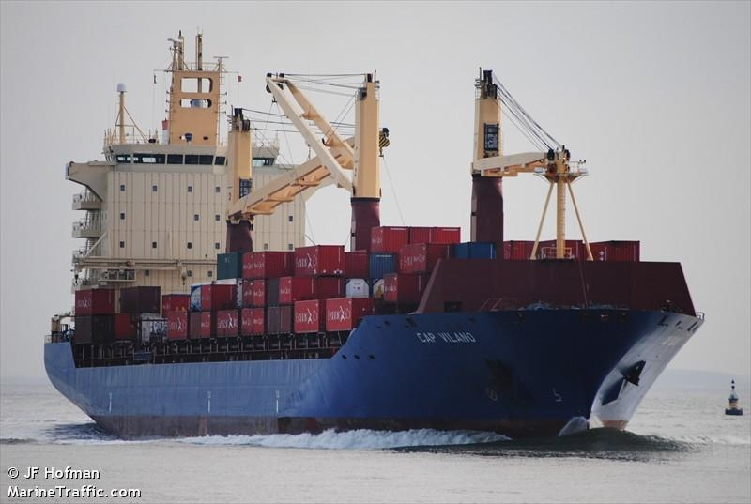
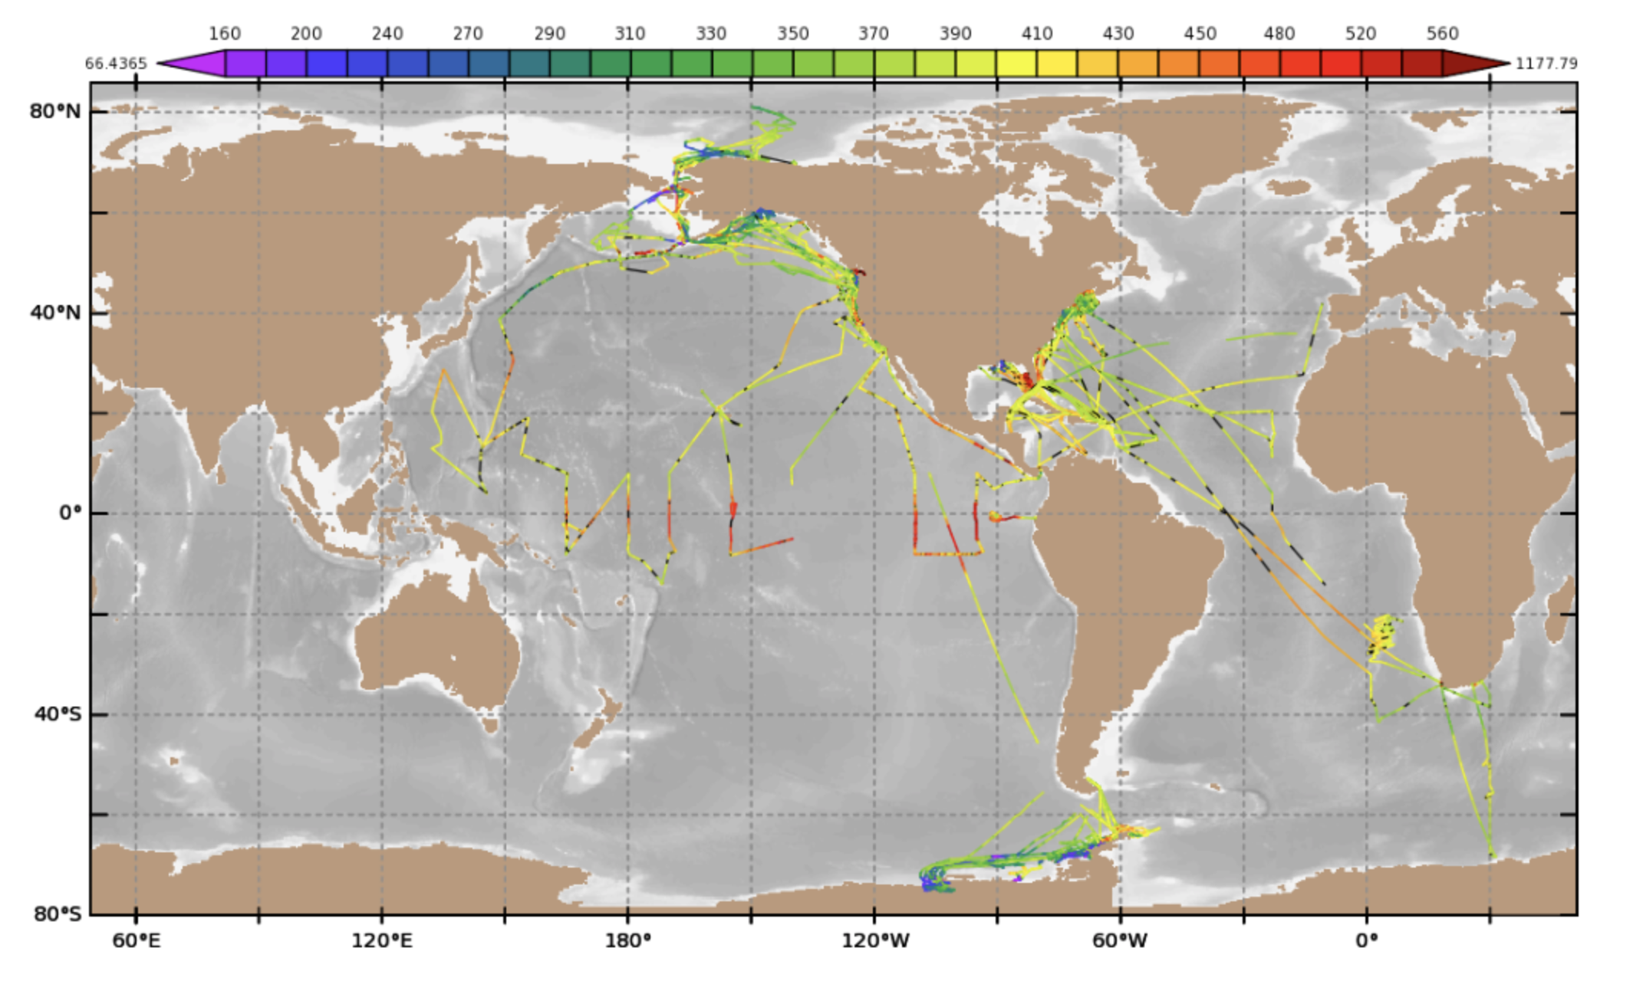
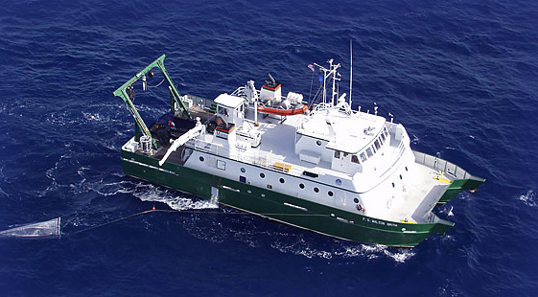
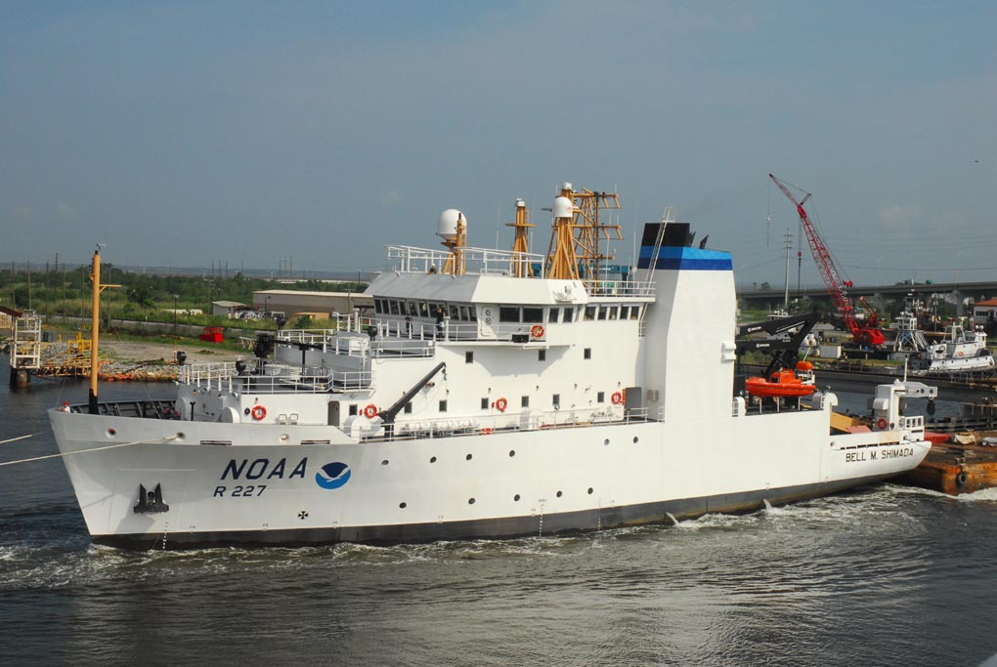
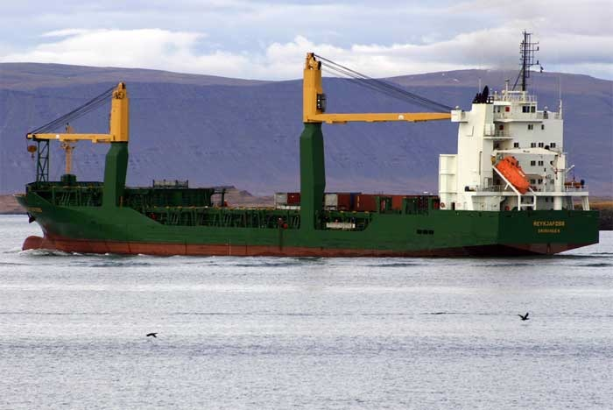
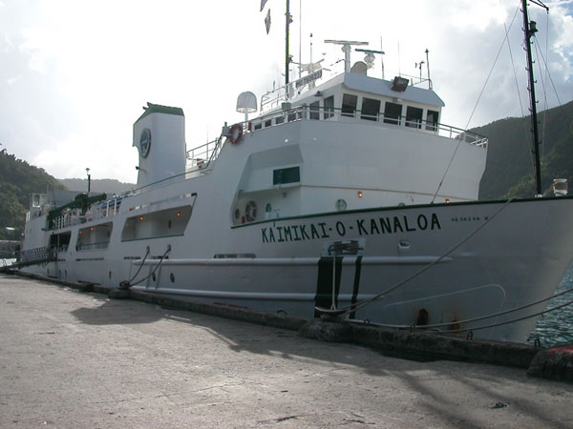
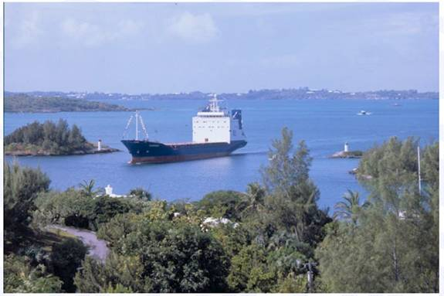
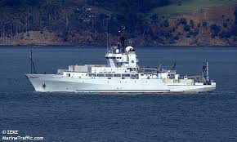
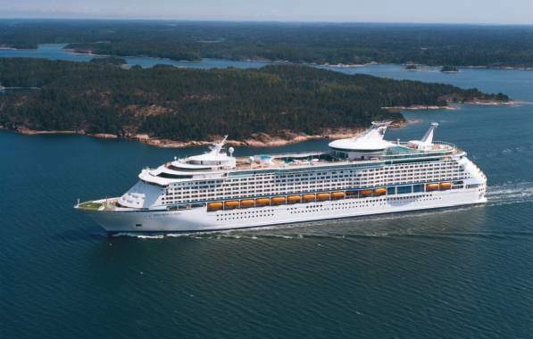
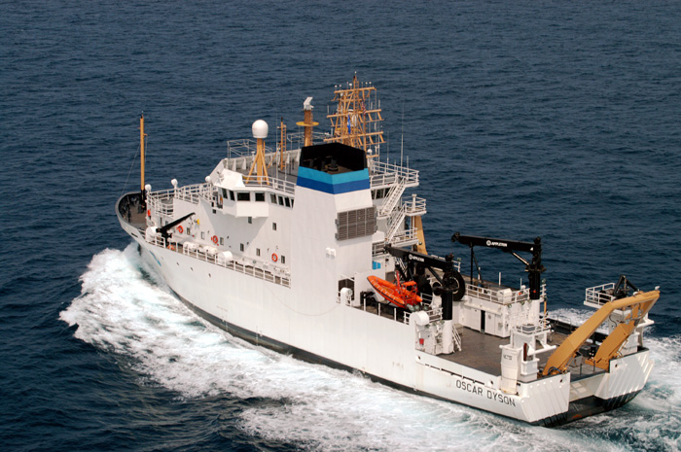
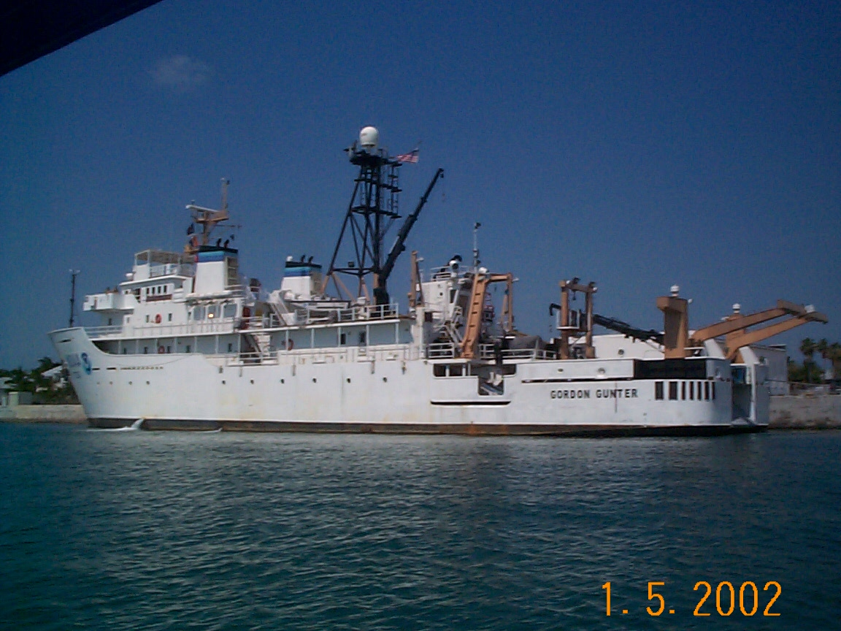
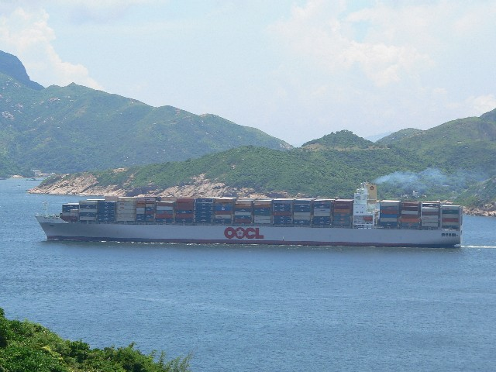
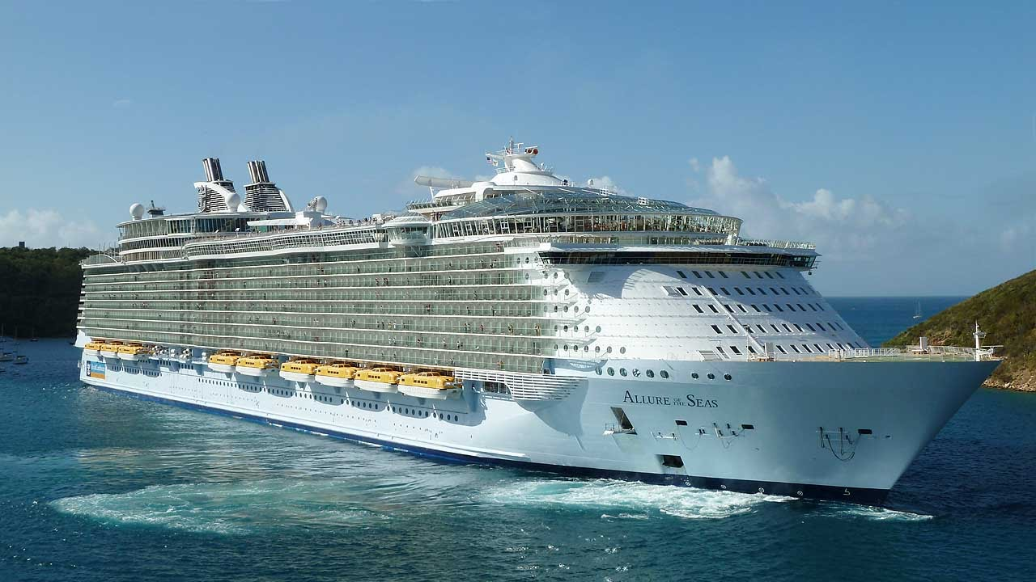
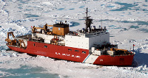
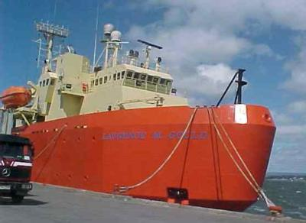
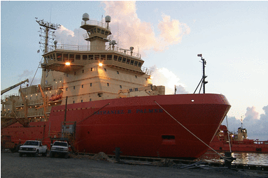
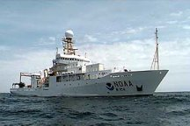
SOOP-CO₂
Ocean Carbon Cycle – Sea-air CO₂ fluxes
Largest ship of opportunity pCO₂ measurement campaign in the world
Comprised of 15 ships of opportunity with automated CO₂ systems in FY20
Research vessels, Cargo ships, Cruise ships
Ship tracks and ships with autonomous pCO₂ systems sponsored by the NOAA/GOMO program in FY 2017-2020
Notes:
Sea-air CO₂ flux = k K_{o} ∆pCO₂ : the sea-air CO2 flux is determined from the gas transfer velocity (k), the solubility of CO2 (Ko) and the partial pressure difference between the surface ocean and atmosphere. The ocean carbon program sponsored by NOAA CPO/COD supports the largest sustained measurement campaign from ships of opportunity in the world contributing roughly half of all the data that goes into the SOCAT effort (Surface Ocean Carbon ATlas) that is used as a comprehensive database to constrain the amount of CO2 entering the ocean.

Slide 3
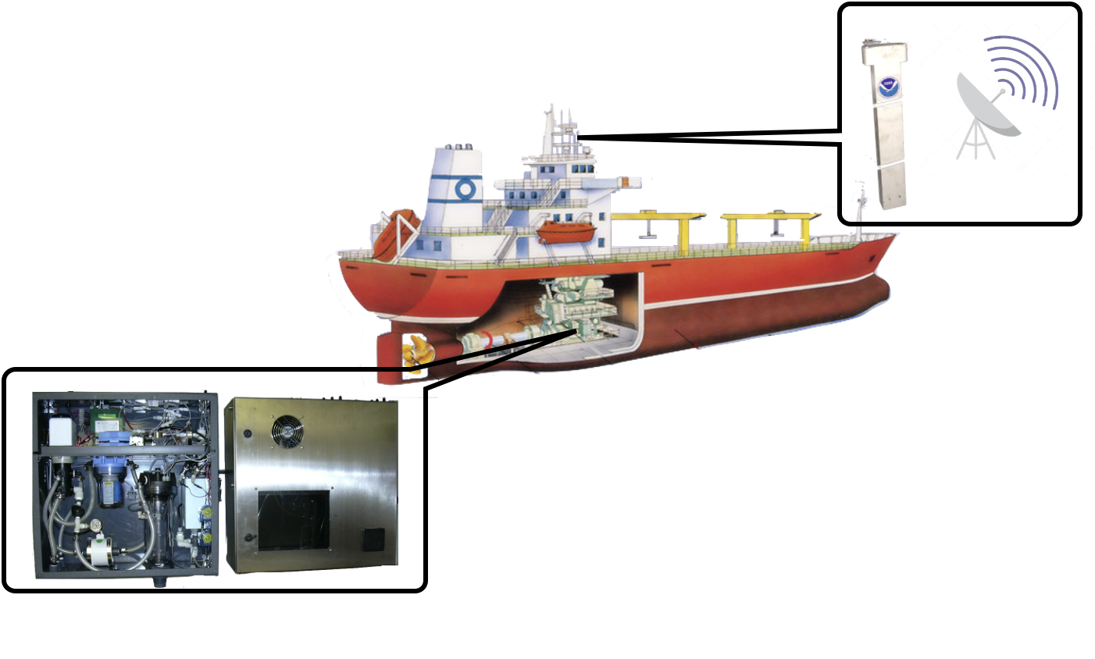
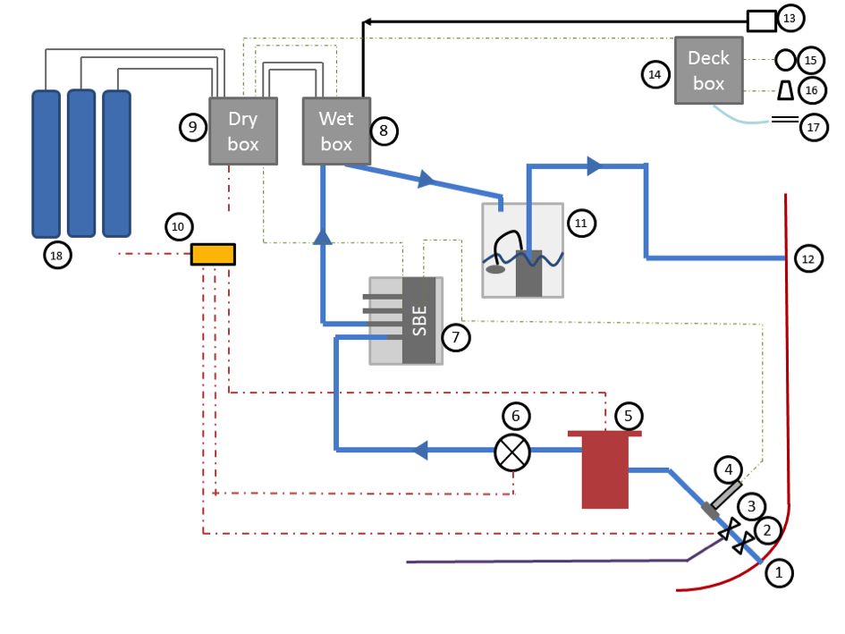
SOOP-CO₂
Ocean Carbon Cycle – Sea-air CO₂ fluxes

Slide 4
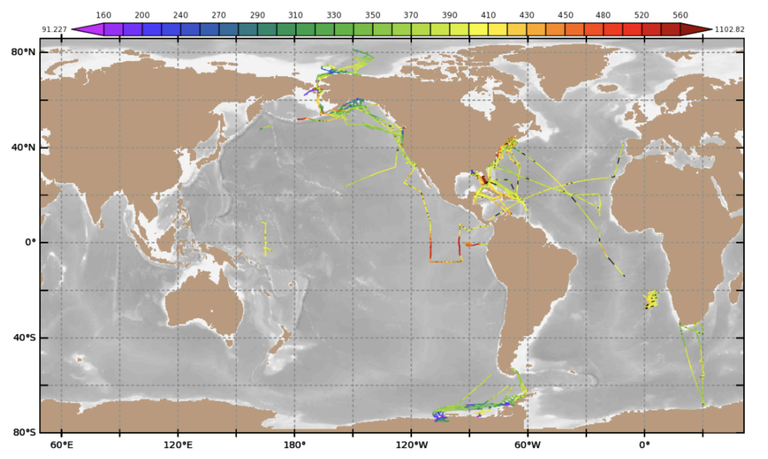
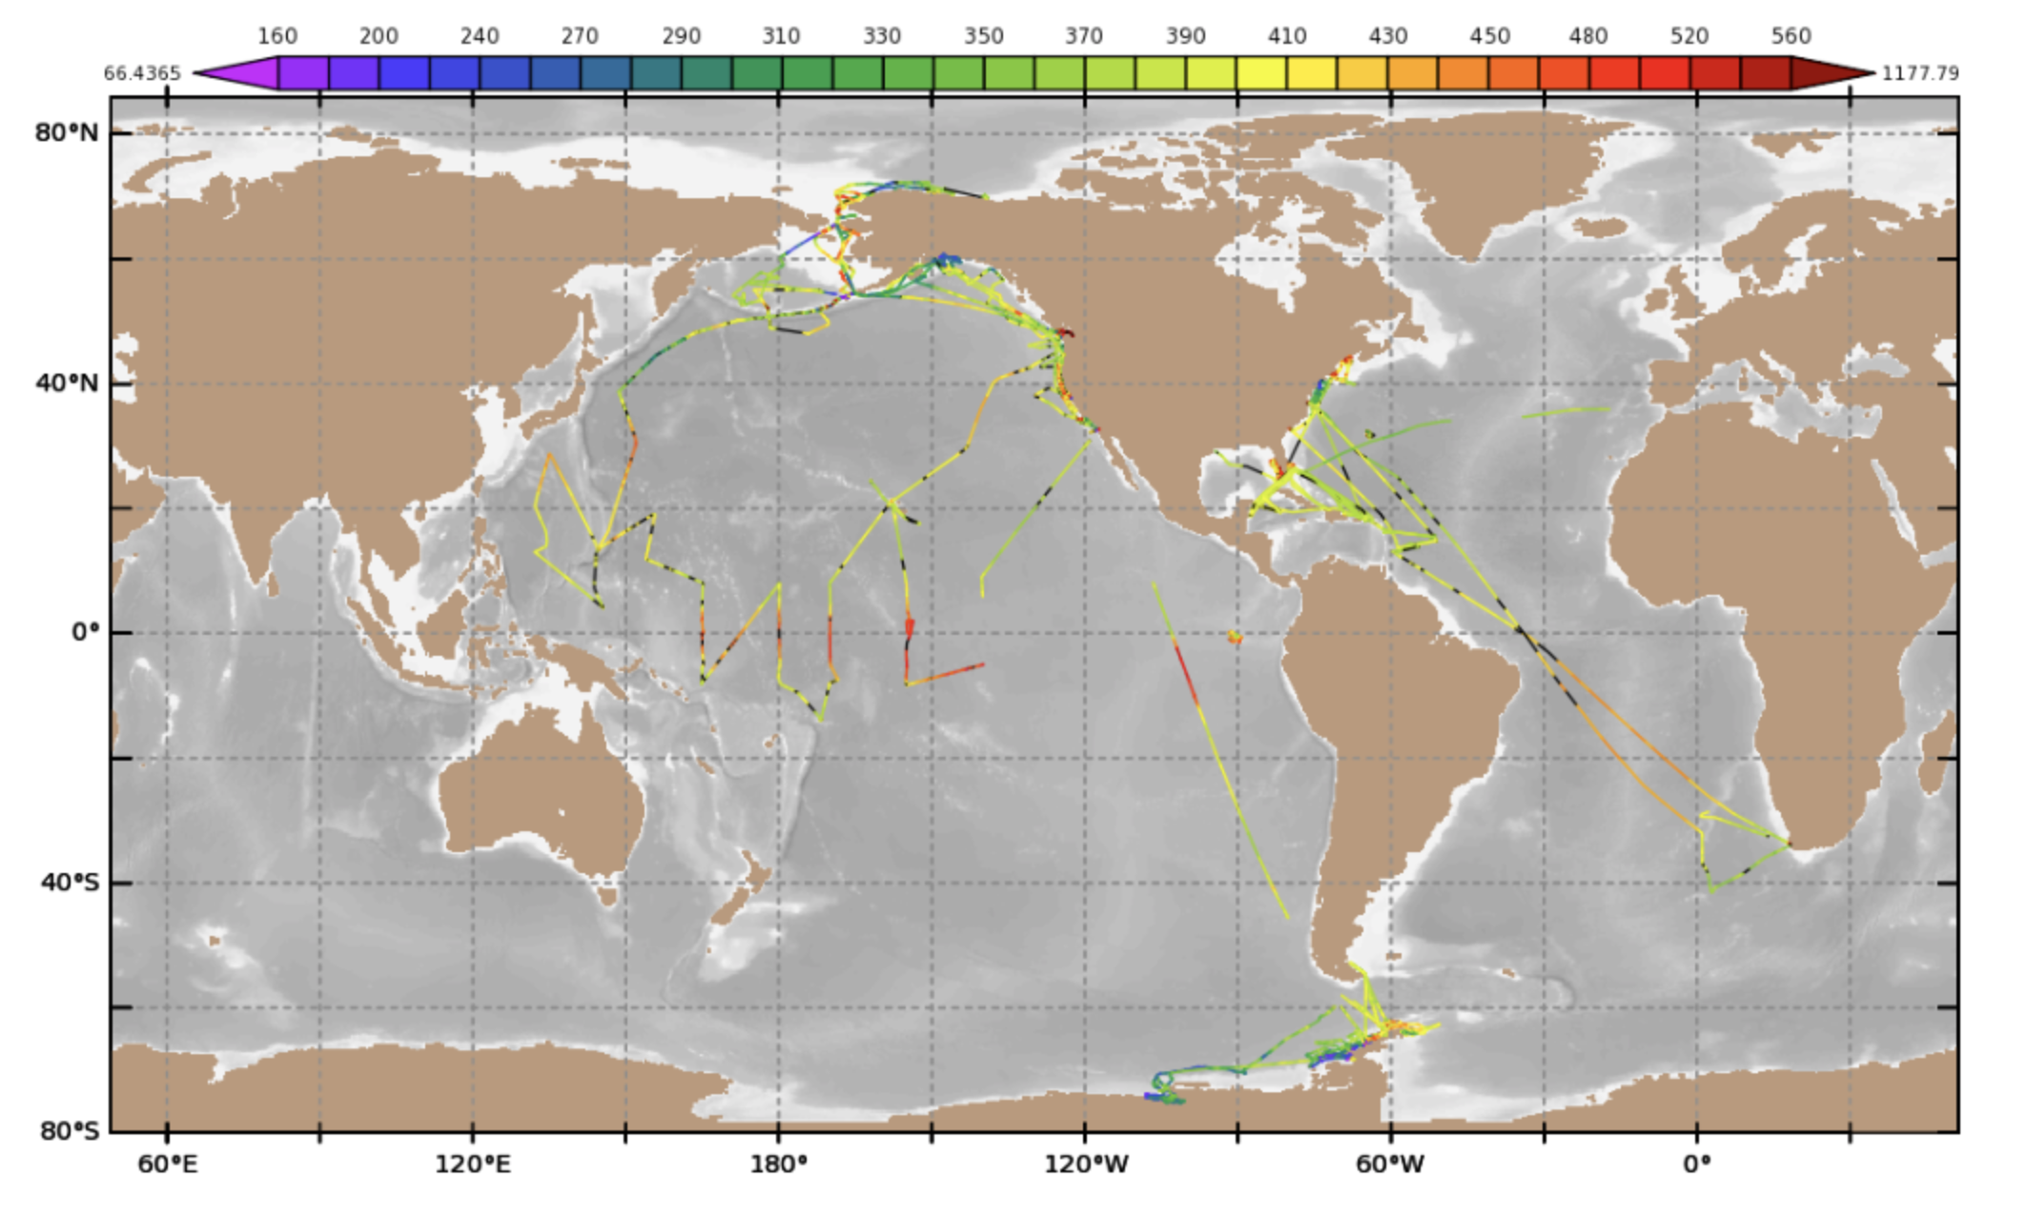
SOOP-CO₂
Ocean Carbon Cycle – Sea-air CO₂ fluxes
Inconsistent coverage of major oceans from year to year.
Pandemic. 2019: 760k data points 2020: 360k data points
2019
2020

Slide 5
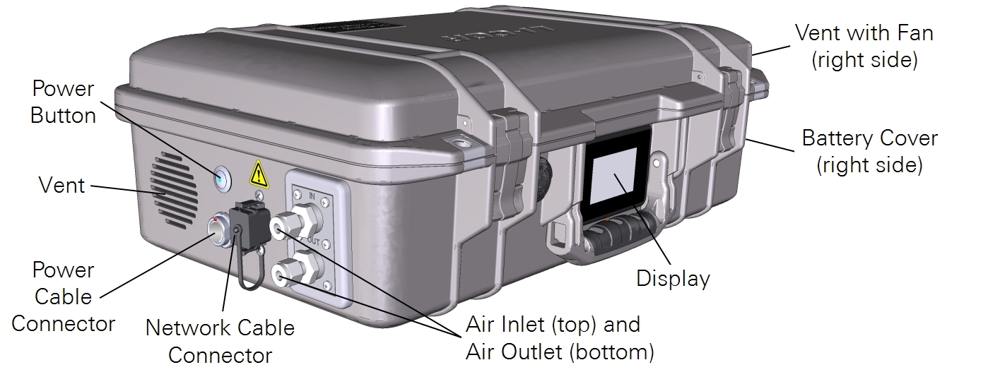
SOOP-CO₂
Ocean Carbon Cycle – Sea-air CO₂ fluxes
Re-design of the underway system
New CO₂ analyzer – old one discontinued
high-precision, high-stability, laser-based gas analyzer that uses Optical Feedback — Cavity-Enhanced Absorption Spectroscopy (OF-CEAS) to measure gases in air.
Improvements: less gas standards, less frequent calibrations, better handle on water interference
Hurdles: Different form factor, gas flow rate required re-design of our system.
New system should be on the market very soon.

Slide 6
SOOP-CO₂
Ocean Carbon Cycle – Sea-air CO₂ fluxes
Issues of the program
System has increased failures in hot environment.
Use engine room ventilation in cold weather
Data losses due to lack of access to ships
Data losses due to lack of support on ship
SHIP RECRUITMENT

Slide 7
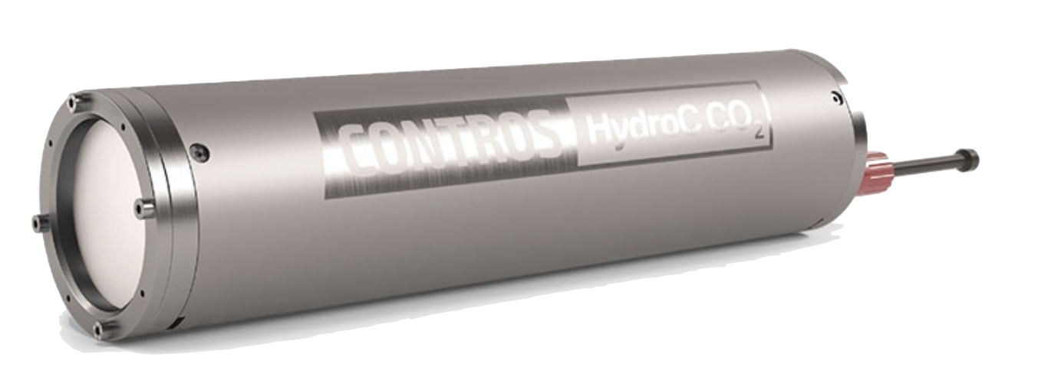
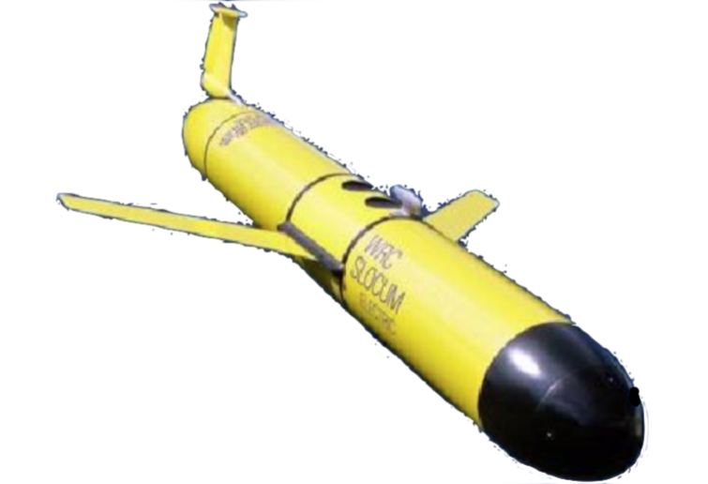
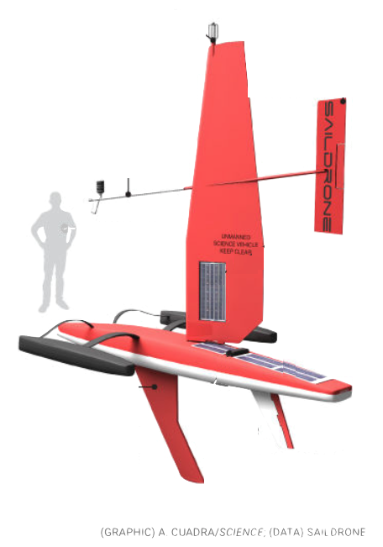
SOOP-CO₂
Ocean Carbon Cycle – Sea-air CO₂ fluxes
Future of the program – increased importance
Groundtruthing of alternate sensors, unmanned vehicles, remote sensors, models
Need to improve the constraint of the CO₂ flux in the global carbon cycle to better our understanding and predictions of the system.
Need to improve measurements, temporal and spatial coverage to assess carbon dioxide removal (CDR) techniques.
Thank you

