Slide 1
SOT – 11
Presented by: Juliet Hermes
Email: jc.hermes@saeon.nrf.ac.za

Slide 2
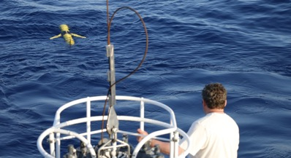
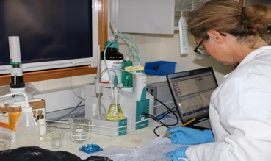
SOT – 11
Part 1: A best practice is a methodology that has repeatedly produced superior results relative to other methodologies with the same objective
Part 2: To be fully elevated to a best practice, a promising method will have been reviewed, adopted and employed by multiple organizations
2

Slide 4
Proposed website text
SOT – 11
Best Practices have always been an essential component across all areas of the observing system and the OCG ocean observing networks are committed to ensuring that their best practices are comprehensive, findable and are used. OCG, the IOC and the WMO Integrated Global Observing Systems (WIGOS <http://www.wmo.int/pages/prog/www/wigos/index_en.html>), are seeking increased collaboration with partner organisations towards the objective of harmonized standards, and better traceability of observations to standards. In an ongoing effort to ensure this SOT is working at providing best practices for the life cycle of all EOVs observed under the program, for each stage of the observation life cycle. The SOT is contributing to this effort by compiling this list of best practice documents available and will identify gaps in the documentation and where documents need to be updated.
Best Practices are defined as a methodology that has repeatedly produced superior results relative to other methodologies with the same objective; to be fully elevated to a best practice, a promising method will have been adopted and employed by multiple organizations (Pearlman et al, 2019). Those best practices which have undergone community review and the network considers to be fully supported by the SOT community will be identified as SOT ‘GOOS endorsed’ and tagged as such in the IODE/GOOS oceanbestpractices.org repository.

Slide 5
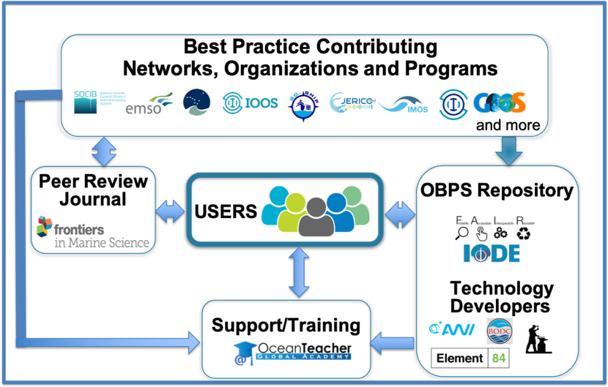
What is the Ocean Best Practices System?
SOT – 11
www.oceanbestpractices.org

Slide 6
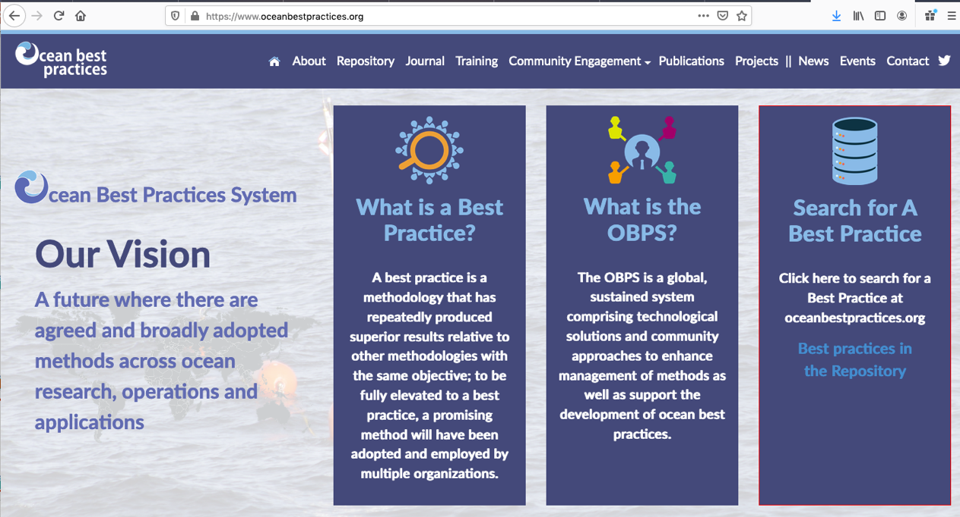

Slide 7
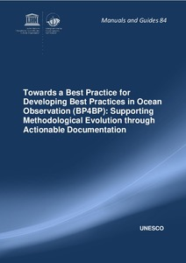
BP Process Guides and Templates
SOT – 11
User Guides
Guidelines for Depositors
Guidelines for Editors
Best Practices for Best Practices
Document Templates (further templates …)
Sensors
Ocean Applications
Data Management
Hörstmann, C.; Buttigieg, P.L.; Simpson, P.; Pearlman, J. and Waite, A.M. (2021) Perspectives on Documenting Methods to Create Ocean Best Practices. Frontiers in Marine Science, 7:556234, 5pp. DOI: 10.3389/fmars.2020.556234
Hörstmann, C.; Buttigieg, P.L.; Simpson, P.; Pearlman, J. ; Karstensen, J. and Waite, A.M. (2020) Towards a Best Practice for Developing Best Practices in Ocean Observation (BP4BP): Supporting Methodological Evolution through Actionable Documentation. Paris, France, UNESCO, 33pp. (Intergovernmental Oceanographic Commission Manuals and Guides No. 84). (IOC/2020/MG/84). DOI: http://dx.doi.org/10.25607/OBP-781

Slide 8
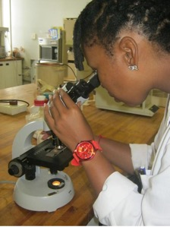
SOT – 11
To qualify as “GOOS endorsed” a best practice is expected to
have completed a rigorous community review process
approved by the leadership of the relevant network
is fit for the purpose and fully satisfies the definition of a best practice on the OBPS
has been recognised through the relevant GOOS body
is available and identifiable within the OBPS repository, or will be submitted as soon as endorsement is received.
Is updated at relevant timeframes

Slide 9
SOT – 11
Announcing the Fifth OBPS Community Workshop - September 20-24, 2021: An Ocean of Values
https://workshop5.oceanbestpractices.org/

