Slide 1
Spain
Elena Tel, Spanish Institute of Oceanography (IEO/CSIC) Elena.tel@ieo.es
JL Arteche (AEMET), G. Gonzalez-Nuevo (IEO/CSIC), J.Sorribas (UTM/CSIC), S.Diez (UTM/CSIC), J.Tintore (SOCIB)

Slide 2
Ship based Met-Ocean Data
Data Operator Agency | Ship owner | Ship | Sensors | Transmision and availability
AEMET (met-office) | IHM | Hospital Ship Esperanza del Mar | METEO | GTS
 |  | Hospital Ship Juan de la Cosa | METEO | GTS
CSIC (nat. research councyl) | UTM (marine tech. Unit) | R/V Hesperides | METEO + TSG | GTS (AEMET)
 |  | R/V Sarmiento de Gamboa | METEO + TSG | VSAT
 |  | R/V Garcia del Cid | METEO + TSG | VSAT
 | IEO (Spanish Inst.of Oceanography) | R/V Ramon Margalef | METEO + TSG | VSAT/ FTP daily
 |  | R/V Angeles Alvariño | METEO + TSG | VSAT/ FTP daily
 |  | R/V Fco. Navarro | METEO + TSG | VSAT/ FTP daily
 |  | R/V Lura | TSG | Mail. Daily
SGP (fisheries administr.) | SGP | R/V Miguel Oliver | METEO + TSG | VSAT daily mail (IEO)
 |  | R/V Vizconde de Eza | METEO | Mail. Survey’s end (IEO)
SOCIB | SOCIB | R/V SOCIB | METEO + TSG

Slide 3
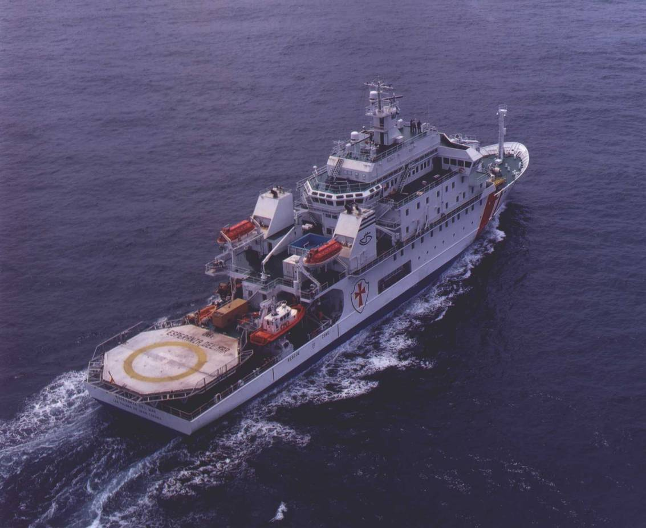
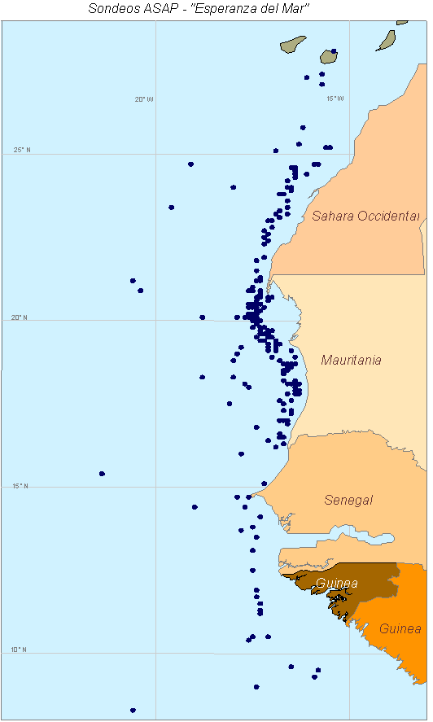
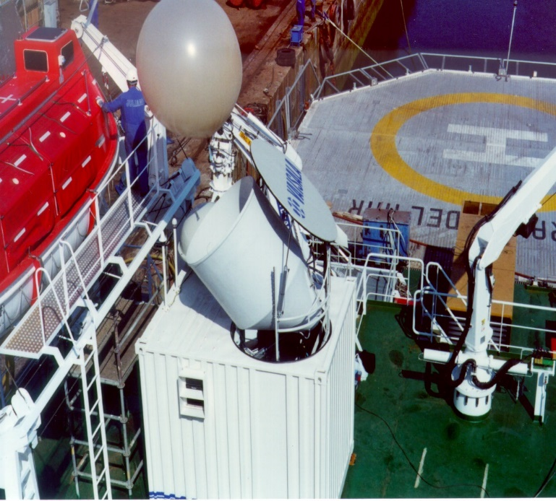
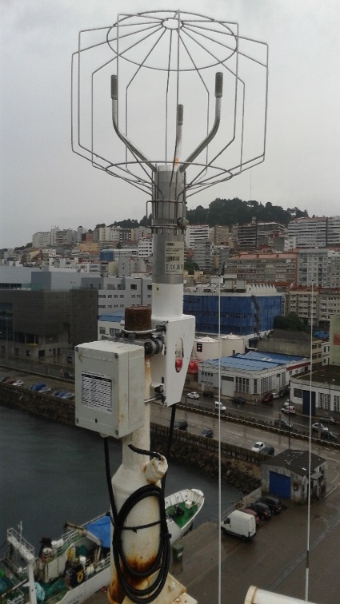
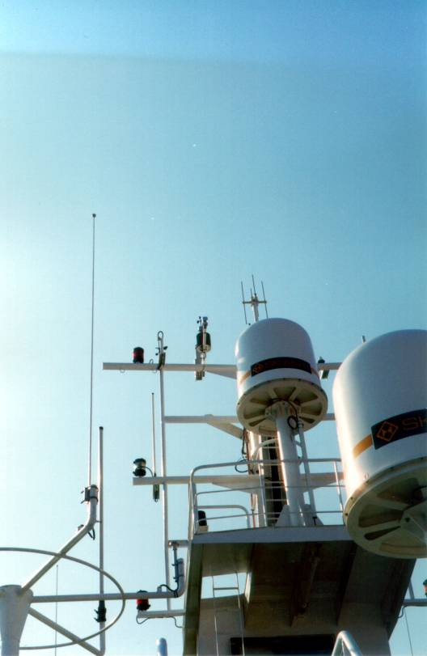
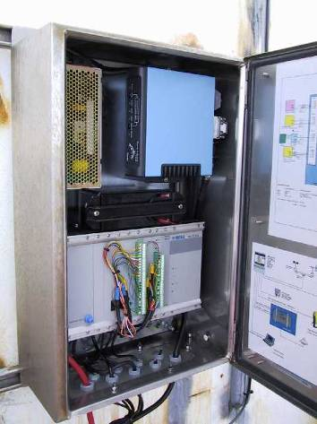
SOT Activities
IHM Hospital Ship “Esperanza del Mar”
ASAP equipment → since 2002 (1 sonde/day (12UTC) via Iridium)
Surface observation: contribution to E-ASAP, VOS, E-Surfmar & Eumetnet

Slide 4
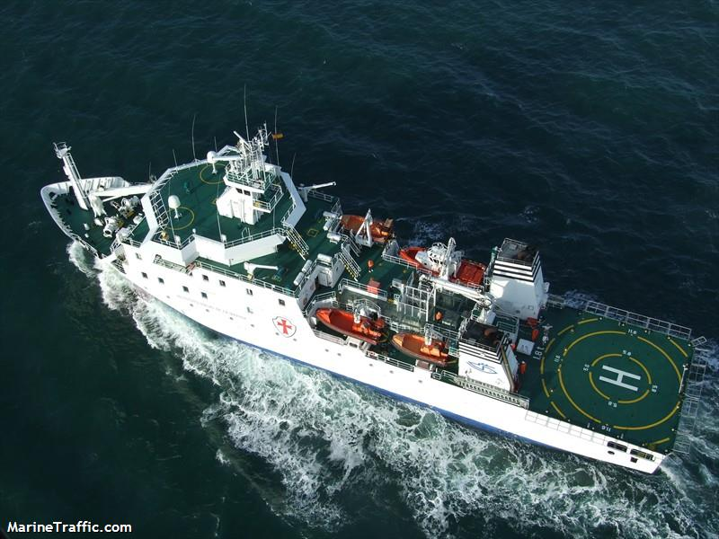
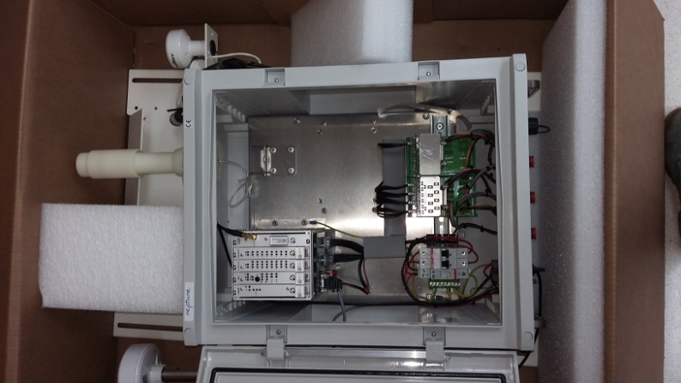
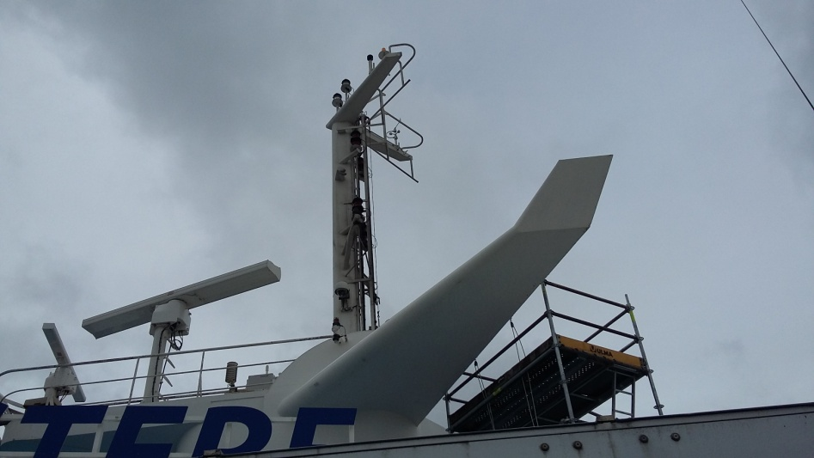
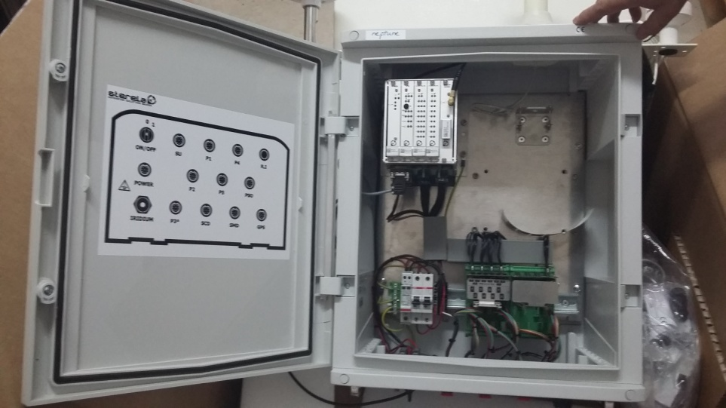
SOT Activities
IHM Hospital Ship “Juan de la Cosa”
Meteo Station Similar to Cap Finistère Brittany Ferries
E-SURFMAR EUCAWS system

Slide 5
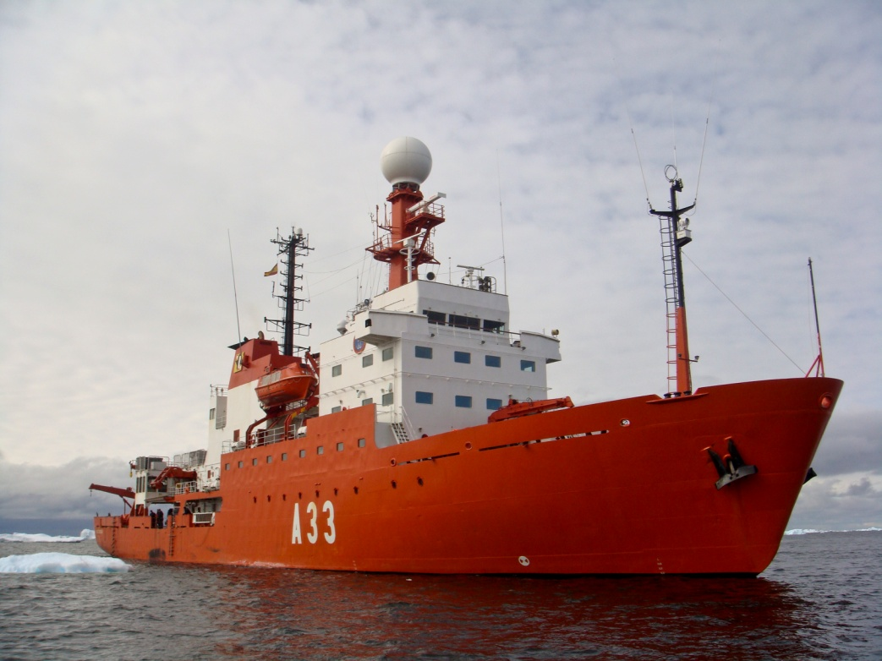
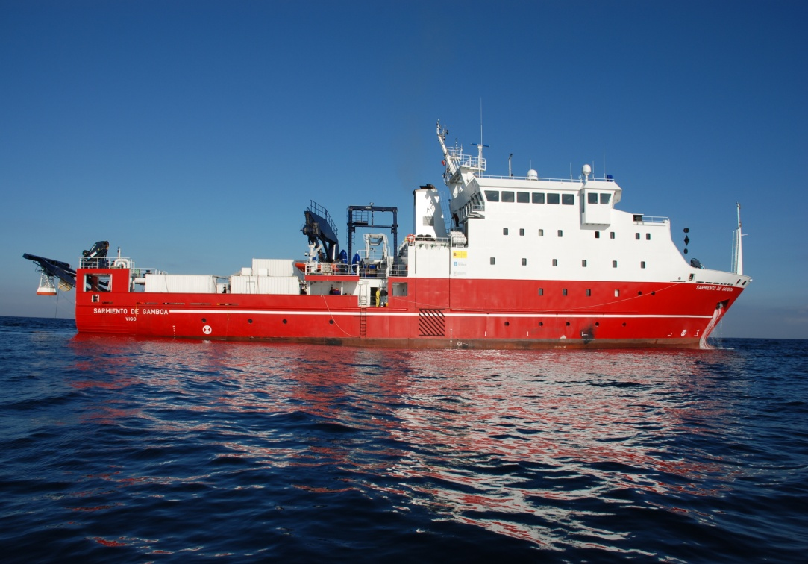
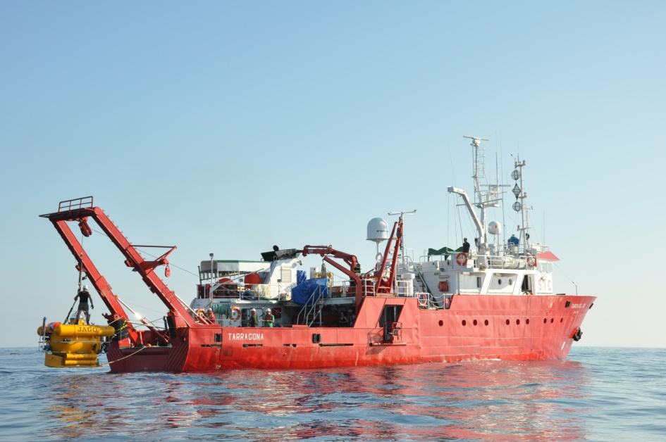
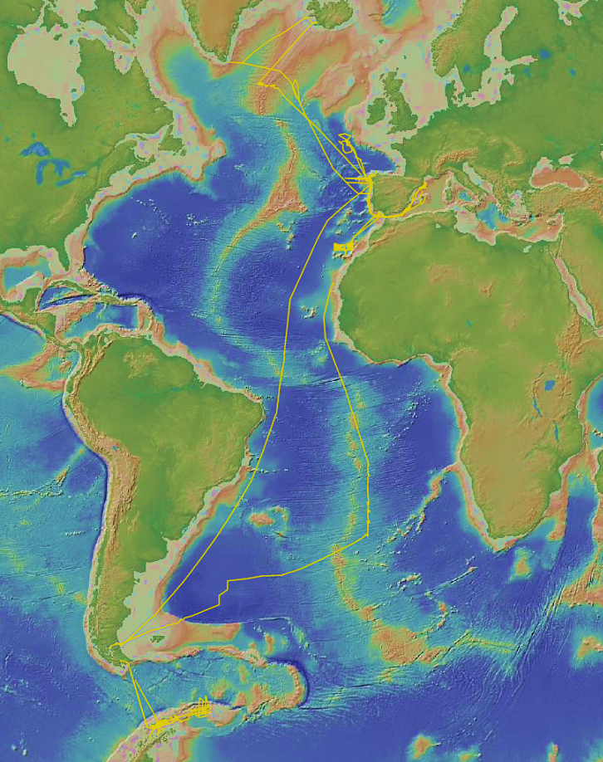
SOT Activities
Surface observation: Meteo+TSG
R/V HESPERIDES observations are being transmitted by GTS since 28/01/2019. SOT ID : GMHQL8E, BUFR header : ISSX01 LEMM. --> including Antartic surveys

Slide 6
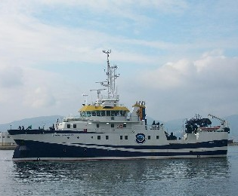
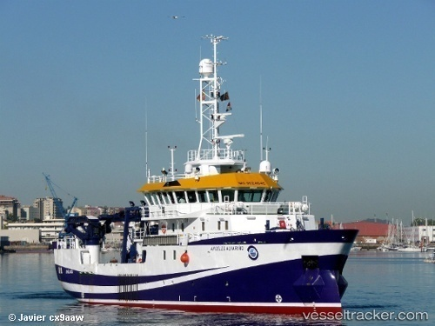
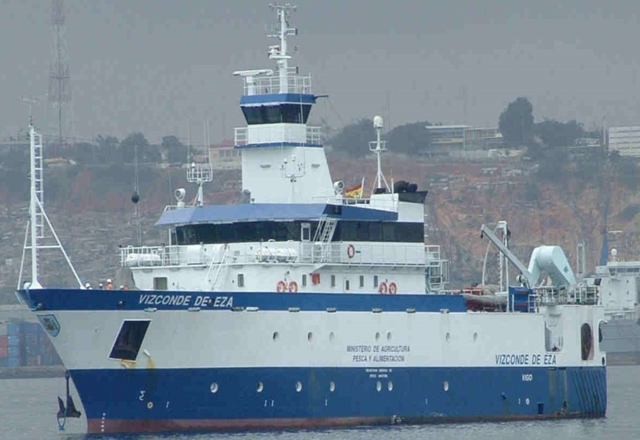
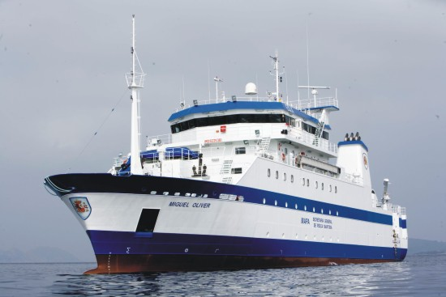
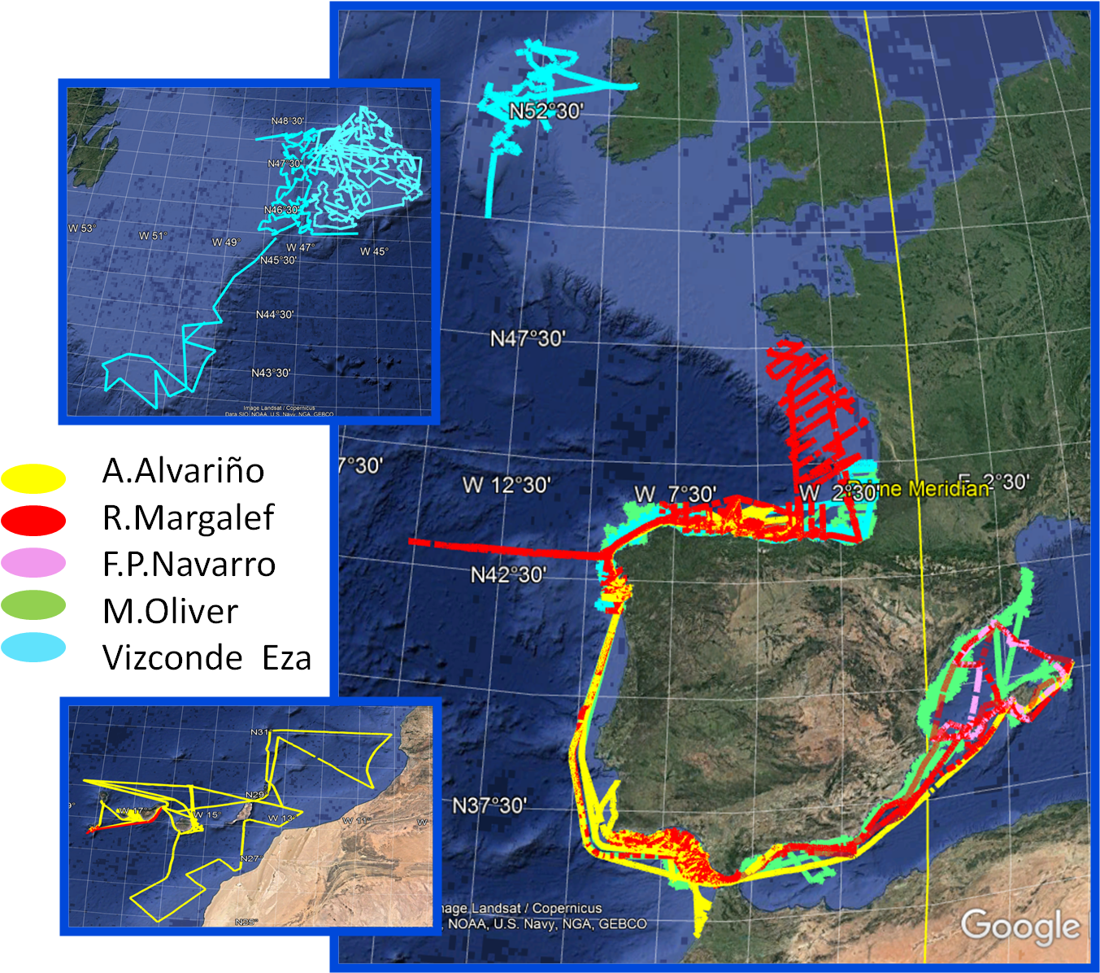
SOT Activities
Give response to institutional/research/social demands
Consolidate oceano-meteorologic observation ship-based network and develop of new technologies in the field of oceanography monitoring
No observations distributed on the GTS.
Data transmitted daily to the IEO Data Center
Daily data from R/V Alvariño and R/V Margalef available by FTP for operational purposes.

Slide 7
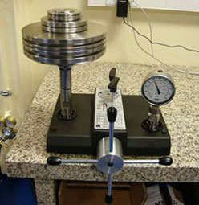
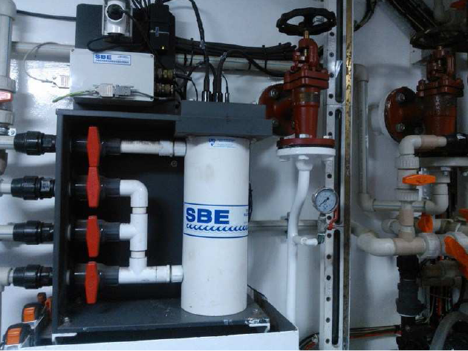
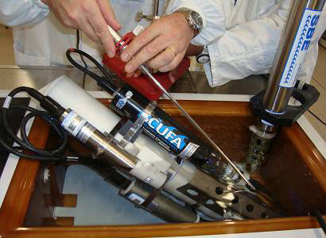
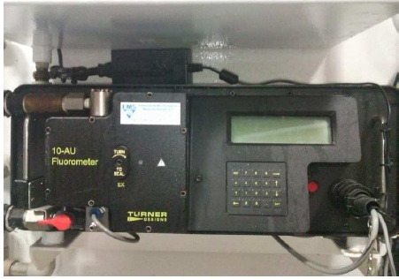
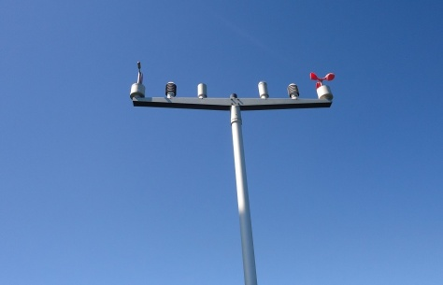
TSG Sensors and Calibration

Slide 8
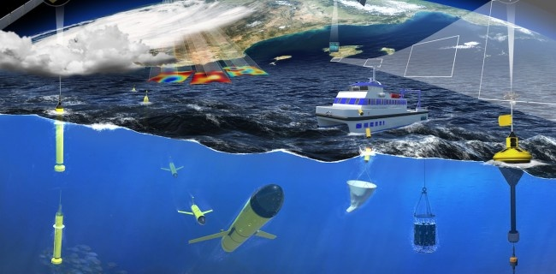
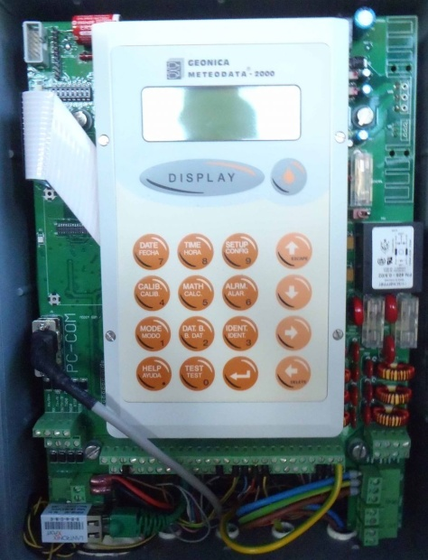
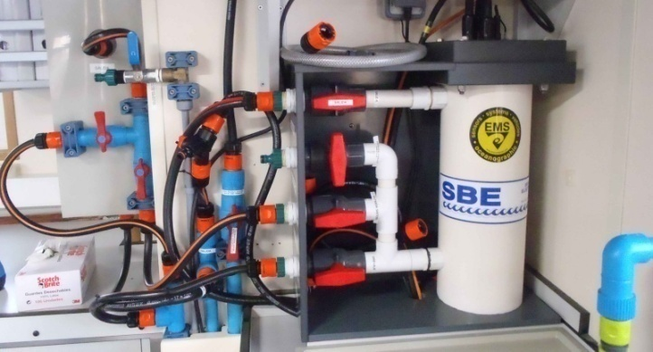
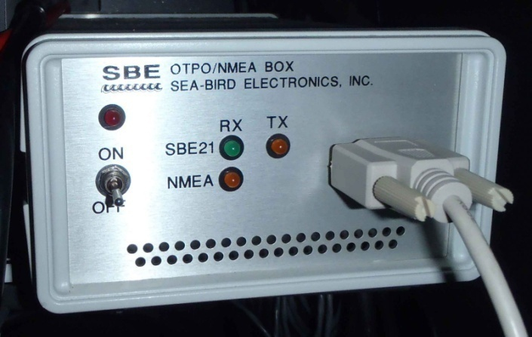
VOS and SOOP SOCIB: Balearic Islands Coastal Observing and Forecasting System
GEONICA
METEODATA 2000
SeaBird SBE21
thermosaliniometer

Slide 9
Covid-19 Impact
Reduction in number/ duration of oceanographic surveys
Less people on board
Health protocols (PCRs, …)
TSG, METEO, etc.
Planned new R/V

