Slide 1
https://irso.info/
The International Research Ship Operators (IRSO) is a group of research ship operators representing 54 organisations from 35 countries who manage over 100 of the world’s leading marine scientific research vessels. IRSO membership is open to all research ship operating institutes or national research programmes that are engaged in the collection of data from ships at sea, and follow established protocols for the open publication of their results.

Slide 2
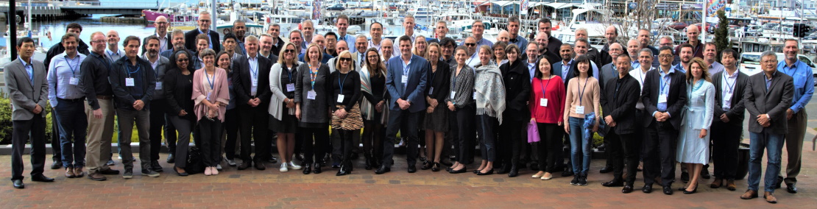
https://irso.info/
Previously known as the International Ship Operators Meeting (ISOM), IRSO was founded in 1986 and is attended voluntarily with meetings hosted by participating countries/institutes.
IRSO members gather annually to share information and solve problems of mutual interest to better support the marine scientific community’s research efforts at sea. IRSO also acts as a voice to promote the research ship community and provide
expert advice to other
bodies as required..

Slide 3
https://irso.info/
IRSO has close links with and is attended by research vessel groups such as the European Research Vessels Operators (ERVO), the Ocean Facilities Exchange Group (OFEG) and the University-National Oceanographic Laboratory System (UNOLS). We welcome links with other like bodies.
Main topics and objectives of the annual agenda are:
Best practice design and operation of research ships and associated scientific equipment
Benchmarking and co-operation in support of marine research
Developments in national research fleets, new builds, greening
The exchange of ship time and equipment between countries
Diplomatic issues, also related to new fields such as gliders, ASVs

Slide 4
THANK YOU FOR YOUR ATTENTION- ANY ENQUIRIES PLEASE CONTACT;
IRSO Chair: Dr. Erica Koning National Marine Facilities (NMF) NIOZ Royal Netherlands Institute for Sea Research PO Box 59, 1790 AB Den Burg, The Netherlands T: +31-222-369441 M:+31-6 11710875 Email: erica.koning@nioz.nl
IRSO Vice-Chair: Greg Foothead General Manager – Vessel Operations NIWA Vessel Management Ltd 301 Evans Bay Parade Greta Point, Wellington, New Zealand T: +64-4-386-0553 M: +64-27-273-3894 Email: Greg.Foothead@niwa.co.nz

