Slide 1
UN DECADE OF OCEAN SCIENCE FOR SUSTAINABLE DEVELOPMENT:
Ann-Christine Zinkann
Slide credit: Liz Tirpak and team

Slide 2
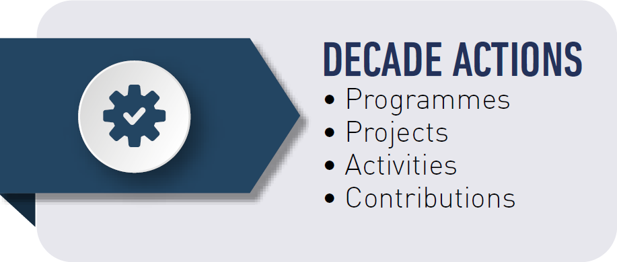
What is a Decade Action?
A Decade Action is a shared, global effort that builds on previous accomplishments in ocean science.
Actions can create new collaborations across disciplines, geographies and generations, and/or provide a new source of support.

Slide 3
Levels of Decade Actions
Decade Programme
Decade Contribution
Decade Project
Decade Activity
Global or regional in scale
Contribute to one or more of the Decade Challenges.
Long-term (multi-year), interdisciplinary and typically multi-national.
Includes component projects, and enabling activities.
Supports the Decade through provision of a necessary in-kind or financial resource.
Can be either for costs related to the implementation of a Decade Action or for coordination costs.
Discrete and focused undertaking of a shorter duration.
Will typically contribute to an identified Decade programme
Typically a one-off standalone activity
Can form part of a programme or project or can relate directly to a Decade Challenge or an outcome.
Notes:
There are four levels of Decade Actions.

Slide 4
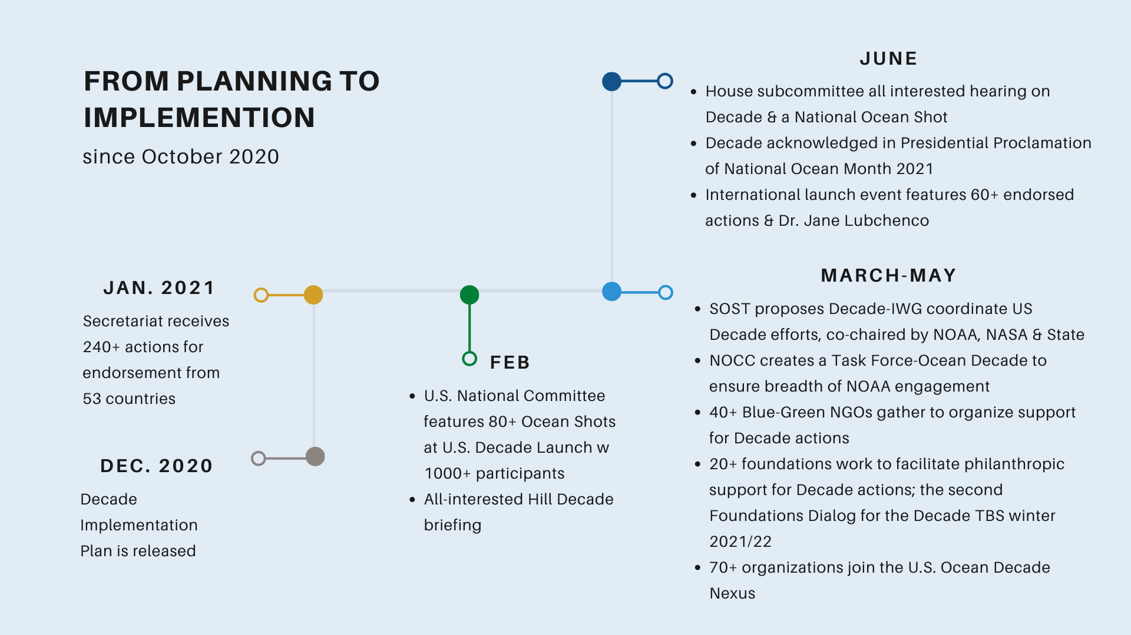
From Planning to Implementation (since Oct 2020)
Notes:
Quick rundown of some (not all!) key activities since Oct.
December - Decade Implementation Plan is released
January - Secretariat receives 240+ actions for endorsement from 53 countries
February
U.S. National Committee features 80+ Ocean Shots at U.S. Decade Launch w 1000+ participants
All-interested Hill Decade briefing
March-May
SOST proposes Decade-IWG coordinate US Decade efforts, co-chaired by NOAA, NASA & State
NOCC creates a Task Force-Ocean Decade to ensure breadth of NOAA engagement
40+ Blue-Green NGOs gather to organize support for Decade actions
20+ foundations work to facilitate philanthropic support for Decade actions; the second Foundations Dialog for the Decade TBS winter 2021/22
70+ organizations join the U.S. Ocean Decade Nexus
June
House subcommittee all interested hearing on Decade & a National Ocean Shot
Decade acknowledged in Presidential Proclamation of National Ocean Month 2021
International launch event features 60+ endorsed actions & Dr. Jane Lubchenco

Slide 5
17 USG Submissions - All Endorsed! Involving all ocean basins, all 7 Decade Outcomes -- as well as all 10 Decade Challenges and 11 of the 17 SDGs!
Does not include proposals (aprx 11) submitted by a non-USG entity that named a USG agency as partner.
Notes:
Through the SOST, we solicited and received a response that reflected the breadth of US interest. We intend to have more SOST agencies respond to the next call! (USAID, EPA, DOI, DOT, etc.)

Slide 6
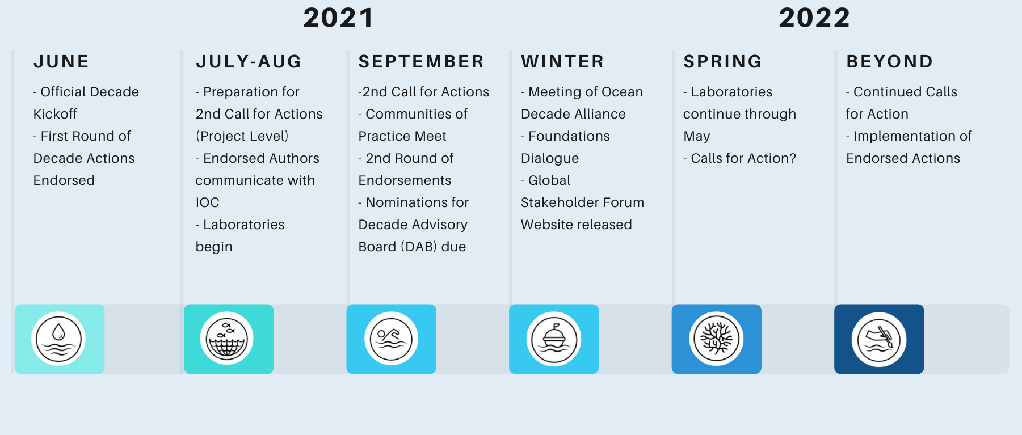
Where Are We Now?
Notes:
There was a previous Decade of Ocean Exploration in the 1970s which gave us several initiatives that are still at play today. Since 2017, there was a preparatory phase through which stakeholder meetings were held around the world and plans were developed for implementation. Now, in 2021, we have entered the so-called “implementation phase” of the decade
The POTUS initiated the last UN Decade of the Ocean...which gave us WOCE, new ways of designing large ocean research initiatives. This time, an overwhelming consensus: BBNJ, World Ocean Assessment, Ocean & Cryosphere Report, etc… SPEC remarks at the Ocean Conservancy/Friends of the Ocean - its too big to ignore!!
2017 UNGA proclaimed the Decade
2018-2020 Preparatory Phase
2021 Implementation Phase
The IDOE research triggered and prompted support for several large scale global ocean research activities pertaining to
the World Climate Research Programme (WCRP) and the International Geosphere-Biosphere Programme (IGBP), such
as the World Ocean Circulation Experiment. Studies of marine pollution, including biological effects and interaction
between physical, chemical and biological processes, increased as well. The international reviews of the health of the
ocean were initiated, with the first completed in 1982.
The IDOE transformed ocean research and observation by impacting the way ocean research was funded and
establishing a model for launching large projects. The IDOE projects were larger, more complex, and longer term than
earlier efforts, and supported scientists from several disciplines and institutions, including from many countries in the
process of initiating oceanography.

Slide 7
Timeline for Laboratories
An Inspiring and Engaging Ocean
July 2021
A Clean Ocean
November 2021
A Healthy & Resilient Ocean
March 2022
A Transparent & Accessible Ocean
May 2022
2021
2022
A Predicted Ocean
September 2021
A Productive Ocean
February 2022
A Safe Ocean
April 2022
Notes:
info will be available online at national

Slide 8
THANK YOU

Slide 9
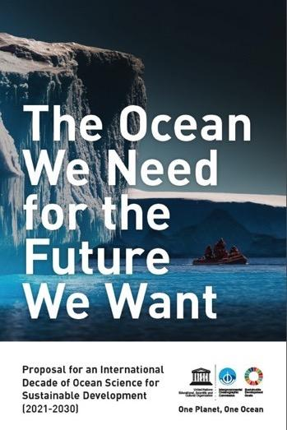
UN General Assembly Proclamation
Dec. 6, 2017
Omnibus Resolution for Oceans and the Law of the Sea (A/RES/72/73)
Proclaimed the UN Decade of Ocean Science for Sustainable Development 2021-2030
Called upon the IOC to prepare an implementation plan for the Decade
Notes:
UN General Assembly Called for UN Decade & asked IOC to organize consultative process
Engage the UN system (some 27 agencies) member states and stakeholders
Prepare an Implementation Plan
Catalyze the Decade but understand that it will be implemented without new UN regular budget funding earmarked for the Decade
Vision
To transform knowledge of the ocean system, its role in the earth and climate system, including the human component, its biodiversity and the seabed, to support sustainable management.

Slide 10
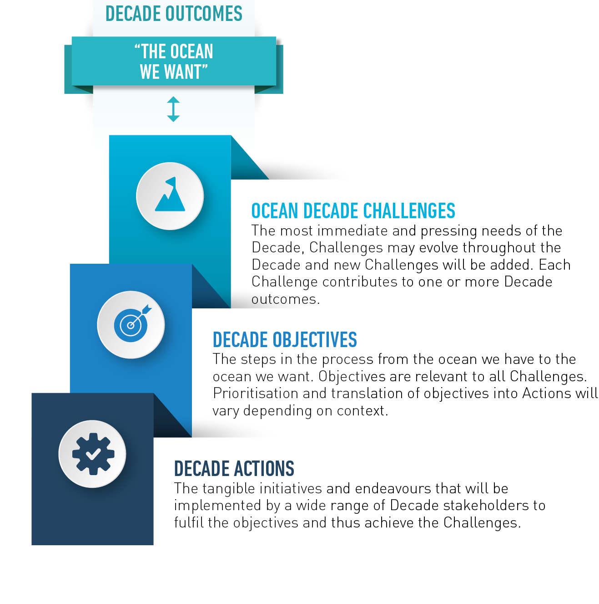
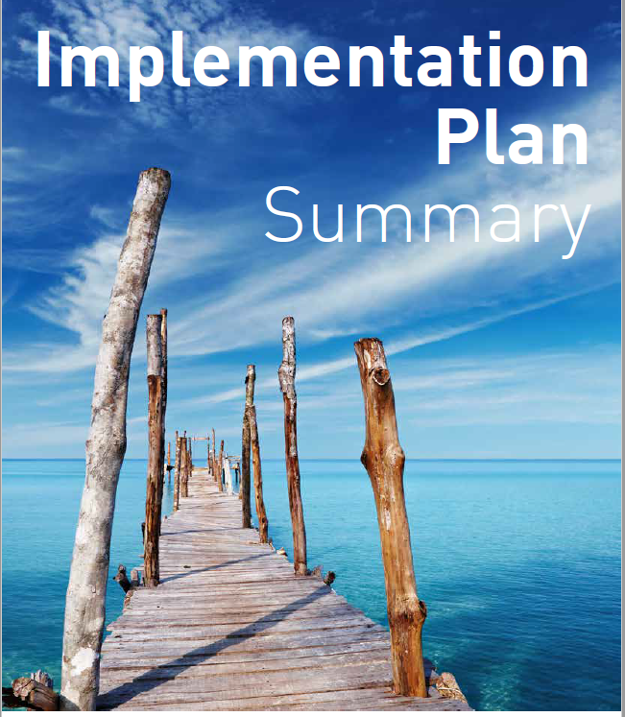
DECADE ACTION FRAMEWORK

Slide 11
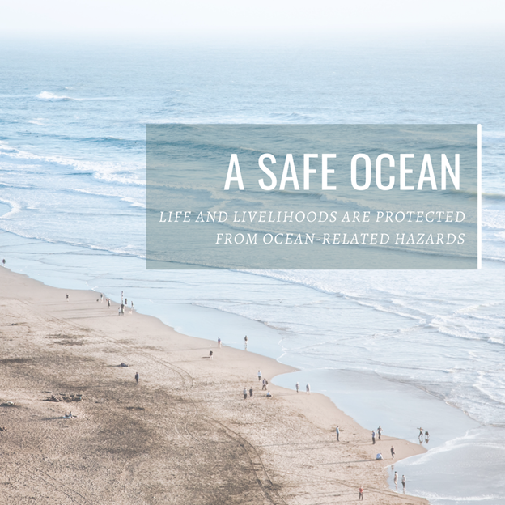
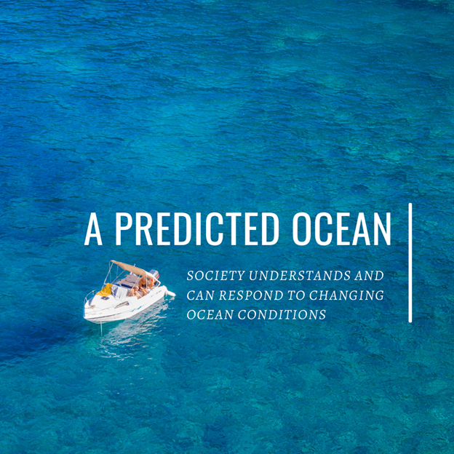
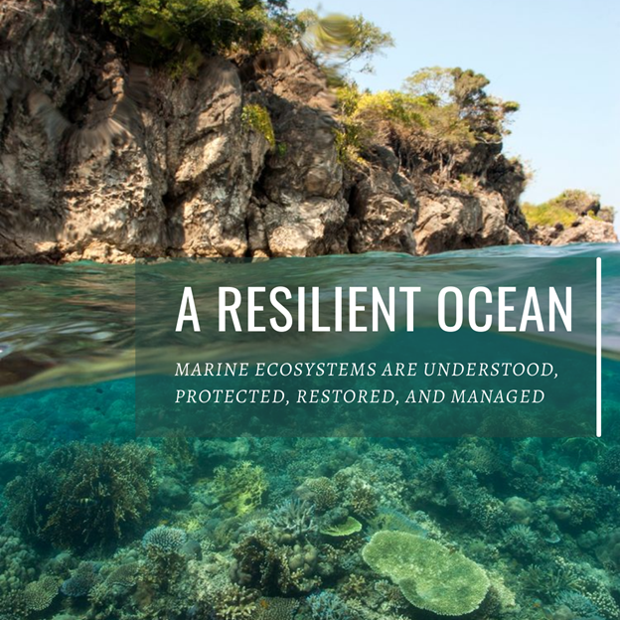
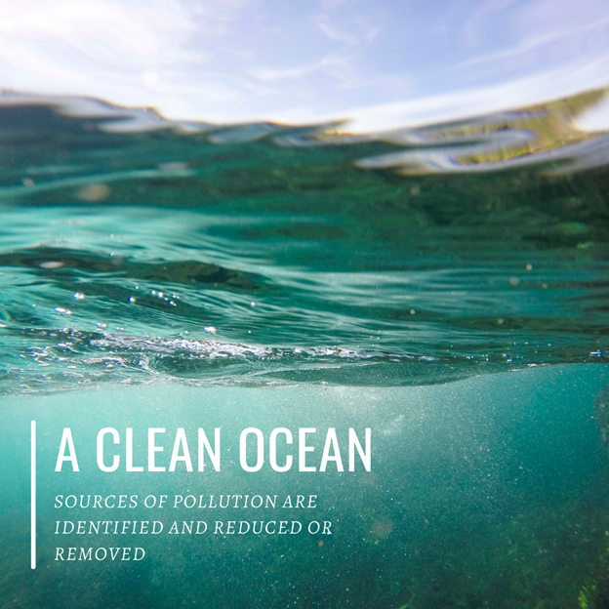
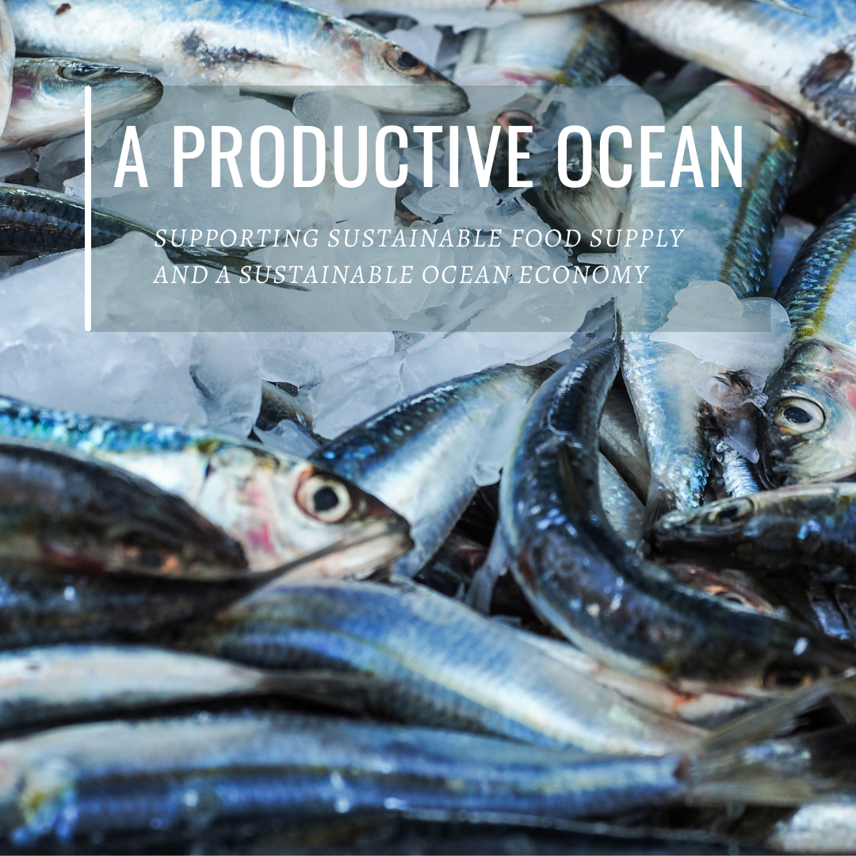
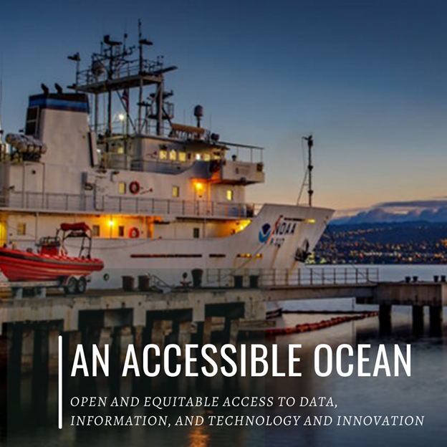
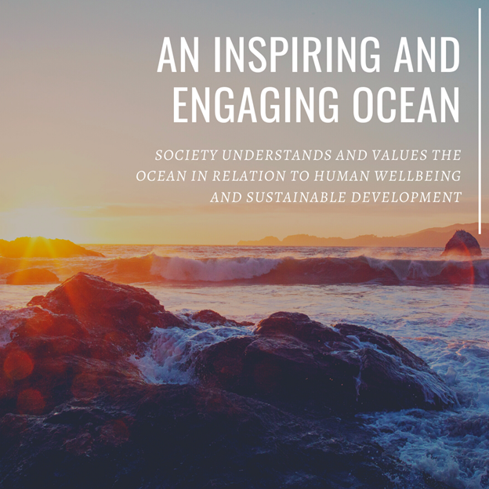
7 Societal Outcomes
Notes:
The Science We Need for the Ocean We Want
Note that an inspiring and engaging ocean is one of the societal outcomes - it is important to build a connection with the ocean
We are more likely to protect what we know and understand, therefore OL crosses all of these!

Slide 12
Origins of the Decade
UNGA Resolution proclaiming Decade
International Decade of Ocean Exploration
1966
1971-
1980
2015
2017
Sustainable Development Goals Adopted
Marine Sciences Act of 1966
Notes:
Marine Sciences Act of 1966
International Decade of Ocean Exploration 1971-1980
Sustainable Development goals
Mindful of the international emphasis of the Marine Sciences Act and the President's pronouncements, the Marine Council under the leadership of Vice-President Humphrey generated, among other marine policy initiatives, an initiative in international marine activities. This was approved in December 1966. This initiative evolved into the IDOE, and in December 1967 the Vice-President recommended it to the President "arguing the case in terms of food for expanding world population, maritime threats to world order, waterfront deterioration in coastal cities, increased pollution at the shoreline, expanding requirements for sea-bed oil, gas, and minerals, and expanding ocean shipping" (Wenk, 1980). The full blessing of the White House was given in March 1968 in the President's conservation message as an International Decade of Ocean Exploration for the 1970s.
International support for the program by other nations and international marine organizations was actively sought by the Marine Council, with the result that on June 13, 1968, the Intergovernmental Oceanographic Commission (IOC) of the United Nations Educational, Scientific, and Cultural Organization (UNESCO) recommended support for IDOE. United Nation's support for the program was obtained in proposition 3 of the General Assembly Resolution 2467(XXIII) cosponsored by 28 nations. This ensured government-to-government endorsement for the program.
Participation of the U.S. marine scientific community in the planning of the IDOE was not ensured until a contract was signed in July 1968 between the Marine Council and the National Academy of Sciences and National Academy of Engineering to elicit the ideas of scientists and engineers relative to the broad goals developed by the Council. The Academies completed their studies and presented their findings and recommendations in a joint report entitled An Oceanic Quest: The International Decade of Ocean Exploration (NAS, 1969).
The program became official in October 1969 when President Nixon announced five initiatives in marine affairs including a commitment of $25 million for IDOE. The National Science Foundation was given lead responsibility for the program
preserve the ocean environment,
improve environmental forecasting,
expand seabed assessment activities,
develop ocean monitoring systems,
improve worldwide data exchange, and
increase opportunities for international sharing of responsibilities and costs for ocean exploration.
the Academy report identified four major topics:
geology and non-living resources,
biology and living resources,
physics and environmental forecasting, and
geochemistry and environmental change
The 1979 NAS report concluded that, ''the IDOE was a watershed in the history of Ocean Research. By providing the structure and resources for large-scale, long term coordinated projects, the program gave a powerful impetus to the transformation of marine science from a descriptive effort to one increasingly driven by experimental and theoretical concerns."

Slide 13
Engagement Strategy
Science community
Science Plan and Survey
Call for Position Papers / Partnership with science networks (eg ICS, SCOR, PICES, Future Earth…)
Private Sector
UN Global compact / WOC
Development and dissemination of Policy Brief for Ocean Business / engagement in global/regional WS
Foundations
27-28 Feb. Foundations Alliance
UN partners
UN-Oceans Decade group
YOUTH/Early Career Prof!
Notes:
Broad engagement strategy is underway through global and regional fora, through public outreach to professional organizations and stakeholders

