Slide 1
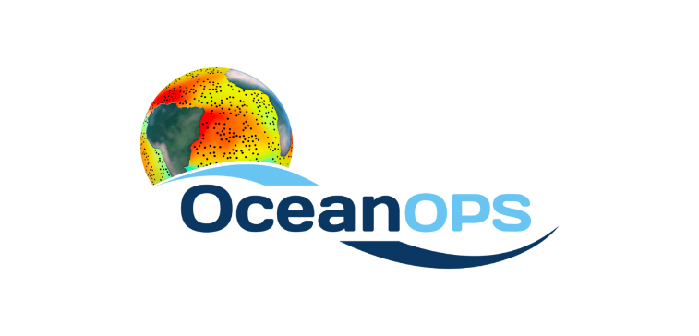
Martin KRAMP
SOT Technical Coordinator
mkramp@ocean-ops.org

Slide 2
SOT-ID: Background
Developed by SOT-ID Task Team ahead of, and presented to, SOT-9.
Goal: Overcome well-known issues with using call-signs or generic “SHIP” mask as identifier
Data integrity not harmed, API archive-approved
Validation per SOT-9, OCG-8, JCOMM-5, INF-I(3)
Implemented by OceanOPS for SOT-10
Strongly recommended for EVERY new station
Used by growing number of VOS operators
Notes:
The SOT noted that per its recommendation to the OCG and from there to JCOMM-5 and eventually WMO infrastructure commission the use of the proposed SOT-ID scheme has been endorsed. OceanOPS has delegated authority to allocate such IDs. Furthermore, OceanOPS now has delegated authority to issue unique IDs for other marine observing systems such as floats and drifters following the WMO-ID concept.

Slide 3
JCOMM-5 Report

Slide 4
SOT-ID in WIGOS-ID
WIGOS identifier scheme:
<series> - <issuer of identifier> - <issue number> - <local identifier>
OceanOPS will issue IDs for marine instrument systems on ships with dedicated <issuer of identifier> 22000
Local identifier (SOT-ID): n1n2n3n4n5n6n7 (n1,n4,n5,n6: letters or digits, n2,n3,n7: letters)
For other marine observing facilities like drifters or floats, OceanOPS is now ALSO the ID-issuing body. The local identifier follows former WMO-ID scheme

Slide 5
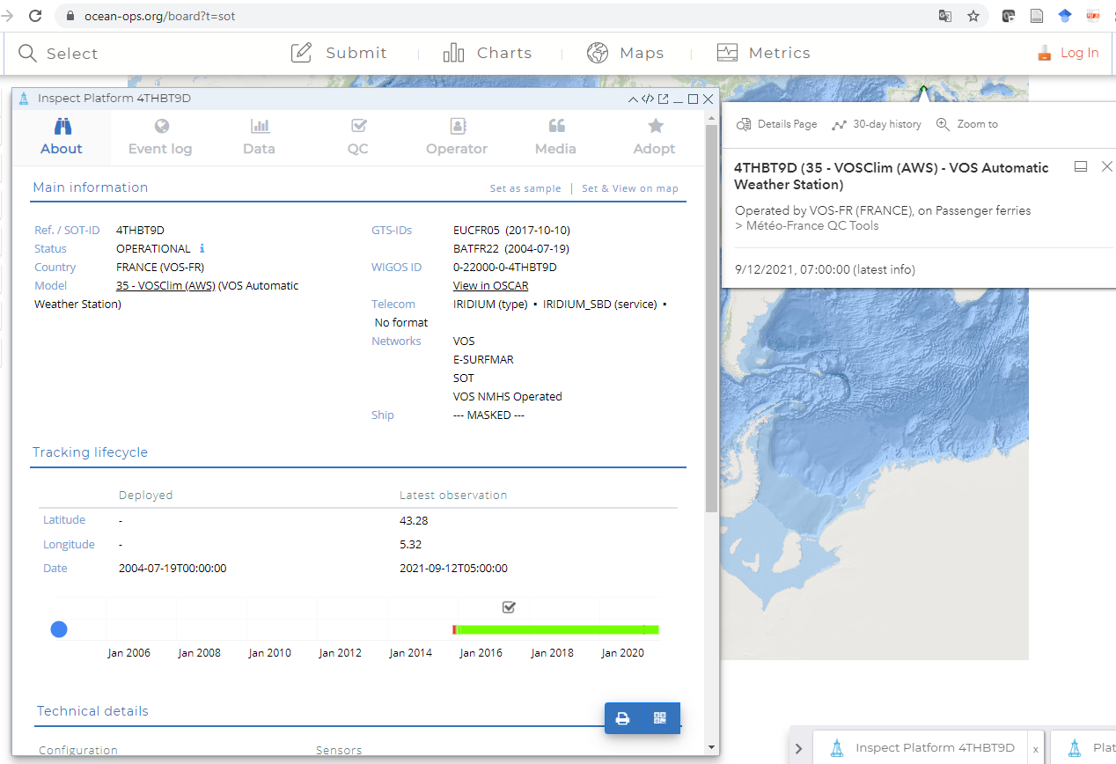
Different IDs: Example
Notes:
The meeting recalled its decision of using SOT-IDs for every new SOT station, its recommendation to migrate to SOT-IDs for all existing stations (noting that OceanOPS allocated SOT-IDs already for all existing or already closed stations) and (in agreement with members presently still using them) to phase out any (other) existing masking scheme, in particular the generic ID “SHIP”.

Slide 6
Different IDs: Example
Notes:
Mr Kramp explained that a request from an instrument operator to “mask” the ship will hide the corresponding ship metadata like name, IMO, call-sign, etc. from non-authorized users. However, vessel type and all station-related metadata like sensor information remain available, which is of high advantage for data users.
A ship potentially hosts more than one instrument (package). The use of the mask option should be limited as much as possible and requires the approval of the TC. The meeting agreed again that in times of AIS and similar technologies the former security concerns are now less of an issue

Slide 7
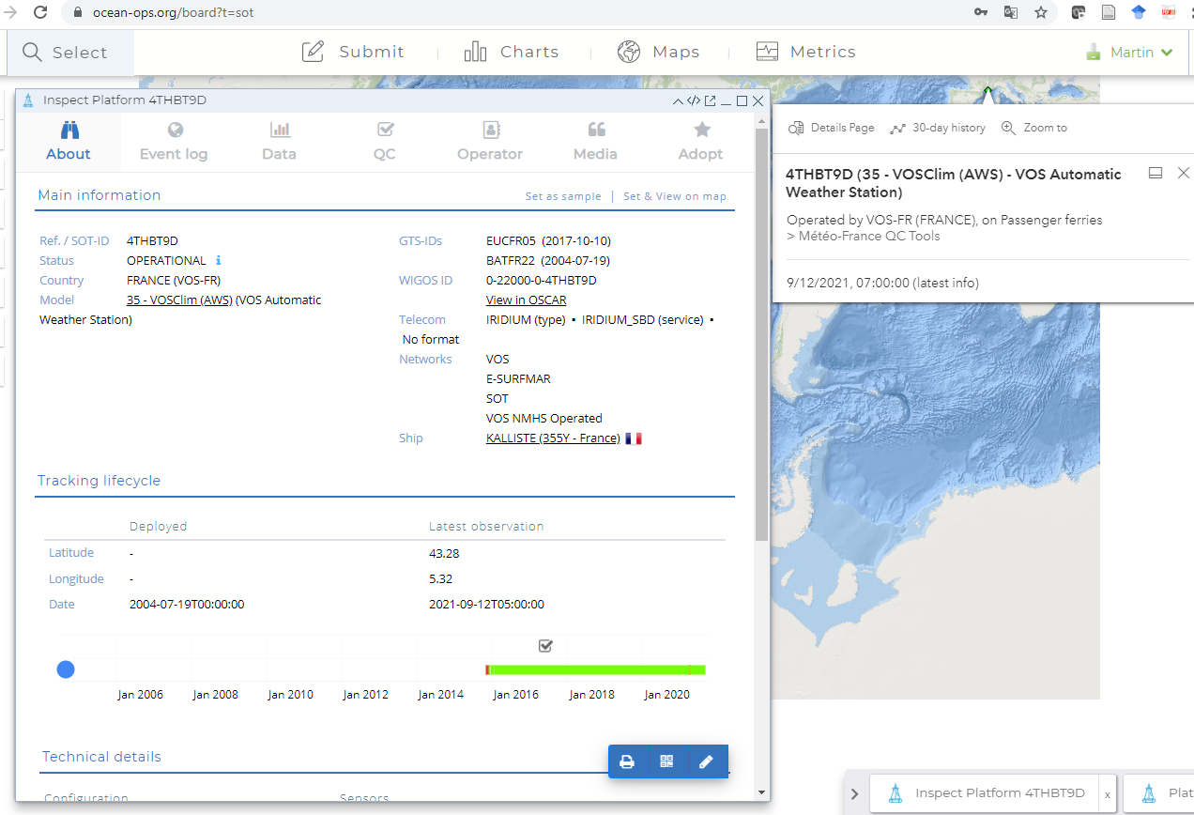
Phase out Masking Schemes
Notes:
Together with the metadata TT, the following workflow has been developed for the transitional period to a new metadata format: Operators who would like to migrate to SOT-IDs for already existing stations can look up these IDs on the OceanOPS website and start using this ID in GTS submissions at any time. In OceanOPS, the “GTS-ID” will be updated automatically. In metadata submissions in the presently still valid Pub47 format, the SOT-ID must then be entered in the call-sign field. Operators who create a new station must first request a SOT-ID from the OceanOPS website, use this ID in GTS submissions, and submit it in the Pub47 call-sign field. A short workflow document has been developed for this purpose.

Slide 8
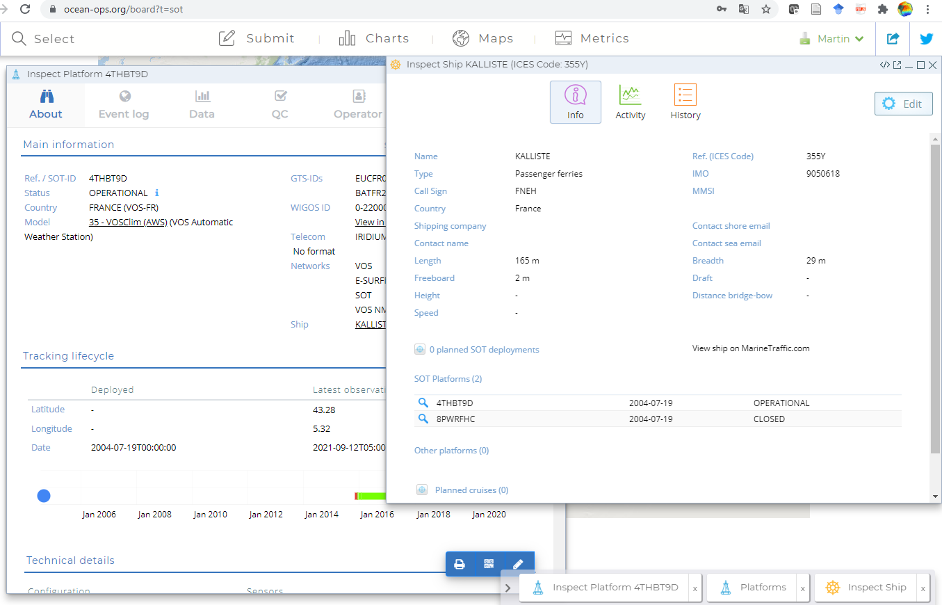
Split ship from station metadata

Slide 9
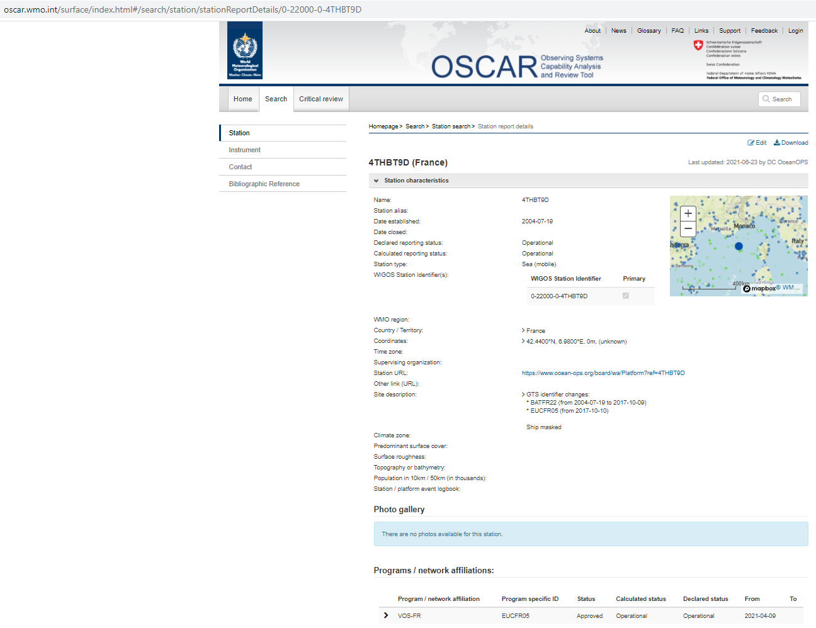

Slide 11
Some reminders
In Pub47, the description for the ID field (6) was always: Call-sign, or WMO (OceanOPS) number
Request SOT-ID at OceanOPS for new stations and use call-sign field for metadata submission and Turbowin in transitional period
Migrate to SOT-IDs for existing stations any time
Arguments for Ship-Tracking with e.g. SailWX are obsolete with BUFR migration
Arguments for increased Ship Masking to reduce facilitated identification are weak now

Slide 12
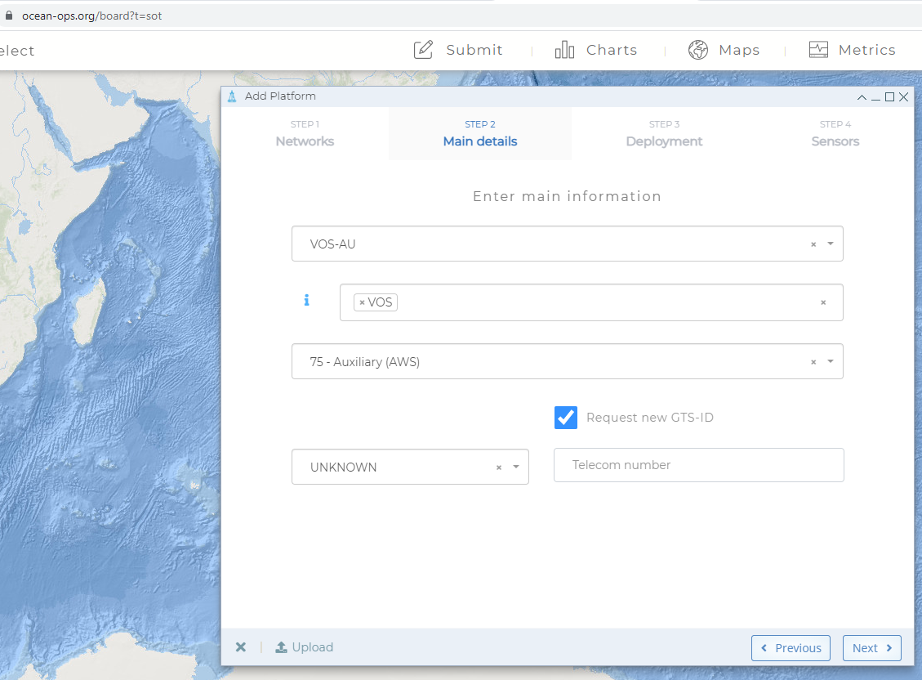

Slide 13
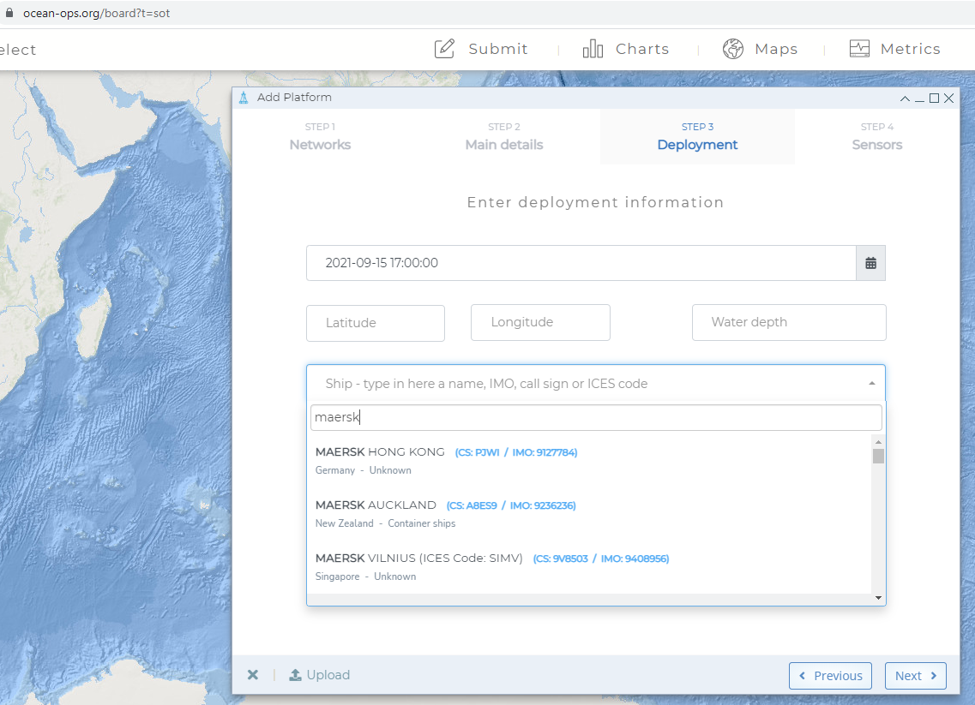
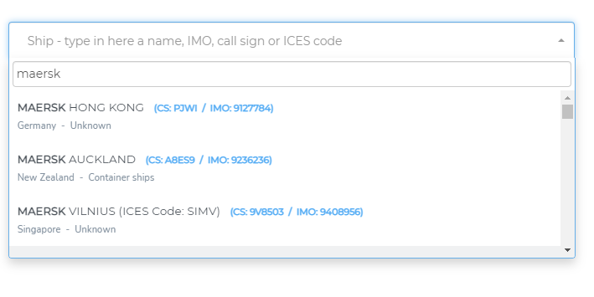

Slide 14
Action/Recommendation
Following its former decisions, the meeting agreed again to use SOT-IDs for new stations, and to phase out masking schemes.
The migration to SOT-IDs for already existing stations was recommended

