Slide 1
Agenda Item 7: Open-GTS / Third Party
Darin Figurskey, SOT Chair

Slide 2
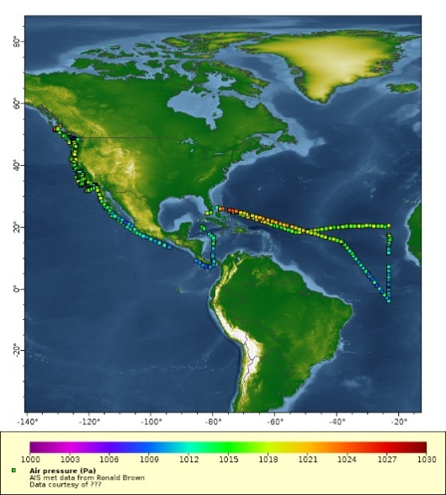
The Open Access to GTS is an GOOS Observation Coordination Group project designed to help increase the volume of observations available on the GTS
The Open–GTS workflow makes it easier for data producers to make their data available to the GTS
The Open–GTS is currently being used to distribute Saildrone data on the GTS (using the newly developed TM315011 BUFR template) and has successfully supported exchange of AIS met data from ~12 ships through the GTS as well
AIS-based pressure data from NOAA ship Ron Brown

Slide 3
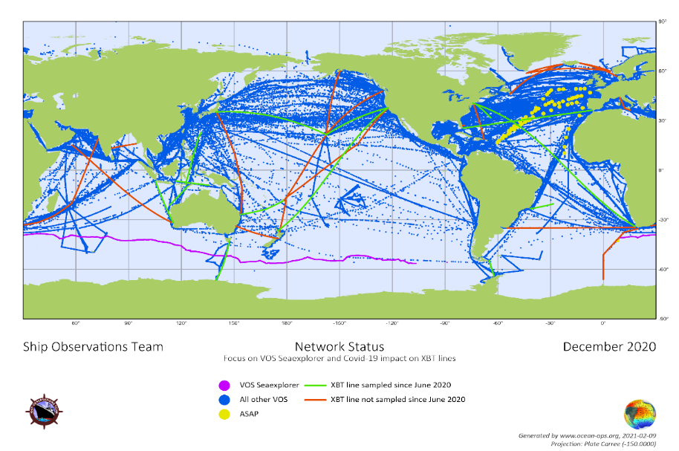

Slide 4
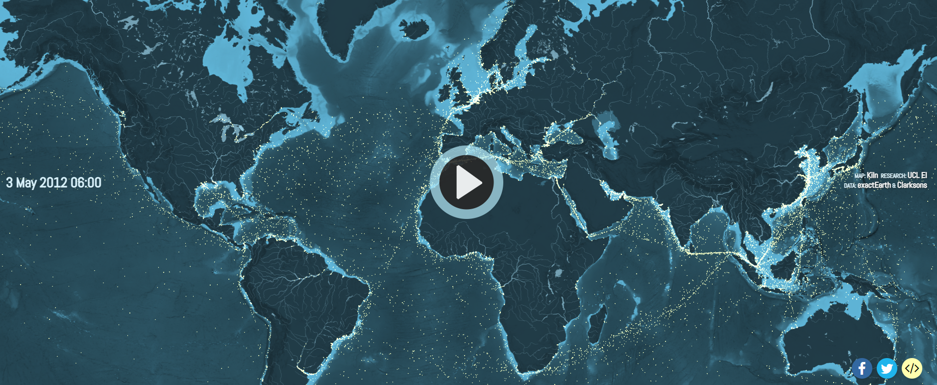
Courtesy:
shipmap.org

Slide 5
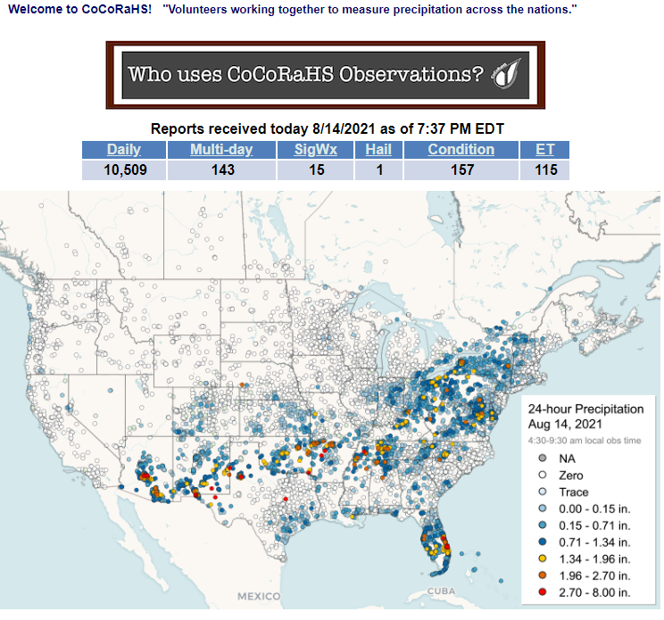
Courtesy:
Community Collaborative Rain, Hail, and Snow Network
(CoCoRaHS)

Slide 6
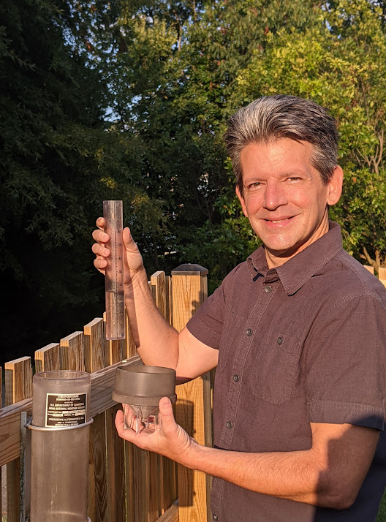
Courtesy:
Community Collaborative Rain, Hail, and Snow Network
(CoCoRaHS)

Slide 7
Synergies with UN Ocean Decade
Looking for partner projects with the United Nations Decade of Ocean Science for Sustainable Development
https://unesdoc.unesco.org/ark:/48223/pf0000261962

Slide 8
Proposed ToR TT-Expansion of Independent Class Observations
The Task Team on the Expansion of Independent Class Observations will:
Review, recommend and coordinate the expansion of independent class observations, including, but not limited to, any related projects and/or programmes through the United Nations of Ocean Science for Sustainable Development along with citizen science initiatives;
Support the development and maintenance of new pilot projects to include gathering of meteorological and oceanographic data and metadata, and their quality control;
Ensure coordination as necessary with WMO, to include the WMO Information System, the Observations Coordination Group, OceanOPS, and others as appropriate;
Liaise with the SOT Task Team on Recruitment, Promotion and Training, and with other relevant task teams, where necessary, and encourage contact with other relevant marine organizations (e.g., IMO, ICS, etc.) to help promote independent class observations;
Develop a guide on the submission of metadata, in coordination with OceanOPS, for independent class VOS and other vessels;
Develop a guide on the submission of observations, in coordination with the OCG, to the WMO GTS / WIS through the Open-GTS or similar initiative;
Coordinate to ensure the updating of WMO manuals as appropriate; and,
Include interested nations, including developing countries, as part of any demonstration and/or implementation.

Slide 9
Ask Approval of the TT
What it is:
Opportunity to increase observations in partnership with industry, citizen science, etc.
Not just for VOS, but for oceanographic and climate purposes and in partnership with other networks.
Complement to traditional VOS.
Already a VOS class codified by SOT.
What it is not:
Replacement for traditional VOS.
A repository for poor quality observations.

