Slide 1
Eleventh Session of the
Ship Observations Team
Online Meeting, 13-16 September 2021
Agenda Item 14.1:
WMO Secretariat Update
Marine/Ocean related Recommendations/Decisions
Outcomes of Cg-18, INFCOM-1 and EC-73
Sarah North & Champika Gallange

Slide 2
18th Congress Resolutions
Resolution 1 (CG-18): WMO STRATEGIC PLAN
Goal 1: Better serve societal needs: delivering, authoritative, accessible, user-oriented and fit-for-purpose information and services
Goal 2: Enhance Earth system observations and predictions: Strengthening the technical foundation for the future
Goal 3: Advance targeted research: Leveraging leadership in science to improve
understanding of the Earth system for enhanced services
Goal 4: Close the capacity gap on weather, climate, hydrological and related
environmental services: Enhancing service delivery capacity of developing countries to ensure availability of essential information and services needed by governments,
economic sectors and citizens
Goal 5: Strategic realignment of WMO structure and programmes for effective policy and decision-making and implementation

Slide 3
18th Congress Resolutions (contd.)
Resolution 7 (Cg-18): Establishment of the WMO Technical Commissions for the 18th Financial Period
Commission for Observation, Infrastructures and Information Systems (INFCOM)
Commission for Weather, Climate, Water and Related Environmental Services and Applications (SERCOM)
Research Board
Resolution 9 (Cg-18): Joint WMO-IOC Collaborative Board (JCB)
Notes:
From 8 technical commissions to 2 technical commissions and a research board.
JCB established as a high-level coordination mechanism with broader engagement of the key relevant bodies of the WMO and IOC.

Slide 4
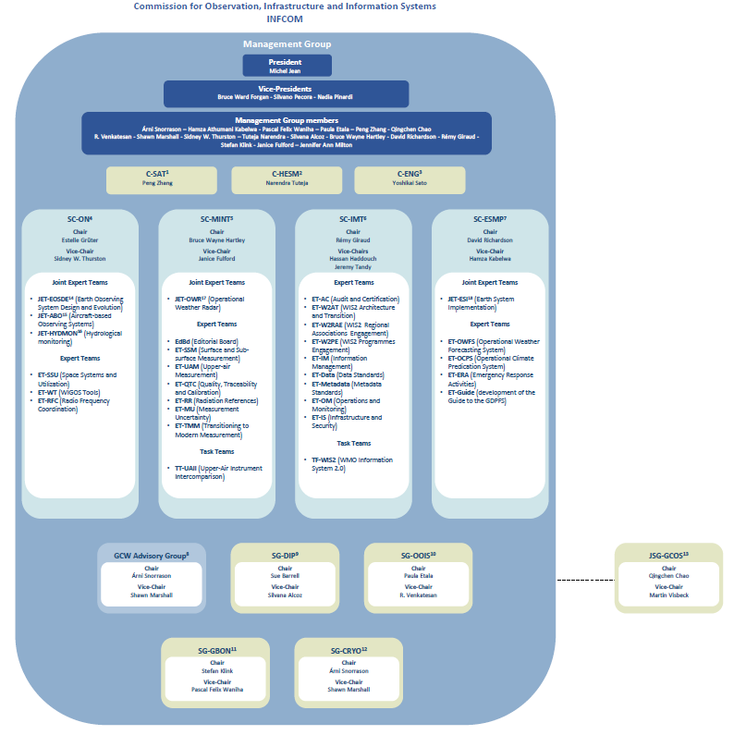
Provisional organigram

Slide 5
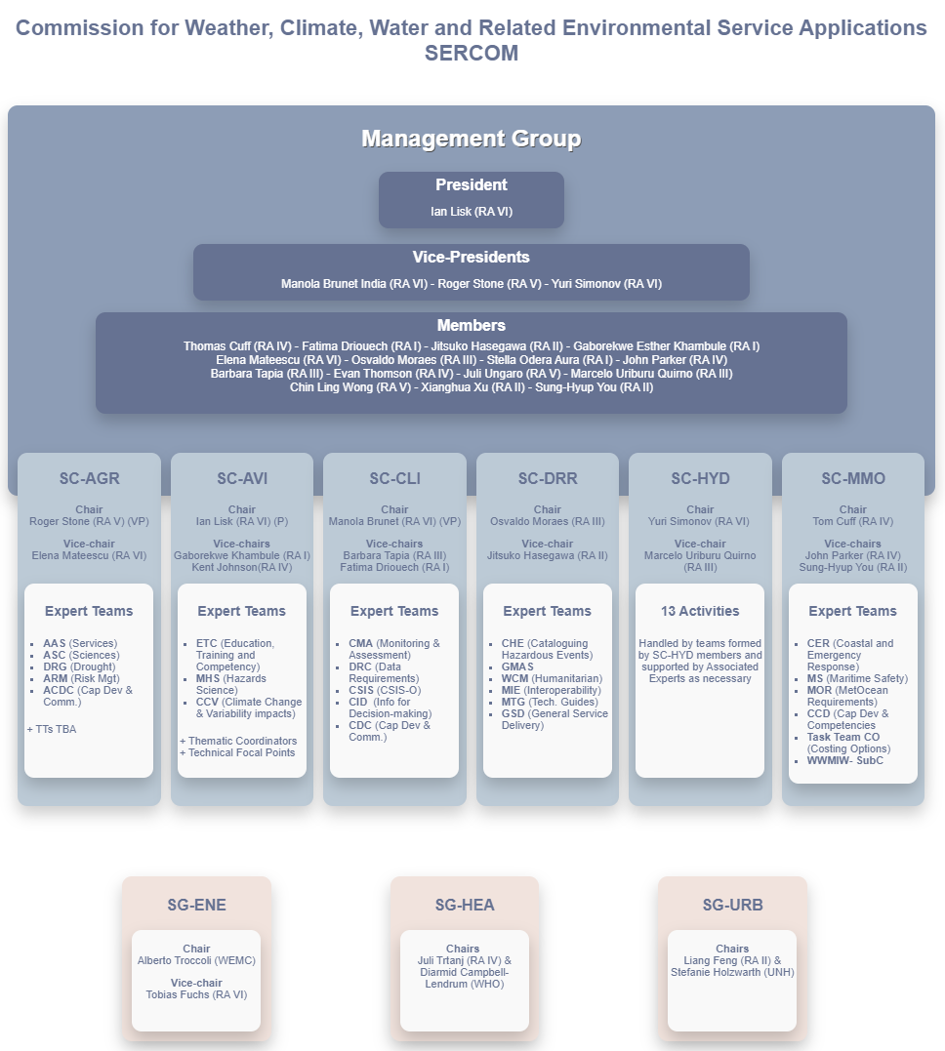

Slide 6
1st Infrastructure Commission Decisions;
Decision 5.1.3(1)/1: Experimental CF-NetCDF profiles for marine and weather radar
Decision 5.1.7: Optimum functional connections for marine meteorological observations and data management
Endorsed connections for Marine Climate Data System (MCDS)
Endorsed governance of DBCP and SOT. SOT and DBCP will report to Observations Coordination Group (OCG).
DBCP & SOT and subsidiary bodies shall operate under their own governance, whereby their Terms of Reference(ToR) are kept under review by the respective panels. Any changes proposed to DBCP and SOT ToRs shall be considered by OCG with a view to their approval by the OCG Executive Board on behalf of the OCG. Respective panels will decide on leadership appointment following their approved ToR and operating principles.

Slide 7
73rd Executive Council Recommendations, Decisions, and Resolutions
Recommendation 3: WMO Unified Policy for the International Exchange of Earth System Data

Slide 8
73rd Executive Council Recommendations, Decisions, and Resolutions
Recommendation 4: Update of Regulatory Material Related to Establishment of the Global Basic Observing Network (GBON)
“3.2.2.10 Members shall maintain the continuous operation of a set of surface marine meteorological observing stations/platforms within their Exclusive Economic Zone that observe, at a minimum, atmospheric pressure and sea surface temperature located such that where opportunity exists, GBON has a horizontal resolution of 500 kilometres or higher , over the marine areas of their jurisdictions, for these variables, with an hourly frequency”
“3.2.2.11 Members should facilitate other Members to make surface marine meteorological observations within their Exclusive Economic Zone, subject to the data being shared internationally according to 3.2.2.5”

Slide 9
73rd Executive Council Recommendations, Decisions, and Resolutions
Resolution 10: Amendments to the Technical Regulations on WIGOS
On behalf of Members, OceanOPS is authorized to issue WIGOS Station Identifies for surface marine stations or sea stations contributing to the co-sponsored GOOS, when asked to do so.
Resolution 13: Guide to the WMO Integrated Global Observing System (WMO-No. 1165)
Includes the guidance on WIGOS Station Identifiers (WSIs) to be used by operators of all Global Ocean Observing System (GOOS) Observation Coordination Group (OCG) Observing Networks and allocated by OceanOPS
Decision 8: Establishment of Data Acquisition Centres (DAC) for Marine Meteorological and Oceanographic Climate Data within the Marine Climate Data System (MCDS)
Endorsed AOML of NOAA, USA to operate as a DAC for Drifting Buoys under MCDS

Slide 10
Action for SOT
SOT members are requested to support the implementation of GBON requirements identified in the WMO NO 1160 (section 3.2.2.10) and provide input to further develop GBON to include marine/ocean domain.

Slide 11
Thank you
Merci

