Slide 1
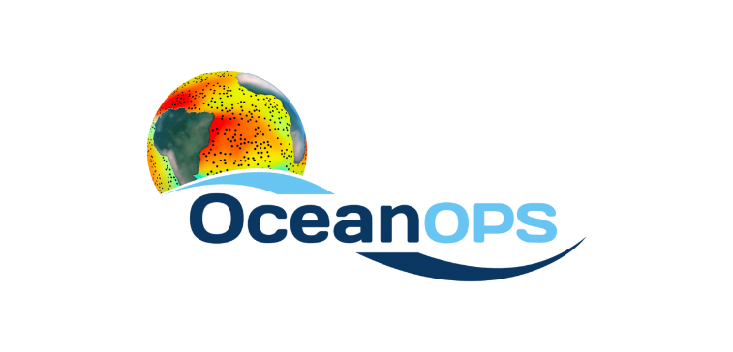
Martin KRAMP
SOT Technical Coordinator
mkramp@ocean-ops.org

Slide 2
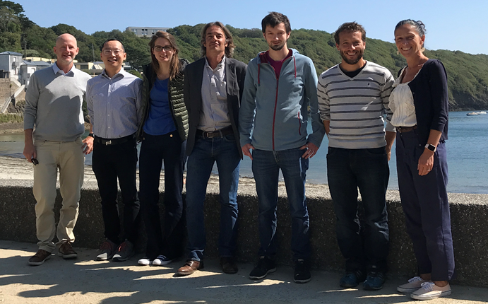
The Brest-based OceanOPS Team
Notes:
The meeting noted that the Brest-based centre now comprises 7 permanent staff members; 4 Technical Coordinators (3 WMO including lead, 1 IOC), 1 Coordinator for Science and Communication (IOC), 1 metadata clerk (WMO), and 1 IT engineer (CLS); the team is additionally supported by an outsourced web-designer, working remotely from Toulouse. The recruitment of an additional Technical Coordinator (IOC) who will work remotely from the Mediterranean Sea is almost completed.
The meeting recalled that the SOT Technical Coordination is part of the Ship Coordinator position which also comprises duties for the repeat hydrography program GO-SHIP and cross-cutting cruise coordination tasks to exploit synergies like deployment/recovery/maintenance opportunities for DBCP and Argo.
In fall 2020, the VOS chair joined OceanOPS in Brest for 4 weeks and worked with the team on the new SOT metadata format.

Slide 3
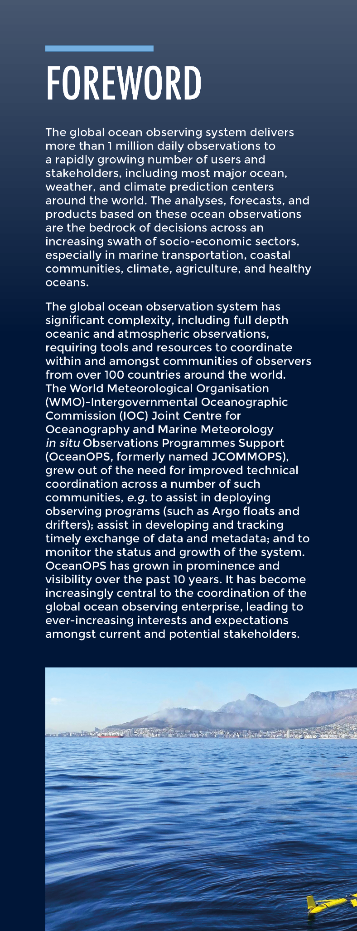
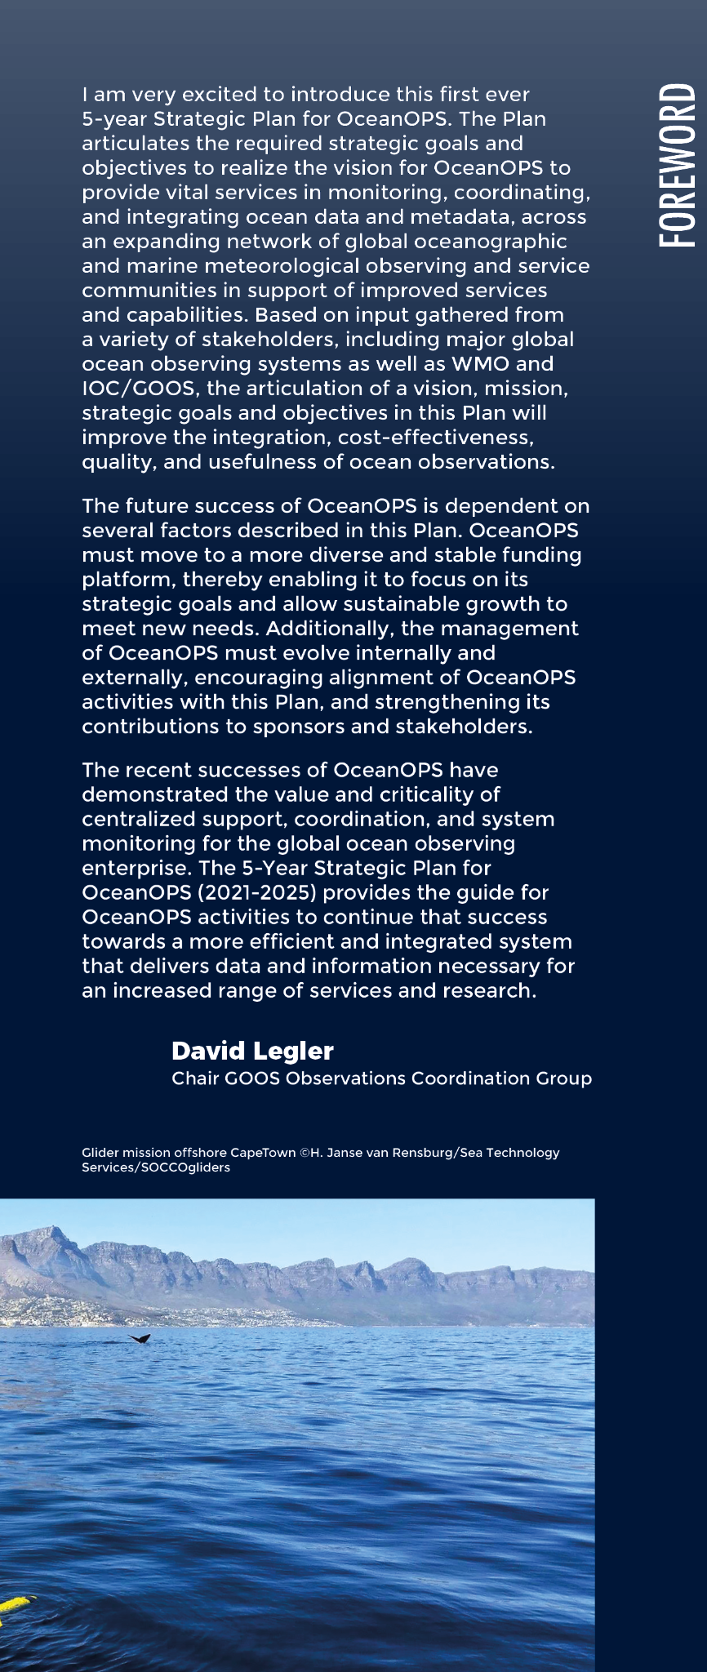
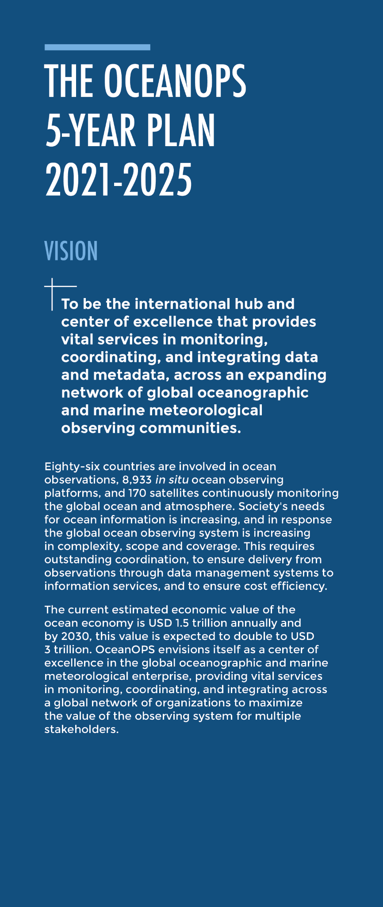
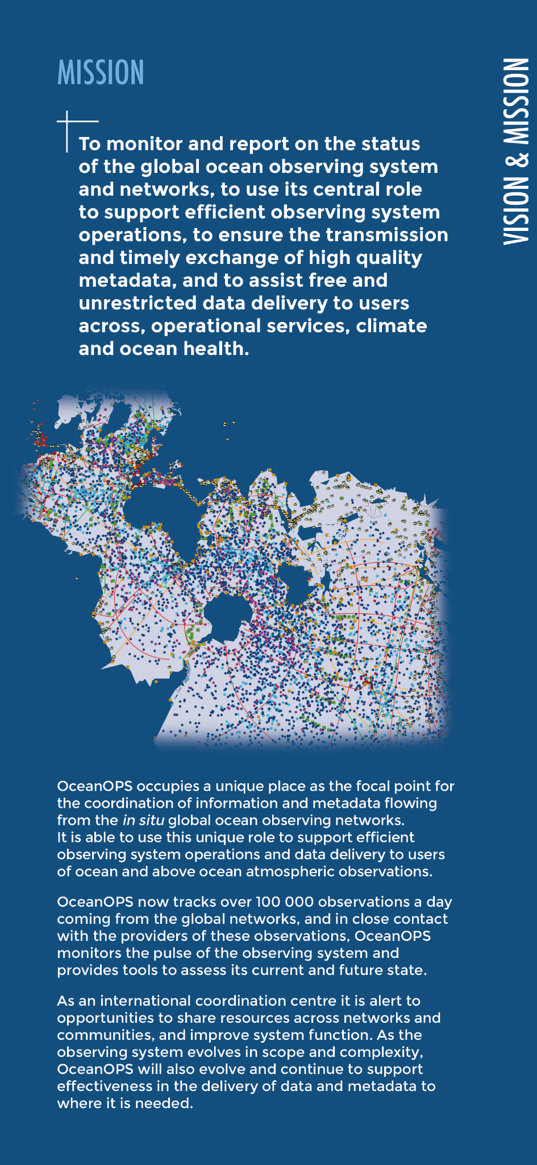
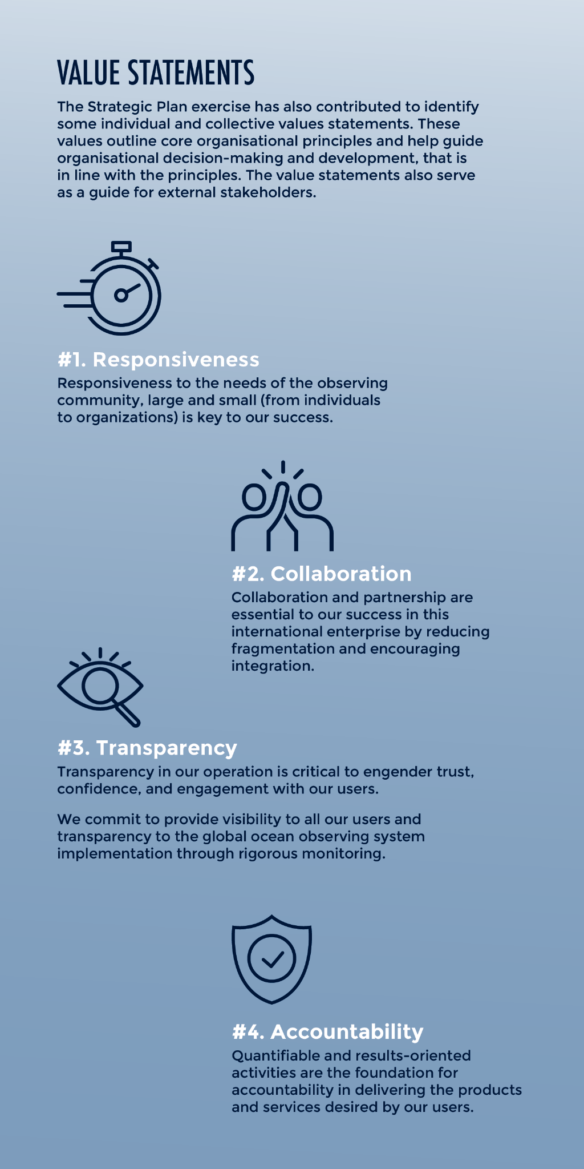
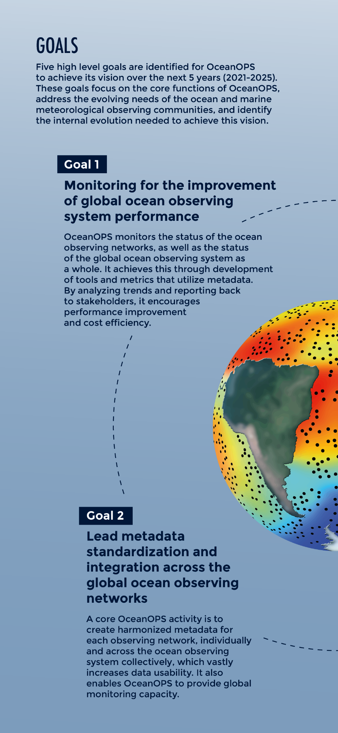
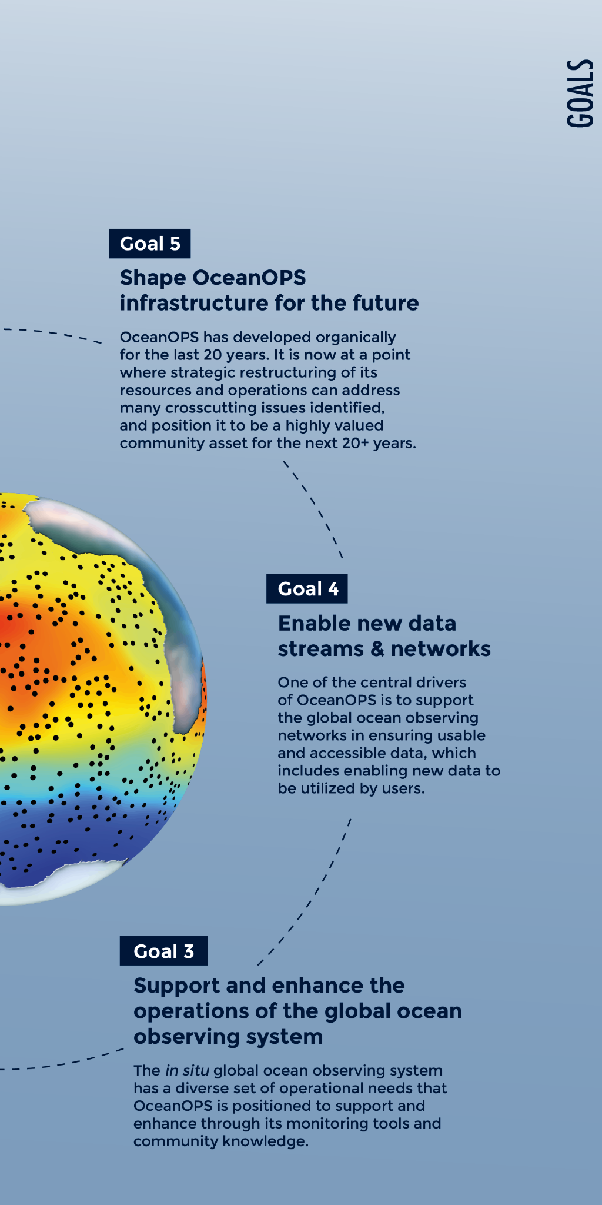
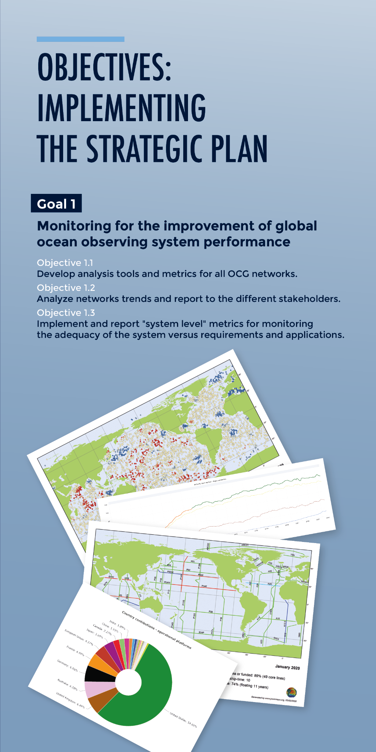
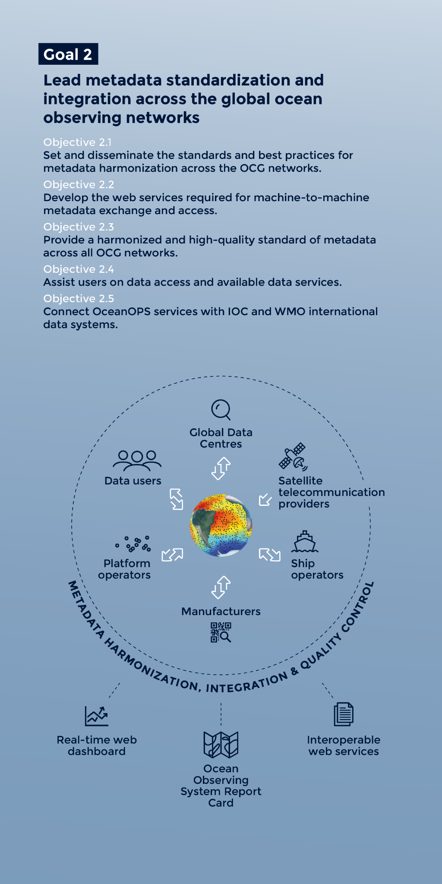
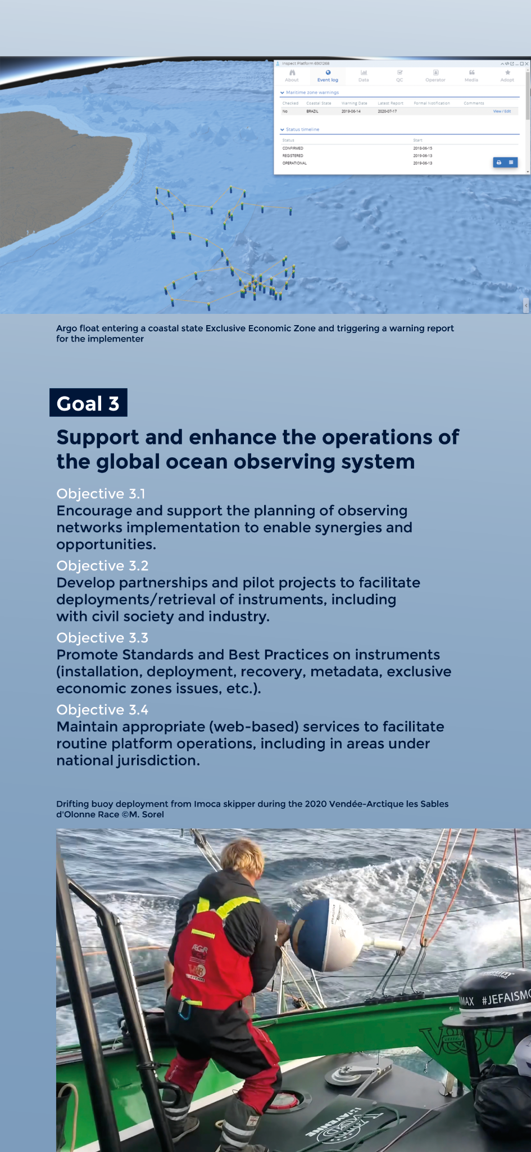
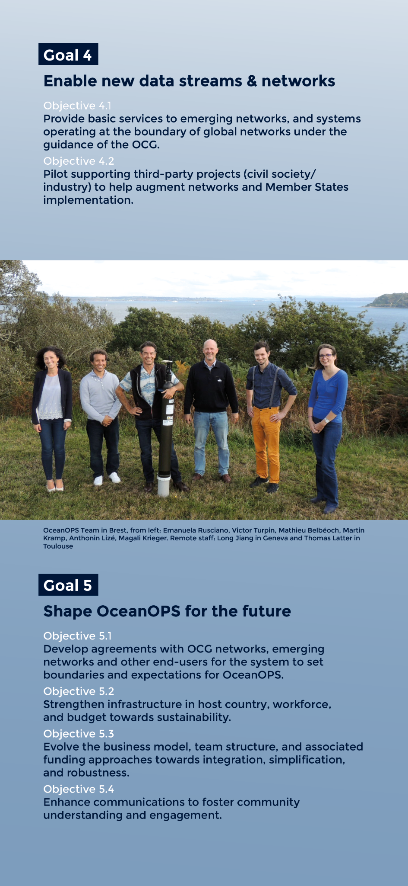
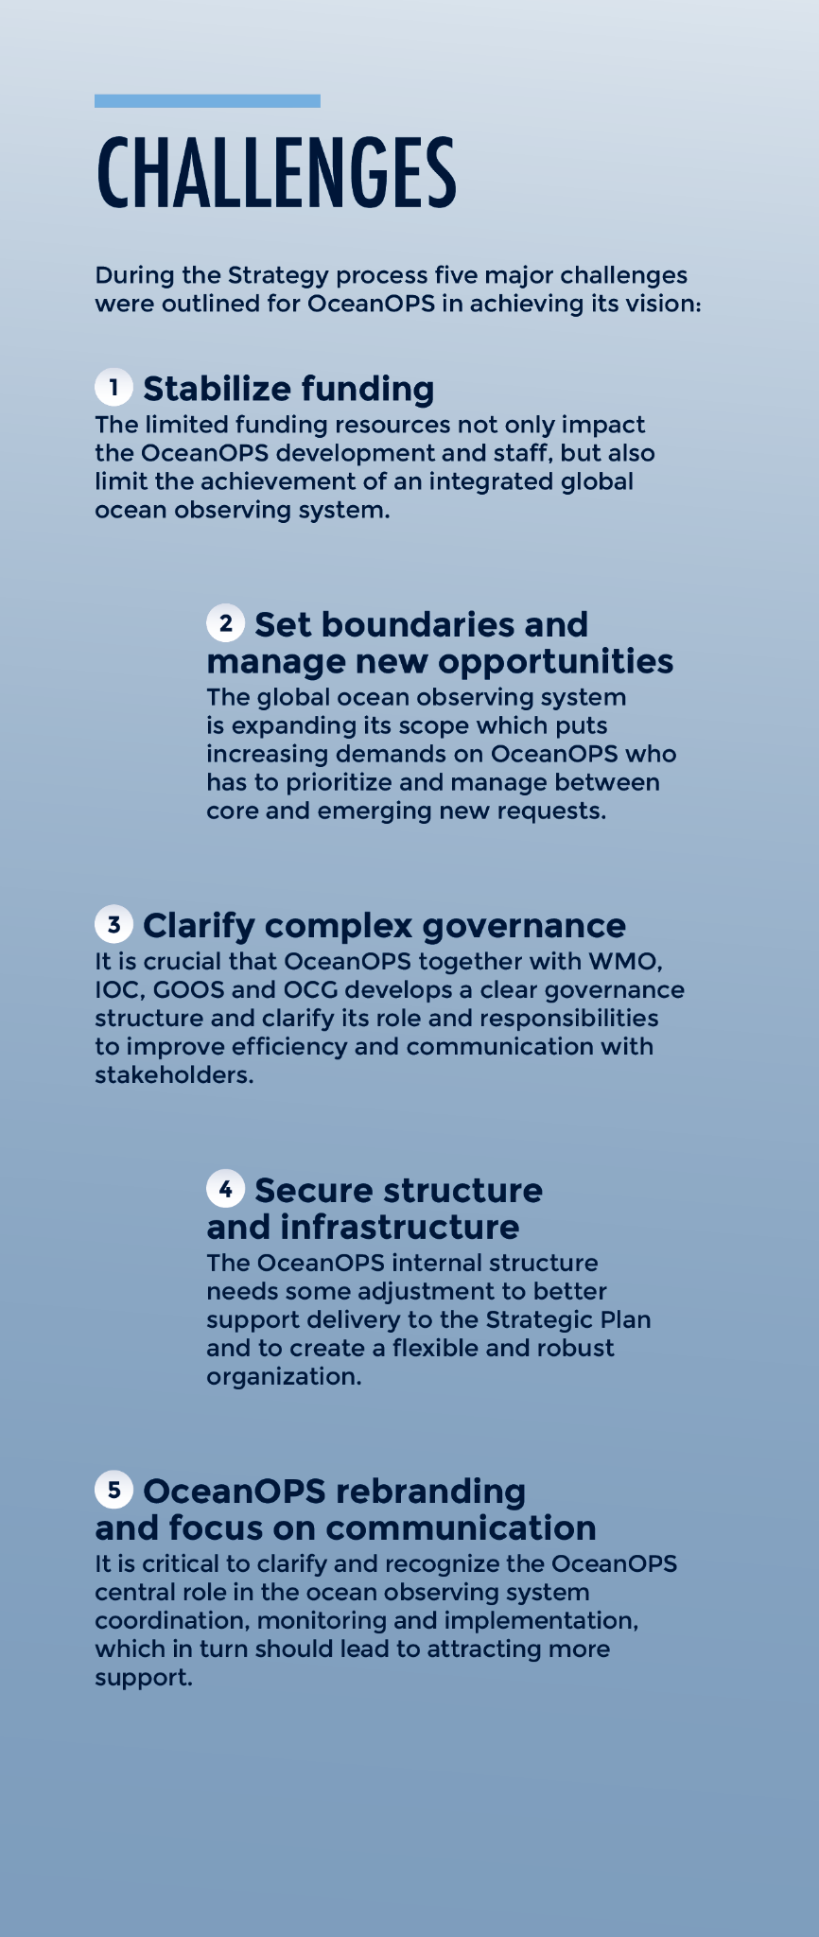
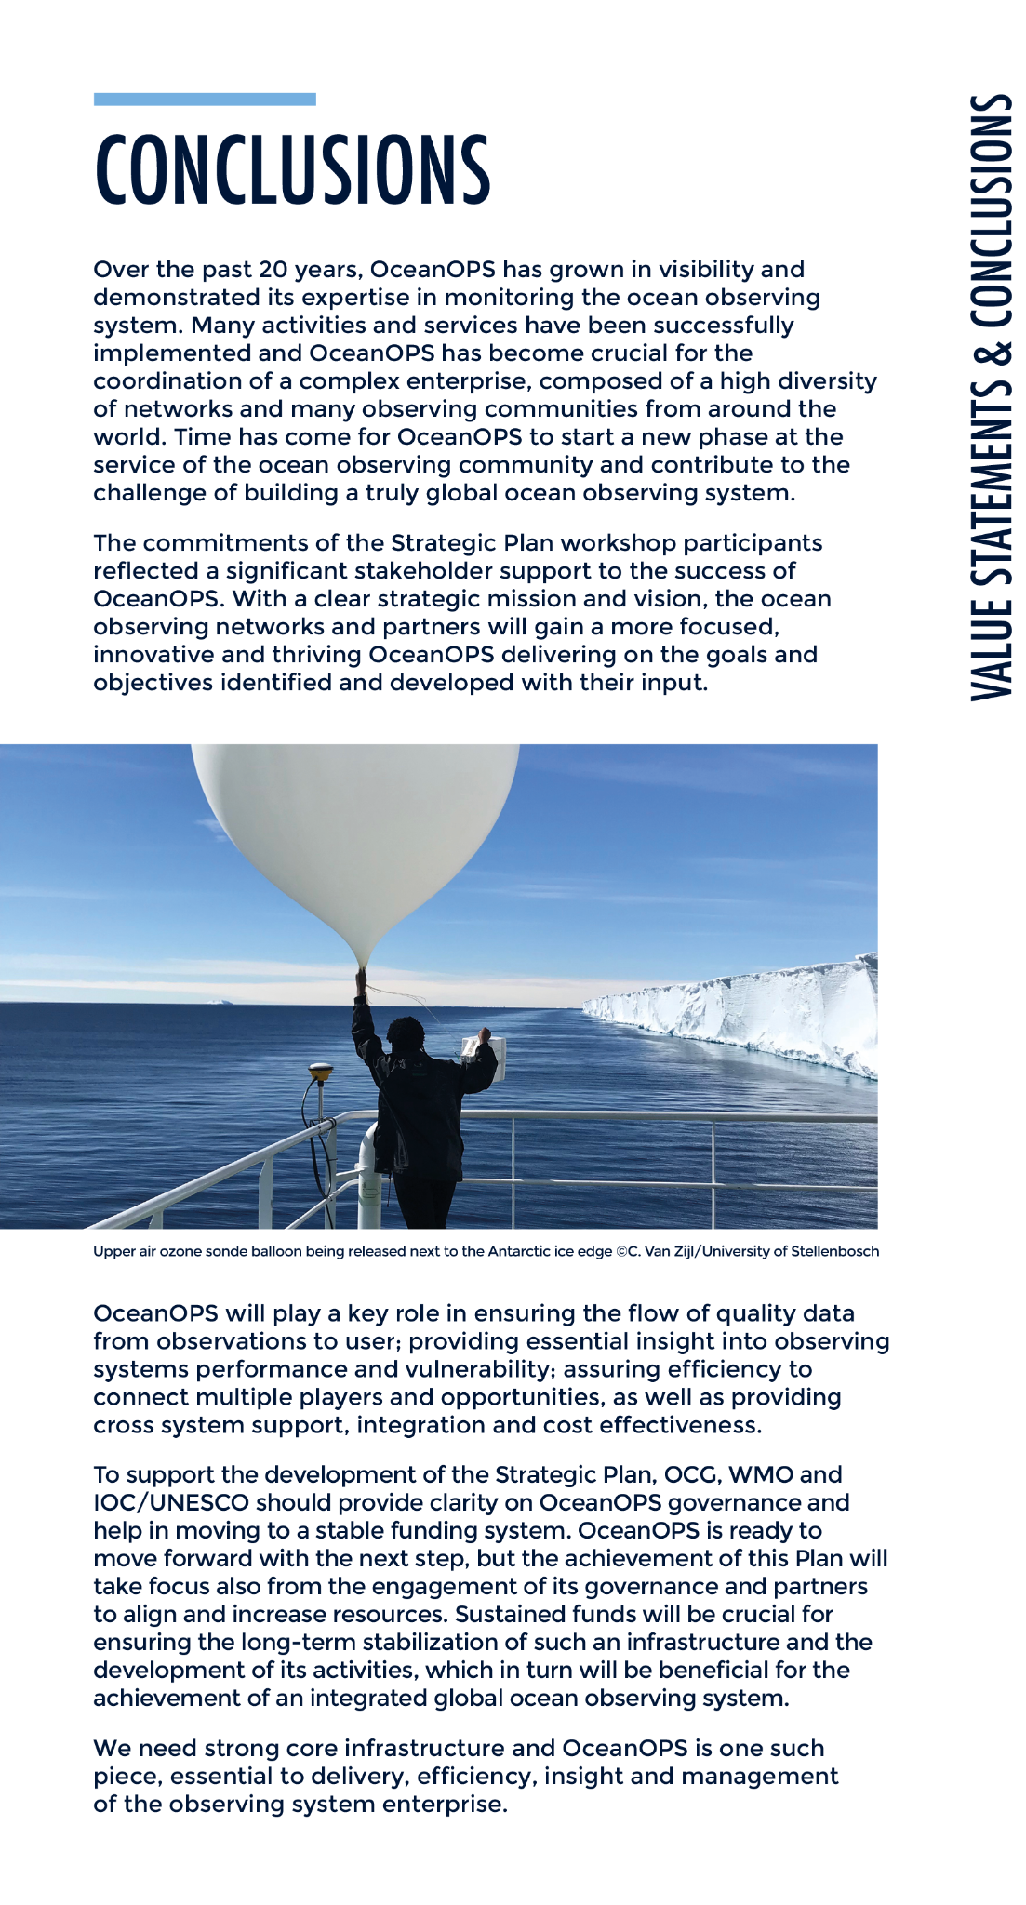
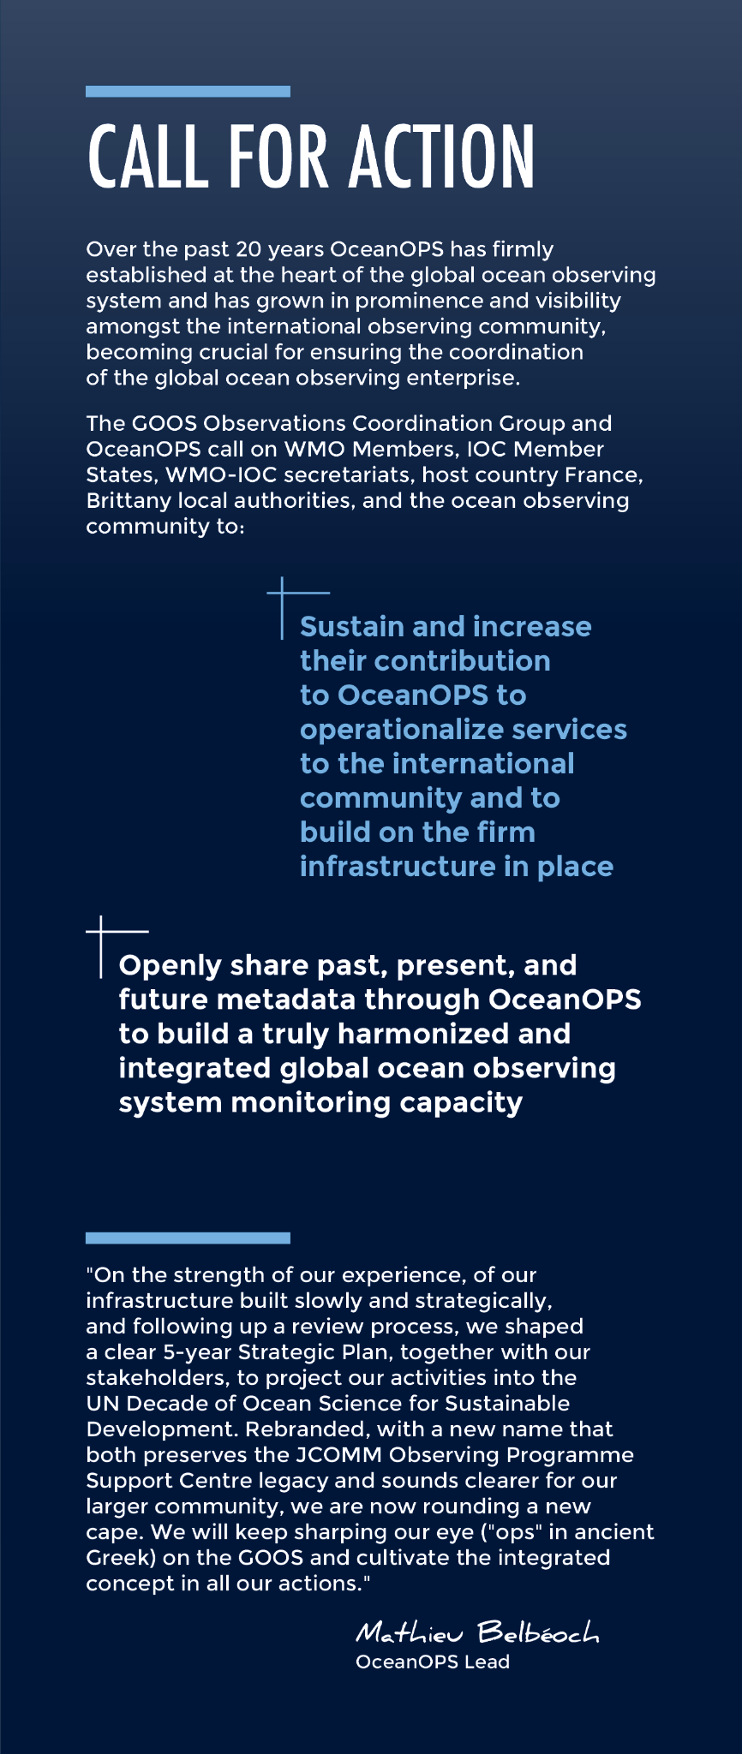
5-year OceanOPS Strategy
Notes:
The centre was re-established as WMO office in December 2019 and renamed from JCOMMOPS to OceanOPS, following a 2021-2025 strategy review and related with the end of JCOMM. A strategy-based workplan was presented to the last session of the Observations Coordination Group (OCG).

Slide 4
New WMO Structure OceanOPS in ESM Division of Infrastructure Department
Notes:
OceanOPS is part of the Earth System Monitoring Division headed by Dominique Berod in the new WMO Infrastructure Department, with ocean observations playing a more important role than before. A formal inauguration ceremony is planned for late 2021. As joint WMO-IOC office, OceanOPS is as before part of the IOC-OOS section headed by Albert Fischer.

Slide 5
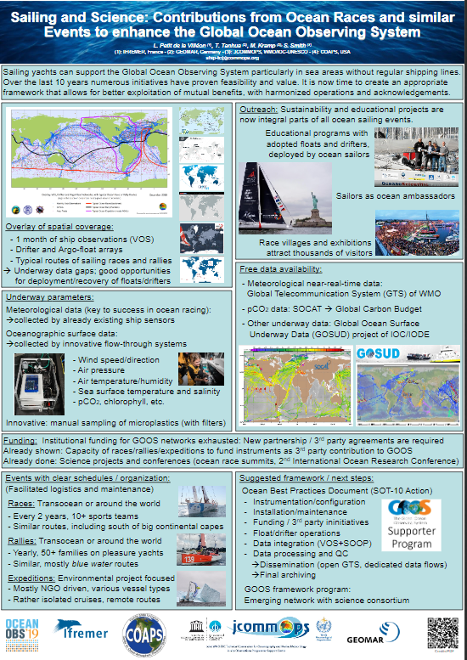
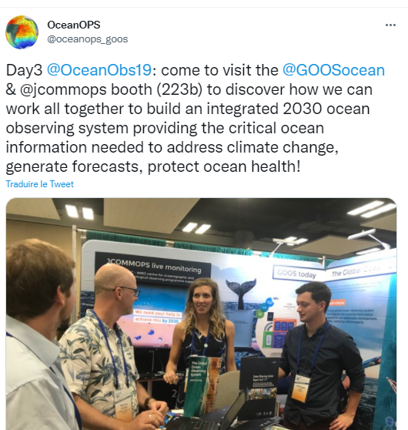
OceanOPS at OceanOBS (2019) 3rd party data a key discussion
Notes:
At the OceanObs’19 Decadal Conference in fall 2019, a joint GOOS-JCOMMOPS booth informed the broader community about the activities of the centre. Of particular interest for the SOT have been discussion with the SAILDRONE developers, KONGSBERG and on Sailing4Science initiatives. The SOT noted the success with operations of innovative underway equipment, submission of innovative RT met data and (beyond SOT) deployment of drifters and floats, always combined with outreach and media activities and financially mostly supported by citizen scientists, private sector or other third parties. A corresponding session proposal for the 2022 Ocean Sciences Meeting (OSM) with title “Leveraging Existing Marine Platforms for Ocean Observing: Engaging the Commercial Sector on Local, Regional, and Global Scales” was co-authored by the SOT TC and accepted by the organizers. A great success in early 2020 was the establishment of a company-wide VOS engagement by MAERSK, driven by the VOS Chair. This success also highlighted the limits of NMHSs in terms of number of ships they can support: alternative third party approaches are urgently required.

Slide 6
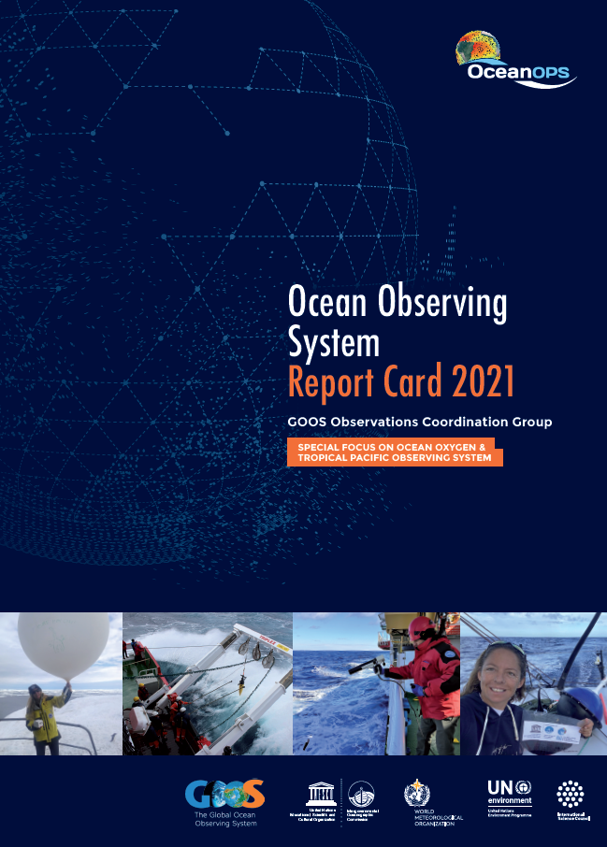
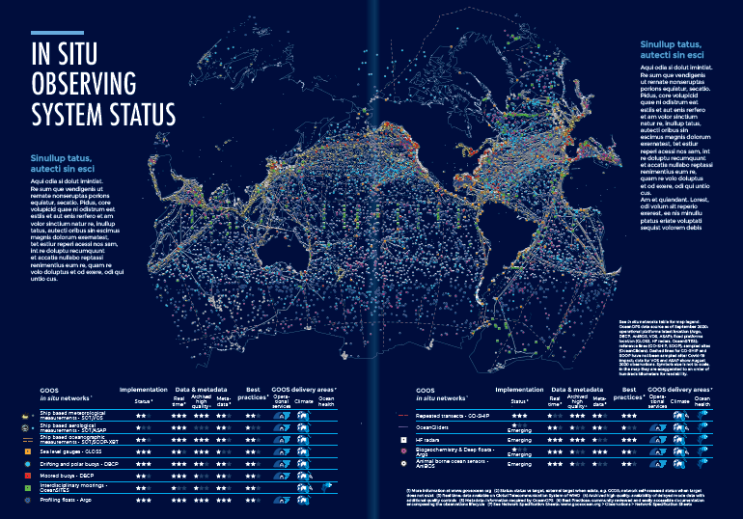
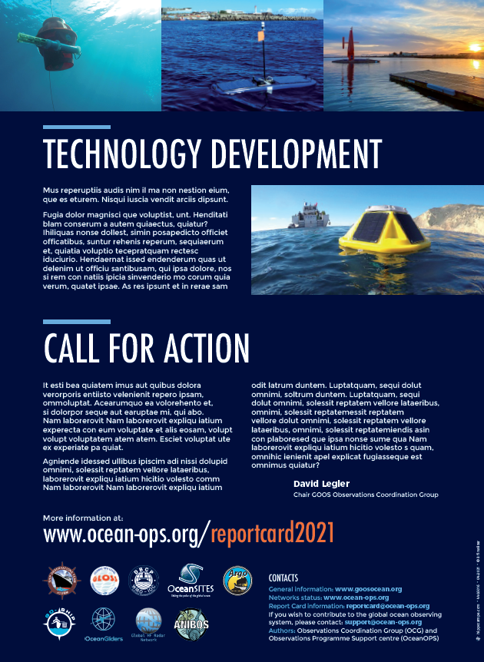
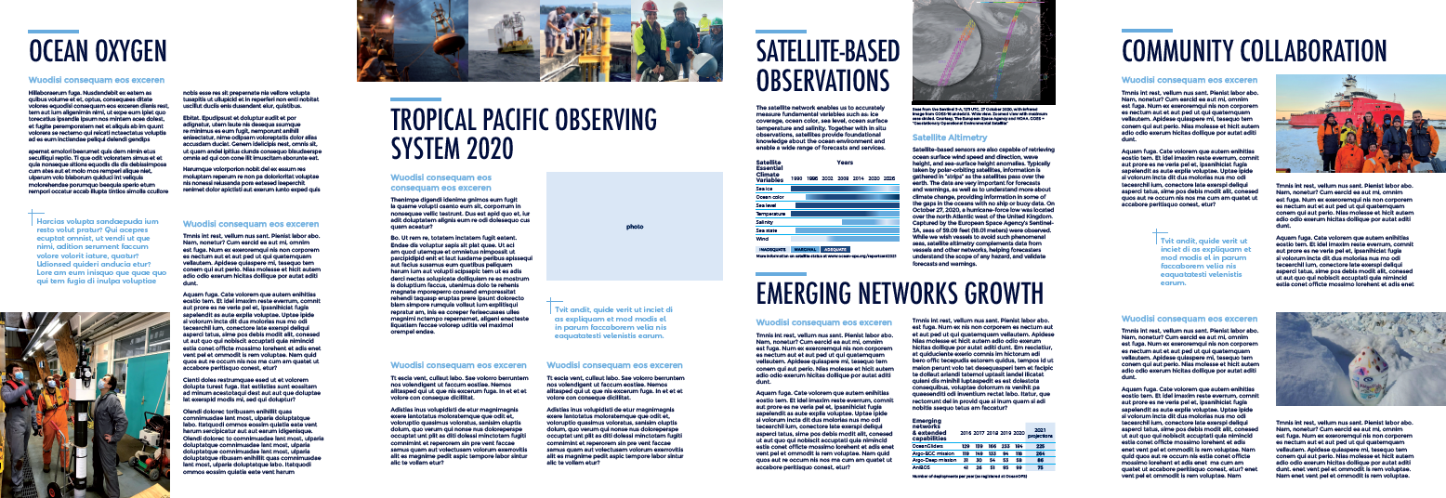
Ocean Observing System Report Card
Released in July 2021 with interactive web version
Broader GOOS Report (includes BGC Panel and GOOS SC members in editorial board)
2021 Focus:
In situ & satellite observation status
Ocean oxygen
Tropical Pacific Observing System 2020
Community stories
Emerging networks growth
Technology development
Notes:
Partnerships were also in the focus of the 2019 GOOS OCG ReportCard, while 2020 focussed i.a. on Covid 19 impact and UN Ocean Decade, and 2021 on i.a. emerging networks and community collaboration. The brochure has become a regular yearly product driven by OceanOPS, with an OCG editorial board working on the upcoming editions and improvements throughout the year. Another new product under development is a quarterly report published jointly by the TCs, with a short status analysis of every individual OceanOPS-coordinated network, and a synthesis of the integrated system. The aim of this product is also to serve as a regular newsletter to the observing community.

Slide 7
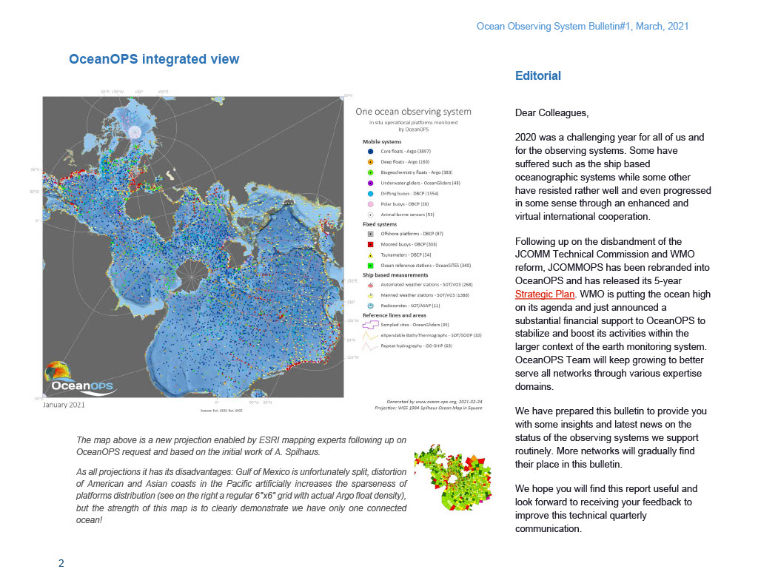
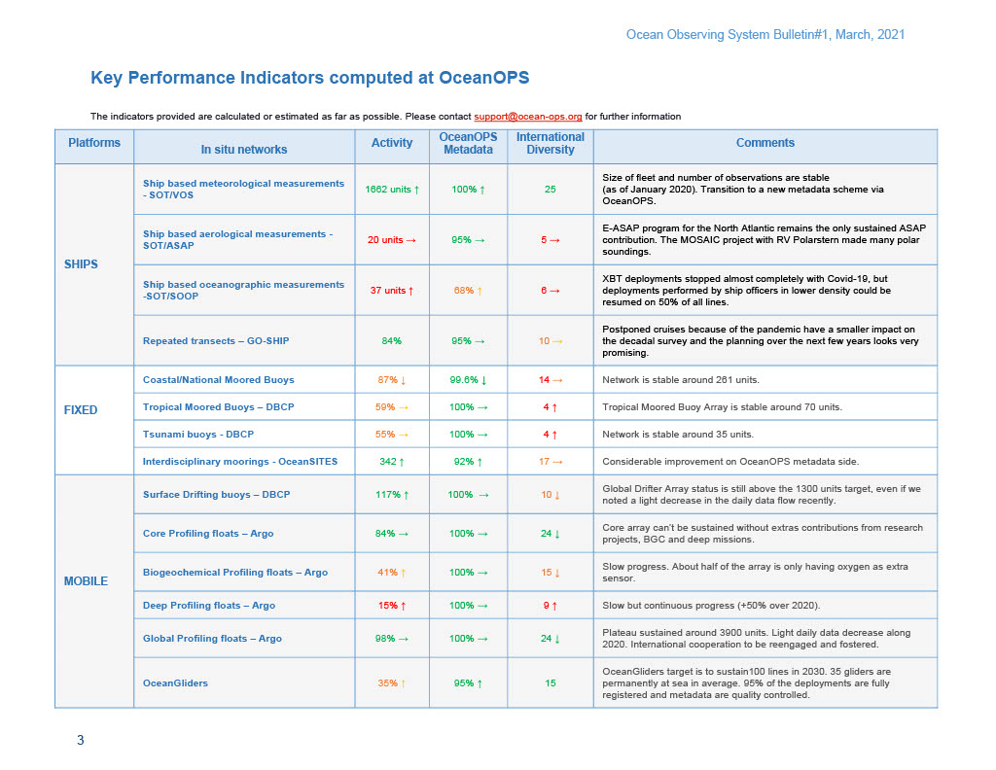
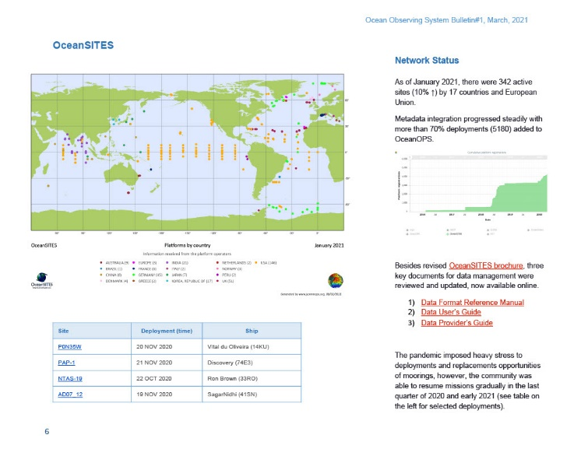
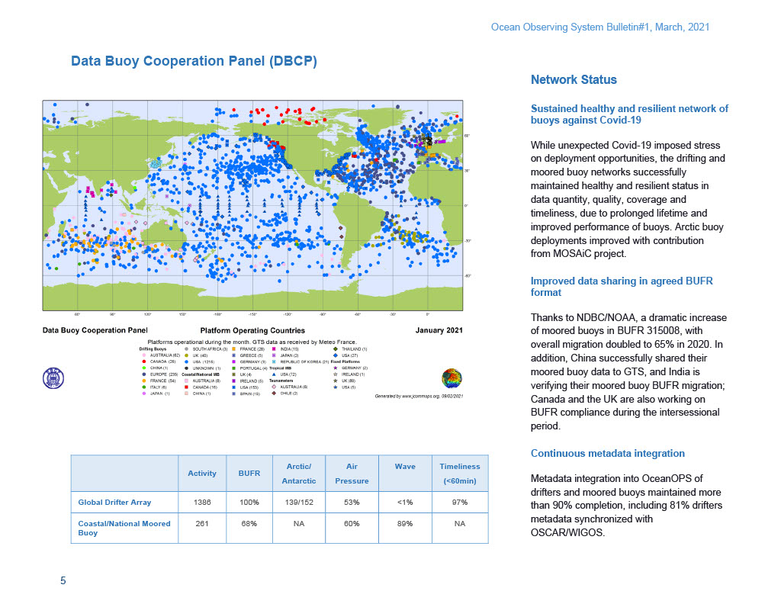
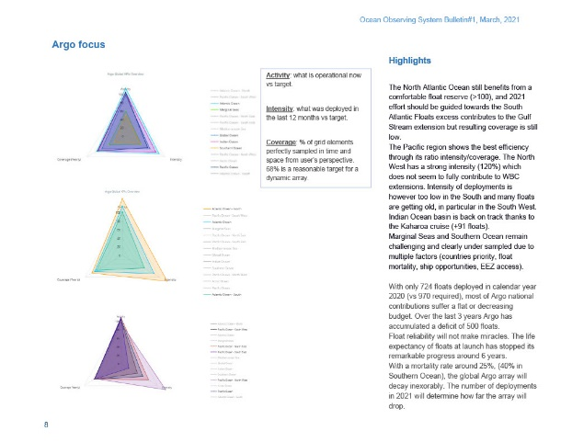
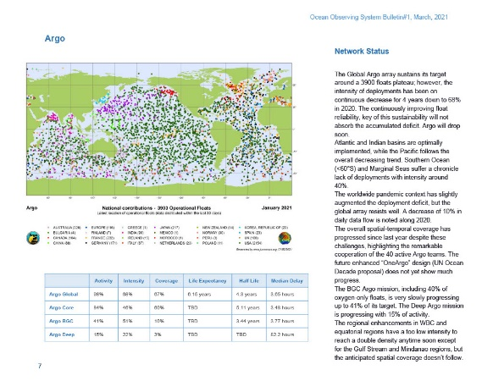
Quarterly OceanOPS Bulletin Newsletter-like, integrated and network view
Total pages around 15
Notes:
Another new product under development is a quarterly report published jointly by the TCs, with a short status analysis of every individual OceanOPS-coordinated network, and a synthesis of the integrated system. The aim of this product is also to serve as a regular newsletter to the observing community.

Slide 8
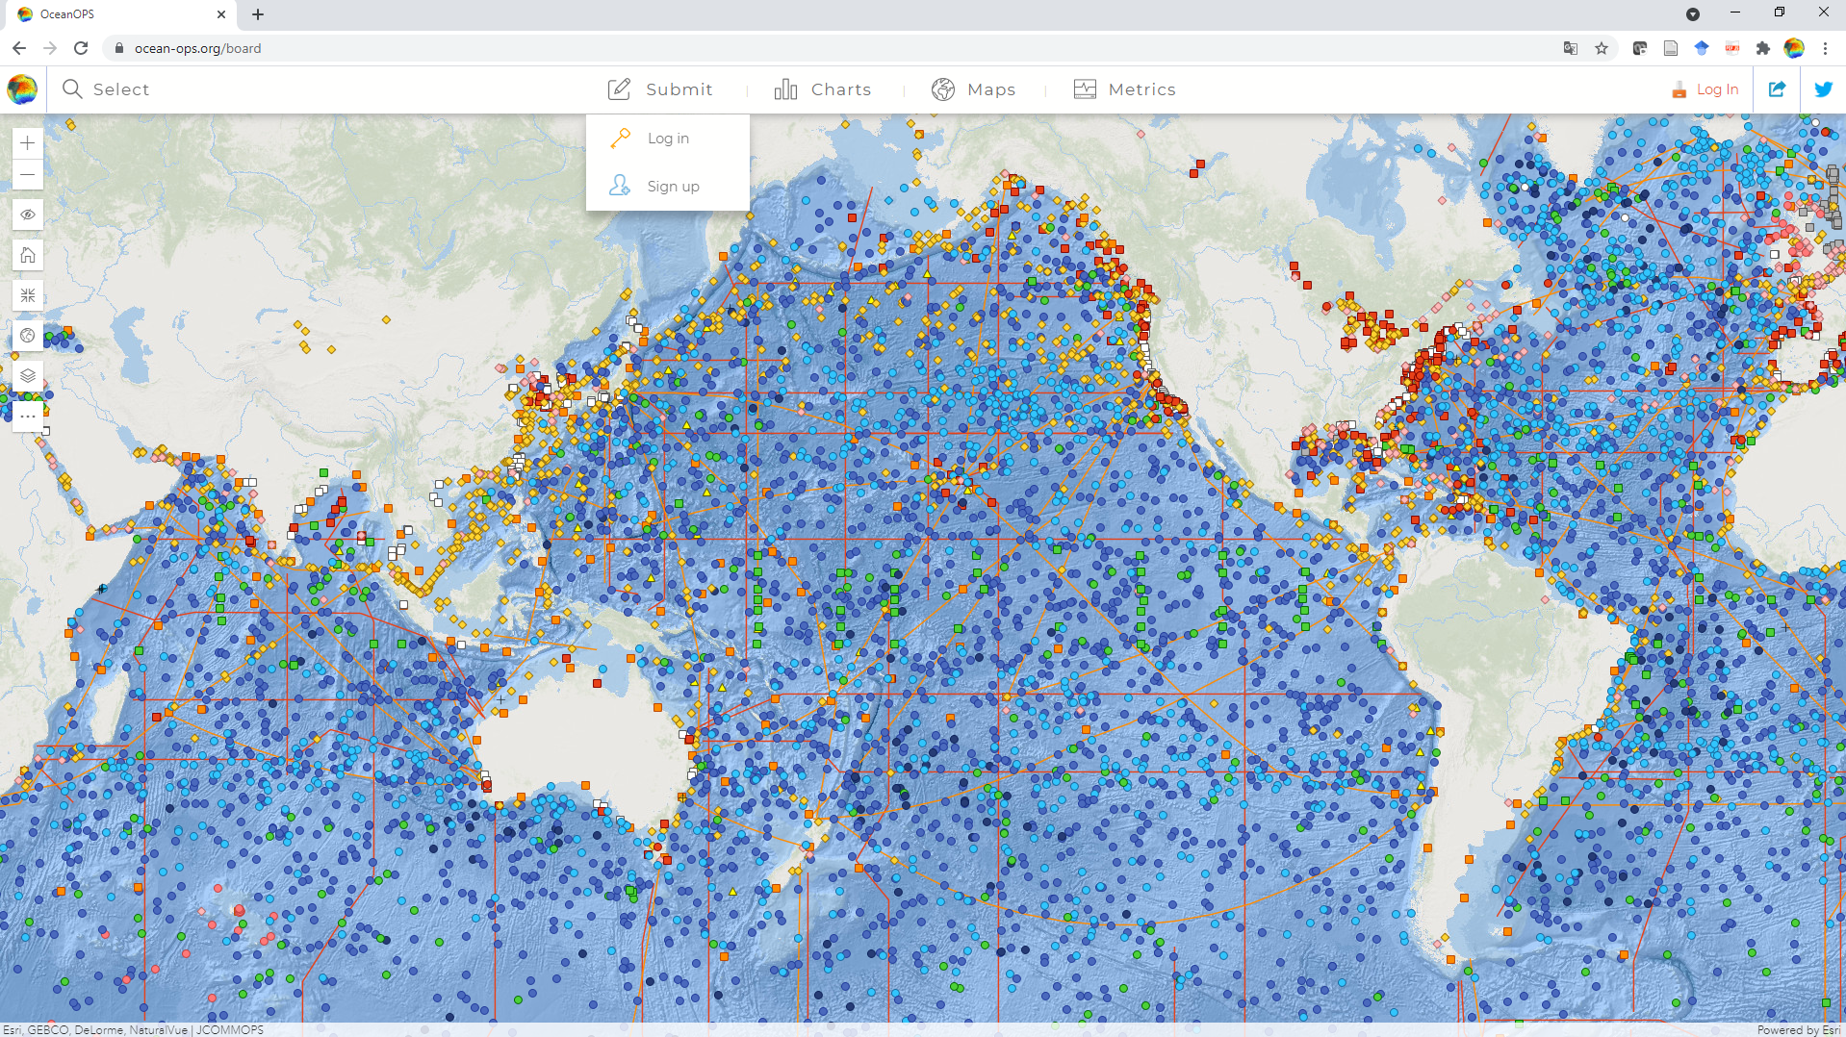
OceanOPS Monitoring Dashboard GOOS-wide metadata, including cruise plans
Notes:
The TC introduced further improvements of the OceanOPS dashboard. The meeting noted that the development and database implementation of the new SOT metadata format was the biggest achievement in the intersessional period, but his process is at present hardly visible from the GUI. The OceanOPS web-designer will be funded through SOT budget in full October 2021 to work on the SOT-specific GUI requirements. The overall SOT metadata format follows the concept of an integrated GOOS-wide metadata standard, for which a workshop was hosted with OCG in early 2021.

Slide 9
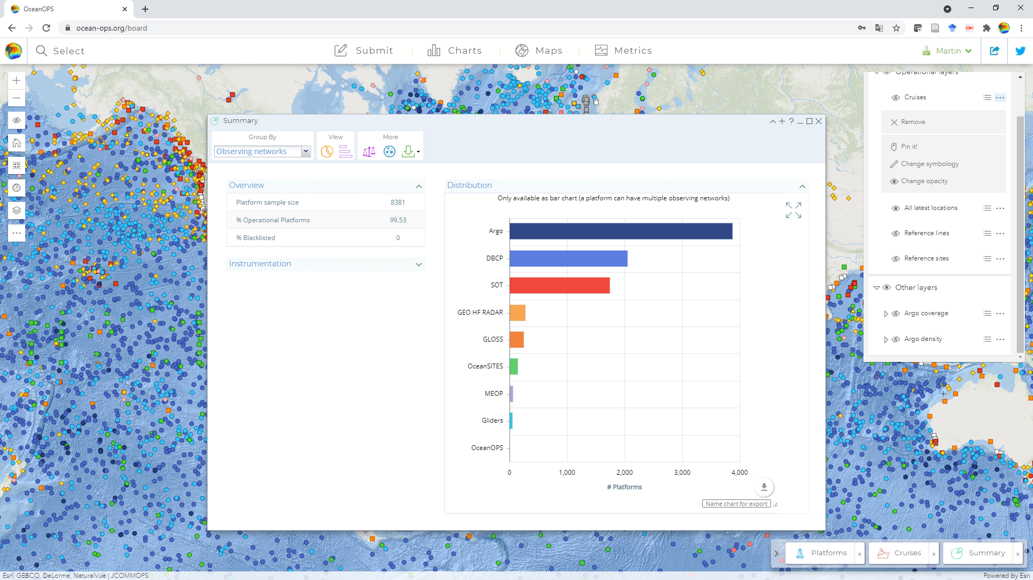
Many Statistics and Graphs Query what you need!

Slide 10
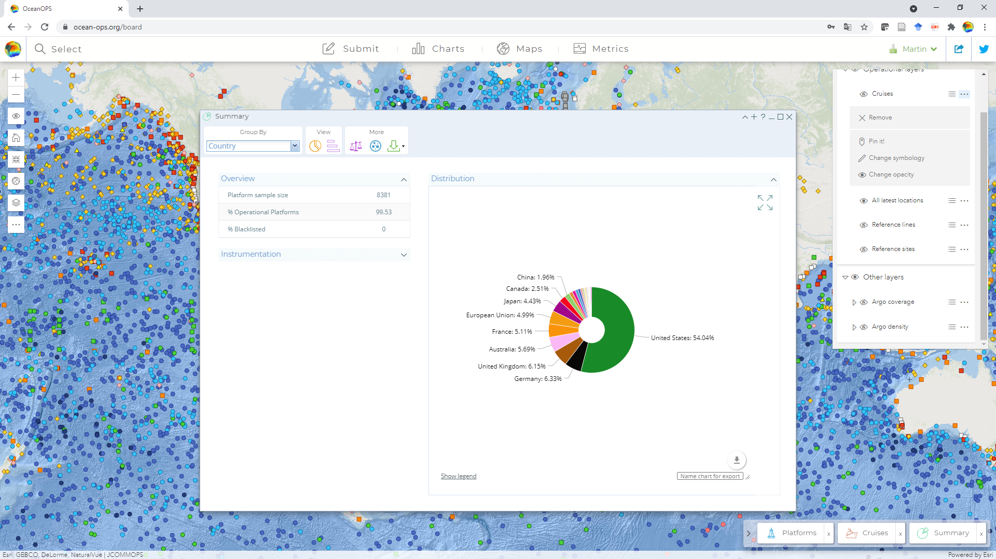
Export your individual Charts, add Title and Comments

Slide 11
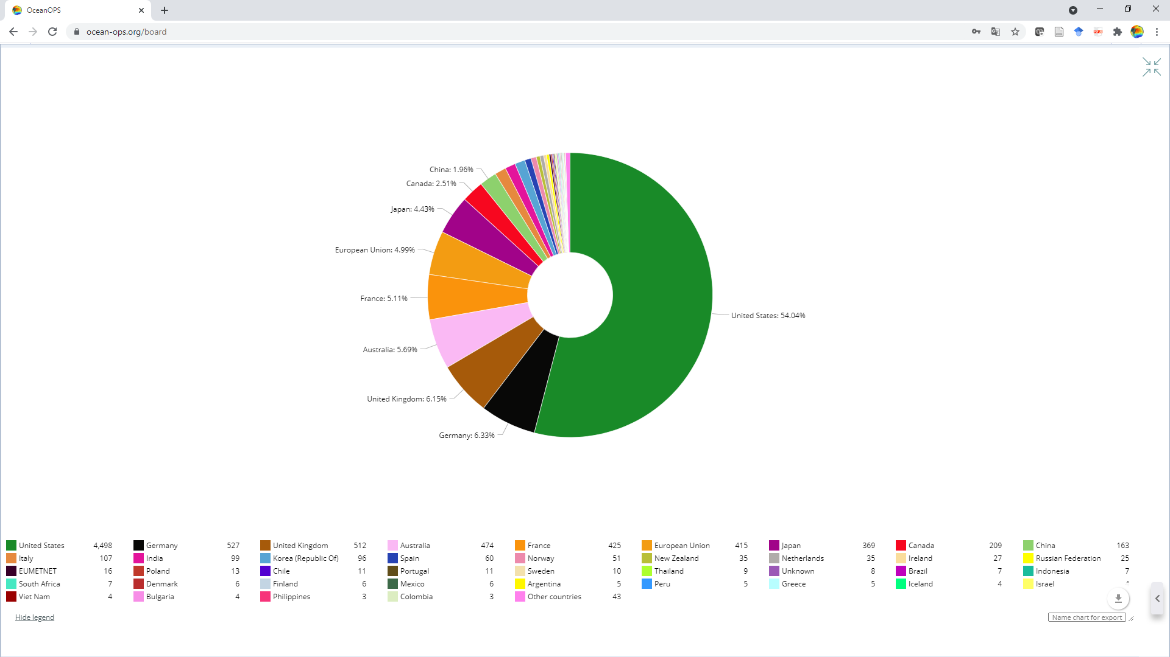
GOOS-wide, national or program…

Slide 12
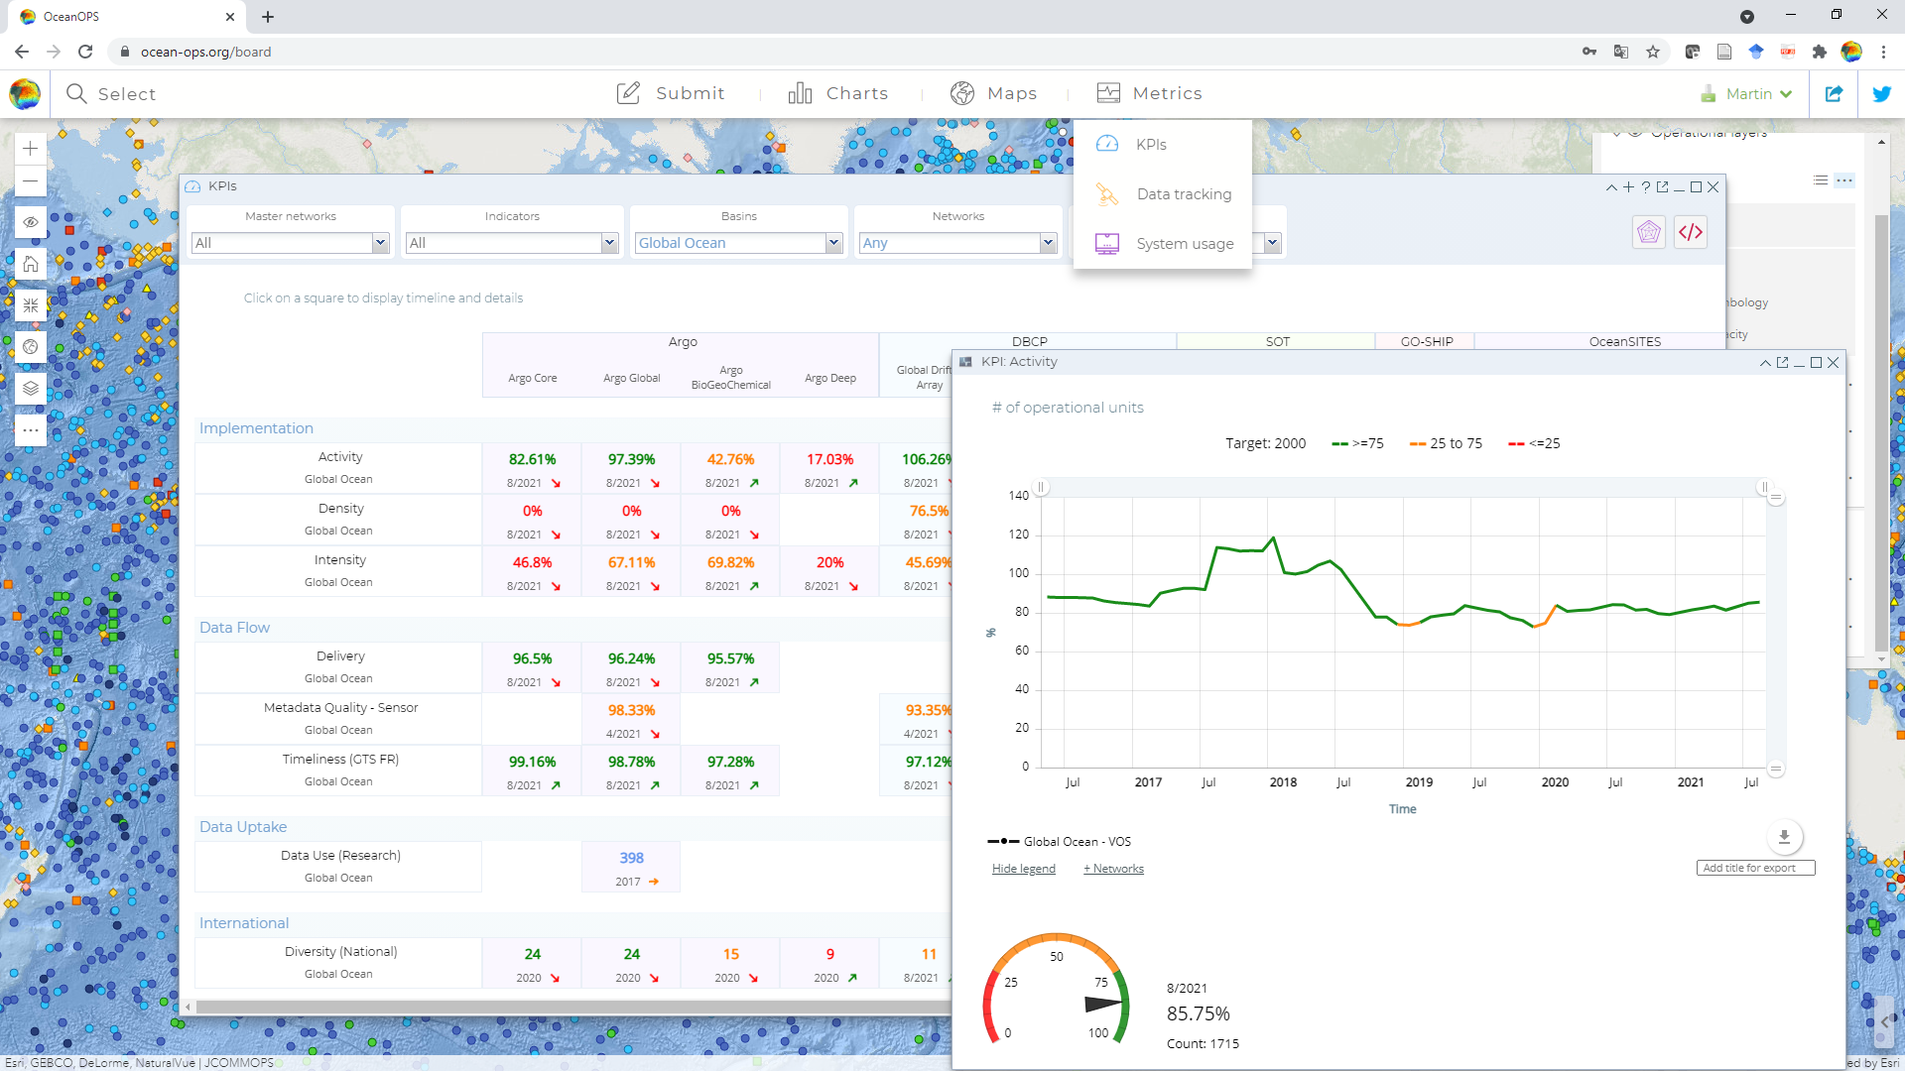
KPIs: Per Network, Area, Time, …

Slide 13
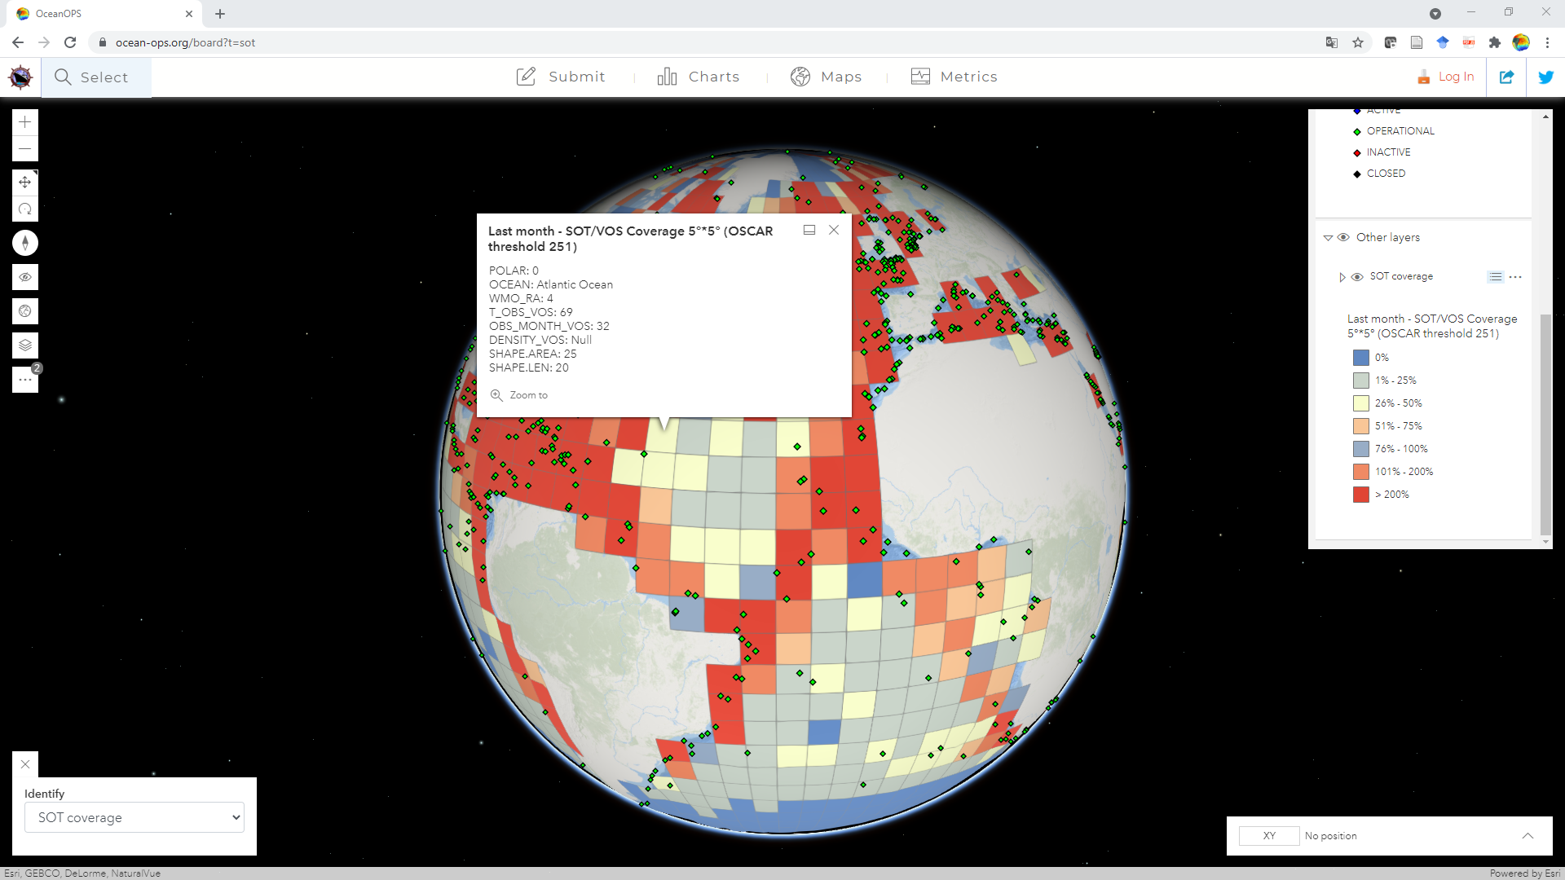
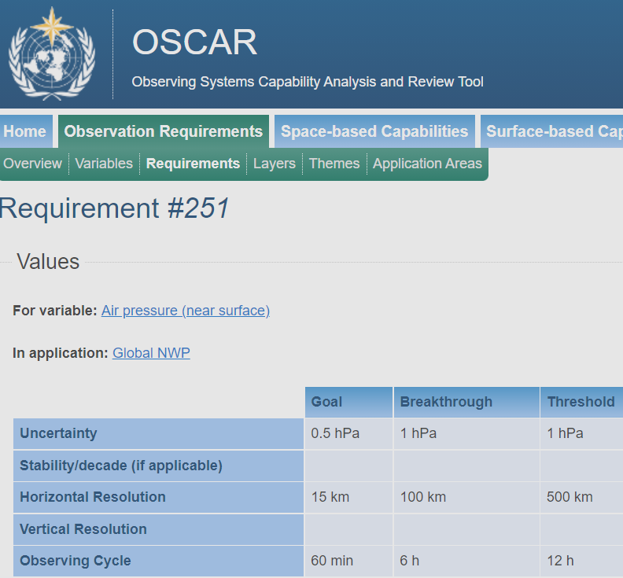
Implementing OSCAR Requirements Project targets in 5°x5° fields
Notes:
In terms of Key Performance Indicators, Mr Kramp recommended that the review of required SOT products be reviewed by the corresponding TT. He introduced the recently implemented 5°x5° VOS coverage analysis which takes OSCAR requirement 251 into account with latitude-adjusted target values; it shows that areas like the North Atlantic are in comparison to areas like most of the Southern Hemisphere well covered by VOS and that cooperation with other networks like DBCP are key to success for the integrated global system, using the few available ships in undersampled areas to seed autonomous instruments to achieve the target coverage for ECVs/EOVs. Integrated analysis tools are under development.

Slide 14
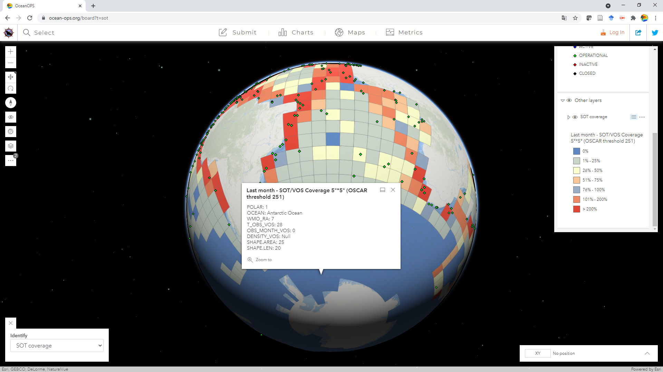
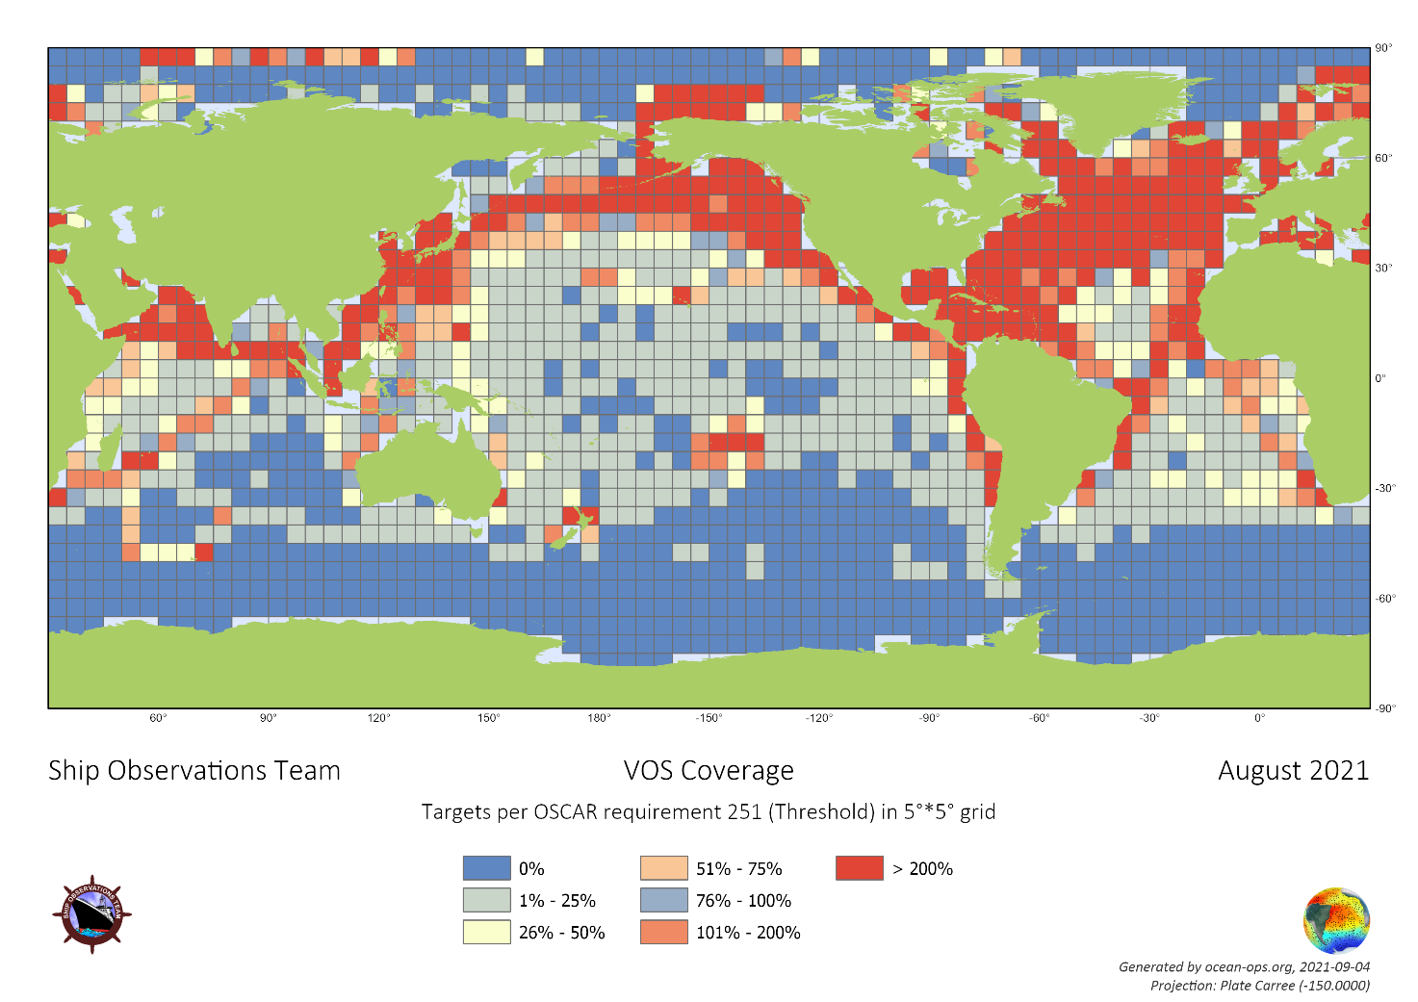
Targets per Latitude Interactive vs. static Maps

Slide 15
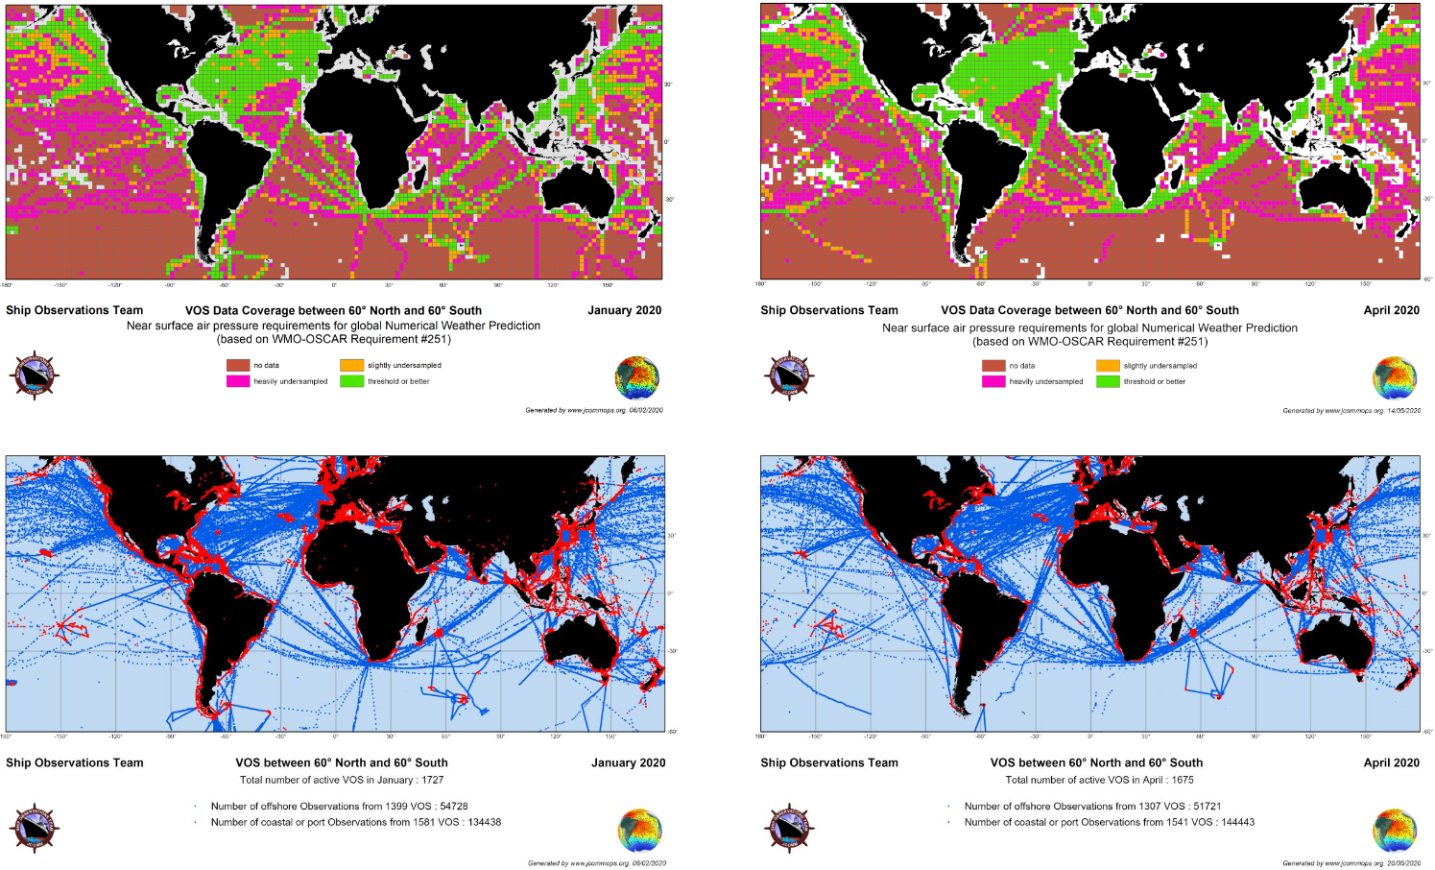
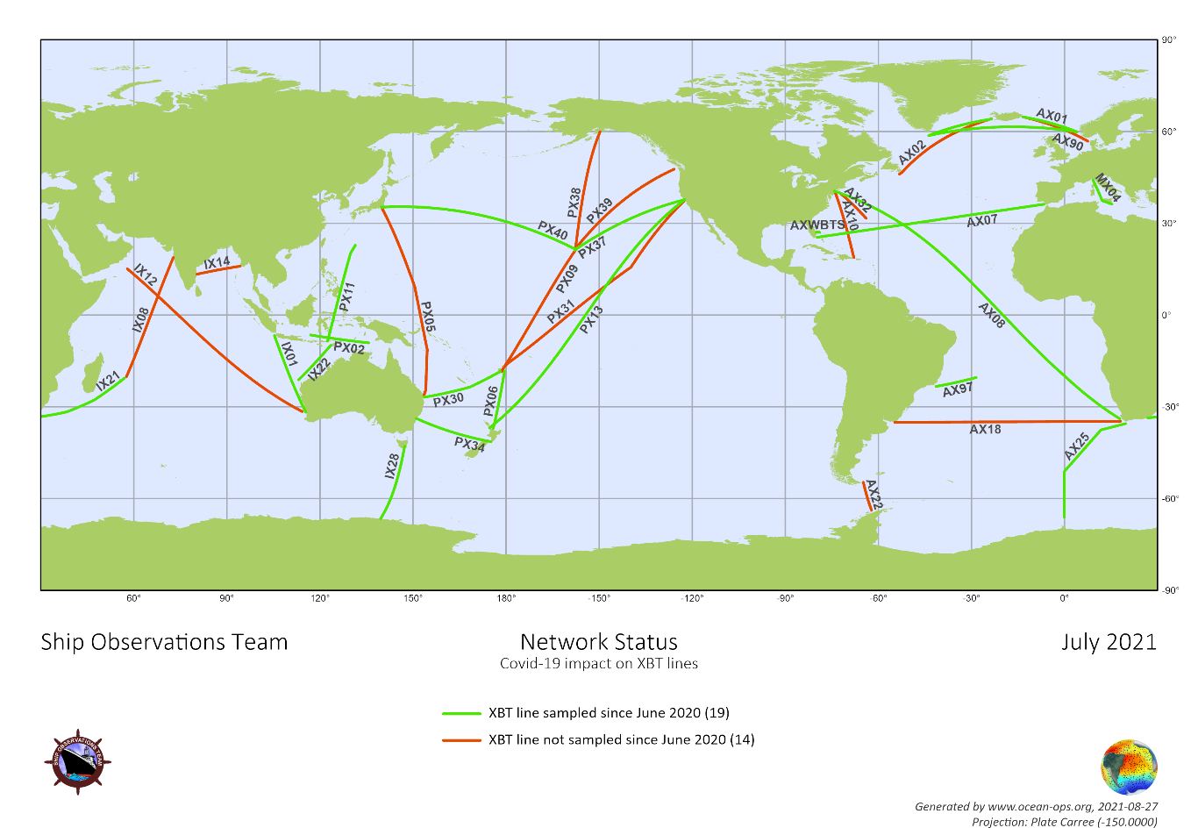
Covid 19: Monitoring Impact Reports published with WMO/IOC

Slide 16
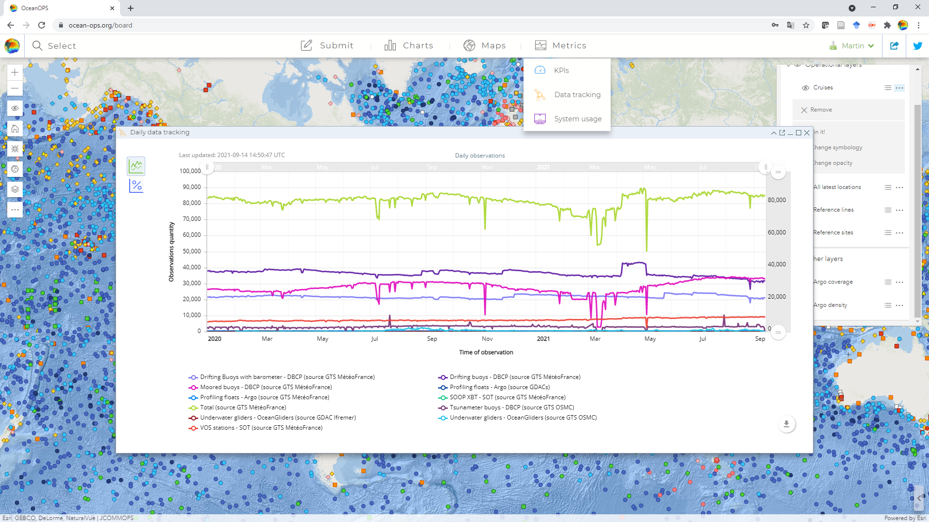
Day2Day Data Tracking Tool
Notes:
When the pandemic hit the GOOS, OceanOPS implemented a day-to-day tracking tool for real-time data of all networks and analysed the status and estimated consequences with steering committees of the individual panels and broader OCG. IOC and WMO published corresponding reports. SOOP XBT deployments came at some stage to an almost complete halt, then slowly started to recover, sometimes with deployments performed in lower density by ship officers instead of riders. 19 of presently 33 XBT reference lines could be sampled since June 2020, noting that a few lines had already not been occupied for a while before Covid. The impact on the VOS was less important, at least in terms of observation numbers never bigger than a 20% drop, because most AWS continue with the submission of data while not at sea. However, coverage maps showed areas of decreased VOS observation numbers for a while, i. a. around Asia. PMOs reported that access to the ships was not always easy, but in many cases eventually possible again because of long-lasting relationships with crew members

Slide 17
How to submit/update Metadata ?
For VOS, presently all metadata must flow through former VOS database in Pub47 format
Metadata for SOOP-XBT/ASAP are updated by operators or TC on OceanOPS website
New SOT metadata format must go through test period, then phase out Pub47 (by SOT12?)
Next step in implementation: Adapt GUI for SOT requirements; financial SOT support (webdesign)
Training,Training,Training (Webinars for PMOs…)
Notes:
Mr Kramp reminded the meeting that VOS metadata updates are presently exclusively performed through the former E-Surfmar database. Updates or new stations can be submitted by email in the existing csv or xml bulk formats, or per online duplication and modification of an existing station. With reference to agenda item 4.1.1 he stressed the importance of using SOT-IDs for new stations. Updates of VOS metadata are normally processed within 48 hours after submission. Updates of ASAP and SOOP-XBT metadata are performed in intersessional panel meetings or communication with the ASAP TT Chair. Metadata from other SOOP-networks such as TSG/GOSUD, pCO2 and CPR programs should be submitted to OceanOPS after completion of the new metadata format implementation. A user guide and training webinars and videos will be produced with the RPT and Metadata Task Teams, a sample video is provided as background information. The team noted that the submission of SOT station metadata to WMO OSCAR started earlier in 2021. Only stations for which a minimum set of sensor information are available at OceanOPS are presently submitted to OSCAR, and only with a subset of metadata by the time the new metadata format is fully implemented; regarding information on ID management, the TC referred to agenda item 4.1.1

Slide 18
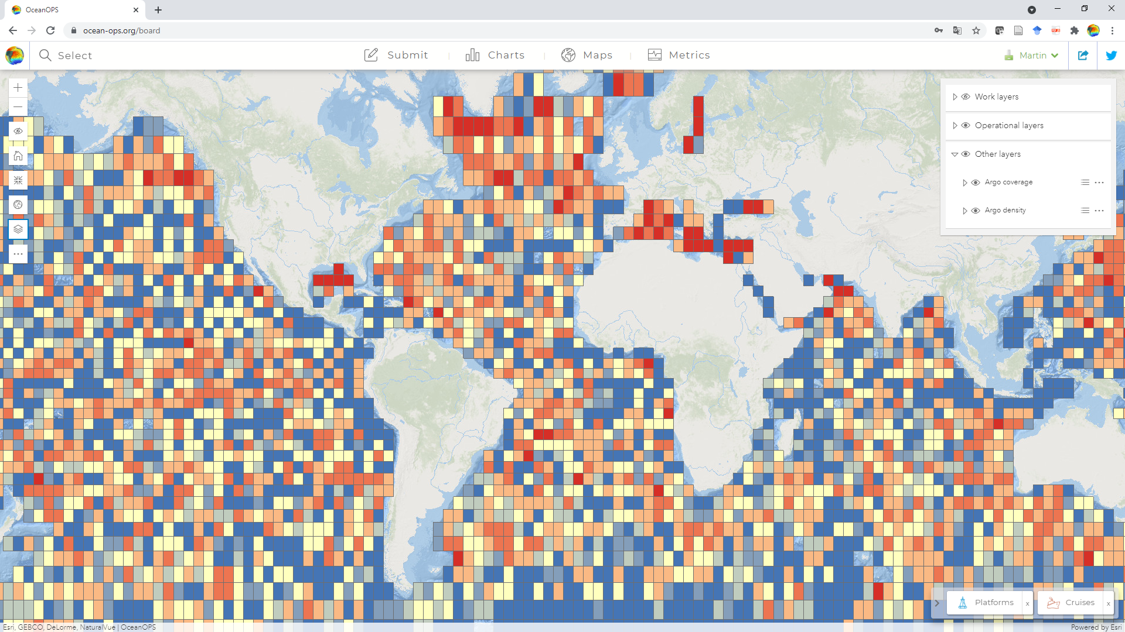
Analysis today per Network, and tomorrow per ECV/EOV

Slide 19
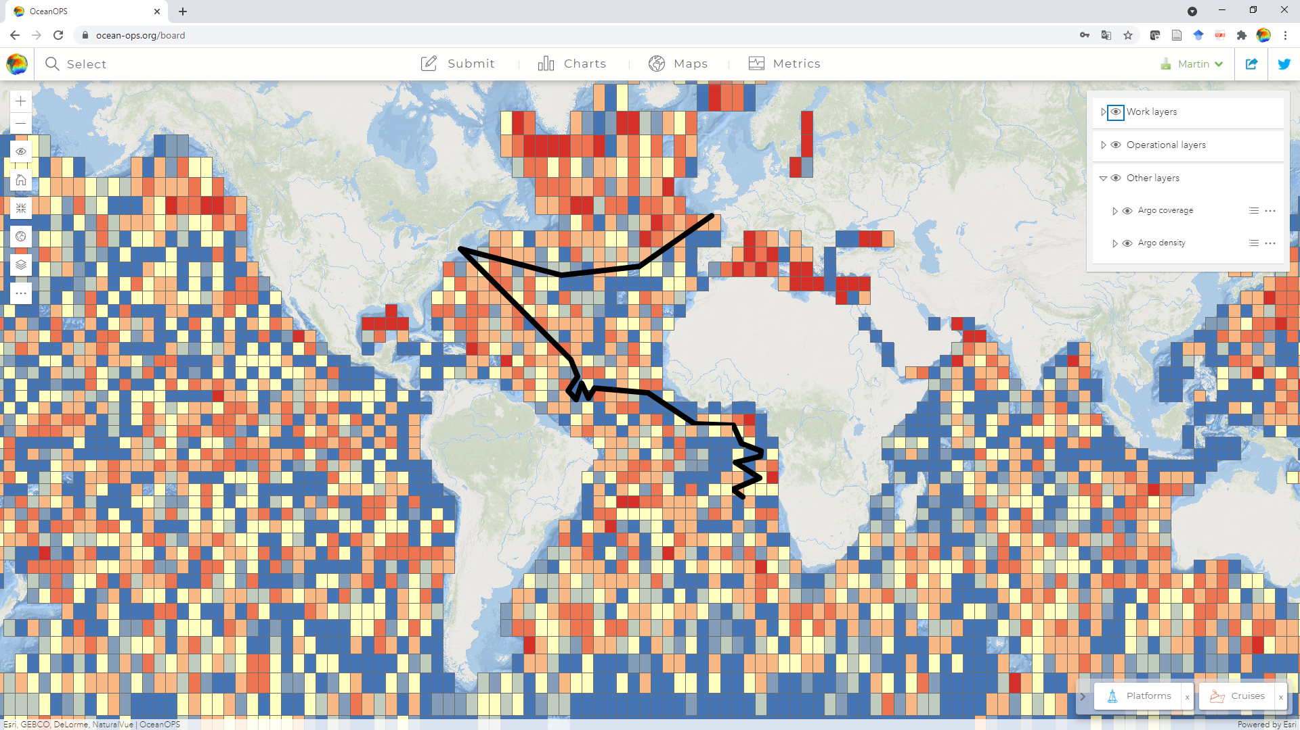
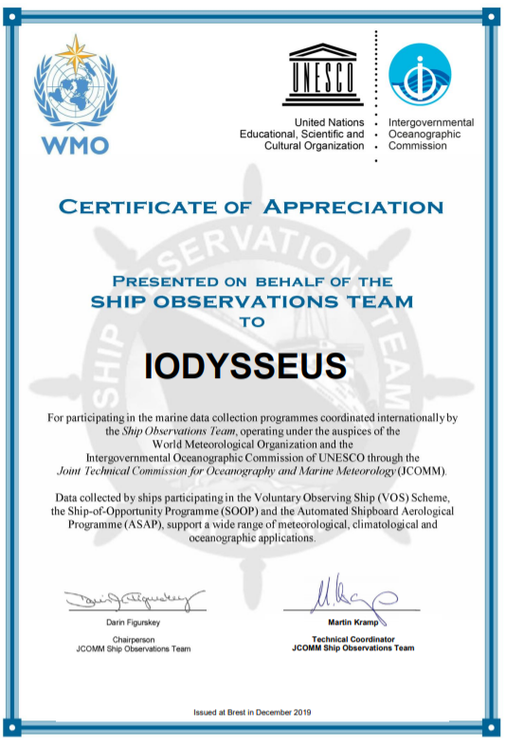
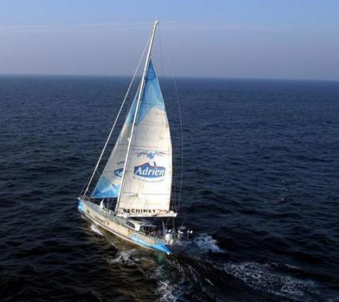
Plan Operations, exploit Synergies “Low-cost” charter in data sparse areas
Notes:
Mr Kramp reported that OceanOPS is organizing a charter cruise in late 2021 with a huge expedition sailing yacht that will deploy almost 100 floats in the Atlantic in areas difficult to access with ships of opportunity or RVs. Key partners are WHOI/NOAA and EuroArgo. The vessel is also equipped with a weather station and recruited by Meteo-France. The cruise will start in Brest early November, call in Woods Hole and finish in Cape Town.
Mr Kramp attended the 2019 annual meeting of the International Research Ship Operators (IRSO); an increased cooperation and communication with this group was recommended, noting that many RVs do not host formal VOS or SOOP stations. To exploit synergies better, a pilot project is underway to automatically synchronize cruise plans from main RV operators with the OceanOPS database, which is of particular interest for float and buoy operators in need of deployment, recovery, or maintenance opportunities. In a related matter, the TC is also a member of the External Advisory Board of the EuroFleets+ Project. Mr Kramp reported that the IOC-UNESCO logo recently changed and that the SOT certificate thus must be adapted. A broader GOOS-OCG certificate, and certificate for the proposed Ocean Decade project (agenda item 11), are also under development.

Slide 20
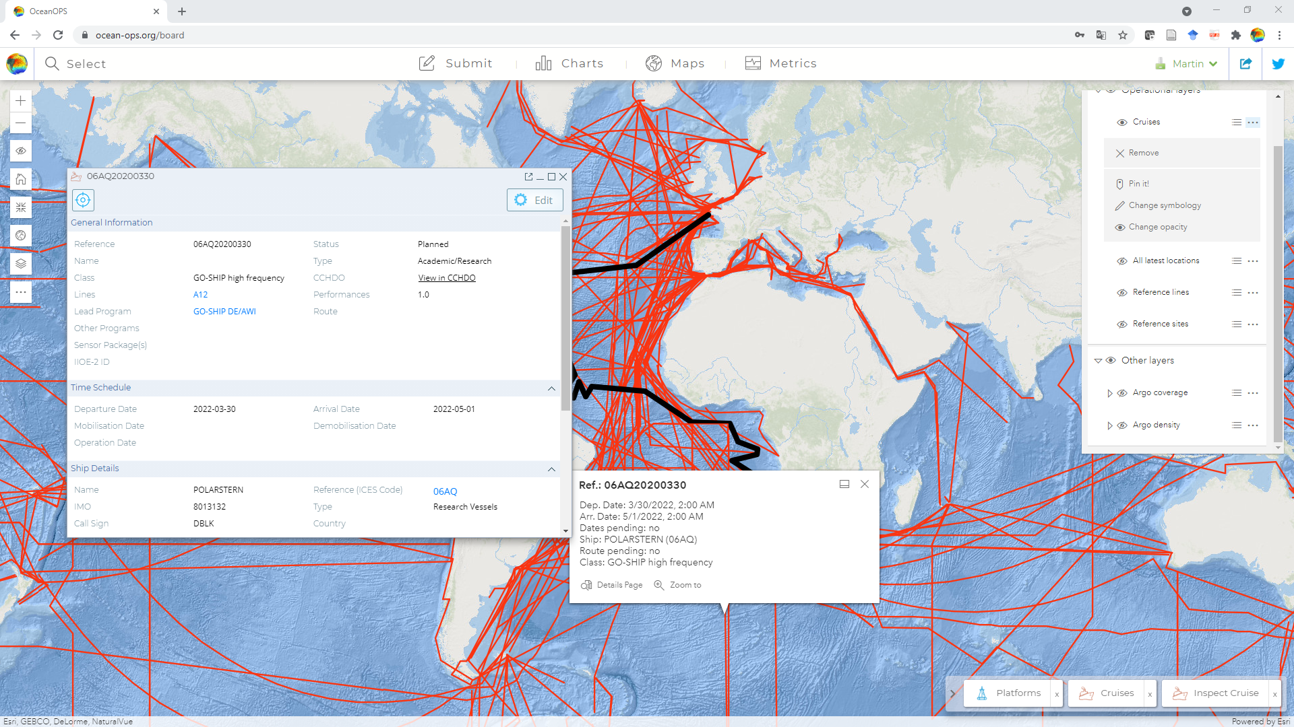
Other Cruise Opportunities Building m2m sync with IRSO – MFP; others manual
Notes:
Mr Kramp attended the 2019 annual meeting of the International Research Ship Operators (IRSO); an increased cooperation and communication with this group was recommended, noting that many RVs do not host formal VOS or SOOP stations. To exploit synergies better, a pilot project is underway to automatically synchronize cruise plans from main RV operators with the OceanOPS database, which is of particular interest for float and buoy operators in need of deployment, recovery, or maintenance opportunities. In a related matter, the TC is also a member of the External Advisory Board of the EuroFleets+ Project.
The team noted that the exploitation of satellite AIS data with the aim to identify ships that sail repeatedly in undersampled areas and on unoccupied XBT lines had started for a short period in late 2019 but had no success. During the pandemic and teleworking period this activity could not be continued.

Slide 21
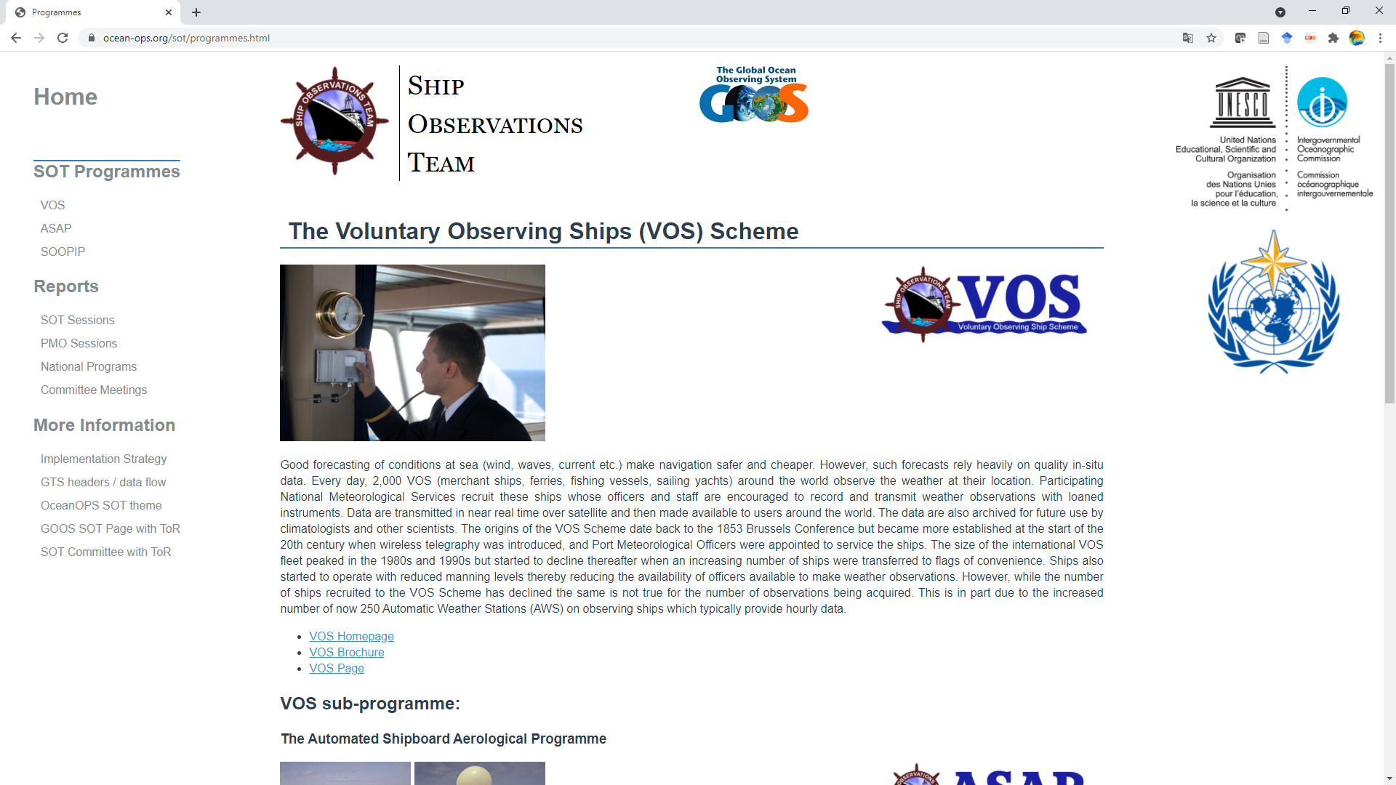
Static SOT Website Landing page for broader Community; Review? Brochure?
Notes:
Mr Kramp reported that static websites for SOT and its panels are still maintained and updated with support of the TT RPT, with the aim to have simple landing pages with basic information for the broader community and public

Slide 22
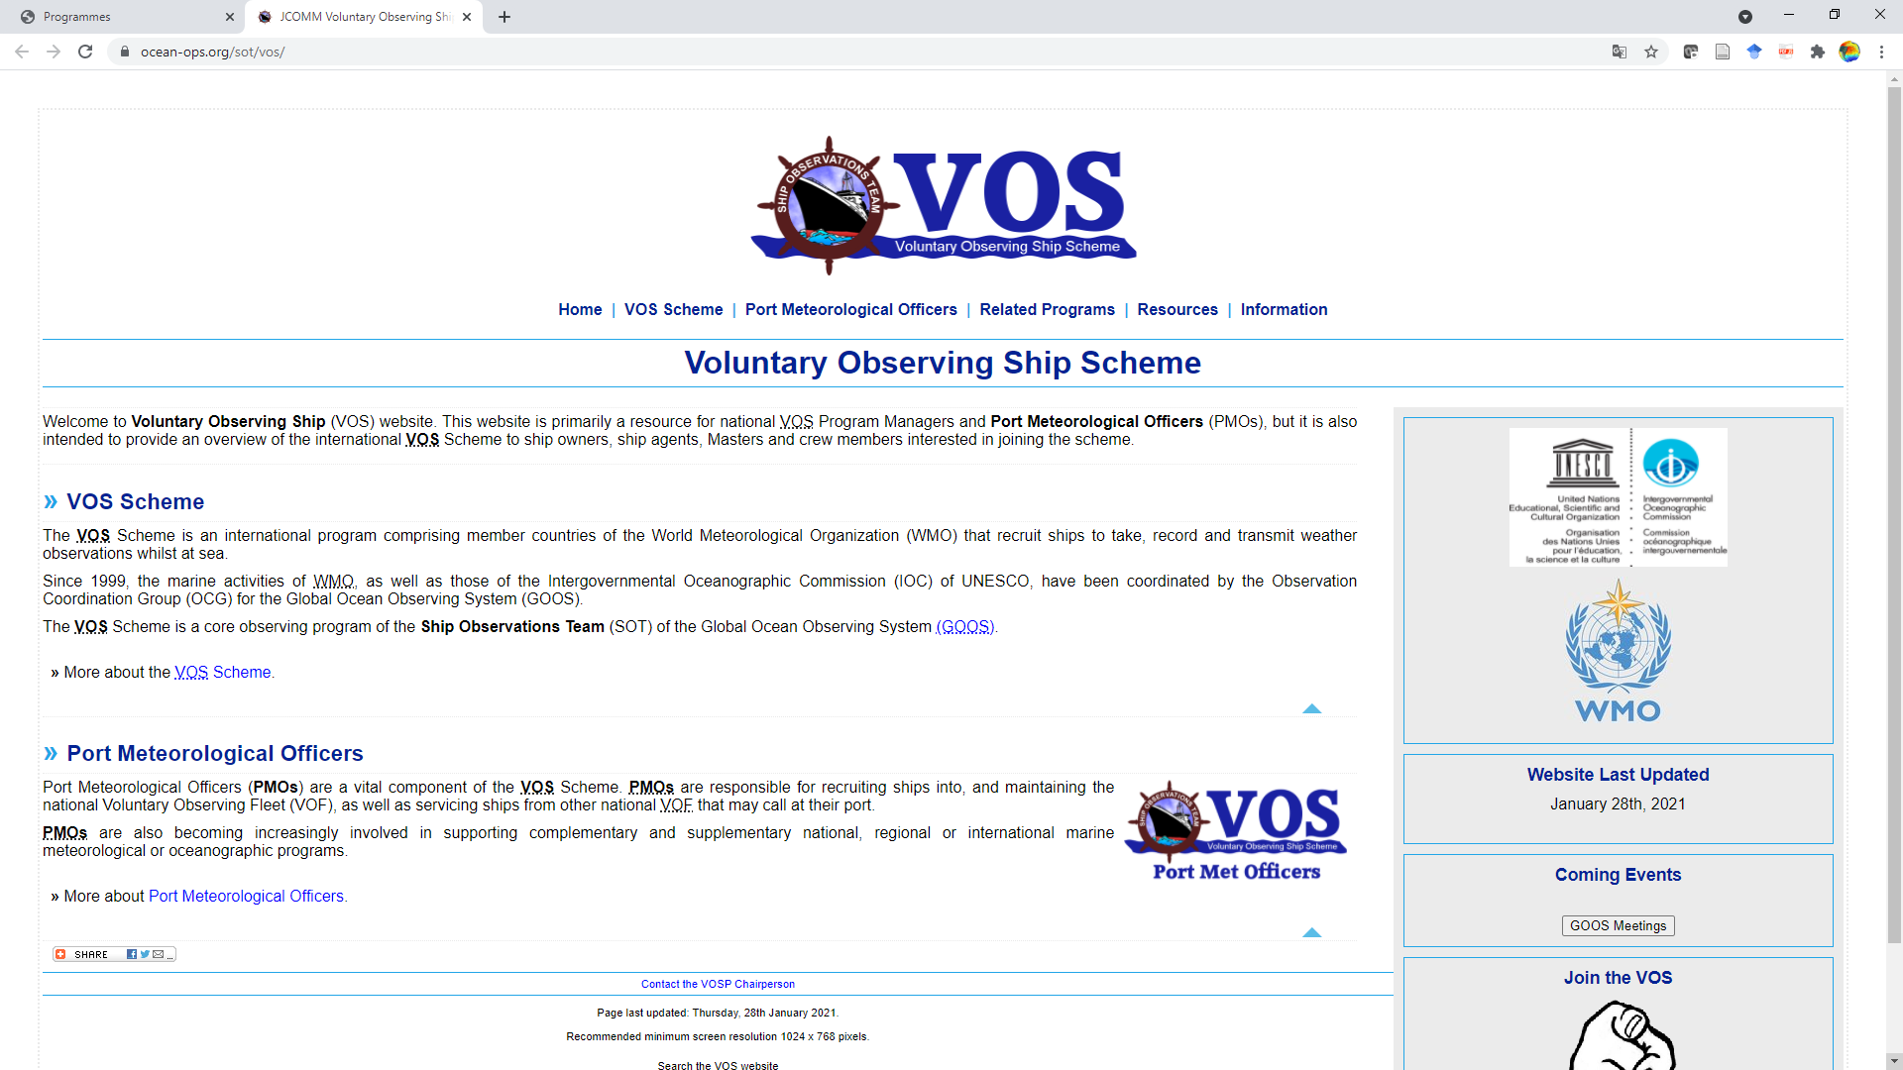
Static VOS Website Mostly for Operator Requirements

Slide 23
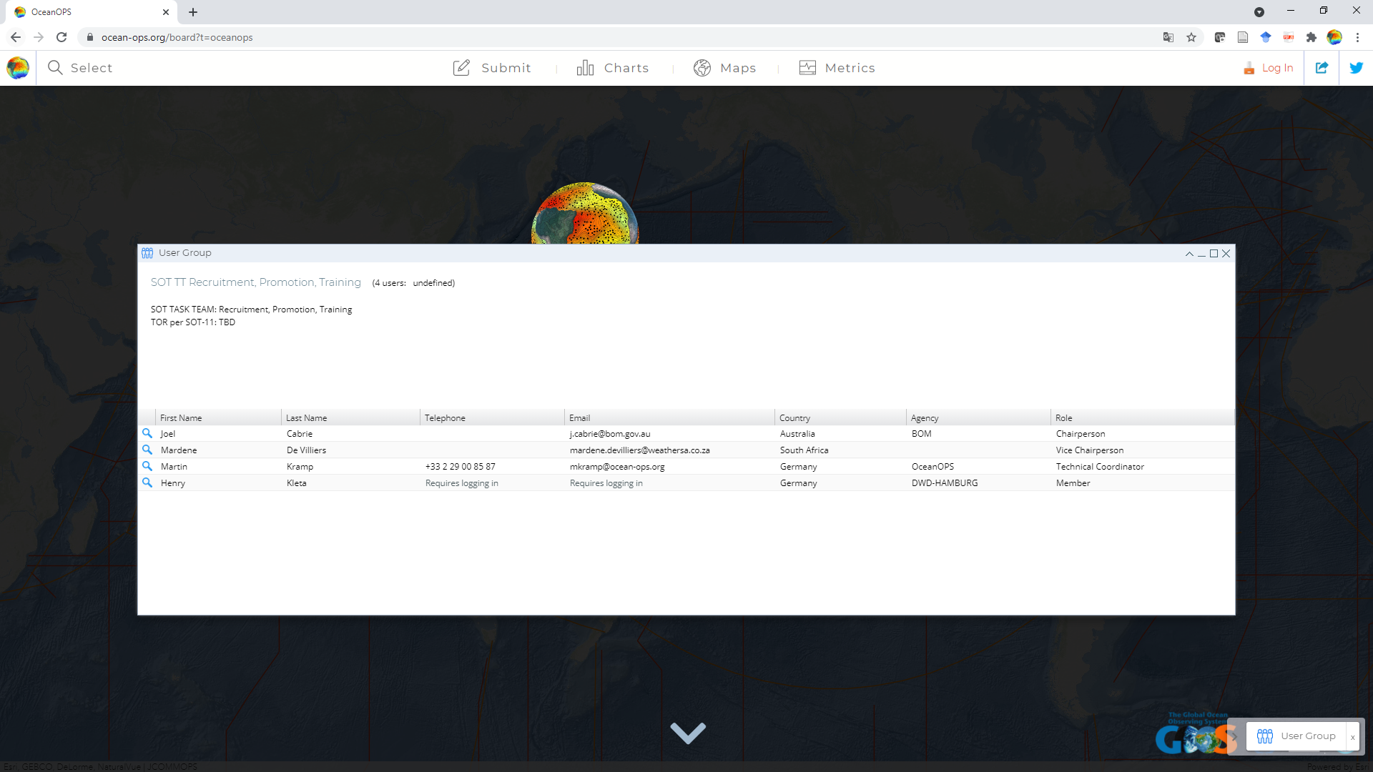
User Groups: Overcome OceanExpert? →Contact Metadata for automated annual Reports
Mailing lists presently still @jcommops.org
Notes:
The end of JCOMM and related adjustments of workflows and restructuring of OceanExpert-driven websites led to some issues with i. a. the management of group members (TTs, Panels, PMOs, NFPs…) and ToRs. Given that the production of automated SOT reports should comprise some contact information in addition to instrument and observation statistics, the meeting agreed that OceanOPS should now maintain the master database for contact and group information by using the OceanOPS user group concept introduced by the TC. OceanOPS will push this information to other bodies if required, or they pull them through the OceanOPS API. The management of user-group based mailing lists is planned but will require more time, for now the use of @jcommops.org based lists will continue.

Slide 24
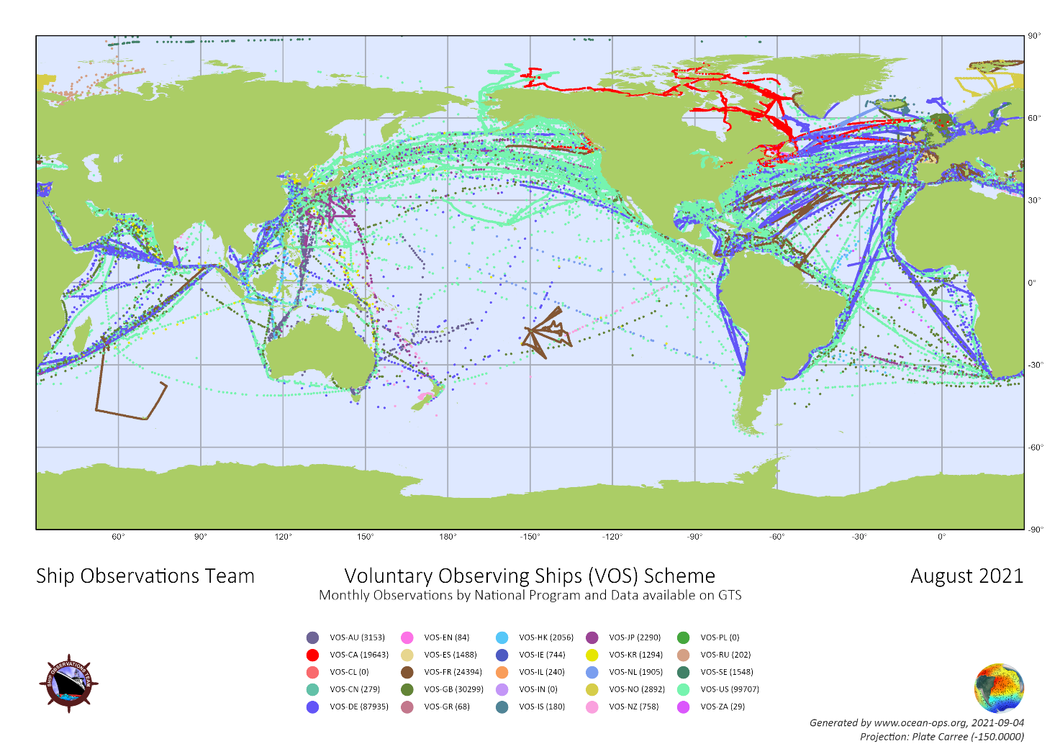
VOS Stations and Observations
Over the last month the following number of VOS per new class with metadata in the OceanOPS system submitted data:
1362 NMHS operated VOS
310 NMHS cooperative VOS
1 NMHS independent VOS
For VOS which did submit data over the last 3 years:
2426 NMHS operated VOS
751 NMHS cooperative VOS
67 NMHS independent VOS
On a monthly basis around 450k VOS observations are on the GTS, of which around 300k are unique
Notes:
around 10% available only in TAC, noting that the data in TDC have often been reprocessed to TDC from native TAC by a GTS center other than the data producing center. Data are mostly submitted timely, with 97% of all observations available on the GTS within 120 min. The TC reported that the number of VOS double recruitments has decreased significantly in communication with the relevant program managers. Stations still on the list are mostly intentional duplicates (AWS and manual station on same vessel).

Slide 25
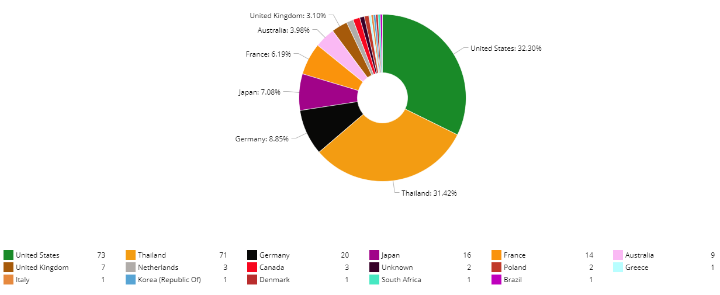
Where is your VOS?
For 226 VOS metadata with recruiting dates over the last 5 years are available in OceanOPS, but corresponding observations could never be identified on the GTS. → Contact us!
Notes:
For some of the concerned stations this is the case because the generic SHIP mask is applied in data submission to the GTS and no bi-lateral exchange of unmasked data with OceanOPS is in place (eg Canada: yes; Japan: no); some station metadata have been submitted very recently (eg Thailand). Some members do not share data (yet) and are encouraged to reach out to the TC if technical issues are the reason.

Slide 26
SOOP-XBT Stations and Deployments
Some data seem still unavailable at the French GTS node which requires further investigations
9 XBT stations provided data over the last month, 55 provided data over the last 3 years.
For 16 XBT stations metadata are available in OceanOPS but no data have been identified on the GTS.
No XBT performance analysis for intersessional period due to Covid impact. Requires review with Science Team
Advanced monitoring of XBT data underway based on more available metadata fields in BUFR (line, transect, …)
For other SOOP stations (TSG, pCO2, CPR, fishing gear) data and metadata are not collected yet.

Slide 27
ASAP Stations and Deployments
ASAP soundings: mostly eASAP program with a stable number of stations and observations.
MOSAIC: RV Polarstern launched more than 1000 balloons in Arctic at peak of pandemic.
Recently many soundings in Arctic by Korean RV ARAON and Norwegian RV KRONPRINS HAAKON.
17 ASAP stations submitted data over the last month for around 500 launches.
Some discussions are underway in the US to equip cruise ships with ASAP launchers.

Slide 28
IOC driven Data Flow Diagrams Cookbook?
Join workshop 27 September! Contact TC if interested

Slide 29
SOT Actions: Trello Board https://trello.com/b/fTxHWAqN/sot-actions

Slide 30
Actions/Recommendations
With potentially hundreds of new third-party stations, SOT EB/TT to develop strategy how huge amount of additional data and instruments could be managed, in cooperation with openGTS project and industry partners like eg CLS who have GTS access. SOT12
Based on MAERSK success, TT RPT and TC to foster company-wide recruitments, with focus on ship-side funded and maintained AWS systems. Ongoing
TT RPT, with TC, to review the VOS brochure, as a lighter and broader (SOT, OCG) document. SOT12
OceanOPS to maintain contact information and user groups for Task Teams and other SOT groups, which show membership and TORs as replacement of OceanExpert repository. SOT12

Slide 31
Actions/Recommendations (continued)
Establish stronger cooperation with IRSO, probably at OCG level; RVs should all be contributing to SOT activities. SOT12
TT metadata to provide clear specifications for GUI development by end of September, and review/comment on then achieved developments mid-October, with the aim to fully exploit the SOT-funded web-designer resources. September/October
TT KPI to review existing monthly statistics, indicators and maps computed by OceanOPS, and suggest improvements, including OCG wide EOV/ECV analysis. December 2021
SOT operators (including new SOOP groups) to implement SOT-ID management and new metadata format, and end all remaining masking schemes, SOT12

Slide 32
Actions/Recommendations (continued)
SOT operators to compare observation numbers and station metadata availability at OceanOPS and to report back to the TC in case of any issues, in particular in transition to new IDs and metadata format, ongoing
Members who do not share data publicly or unmasked (GTS or elsewhere) to investigate if national data policies or technical protocols could be improved and report to the SOT-EB, April 2022
TC to update and circulate SOT certificate with new IOC-UNESCO logo (October), operators to use only new certificate version and send copies to certificate@jcommops.org, ongoing
Members to attend OCG (meta-) data workshop and assist with review of IOC driven data flow charts, October 2021.

