Slide 1
Agenda Item 10: Executive Board Status
Darin Figurskey, SOT Chair

Slide 2
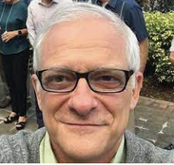
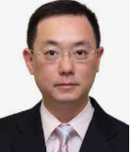
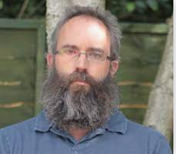
Thank You!
Rebecca Cowley
Outgoing SOOP Chair
We are grateful for their years of service, their commitment to science and observations, and their friendship.
Gustavo Goni
Outgoing SOOP VChair
S.T. Chan
Outgoing VOS VChair
Dave Berry
Outgoing SOT VChair

Slide 3
Prospective EB for the Next Intersessional Period
With thanks, volunteers for the SOT EB for the next intersessional period are:
SOT
Darin Figurskey, Chair (United States); Elizabeth Kent, Vice Chair (United Kingdom).
VOS Panel
Henry Kleta, Chair (Germany); vacant, Vice Chair.
SOOP Panel
Tamaryn Morris, co-Chair, Logistics and Development (South Africa), Francis Bringas, co-Chair, Data Management (United States)
Justine Parks, Vice Chair (United States).
The SOT is requested to approve the slate of volunteers for the SOT EB for term one per the SOT EB terms of reference.

Slide 4
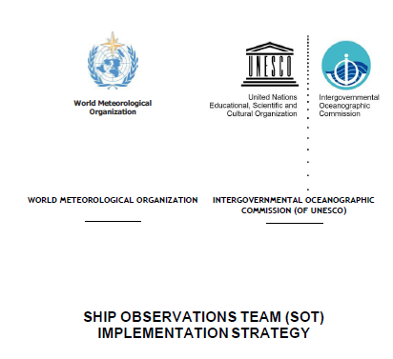
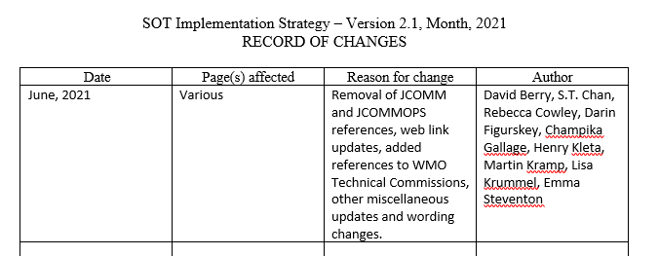
SOT Implementation Strategy
Following SOT-10, the SOT codified its EB terms of reference and the SOT Implementation Strategy, version 2.0.
One of the overarching mission statements of the SOT in its implementation strategy is the promotion of the free and unrestricted exchange of quality ship-based weather and ocean observations for a better understanding and prediction of the marine environment and to support safety of life at sea.
Currently, the SOT has completed a draft version of an update to the implementation strategy, version 2.1. This implementation strategy should serve the SOT well as it executes activities during the next intersessional period.
The SOT is requested to approve the updated version of the implementation strategy, which will be updated again by SOT-12, acknowledging an update to the cookbook in 5.2 and working to make the implementation strategy even more strategic (action).

Slide 5
SOT Financial Report
The SOT is requested to approve the financial report, which includes the SOT spending plan for the upcoming intersessional period.
SOT spending will have a near-term focus on a capacity development initiative for nation or nations, depending on available funds, dedicated to developing and sustaining a new VOS network or networks.
To reduce the maintenance burden of an additional trust fund (TF), BoM focal Point (Mr. Joel Cabrie) approved to transfer all the funds in ASAP-TF (CHF 12,906) to the DBCP TF SOT project for pure SOT activities and granted spending authority to SOT Chairperson.
Accordingly, the funds were transferred, and the ASAP-TF was closed in 2021.

Slide 6
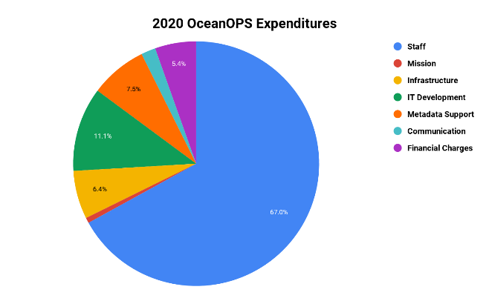
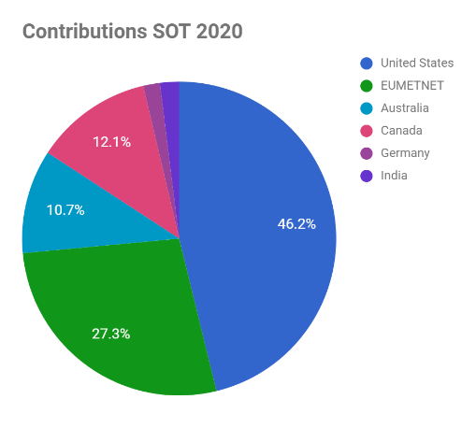
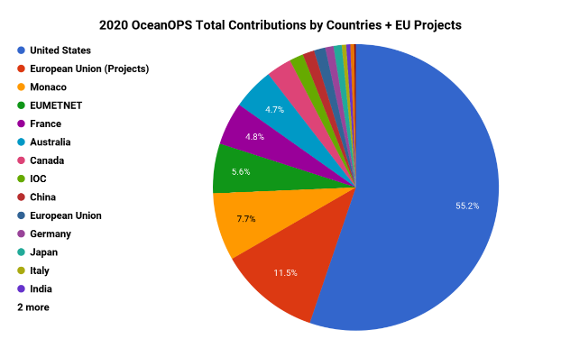
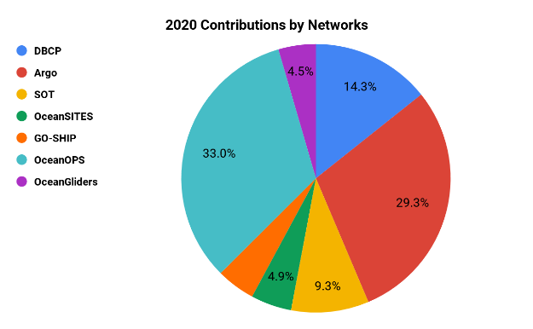
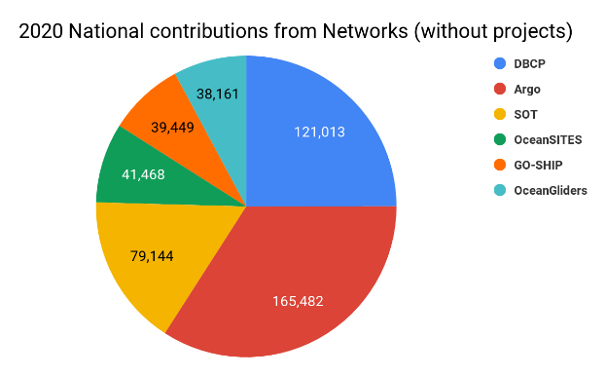
OceanOPS Budget – Update for SOT#11
OceanOPS supports the activity of OCG Networks, including SOT, through:
7 staff + 1 outsourced web developer, including 1 dedicated staff for overall ship coordination
For a budget of ~1M$/year (1.2 M$ in 2020)
WMO will fund OceanOPS manager on regular budget (end 2021)
IOC provided one off support to help sustain some staff (2020)
Target for network contribution to OceanOPS is 116k$ / year
SOT 2020: 79144$ (regular) from 5 Members + Eumetnet
SOT 2021: +8k$ for dedicated web development (October)
SOT to seek ~30k$ to help OceanOPS to sustain => diversify national contributions

