Slide 1
Voluntary Observing Ship Global Data Assembly Centres (VOS-GDACs)
SOT-11 Report
Hildrun Otten-Balaccanu¹, Callum Stone², Axel Andersson¹
¹Deutscher Wetterdienst, Hamburg, Germany
²UK Met Office, Edinburgh, United Kingdom

Slide 2
Voluntary Observing Ship Global Data Assembly Centres - Background
Delayed mode data exchange
Long term preservation and availability of observations
Important for climate applications!
Quality controlled and consolidated data
Enhanced metadata
Manual data preparation and exchange
Not restricted to GTS data
Open access

Slide 3
Voluntary Observing Ship Global Data Assembly Centres - Background
Delayed mode data exchange
Long term preservation and availability of observations
Important for climate applications!
Quality controlled and consolidated data
Enhanced metadata
Manual data preparation and exchange
Not restricted to GTS data
Open access
Existing since 19th century
1963: The Marine Climatological Summaries Scheme (MCSS) was established by the WMO Commission for Marine Meteorology.
1994: In an effort to improve data flow and quality of global marine data two Global Collecting Centres (GCCs) were created.
2017: the MCSS was declared obsolete at the Fifth session of JCOMM and officially replaced by the Marine Climate Data System (MCDS). The VOS GDACs operate in the structure of the new MCDS.

Slide 4
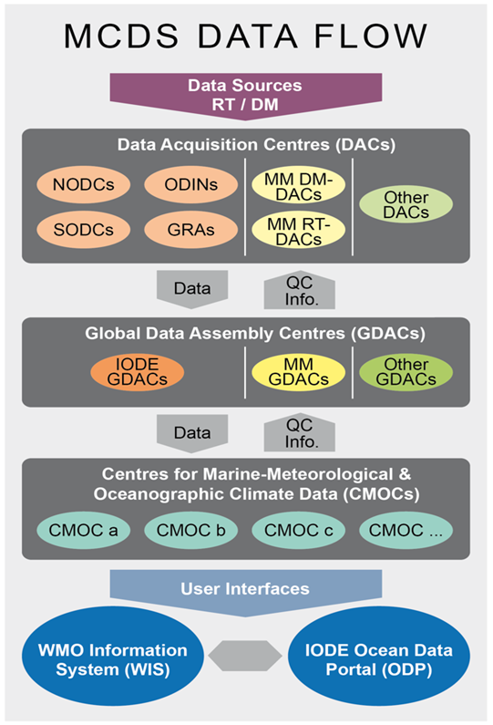
VOS GDACs - Background
Delayed mode data exchange
Long term preservation and availability of observations
Important for climate applications!
Quality controlled and consolidated data
Enhanced meta data
Manual data preparation and exchange
Not restricted to GTS data
Open access
International data exchance through WMO / IOC „Marine Climate Data System“ (MCDS)
Formalized system for all kinds of marine climate data
under IOC / WMO

Slide 5
VOS GDACs - Background
Delayed mode data exchange for VOS data
DAC (Data Aqcuisition Centre)
Data is collected offline by data provider (NHMS, PMO…)
Basic QC is applied
Data is forwarded to GDACs

Slide 6
VOS GDACs - Background
Delayed mode data exchange for VOS data
GDAC (Global Data Assembly Centre)
Two VOS GDACs (DWD and UK Met Office) collect and consolidate international VOS data contributions
Datasets are publicly accessible on the internet
Contacts for data submission:
www.dwd.de/vos-gdac
vos-gdac@dwd.de GDAC@metoffice.gov.uk

Slide 7
VOS GDACs - Background
Delayed mode data exchange for VOS data
GDAC (Global Data Assembly Centre)
Two VOS GDACs (DWD and UK Met Office) collect and consolidate international VOS data contributions
Datasets are publicly accessible on the internet
Contact for data submission:
www.dwd.de/vos-gdac
vos-gdac@dwd.de GDAC@metoffice.gov.uk
Data is included in the „International Comprehensive Ocean-Atmosphere Data Set“ (ICOADS)

Slide 8
VOS GDAC Data received in 2020

Slide 9
Number of contributed observations in 2020
14 of 27 registered countries submitted data
Over 1.5 Million Observations in total
observations from 558 VOS
55% of the received observations were coded in the most recent IMMT-5 format and 43% in the IMMT-4 format. 1% of the received observations were coded in the older IMMT-3 format and 1% in the very old IMMT-1 format.

Slide 10
Numbers of contributed observations and active contributors by year
Strong increase due to submission of AWS data
Further Increasing numbers expected (already ~3 million obs in 2021)

Slide 11
Total number of observations per year
62% of the data were observed in the last two years, 2019 and 2020

Slide 12
Spatial Distribution of Observations received in 2020

Slide 13
VOSClim
The VOSClim Project aims at providing a high-quality subset of marine meteorological data with detailed information on how data have been obtained.
During 2020:
10 of the 12 countries with registered VOSClim ships submitted observations.
The VOS-GDACs received data from over 226 ships listed as VOSClim.
489,310 observations were received and processed from VOSClim registered ships.
This represents 31% of data received by the VOS-GDACs from the VOS fleet.
193,015 of the VOSClim observations (39%) contain the additional VOSClim elements.
Question: How do we handle VOSClim in the future? (no dedicated VosClim class in new metadata standard)

Slide 14
Actions / Decisions / Recommendations

Slide 15
Actions
Consider VOS GDAC report 2020
Not yet registered countries are encouraged to register a DAC and contribute their data.
Data Acquisition Centres (DACs) that did not submit data during 2020 should do so in 2021.
If DACs are not able to submit their data because of issues e.g. with digitizing or converting into the IMMT format, Please contact the GDACs for advice.
All data are important – even small contributions!

Slide 16
Actions
All VOSClim class ship observations should include the additional VOSClim elements.
As DACs continually move to automated voluntary observing fleets there is a risk that data could be lost. In order to submit these data to the VOS-GDACs, common procedures for producing observations in the IMMT format directly from Automatic Weather Stations (AWS), or for converting observations into the IMMT format at a later stage should be investigated.
Observations should contain the same call sign, as on the GTS; i.e. the SOT-ID should be used as call sign also in IMMT, if it is used for GTS real time data.

Slide 17
Recommendations: IMMT / MQCS
The IMMT-format and the MQCS need to be revised in order to:
be compatible with parameters, flags and accuracies provided in the BUFR format
be flexible for future changes in other fields such as the IMO-number
maintain compatibility with OceanOPS meta data structure (e.g. new VOS Classes)
provide accurate quality flags for all relevant parameters
An (ad-hoc) Task Team should be set up under the VOS Panel to investigate and propose changes or alternatives to IMMT.
Remark: IMMT and MQCS are referenced in WMO No. 471 (Guide to Marine Meteorological Services), TT would be required to liaise with WMO INFCOM

Slide 18
VOS GDAC Contacts:
vos-gdac@dwd.de
GDAC@metoffice.gov.uk
www.dwd.de/vos-gdac

