Slide 1
IOC Secretariat Report - News
The Global Ocean Observing System
www.goosocean.org
Emma Heslop
GOOS Programme Specialist GOOS - IOC/UNESCO GOOS IOC
SOT-11 September 2021

Slide 2
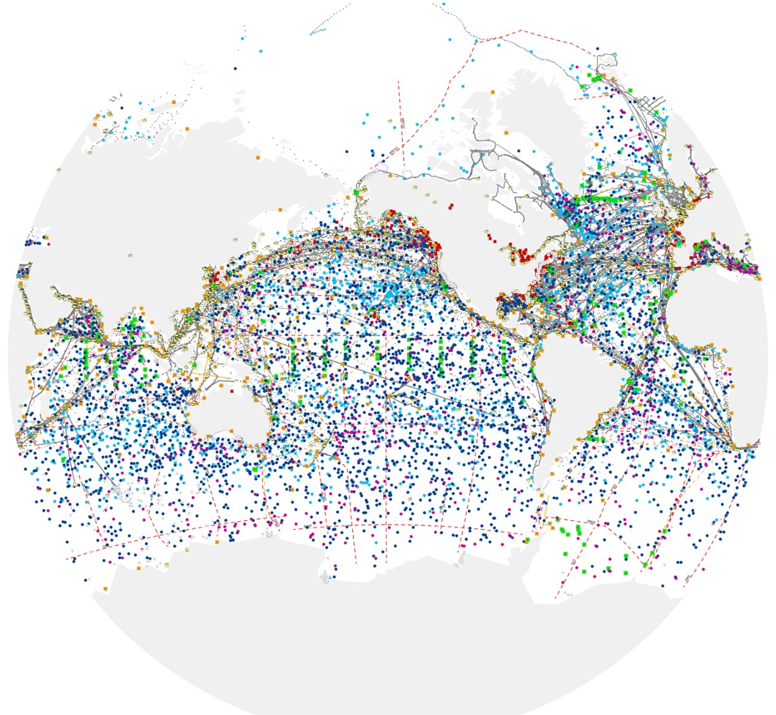
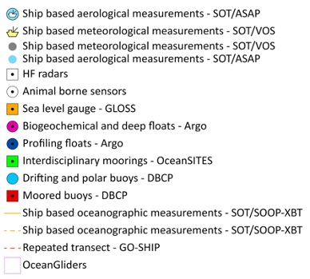
GOOS today
Observation Coordination Group networks
Established arrays (Argo, DBCP), new networks (gliders, HF Radar)
86 countries, 8,933 in situ observing platforms, 170 satellites
Early focus was on climate and operational services - increasing ocean health and human impacts
in situ ocean observations – 12 global ocean observing networks
www.ocean-ops.org/reportcard2020
Notes:
We have built tools to monitor and evaluate the system and centrally support implementation

Slide 3
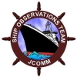
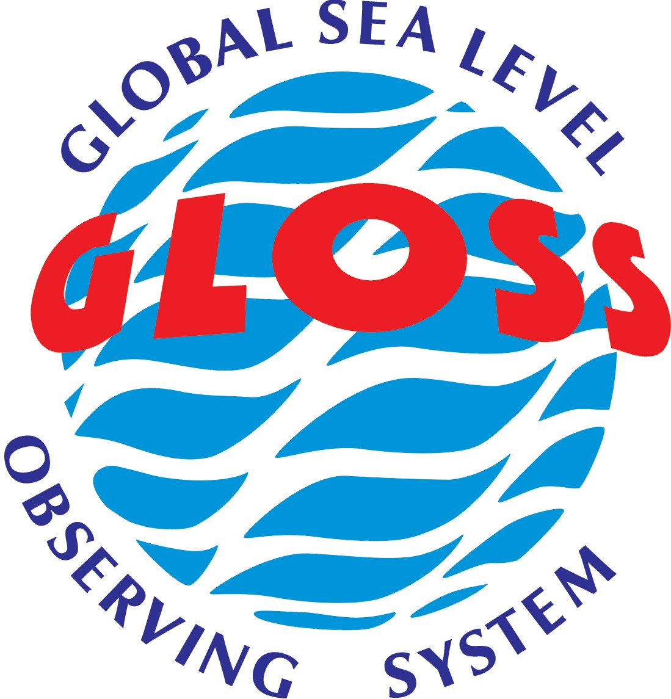
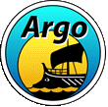
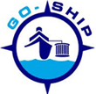
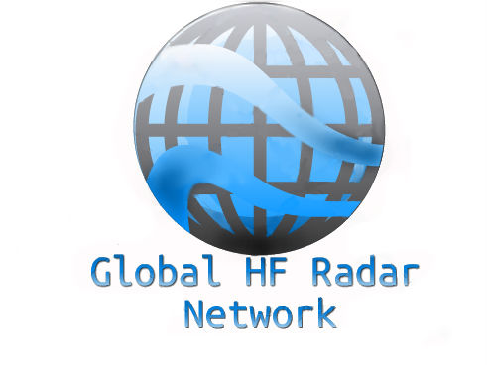
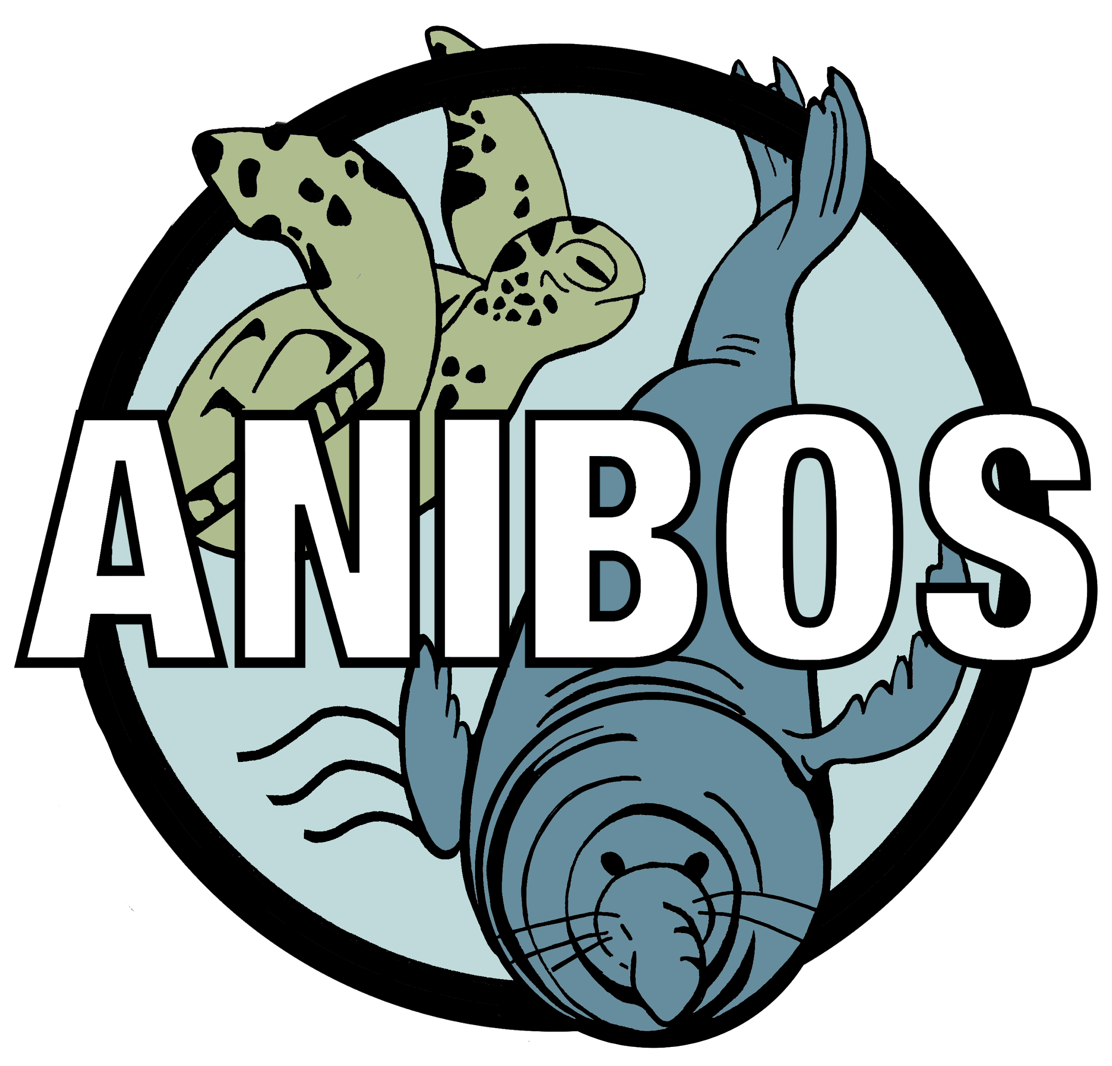
GOOS today Ocean Observing Report Card 2020
Notes:
We have built tools to monitor and evaluate the system and centrally support implementation
annual reporting on the status

Slide 4
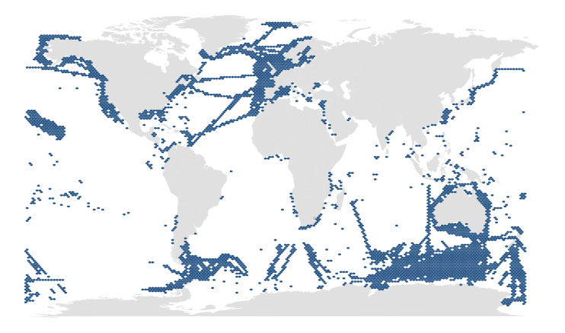
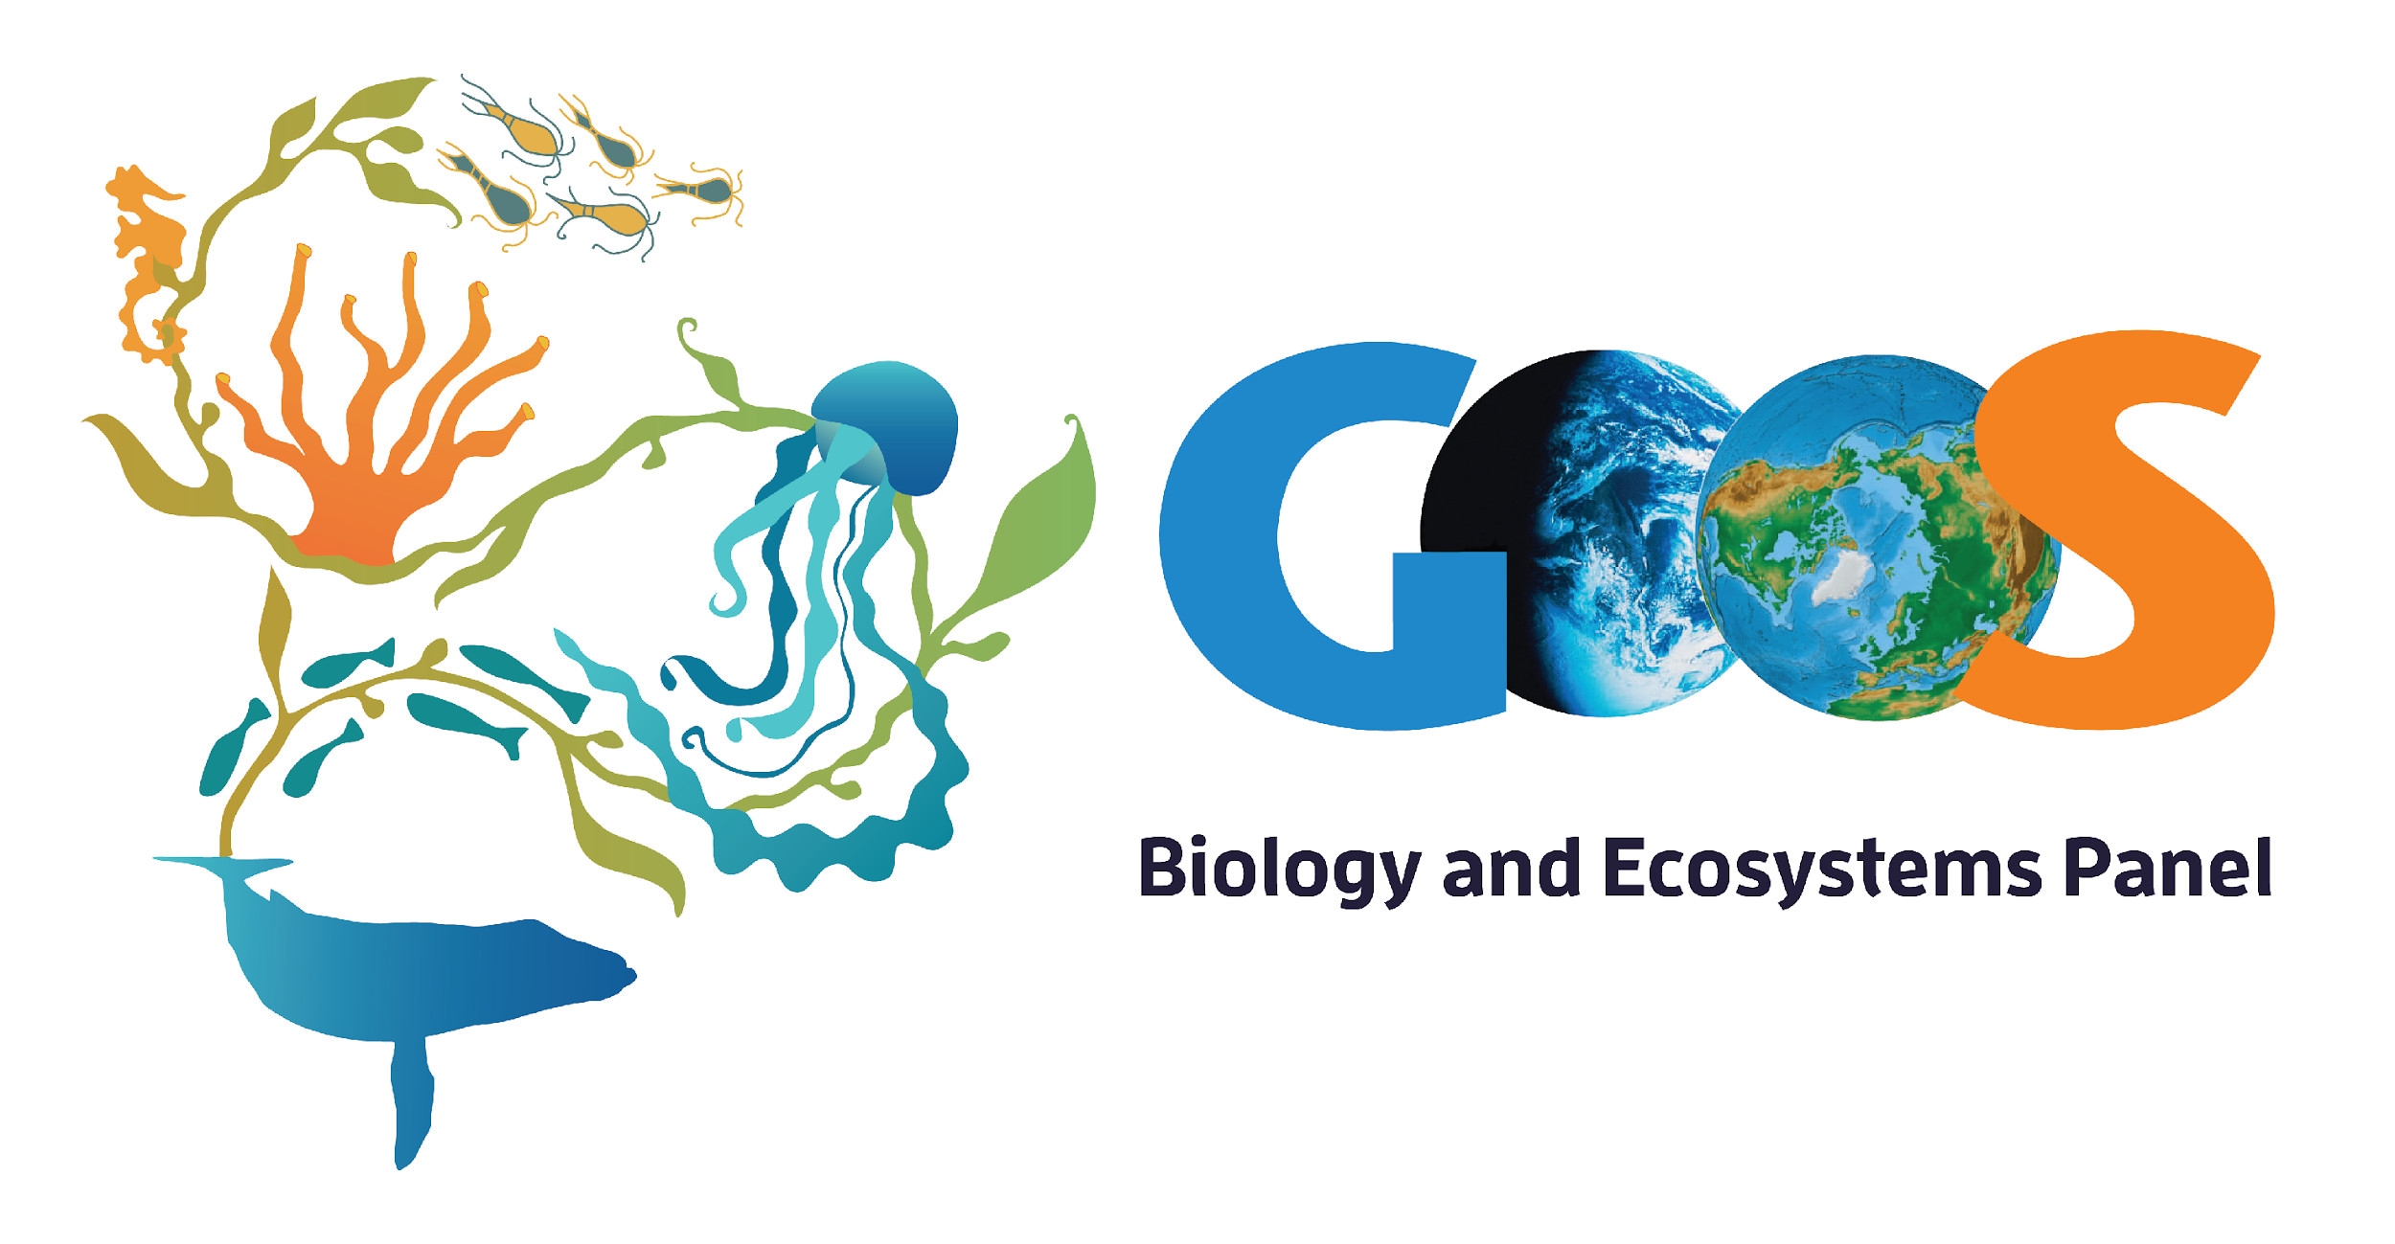
GOOS today
BioEco observations
203 active long-term biological observing programs*
10 BioEco Essential Ocean Variable (EOV) based observing networks
Working towards the – GOOS Vision
Coverage 6 -7% of the global ocean, 93% without known sustained observations
* Survey 643 observing entities identified, 371 responded, 203 programs were active, long-term (5 years or more) and sampled at least EOVs systematically but spatial data were only available for 192 observing programs (Satterthwaite et al. 2020 in prep)
ocean-ops.org

Slide 5
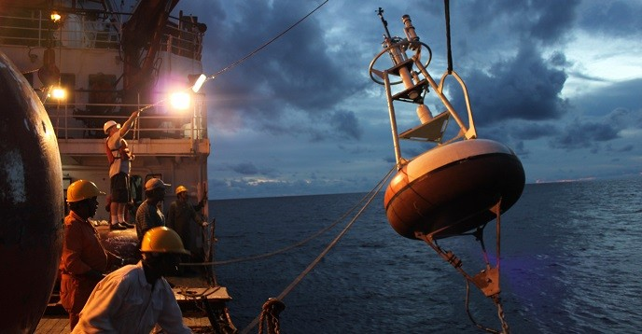
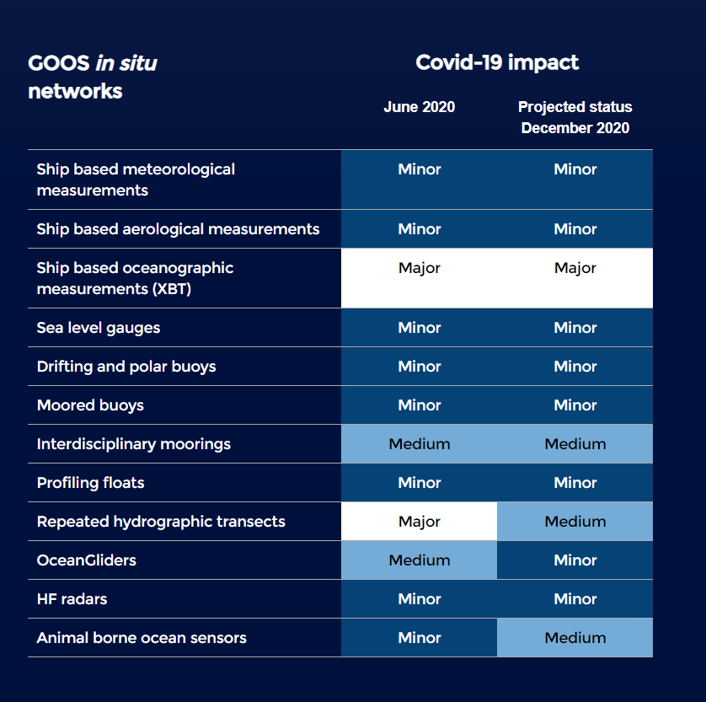
Covid-19 impact Tracking and mitigating impacts of restrictions on implementers
goosocean.org/covid-19
Notes:
Continue tracking:
Argo array down 10% to end 2020
Drifting buoys network back up to operational levels
50% fewer animals tagged Southern Ocean 2020/2021
Voluntary Observing Ships – approx. 5% reduction
Research vessels re-commenced with restricted operations
Locally and for specific datasets impacts can be higher
Observing system adaptation:
Ships of Opportunity Programme trained commercial shipping partners crew – now 5/32 lines operational - 15%
Use of charter vessels and local vessels for re-seeding and mooring turnaround
Increased cross-network cooperation for operations
Training of local operators to undertake calibration work

Slide 6
Covid-19 impact Resilience of the Ocean Observing System
Use of autonomous instruments – delay in impact
Commercial ships remained operational
Strong effort by operators – working from home, monitoring data flow, work arounds for remote calibration, etc.
Community collaboration, with ship operators, across networks, sharing information
Identified as essential operations
Notes:
However the system showed resilience - in part due to increased automation – commercial vessels and VOS are OK, arrays of autonomous platforms take time to decay, land based not maintained but functioning and gliders recovered quickly.

Slide 7
A brief summary of issues relevant to SOT
Thirty First Intergovernmental Oceanographic Commission Assembly (IOC-31)
Tenth GOOS Steering Committee (GOOS SC-10)
Observation Coordination Group Twelfth Session (OCG-12)
Ocean Decade
GOOS Implementation Plan
GOOS Governance
Value of Ocean Observations
OCG Foci and Actions
WMO – GOOS Connections
Notes:
However the system showed resilience - in part due to increased automation – commercial vessels and VOS are OK, arrays of autonomous platforms take time to decay, land based not maintained but functioning and gliders recovered quickly.

Slide 8
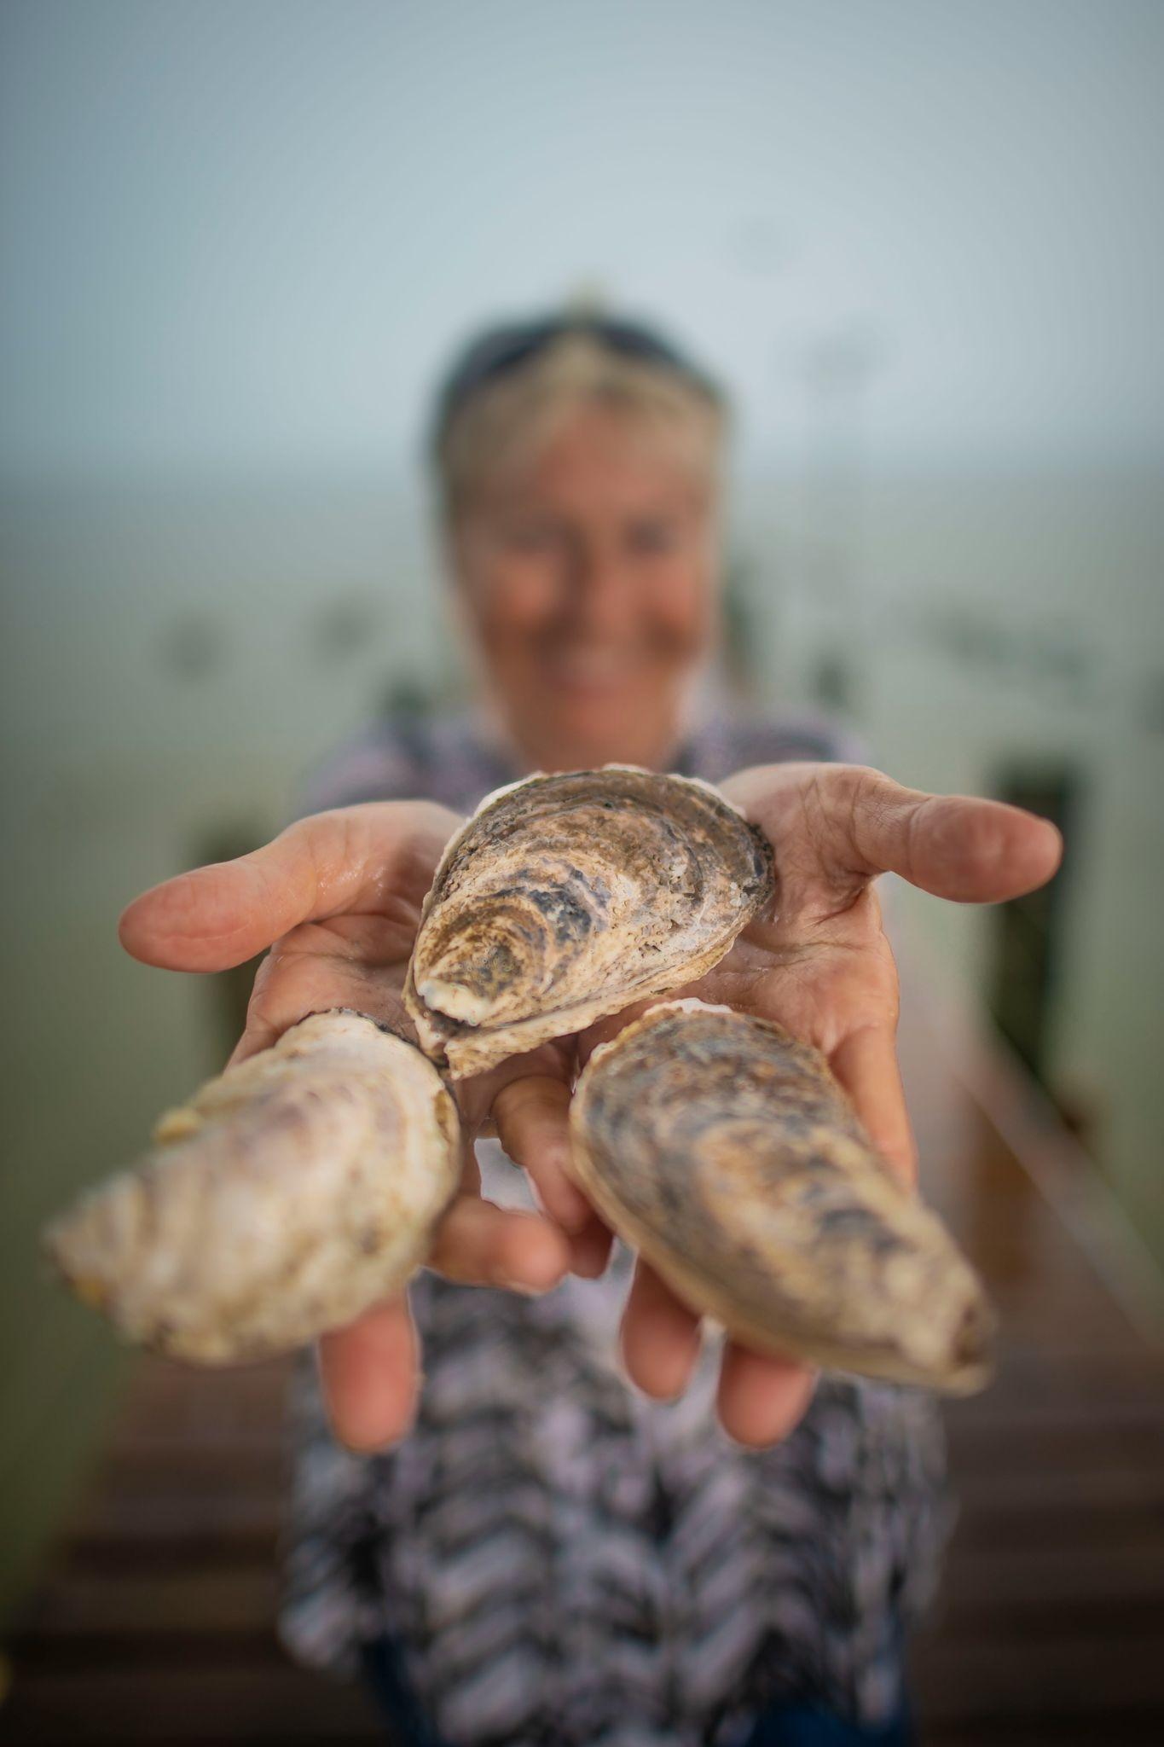
UN Decade of Ocean Science
The vision of the Ocean Decade is ‘the science we need for the ocean we want’.
The mission of the Ocean Decade is ‘to catalyse transformative ocean science solutions for sustainable development, connecting people and our ocean’.
The most pressing need is to collectively find transformative solutions to the existing and future challenges that face the ocean and thus humankind.
Notes:
We have to move faster (Implementation plan)
The ocean is a complex and dynamic socio-ecological system that is influenced by land-based activities, as well as ocean-atmosphere and ocean-cryosphere Interactions.
7 societal benefit areas one of them a predicted ocean

Slide 9
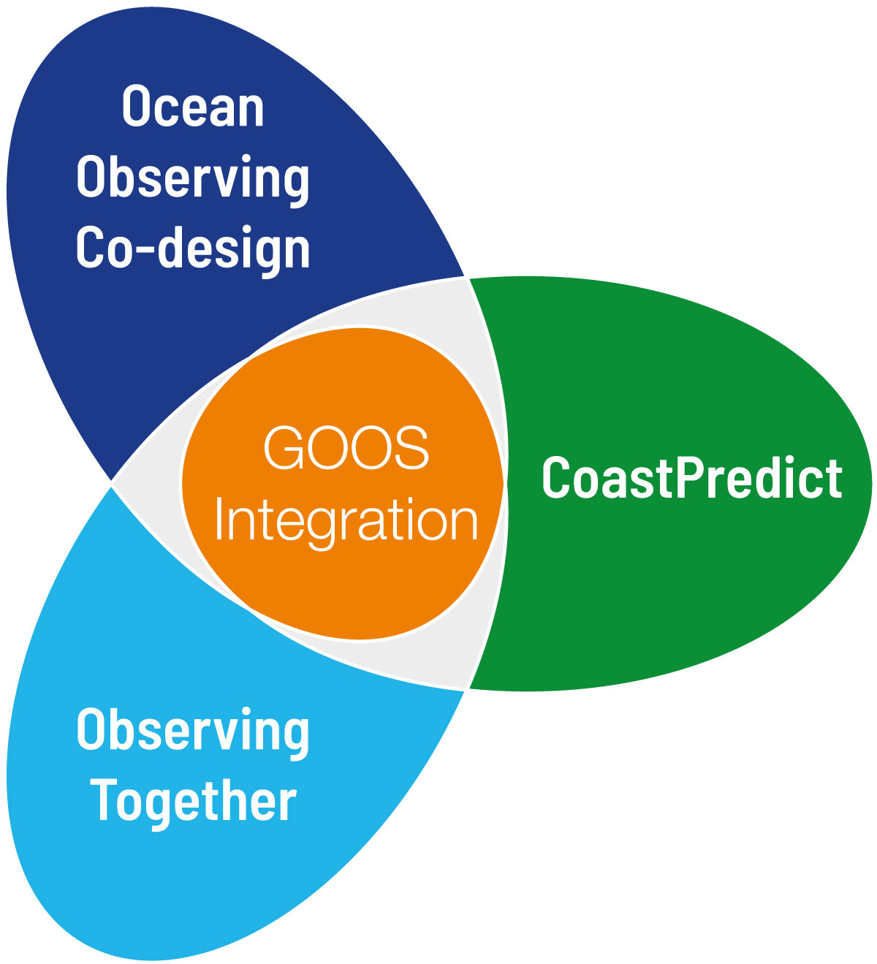
Ocean Observing Co-Design
Ocean Observing Co-Design will create a system co-designed with observing, modelling and key user stakeholders that will evolve ocean observing and give us the ocean we need for the future we want.
Leads: Sabrina Speich, David Legler, Emma Heslop
CoastPredict
CoastPredict will redefine the science of observing and predicting the Global Coastal Ocean to help the Ocean Decade succeed in its aims and give us the ocean we need for the future we want.
Leads: Nadia Pinardi, Villy Kourafalou, Joaquín Tintoré
coastpredict.org
Observing Together
Observing Together will transform ocean data access and availability by connecting ocean observers and the communities they serve through enhanced support to both new and existing community-scale projects.
Leads: Kim Currie and Molly Powers

Slide 10
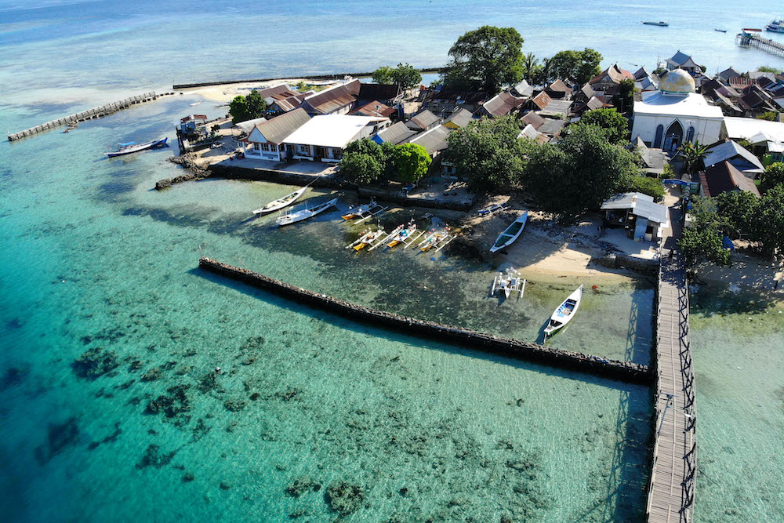
IOC Resolution A-31/1: Implementation of the United Nations Decade of Ocean Science for Sustainable Development (2021–2030)
GOOS SC-10 Decision 1 Ocean Decade
First UN Ocean Decade Programmes have been endorsed
The Ocean Decade Implementation Plan is approved and work will begin on the collaborative centres, programme funding, project calls and further endorsements etc.
New call for projects in Oct 2021 and every 6 months
The Ocean Decade has visibility, national and UN level, and is a great opportunity for ambitious ideas across the observing system.
Encourage SOT to think of about what it could do, e.g., ‘citizen science’ observations from different vessels.

Slide 11
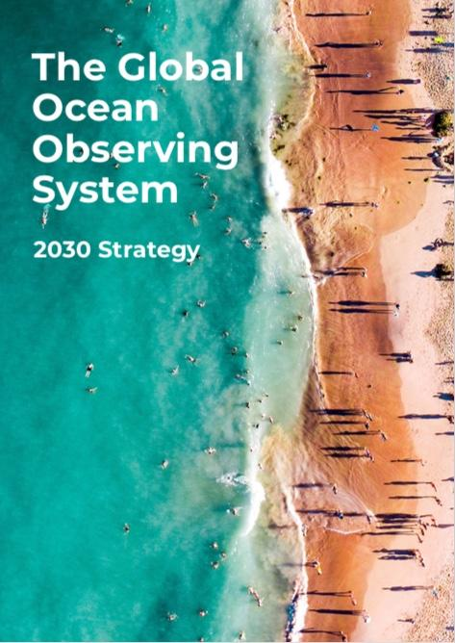
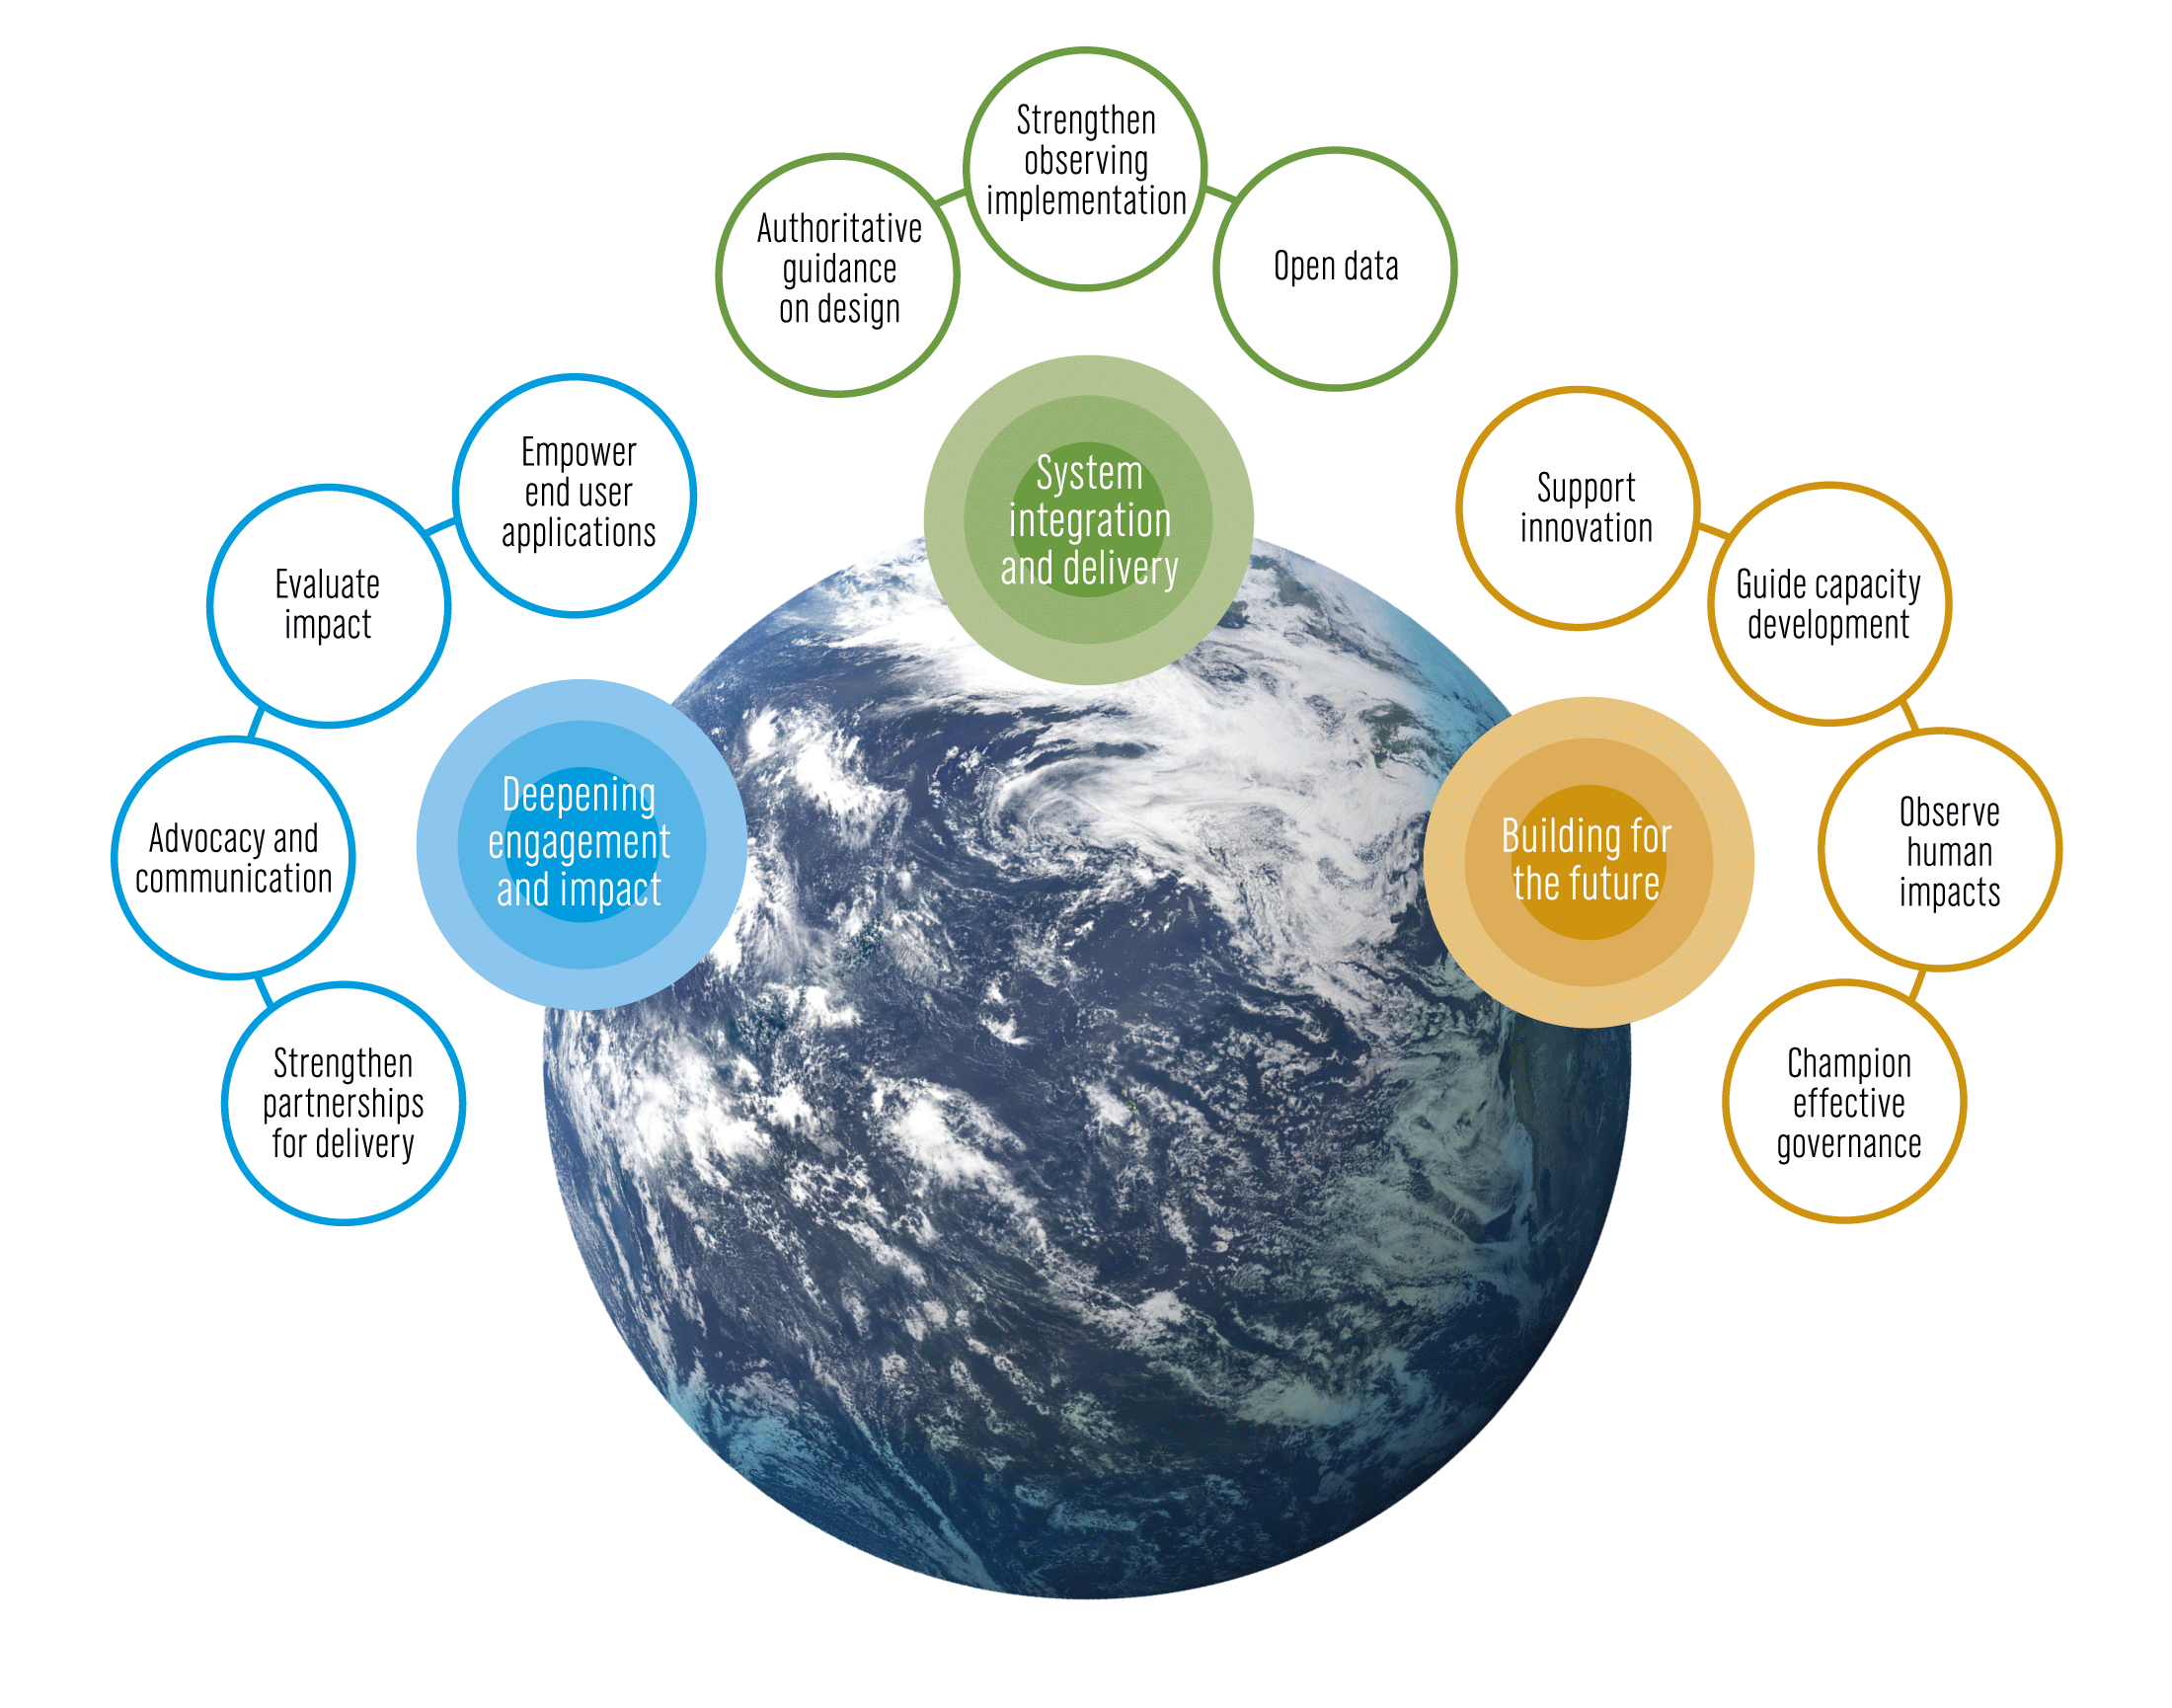
Building on the GOOS 2030 Strategy
Vision
A truly global ocean observing system that delivers the essential information needed for our sustainable development, safety, wellbeing and prosperity
Mission
To lead the ocean observing community and create the partnerships to grow an integrated, responsive and sustained observing system
goosocean.org/2030strategy
Notes:
The IOC Assembly in 2019 adopted a Global Ocean Observing System 2030 Strategy which now informs our work.

Slide 12
GOOS Implementation Plan
IOC Decision A-31/3.5.2 I - Global Ocean Observing System Work Plan
GOOS SC-10 Decision 5: Implementation Planning
Development the GOOS Implementation Plan
Key OCG and OceanOPS workplan actions, for example Best Practices, data and metadata, metrics, the Report Card, are part of the Implementation Plan.
OCG is leading initiatives in some areas
GOOS will need to find additional resource to support the Implementation Plan, including for OCG.
IOC Assembly 31 – Agenda item 3.5.2 Exec Summary of the IP

Slide 13
Implementation planning Ambition against objectives

Slide 14
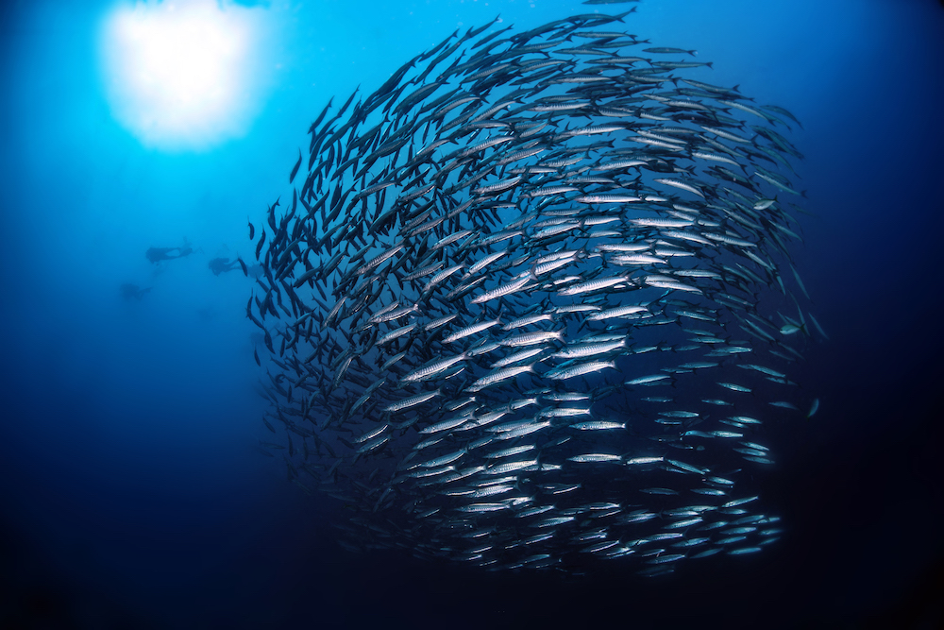
GOOS governance “committed to change”
GOOS SC-10 Decision 1: Governance
GOOS commissioned study and survey of support structures for ocean observing (Neville Smith, survey/interviews with 60+ stakeholders)
“The present form of support arrangements for global and regional ocean observing systems lacked authority, clarity and transparency, and its effectiveness and efficiency were determined to be unsatisfactory for many stakeholders” Recommendation: renovate and rejuvenate the current hub-and-spoke arrangement
Improving governing and support structures
Design a process of change with stakeholders
Assess internal architecture aligned with key functions
Ask co-sponsors (IOC, WMO, UNEP, ISC) to prepare for governance change

Slide 15
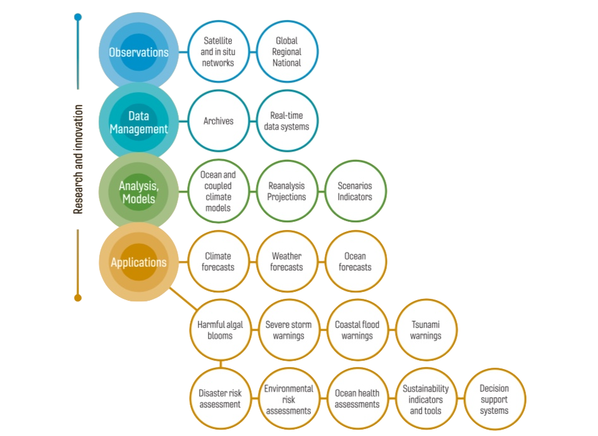
Underpinning a wide range of applications
The need for expansion of a global ocean observing system, designed to meet the requirements of a broad suite of users, is clear and urgent.
Notes:
The work of ocean observations and forecasting systems, the work of GOOS, is a key infrastructure to enable a large number of applications related to climate, to forecasting and early warning for a wide range of end users, and creating sustainable and resilient marine economies while conserving key ocean ecosystem services now and for the future.

Slide 16
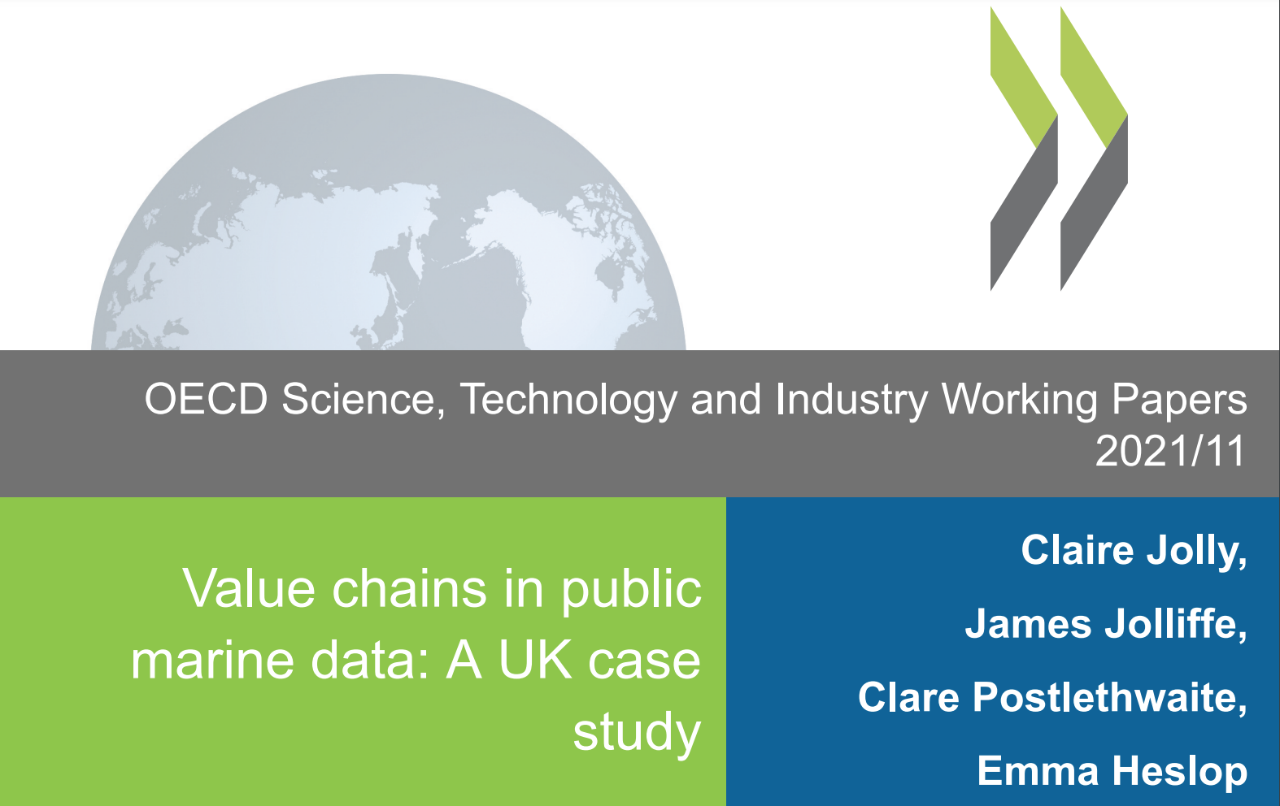
Value Ocean Observing OECD-GOOS
Ocean information increasingly finds uses in a wide range of public policy arenas and in supporting commercial activities, bringing new efficiencies, productivity gains, or cost avoidances BUT knowledge of the economic value of the services it enables is scattered and not well defined.
OECD, GOOS, MEDIN – Survey MEDIN user base 2020
Paper: Value Chains of Public Marine Data: A UK Case Study
Step towards understanding ocean data flow and value in economies.
https://www.oecd.org/fr/numerique/value-chains-in-public-marine-data-d8bbdcfa-en.htm
Notes:
2016 – first exploratory workshop OECD/observing community
2018 – extensive literature review on the ocean observations valuation – Report on Socio-Economic Valuation of Ocean Observation Data - understood need to look at value chains
2019 – initiated an OECD-GOOS Project to look at value chains – 2 parts

Slide 17
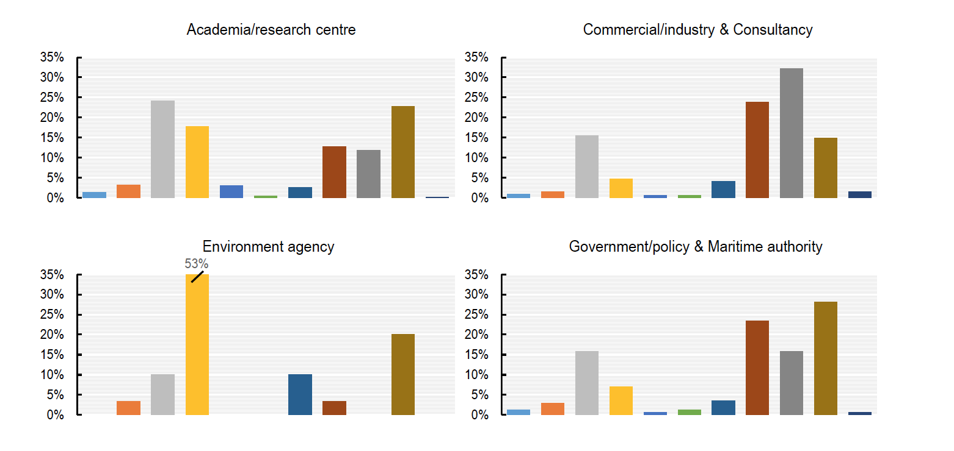
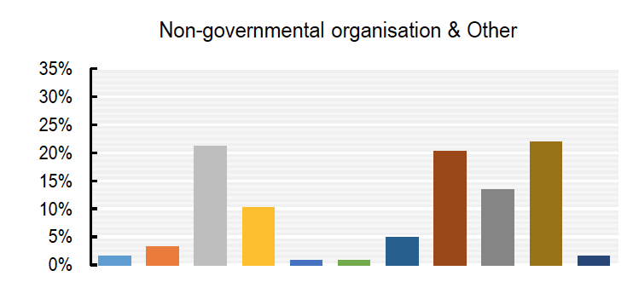
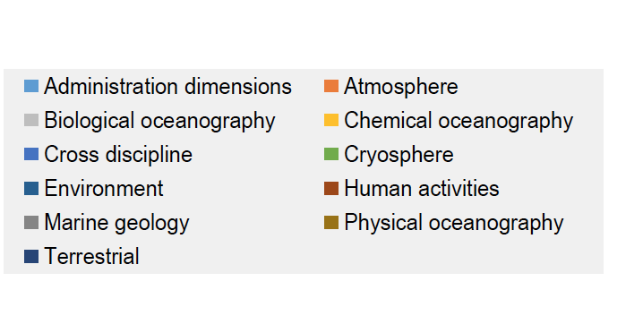
Patterns in data type use across sectors
Uses all 5 core data types
high use marine geology, human impacts, biological and physical,
human activities, physical and biological
5 core data types
Chemical oceanography high, physical, biological and environment
Similar to NGOs
* Environment agency – indicative only, due low sample size

Slide 18
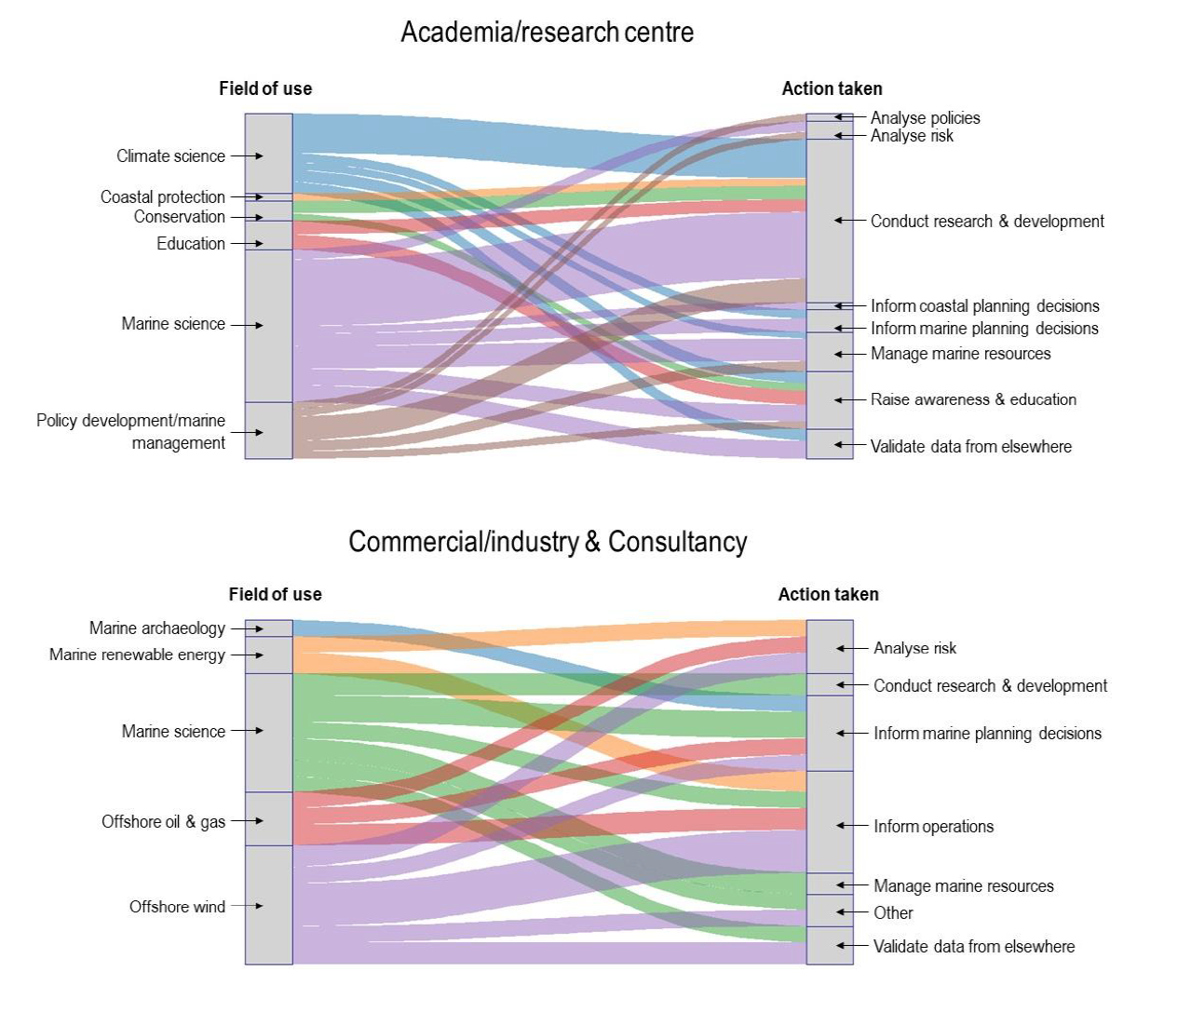
Tracking value chains
Mapping from role to sector to action
– first steps in a novel value chain approach
Easily identify differences in the types of action data is informing across sectors
Identify which actions are most frequent use for data
Identify the collection of actions that each field is engaging - broad or narrow, and if not using data
Segment size indicates frequency of that response
Notes:
First time this aggregated use has been tracked through the ‘value’ chain

Slide 19
Role of OCG
The Observation Coordination Group (OCG) works to efficiently operate, maintain, coordinate and integrate a comprehensive in-situ global ocean observing system
OCG now targets 8 foci:
Requirements
Observing Advances
Standards and Best Practices
Data Management
OceanOPS
Metrics (new foci)
Environmental Stewardship (new foci)
Capacity Development
Additional investments of time:
* Responding to COVID-19 (assessing impacts, GOOS sources were often cited in news stories)
* WMO (reorganization, WIGOS, etc.)
* Ocean Decade (OCG and the community)

Slide 20
OCG Actions SOT involvement
Action | SOT
Advancing integrated global ocean observing design (increase focus around EOVs and ECVs) identify opportunities | DBCP and SOT representing networks and OCG at the interface to GBON
Best practice development in networks and GOOS best practice ‘endorsement’ process | Amongst some of the developments SOOP involved and reaching out to ASAP.
OCG Data Management / Data and Metadata Work | VOS, SOOP, ASAP Maps data flow, Open-GTS WIS 2.0 SOT contacts involved in Data and Metadata work
EOV views of ocean observing | OceanOPS work with WMO – see this would have connection with the SOT KPI work
OCG revised ToRs | These are under review by the GOOS SC now, SOT reviewed
OCG, GOOS, networks and the Ocean Decade | OCG Roundtable to look at potential to work across OCG / GOOS
Boundary Currents: workshop group to work on regional pilot/s - scoping needs with stakeholders/modelling, looking at from EOV perspective, working on optimal design / trade-offs. Connect to OOPC | Lead is Tammy Morris SOOP!

Slide 21
WMO – GOOS Connections
Joint WMO-IOC Collaborative Board
IOC Decision A-31/3.5.5 - Adoption of a WMO-IOC Collaborative Strategy and Report on the establishment of the Joint WMO-IOC Collaborative Board
Adopts the WMO-IOC Collaborative Strategy, subject to its parallel adoption by the WMO Executive Council at its 73rd Session (14–25 June 2021)
This strategic body should now go on to advise IOC and WMO on actions or projects to support the Collaborative Strategy
Work across the value chain research, observations, data management, services etc.
The Study Group on Ocean Observations and Infrastructure Systems (SG-OOIS)
Established by INFCOM, reports to the INFCOM Management Group.
General goal to propose optimal functional connections between the WMO and IOC-GOOS bodies, programs and systems to ensure the objectives defined by WMO Members.
Post-JCOMM, this group is developing a comprehensive view of the functional and strategic connections between WMO and GOOS structures, including the networks.
The synthesis of the work has not been completed yet, however when done this should provide recommendations to WMO and by extension GOOS on optimal connections – for effective partnership

Slide 22
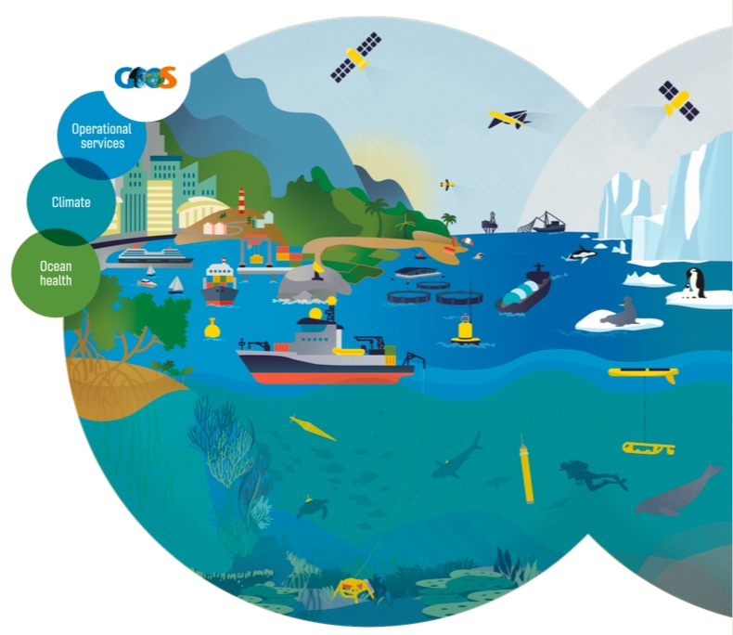
Thank you
e.heslop@unesco.org
goosocean.org

