Slide 1
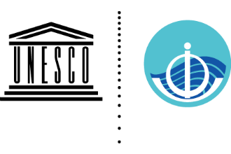
Synergistic Observing Network for Impactful and Relevant Ocean Predictions (SynObs): An Introduction
SynObs
Yosuke Fujii (JMA/MRI, OceanPredict OS-Eval TT co-chair)
Supported by OceanPredict OS-Eval, DA, COSS, and MEAP TTs
Notes:
Hello everyone,
I am Yosuke Fujii, working at Meteorological Resaerch Institute, Japan Meteroological Agency.
I am co-chairing OceanPredict Observing System Evaluation Task Team.
We are now proposing “Synergistic Observing Netowrk for Impactful and Relevant Ocean Predictions” or SynObs as an UN Decade Project.
In this presentation, I will introduce what we aim and what we will try in SynObs.

Slide 2
SynObs: A common comprehensive project
SynObs
ForeSea
Ocean Observing Co-Design
CoastPredict
Decade
Programmes
COSS-TT
MEAP-TT
DA-TT
OS-Eval TT
SynObs
aims to generate transformative collaboration among the three UN Decade Programmes.
Decade Project
Notes:
You know, SynObs is suggested as a common comprehensive project among the three UN Decade programmes, ForeSea, CoastPredict, and Ocean Observing Co-Design.
You know, ForeSea is proposed by OceanPredict in order to enhance the ocean prediction value chain.
CoastPredict is also proposed to promote use of coastal predictions for societal benefits.
These programmes need to collaborate with observational communities to construct the observing systems which are effective for predictions.
Meanwhile, Ocean Observing Co-Design is proposed by GOOS to make the ocean observing network optimal for various purposes.
So, SynObs is proposed as a UN Decade Project under the collaboration of OceanPredict task teams in order to generate transformative collaboration among the three UN Decade Programmes.

Slide 3
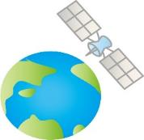
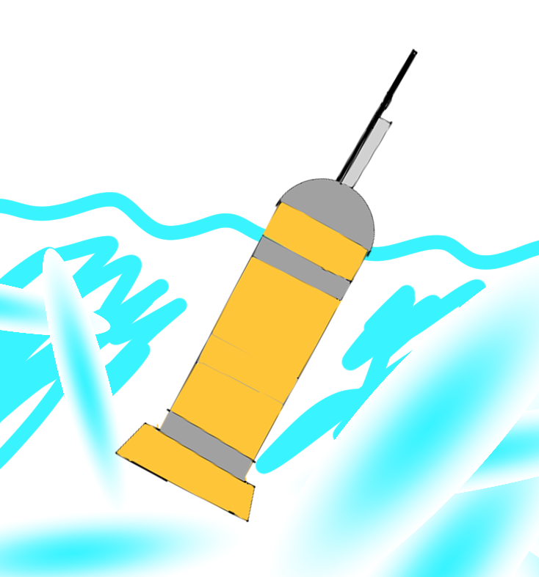
Objective and Strategy of SynObs
SynObs
Objective
SynObs will seek the way to extract maximum benefits from the combination among various observation platforms, typically between satellite and in situ observation data, or between coastal and open ocean platforms, in ocean/coastal predictions.
Strategy
SynObs aims to identify the optimal combination of different ocean observation platforms through observing system design/evaluation, and to develop assimilation methods with which we can draw synergistic effects from the combination.
Scope
Targets of SynObs include open-ocean (global, tropical, mid-latitude, polar areas), coastal, and biogeochemical (BGC) observing systems
Synergy
Notes:
So, the objective of SynObs is to seek the way to extract maximum benefits from the combination among various observation platforms, typically between satellite and in situ observation data, or between coastal and open ocean platforms, in ocean and coastal predictions.
On the strategy, SynObs aims to identify the optimal combination of different ocean observation platforms through observing system evaluation and design, and to develop assimilation methods with which we can draw synergistic effects from the combination.
Then, our target includes open-oceans, such as the global ocean, tropical ocean, mid-latitude, and polar areas, and coastal and biogeochemical observing systems.

Slide 4
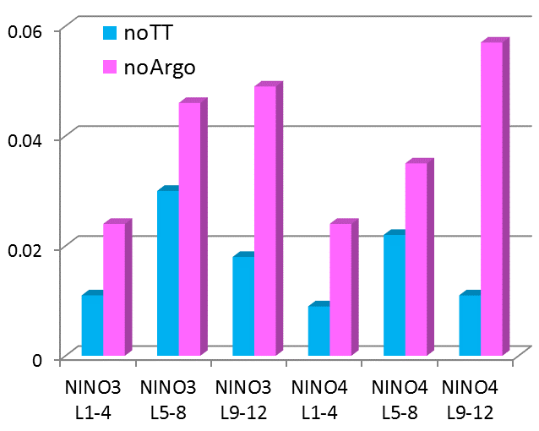
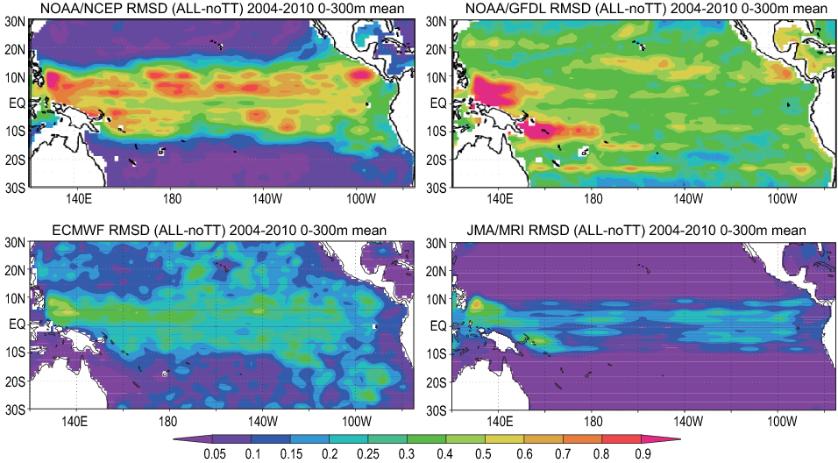
Example 1: Evaluate the existing network
SynObs
SynObs aims to evaluate the ocean observing network using ocean prediction systems to support their sustainment and further development
It is necessary to perform evaluation with multiple systems to get a robust and reliable conclusion because results will have severe system-dependency.
NCEP
GFDL
Evaluation for ENSO forecasts.
Fujii et al., QJRMS, 2015
TAO/TRITON
Argo
ECMWF
JMA
Impacts of TAO/TRITON and Argo in the JMA ENSO forecasting system
Multi-System Evaluation of TAO/TRITON impacts in 4 ocean reanalysis systems (0-300m average)
Notes:
An expected activity of SynObs is evaluating the existing ocean observing network.
For example, this figure shows the impacts of the TAO/TRITON arrays and Argo floats on the ENSO forecasts, which were provided at the 2014 Tropical Pacific Observing System Workshop held after the crisis of the TAO array.
We will continue this kind of activities, that is, we aim to evaluate the ocean observing network using ocean prediction systems to support their sustainment and further development.
And it should be noted that evaluation results will be severely system-dependent as illustrated by this figure.
This figure shows that the impact of TAO/TRITON is very different among different systems.
So it is necessary to perform evaluation with multiple systems to get a robust and reliable conclusion.
Therefore, community collaboration is very important.

Slide 5
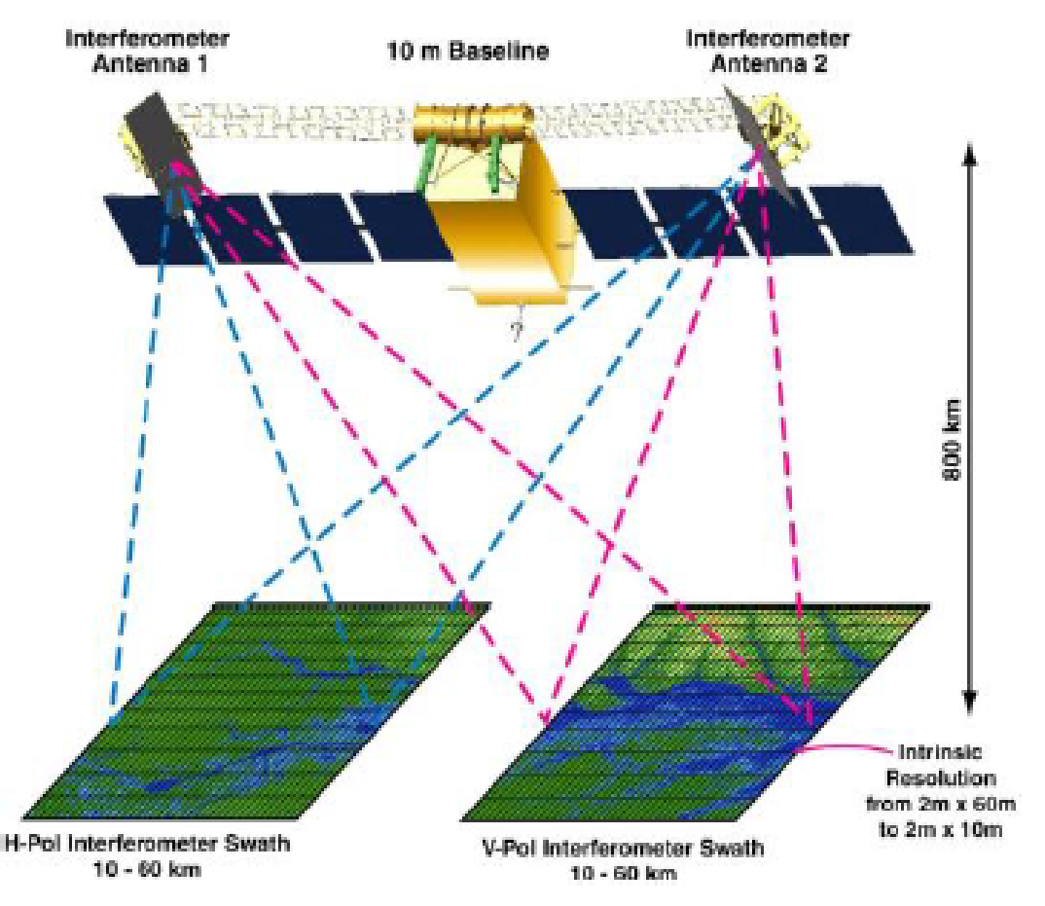
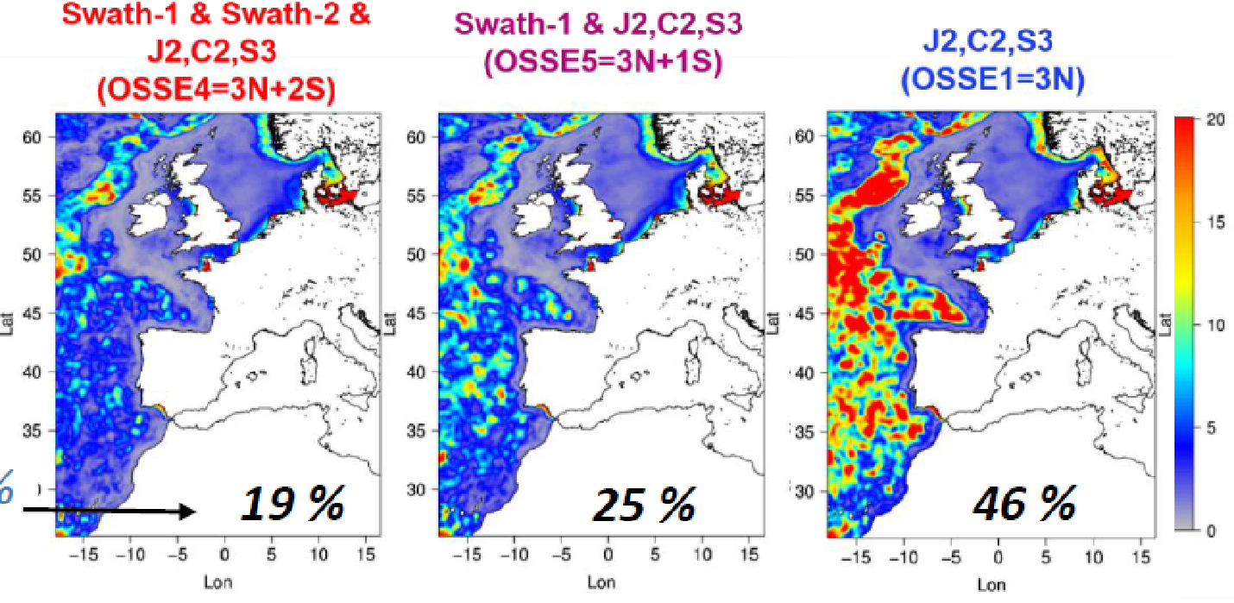
Example 2: Support new observations
SynObs
SynObs will support designing new observing systems through OSSE or some other methods (e.g., FSOI).
SynObs will also promote developments of DA schemes to assimilate new observations, as well as developments to get more benefits from existing observations.
SWOT launch in 2021
http://swot.jpl.nasa.gov/
SSH Error variance
in cm²
OSSE results with the MOI system.
Bonaduce and Benkiran, Ocean Science, 2018
Error/NatRun Variance
Notes:
We also aim to support new observations.
SynObs will support designing new observing systems through Observation System Simulation Experiment, OSSE, or some other methods.
For example, this figure shows clear reduction of errors when data of two swath altimetry satellites are assimilated.
We will support new satellite missions or constructing new in-situ observing systems through this kind of activities.
We will also promote developments of data assimilation schemes to assimilate new observations, as well as developments to get more benefits from existing observations.

Slide 6
Example 3: Summarize and provide information
SynObs
SynObs will summarize the information on the observation data (usage, QC, impacts) which we get through ocean predictions. Those information will be provided to observation communities to suport the management of ocean observing systems
Table on usage of observations (for moorings) in Ocean Prediction Systems
https://oceanpredict.org/observations-use/
Notes:
Then, we will summarize and provide the information we get through operational activities or evaluation efforts using ocean prediction systems.
This is the table on usage of observations in the ocean prediction systems we are currently presented on the webpage.
Thus, SynObs will summarize the information on the observation data such as usage, QC, and impacts which we get through ocean predictions.
Those information will be provided to observation communities to support the management of ocean observing systems.

Slide 7
Focus on Synergy among Various Observations
SynObs
To lead a transformative change on ocean predictions in this decade, we need to maximize benefits from the whole ocean observing network
⇒SynObs focuses on synergies among different ocean observing systems
Combination of observations targeted in SynObs
Satellite altimeters, satellite ocean current observations (SKIM) and Argo floats
Satellite SST observations, near surface in situ observations (from Mooring buoys and Argo floats, etc.), and sea surface atmospheric parameters
Satellite ocean colour observations and in-situ (Argo) observations
Observations of sea ice concentrations and sea ice thickness
Coastal ocean radars and sensors, gliders, drones, satellite remote sensing, and Argo floats
Notes:
Meanwhile, so far we tend to focus on a specific observing system.
But, to lead a transformative change on ocean predictions in this decade, we need to maximize benefits from the whole ocean observing network.
Therefore, we decided that SynObs will focus on synergies among different observing systems.
So, we will focus on the synergy from the following combinations of observing systems.
First, satellite altimeters, satellite ocean current observations, and Argo floats, mainly for ocean predictions.
Second, satellite SST, near-surface in situ observations and sea surface atmospheric parameters, mainly for coupled data assimilations
Third, satellite ocean color and in situ observations for biogeochemical predictions,
Fourth, sea ice and sea thickness observations for polar predictions,
and Fifth, coastal ocean radars and senors, gliders, drones, satellite remote sensing, and Argo floats for coastal predictions.

Slide 8
Outcomes for the society
SynObs
A straightforward reason for sustaining the ocean observing network
A guideline toward a synergistic ocean observing network for “A Predicted Ocean”
Suggest effective investment for the ocean observing systems
Improved ocean/coastal prediction capacity.
Make benefits to marine disaster prevention, marine economy promotion, marine ecosystem management, climate predictions, etc.
Notes:
Then SynObs will bring benefits to the society.
You know, SynObs provides a straightforward reason for sustaining the ocean observing network.
then it also make a guideline toward a synergistic ocean observing network for “A predicted Ocean”, and, thus, suggests effective investment for the ocean observing systems.
It will also support improved ocean and coastal prediction capacity, which will make benefits to marine disaster prevention, marine economy promotion, marine ecosystem management, climate predictions, and so on.

Slide 9
Contribution to “A Predicted Ocean”
SynObs
SynObs will evaluate the ocean observing network to sustain it as a indispensable infrastructure for “A Predicted Ocean”
SynObs will design ocean observing systems to improve ocean/coastal prediction capacities.
SynObs will promote developments for effective use of observation data in ocean/coastal predictions.
SynObs will contribute to ForeSea and CoastPredict, and “A Predicted Ocean” through these activities.
Notes:
So, SynObs will surely contribute to A Predicted Ocean.
SynObs will evaluate the ocean observing network to sustain it as a indispensable infrastructure for “A predicted Ocean”.
SynObs will design ocean observing systems to improve ocean and coastal prediction capacities.
SynObs will promote developments for effective use of observation data in ocean and coastal predictions.
through these activities, SynObs will contribute to ForeSea, Coastpredict, and “A Predicted Ocean”.

Slide 10
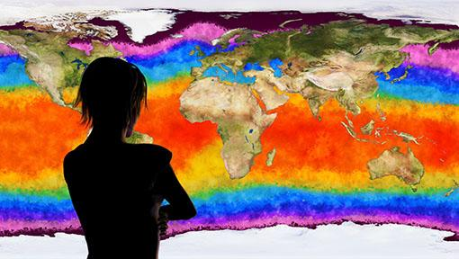
Contributions to Ocean Observing Co-Design
SynObs
SynObs will provide information on importance/necessity and effective designs of the ocean observing network for ocean/coastal predictions
SynObs will make input to the authorized report on future evolution of the ocean observing network from the perspective of ocean/coastal predictions
SynObs aims to construct a positive feedback cycle between the observing network and ocean prediction systems
Notes:
Of course, SynObs will contribute to Ocean Observing Co-design.
SynObs will provide information on importance, necessity and effective design of the ocean observing network for ocean and coastal predictions.
It will also make input to the authorized report on future evolution of the ocean observing network from the perspective of ocean and coastal predictions.
Thus, SynObs aims to construct positive feedback cycle between the observing network and ocean prediction systems.

Slide 11
How can you get involved in SynObs?
SynObs
On-site and on-line meetings
A symposium is planned in Nov. 2022 in Tsukuba, Japan.
Regular on-line meetings (every 2-3 months) hosted by OceanPredict OS-Eval Task Team.
Share your results and join the collaborative works for future evolution of the ocean observing network.
Collaboration among observational and model&DA communities is indispensable for successful evaluation, design and development.
Results using different prediction systems are necessary to get robust and reliable conclusions
we will really welcome participation of various people
See the webpage or mail to the contact addresses!
Notes:
Then, how can you get involved in SynObs?
You know, SynObs will have on-site and on-line meetings.
A symposium is planned in Nov. 2022 in Tsukuba, Japan.
We also have on-line meetings every 2 to 3 months.
So, it would be nice if many people attend those meetings and share the results and join the collaborative works for future evolutions of the ocean observing network.
Collaboration among observational and model and data assimilation communities is indispensable for successful evaluation, design and development.
In addition, results using different prediction systems are necessary to get robust and reliable conclusions.
So we will really welcome participation of early carrier scientists and various kind of people.
See the webpage or mail to the contact addresses to join our activities.

Slide 12
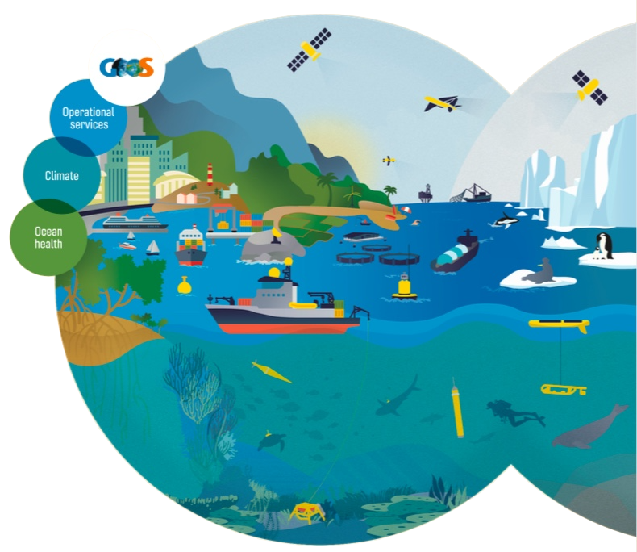
Contact
SynObs
(OceanPredict OS-Eval TT co-chairs)
Yosuke Fujii (JMA/MRI)
yfujii@mri-jma.go.jp
Elisabeth Rémy (MOI)
elisabeth.remy@mercator-ocean.fr
Webpage for Information of SynObs
https://oceanpredict.org/science/
task-team-activities/observing-system-evaluation/#section-projects
Notes:
These are information on the contact and the webpage of SynObs.
Don’t hesitate to contact us.
That’s it.
Thank you for your watching this presentation, and I am looking forward to seeing you in SynObs activities.

