Slide 1
E-SURFMAR
Chairs: María Isabel Ruiz Gil de la Serna (Spain) & Kai Herklotz (Germany)
Rapporteur: Christophe Guillerm (France)
8-11 November 2021 DBCP 37

Slide 2
E-SURFMAR
What is E-SURFMAR?
Objectives
to coordinate, optimise and progressively integrate the European activities for surface observations over the sea in support of weather forecasting and climate monitoring
Two components
Conventional Voluntary Observing Ships (VOS) or ships equipped with Automated Weather Stations (S-AWS)
Drifting and Moored Data Buoys

Slide 3
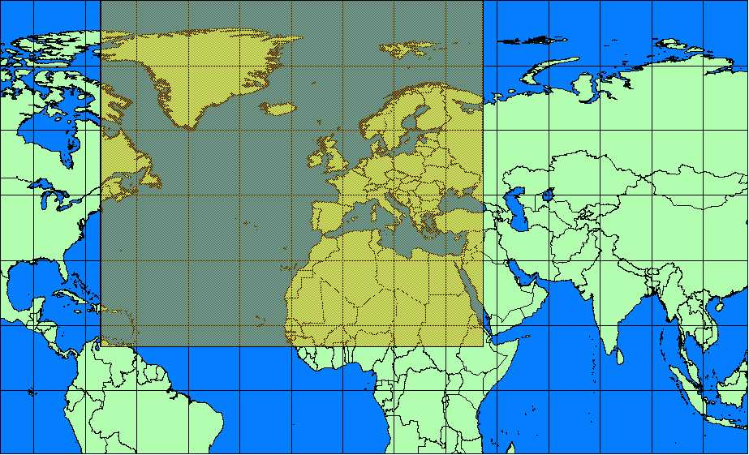
E-SURFMAR area
1. E-SURFMAR
10°N-90°N
70°W-40°E

Slide 4
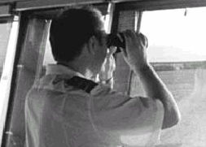
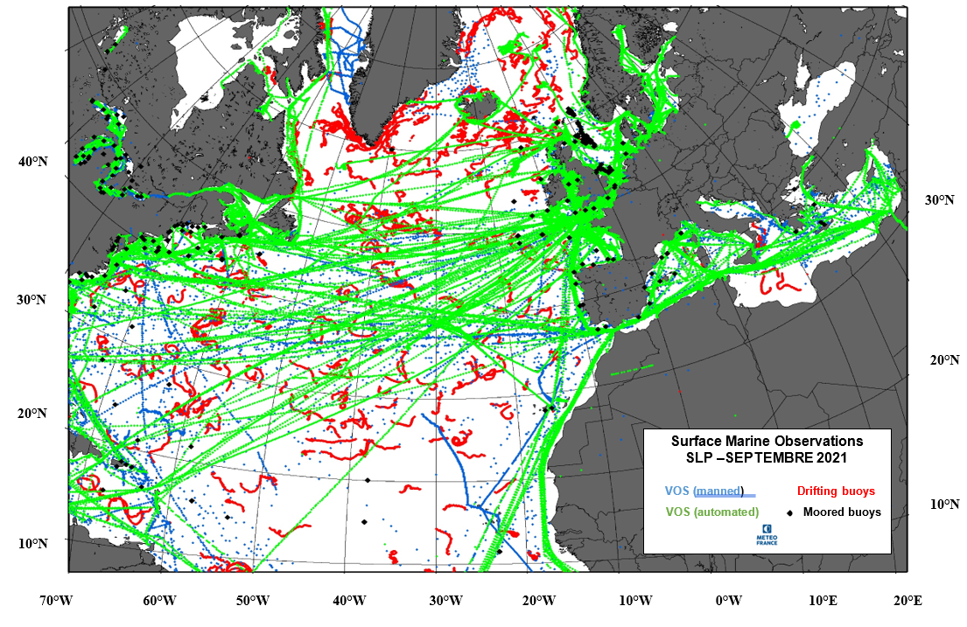
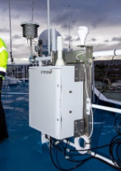
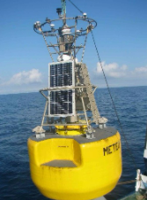
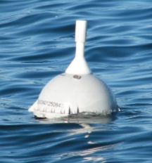
2. Map of primary area
Voluntary Observing Ships
Data Buoys
+Contributions to Tropical Atlantic

Slide 5
3. Status and Highlights this year
Deployment
92 SVP-B buoys deployed since July 2020
46 buoys deployed july 2020 to june 2021, 67 still operational. Total of 154 deployed buoys since beginning
TRUSTED project
E-SURFMAR Programme management
Christophe Guillerm still PM until avril 2022.
New PM recruited, Olivier Desprez de Gésincourt arrived on 09/2021, will be E-SURFMAR PM by 05/2022
Maybe 2022 new phase (III) : maybe 25 more buoys.

Slide 6
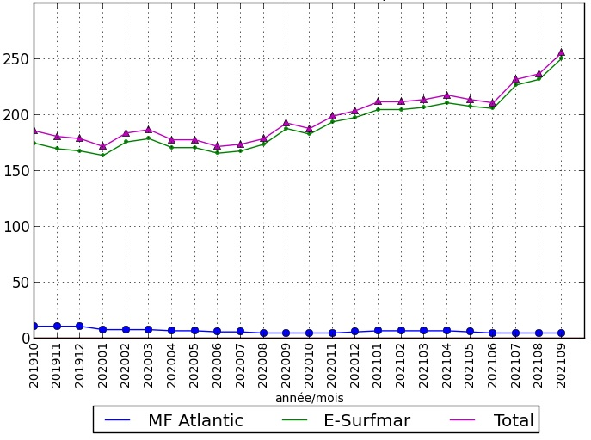
4. Focus for this year
E-SURFMAR drifting buoys network stayed robust
Number of buoys deployed
TARGET

Slide 7
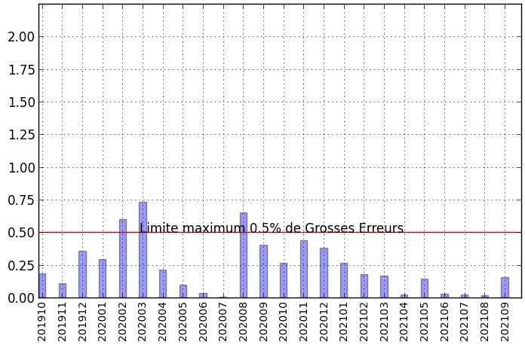
4. Focus for this year
E-SURFMAR Quality control focus
% based on the number of messages received with pressure
Year/month

Slide 8
5. Key take-home messages
Successful work with GDP continues, GTS insertion done by SIO/LDL for E-SURFMAR upgrades : optimization of Iridium activation.
Continue synergies with satellite agencies via SVP-BRST buoys (for sat. cal/val).
Drifters environmental impact : more and more questions about this point (less plastic).
Thankful to all European countries for their drifting deployments participation as well as USA and Canada.

