Slide 1

French National Report
DBCP – 37, VIRTUAL, 8-11 November 2021
Christophe Guillerm, Météo-France
with contributions from -CEREMA
-IFREMER,
-IRD,
-IUEM,
-SHOM.

Slide 2
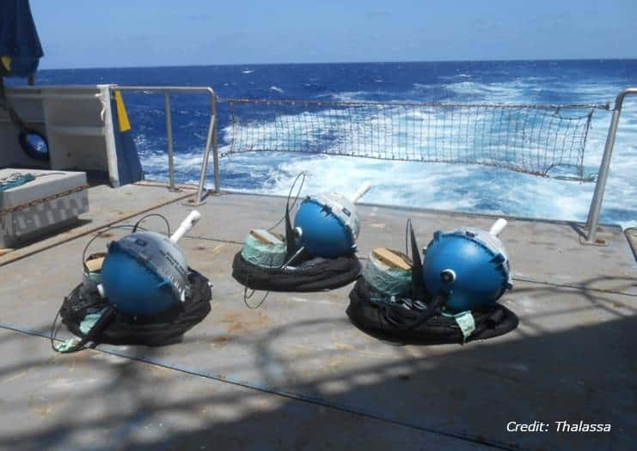


Deployed Drifting Buoy
July 2020 to june2021
Agency | Type of buoys | Number | Purpose | area
 | SVP-B SVP-B SVP-BRST | 30 92 46 | Operational Developmental | IPBIO E-Surfmar Eumetsat
 | Code/davis SC40i Surface Sc40i drogued | 3 3 15 | Operational Research Developmental | Gibraltar North Iceland

Slide 3
Drifting buoy Networks
Agency | Type of buoys | Number | Purpose | area
 | SVP-B SVP-B SVP-BRST | 209 61 76 | Operational Developmental | E-Surfmar IBPIO Eumetsat
 | Code/davis SC40i Surface Sc40i drogued | 3 3 15 | Operational Research Developmental | Gibraltar North Iceland

Slide 4





Moored buoys Networks
Agency | Type of buoys | Number | Purpose | area
 | Moored buoys Wave Rider | 5 1 | Operational Developmental | -Noth Atlantic -Mediterranean Sea -Continental French Coast
 | Wave Rider | 28 | Operational Developmental | -Continental French Coast -Saint Pierre &Miquelon -French Guyana
 | Moored buoys | 6 | Operational Research | -Eastern Tropical Atlantic Ocean and Gulf of Guinea
 | Wave Rider | 20 | Research (7 month) | -Bay of Biscay
 | Coastal Moored Buoy | 1 | Operational Developmental | -Continental French Coast

Slide 5
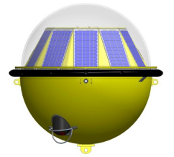
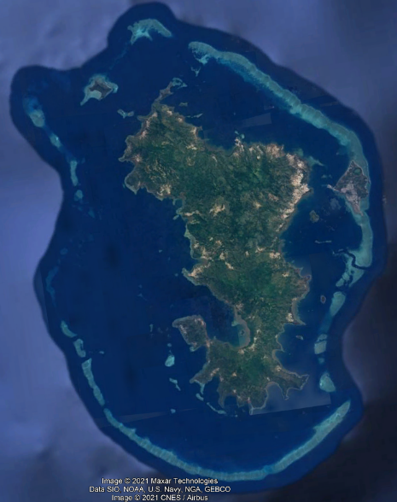
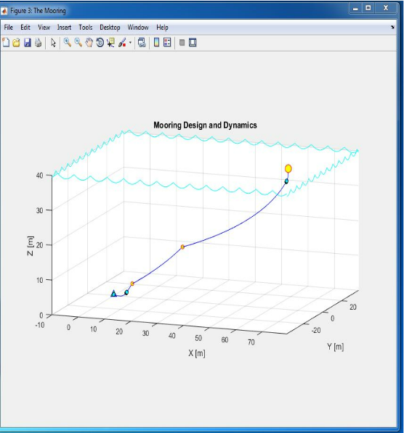
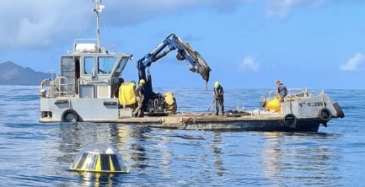
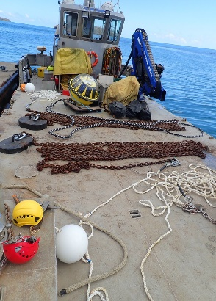
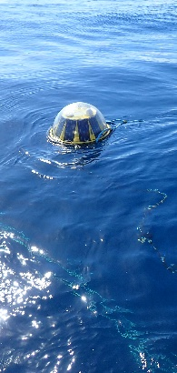

Wave Rider deployment
Location : Mayotte (Indian Ocean) for Coastal risk prevention
2019
2019
2021 (Covid delay)
September 2021
GTS
Study
Design
Deployment
Data

Slide 6

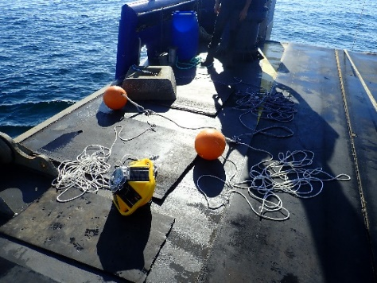
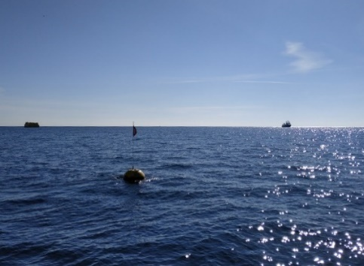
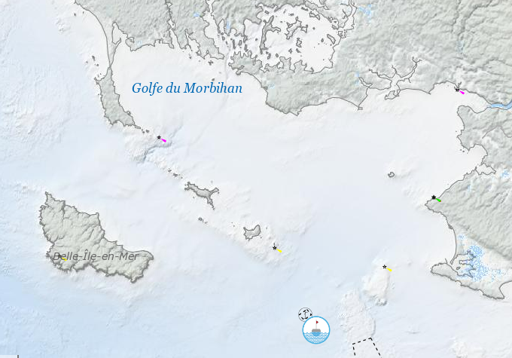

WaveRiders Comparison
Institutes :
Instruments :
  Datawell vs Spotter
Location :
  South of Brittany (France)
  Ocean studies restricted area
  30m depth/ Hmax 10m/1,5 knots
Measurement:
  June to october 2021
Conclusion:
  2022

Slide 7
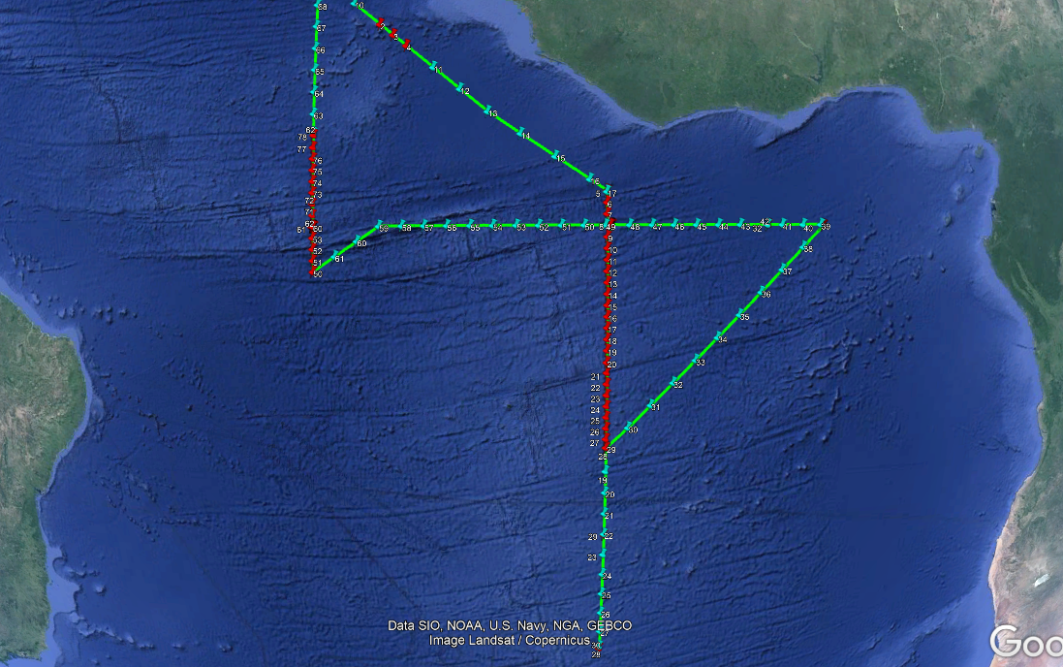
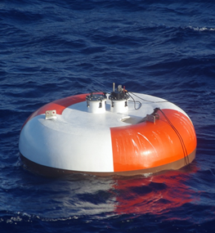
INCIDENTS OF VANDALISM
Total of 3 vandalism incidents during Pirata Cruse
-2 buoys adrift (not yet retrived)
-1 buoy has lost atmospheric sensors and aluminum buoy frame
Buoys locations

Slide 8
2022 PLANNED DEPLOYMENT
Agency | Type of buoys | Number | Purpose | area
 | -SVP-B -waverider | 100 2 | Operational Operational | -Noth Atlantic/Indian -Continental French Coast
 | -Wave Rider | 5 | Operational Research | -Continental French Coast
 | -Drifters | 24 | Operational Research Developmental | -not specified

Slide 9
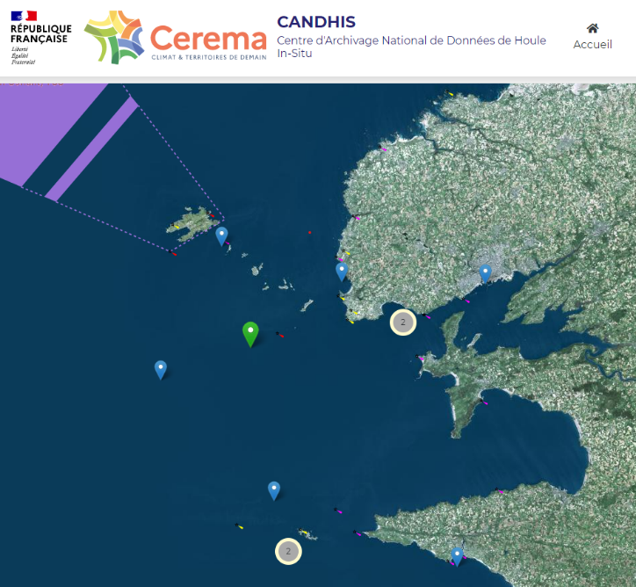
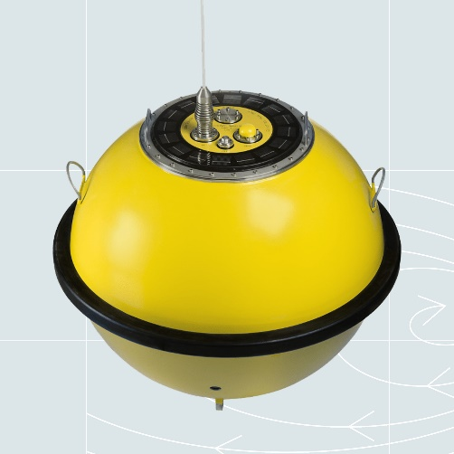
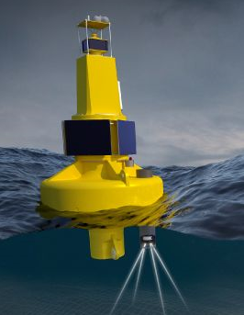

Studies for 2022
WaveRider Comparison (mars-may)
-Institute :
-Instruments :
VS
Datawell
Motus Aanderaa
Location : Ouest of Brittany (France)

Slide 10
Thank you!

