Slide 1
GRA Background Report NEAR-GOOS
Dr Guimei LIU
National Marine Environmental Forecasting Center (NMEFC),
Ministry of Natural Resources, China

Slide 2
General information
GRA leadership (Chair/coordinator) and contact:
Chair: Guimei LIU (election: 2020, 2years)
E-mail: liugm@nmefc.cn
IOC/WESTPAC Coordinating Committee (CC) for NEAR-GOOS
2 members from China, Japan, Korea, and Russia
Secretariat:
Mr Wenxi Zhu, Technical Secretary, IOC/WESTPAC
E-mail: w.zhu@unesco.org
Website:
http://iocwestpac.org/north-east-asian-regional-goos/172.html
Membership:
8 organizations from China, Japan, Korea, and Russia
Key Partners:
NOWPAP, PICES, PACON
Funding characterization:
self-funded by Member States

Slide 3
Terms of Reference
a) Coordinate the development of applications in operational oceanography that demonstrate the usefulness of regional collaboration;
b) Encourage the increase the volume of quality-controlled data available to the NEAR_x0002_GOOS Community through the respective national and regional databases, where possible with the smallest time delay possible;
c) Inventory and analyse existing activities relevant to NEAR-GOOS including operational systems and programmes, organizations, scientific programmes, services and products, commercial interests, and training and capacity building;
d) Coordinate to produce integrated comprehensive data sets and data products that conform to the principle of end-to-end data management;
e) Prepare a NEAR-GOOS Strategic Plan that highlights the direction of NEAR-GOOS over the next five years that incorporates the economic, social and environmental protection needs of the region with a clear approach to enhancing the coordinating mechanism of NEAR-GOOS;
f) Publicise and disseminate NEAR-GOOS plans and information to regional governments and the general public;
g) Recommend scientific and technical activities to support NEAR-GOOS implementation by coordinating new pilot projects and providing linkages to existing projects and programmes;
h) Produce guiding documents for the near real time data collection and exchange in the NEAR-GOOS region;
i) Advise and consider sources of funding for pilot project development with various funding agencies and in consultation with pilot project leaders;
j) Liaison with national NEAR-GOOS committees, J-COMM, GOOS Project Office and other GOOS-related bodies as appropriate;
k) Develop linkages with existing relevant organizations, programmes and projects in the region.

Slide 4
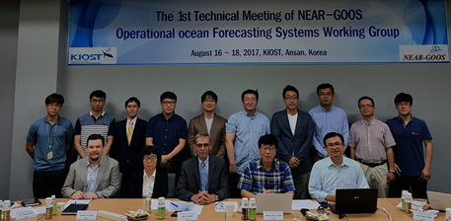
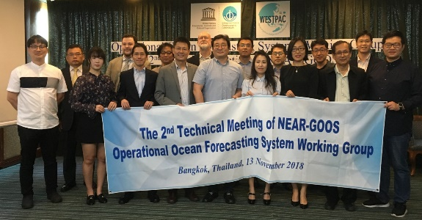
Working Group on Ocean Forecasting Systems
OFS WG organized 3 technical meetings since its first meeting in 2017
Agreed to release of charts and gridded data of surface and subsurface temperature forecast as a part of NEAR-GOOS OFS
Develop new products for JMA’s new operational system for monitoring and forecasting coastal and open ocean states around Japan

Slide 5
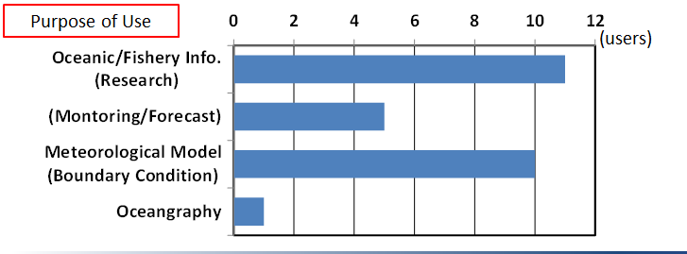
Working Group on NEAR-GOOS Product
One Objective: review the status of NEAR-GOOS products, identify the deficiencies and suggest improvements;
Activities:
-The WG had “Session on NEAR-GOOS Working Group on Products” on 20 November 2017
-A questionnaire survey was implemented by JODC and JMA in 2018
-Started to create inventory of data and products on NEAR-GOOS DBs
Application of Observation Data from the questionnaire survey

Slide 6
Working Group on Data Management
One Objective: maintain and develop the database network, and review the present database network and improve it;
Activities: Launched two Questionnaires of NEAR-GOOS to all Members to survey on quality control methods, NEAR-GOOS data QC/QA standards, and the list of Observation Data Shared, etc.
Plan: develop an inventory for all data and products in NEAR-GOOS data exchange system

Slide 7
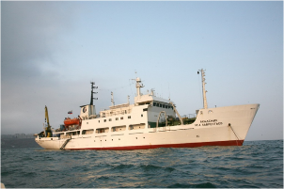
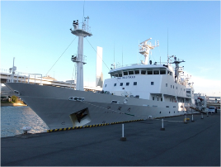
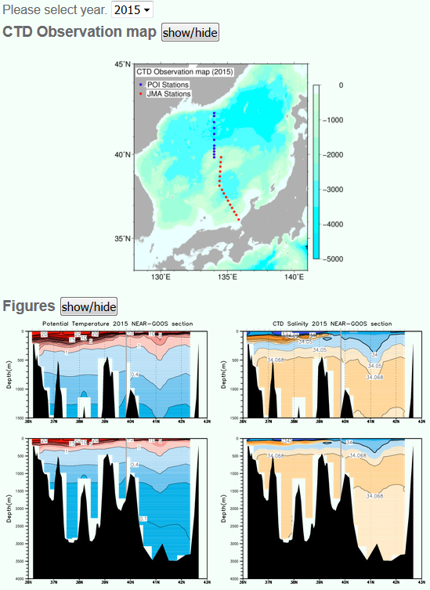
Pilot Project: Climate Monitoring Section
One objective: to improve the understanding of the response of the regional seas to climate change
Activity: annual connecting CTD- sections across the basin by JMA (Japan) and POI (Russia) since 2011 with the following data exchange and web presentation
Plan: continue every year observations, add other sections in the east, biological samplings and marine micro-plastic sampling

Slide 8
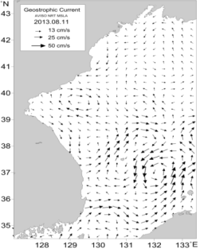
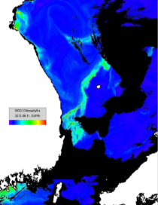
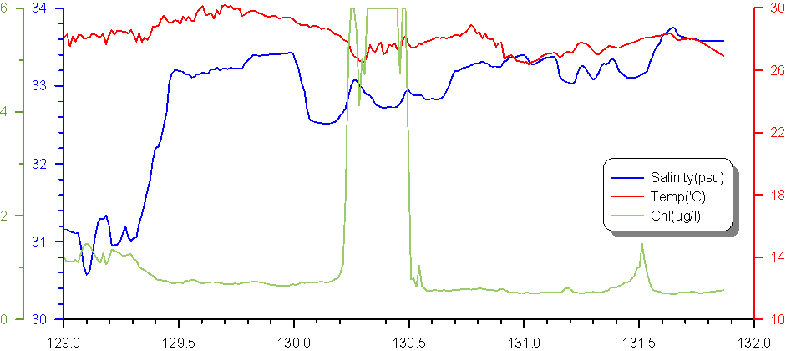
Pilot Project: Ferry Based Monitoring
Objective: Monitoring the status and changes in the marine environment
Vladivostok
Proposed and promoted by NIFS, Korea
Ferry boats observe surface water temperature and salinity during cruising between Donghae, Korea and Vladivostok, Russia.
Installed a new sensor following to the recommendation by PICES. Data will be shared among the members of project by the end of this year.
Another observation line between Donghae city, Korea and Sakhalin Island using a cargo ship became operational.
For future plan, establish monitoring lines with Japan in near future.
Donghae

Slide 9
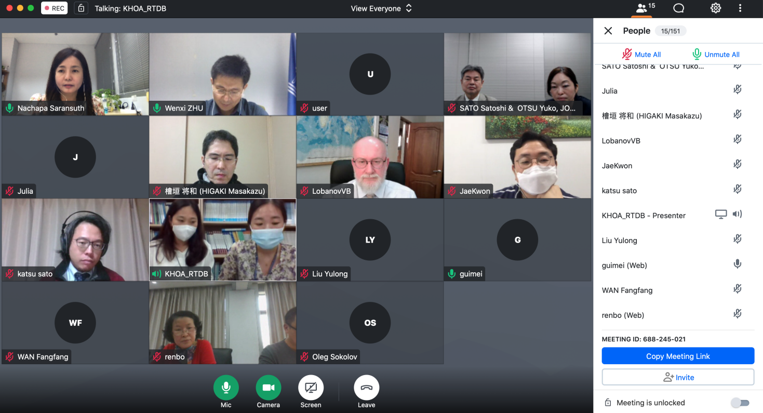
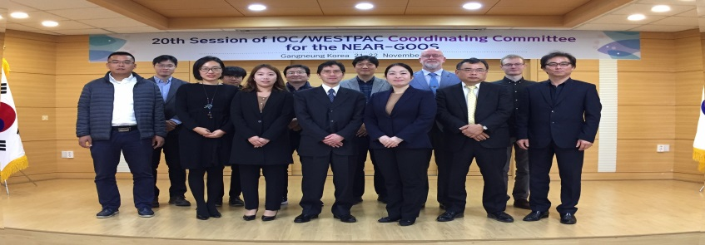
Meetings
Past:
20th NEAR-GOOS CC Session in Nov. 2019
NEAR-GOOS Online Meeting in Oct. 2020
PICES 2020 online session in Oct. 2020
13th Intergovernmental Session of IOC WESTPAC in April 2021
NEAR-GOOS online meeting with IOC WESTPAC Office in July 2021
GRA-X Forum in Sep. 2021
Future：
NEAR-GOOS Online Meeting in Nov. 2021
20th NEAR-GOOS CC Session
NEAR-GOOS CC Online Meeting in 2020

Slide 10
Success ‘Stories’- Provide Stable Oceanographic and Meteorological Data
USERS
Regional Real-Time Data Base (RRTDB) and Regional Delayed Mode Data Base (RDMDB) are stably operated by Agencies from China, Japan, Korea and Russia
The total volume of oceanographic/marine and meteorological data: over 230GB by June 2021
over 89,000 files and 50.4 GB data were downloaded from RDMDB of JODC of Japan in 2020
Increased total times for accessing NEAR-GOOS RRTDBs and RDMDBs from 2019 to 2020
Regional Real Time Data Base
Regional Delayed Mode Data Base
GTS
National Real Time Data Base
National Delayed
Mode Data Base
Data provider
Data provider

Slide 11
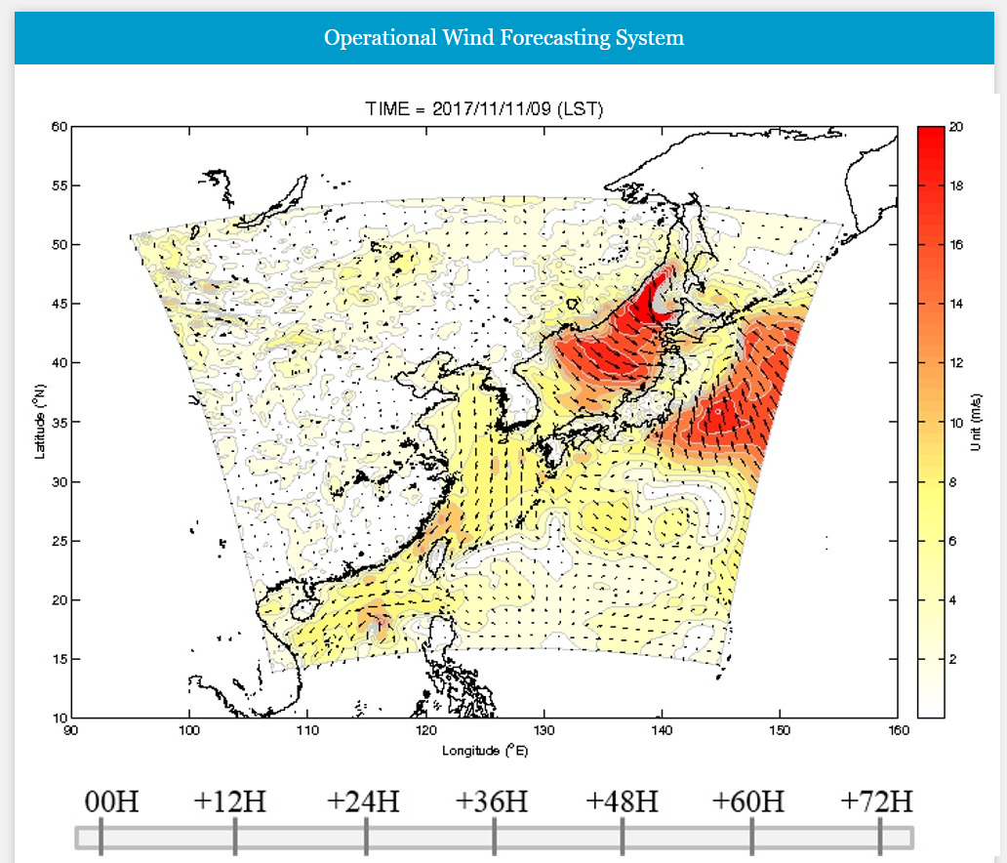
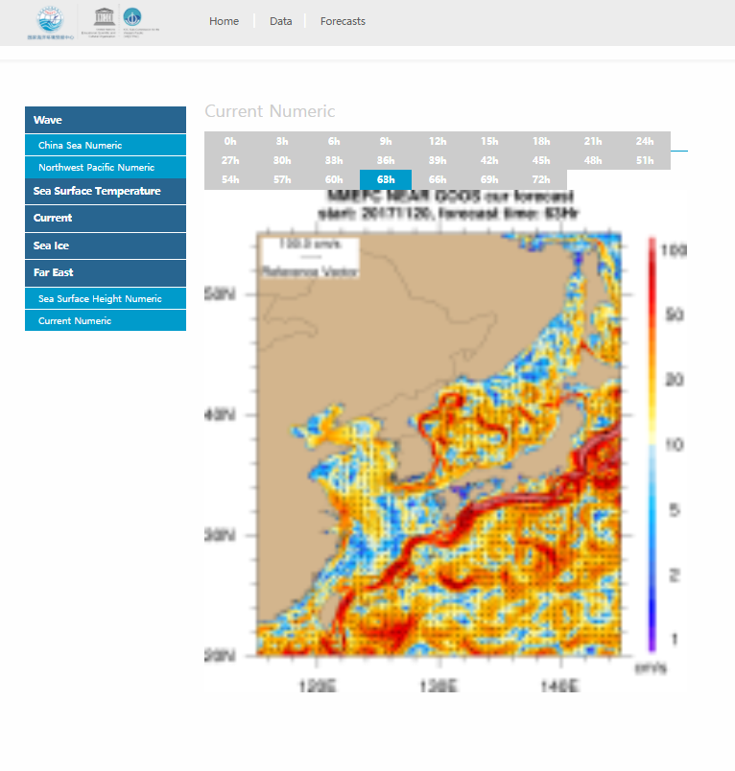
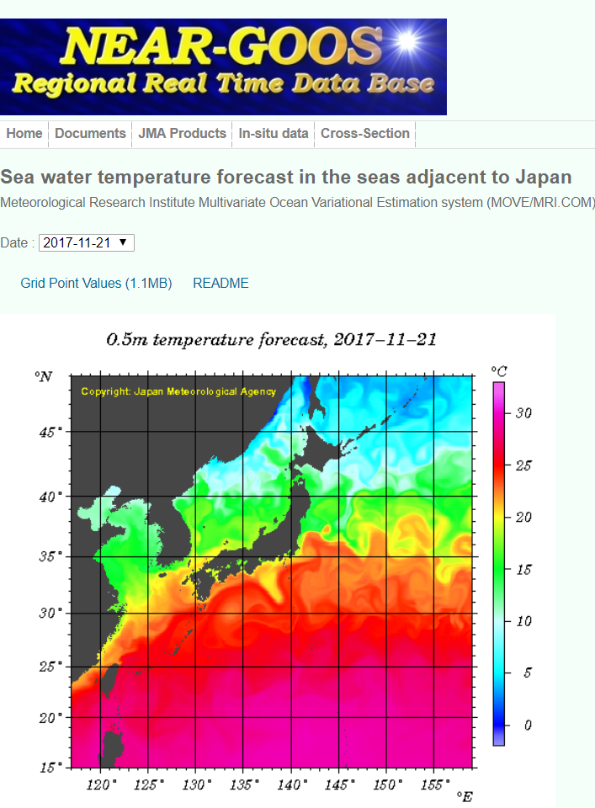
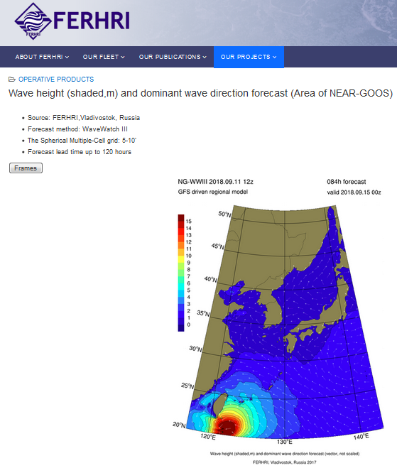
Success ‘Stories’- Provide operational Forecasting Products
Forecasting service products including currents, wave, wind, sea surface temperature, sea surface height have been provided daily from the websites of China, Japan, Korea and Russia
Wind@KHOA&KIOST Current@NMEFC Temperature@JMA Wave@FERHRI

Slide 12
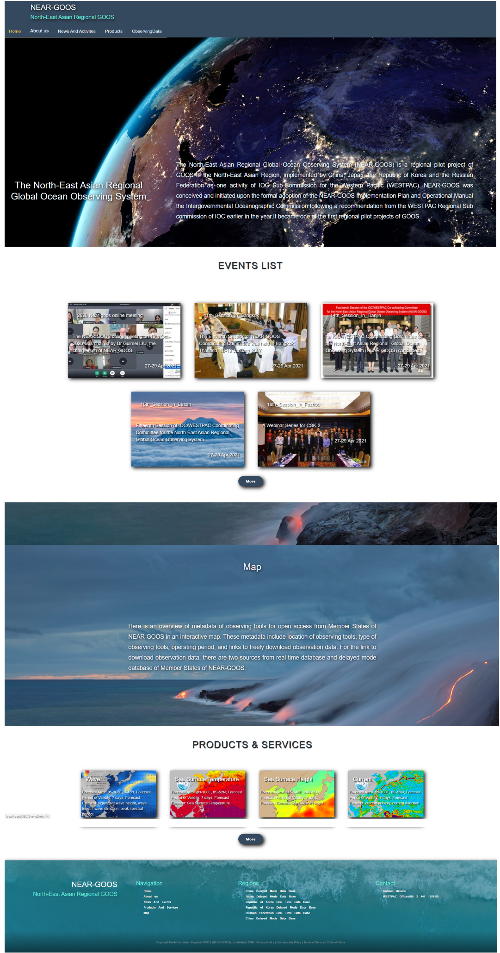
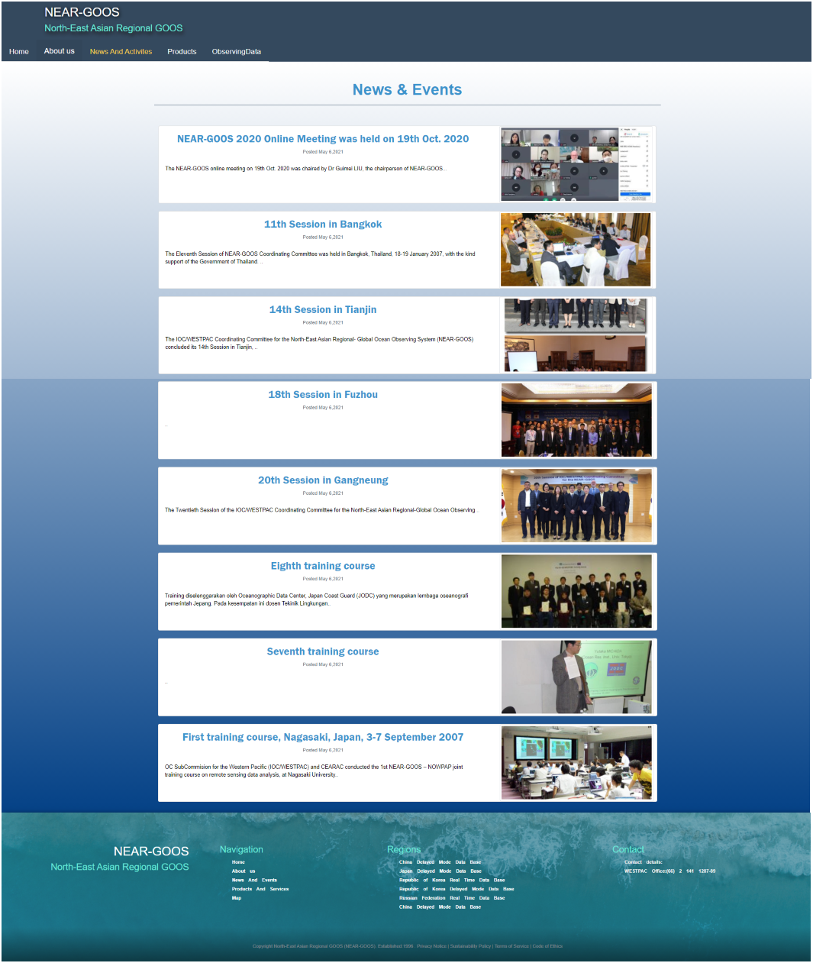
Success ‘Stories’- Develop NEAR-GOOS gateway website
The first NEAR-GOOS gateway website will provide unified introduction, news and events of NEAR-GOOS to increase its visibility.
It will be on pilot operation by the end of this year which is funded by NMEFC of China for development.
Home Page
News and Events Page

Slide 13
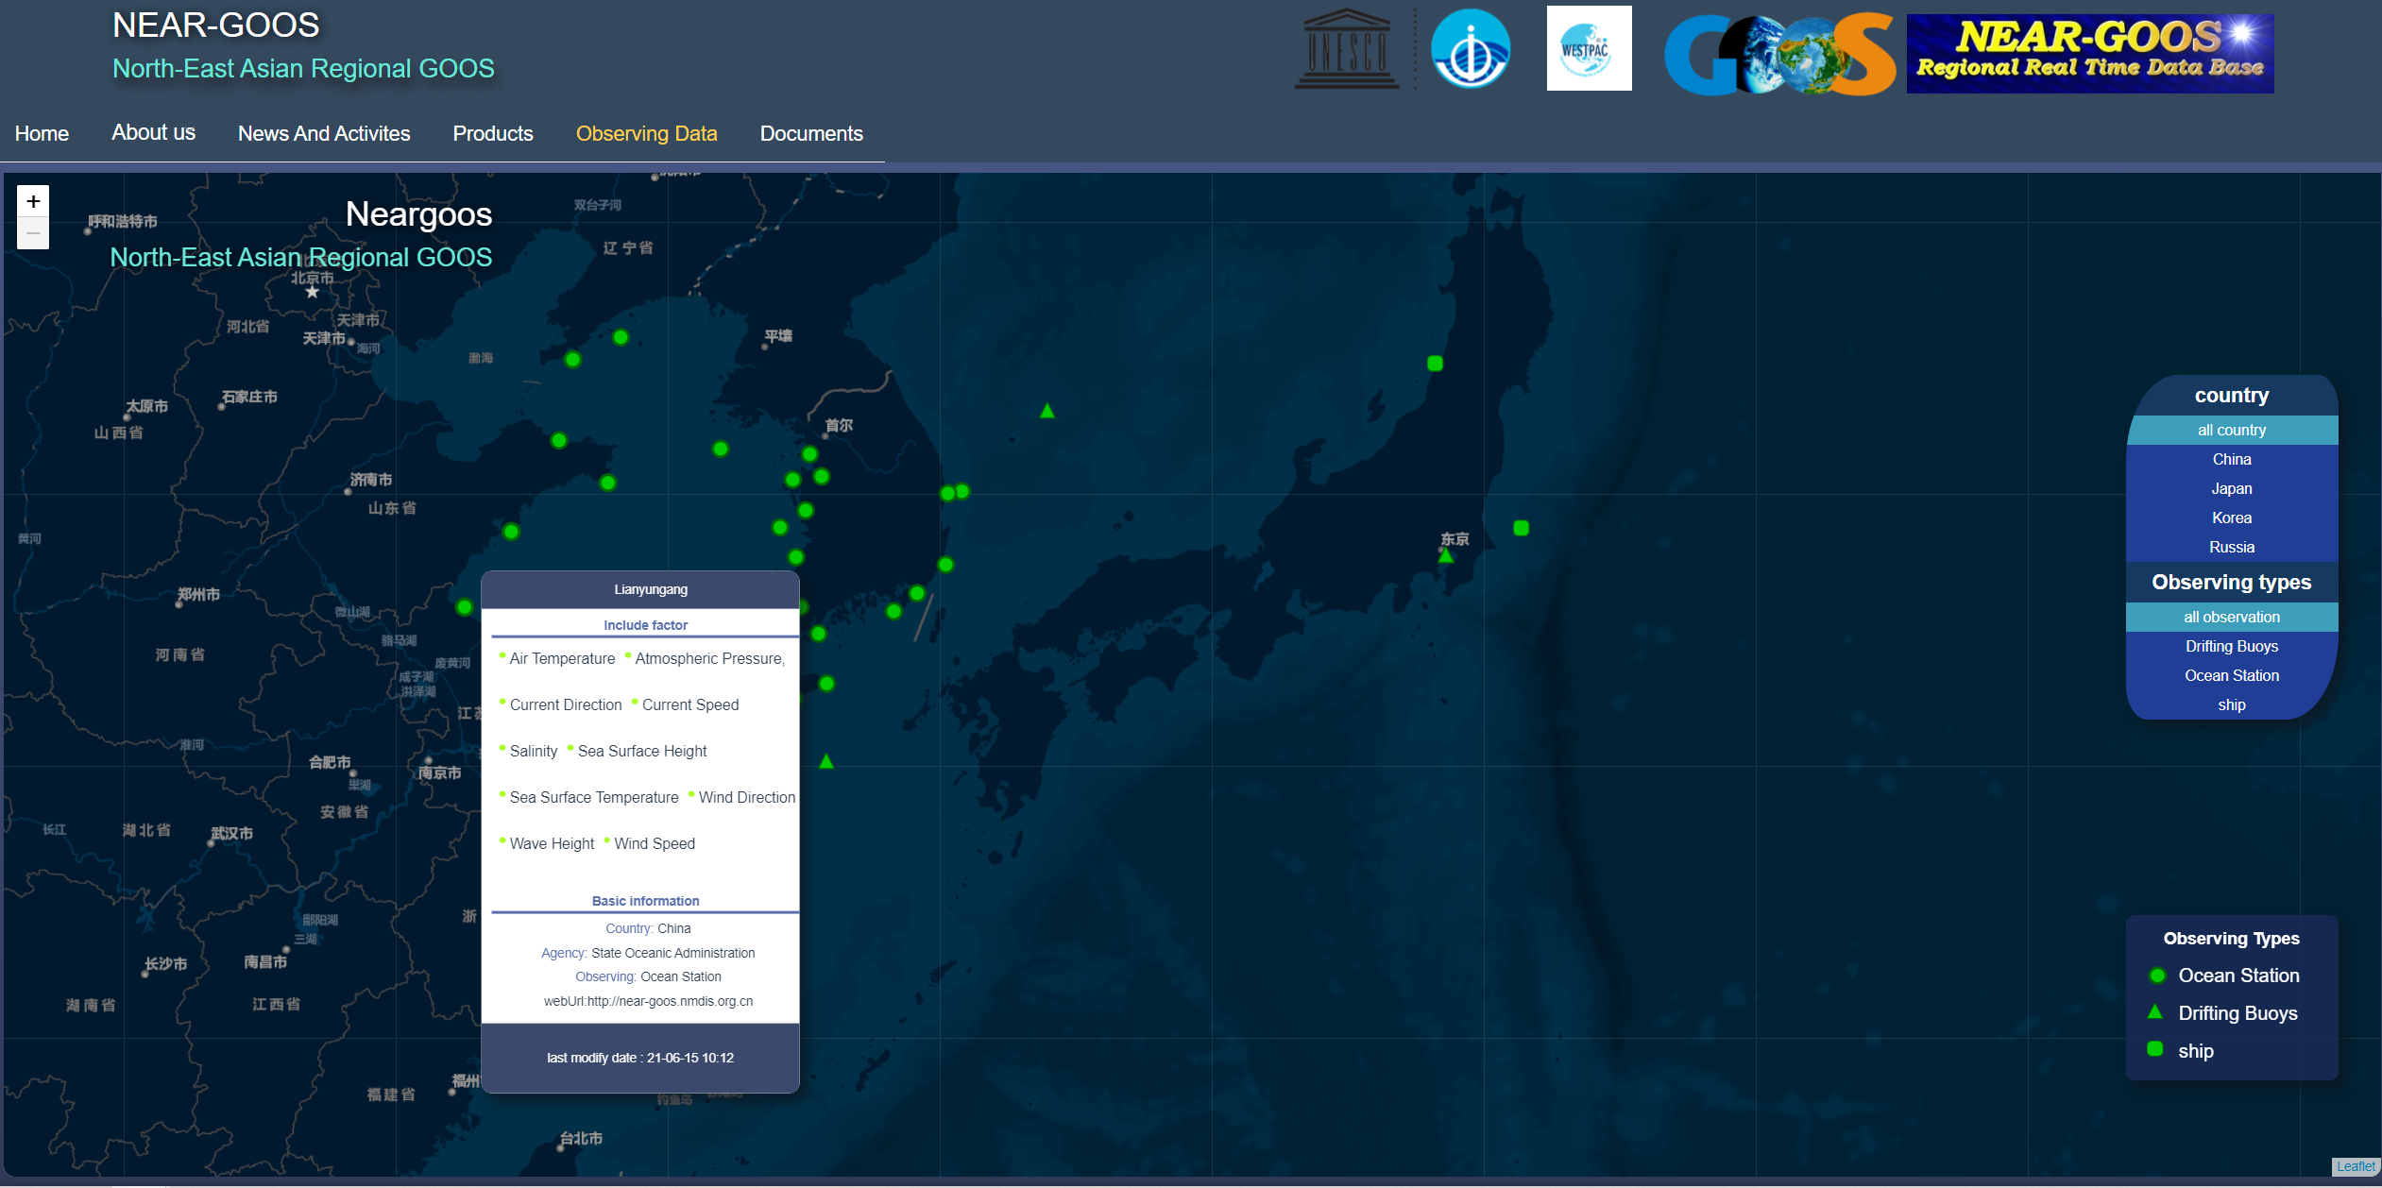
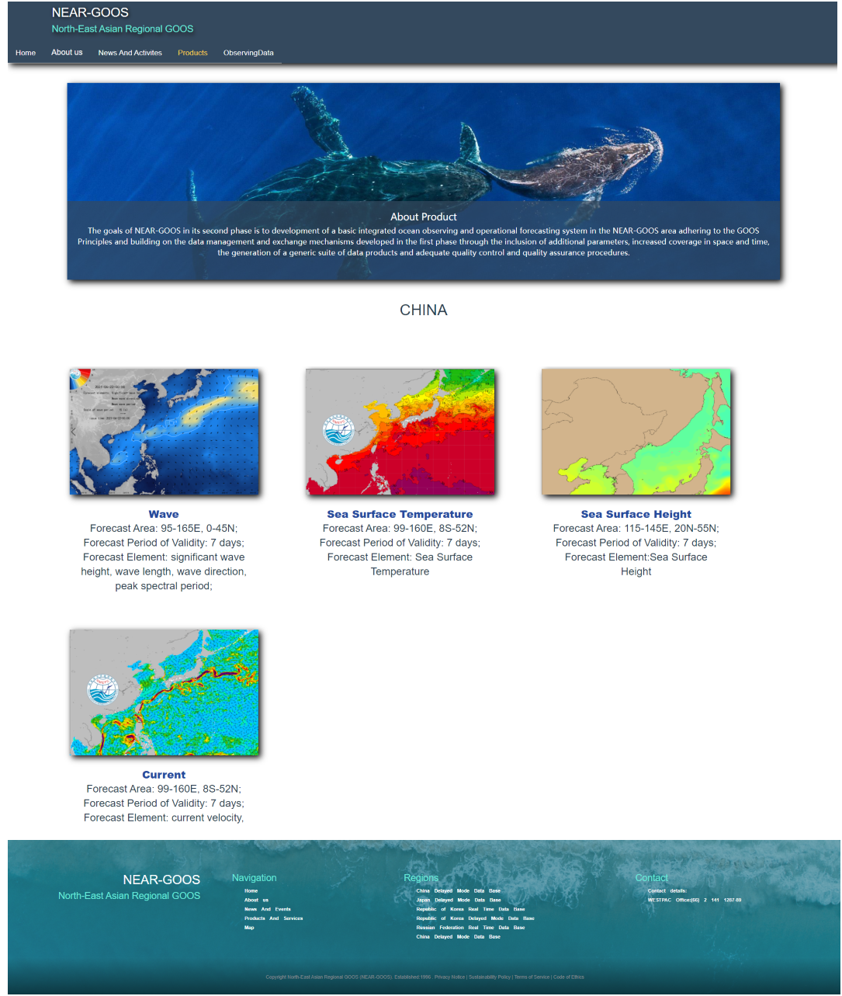
Success ‘Stories’- Develop NEAR-GOOS gateway website
Provide interactive overview of metadata of observing tools under NEAR-GOOS and links to download observing data of these tools.
Provide forecasting products and services from relevant agencies of 4 Member States of NEAR-GOOS.
Observing metadata
Products and Services

Slide 14
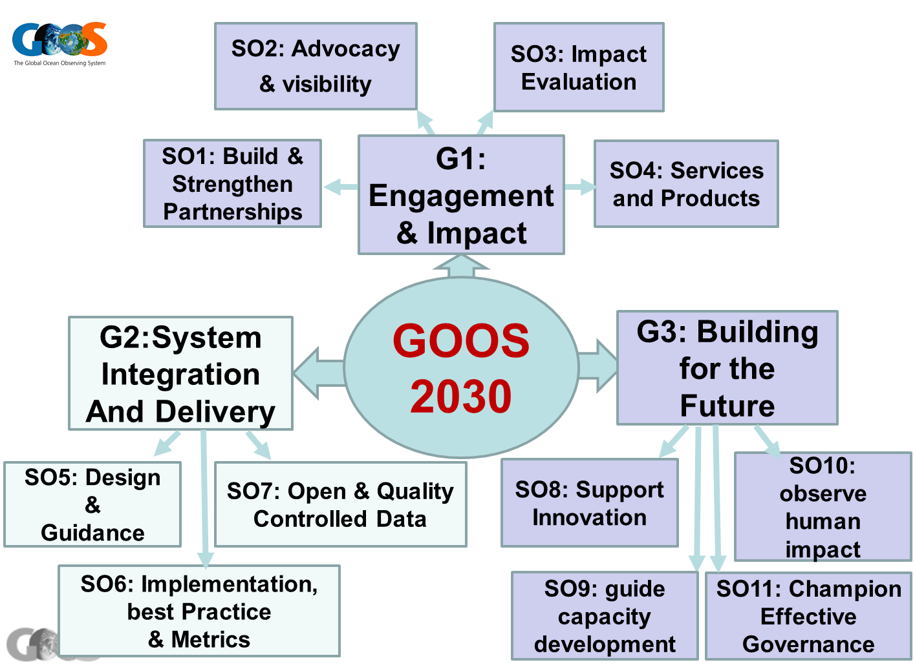
Engage in GOOS 2030 Strategy
As part of GOOS, NEAR-GOOS can engage in and benefit from GOOS 2030 Strategy by following objectives:
1. Strengthen partnerships to improve delivery of forecasts, services, and scientific assessments
2. Build advocacy and visibility with stakeholders through communicating with key users and national funders
3. Ensure GOOS ocean observing data and information are findable, accessible, interoperable, and reusable, and latency

Slide 15
Challenges
Encourage Member States to share more observing data and improve data quality of these data
Set up unified standard for ocean forecasting products from 4 separate agencies of Member States of NEAR-GOOS
Further financial and secretarial support for the activity of NEAR-GOOS CC, its working groups and planned workshops are needed

Slide 16
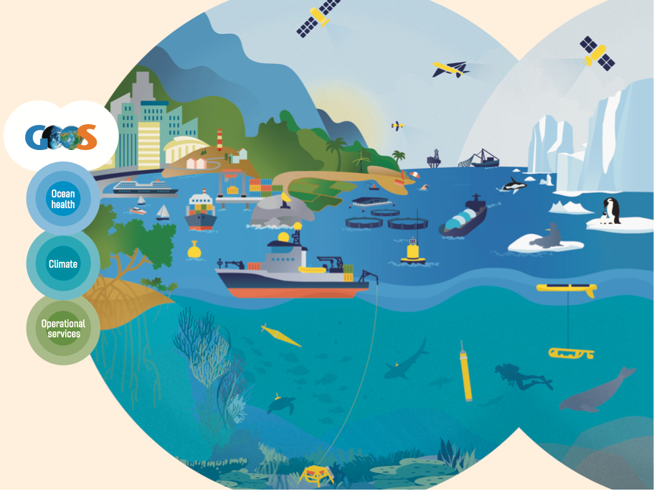
END

