Slide 1
International South Atlantic Buoy Program (ISABP)
Chair: Ms. Tania Daniels (nee Williams) (SAWS)
Coordinator: Mr. Shaun Dolk (GDP, AOML, Miami, USA)
Rapporteur: Ms. Tania Daniels
DBCP 37

Slide 2
1. Statistics
ISABP meetings are held prior or during DBCP. A virtual meeting took place in September 2021 prior to DBCP-37.
Actions
As of September 27, 2021, there were a total of 176 drifters transmitting good data in the ISABP region. (SVP:37, SVPB:139), all but one are iridium.
This year for the first time in more than 10 years, we partnered again with Argentina, through the University of Buenos Aires.
We will continue to address observational gap area.
COVID-19 continues to impact deployment opportunities and our ability to seed the region, as several cruises were delayed/cancelled

Slide 3
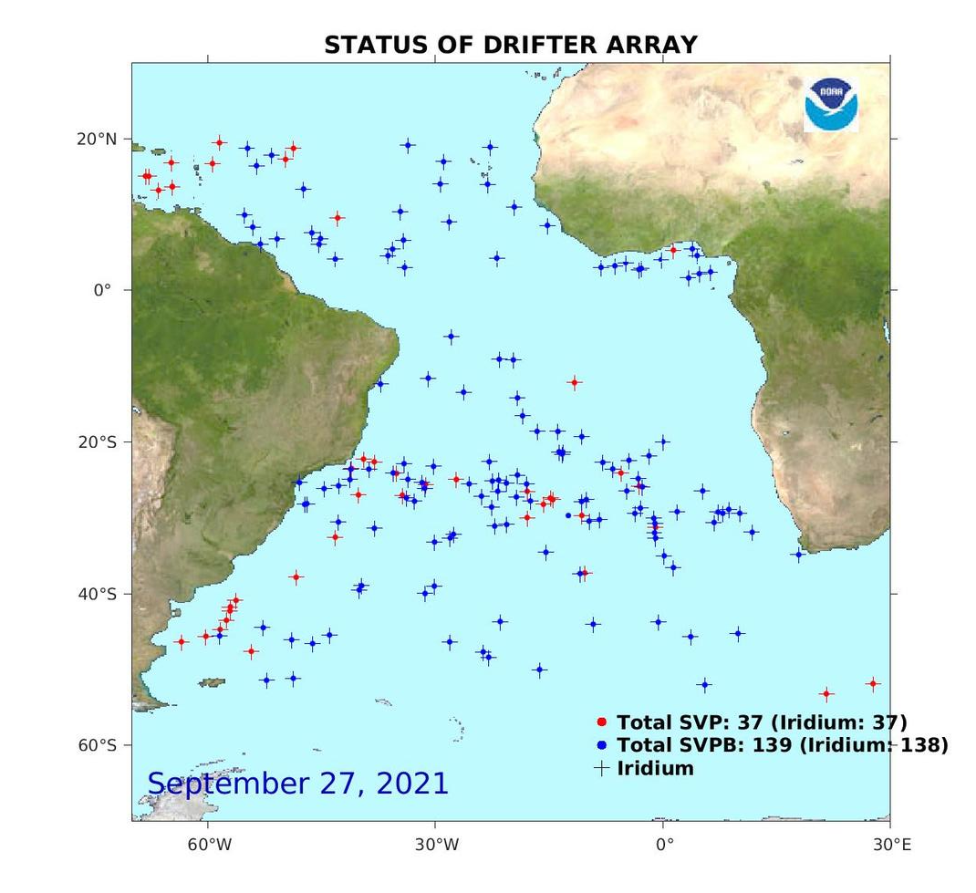
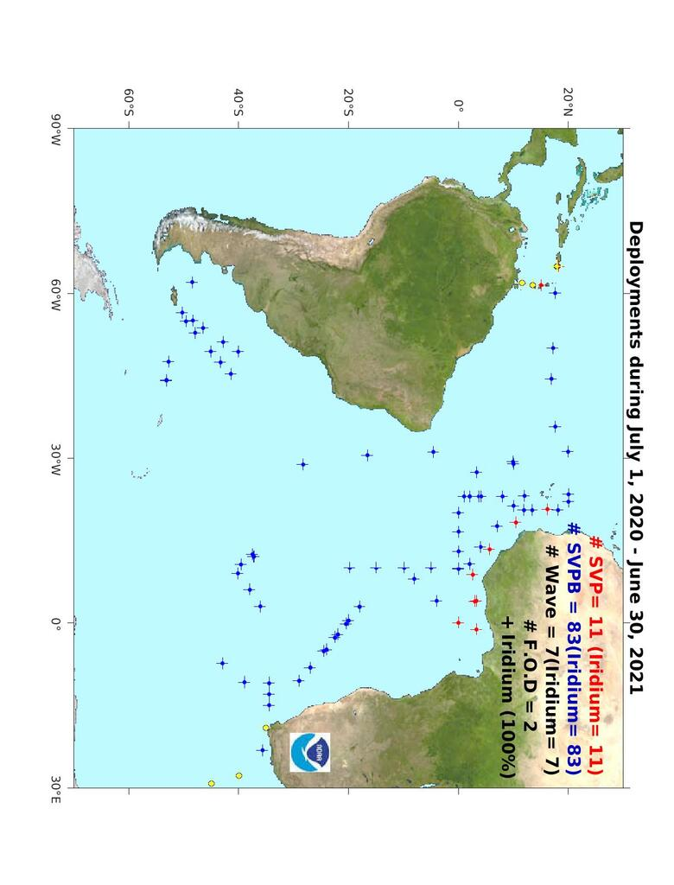
2. Key Highlights
* A total of 101 drifters were deployed in the ISABP area.
As of September 27, 2021 a total of 176 drifters are present in the region.
Countries interested in the region: Brazil, US, France, South Africa, Tristan Is., Gabon, UK, Argentina.

Slide 4
3. 2-3 Key focus areas for next year
GDP deployment plan from July 1, 2020 – June 30, 2021 is as follows:
Tropical Atlantic (20S – 30N):
SVP=60 SVPB=40
Extra Tropical Atlantic (400S – 200S):
SVP=15 SVPB=25
Southern Atlantic (600S – 400S):
SVP=0 SVPB=40

Slide 5
5. Key take-home messages*
The ISABP group will like to ask for help to:
Encourage other countries interested in this area to join and help seed the region
Encourage interested countries to pay to add a barometer sensor to an existing basic SVP drifter with the Global Drifter Programme.

