Slide 1
DBCP 37th Session – 8 November 2021
Observing Air-Sea Interactions Strategy (OASIS) – amplifying DBCP activities
SCOR Working Group #162 for Developing an OASIS
Co-Chairs: Meghan Cronin (NOAA, USA), Christa Marandino (GEOMAR, Germany), Seb Swart (UG, Sweden)
Taking a "system-as-a-whole" approach for making surface and boundary layer observations relevant to the Earth's energy, water, and carbon cycles, including their physical, biological, and geological components
Notes:
Thank you for this invitation to talk about the Observing Air-Sea Interactions Strategy (OASIS) and how it might amplify DBCP activities.
I’m Meghan Cronin and I, along with Christa Marandino and Seb Swart, co-chair the OASIS SCOR Working Group that is “taking a “systems-as-a-whole” approach for making surface and boundary layer observations relevant to the Earth’s energy, water, and carbon cycles, including their physical, biological, and geological components.
OASIS was recently endorsed as a UN Ocean Decade Programme.
We’re still learning what exactly this means. But I think we can say, that this endorsement is a greenlight to try to harmonize the decade plans from OceanObs19 and try to make these a reality.

Slide 2
What processes need to be observed in the OASIS?
To understand and predict the ocean’s influence on weather and climate, we must accurately resolve air-sea heat fluxes!
Goal for 2030 is to produce
Gridded (3-hourly at 25 km) Air-Sea Heat Flux & Wind Stress with breakthrough 1-day random uncertainties of: 15 W m⁻² (5%) & 0.01 N m⁻² (5%)
Cronin et al. (2019) “Air-sea fluxes with a focus on heat and momentum”
Credit: NASA
Notes:
To understand and predict the ocean’s influence on weather and climate, we need to accurately resolve air-sea heat fluxes.
The first step of developing the OASIS is determining what processes need to be observed, their sampling requirements, and uncertainty specification.
The color coding then shows what accuracy the fluxes must be to achieve a 20% signal to noise ratio.
Based upon this, we determined that our
Goal for 2030 is to produce
Gridded (3-hourly at 25 km)
Air-Sea Fluxes with breakthrough
1-day random uncertainties of:
15 W m⁻² (5%) & 0.01 N m⁻² (5%)
And Biases less than:
5 W m⁻² & 0.005 N m⁻²

Slide 3
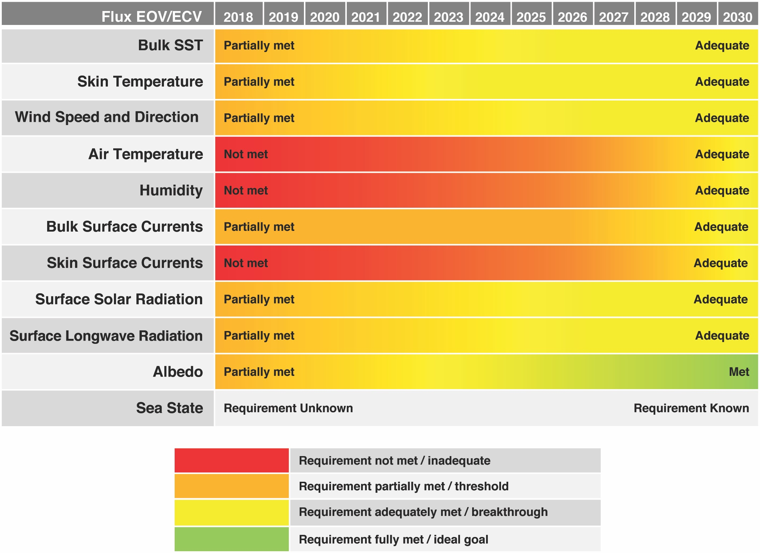
Air-sea fluxes depend upon many co-located state variables. To meet accuracy targets for air-sea heat fluxes with global coverage we must:
1. Optimize satellite-based boundary layer obs for all state variables, but particularly near-surface air temperature & humidity.
2. Expand the global network of in situ air-sea interaction observations
3. Improve boundary-layer processes in coupled models
Cronin et al. (2019) “Air-sea fluxes with a focus on heat and momentum”
Notes:
The tough thing is that to air-sea fluxes depend upon many co-located state variables. For air-sea heat fluxes, as an example, we need more than 8 essential ocean & climate variables, and at present, satellite are unable to measure near-surface humidity and air-temperature with the required accuracy
Thus OASIS has three Big Asks:
Optimize space-based retrievals for near-surface humidity and air temperature, based upon an
Expanded global network of in situ air-sea interaction observations.
Improve Boundary-layer Processes in coupled models that would synthesize these in situ and remotely-sensed air-sea obs into high-resolution, accurate fields.

Slide 4
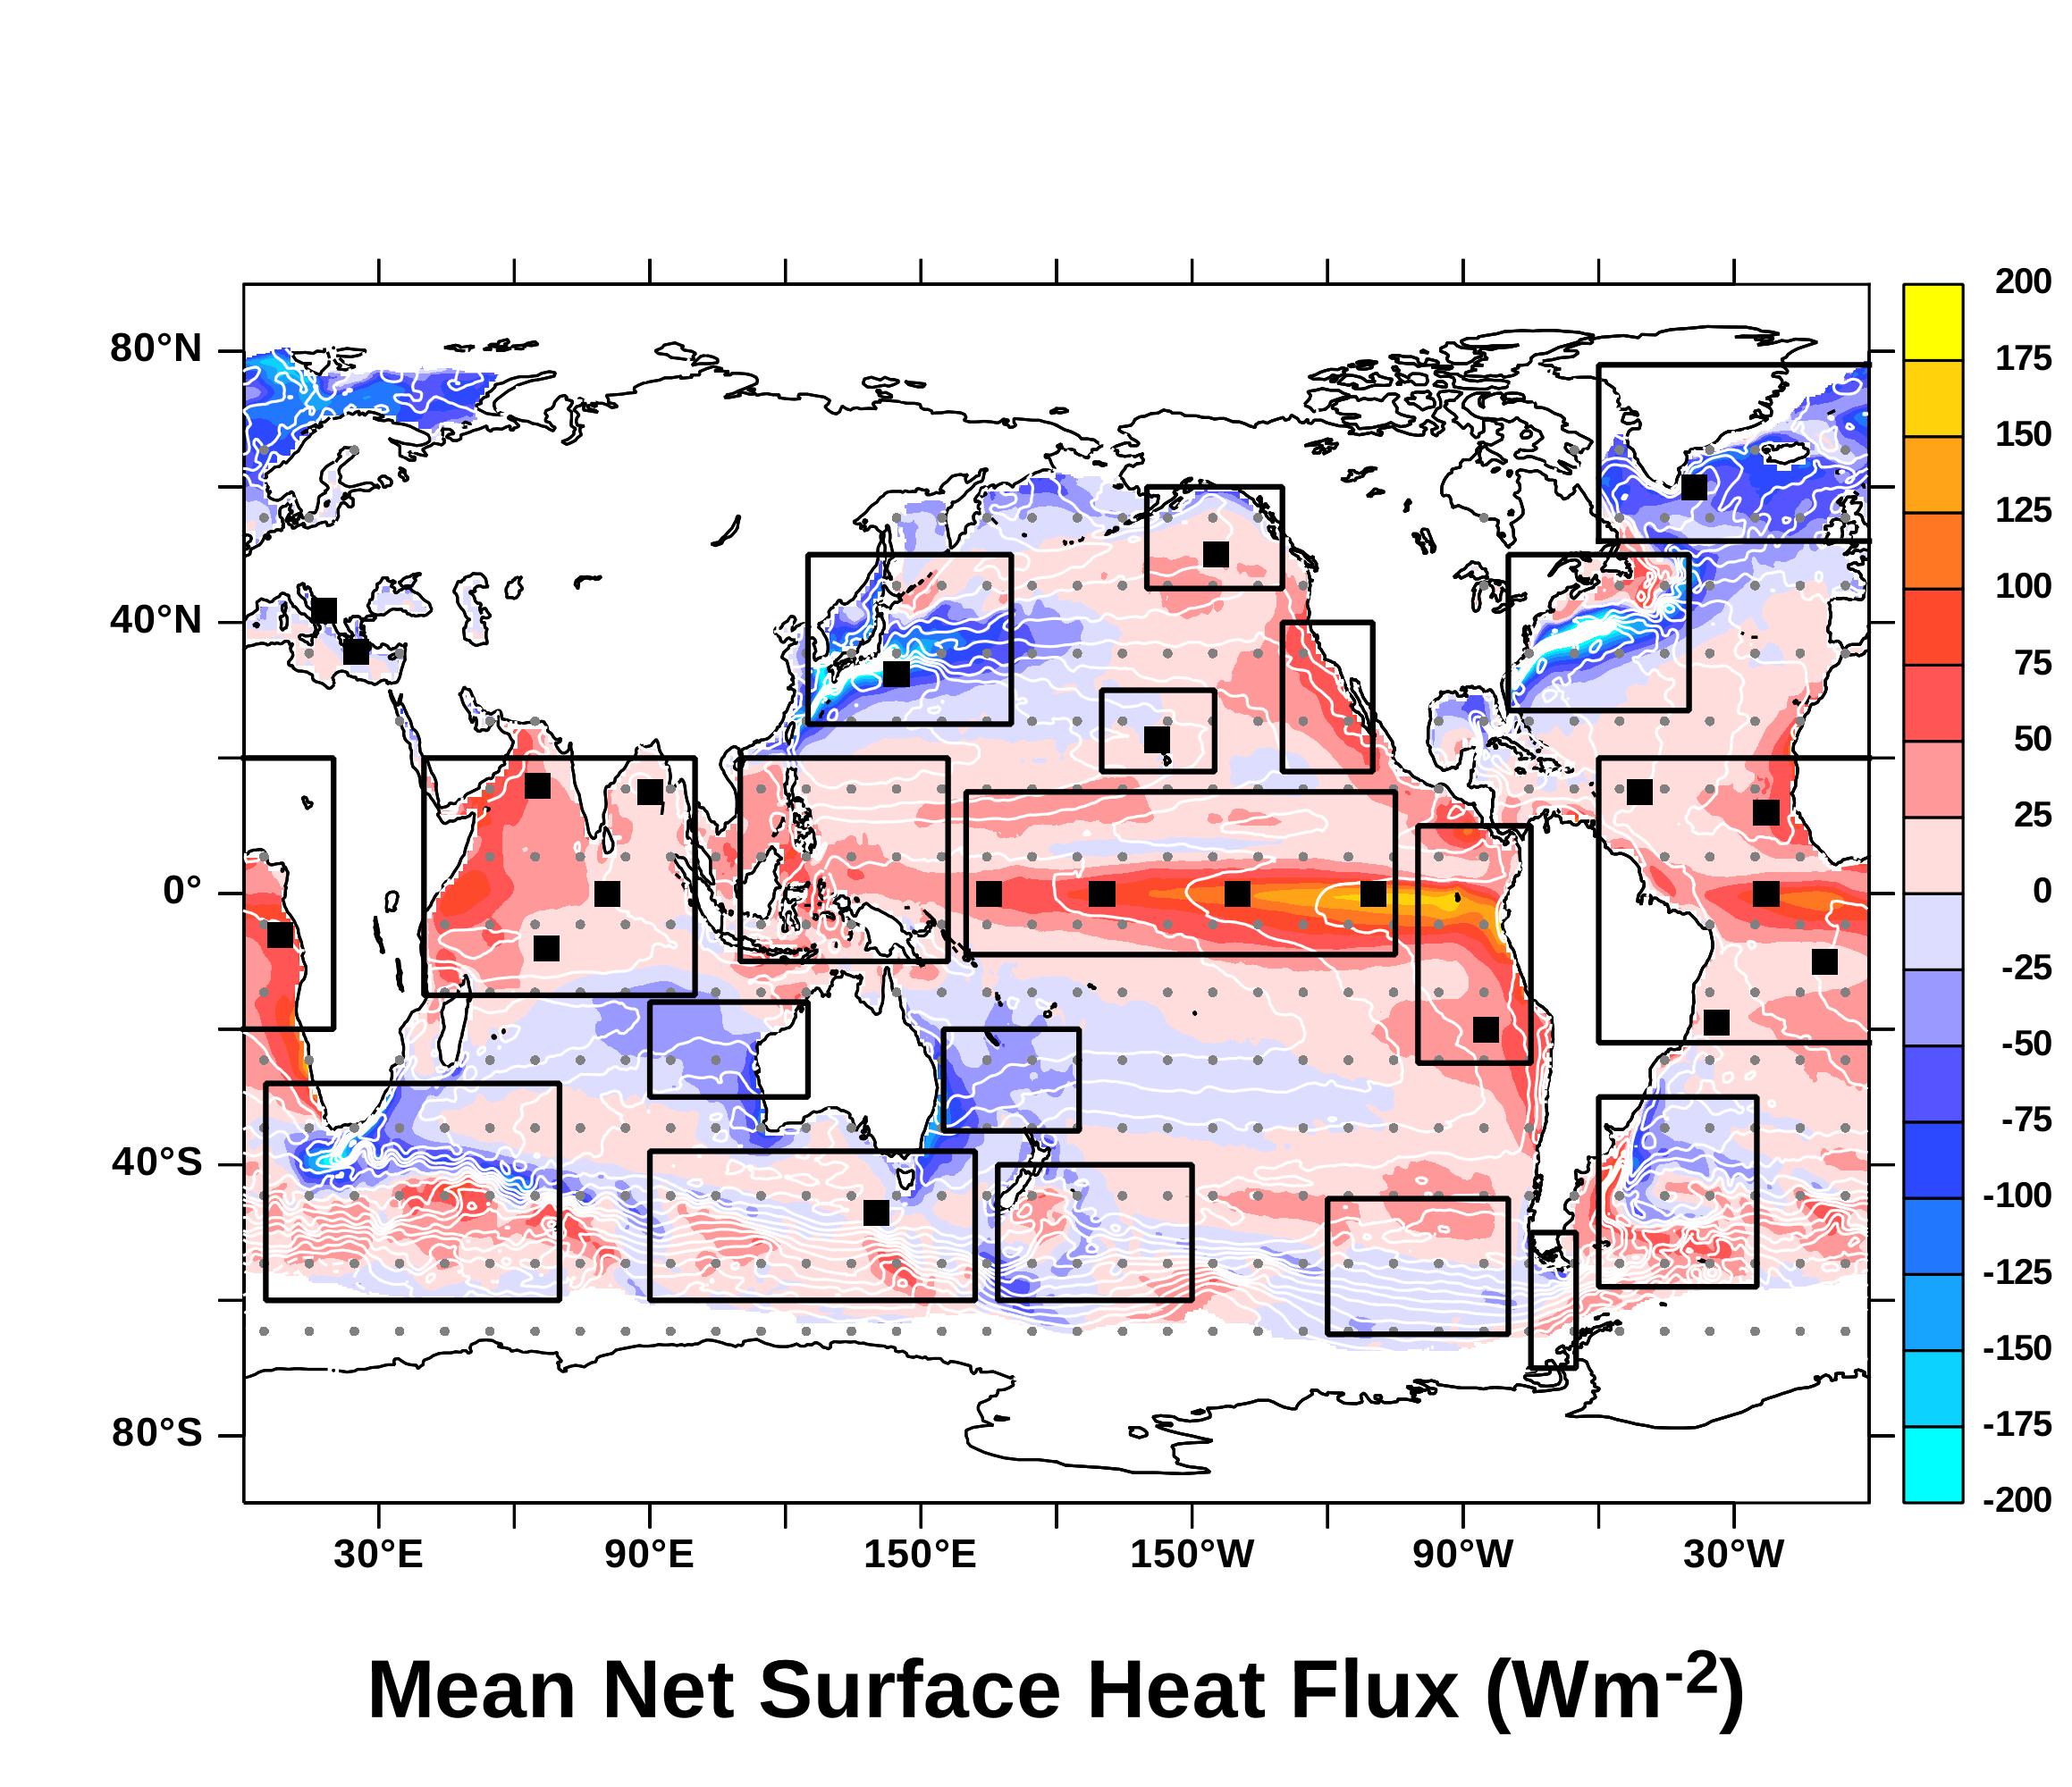
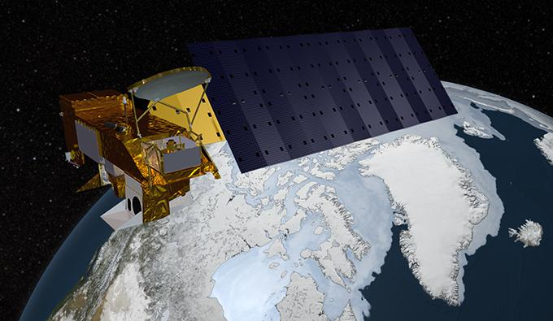
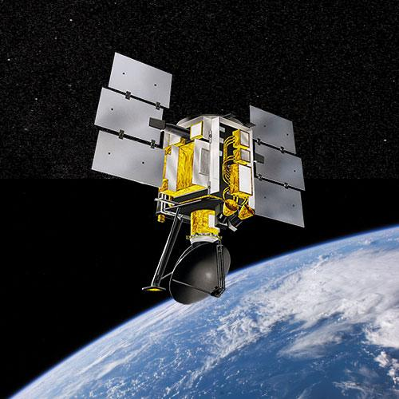
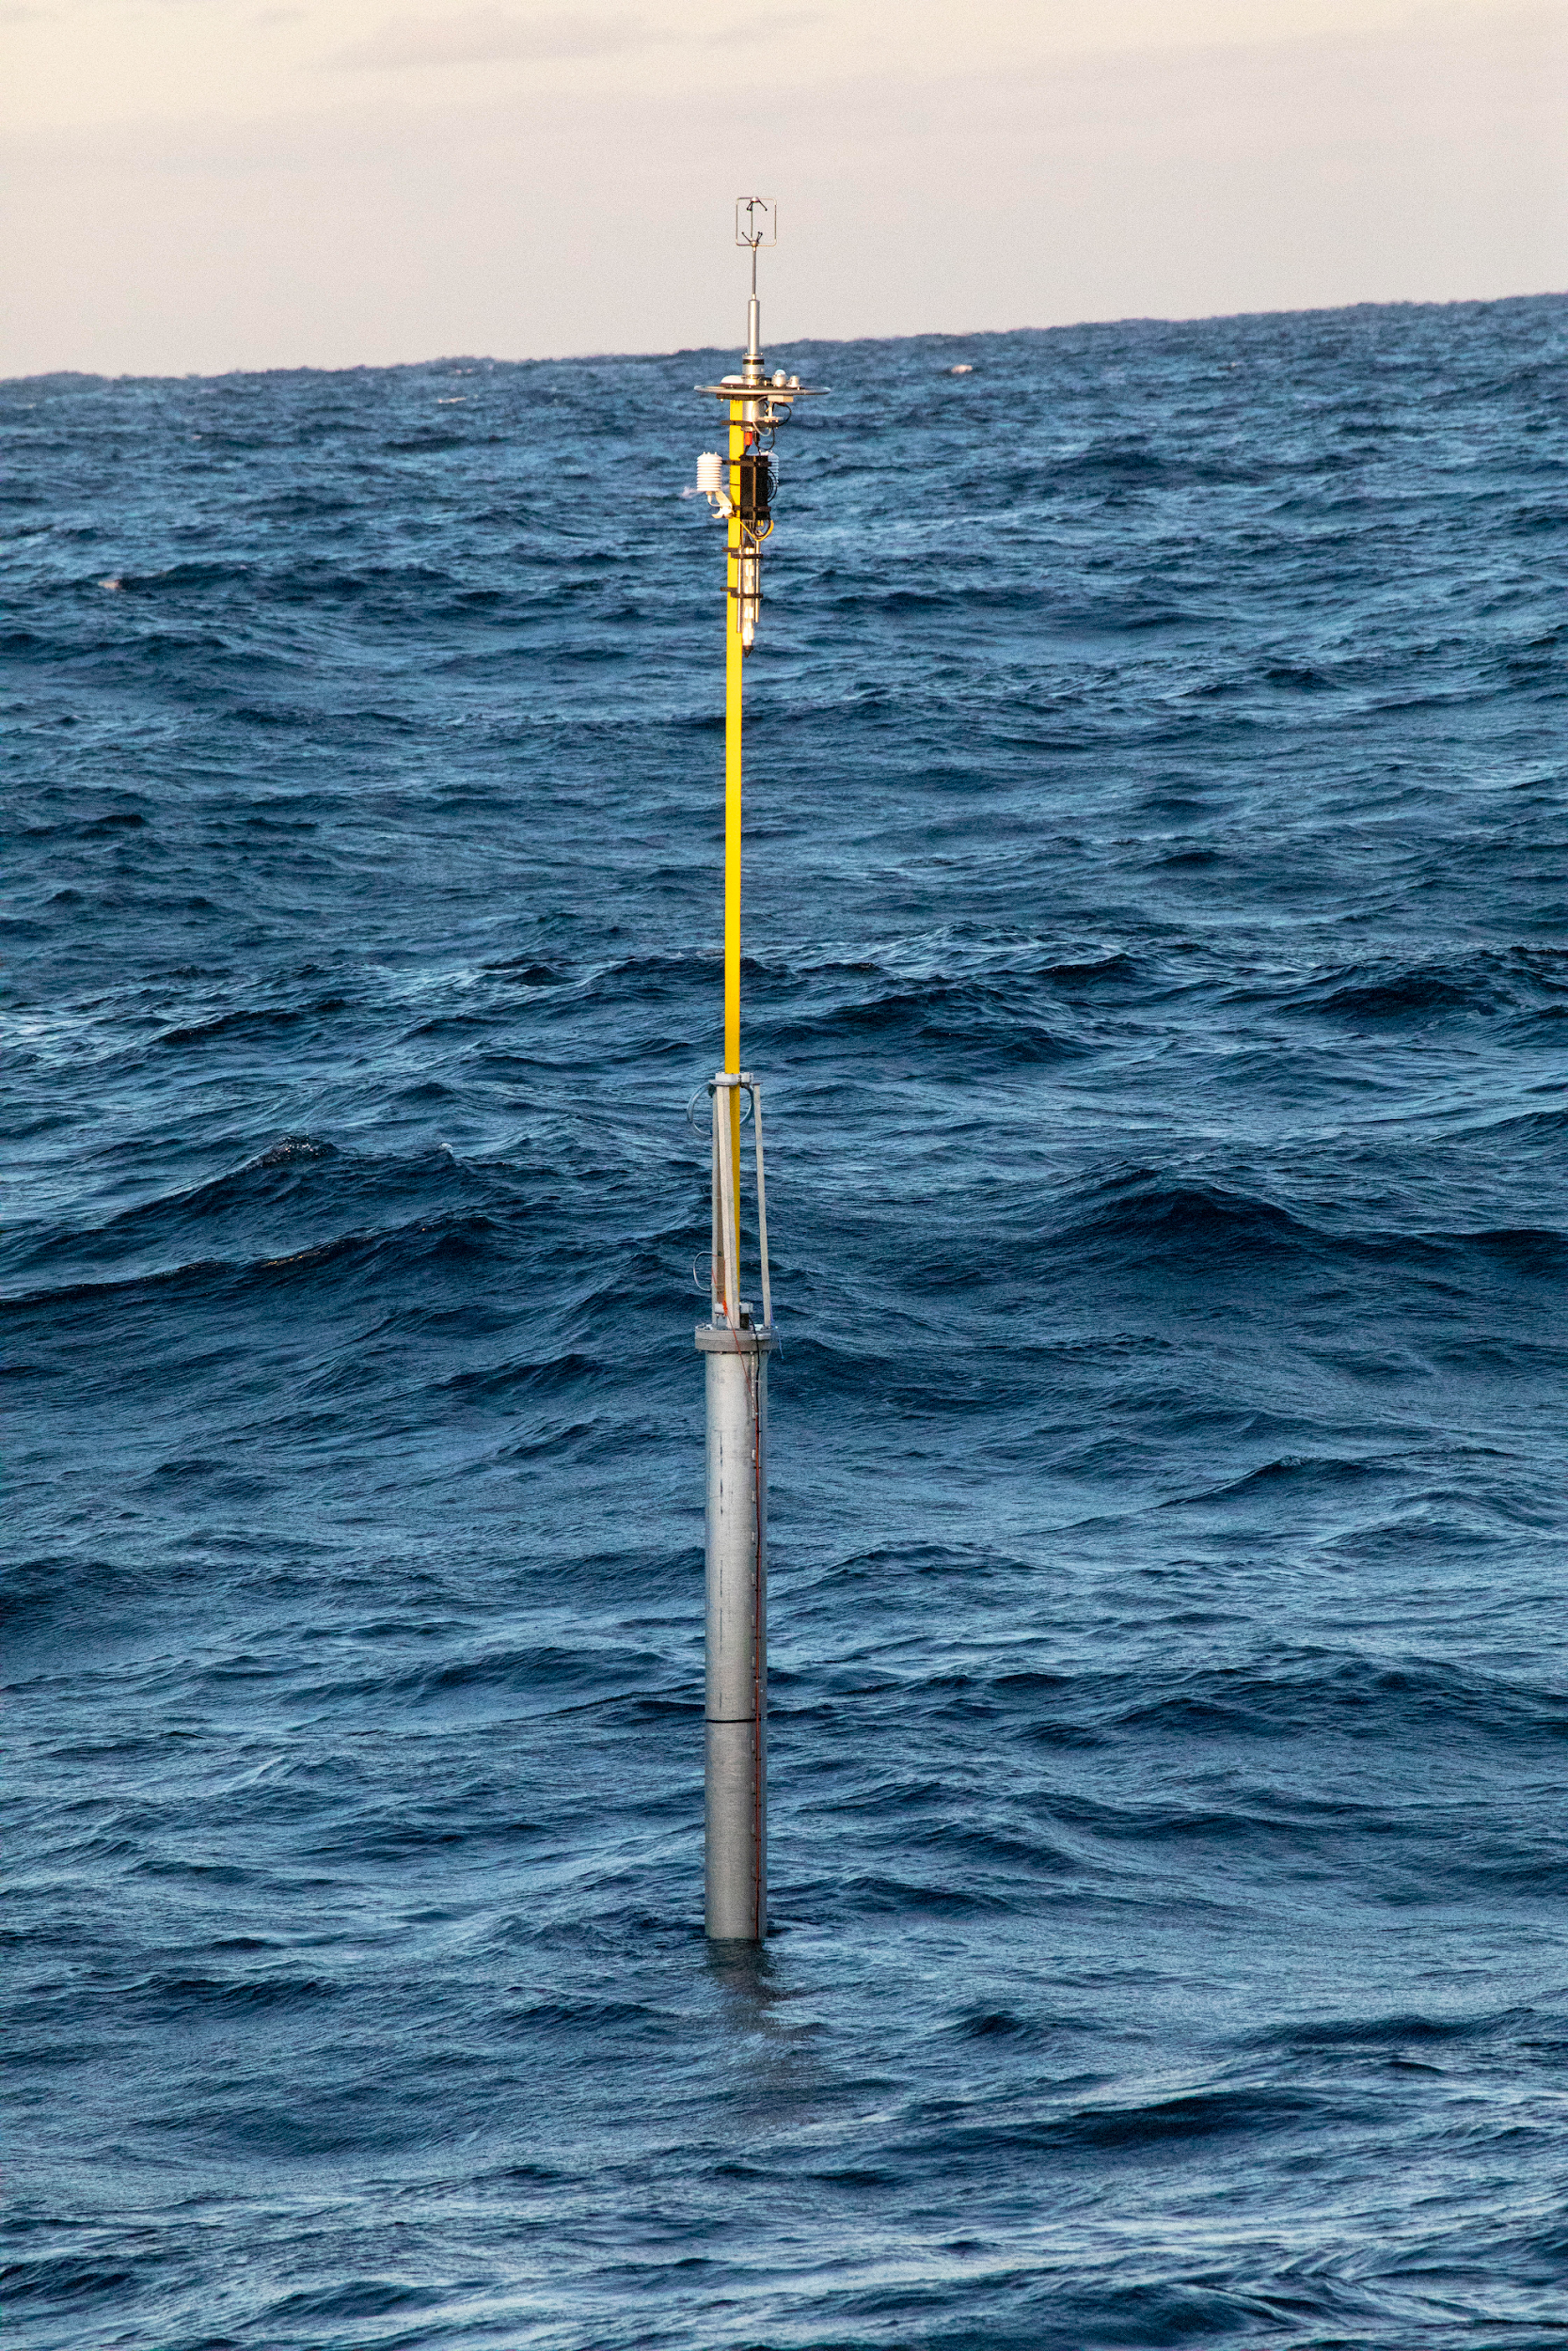
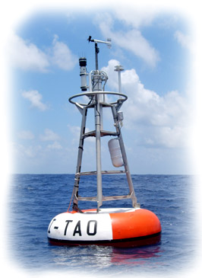
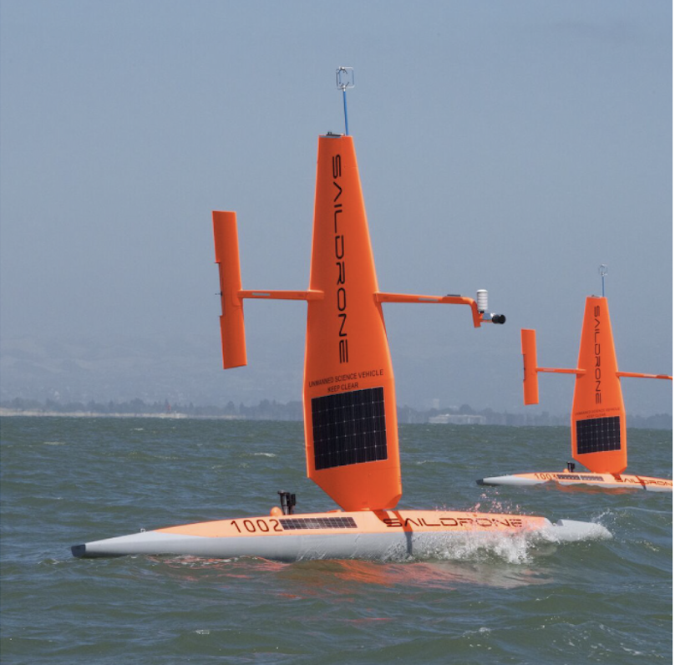
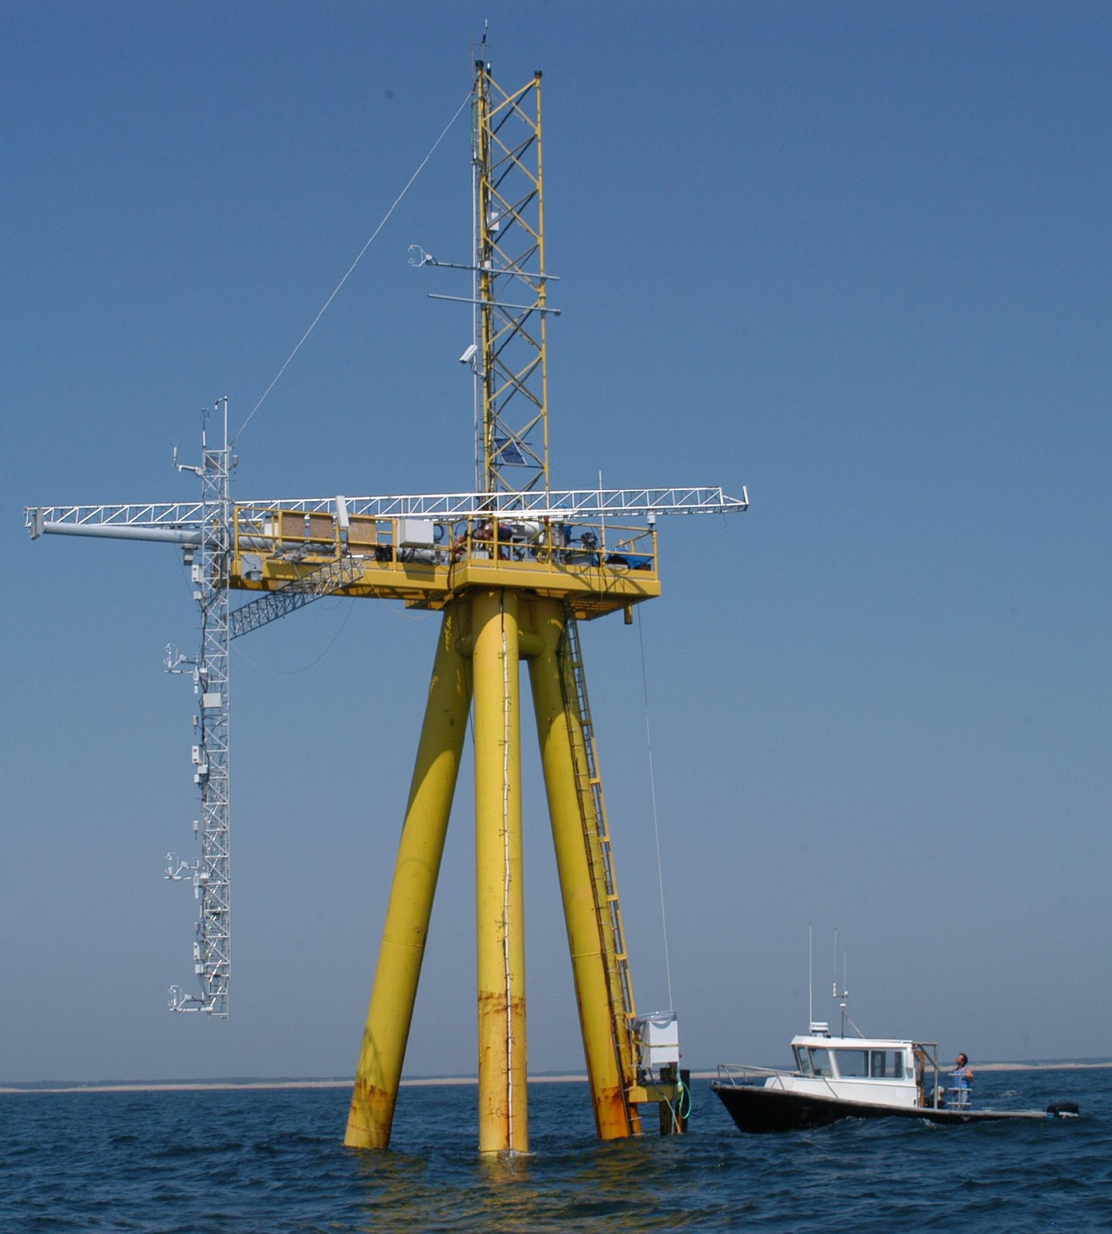
OceanObs19 recommendation: Create a global network of 500-1000 drifting or mobile platforms, built around expanded reference station (squares) network with Super Sites in key (boxed) regions
Drifting and Mobile Flux Platforms (examples)
Reference Stations
(examples)
Cronin et al. (2019) “Air-sea fluxes with a focus on heat and momentum”
Notes:
Right now net surface heat fluxes are measured at 22 surface mooring reference stations, shown here by the dark squares.
OASIS envisions a global network of drifting and mobile platforms, built around an expanded OceanSITES network of reference stations in 22 key (boxed) regions shown in this map.
In particular, these 368 light grey dots indicate 10 degree by 10 degree gridpoints. Thus with 500–1000 flux platforms, we could have 1-3 platforms in each nominal 10 by 10 degree box.

Slide 5
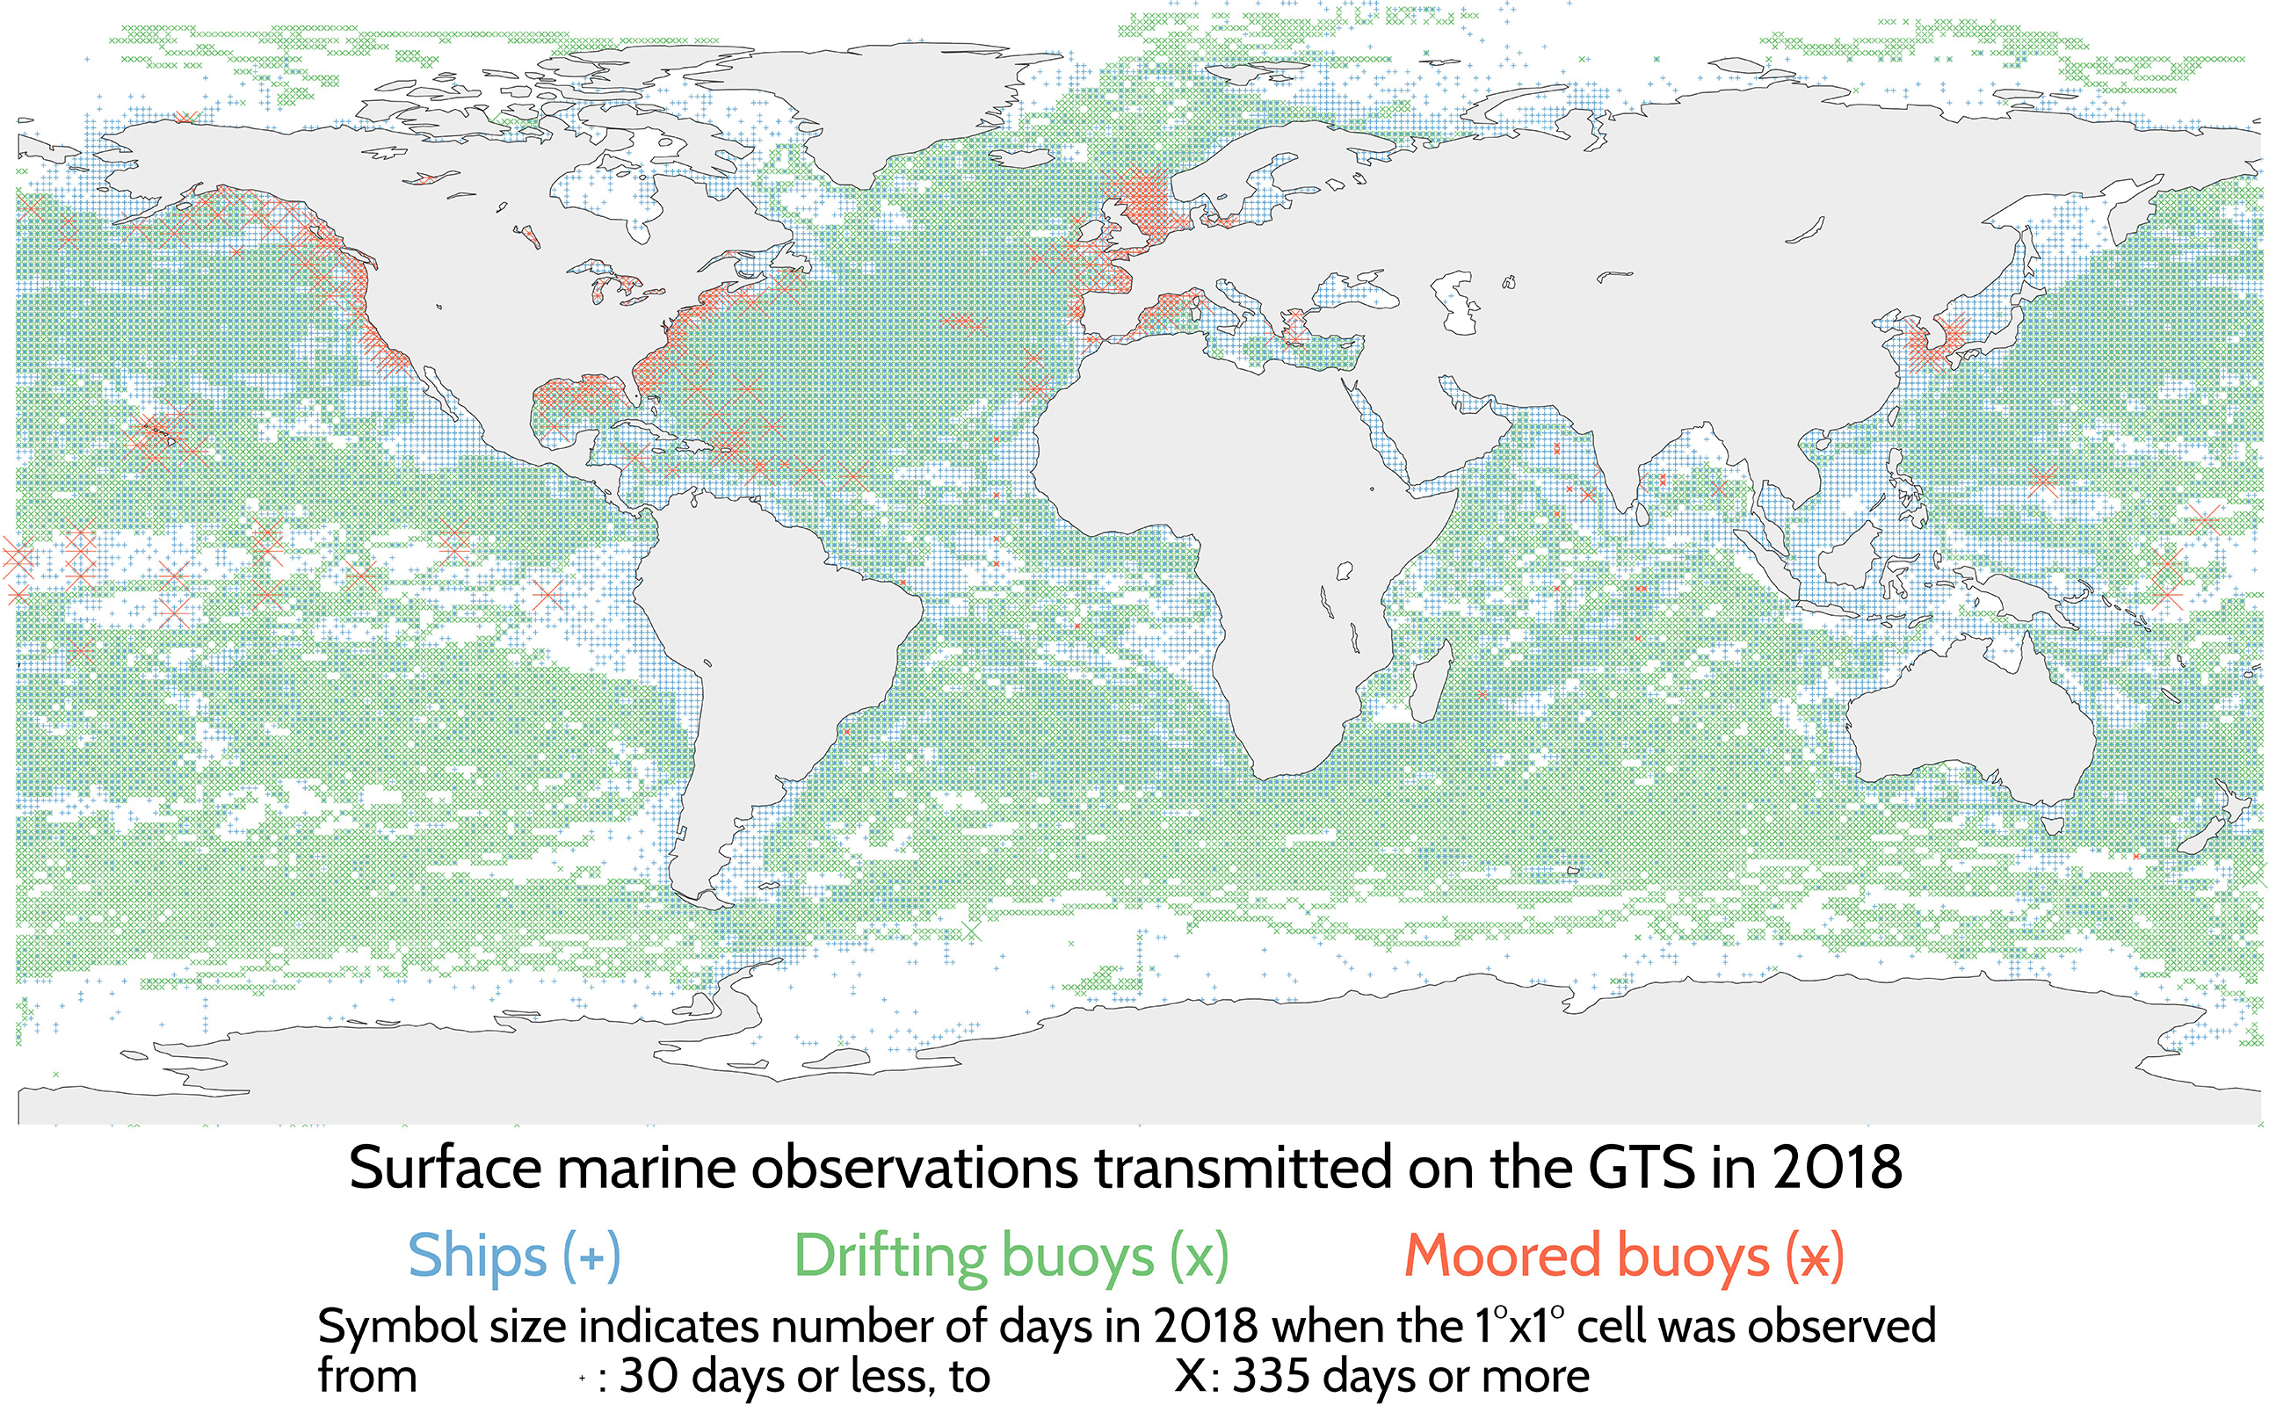
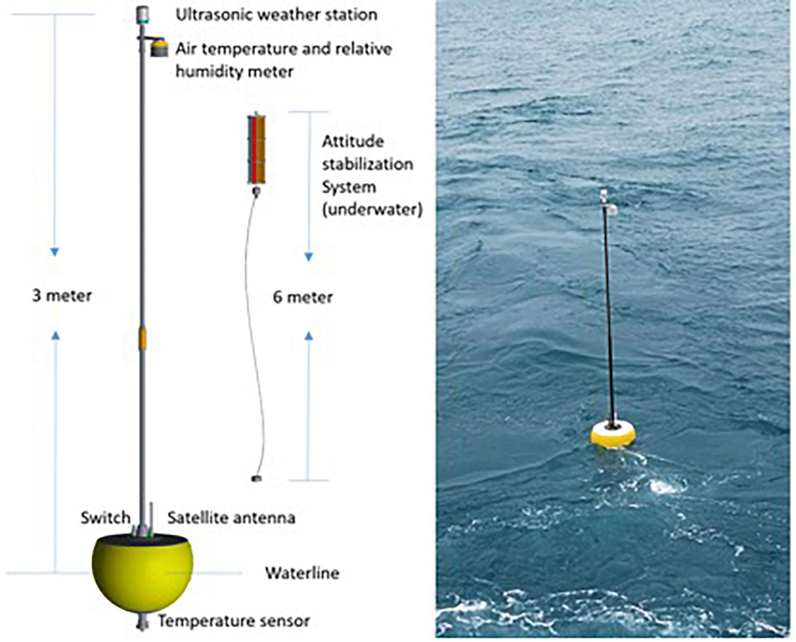
OceanObs19 recommendation: Expand and enhance the network of surface meteorological and oceanic measurements using new technologies
New technology for measuring directional waves
… and meteorological variables
Centurioni et al. (2019) “Global in situ Observations of Essential Climate and Ocean Variables at the Air-Sea Interface”
Notes:
From the weather side, Luca Centurioni and collaborators also called for an Integrated network, with drifting, mobile and moored buoy platforms carrying a range of sophisticated sensors, many of which were described in the Cronin et al. strategy paper.

Slide 6
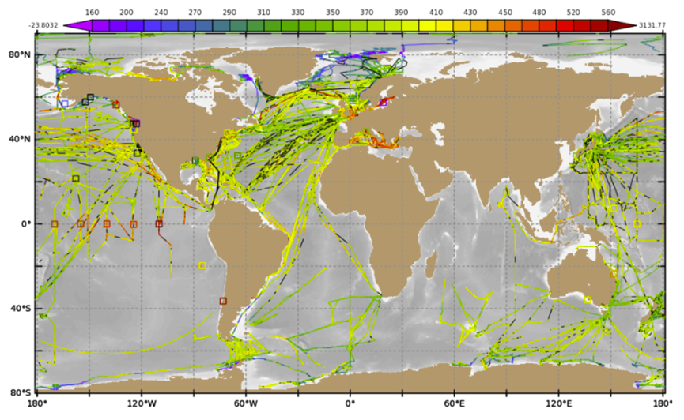
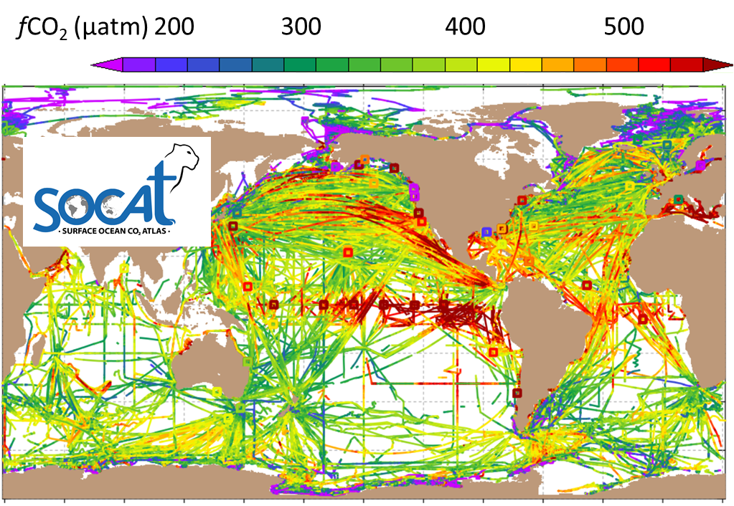
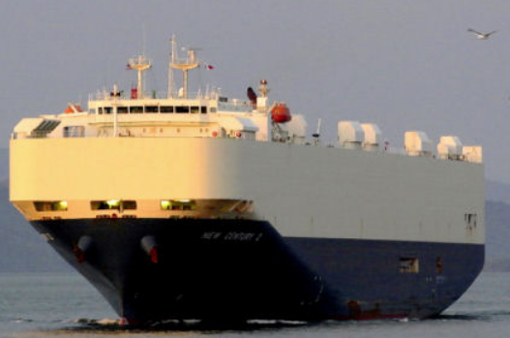
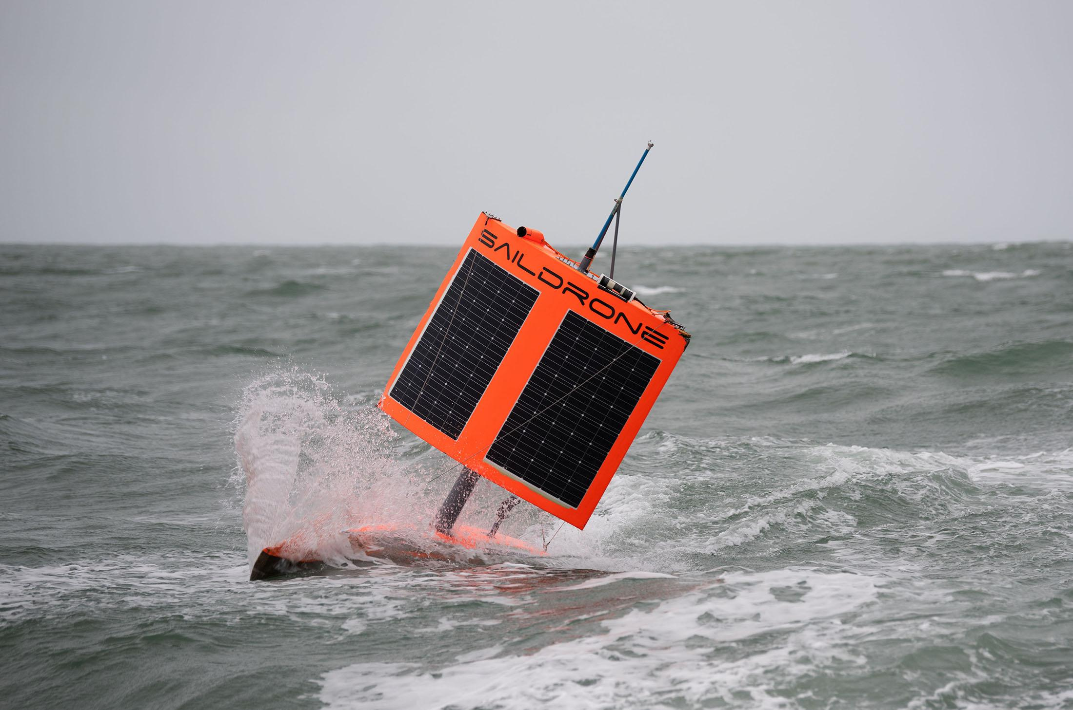
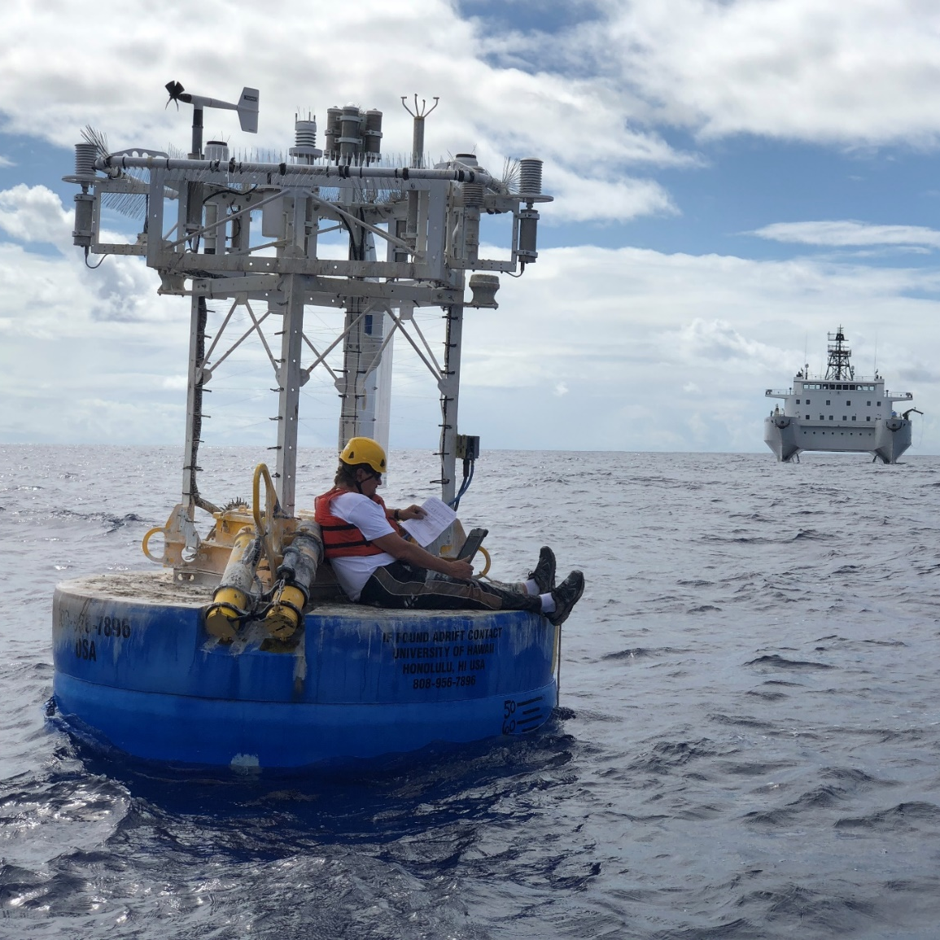
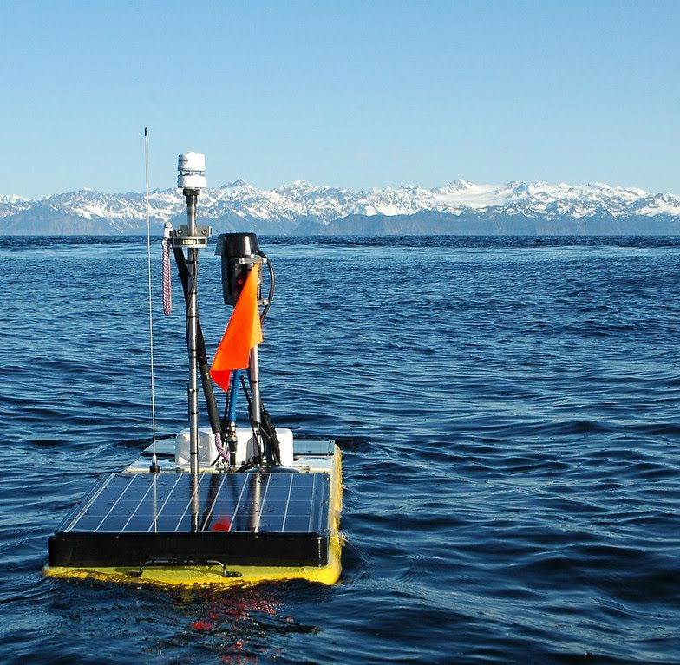
OceanObs19 recommendation: Create a global network of surface ocean and marine boundary layer CO₂ measurements
Established Platforms:
New Technology:
Photo: Saildrone
Photo: UH
Surface ocean CO₂ flux: all seawater pCO₂ measurements collected since 1957 Wanninkhof et al. (2019) “A Surface Ocean CO₂ Reference Network, SOCONET and Associated Marine Boundary Layer CO₂ Measurements”
Annual maps show even more observing gaps!
Hauck et al., 2020: “Progress in understanding the global ocean carbon sink necessitates … a game-changing increase in high-quality pCO₂ observations”
Notes:
A similar global network of in situ surface flux platforms has also been envisioned by the Carbon Community called SOCONET, a Surface Ocean CO2 Observing Network
This figure shows all the sea surface pCO2 measurements made from ships and buoys since 1957.
However, in 6 decades of observing we still have areas where CO2 measurement have never been collected. And if you were to look at any one year, you’d see many gaps in other regions of the globe.
OASIS is aiming to provide a roadmap to fill those gaps.
----------
New technologies such as Wave Gliders and Saildrones show promise for extending the temporal and spatial coverage of surface ocean pCO2 measurements globally. And can help make more out of BGC argo

Slide 7
Members of SCOR WG #162 for developing an Observing Air-Sea Interactions Strategy (OASIS)
SCOR WG Member | Institution | Expertise
Meghan Cronin* | NOAA Pacific Marine Environmental Laboratory, US (co-chair) | In situ physical fluxes; OceanSITES; TPOS2020
Sebastiaan Swart* | University of Gothenburg, Sweden (co-chair) | In situ physical & CO2 fluxes; SOFLUX
Christa Marandino* | Geomar, Germany (co-chair) | Trace gas fluxes; SOLAS
R. Venkatesan | National Institute of Ocean Technology, India | In situ physical fluxes; OceanSITES; Capacity Building
Phil Browne ^ | ECMWF, UK | Operational Models; Coupled DA
Warren Joubert ^ | South African Weather Service, South Africa | Operational Center; BGC; Capacity Building
Ute Schuster | University of Exeter, UK | In situ CO2 fluxes; BGC; SOCONET; AtlantOS;
Nadia Pinardi | University of Bologna, Italy | Numerical ocean forecasting systems; WMO
Shuangling CHEN ^& | Second Institute of Oceanography, China | Satellite CO2 fluxes; BGC
Clarissa Anderson | Scripps Institution of Oceanography, US | Biological oceanography; capacity building; IOOS
Jim Edson | Woods Hole Oceanographic Institution, US | Direct covariance fluxes; parameterizations; technol.
Zhaohui CHEN | Ocean University of China, China | In situ physical fluxes; technology
Juliet Hermes | South African Environmental Observation Network, South Africa | In situ physical fluxes; capacity building; OBPS; OCG
Fabrice Ardhuin | University Brest, CNRS, IRD, Ifremer, LOPS, IUEM, France | Satellite fluxes;
Oscar Alves | Bureau of Meteorology, Australia | Operational models; coupled DA; WGNE
Hiroyuki Tomita | Graduate School of Environmental Science, Hokkaido University, Japan | Satellite fluxes; J-OFURO
* Co-chairs;
^ ECOP; ^&UN Ocean Decade ECOP Co-Lead
Notes:
OASIS cuts across the spectrum of expertise and flux type, from physical fluxes to carbon fluxes, from In situ, to satellite-based air-sea fluxes, to parameterizations and full coupled data assimilating systems.
We also span the globe, and are diverse in terms of gender and career level.
Nearly all members were involved in OceanObs’19 either as lead authors or contributing authors.

Slide 8
OASIS Co-Chairs & Staff
To join Theme Teams, select
“Get Involved” button on
airseaobs.org
https://airseaobs.org/get-involved
SCOR Working Group #162
OASIS Community
OASIS
Theme Team
Obs Network Design & Model Development
Capacity Building & Partnerships
Ocean Shots & UN Decade
Best Practices & Interoperability
FAIR Data, Model & OASIS Products
 | What physical, biogeochemical, and ecological air-sea interaction processes should be included in the OASIS to promote a Predictable Ocean, & a Clean, Healthy & Productive Ocean |  | How can OASIS become truly global through capacity building and sharing? |  | How can OASIS implement these "Ocean Shots" needed to make a Predictable Ocean? UN Ocean Decade Endorsed Projects linked to OASIS |  | What Best Practices should OASIS develop? |  | What Findable-Accessible-Interoperable-Reusable (FAIR) OASIS data, models and products need to be developed to create a Predictable Ocean?
 | Harmonize OO19 recommendations into OASIS, Define Ocean Shots & Process Studies |  | Develop Curriculum, Summer Schools, Mentoring, and Partnerships |  | Propose/implement globally distributed observing network; Supersites, Optimize satellites |  | Endorsed Community Best Practices |  | Air-sea flux toolbox, Gridded Flux Products, Direct Covariance Flux library, Open Data
Defining Question
Near-term tasks SCOR WG #162 deliverables
Notes:
This is our organizational chart. The SCOR Working Group #162 will work with community members across 5 ThemeTeams.
Our core Theme Team will be the The Observing Network Design & Model Development Theme Team that will harmonize the OceanObs19 recommendation into the strategy. This Theme Team will also define Process Studies & “Ocean Shots” – like “moon shots” needed to reach our 2030 goals of a Predicted Ocean, Healthy & Productive Ocean, Clean & Safe Ocean.
To do that we need capacity. We need people. The “Capacity and Partnership Building” Theme Team will work with the other teams to develop curriculum, and will work with Summer Schools and Mentoring Programs around the world to build capacity and partnerships and in this way make OASIS become truly global.
The “Ocean Shots” Theme Team will implement the OASIS Ocean Shots, working through the UN Decade and National Committees.
The “Best Practices & Interoperability” Theme Team will develop Best Practices and perform experiments to ensure that the air-sea interaction variables are interoperable across platform to within the required measurement accuracy.
The “Findable-Accessible-Interoperable-and Reusable (FAIR) Data, Models & OASIS Products” theme team will develop OASIS products, including an air-sea flux toolbox, and a library of direct covariance flux measurements. This theme team will work to improve gridded flux products and make air-sea interaction information open and FAIR.

Slide 9
SCOR Working Group #162 for developing an Observing Air-Sea Interactions Strategy (OASIS) airseaobs.org/get-involved
Photo of Earth taken by Apollo 17 crew enroute to Moon on December 7, 1972. Credit: NASA.
DBCP 37th Session (8 November 2021)
Notes:
Looking forward to 2030, and back to 1972…
This is the famous photo of Earth taken by the Apollo 17 astronauts enroute to the Moon in 1972.
This photo changed our perspective of our place in the Universe.
50-years later, Global warming is undeniable.
Our role in the Universe needs to change.
I hope that through OASIS, we can work together to track the carbon dioxide emissions as they are absorbed into the ocean,
And observe, understand and predict the air-sea interactions that influence weather and climate, and ultimately
the ocean environment, ecosystem, and biosphere.
Through OASIS, I hope that the World gains a better understanding of the delicate balances that govern weather, climate, and the ocean environment,
And a better understanding of our role in the Universe.

Slide 10
OASIS Co-Chairs & Staff
To join Theme Teams, select
“Get Involved” button on
airseaobs.org
https://airseaobs.org/get-involved
SCOR Working Group #162
OASIS Community
OASIS
Theme Team
Obs Network Design & Model Development
Capacity Building & Partnerships
Ocean Shots & UN Decade
Best Practices & Interoperability
FAIR Data, Model & OASIS Products
 | What physical, biogeochemical, and ecological air-sea interaction processes should be included in the OASIS to promote a Predictable Ocean, & a Clean, Healthy & Productive Ocean |  | How can OASIS become truly global through capacity building and sharing? |  | How can OASIS implement these "Ocean Shots" needed to make a Predictable Ocean? UN Ocean Decade Endorsed Projects linked to OASIS |  | What Best Practices should OASIS develop? |  | What Findable-Accessible-Interoperable-Reusable (FAIR) OASIS data, models and products need to be developed to create a Predictable Ocean?
 | Define Ocean Shots & Process Studies, Harmonize OO19 recommendations into OASIS |  | Develop Curriculum, Summer Schools, Mentoring |  | Propose/implement globally distributed observing network; Supersites, Optimize satellites |  | Endorsed Community Best Practices |  | Air-sea flux toolbox, Gridded Flux Products, Direct Covariance Flux library, Open Data
Defining Question
Near-term tasks SCOR WG #162 deliverables
Notes:
This is our organizational chart. The SCOR Working Group #162 will work with community members across 5 Theme Teams on near-term tasks laid out in our prospectus.
Our core Theme Team will be the The Observing Network Design & Model Development Theme Team that will harmonize the OceanObs19 recommendation into the strategy. This Theme Team will also define Process Studies & “Ocean Shots” – like “moon shots” needed to reach our 2030 goals of a Predicted Ocean, Healthy & Productive Ocean, Clean & Safe Ocean.
To do that we need capacity. We need people. The “Capacity and Partnership Building” Theme Team will work with the other teams to develop curriculum, and will work with Summer Schools and Mentoring Programs around the world to build capacity and partnerships and in this way make OASIS become truly global.
The “Ocean Shots” Theme Team will implement the OASIS Ocean Shots, working through the UN Decade and National Committees.
The “Best Practices & Interoperability” Theme Team will develop Best Practices and perform experiments to ensure that the air-sea interaction variables are interoperable across platform to within the required measurement accuracy.
The “Findable-Accessible-Interoperable-and Reusable (FAIR) Data, Models & OASIS Products” theme team will develop OASIS products, including an air-sea flux toolbox, and a library of direct covariance flux measurements. This theme team will work to improve gridded flux products and make air-sea interaction information open and FAIR.

