Slide 1
Task Team on Capacity Building
(TT-CB)
Chair:QIU JIANG (Rachel)
Vice-chair: Sid Thurston
DBCP 37

Slide 2
1. Statistics
1.How many meetings did you have this year ? 7 remotely.
1300UTC, 24th Sep，TT-CB annual call，17participants.
2.How many actions do you have ? 2
3.How many actions have been completed or will be completed this year ? 2
4.How many actions have not progressed ? 0
5.How many new actions have been added? 2

Slide 3
2. Realignment of ToRs to DBCP strategy*
How many Strategic Pillars does your TT align to? 4
Pillar1. Impact and value Pillar4. Environmental protection
Pillar5. International cooperation and partnerships
Pillar6 Diversity and inclusivity
2. How many Strategic Actions does your TT align to? 11
Actions1.1，1.3，1.6，1.8，4.1，4.2，5.1，5.2，6.1，6.2，6.3
3. Which is/are the Key Strategic Pillar/s for your TT?
Pillar5. International cooperation and partnerships
Pillar6 Diversity and inclusivity
4. Which is/are the Key Strategic Action/s for your TT?
Actions 5.2，6.1，6.2，6.3
5. What is/are the indicator(s) measuring success of your TT?
Feedback from stakeholders, awareness increasing, diversity activities and rooted in region.
* refer to the DBCP Strategy – for Q4 you can use the ID numbers in the Strategy.

Slide 4
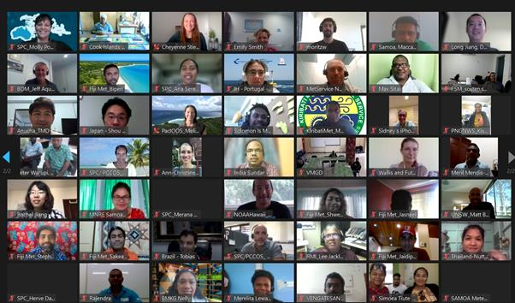
3. 2-3 Key highlights this year*
As the flagship activity of TT-CB, 5th DBCP Pacific Islands Training Workshop on Ocean Observations and Data Applications (Virtual) successfully organized on 26-27 May and 09-10 June 2021.
There are 90 participants ,9 sessions,16 recommendations from the workshop
and around 20 topics from the workshop , also excellent hands on exercises give the participants clearly pictures and tranining on marine observation.
Thanks for Secretariat of the Pacific Community (SPC) kindly host this workshop and generously efforts,

Slide 5
4. 2-3 Key focus areas for next year
Pillar 5 International cooperation & Pillar 6 Diversity and inclusivity
Pilot Joint Deployment
Responding to recommendations PI-4, PI-5…, a pilot of jointly deploying the emerging observation sensors including , but not limited to, wave drifters, underwater gliders and deep-Argo, and provide seed funds together with identified partners the data will be mutually shared by all stakeholders. Once the capacity building efforts are concluded, it is expected that the recipient will take responsibility for maintaining the assets.
2. Enhance training and workshop
Initiate , coordinate the implementation the regular Training Course on buoy programme implementation and data management, in 2022 mainly focus on the West Indian Ocean and Pacific Islands Region
.
Before Dec 2021
Announcement
Before June 2022,
Confirm the agreement and workflow
Before June,2023
Coordinate opportunities for joint deployment
Identified the participants and partners

Slide 6
5. Key take-home messages*
Pilot Joint Deployment is inviting expressions of interest , please submit your proposal to the Chair of the TT-CB (Rachel, jlzxjq@163.com) and explain your motivations , gaps and what support you may supply.
TT-CB looking forward to hearing the intentions from members/member states or other communities to host DBCP Capacity Building Workshop in 2022.
TT-CB will strive to the Diversity and Inclusivity in the way forward .

