Slide 1
DBCP and OceanOPS Report
8-11 November 2021
Long Jiang, Technical Coordinator
LJiang@Oean-ops.org

Slide 2
Status

Slide 3
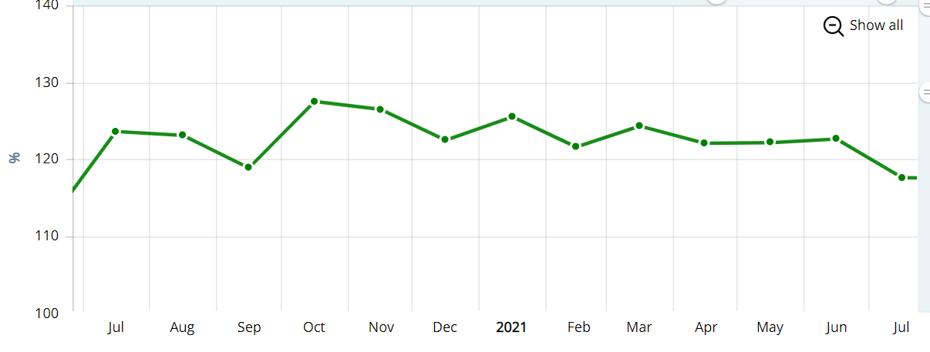
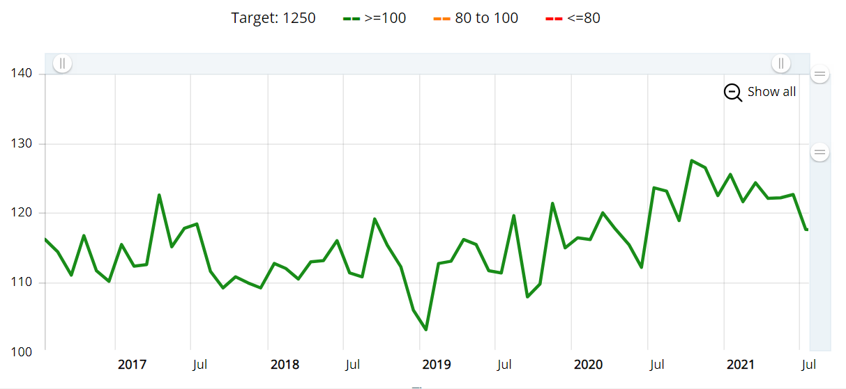
Global Drifters Array

Slide 4
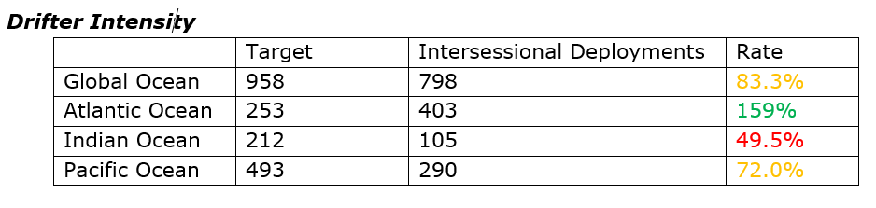
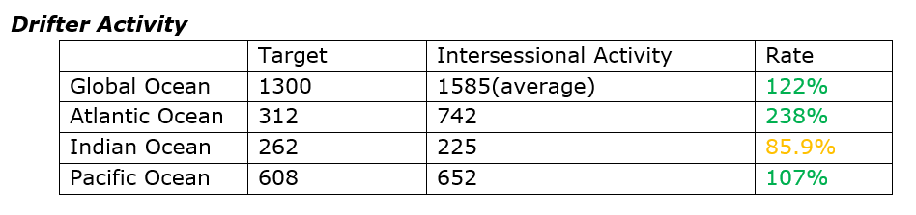
Global Drifters Array

Slide 5
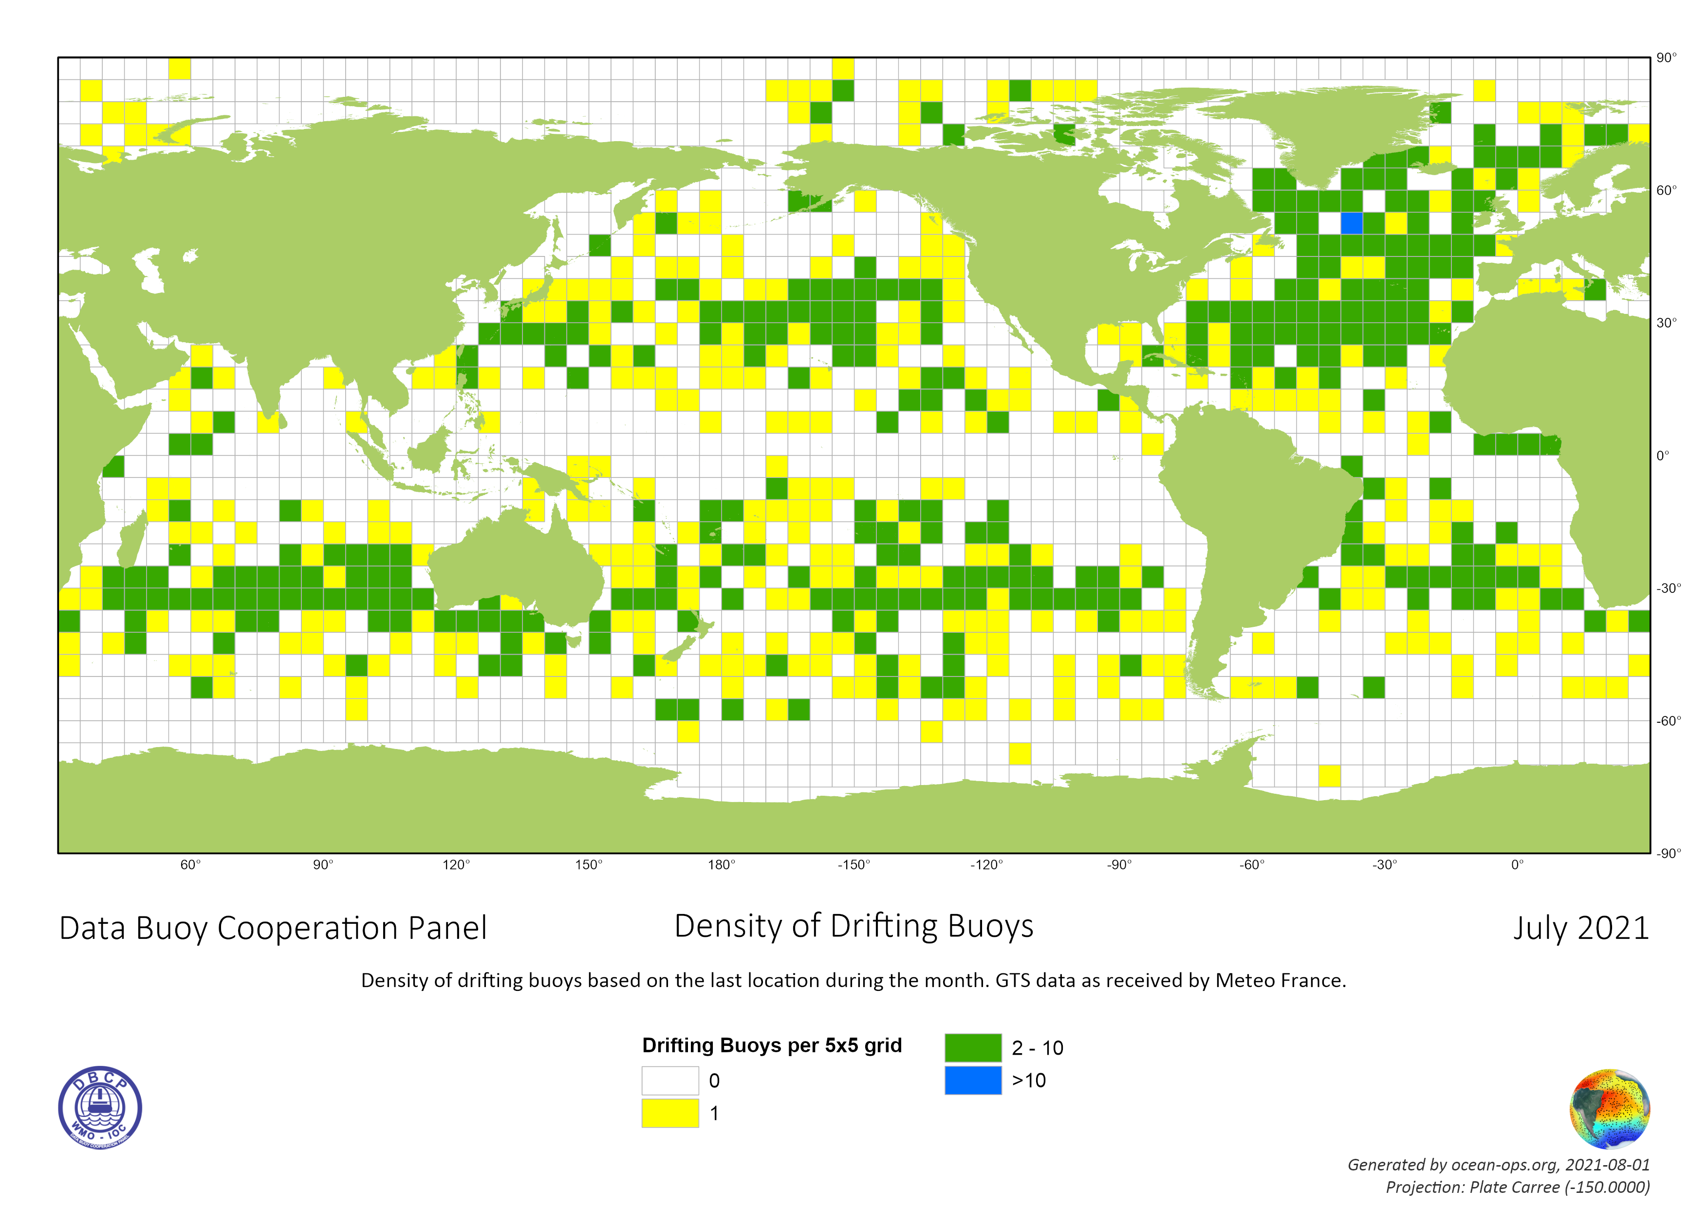
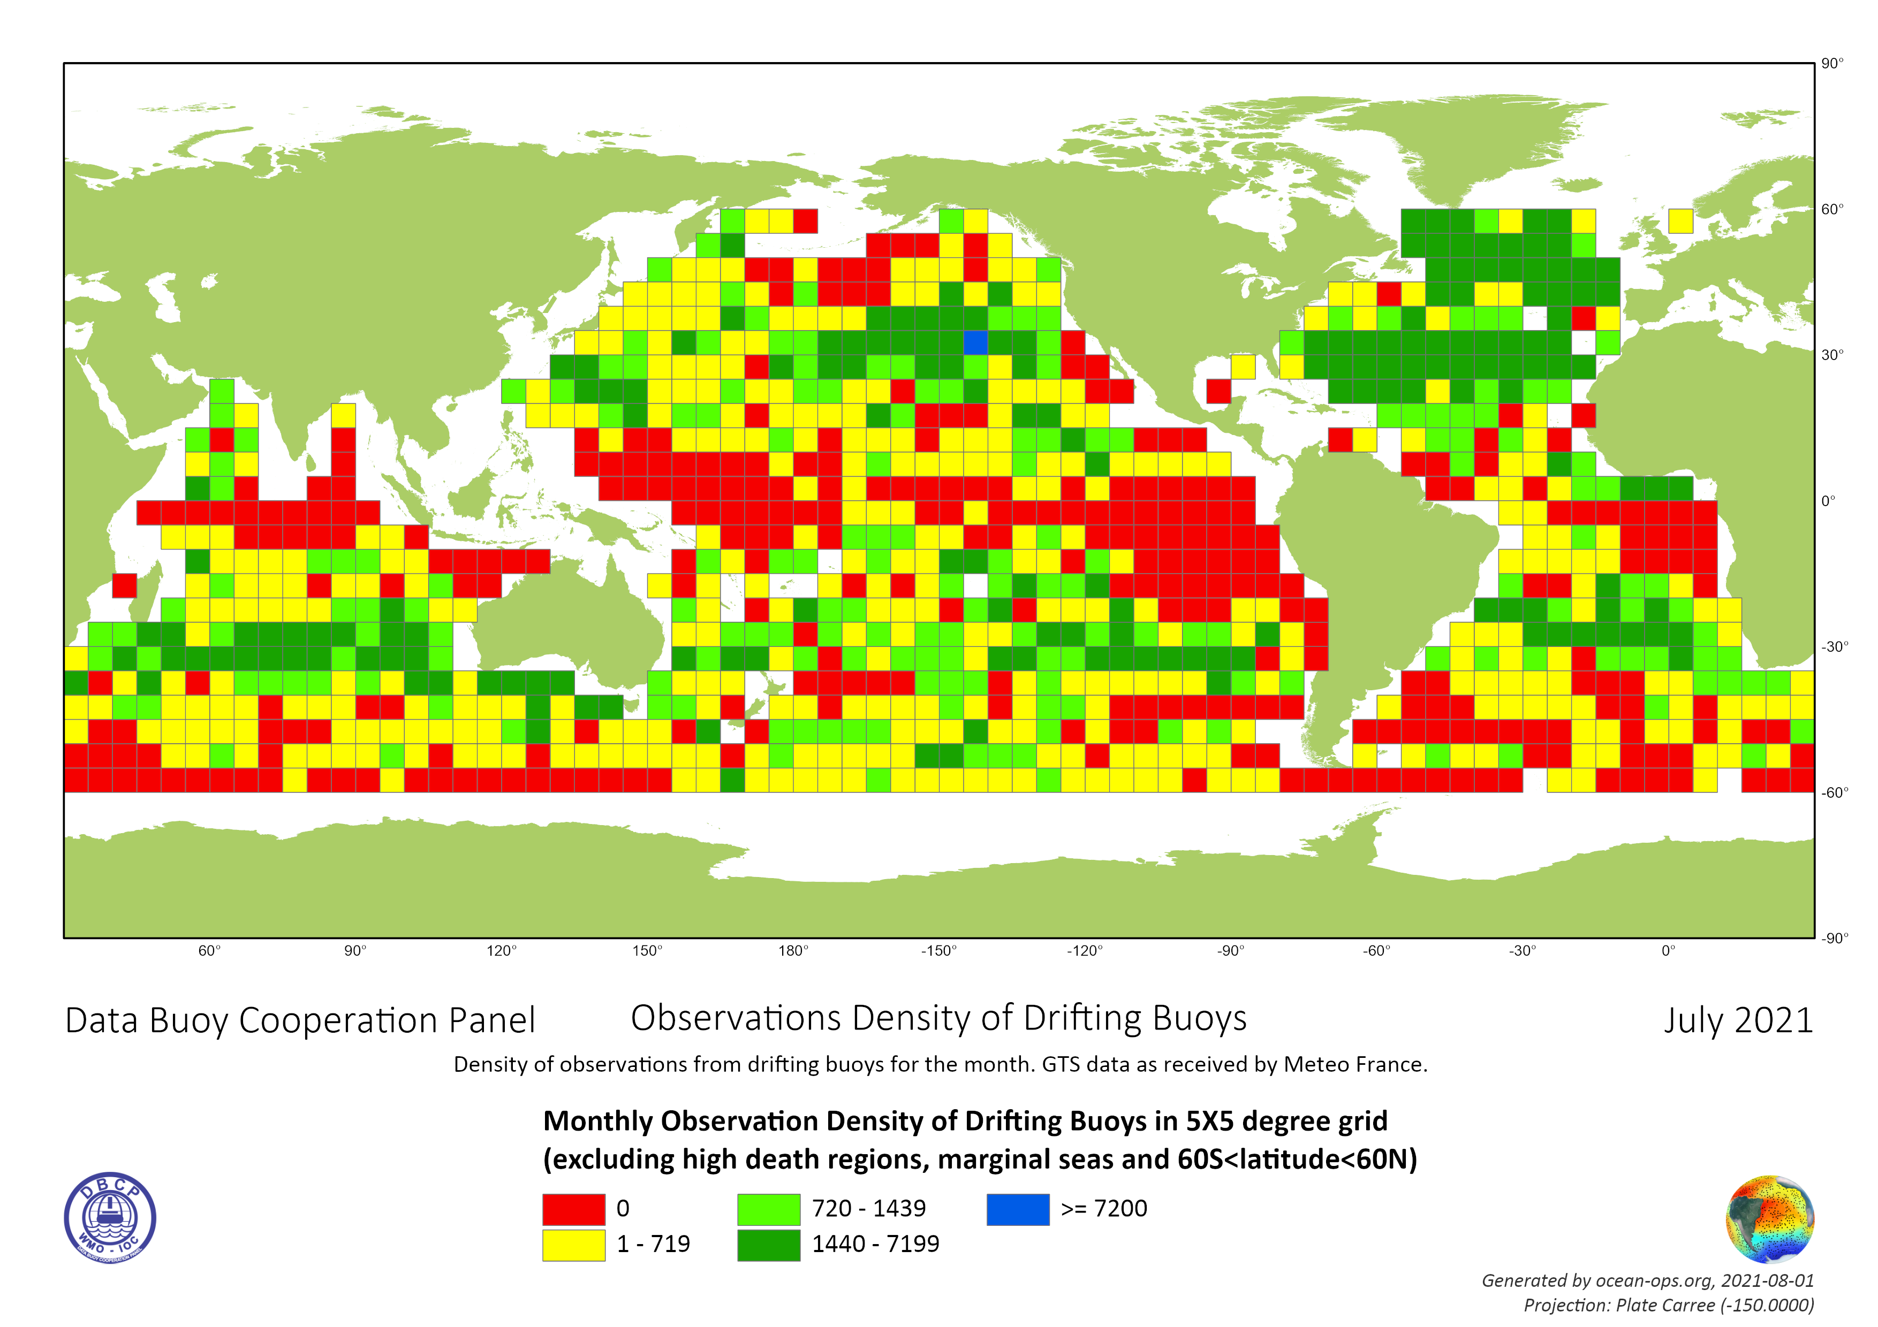
Global Drifters Array
Notes:
HRSST

Slide 6
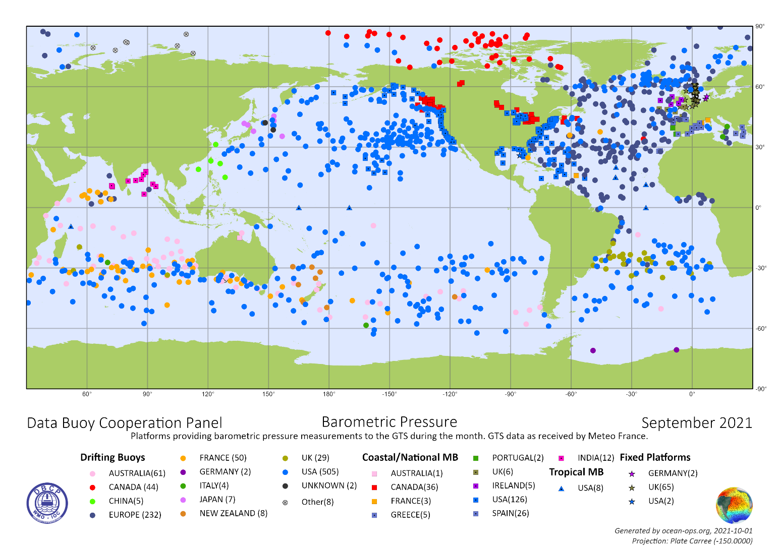
Barometric Pressure Observations
(Sep 2021, OceanOPS)
Platform | Percentage of Pressure Obs
Drifting Buoys | 59.7%
Coastal Moored Buoys | 63.2%
Tropical Moored Buoys | 13.3% (8/60)
Tsunameters | 0
Arctic | 58.8%
Antarctic | 66.7%
Barometer Upgrade
Notes:
HRSST workshop
GOMO workshop on hurricane intensity forecasts

Slide 7
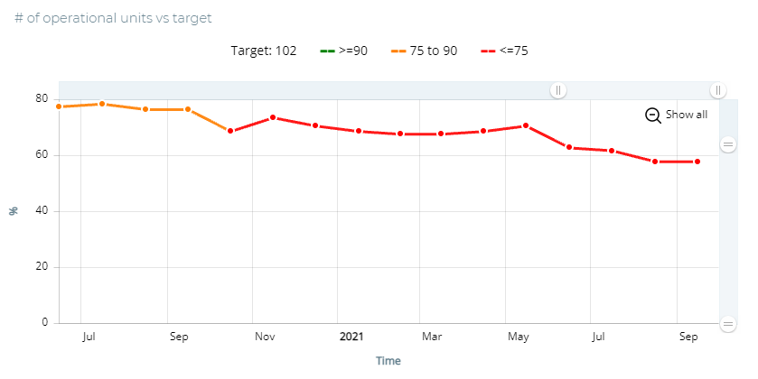
Global Tropical Moored Buoys Array
TAO: 40/55
RAMA-OMNI: 7/29
PIRATA:12/18
https://incois.gov.in/portal/datainfo/buoys.jsp
Sep 2021
Notes:
100% BUFR
69.5% average

Slide 8
OSCAR & BUFR
BUFR migration
(MB 315008, excl. tsunameters)
China
France
Greece
India
Ireland
Japan
Portugal
Spain
USA
65% overall average
OSCAR
WSI approved by INFCOM
ID Allocation automatically by OceanOPS (support@ocean-ops.org)
~100% for drifters
Under development for moored buoys

Slide 9
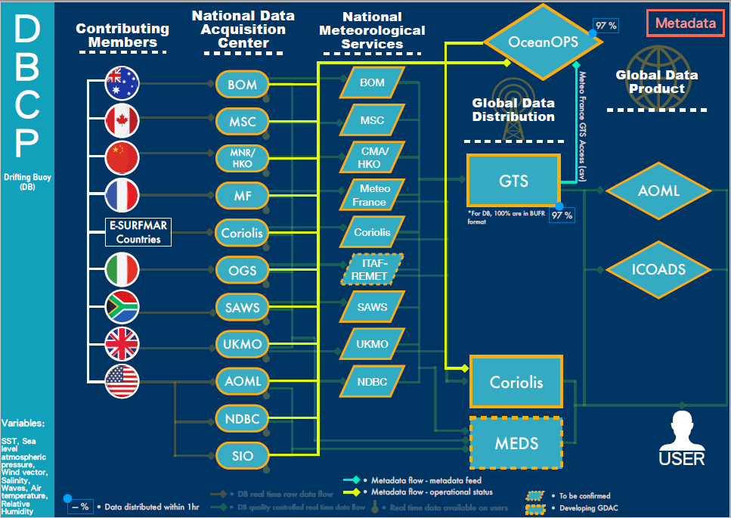
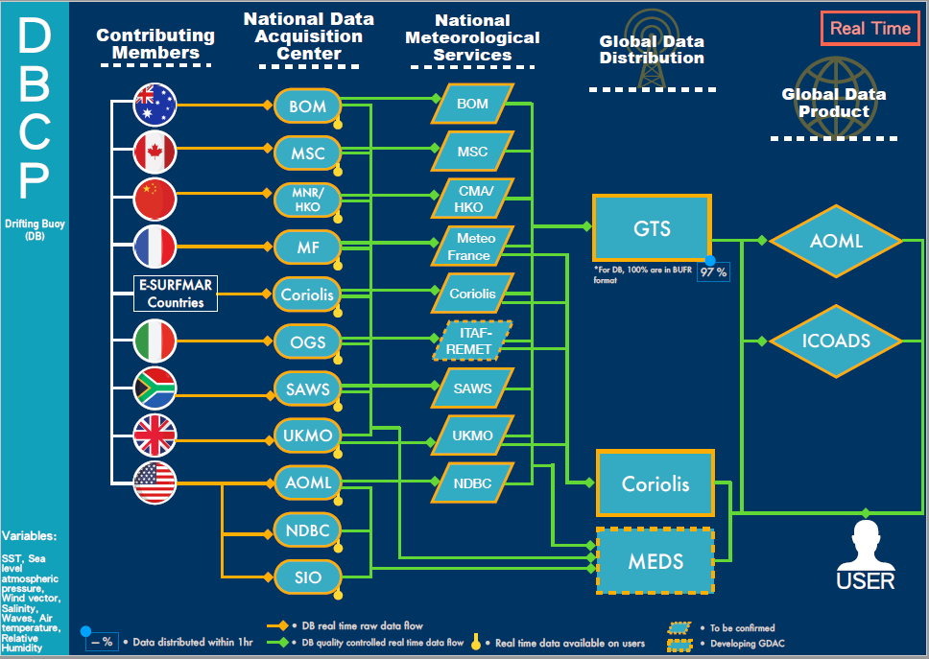
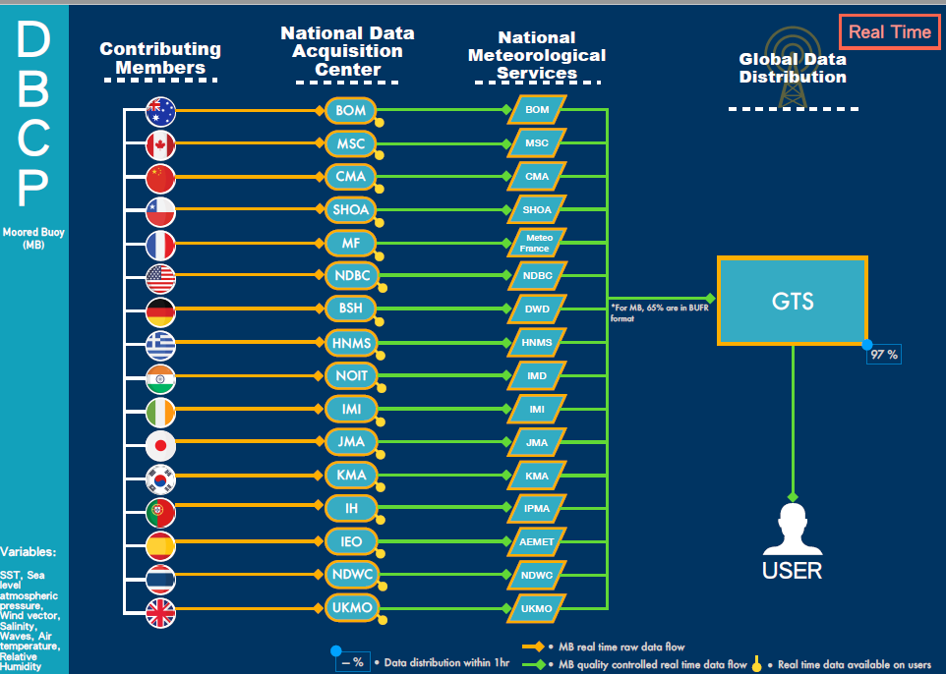
Data & Metadata Mapping
Notes:
Work with us to complete and make it accurate

Slide 10
NRT Analysis
Not all operating members participate in DBCP
Not all participating members submitted a NRT
Not all deployments recorded in NRT
Not all reported in NRT share data to GTS
9 out of 27 shared >50% data to GTS regardless format: Australia; Canada; France; Hong Kong, China; India; Italy; Russian Federation; Spain; USA
Notes:
See the participating map

Slide 11
Activities of Groups
TT-DM: data and metadata mapping, drifter wave data
TT-MB: metadata template and contents
TT-CB: PI-5 (SPC, Rachel, Sid, et al. ), wave drifter award
TT-ES: Establishment, deliverables, and webpage (Karen)
TT-DBPD: Expansion scope of work (Rick)
TT-WM: wave workshop postponed (Val, Bob)
ITP: a survey and tsunami detection workshop proposed (Boris, Venkat, Chris Moore, Chris Meinig, Bruce Howe, …)
WG-Vandalisms
Metadata for TRUSTED HRSST
…

Slide 12
Data Policy and Sharing
WMO Unified Data Policy
The Global Ocean Observing System: Oceans of Data for Earth System Predictions (Sid Thurston, et al.)
Core ocean data (Jon Turton, et al.)
RAII&RAV side events on ocean
Notes:
FYI

Slide 13
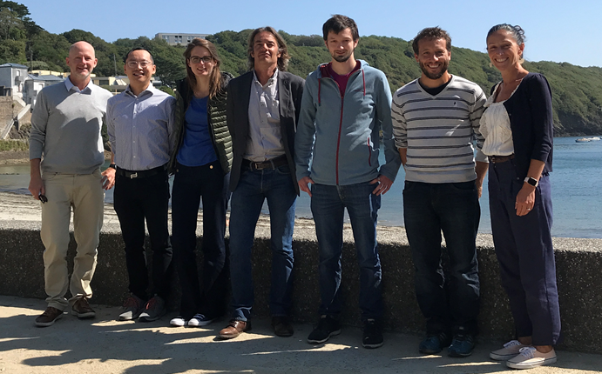
OceanOPS Team@Brest

Slide 14
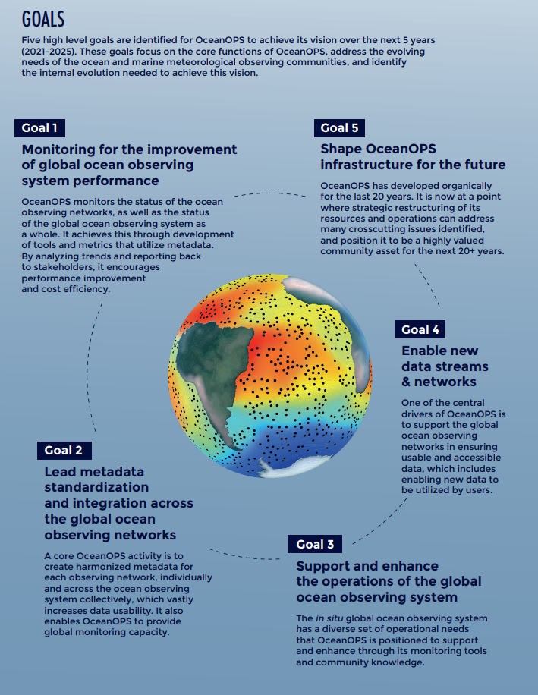
OceanOPS Strategy Implementation

Slide 15
OceanOPS Metadata
Harmonized and Integrated
Dedicated staff
API (https://www.ocean-ops.org/api)
Documentation with format (https://ocean-ops.org/metadata )
DBCP teams to work with us on finalization and feedback
One priority item in 2022

Slide 16
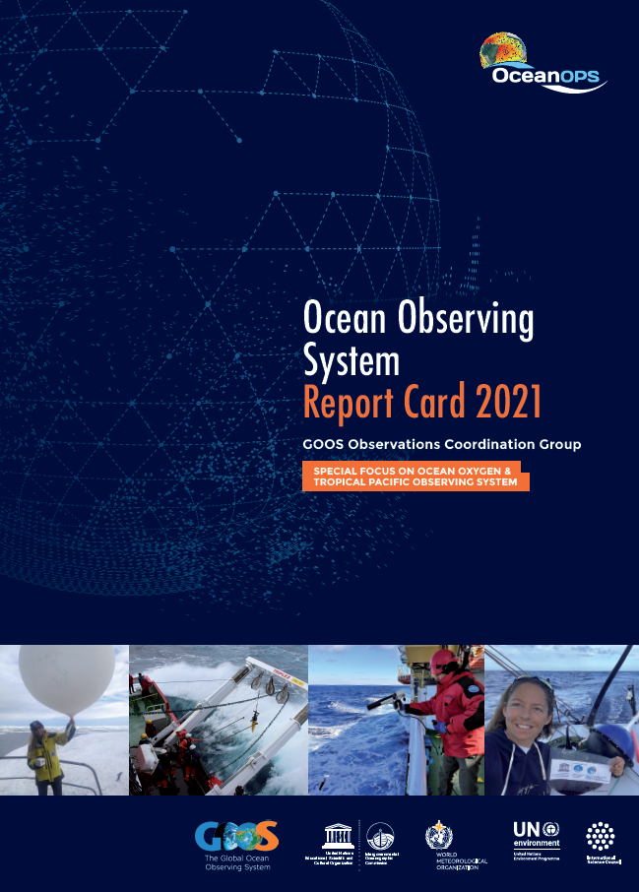
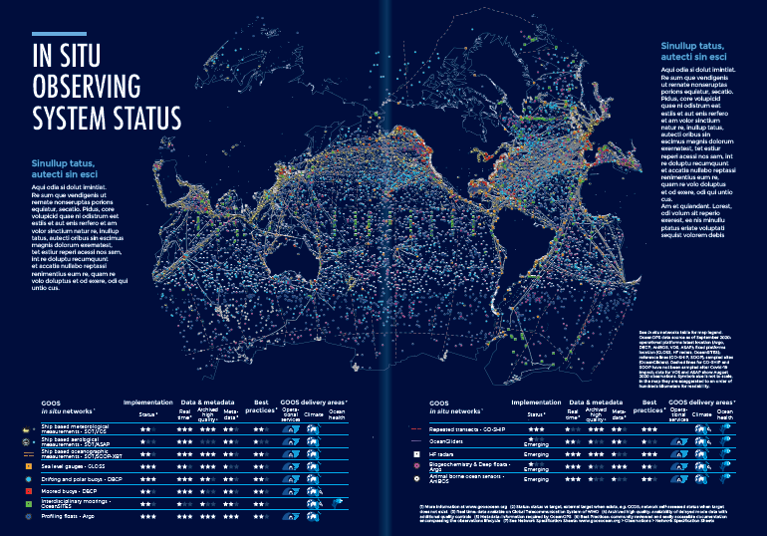
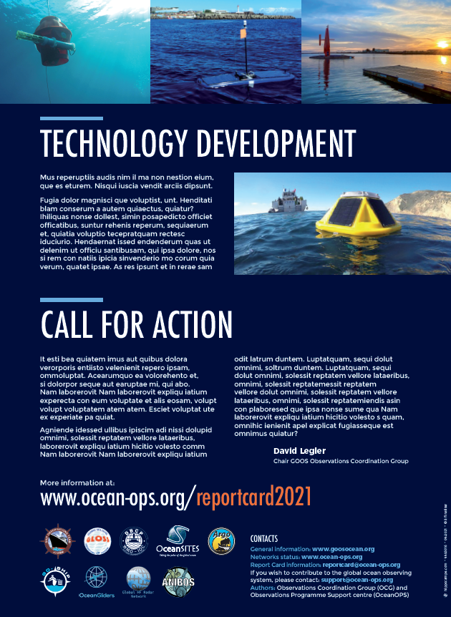
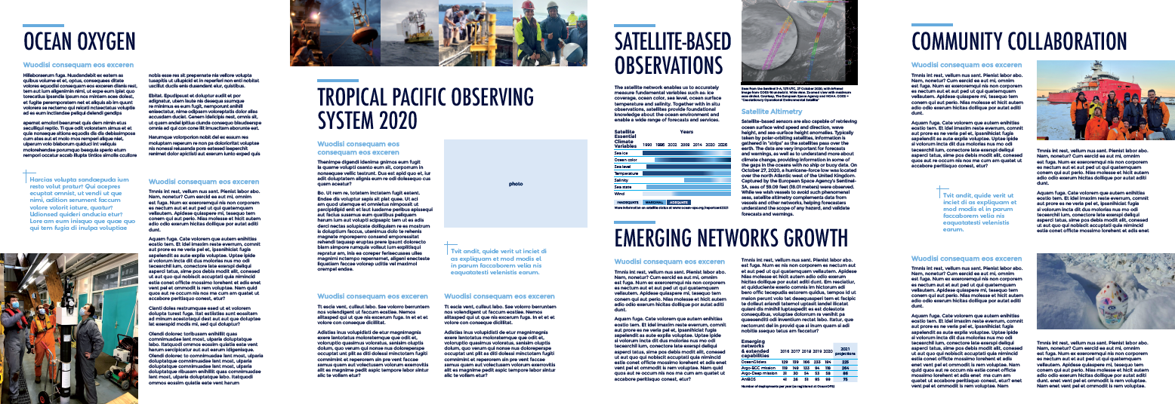
Ocean Observing System Report Card
Released in July 2021 with interactive web version
Broader GOOS Report (includes BGC Panel and GOOS SC members in editorial board)
2021 Focus:
  In situ & satellite
  observation status
  Ocean oxygen
  Tropical Pacific
  Observing System 2020
  Community stories
  Emerging networks
  growth
  Technology
  development

Slide 17
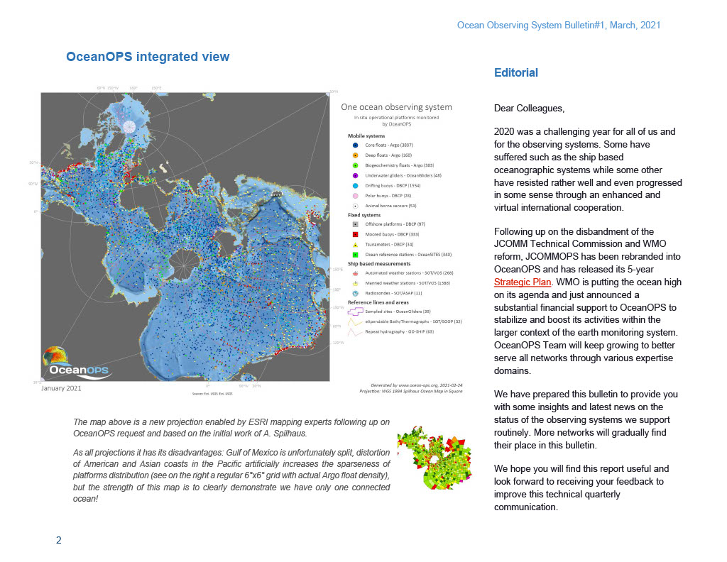
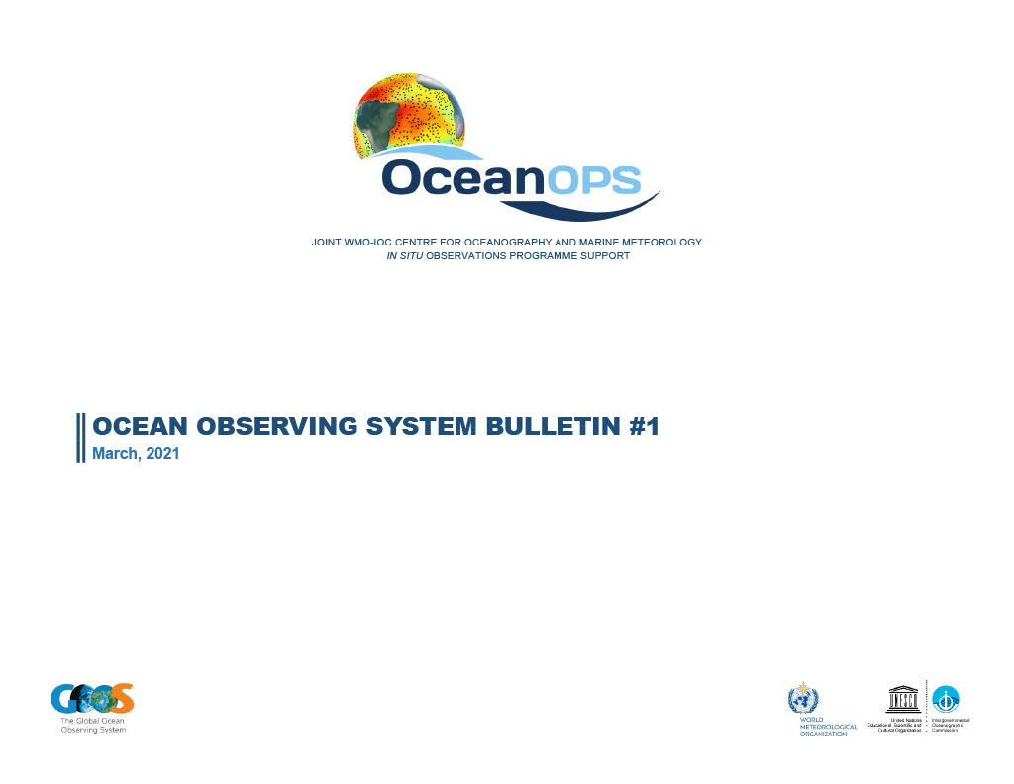
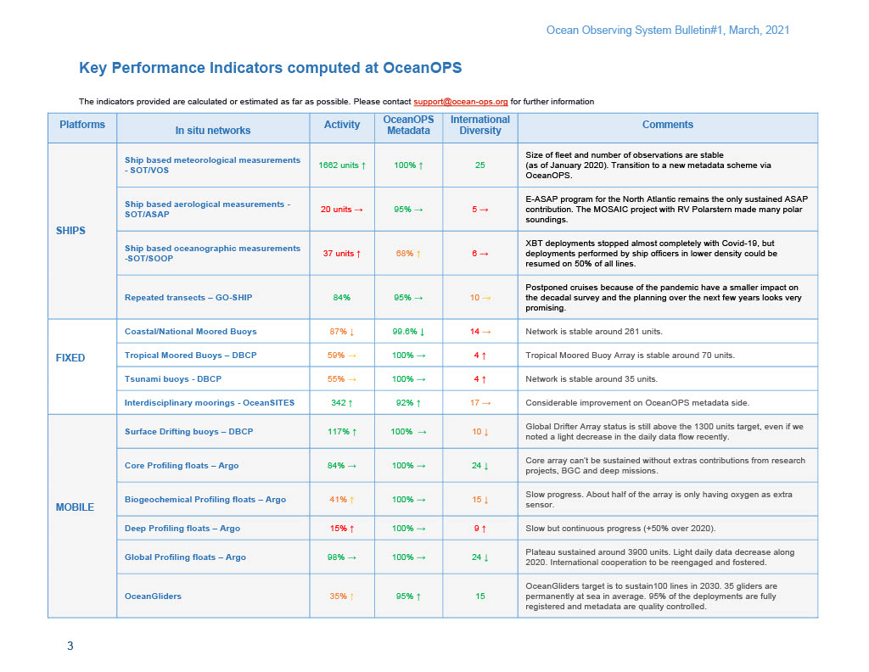
Quarterly OceanOPS Bulletin
Newsletter-like, integrated and network view
Notes:
Another new product under development is a quarterly report published jointly by the TCs, with a short status analysis of every individual OceanOPS-coordinated network, and a synthesis of the integrated system. The aim of this product is also to serve as a regular newsletter to the observing community.

Slide 18
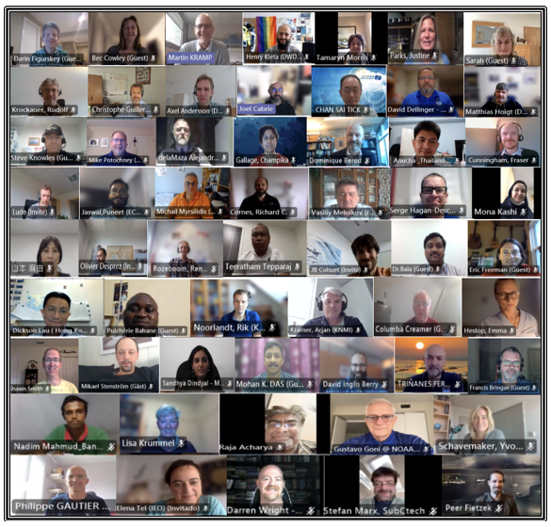
SOT Overview in Brief
Developments, Achievements, Intersessional Plans and Opportunities
SOOPIP
  Very good progress on standards and best practices.
  Recent cross-network workshop on boundary currents.
  Coordinating on environmental stewardship
VOS
  Hosted PMO-6.
  Validated the SOT metadata structure, including reference tables / definitions.
  Website improvement for metadata management being completed
  SOT-ID codified at recent INFCOM session.
  Maersk coordination and developing closer relationships with other partners.
ASAP (now a panel)
  Great coordination with Polarstern Arctic research expedition.
  GOOS webinar hosted November 3.
Plans and Opportunities
  Hosted SOT-11 virtually September 13 – 16.
  Working through the UN Decade of Ocean Science.
  Renewed attention to SOT-wide KPI(s).
  Continued metadata transition activities.
  Capacity development.
  Best practices.
  WMO functional connections.
  Periodic webinars.
  More compact implementation strategy.
Notes:
And deployment opportunities

Slide 19
Deployment Opportunities
Maintenance and Recoveries?
From the OceanOPS system, many cruises are available that could be used as opportunities for DBCP
While updating of the information is at present still a time-consuming manual task (Covid changes), many RV cruises will soon be synchronized m2m per MFP with OceanOPS
Increased cooperation with IRSO is also beneficial for recoveries and maintenance; "Eurofleets" project could even fund extra shiptime.
Citizen "Science" is of growing importance, OceanOPS leads a corresponding Decade Project. Such deployments are presently underway and comprise big outreach potential
SOT panels have always been supportive but are often not used (apart some SOOP lines): ship suppliers and warehouses good pilot project -> continue!
Notes:
And deployment opportunities

Slide 20
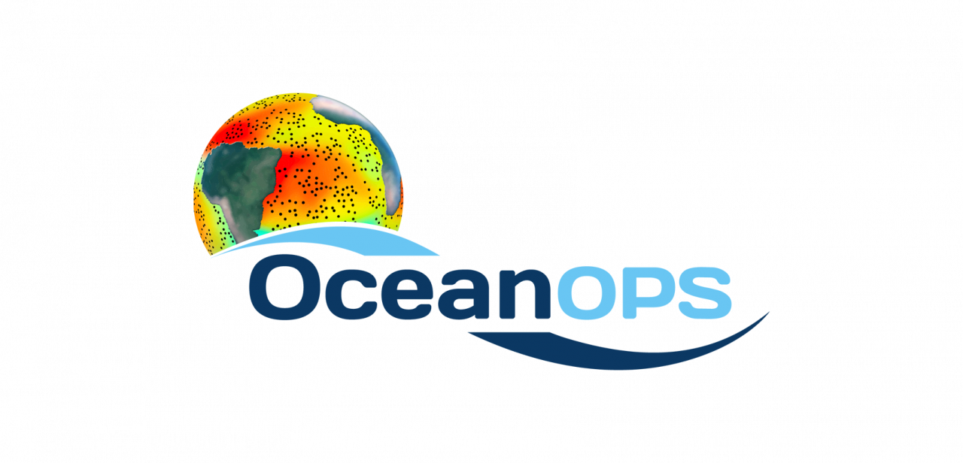
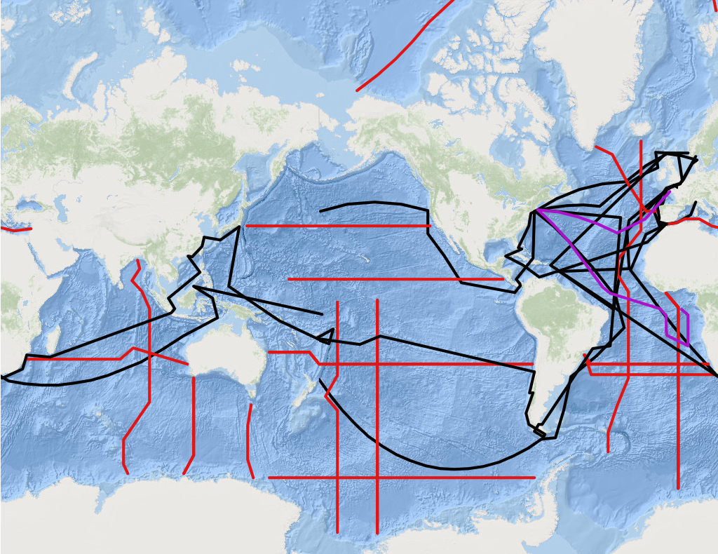
Deployment Opportunities
Maintenance and Recoveries?
planned GO-SHIP Cruises
planned Civil Society Cruises (sel.)
planned Charter Cruises
From the OceanOPS system, many cruises are available that could be used as opportunities for DBCP
While updating of the information is at present still a time-consuming manual task, many RV cruises will soon be synchronized m2m per MFP with OceanOPS
Increased cooperation with IRSO is also beneficial for recoveries and maintenance; "Eurofleets" project could even found extra shiptime.
Citizen "Science" is of growing importance, OceanOPS leads a corresponding Decade Project. Such deployments are presently underway and comprise big outreach potential
SOT panels have always been supportive but are often not used (apart some SOOP lines): ship suppliers and warehouses good pilot project -> continue!
Contact Martin Kramp,
mkramp@ocean-ops.org
Notes:
And deployment opportunities

Slide 21
Future work 2021-2022
GDA further optimization (divergence regions…)
GTMA (69.5%, huge gap Indian Ocean)
Metadata (moored buoys + drifters)
Data sharing in standard format, progress to BUFR, complete netCDF at GDAC to enable ERRDAP service, and complete metadata with OceanOPS
Notes:
GTMA: pandemic, vandalism, resources

Slide 22
Future work 2021-2022
Barometer upgrade (enhance awareness)
deployment opportunities + UN decade Odyssey, other networks
Support groups: ES, Data impact and value, …
Work with us for your contribution visible

Slide 23
Thank you
Questions?

