Slide 1
Working Group 2+3: Seismic, Geophysical and Sea Level measurements Report on intersessional activities Co-chairs Anna von Gyldenfeldt (BSH) Musavver Didem Cambaz (KOERI)
Virtual ICG-NEAMTWS WGs and TTs meetings , 24 and 26 November 2021

Slide 2
Plan of Actions
WORKING GROUP II+III : Seismic, Geophysical & Sea Level Measurements: DRAFT PLAN OF ACTION for 2022
CO-CHAIRS : Anna von Gyldenfeldt (Federal Maritime and Hydrographic Agency / Germany),
Musavver Didem Cambaz (Kandilli Observatory and Earthquake Research Institute / Turkey)
Strategic Area | Activity | Target / Result Indicators | Time Frame | Responsible Per/ Inst
Working Group 2+3: Seismic, Geophysical and Sea Level Measurements Anna von Gyldenfeldt (BSH, Germany) & Musavver Didem Cambaz (KOERI, Turkey) | a) Identify reference contacts for Seismic, Geophysical & Sea Level networks, to be included in the sensor data-bases, in order to facilitate bilateral agreements (persons not necessarily included in the list of experts). | IOC Circular Letter | 2022 | WG2+3 / IOC Secretariat
 | b) Continue the evaluation of ocean bottom instruments, the progress of MS in the installations of offshore facilities and their possible inclusion in the operations of the TSPs. | Report to ICG | ongoing | WG2+3
 | c) Maintain and strengthen cooperation with EC-JRC in providing real time data for the NEAMTWS. | Report to ICG and update relevant list | ongoing | WG2+3 / JRC
 | d) Provide a list and/or identity online repositories of possible sea level stations by following developments in the EuroSea Project | Update list and compile online resources | 2022 | WG2+3
 | e) Promotion of possible cooperation(s) with EuroGOOS Task Teams, like the one on HF radars for possible tsunami detection. | Report to ICG | ongoing | WG2+3
 | f) Participation of WG2+3 co-chairs in meetings and the Steering Committee report progress to the ICG/NEAMTWS | 1 Co-Chairs meetings 2. Participation in SC 2022 3. Progress report to ICG/NEAMTWS | 2022 | WG2+3
 | g) Explore, together with WG4, possibilities of conveying useful information of WG2+3’s work content through NEAMTIC (To be confirmed with the WG4 Co-Chairs at the next Steering Committees meeting). | Report to ICG | 2022 | WG2+3 / WG4

Slide 3
Seismic Data Availability
Seismic Networks TSPs

Slide 4
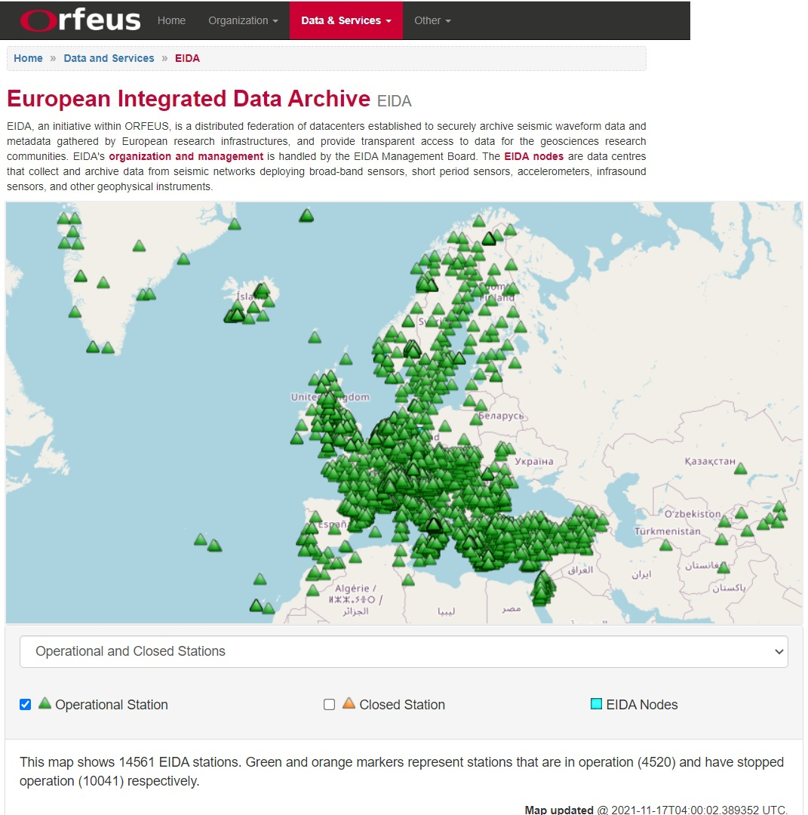
Projects

Slide 5
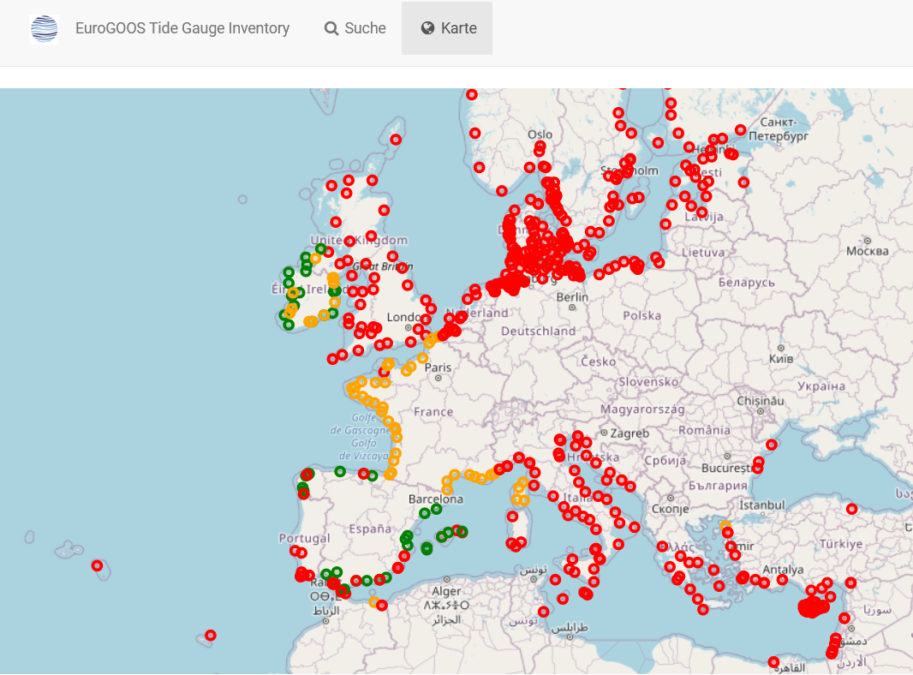
Sea Level Data Availability
EuroGOOS Tide Gauge Inventory
Metadata catalogue of all permanent, managed tide level monitoring stations across Europe and adjacent coastlines, including North Africa

Slide 6
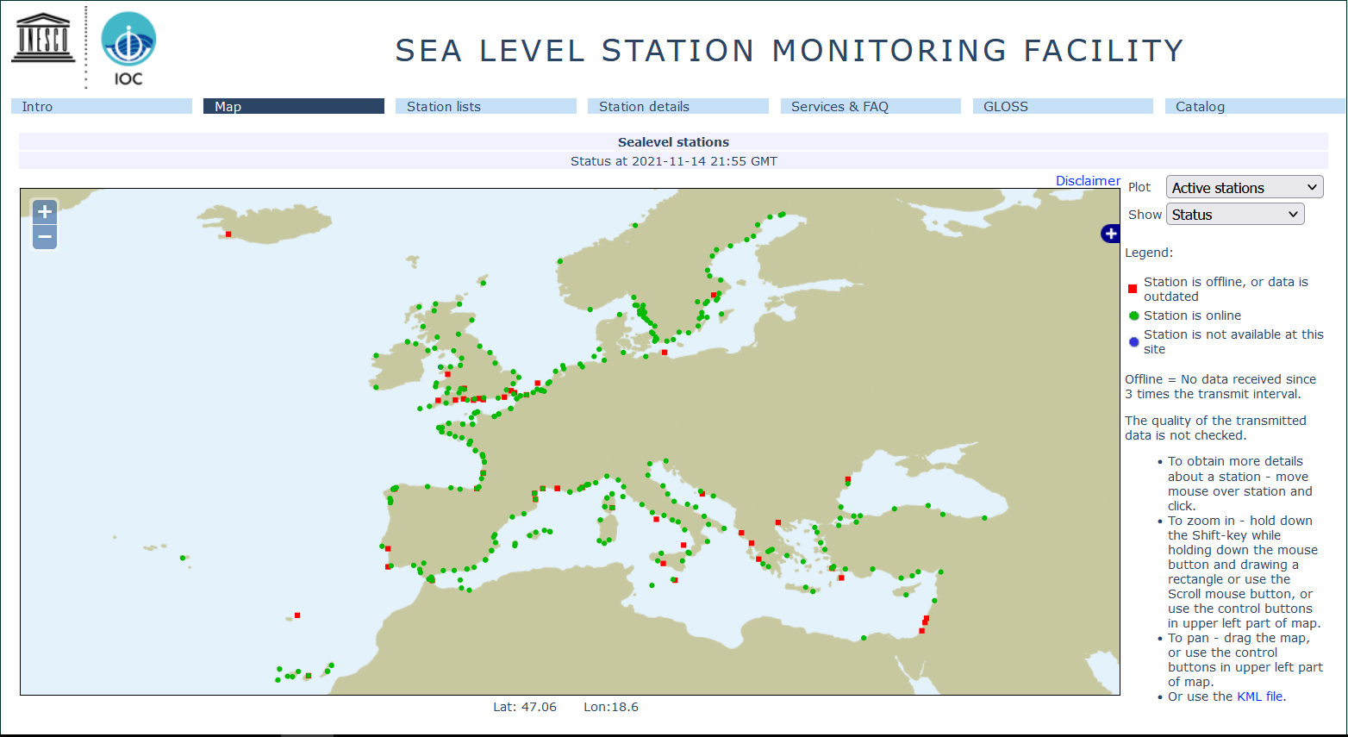
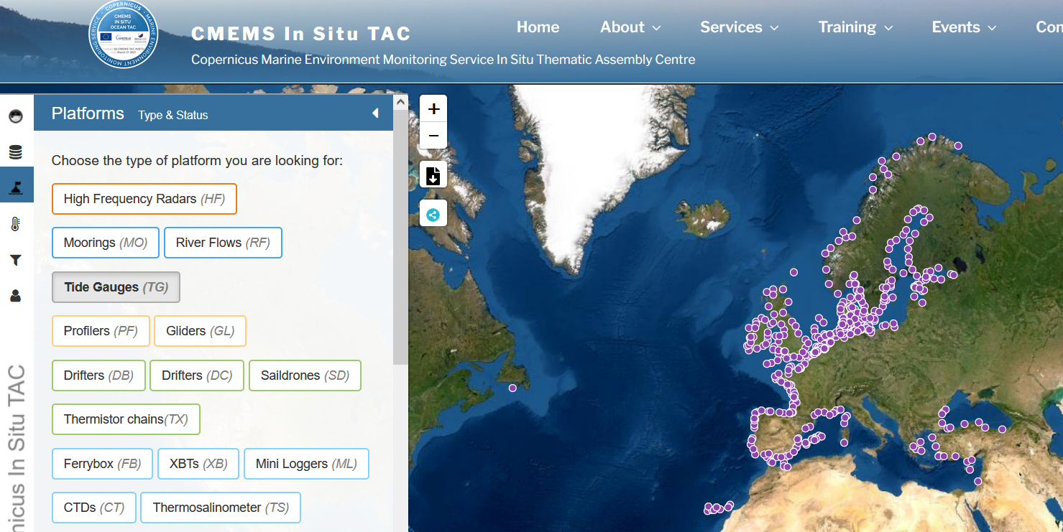
Sea Level Data Availability
Publicly Accessible Sea Level Stations
IOC SLSMF
CMEMC In Situ TAC
Copernicus Marine Environment MonitoringService In Situ Thematic Assembly Centre

Slide 7
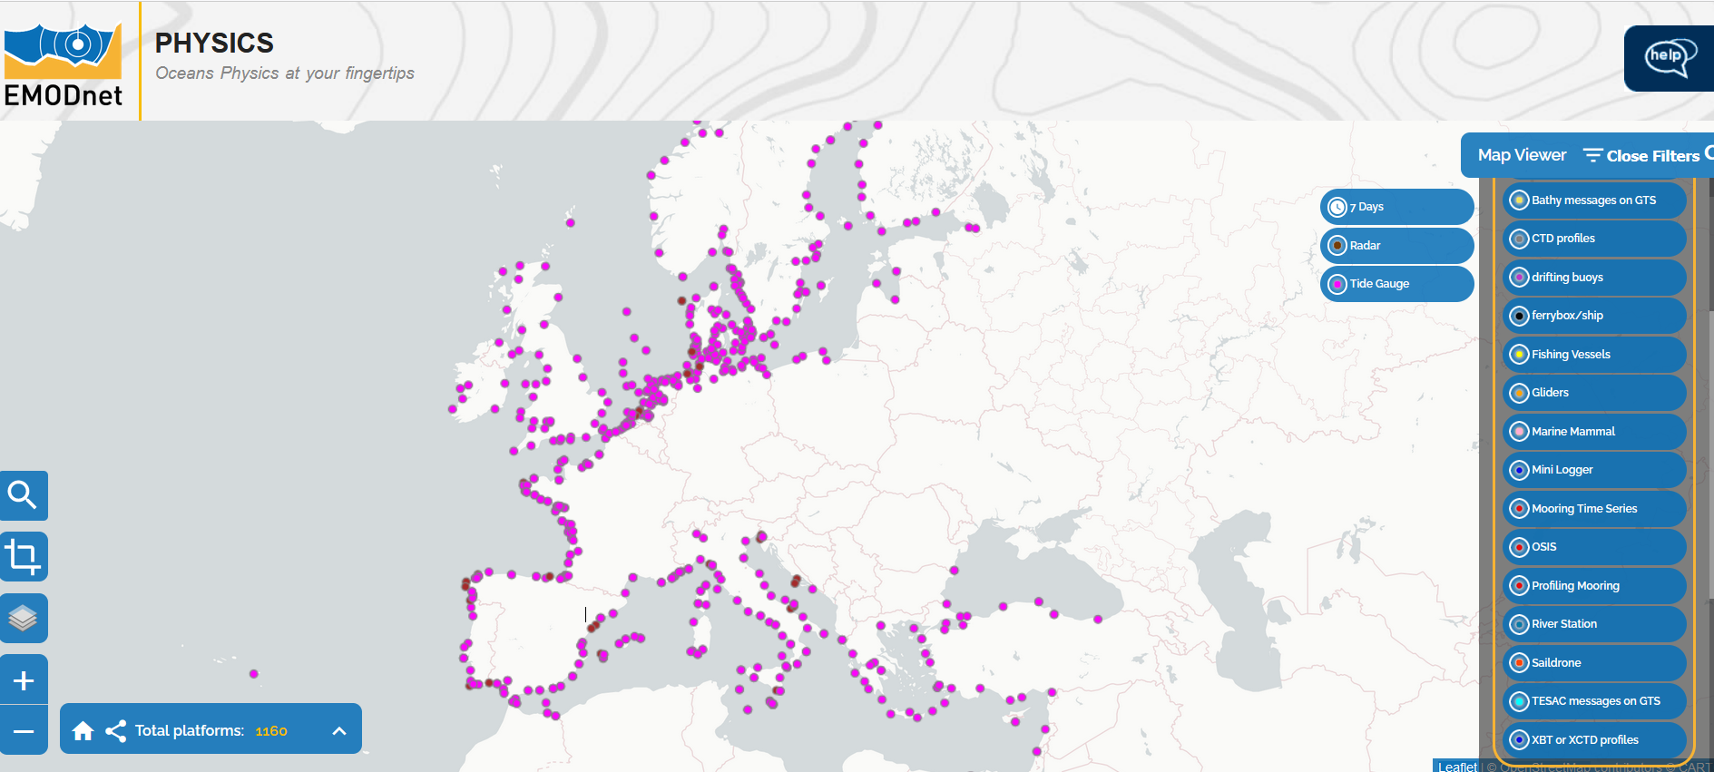
Sea Level Data Availability
Publicly Accessible Sea Level Stations
EMODnet Physics

Slide 8
Projects
1.November 2019-31.12.2023

Slide 9
Actions and Participations
Update of WG 2&3 Member List
Update on Seismic and Sea Level Networks
Participation in virtual Steering Group meeting, April 2021
Report at virtual WG and TT meeting, November 2021
Preperation of PoA for 2022

Slide 10
Thank You!

