Slide 1
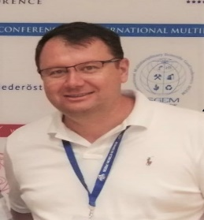
TSUNAMI RELATED ACTIVITIES AT NIEP (ROMANIA)
NATIONAL INSTITUTE FOR EARTH PHYSICS

Slide 2
General Background
Seismic and tsunamigenic sources in the Black Sea
Earthquakes and tsunamis recurrence periods
Black Sea tsunamis monitoring
Detection &Warning
IDSL Black Sea Level Measurement
Tsunami modeling
Functions And Requirements For Tsunami Service Providers
Conclusions

Slide 3
GENERAL BACKGROUND - BLACK SEA
Almost all countries surrounding the Black Sea have faced tsunamis in the past.
A total number of 22 tsunamis were generated in the Black Sea (Altinok, 1999), 12 of them in the 20th Century. 9 were triggered in Crimea region, 4 in Bulgaria, 6 in Georgia and Russia, 3 in Turkey (2 generated by inland earthquakes).
The velocity of travel waves was around 120 - 140 km/h and the time of travel from one coast to the another varied between 10 to 110 minutes (Nikonov ,1997a).
The first historical documented tsunami from the Black Sea is an event triggered in the 1st Century BC, in Bisone area, on the Bulgarian shore of the Black Sea (Nikonov, 1997).
The event with the highest magnitude was an earthquake of M = 8, on 25th of December 1939, in Turkey, known as “Erzincan Earthquake” (Yalciner, 2004). It was generated inland, 60 km away from the shore, but still triggered small tsunami waves.
The most known tsunami from the western Black Sea area was related to an earthquake of M = 7.2, generated in Shabla area (Bulgarian shore) on 31st of March 1901. It has triggered tsunami waves of 5 m height and according to some sources (Papadopoulos et al., 2011), and waves of 2.5-3 m height, according to other source (Ranguelov & Gospodinov, 1995).
The most recent tsunami was observed on 7th of May 2007 on the Bulgarian coast of the Black Sea, generating waves of 1.2 m. This event had a non-seismic source, being most probably generated by an underwater landslide (Ranguelov et al., 2008).

Slide 4
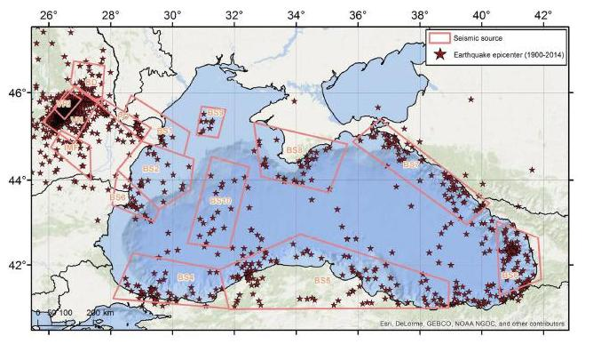
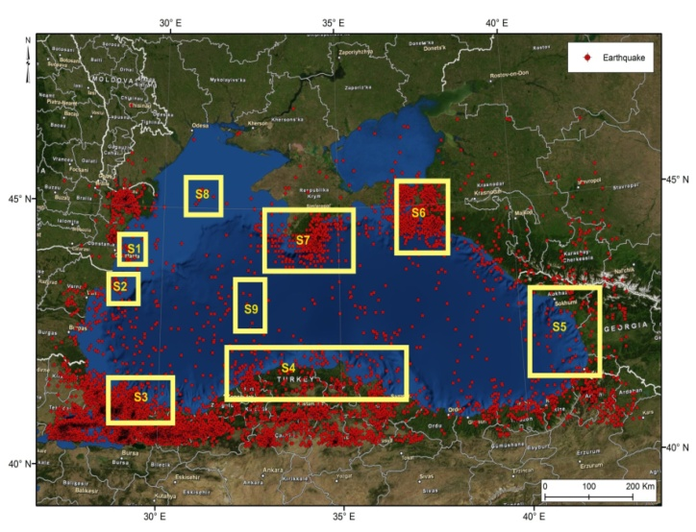
SEISMIC AND TSUNAMIGENIC SOURCES IN THE BLACK SEA
According to previous studies, the Black Sea area is divided in 9 seismic sources (M. Diaconescu et al., 2008), of which only 4 are of interest for possible tsunami generation along the Romanian shore: S1 - Central Dobrogea, S2 - Shabla, S7 - Crimea, and S8 - West Black Sea.
I.A. Moldovan et al. (2014) use a different approach, dividing the area in 10 different seismic sources, with irregular shapes. The two approaches have similar locations of the sources, but spread differently.
The earthquakes responsible for tsunamis generation must have: normal or inverse fault plane solutions, magnitude Mw > 6.5, and focal depth lower than 20-40 km.

Slide 5
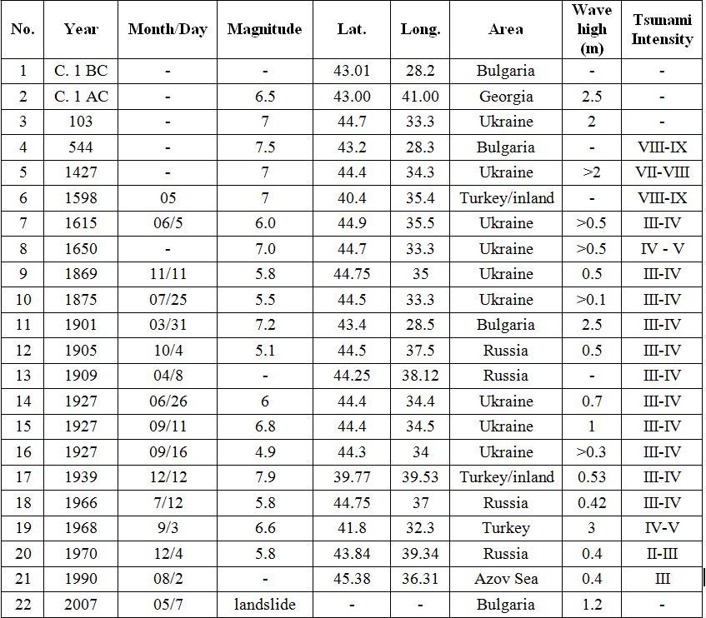
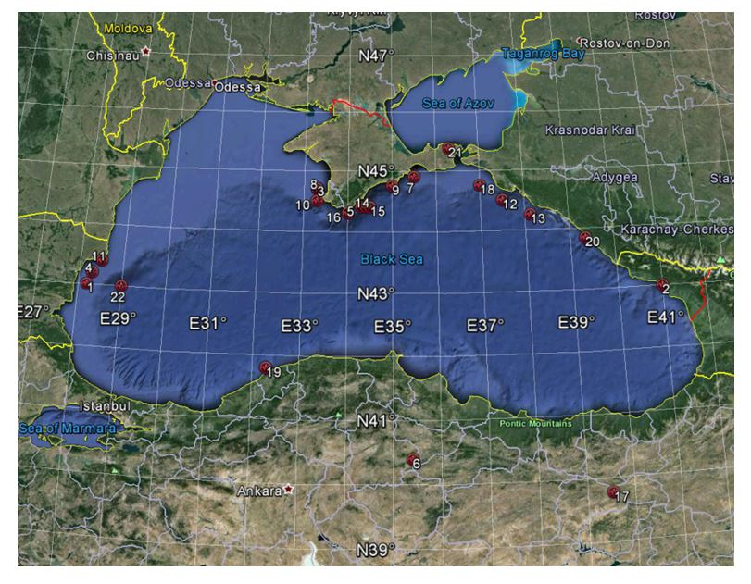
PAST EVENTS - BLACK SEA
Past tsunamis generated in the Black Sea, extracted from the catalogue of Papadopoulos et al. (2011)
The Tsunami Intensity corresponds to the Papadopoulos and Imamura intensity scale (2001) and incorporates 12 divisions, arranged according to the tsunami's effects on humans, on objects (including boats), and damage to buildings.

Slide 6
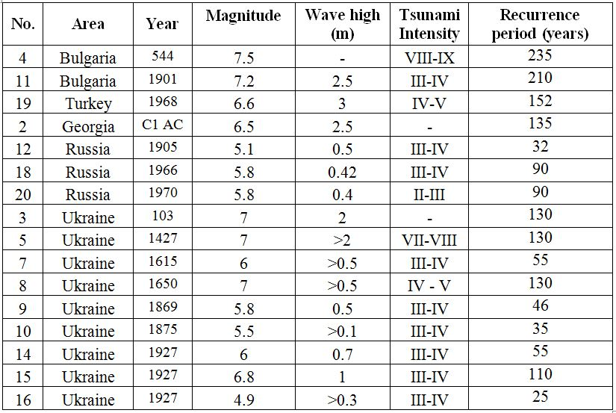
EARTHQUAKES AND TSUNAMIS RECURRENCE PERIODS
The recurrence periods have been computed using the Gumbel I extreme values distribution (Gumbel, E.J., 1958), for the sources where tsunamis have been observed in correlation with earthquakes, and for the magnitudes of the earthquakes that triggered tsunamis.
The studies have been conducted only for five regions, where tsunamis have been triggered by earthquake occurrence: Bulgaria - Shabla (4, 11), Turkey (19), Georgia (2), Russia (12, 13, 18, 20) and Ukraine - Crimea (3, 5, 7, 8, 9 10, 14, 15, 16).
Using the parameters provided by Moldovan I. A. (2013) and a numeric procedure, the most probable and the expected magnitudes as function of their return periods were also computed.
Earthquakes from Black Sea which triggered tsunamis, and their return periods computed with Gumbel I distribution

Slide 7
BLACK SEA TSUNAMIS MONITORING
The Black Sea area is liable to tsunamis generation and the statistics show that more than twenty tsunamis have been observed in the past (G.A. Papadopoulos, 2011).
• The most known tsunamigenic event being generated on 31st of March 1901, when, according to past studies, an earthquake with Mw = 7.2 has generated tsunami waves of 5 m height (Papadopoulos et al., 2011).
• The National Institute for Earth Physics (NIEP) in collaboration with other institutions of Romania, is acting to strengthen the cooperation and data exchanges with the Black Sea surrounding countries.
• The first tsunami early-warning system in the Black Sea has been implemented and installed since 2013, being part of the of the routine monitoring activity.
• NIEP is Tsunami National Contact (TNC) and Tsunami Warning Focal Points (TWFP) of Romania for The Intergovernmental Coordination Group for the Tsunami Early Warning and Mitigation System in the North-eastern Atlantic, the Mediterranean and connected seas (ICG/NEAMTWS), actively participating to the group’s activity and annual meetings, in the last 6 years.
• NIEP developed and implemented a dedicated infrastructure for becoming potential Tsunami Warning Centre in the Black Sea area, used for Global and regional tsunami monitoring, detection and warning (tsunami.infp.ro).

Slide 8
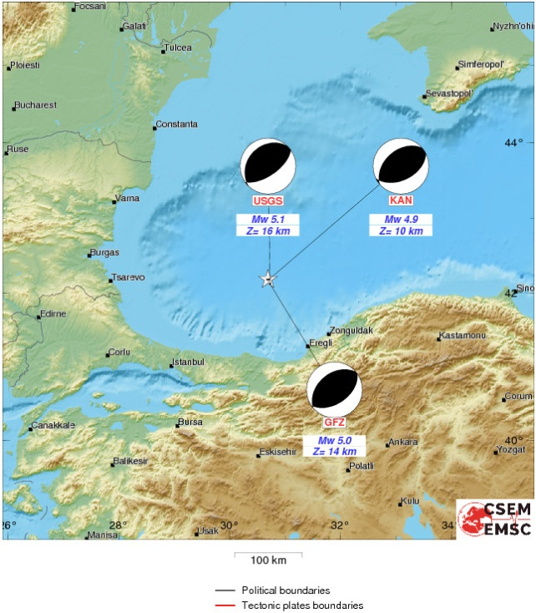
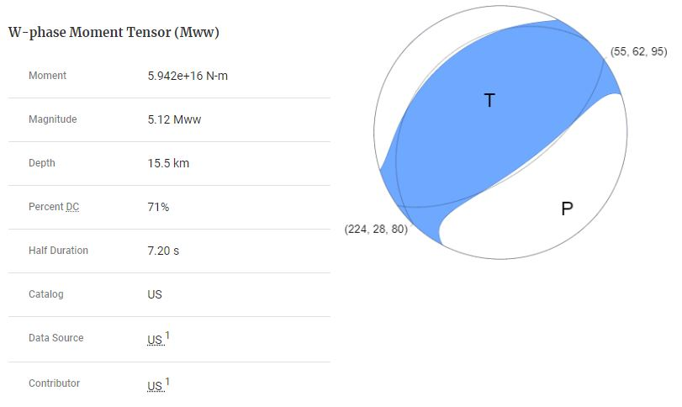
NEAR REAL TIME FOCAL MECHANISM SOLUTIONS
Example of a recent event from Black Sea (Turkey) with Mw>5, 15.10.2016, Mw 5.1
(sources: EMSC-CSEM,USGS)
NIEP perform MT in automatic mode using FMNEAR (Bertrand Delouis ) and TOAST (Gempa LTD). In manual mode we use ISOLA.

Slide 10
TSUNAMI EARLY WARNING SYSTEM
The first tsunami early-warning system in the Black Sea has been implemented in 2013 in the framework of the project “Set-up and implementation of key core components of a regional early-warning system for marine geo-hazards of risk to the Romanian-Bulgarian Black Sea coastal area - MARINEGEOHAZARDS”, in collaboration with the National Institute for Marine Geology and Geoecology (GeoEcoMar), the Institute of Oceanology and the Geological Institute, belonging to the Bulgarian Academy of Science.
The tsunami warning system consists of both onshore and offshore equipment: buoys, sea level sensors, seismic stations, Tsunami Analysis Tool (TAT) and GEM software. Different types of data and information are transmitted to the main NIEP Center.
NIEP developed a coastal seismic network (Installation of 3 seismic stations) and a sea level sensors (radar and pressure sensors in 3 sites) ; - Seismic data exchange agreement with Black Sea countries;
Seismic Early Warning System for crustal earthquakes near coastal area;
- Tide gauges data exchange with Black Sea countries through global network;
- Meteorological and GPS stations at every site.
- 3 Buoys sensors were also installed and are functioning, belonging to GeoEcoMar.

Slide 11
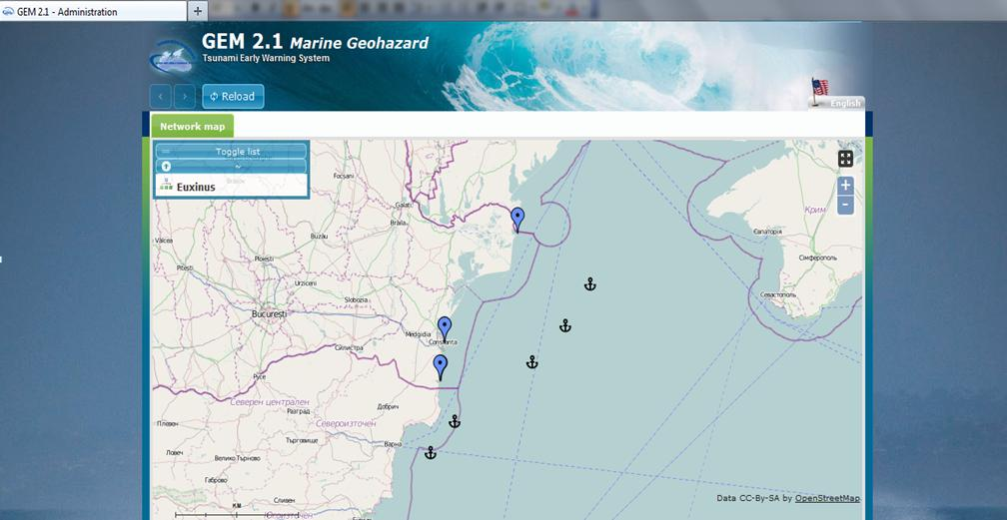
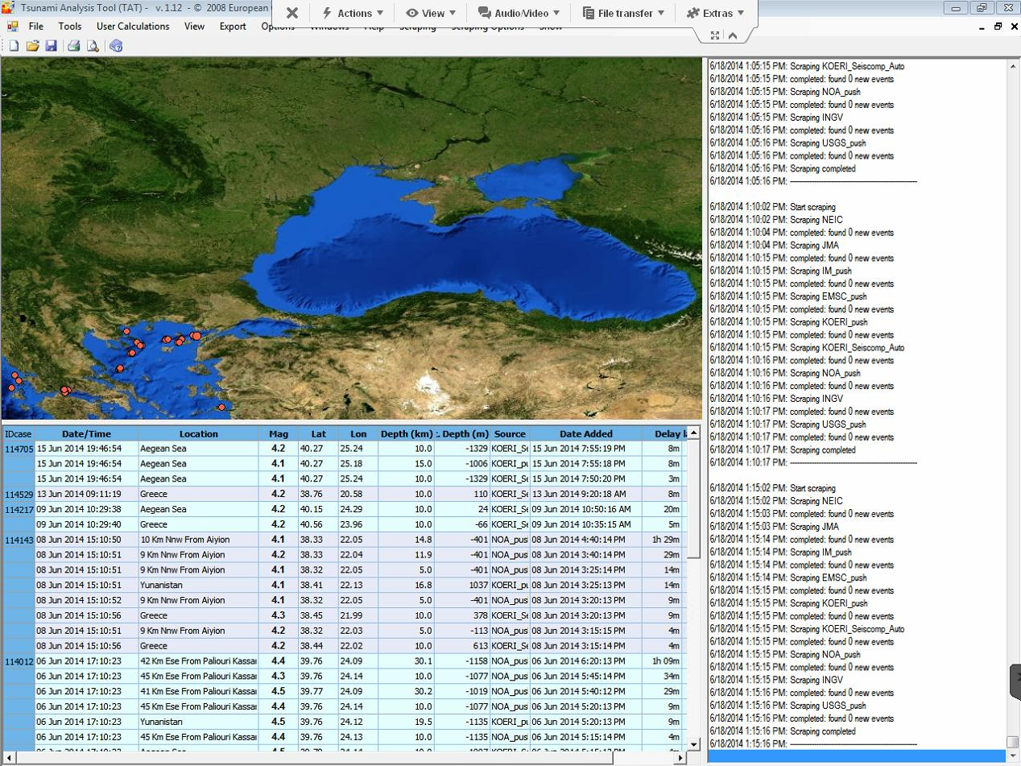
MARINEGEOHAZARDS PROJECT
GEM software
interface
Tsunami Analysis Tool (TAT) software interface

Slide 12
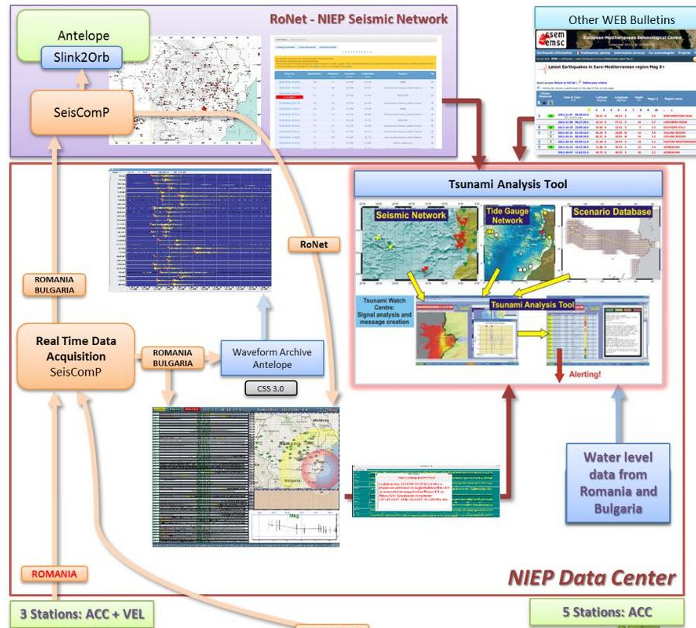
TSUNAMI DETECTION WORKFLOW

Slide 13
TSUNAMI DETECTION WORKFLOW
Earthquake detected
EWS +LocSat-Antelope
BLACK SEA EVENT
M>3.0
Portal
M>5.0
Report
Analyze if Earthquake has Potential to Generate Tsunami (TAT, Moment tensor, Fault
Message
Portal, Autorities
Email, SMS- users
YES
NO
Message (Cancel)
Message
Sea Level Measurement
No, threat
Message
YES, threat
Message
Tsunami threat ended
Message

Slide 14
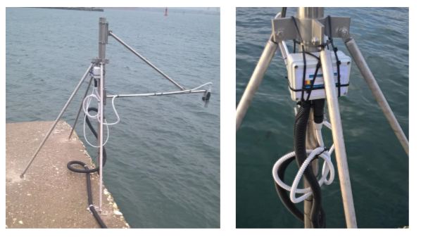
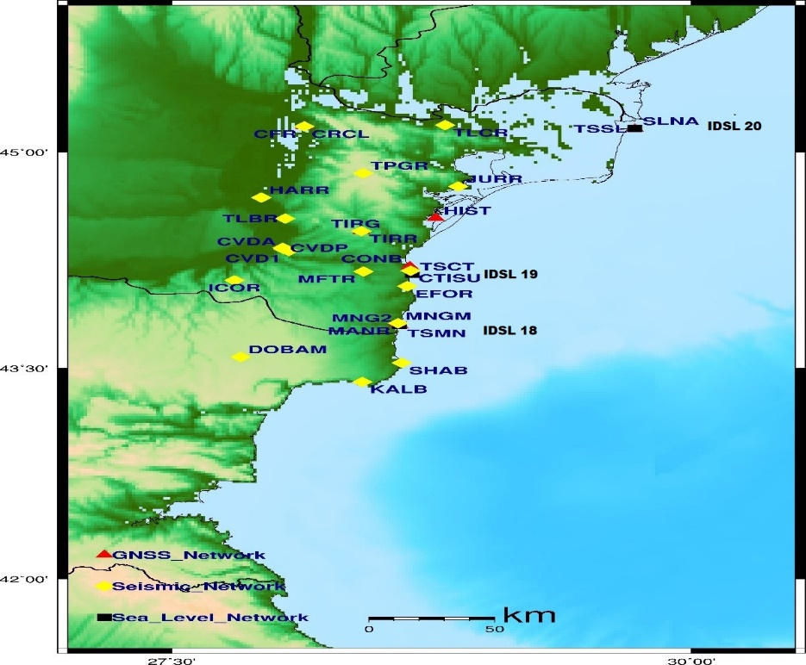
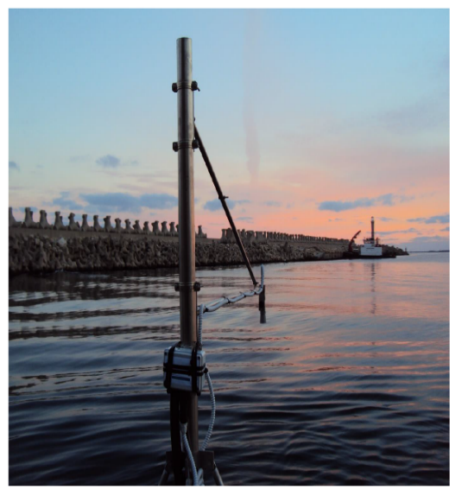
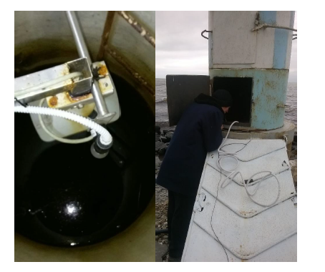
IDSL BLACK SEA LEVEL MEASUREMENT DEVICE
IDSL 18 Mangalia
- Capability map of GPS / GNSS monitoring systems, seismic stations and IDSL water level for the Dobrogea area
IDSL 19 Constanta*
IDSL20 Sulina*
* IDSL 19 and 20 are currently in revision for solving some technical problems

Slide 15
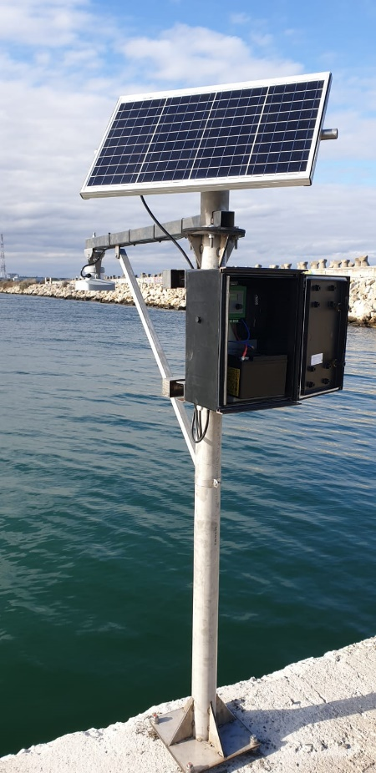
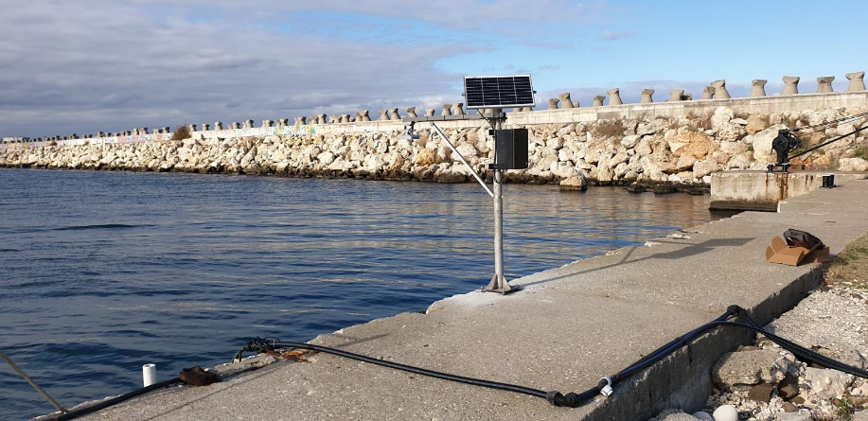
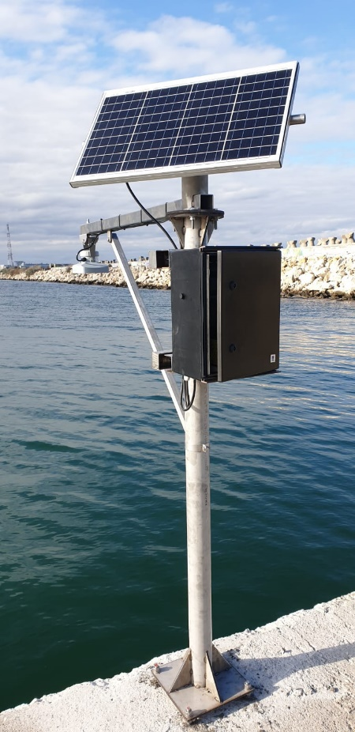
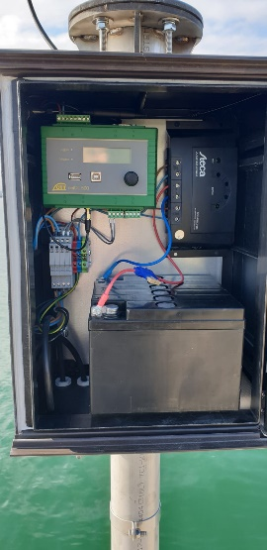
IDSL BLACK SEA LEVEL MEASUREMENT DEVICE
In addition to the old IDSL water level monitoring, recently NIEP has signed a MOU with the Romanian Marine Hidrographic Direction for using the water level data from their devices (Hydromet OTT), situated in Sulina-Far, Cobu-Far, Constanta-Far, Mangalia-Far - the order of sites is from North to South of the Romanian Black Sea Coast.
One of the Romanian Marine Hidrographic Direction Water level device for which the MOU was signed

Slide 16
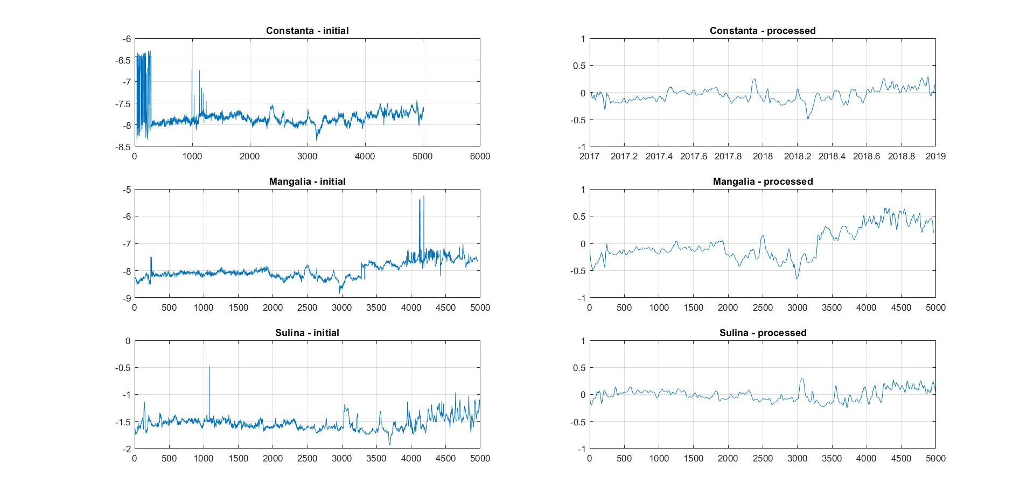
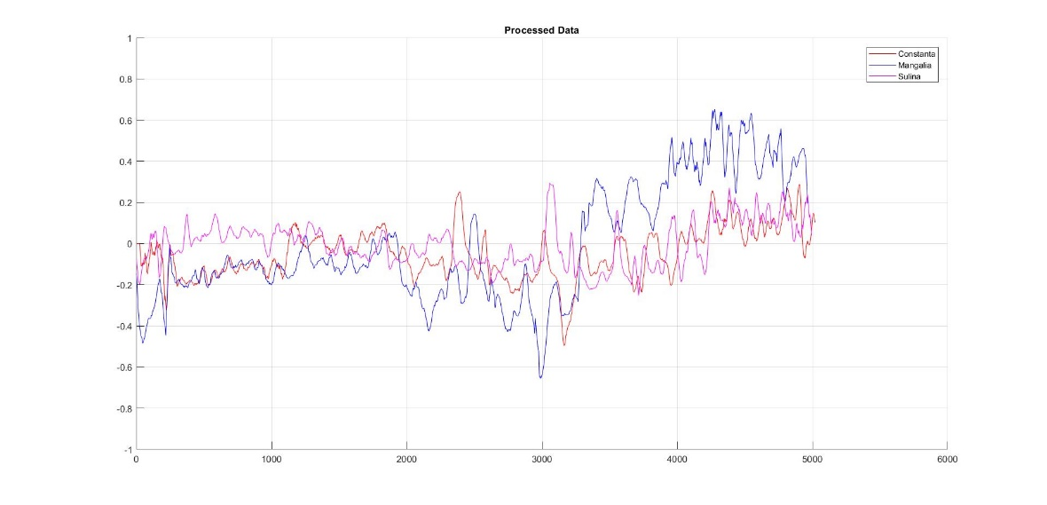
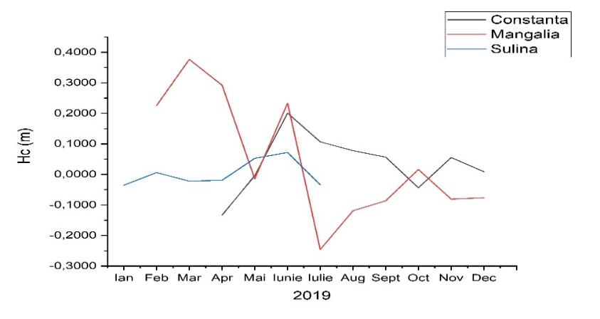
IDSL BLACK SEA LEVEL MEASUREMENT PROCESSING DATA
Measurements of sea level data recorded by an IDSL sensor and processed in order to eliminate any false alarms and reduce the level of clutter [Nagal 2014]. The data was recorded from 06.04.2017 to 07.03.2018 in the coastal cities of Constanta, Mangalia and Sulina
Figure 2. Comparative view of the processed sea level data from the each of the three locations
Figure 1. Comparative view of the measured height data, before and after processing Data 2018

Slide 17
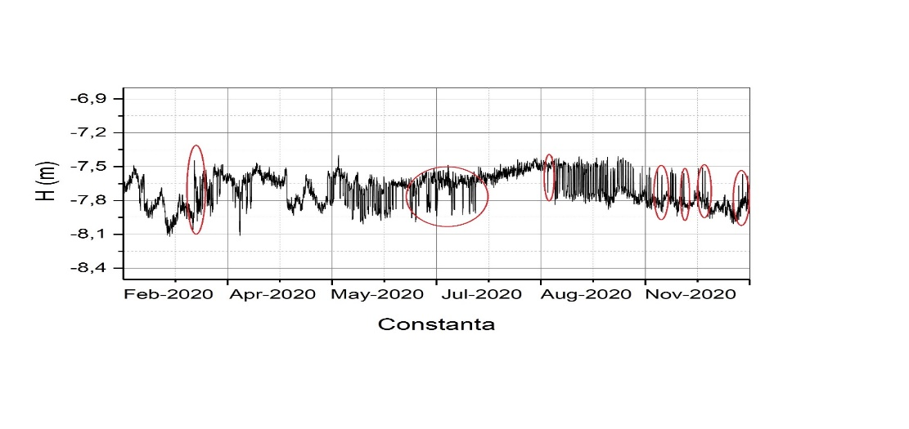
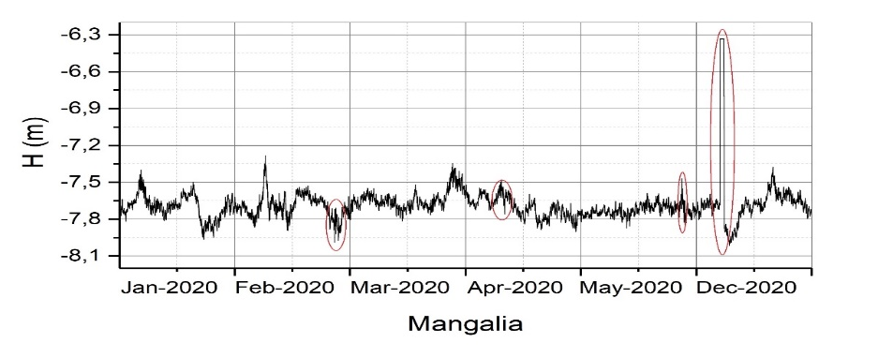
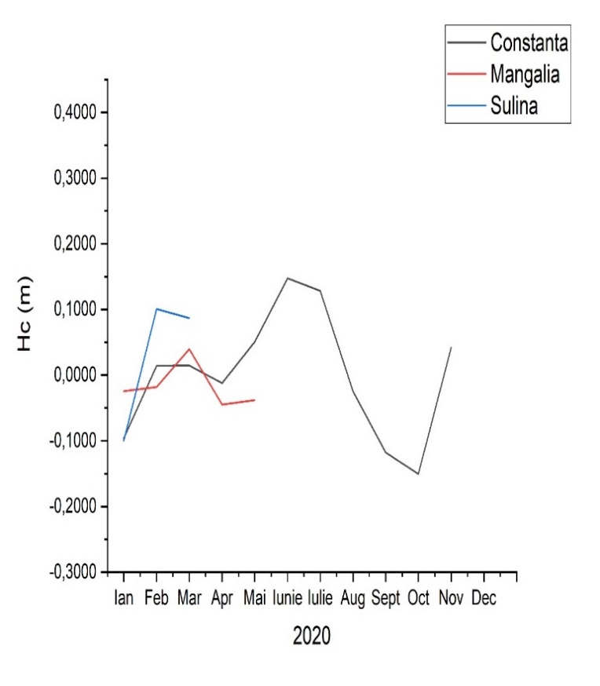
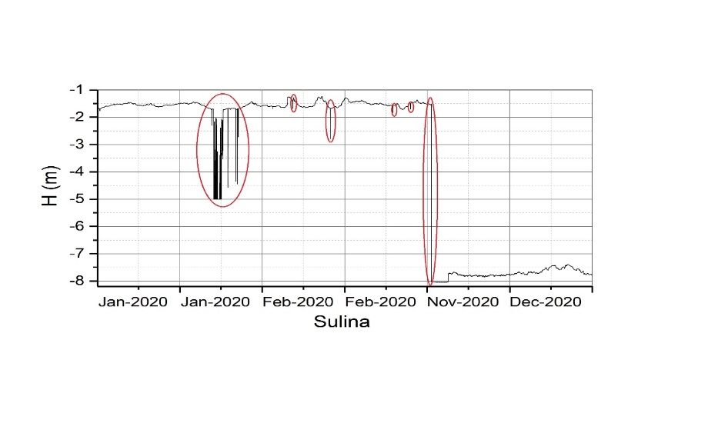
IDSL BLACK SEA LEVEL MEASUREMENT PROCESSING DATA
Data | Constanta Hc (m) | Mangalia Hc (m) | Sulina Hc (m)
January | -0,0960 | -0,0246 | -0,1000
February | 0,0143 | -0,0179 | 0,1007
March | 0,0145 | 0,0398 | -
April | -0,0121 | -0,0450 | -
May | 0,0506 | -0,0378 | -
June | 0,1476 | - | -
July | 0,1285 | - | -
August | -0,0249 | - | -
September | -0,1180 | - | -
October | -0,1507 | - | -
November | 0,0422 | 0,0712 | -
December | - | 0,0116 | -
Data | Constanta Hc (m) | Mangalia Hc (m) | Sulina Hc (m)
January | -0,0960 | -0,0246 | -0,1000
February | 0,0143 | -0,0179 | 0,1007
March | 0,0145 | 0,0398 | -
April | -0,0121 | -0,0450 | -
May | 0,0506 | -0,0378 | -
June | 0,1476 | - | -
July | 0,1285 | - | -
August | -0,0249 | - | -
September | -0,1180 | - | -
October | -0,1507 | - | -
November | 0,0422 | 0,0712 | -
December | - | 0,0116 | -

Slide 18
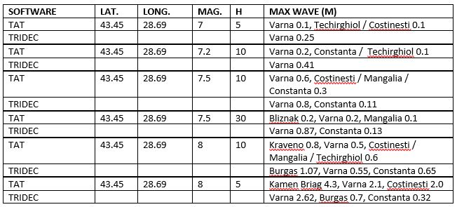
TSUNAMI MODELING
• The Romanian shore is affected mostly by high magnitude earthquakes triggered in Shabla, Crimeea and Istanbul regions.
• NIEP has structured databases of tsunami modeling scenarios using two different software: Tsunami Analisys Tool (TAT) and TRIDEC Cloud.
• A comparison of scenarios was accomplished, using both software and same input earthquake parameters. Some of the results are presented bellow.
• Moreover, a PhD thesis is in course, based on tsunami modeling simulations and using the whole Black Sea as study area, with the title:
“Black Sea tsunami modeling scenarios”
• Two examples of simulations are presented in the following slides, using both software and similar input earthquake parameters (same location and magnitude, different depth).

Slide 19
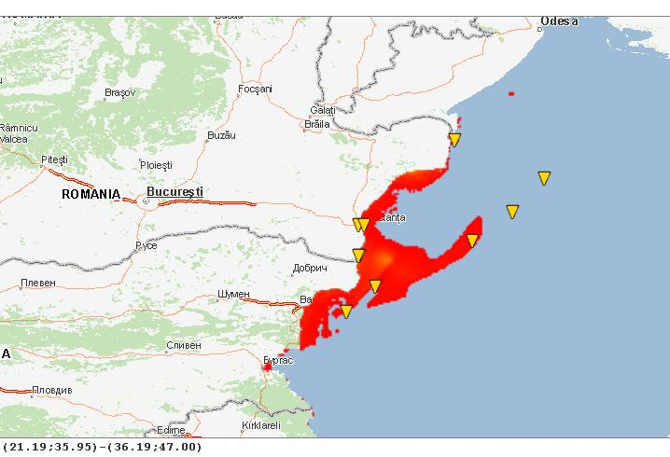
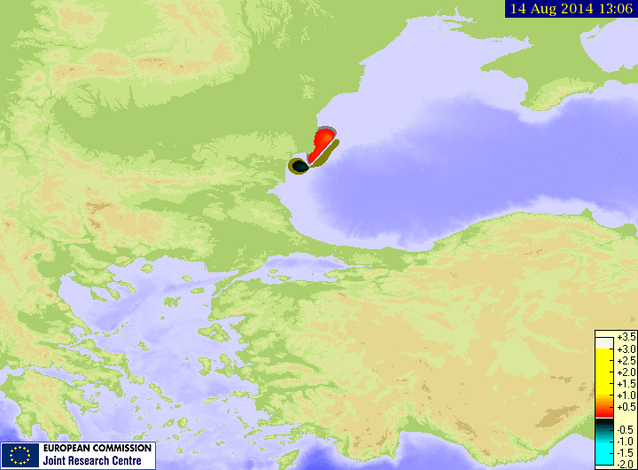
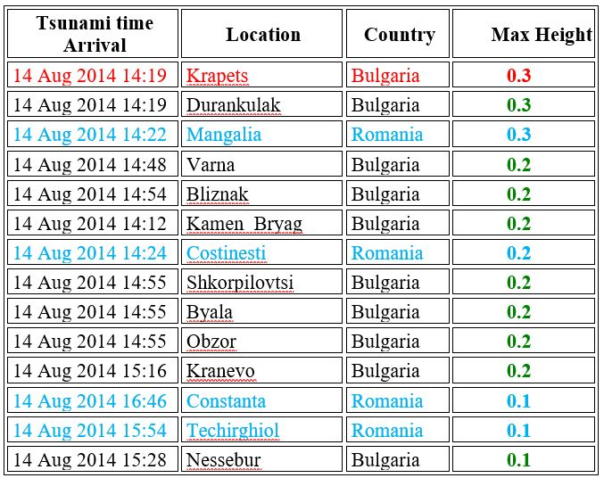
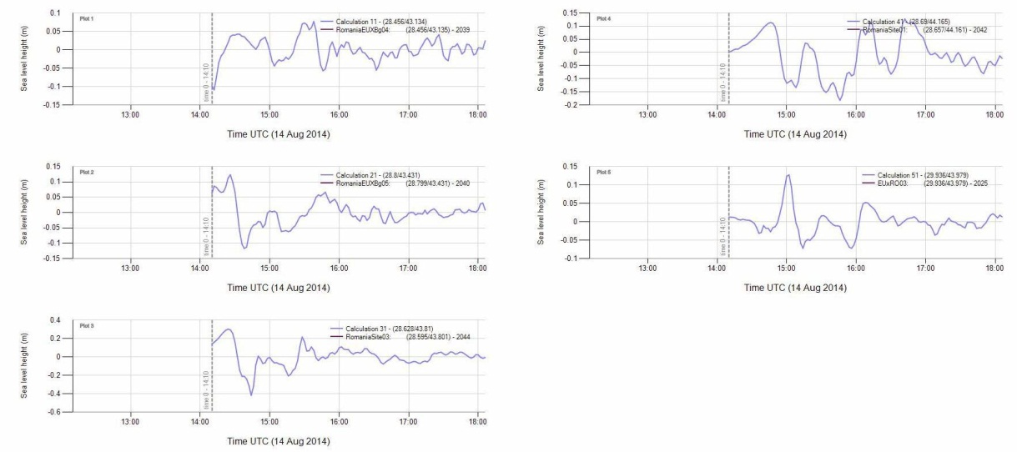
TSUNAMI SIMULATION FOR AN EARTHQUAKE IN SHABLA AREA (TAT software) INITIAL CONDITIONS: LAT. 43.45, LONG. 28.69, Mw 7.5, DEPTH 10 KM

Slide 20
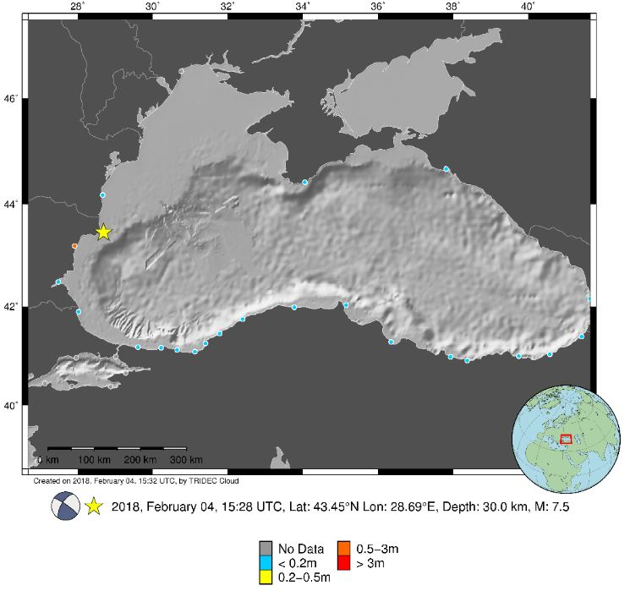
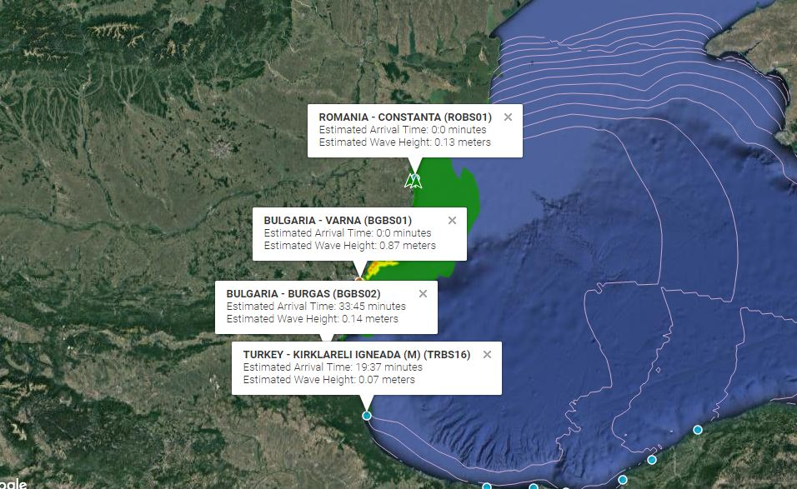
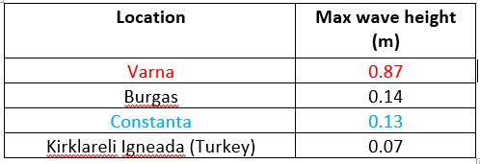
TSUNAMI SIMULATION FOR AN EARTHQUAKE IN SHABLA AREA (TRIDEC software) INITIAL CONDITIONS: LAT. 43.45, LONG. 28.69, Mw 7.5, DEPTH 30 KM

Slide 21
FUNCTIONS AND REQUIREMENTS FOR TSUNAMI SERVICE PROVIDERS
Watch Function
Reception and interpretation of real-time seismic and sea-level measurements
Determination of seismic parameters
Forecast of tsunami arrival times and level of alert at forecasting points specified by Member States
Exchange seismic and sea level parameters and information with other TSPs and NTWCs
Disseminate watch and cancellation messages based on the alert-level decision matrix (or best practices including numerical simulations and other methods ) to NTWCs and the TWFPs
Monitoring of tsunami propagation and disseminate updated information in priority tsunami amplitude measurements
Function as a NTWC
Function above and beyond watch time
Monthly internal tests of the watch system
Actively participate in communication and tsunami exercises
Contribute to training courses in coordination with IOC
Participate actively in, and report to, the ICG and working groups and task teams
Requirements
Seismic as well as tsunami/oceanographic expertise
Direct access to a local database of tsunami and large earthquakes
Real-time transmission systems for reception of data
Real-time alert reception and transmission systems including GTS, internet, fax
Operational manual describing procedures and documentation for TSRs
Backup and redundant system
24/7 watch staff
Tsunami modelling capacity for travel time computation

Slide 22
CONCLUSIONS • Along with other Institutes, we have achieved the first system of monitoring and real-time warning of marine hazards in the Black Sea. • Given its increased interest shown lately in marine related hazards, NIEP is planning to add new equipment to the existing network and to continuously monitor the seismic activity in the western Black Sea area. • Researchers from NIEP have structured numerous scientific papers, presented at national and international conferences, and/or published in different articles, related to earthquakes and tsunamis in the Black Sea. • NIEP was and is still involved in national, regional and international tsunami related projects: National projects: Multidisciplinary researches on natural hazards. Case study: tsunami type phenomenon in the Black Sea (PROFET) Regional projects: Black Sea Earthquake Safety Net(work) (ESNET); Set-up and implementation of key core components of a regional early-warning system for marine geo-hazards of risk to the Romanian-Bulgarian Black Sea coastal area (MARINEGEOHAZARDS). International projects: Assessment, STrategy And Risk Reduction for Tsunamis in Europe - Black Sea (ASTARTE); Global Tsunami Informal Monitoring Service (GTIMS); Global Tsunami Informal Monitoring Service 2 (GTIMS2); All Risk Integrated System Towards the Holistic Early-Warning (ARISTOTLE), All Risk Integrated System Towards the Holistic Early-Warning 2 (ARISTOTLE 2), Accelerating Global science In Tsunami HAzard and Risk analysis (AGITHAR) • NIEP is also part of the Global Tsunami Monitoring (GTM) group. • The Global Earthquake Monitoring Processing Analysis (GEMPA) software was also recently installed at NIEP, with its tsunami related section Tsunami Observation and Simulation (TOAST).

Slide 23
Contributing Authors:
NIEP
Constantin Ionescu
Iren-Adelina Moldovan
Cristian Ghita – presenting author
Raluca Partheniu
Alexandru Marmureanu
Edvin Murat
GEOECOMAR
Vlad Radulescu

Slide 24
THANK YOU FOR YOUR ATTENTION!

