Slide 1

DEVELOPING TSUNAMI READY PROGRAMME IN NEAM REGION
ARETI PLESSA and CECILIA VALBONESI
CO - CHAIR WG4 Public Awareness, Preparedness and Mitigation

Slide 2
TSUNAMI READY COMMUNITIES IN NEAM REGION
SPAIN: Chipiona
FRANCE: Cannes
ITALY: Palmi, Minturno, Marzamemi
TURKEY: Bodrum, Didim, Marmaris, Fethiye and Kaş were identified potential Tsunami Ready candidates
The contribution of Last Mile Project to TR

Slide 3
TSUNAMI READY IN SPAIN: CHIPIONA
IHCantabria is finalizing the first phase of a project, with the support of the University of Malaga and sponsored by the Municipality of Chipiona, aimed at preparing the municipality of Chipiona for a potential tsunami event.
The project is framed within the internationally recognized Tsunami Ready program,

Slide 4
TSUNAMI READY IN SPAIN: CHIPIONA
Throughout this first phase of the project, coordinated by IHCantabria experts Ignacio Aguirre Ayerbe and Mauricio González, several activities have been carried out with the purpose of obtaining such recognition.
First, tsunami inundation and evacuation maps were modelled and produced for the municipality and the preliminary results of these maps were presented last September to a group of key stakeholders in the municipality at an on-site desk validation workshop.
The work developed also included an exercise, held last October, in which the time needed for the population to move on foot to a safe area along the evacuation routes was analysed. This took into account, on the one hand, different types of population and on the other hand, different conditions of the routes, in terms of limitations and intensity of use.

Slide 5
TSUNAMI READY IN SPAIN: CHIPIONA
The regional drill "RespuestA 21" took place, coordinated by the Junta de Andalucía, where the mechanisms and response times in terms of communication in the municipality of Chipiona were examined, in the event of a potential tsunami event.
Finally, with the support of the tsunami team of IHCantabria, the municipality of Chipiona inaugurated last Wednesday November 3, 2021, a Tsunami Ready office with a permanent exhibition open to the public to raise awareness and thus to contribute to the preparation of the community for such events.

Slide 6
TSUNAMI READY IN FRANCE: CANNES
The TR pilot site for France is the municipality of Cannes. ➯Five main actions have been carried out all year long:
1. Experiments on the population alert capacities: testing of the different channels for broadcasting an alert (siren, loudspeakers, SMS/Calls) and improvement of the alert messages broadcasted to the population;
2. Finalization of evacuation plans and the online publication of an interactive map;
3. Validation of a tsunami signage with the representatives (after having presented several samples of different supports);
4. Extension of the tsunami Charter to hotel owners: it was signed on November 5th during a seminar led by the Cannes Mayor’s
office;
5. Exercise on November 5 ( signposting of two tsunami evacuation routes, testing of messages via loudspeakers) which mobilized the Civil Security Reserve of the city of Cannes, students from the University of Montpellier 3 and passers-by.

Slide 7
TSUNAMI READY IN FRANCE: CANNES
At the national level, it is going to be created the French regional committee (with our TNC and a representative of CEA/CENALT). We hope to submit the composition to UNESCO soon, following the model of what has been done by Italy.
A funding is being requested in order to work on the prevention of tsunami risk in France according to a particular axis around the maritime domains and the specific stakes of tourist accommodations.

Slide 8
TSUNAMI READY IN FRANCE: CANNES
Other actions carried out this year :
1. Every month, the tsunami alert chain is tested by the national civil security (DGSCGC).
2. Every three months, local authorities are associated. This is an opportunity for the municipalities to work on their procedures and to think about prevention actions.
3. The standard operating procedures of the Bouches-du-Rhône department were reviewed and tested during an exercise that took place on November 4. This exercise involved the city of Marseille (2nd French city!) and industrial sites with high technological risks.

Slide 10
TSUNAMI READY IN ITALY: PALMI
PALMI (Tyrrhenian Sea, CALABRIA):
On December 30, 2020, the Municipal Council of Palmi decided officially to participate in the TR programme (see next slide)
The Municipal Council nominated the Tsunami Ready Local Committee
On November 15, 2021, a new Regulatory Plan and Civil Protection Plan was officially approved (including tsunami risk)
Several of the TR 12 indicators are completed (see next slide)

Slide 11


TSUNAMI READY IN ITALY: PALMI

Slide 12
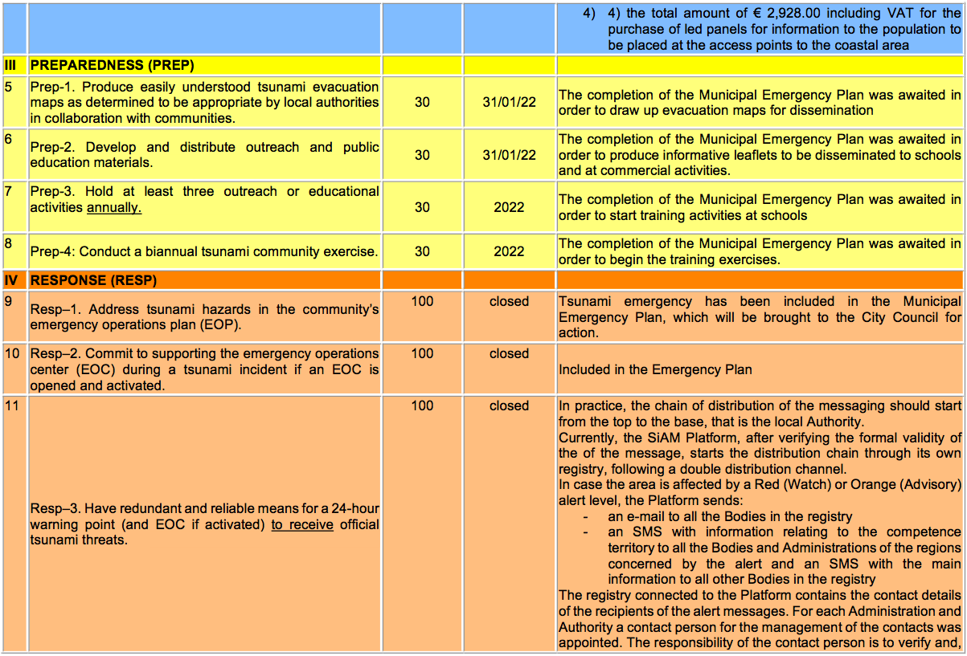
TSUNAMI READY IN ITALY: PALMI

Slide 13
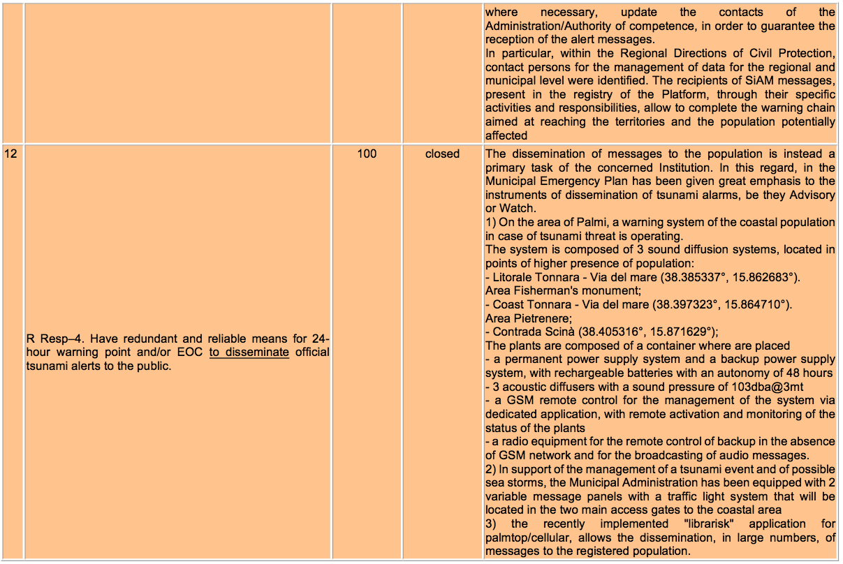
TSUNAMI READY IN ITALY: PALMI

Slide 16
RESOLVES
To enthusiastically join the pilot project sponsored by the Intergovernmental Oceanographic Commission of UNESCO (UNESCO / IOC) that will lead the Municipality of Palmi to obtain the recognition of "TSUNAMI READY" community;
To delegate to the Vigilance and Civil Protection Area, with the assistance of the Municipal Civil Protection Group, the implementation of all procedures and activities aimed at achieving the aforementioned objective;
to arrange for the transmission of this adhesion resolution to the Presidency of the Council of Ministers Department of Civil Protection, to INGV, to the Civil Protection Unit of the Calabria Region, to the Prefecture of Reggio Calabria;
the Municipal Council, by open vote (by roll call by Councillor Surace and by show of hands by the other No. 7 Municipal Councillors present in addition to the Mayor), for a total of No. 9 components of the Municipal Council, with votes in favour No. 9 (Ranuccio, Celi, Galletta, Bonaccorso, Magazzù, Surace, Mauro, Iacovo, Cosentino); votes against: none; abstained: none; absent: 8 (Arcuri, Trentinella, Ippolito, Di Certo, Misale, Melara, Randazzo, Donato); resolves to declare this deed immediately executable, pursuant to and for the purposes of art. 134, paragraph 4, of Legislative Decree no. 267/2000.

Slide 17
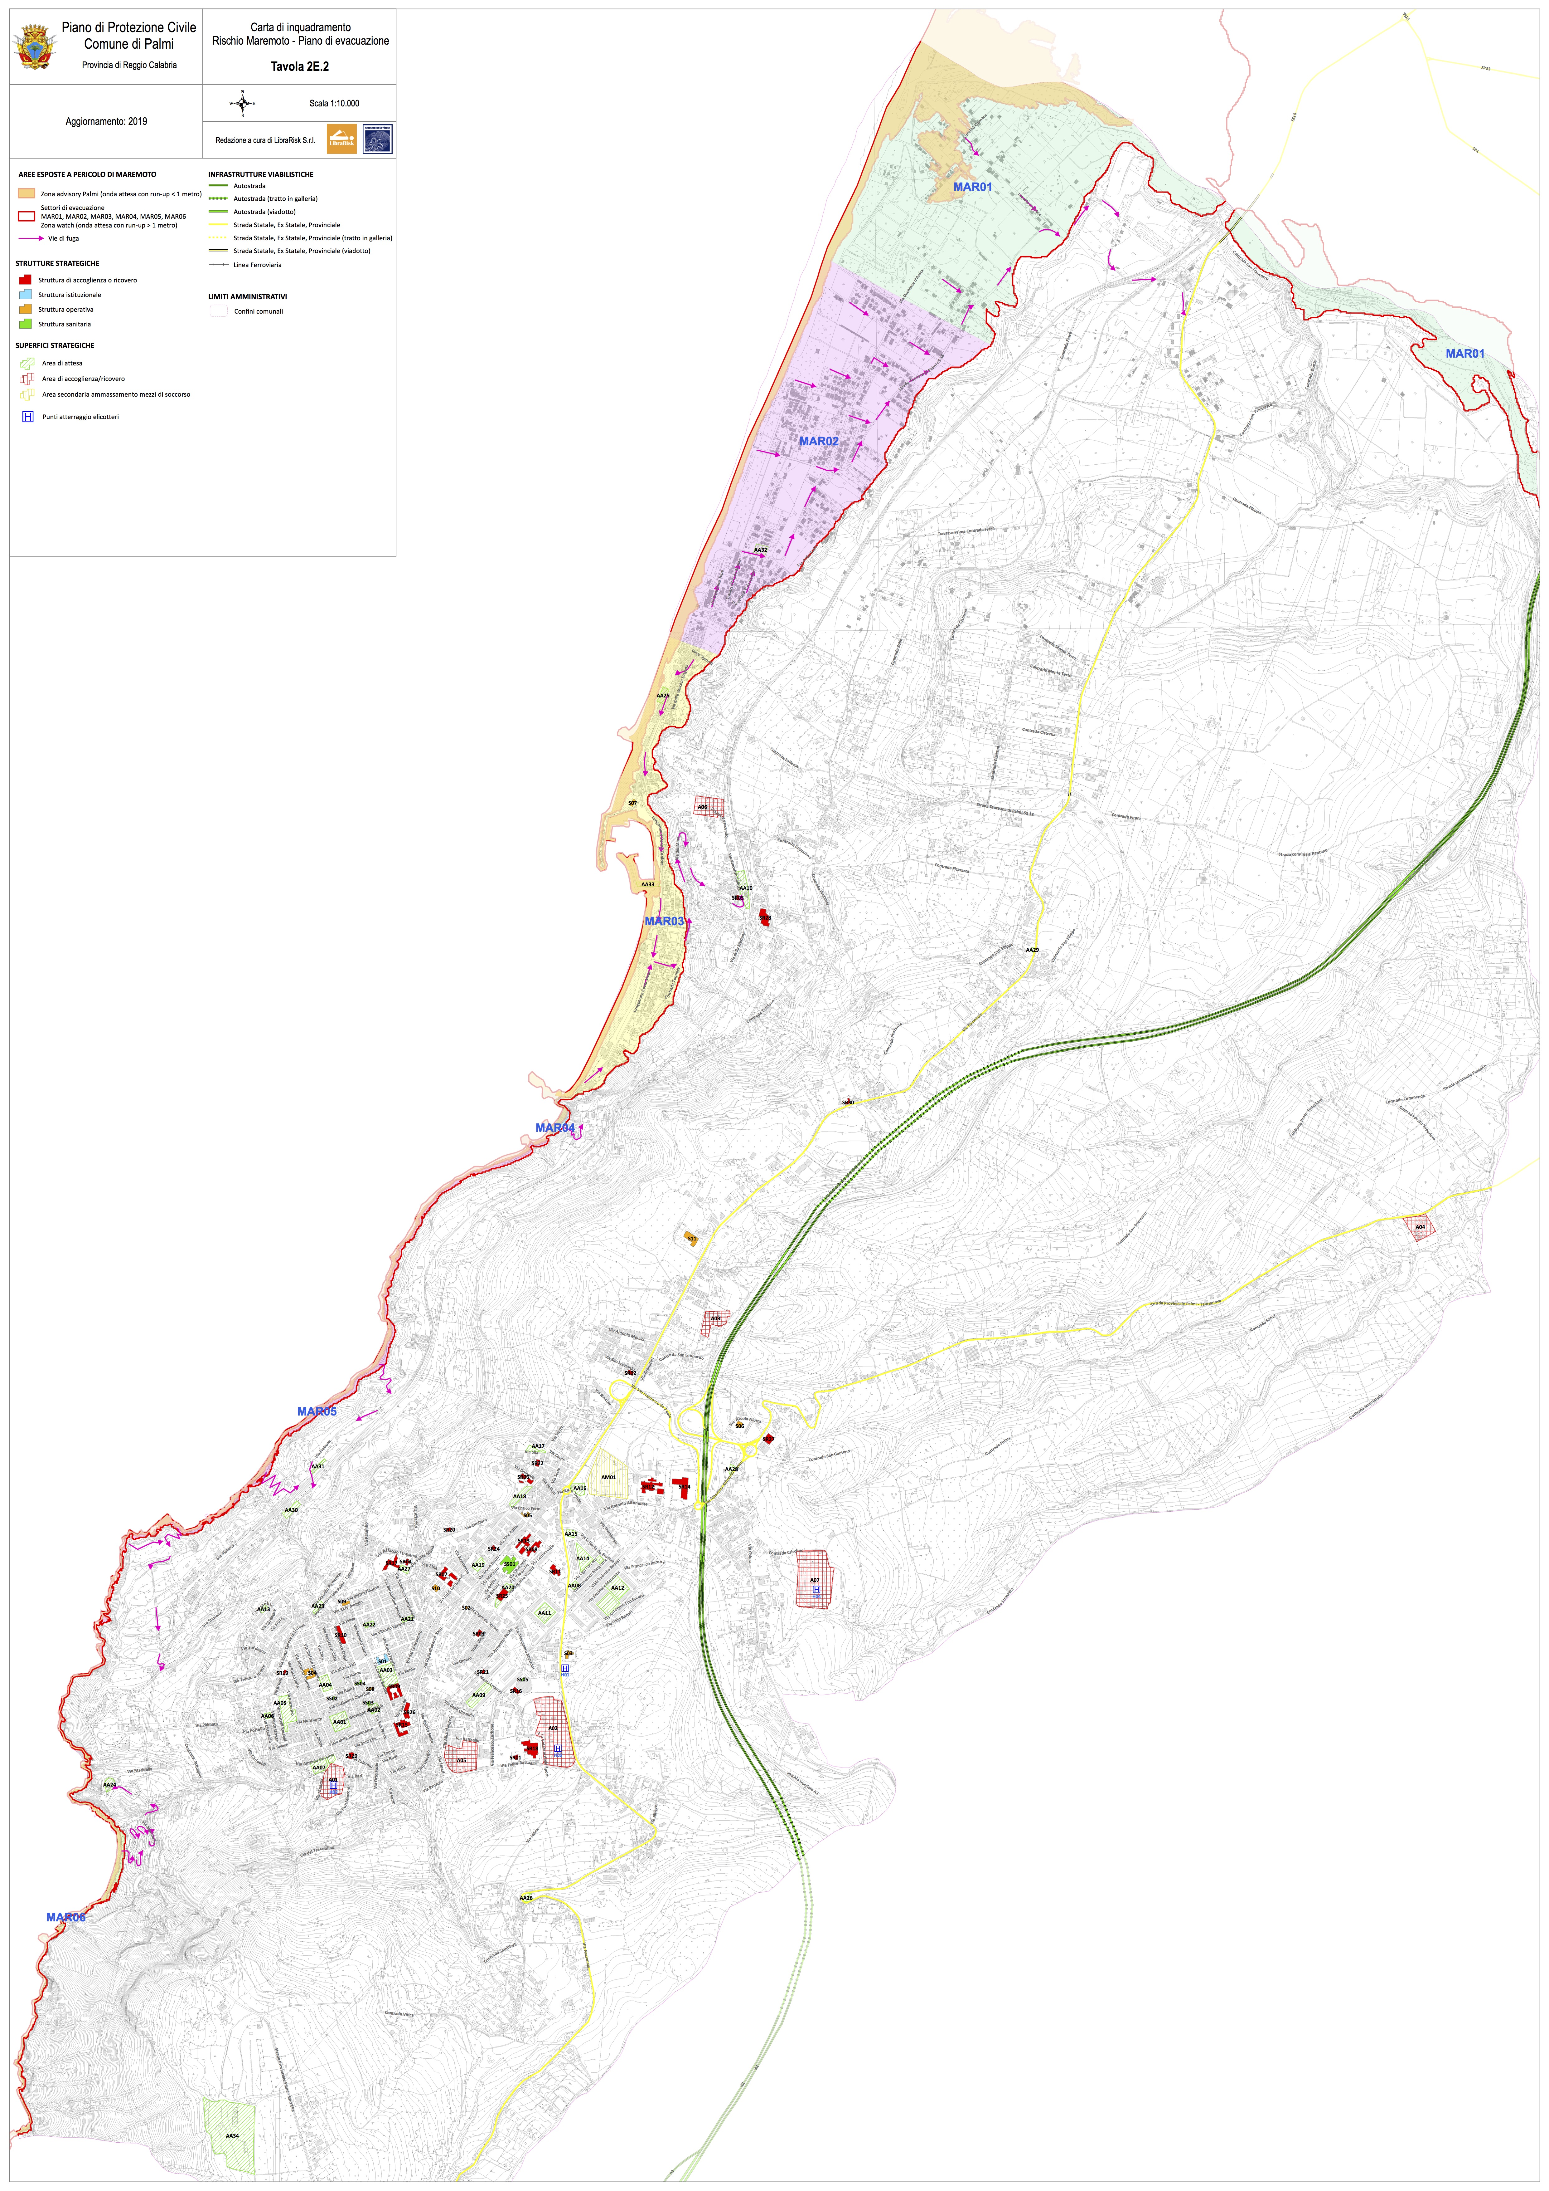
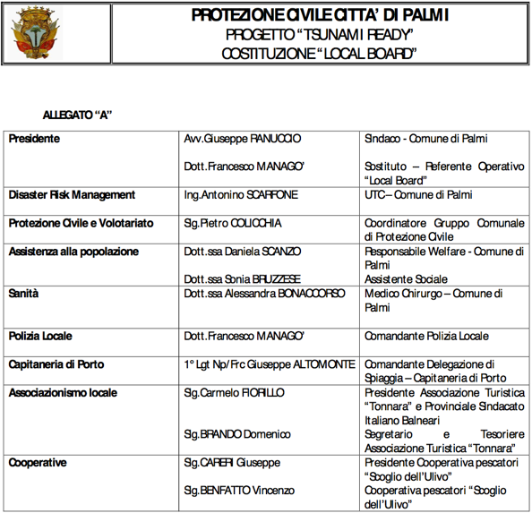
TSUNAMI READY IN ITALY: PALMI

Slide 18
TSUNAMI READY IN ITALY: PACHINO (MARZAMEMI)
MARZAMEMI (Ionian Sea, SICILY)
On April 28, 2021, Marzamemi officially joined the project with a Municipal Council resolution (see next slide)
Note: The municipality was commissioned until October 2021. Now there is a newly elected woman Mayor.

Slide 19
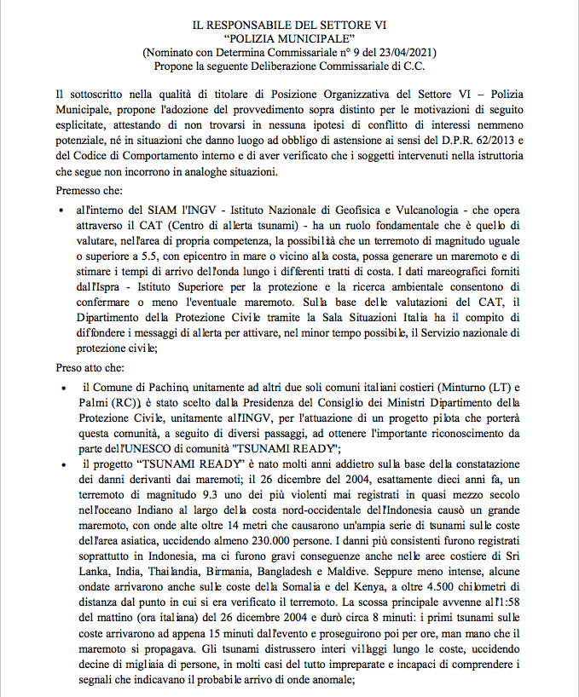
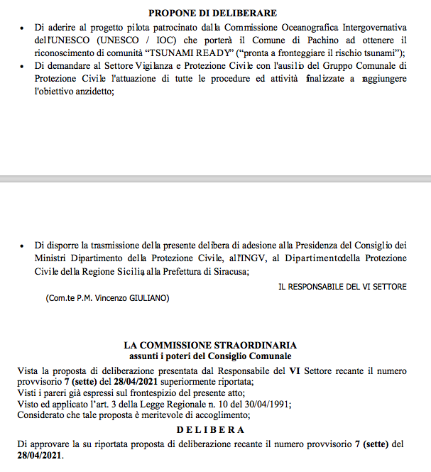
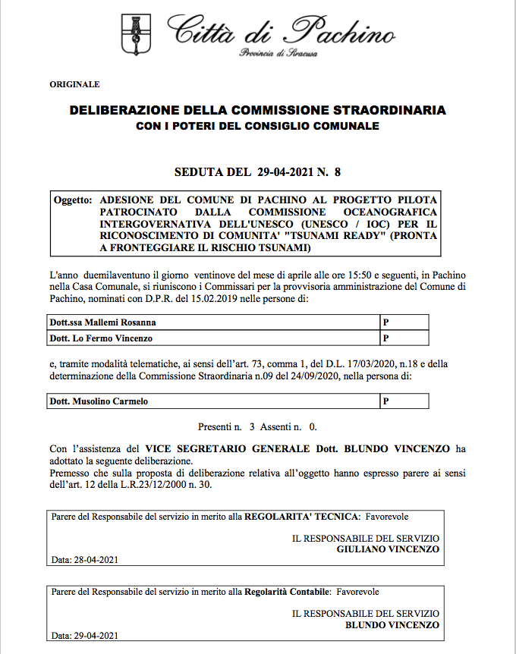
TSUNAMI READY IN ITALY: PACHINO (MARZAMEMI)

Slide 20
TSUN TSUNAMI READY IN ITALY: MINTURNO PALMI
Minturno (Tyrrhenian Sea, Latium):
a) On March 3, 2021, the TR Local Committee was nominated (see the document in next slide).
b) During the NEAMWAVE exercise on 9 March 2021, they tested the sirens and warning lights, as well as the operation level of the APP Alert Sistem.
c) The vertical evacuation of the school was also a very valuable moment because it led to the pupils asking a lot of questions and overall asking to be informed about tsunami risk. A specific educational project is being prepared to follow up on these questions.
d) Most part of Tsunami Ready indicators will be soon completed (see next slides)

Slide 23
DELIBERATES
- To adhere to the pilot project sponsored by the UNESCO Intergovernmental Oceanographic Commission (UNESCO/IOC) that will lead the Municipality of Minturno to be recognised as a "TSUNAMI READY" community;
- To set up the Tsunami Ready Local Committee ("local board") which will be in charge of coordinating activities and interfacing with its equivalent at national level, as per Annex A;
- To delegate to the Civil Protection Service, with the assistance of the Municipal Civil Protection Group, the implementation of all the procedures and activities aimed at achieving the aforementioned objective;
- To order the transmission of this resolution to the Presidency of the Council of Ministers, Civil Protection Department, INGV, Lazio Region Civil Protection Agency, Prefecture of Latina;
By vote, with the same result as the previous one; DECLARES
This deed immediately executable, pursuant to and for the purposes of Article 134, paragraph 4, of Legislative Decree no. 267/2000.

Slide 25
TSUN TSUNAMI READY IN ITALY: MINTURNO PALMI

Slide 26
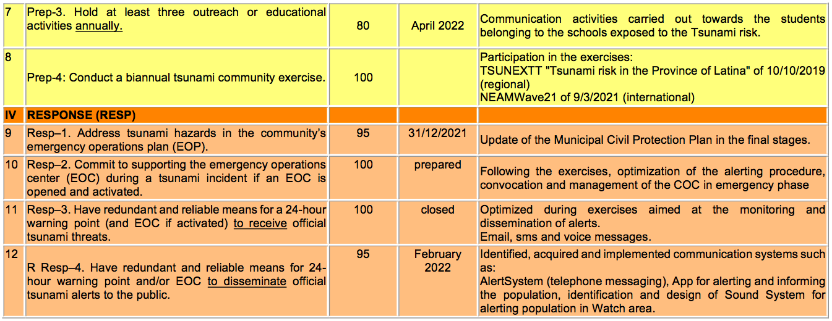
TSUN TSUNAMI READY IN ITALY: MINTURNO PALMI
General Score: 1050 / 1200 = -150

Slide 27


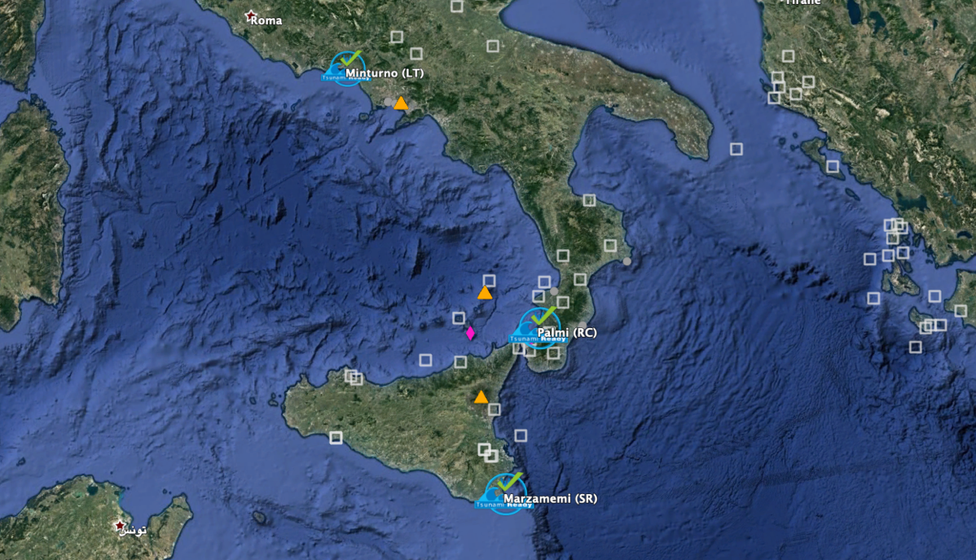

– Enthusiastic authorities response
– By the end of 2020 two municipalities have adopted official resolutions
– Municipalities have developed timetables of actions to be taken
3 coastal municipalities involved with high to moderate tsunami hazard
In 2020 we have started the Tsunami Ready programme in Italy
Tsunami Ready in Italy:
first steps
Valbonesi C.
Amato A.
Cugliari L.
Minturno, Latium, pop. 19,700
Tyrrhenian Sea – Medium-Low Hazard
Formal subscription: 2020
Local Board: 2021
Palmi, Calabria, pop. 17,000
Tyrrhenian Sea – Medium-High Hazard
Formal subscription: 2020
Marzamemi-Pachino, Sicily, pop.376/21,000
Ionian Sea – High Hazard
Formal subscription: soon
Tsunami Ready is a virtuous model for tsunami risk mitigation with the aim of increasing coastal populations’ and tourists’ resilience.
It promotes education and learning processes to reduce the "last mile" gap.
The Tsunami Local Board implies a bottom-up risk management process, involving citizens at every level.
The TR international guidelines guarantee a valuable benchmark for decision-makers and cautionary standards for civil protection officers in charge of risk management.
Map Legend
Tsunami Ready pilot sites
EQ Tsunami sources
Volc Tsunami sources
From EMTC 2019 - Maramai et al.

Slide 28
TSUNAMI READY IN TURKEY
During the first WG4-Tsunami Ready Group Meeting on 6 April 2021, KOERI presented an overview of what has been achieved during the Last Mile Turkey Project completed in 2019 with the support of EC-JRC and in partnership with Middle East Technical University (METU).
The Last Mile Turkey project implemented in Bodrum contributed to the development of some TR indicators/ TR “elements” (preparation of high-resolution tsunami inundation and evacuation maps, awareness and preparation activities, such as seminars and workshops, a tsunami exercise in Bodrum).

Slide 29
TSUNAMI READY IN TURKEY
Bodrum has a great potential to be identified as a possible Tsunami Ready location in Turkey.
Due to their geographical proximity and degree of similarity in tsunami risk, Didim, Marmaris, Fethiye and Kaş were identified as additional potential Tsunami Ready candidates.
In addition, significant progress has been made in Istanbul, where tsunami modelling, vulnerability and hazard analysis reports have been prepared for each coastal municipality and published online by the Istanbul Metropolitan Municipality in close cooperation with METU.
unam-blg-ktapiklari

Slide 30
TSUNAMI READY IN TURKEY
Tsunami action plan and district-based tsunami risk analysis, inundation and evacuation maps are publicly available at the following links: https://depremzemin.ibb.istanbul/guncelcalismalarimiz/#stanbul-tsunam-eylem-plani https://depremzemin.ibb.istanbul/guncelcalismalarimiz/#le-ts

Slide 31
TSUNAMI READY IN TURKEY
As communicated during the second meeting of WG4-Tsunami Ready Group on 30 June 2021, Prof. Dr. Ahmet Cevdet Yalçıner from METU was nominated on 5 July 2021 as an additional member of WG4-Tsunami Ready Group.
In September 2021, Istanbul Metropolitan Municipality begun with the installation of tsunami evacuation signages in Büyükçekmece district in the European part of Istanbul as a pilot project.
The municipality aims to finalize the installation of tsunami evacuation signages in all coastal districts facing Marmara Sea by the end of 2022.

Slide 32
TSUNAMI READY IN PORTUGAL
Tsunami Awareness Day, 5th November 2021
ANEPC organized a webinar on “Management of Tsunami Risk: Alert, Warning and Evacuation”.
The same day ANEPC announced the publication of the “Reference Guide for Tsunami Evacuation Planning” available online in the collection of technical documents PROCIV: http://www.prociv.pt/bk/EDICOES/CADERNOSTECNICOS/Documents/CT_28_Guia%20de%20Refer%C3%AAncia%20para%20Planeamento%20de%20Evacua%C3%A7%C3%A3o%20em%20caso%20de%20Tsunami.pdf
Many institutions (IDL, IH, UC, LNEC, IPMA, CERU) followed the recommendations of the Portuguese IOC Delegation and advertised publicly the day and distributed the tsunami leaflet on Tsunami Risk prepared in 2019 by CERU available at http://www.ceru-europa.pt/pt/downloads/Folheto_Tsunami_v6.pdf

Slide 33
TSUNAMI READY IN PORTUGAL
NEAMWAVE’21 Exercise
ANEPC participated on all exercise phases with the objective to test the effectiveness of the information transmission procedures as defined by the Operational Directive (4105/2018) regarding the reception of the tsunami alert messages produced by the Tsunami Service Providers in the NEAM region operational at the time of the exercise.
ANEPC tested the procedures that consider a simultaneous notification of the information provided by IPMA to the headquarters (CNEPC) and to the Regional Commands for Relief Operations (CDOS).
The exercise was conducted by ANEPC in mode CPX (Command Post Exercise) involving all coastal districts from North to South of Portugal mainland. Several notification methods were tested, namely SMS, e-mail, fax and voice, between the National Command for Emergency and Civil Protection (CNEPC), the District Commands (CDOS), the Municipality Services for Civil Protection (SMPC), the Firefighters Brigades, the General Direction for the Maritime Authority (DGAM), the National Maritime Search and Rescue service (MRCC) and 8 entities responsible for critical infrastructures and to provide essential services.

Slide 34
TSUNAMI READY IN PORTUGAL
The Regional Services for Emergency and Civil Protection from Madeira and the Azores participated for the first time on a tsunami exercise.
IPMA and CENALT were the agencies at ICG/NEAMTWS responsible for the preparation of the tsunami scenario that was run in Portugal and other participating countries in the NE Atlantic.
IPMA, as a Tsunami Service Provider for the NE Atlantic and the National Authority for Tsunami Warning, issued the Tsunami Alert Messages according to the scenario, using the established communication protocols to the service subscribing countries, among others, Morocco, Spain, United-Kingdom, Denmark, France, Germany, Ireland.

Slide 35
TSUNAMI READY AND LAST MILE IN MALTA
During the final exercise of theTsunami Last Mile 2 project in Malta (of 5 November 2021, i.e. the Tsunami World Awareness Day ):
all the newly installed devices for tsunami warning of the local community were tested (2 seismographs; 2 IDSLs – Inexpensive Devices for Sea Level monitoring; 2 TADs – Tsunami Alerting Devices; 1 long-range siren)
the alert messages from the regional tsunami service provider (CAT-INGV) were received and integrated in the draft tsunami emergency protocol (SOP) at test during the exercise
all the emergency response system, local and national, was mobilized
all the residents in the expected inundation area of Marsaxlokk were invited to evacuate via newly identified evacuation routes, following the tsunami evacuation signs (temporarily installed for the exercise), towards the meeting/assembly points.
AN ANALYSIS OF THE EXERCISE OUTCOMES AGAINST THE TSUNAMI READY INDICATORS WILL ALSO BE PERFORMED.

Slide 36
TSUNAMI READY AND LAST MILE IN MALTA
From the initial findings, we can already mention that Marsaxlokk didn’t have any tsunami mitigation measure before the implementation of the Tsunami Last Mile 2 project. Today, in addition to the mentioned suite of devices for locally warning the population, they have:
Detailed tsunami modelling (University of Malta)
Detailed analysis of expected inundation areas (University of Malta)
Tsunami emergency protocol for Marsaxlokk (Malta Civil Protection Department)
Tsunami evacuation routes & meeting points (Malta Civil Protection Department)
Prototype tsunami signs (Malta Civil Protection Department)
Information material (leaflets in Maltese and English) about tsunami risk (Malta Civil Protection Department)
A local community informed about tsunami risk in their area (see pictures in the attached “evaluation instructions” document; further details will come with the final evaluation report)

Slide 37
LEGAL IMPLICATIONS OF PILOTING TSUNAMI READY-INITIATIVES
THE ROAD MAP OF:
Study on the impact of TR guidelines on the responsibilities of scientists, public administrators and civil protection officers.
Study on the responsibilities of the members of the local and the national TR board as well as the evaluation of the role of UNESCO in the recognition of a municipality as TR.
⬇︎⬇︎⬇︎⬇︎⬇︎☟
The research started from Italy regulatory framework
It could be extended to other NEAM COUNTRIES

Slide 38
LEGAL IMPLICATIONS OF PILOTING TSUNAMI READY-INITIATIVES
Clarify the nature of TR PILOT PROJECT:
The new draft starts with this disclaimer:
«A Tsunami Ready recognition will not imply approval or promise that a community can or will perform at a certain level in case of tsunami. Tsunami Ready recognition does not mean that a community is tsunami proof; it is rather the acknowledgement of the mitigation measures adopted by the community to tackle with the tsunami risk»

Slide 39
LEGAL IMPLICATIONS OF PILOTING TSUNAMI READY-INITIATIVES
Unfortunately, in Italy, the disclaimer can only indicate but not really determine the exact area of responsibility.
So, to answer the question of what impact TR has in the system, the following steps were analysed:
1. Nature of regulatory source: guidelines-soft law
2. Positioning of soft law guidelines in national sources.
3. Relationship with national legislation on risk: D.lgs. 1/2018 and guidelines of 2018 of the Department of Civil Protection on tsunami risk: although TR guidelines are an international source, they have a supplementary role in the legislation as to the prescriptions that must be adopted.
4. The responsibility of the local board: the members have a recognition role. It means that there is no direct responsibility on their part, unless they directly take civil protection decisions, "de facto" supporting the measures taken by the mayor or the civil protection manager. Those who hold positions of obligation under Italian law, relating to civil protection, remain responsible for their tasks.

Slide 40
LEGAL IMPLICATIONS OF PILOTING TSUNAMI READY-INITIATIVES
5. The TR National Board has a role of recognition that does not involve a direct responsibility unless its members do not interfere in the choices of municipality’ civil protection .
6. The adoption of the TR program is a voluntary choice. However, its dissemination and accreditation around the world may represent a paradigm of behaviour for mayors and local civil protection authorities, whether or not they have joined the program.
☟
Indeed, TR program represents the "best science and experience of the historical moment."

Slide 41
LEGAL IMPLICATIONS OF PILOTING TSUNAMI READY-INITIATIVES
7. UNESCO's role in TR recognition: the research is going on. The role of UNESCO must be analysed in the light of international law, especially for the role reserved to international organizations.
THE MAIN TOPIC OF A FUTURE RESEARCH IS ENHANCING THE RISK COMMUNICATION IN THE FRAMEWORK OF THE TR PROGRAM.

Slide 42
WE WANT TO THANK ALL THE TSUNAMI READY GROUP MEMBERS WHO ARE WORKING HARD TO ACHIEVE THIS IMPORTANT GOAL

