Slide 1
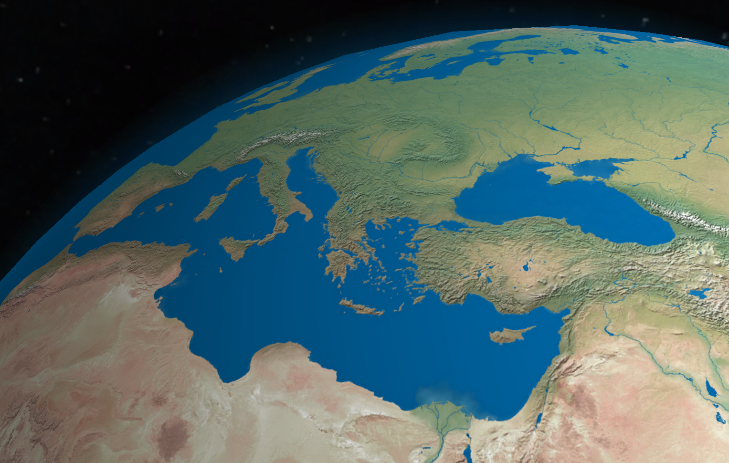
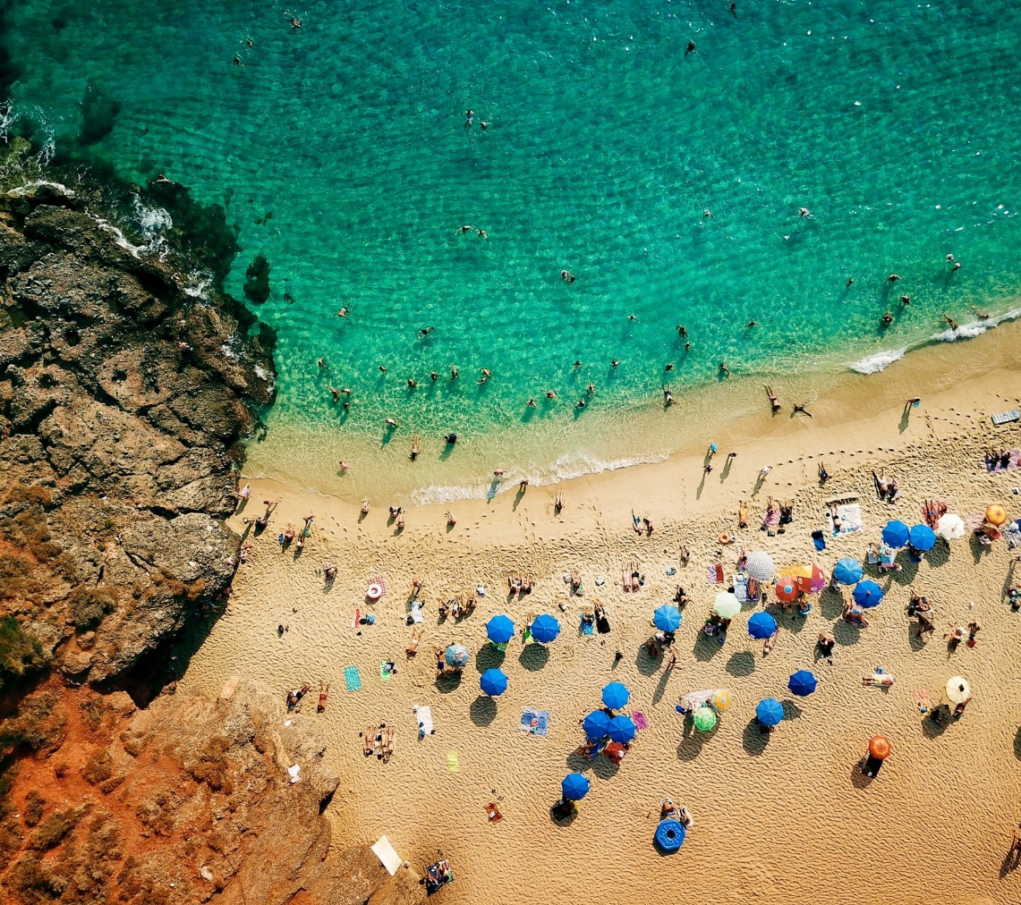
ICG/NEAMTWS XVII Session 24-26 November 2021
Report by the IOC Secretariat
Denis CHANG SENG, PhD
Programme Specialist
Tsunami Unit, Technical Secretary (ICG-NEAMTWS) Global Ocean Observing System (GOOS) & IOC Focal point for MHEWS/ IN-MHEWS
Intergovernmental Oceanographic Commission of UNESCO

Slide 2
Outline
Documentation / publications
Communication and outreach
Meetings/Events
Project

Slide 3
DOCUMENTATION & PUBLICATION
5 Documentation / Publications
ICG/NEAMTWS NEAMWave21 Exercise Manual
ICG/NEAMTWS Status on Tsunami Education Awareness and Preparedness in NEAM region (Under Final Review)
ICG/NEAMTWS 2030 Strategy (Under Final Review)
Documentation on Sea Level Network in Northern Africa-IOC-Africa and TSU Initiative (Ongoing)
Development of a coastal multi-risk perception, resilience study and survey questionnaires

Slide 4
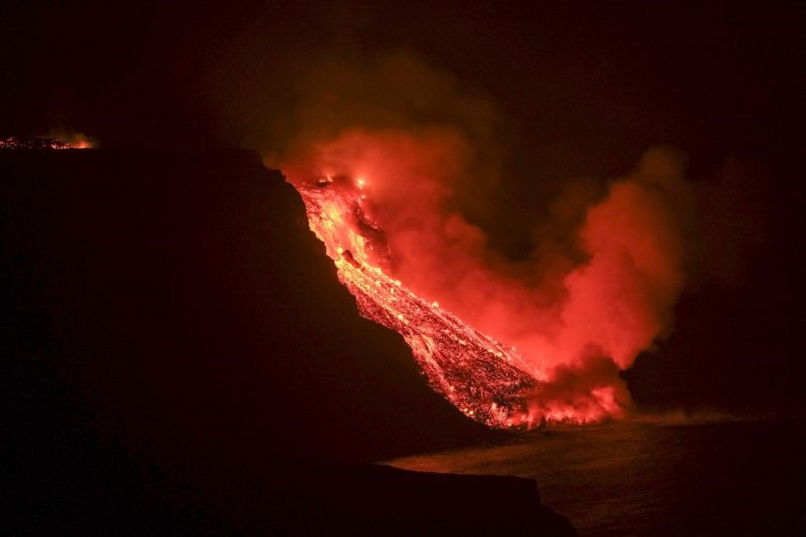
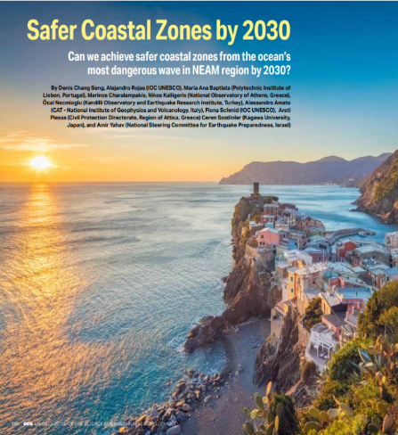
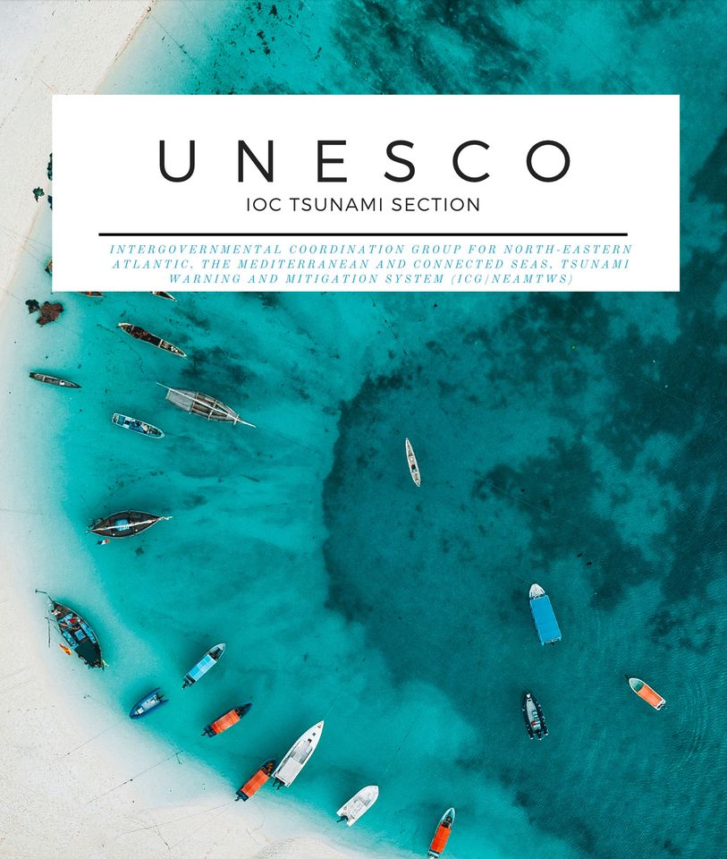
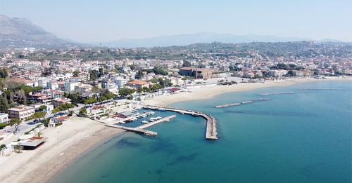
COMMUNICATION, OUTREACH IMPACT
9 Articles
Concerns in the wider region about the possible flank collapse of Cumbre Vieja triggering a tsunami. Role of Tsunami Early Warning and Mitigation System in the region
Italy launches new sea level observation network to help enhance the detection, monitoring of tsunamis, and other sea level hazards in the Mediterranean Region
Working Together Towards Community Tsunami Ready in the NEAM Region
An international team coordinated by INGV presents a new model for tsunami early warning following an earthquake
The Tsunami Snapshots: A New Spotlight on Regional and National Tsunami Warning and Mitigation System
Emerging Pilot Tsunami Ready Initiatives: Italy’s Civil Protection Council of Ministers establishes the Italian National Tsunami Ready Board, a first in NEAM Region
ECO Magazine UN Decade Article: Safer Coastal Zones by 2030
Greek Tsunami Service Provider Announces the Deployment of New Tsunami Information Products
Countries in NEAM region Prepare for the fourth Regional Tsunami Exercise (NEAMWave21)

Slide 5
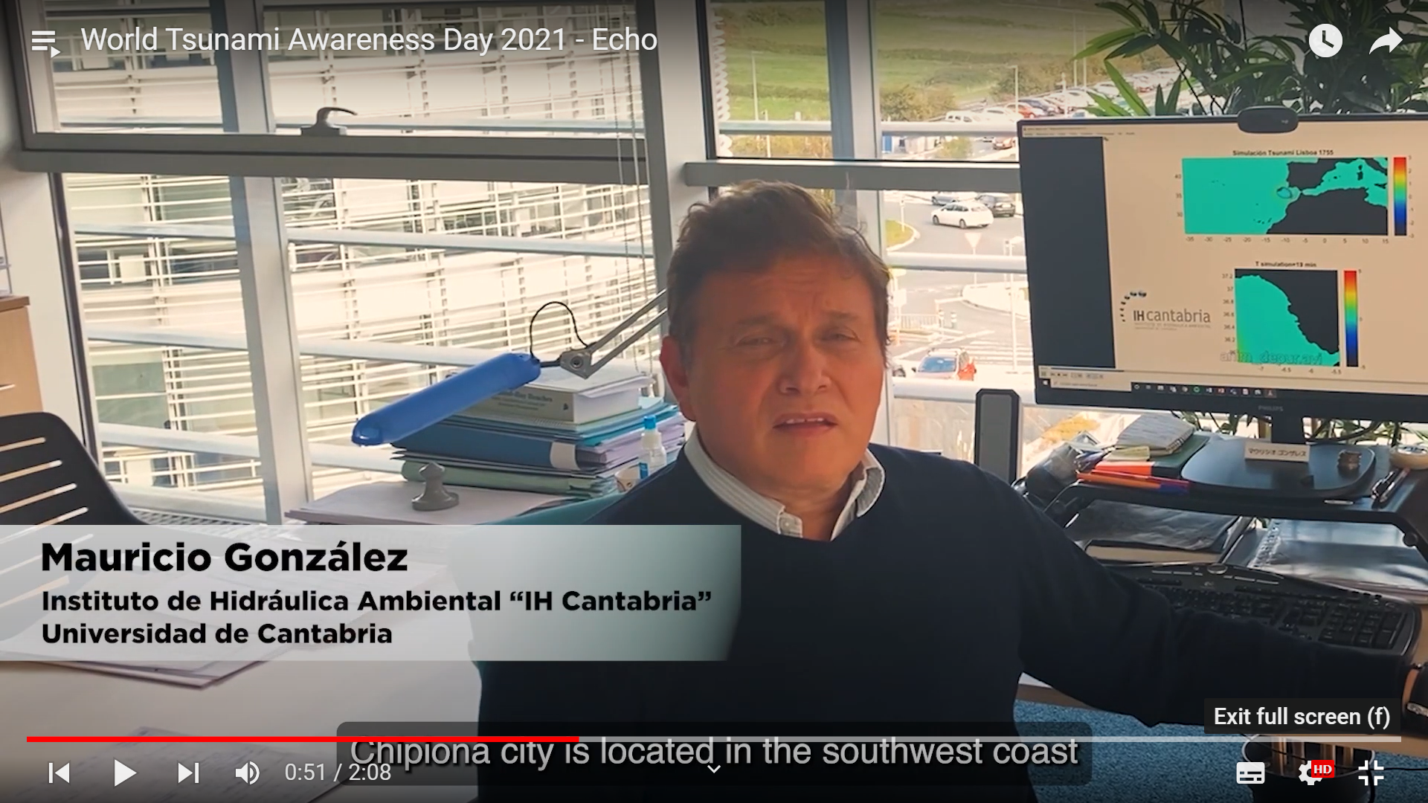
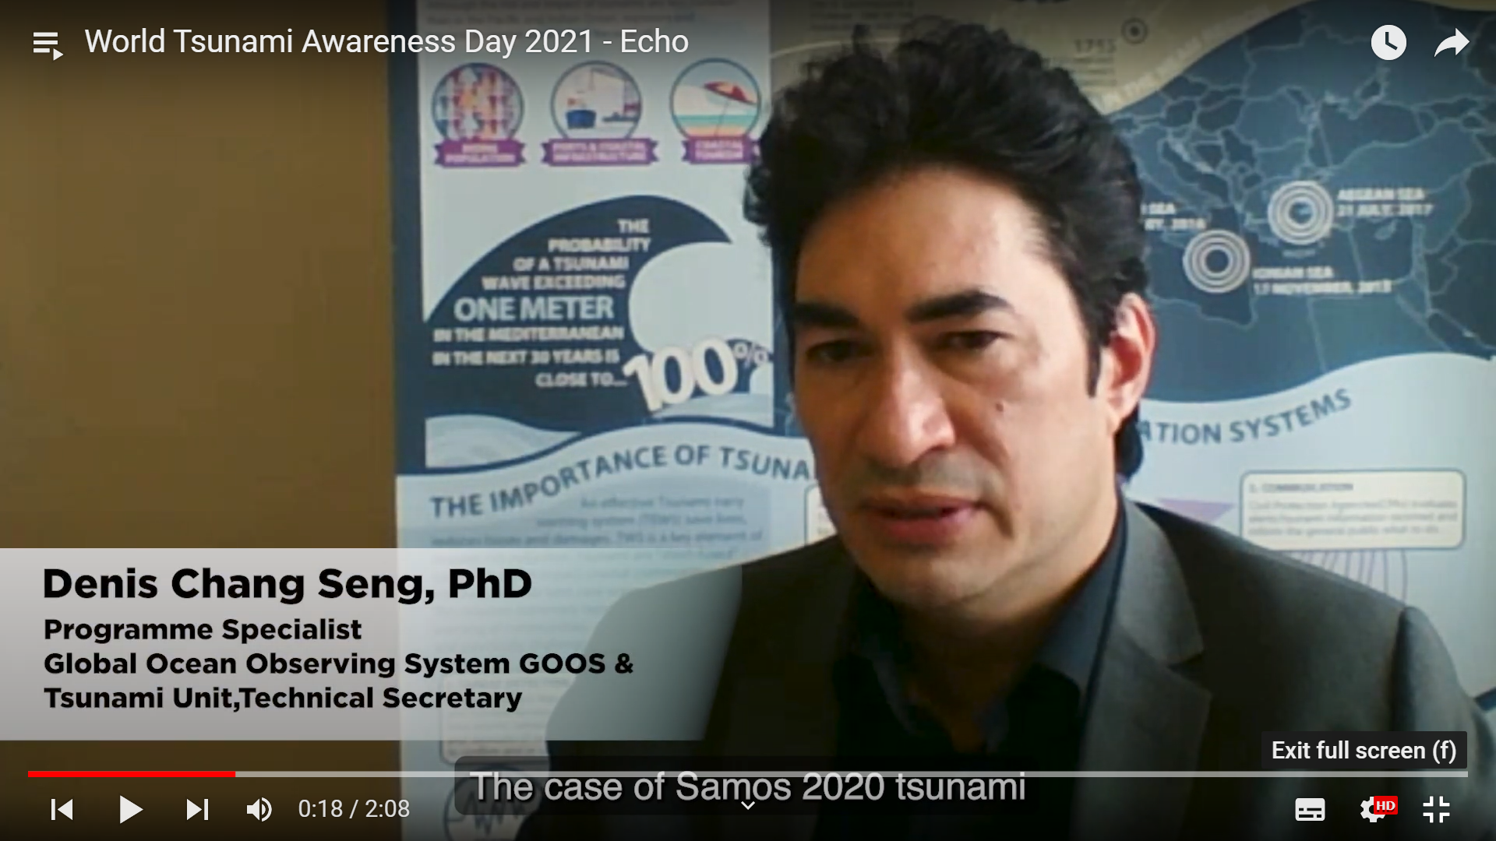
COMMUNICATION, OUTREACH IMPACT
1 Video on WTAD EU ECHO Project / Tsunami Ready
https://www.youtube.com/playlist?list=PLWuYED1WVJIO3g5f7y_aDXtX7LVHDmoOn

Slide 6
MEETINGS/ EVENTS
19 Feb | ERCC-IOC Training NEAMWave21
22 – 23 Feb | TOWS WG Inter-ICG TT DMP: TOWS WG Inter-ICG Task Team on Disaster Management & Preparedness New Technical Secretary for TT DMP Prepared Summary Reported of TT DMP Organized Three TT DMP online meetings: Regional Wave Exercises, Nominations of Experts to the: Recommendation of TT-DMP on the Tsunami International Science Committee Recommendation of TT-DMP on the International Tsunami Coalition-broader stakeholders
2 2- 23 Feb | TOWS WG Inter-ICG TT TWO: TOWS-WG Inter-ICG Task Team on Tsunami Watch Operations
25- 26 Feb | TOWS-WG-XIV: 14th session of Working Group on Tsunamis and Other Hazards Related to Sea-Level Warning and Mitigation Systems (TOWS-WG)
9– 10 Mar | NEAMWave21: ICGNEAMTWS NEAMWave21 Tsunami Exercise
1 Apr | TT on Documentation ICGNEAMTWS 2030 Strategy
2 Apr | ICG/NEAMTWS TT on Operations Strategy
6 Apr | First ICG-NEAMTWS Tsunami Ready TEAM Meeting
8 - 9 Apr | ICGNEAMTWS SC 2021: Virtual ICGNEAMTWS Steering Committee Meeting 2021
8 Jul | ICG/NEAMTWS Task Team on Operations Virtual Meeting
4-7 Nov | TLM End to End Exercises in Marsaxlokk, Malta and Exercises in France
8 Nov | World Tsunami Awareness Day, Webinar organized by NIOF, Egypt
24 - 26 | ICG/NEAMTWS XVII : 17th Session of the Intergovernmental Coordination Group for the Tsunami Early Warning and Mitigation System in the North-eastern Atlantic, the Mediterranean and Connected Seas (Hybrid)

Slide 7
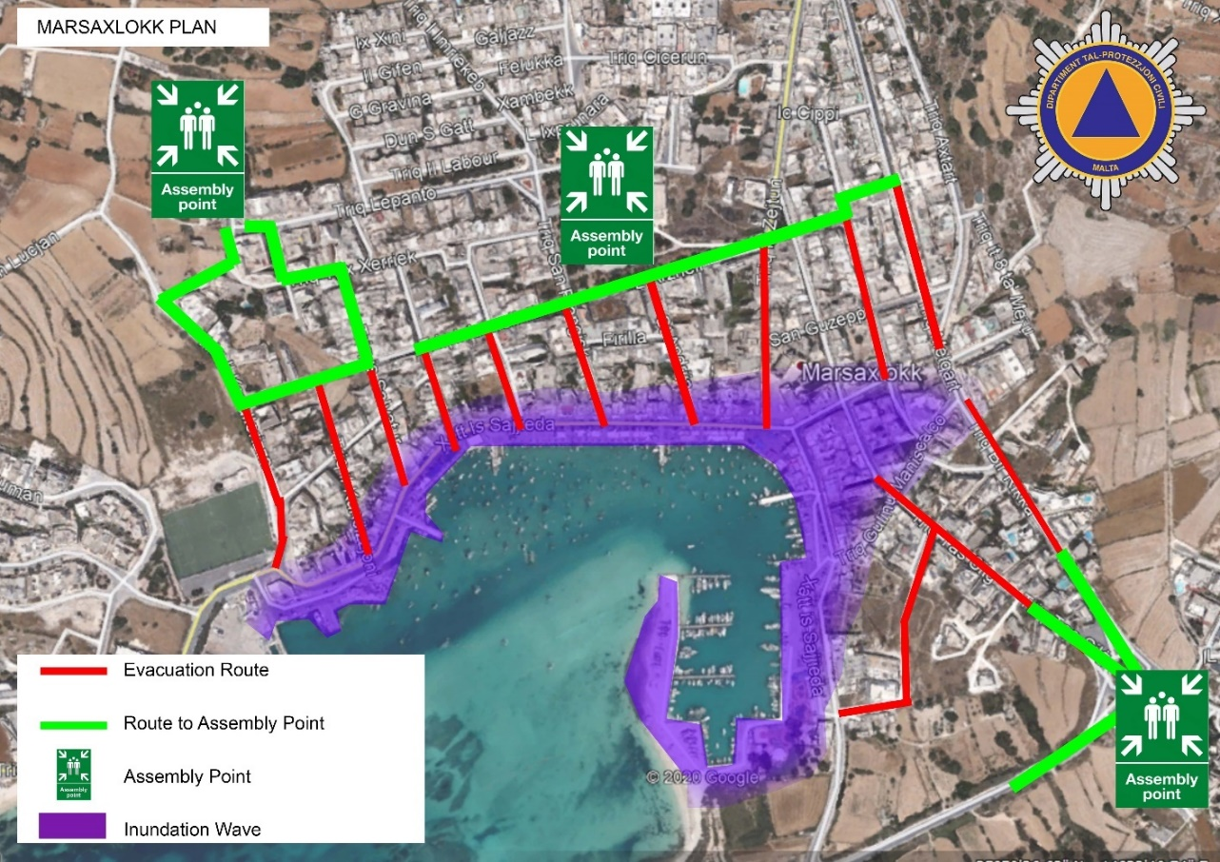
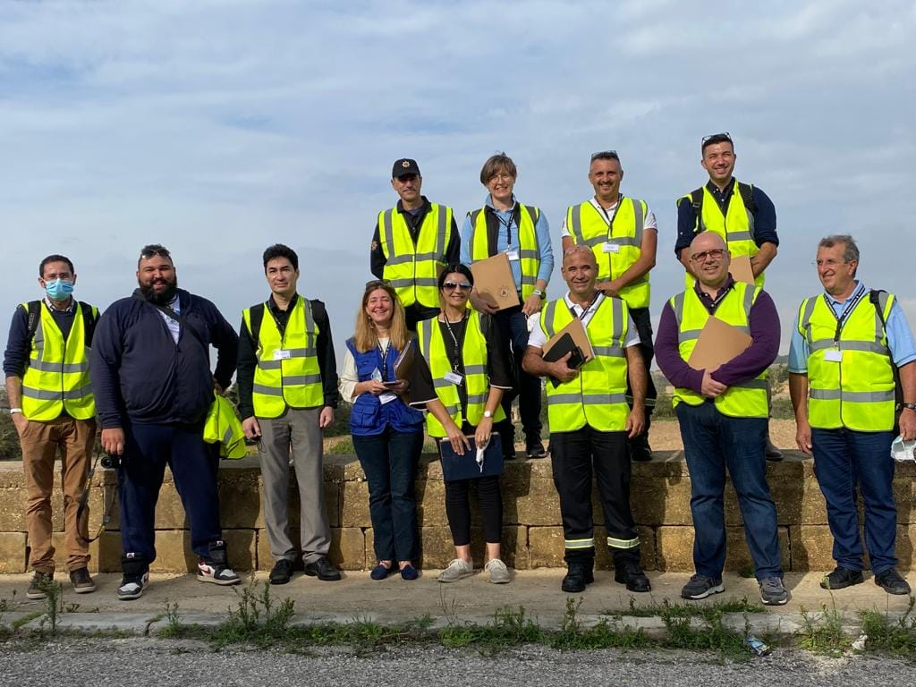
Last Mile Project-Phase 2 Malta
First Mission since Feb 2020
Project Implementation Study Area: Marsaxlokk town
Malta first end-to-end exercise, 5 Nov 2021
Source Malta CPD /JRC / M. Sanitini 2021

Slide 8
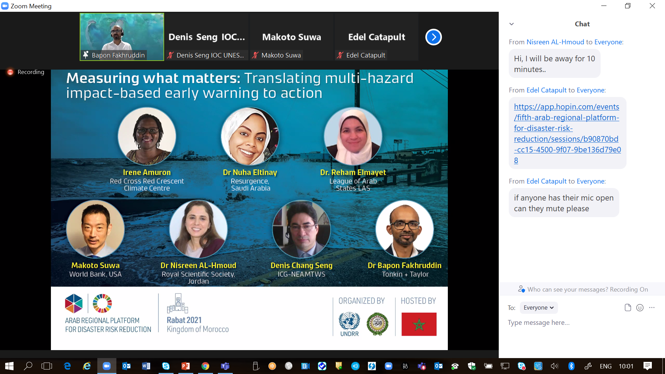
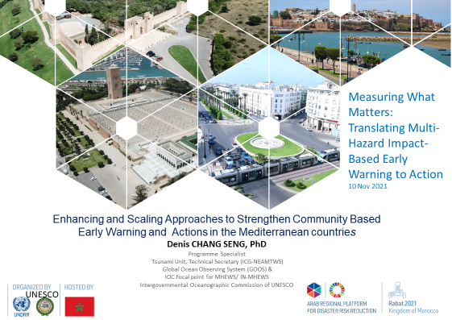
MEETINGS/ EVENTS
5th Arab Regional Platform for Disaster Risk Reduction, 8-11 Nov 2021

Slide 9
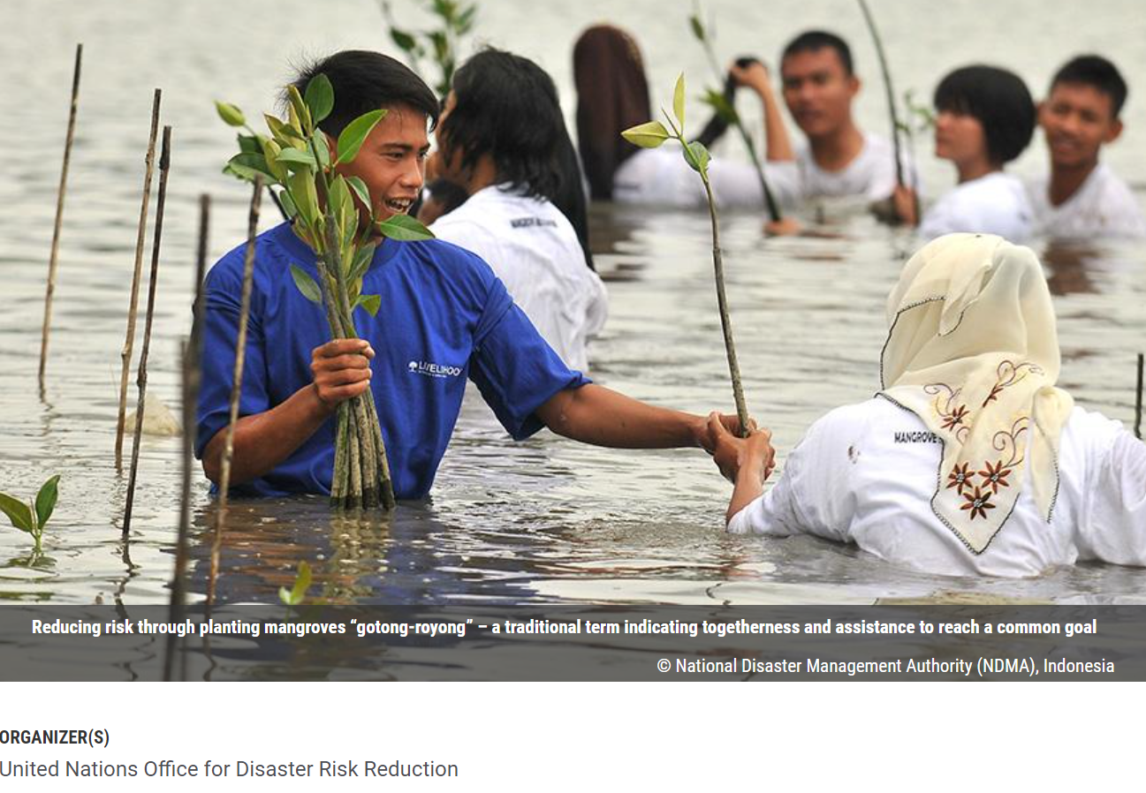
MEETINGS/EVENTS
23 - 28 May 2022 Seventh Session of the Global Platform for Disaster Risk reduction ( GP2022)
Coordinating IOC UNESCO Input
Thematic Session 3 Organizing Team Member on Thematic Session: Multi-hazard and Multi Sector
Thematic Session 15 Organizing Team Member on EWEA
Member of IN-MHEWS Planning and Organization of IN-MHEWS Side Event at GP2022

Slide 10
PROJECT
Project “Strengthening the Resilience of Coastal Communities in the North-East Atlantic and Mediterranean Region to the Impact of Tsunamis and Other Sea Level-Related Coastal Hazard”
Approved by the European Union (EU) Directorate-General for European Civil Protection and Humanitarian Aid Operations (DG ECHO)
Geographical scope/benefitting countries | North Eastern Atlantic and Mediterranean Sea: Cyprus, Egypt, Greece, Malta, Morocco, Spain, and Turkey
Technical Advise | Italy and France
Area of influence | 40 NEAMTWS Member States
Period | 01/09/2021 --- 30/03/2024

Slide 11
END

