Slide 1
XVII Session of the ICG/NEAMTWS
(24-26 November 2021)
Consultant Report
Mr. Alejandro Rojas Aldana
UNESCO-IOC
Tsunami Unit
ICG/NEAMTWS
1

Slide 2
Consultant to assist the ICGNEAMTWS
ii. Support management of NEAMTIC and IOC-TSUNAMI
Portals, including social media sites.
iii. Support preparation and evaluation of NEAMWave21 (Survey)
iv. Administrative support of key ICG/NEAMTWS meetings
i. Support the draft of key ICG/NEAMTWS documents/articles
Core of Activites

Slide 3
Update of Sea Level Tide Gauge Stations in North African Member States
A task coordinated by the IOC Sub Commission for Africa and the Adjacent Island States and the Tsunami Section.
Present status of tide gauge sea level stations (operational? Real time or near real time? GLOSS? IDLS? Mandate? Authorities?)
North African Member States: Algeria, Egypt, Mauritania, Morocco, and Tunisia.
This inventory goes towards updating the present GLOBAL SEA LEVEL OBSERVING SYSTEM (GLOSS). A good opportunity for European Member States to have / share key sea level data from North African Member States.
Country | Location | GLOSS ID | IDSL ID | Latitude | Longitude | Contacts/Authority | Operational Status | Mandate
Algeria | Oran |  |  | 35.43 | 0.42 | Institut National de Cartographie et de Télédétection | Operational (Real Time)
Egypt | Alexandria | 349 | 23 | 31.19/ 31.21 | 29.91/ 29.88 | NIOF/ EC-JRC | Operational (SONEL) (Real Time) | Amr Zakaria Hammouda (Egypt TNC)
Mauritania | Nouakchott | Committed but no ID |  | 17.98 | -16.03 | Port Autonome de Nouakchott | Non-Operational
Morocco | Tan Tan | 282 |  | 28.5 | -11.05 |  | Non-Operational (radar only)
Notes:
GLOBAL SEA LEVEL OBSERVING SYSTEM (GLOSS).
Inexpensive Device for Sea Level Measurements (IDSL)

Slide 4
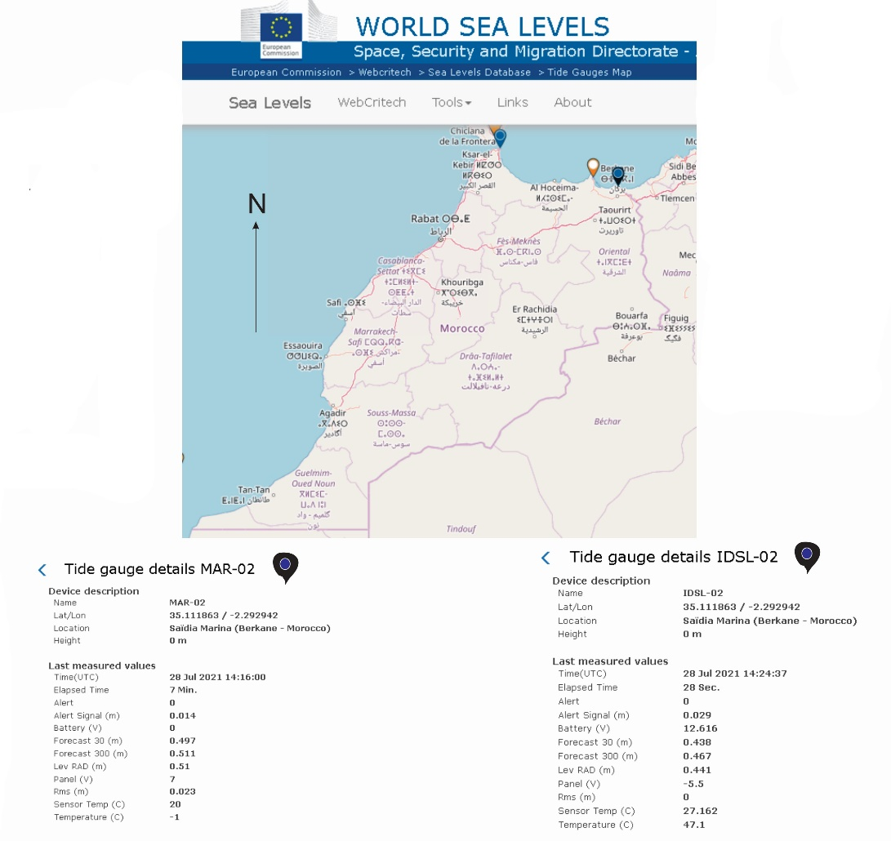
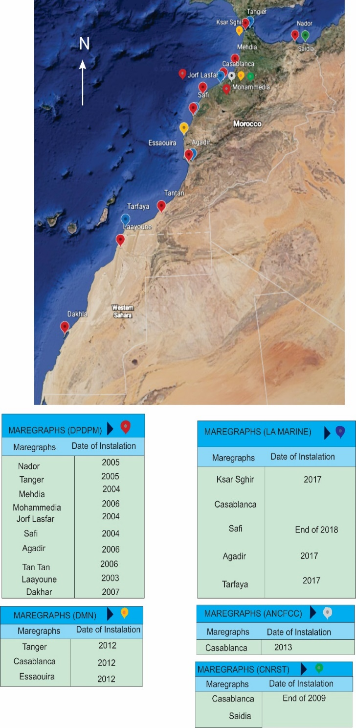
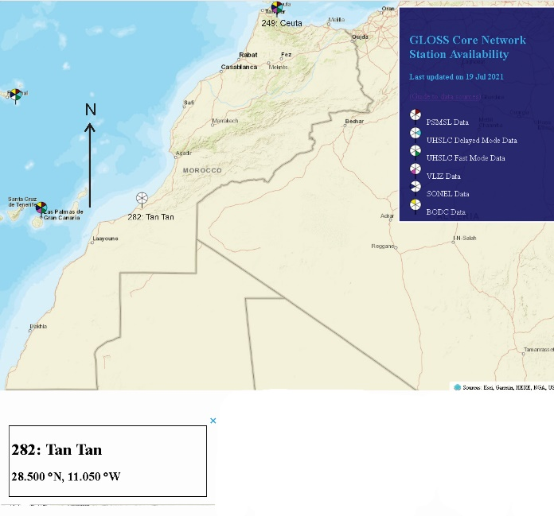
https://docs.google.com/spreadsheets/d/1okpxq2VBx0R-UfIgxPq4PdZWUUCM-bV-vMchi5l5oFQ/edit?usp=sharing
Notes:
The XVII Session of the ICG/NEAMTWS is a good platform to inform about this on going work and fill in gaps in information:

Slide 5
Support management of NEAMTIC and IOC-TSUNAMI Portals, including NEAMTIC social media sites
NEAMTIC and IOC-TSUNAMI Portals
Continue to have a high number
of hits.
NEAMTIC social media channels are the opposite (low number of likes). The XVII Session of the ICG/NEAMTWS is a good opportunity to share the new sites and grow in followers.
Facebook
LinkedIn
Instagram
Twitter
IOC UNESCO Press Release

Slide 6
Thank you!

