Slide 1
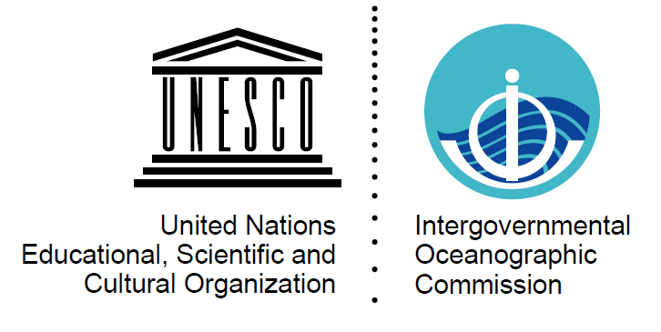
Tsunami threat level: first insights from a meta research
Andrea Cerase
Sapienza University of Rome,
National Institute of Geophysics and Volcanology
Intergovernmental Coordination Group for the Tsunami Early Warning and Mitigation System in the North-eastern Atlantic, the Mediterranean and connected seas (ICG/NEAMTWS)
XVIII session Paris, November 24-27 2021
ICG/NEAMTWS – XVIII SESSION
23/11/2021
Page 1

Slide 2
Why a meta-research?
The concept of tsunami threat levels (TTL) is as a way to link tsunami expected impacts with emergency response at both individual and societal level
TTL should match scientific hazard assessment with crisis / emergency measures and well-designed messages, aimed at improving people’s and community capacity to cope with tsunami
Hence, research should investigate underlying factors that would make messages clear, meaningful and properly understood by receivers
ICG/NEAMTWS – XVIII SESSION
23/11/2021
Page 2

Slide 3
First step: an overview on Tsunami Related TL issues
Some emerging issues
Scopus and Web of Science actually do not provide an extensive list of papers on this topic
Google Scholar provides a huge number of entries but only few are relevant
Lack of shared definitions of physical parameters to define threat levels and related self-mitigating behaviours
Lack of research literature on the ways threat levels are perceived and understood by receivers
ICG/NEAMTWS – XVIII SESSION
23/11/2021
Page 3

Slide 4
The Australian research: an overview
“Community understanding of the tsunami risk and warnings systems in Australia” is a research program by prof. Douglas Paton and prof. David Johnston
This project is intended to support the development of the Australian Tsunami Warning System and received relevant funding
Research is based on qualitative methods such as in-depth and semi-structured interviews, to better investigate people’s sources, knowledge, understanding and beliefs about tsunamis
ICG/NEAMTWS – XVIII SESSION
23/11/2021
Page 4

Slide 5
The Australian research: main findings
Participants knowledge of tsunami was limited and overwhelmed by representations of tsunamis as ‘destructive’ phenomena
This resulted into fatalistic attitudes and low confidence toward self-mitigation measures
Participants were unaware of past tsunamis, also sharing misleading ideas on tsunami risk in Australia, held to be absent or very low
Tsunami risk exposure in Australia is very different than in the NEAM area (e.g. coastal population density, travel times and so on)
ICG/NEAMTWS – XVIII SESSION
23/11/2021
Page 5

Slide 6
Discussion and preliminary conclusions
TTL implementation should lie on a comprehensive and consistent understanding of physical hazard, civil protection decisions and self-effective measures (eg. stay away from beaches, self-evacuation, sheltering)
Since past research does not provide ready-made viable solutions, social and psychological research can investigate people’s awareness and test a TTL communication strategy to improve its effectiveness
Past experiences: research on tsunami risk perception (Cerase, 2019) and citizens’ comprehension of tweets issued by INGV (Comunello e Mulargia, 2018) provide useful insights to be applied in crisis communication
ICG/NEAMTWS – XVIII SESSION
23/11/2021
Page 6

