Slide 1
17th session of the ICG/NEAMTWS
24-26 November 2021
Ms. Fiona Schmid
Consultant
UNESCO/ IOC Secretariat
Tsunami Unit

Slide 2
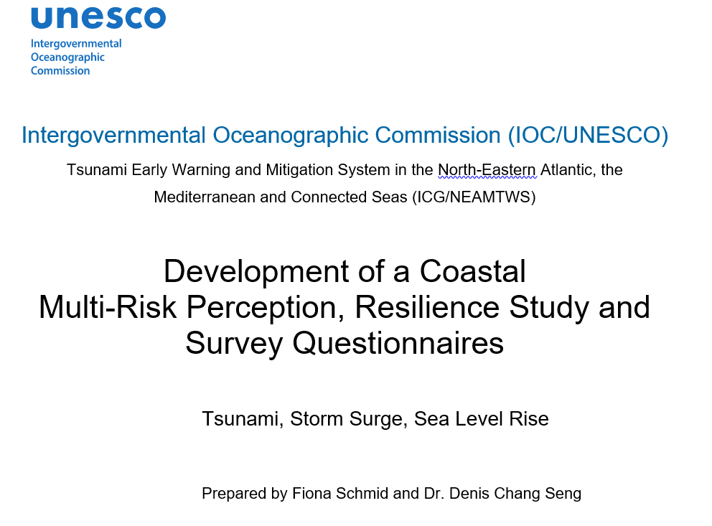
Development of a COASTAL multi-risk perception & resilience study AND SURVEY QUESTIONNAIRES
Strengthening the Resilience of Coastal Communities in the North-Eastern Atlantic and Mediterranean Region to the Impact of Tsunamis and Other Sea Level-Related Coastal Hazard
60 publications examined
2 questionnaires proposed (between 63 and 69 questions)

Slide 3
Key objectives
Understand
characterization of sea-level related hazards (tsunamis, sea-level rise, and storm surge) and risk perceptions à identify crucial gaps and misconceptions
Investigate
preparedness measures and response patterns, including the willingness to evacuate in the case of an anticipated sea level related event
Understand
target groups’ incentives to change behaviors (e.g. willingness to evacuate) and identify people’s trust and confidence in risk management authorities and governments
Improve
awareness, education measures and communication strategies
Support
the establishment of pilot Tsunami Ready communities in NEAM countries
Measure
the status of resilience among the pilot communities

Slide 4
Knowledge status on coastal multi-hazard risk perceptions
Sea level related risk perceptions have been investigated in the NEAM region and elswhere, but studies remain sparse and or single hazard /risk focused
Coastal populations display a range of different knowledge, awareness, preparedness and understanding levels according to hazard/risks
Tourists can be better or less informed than local populations
Risk perceptions have implications at community level (response /actions) and also for disaster risk reduction strategies

Slide 5
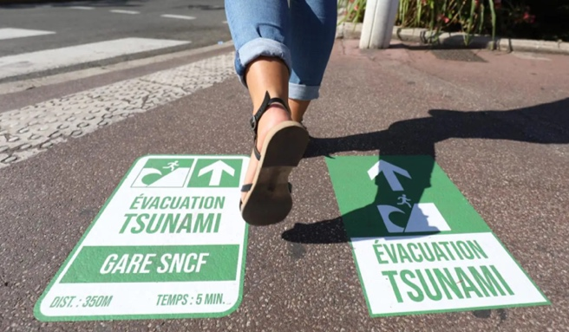
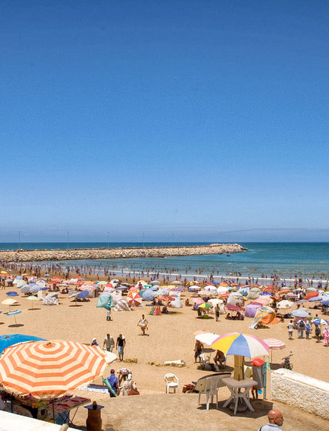
Survey target groups
Education Sector: schools, universities – pupils, students, teachers/ professors → children under 14 will be considered seperately
Tourism Sector: hotel, restaurant, and shop owners; tourists
DRR Sector: CPAs, ministries, DRR stakeholders; Civil Society: individuals (community level shall be investigated too)

Slide 6
Survey methods
Conducting Survey : Mixed Approach
Citizen Summit combined with workshop
Focus group approach
Information / interactive workshop
Web-based survey
Engaging children

Slide 7
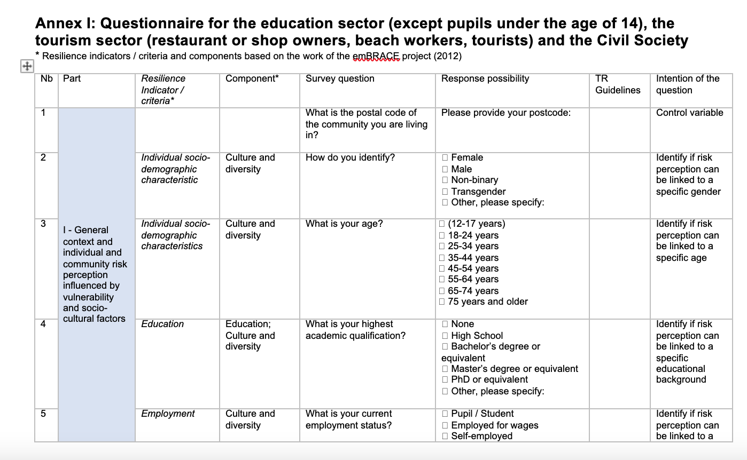
Survey questionnaire
Four Components:
General context and individual and community risk perception influenced by vulnerability and socio-cultural factors
Pre-disaster: Awareness, education, risk perception, mitigation, assessment and preparedness levels influenced by external factors
Disaster response and factors affecting individual and collective response patterns
Post-disaster: Recovery and learning opportunities enhancing resilience

Slide 8
NEXT Steps
Contribute to component 1, outcome 2 of the European Union ECHO project on Strengthening the Resilience of Coastal Communities in the North-Eastern Atlantic and Mediterranean Region to the Impact of Tsunamis and other Sea Level-Related Coastal Hazards
Component 1: Adapt Global Tsunami Ready Standards and Guidelines and pilot Tsunami Ready within the framework of the ICG/NEAMTWS.
Outcome 2: Understanding and communication of tsunami and other sea-level related risk in selected communities in Cyprus, Egypt, Malta and Morocco enhanced

