Slide 1



ICG/NEAMTWS XVII
CAT-INGV
Italian NTWC and Tsunami Service Provider @NEAMTWS
Part of the
Italian Tsunami Alert System (SiAM)
with
Department of Civil Protection
ISPRA (Ist. Sup. Ricerca e Protezione Ambientale)

Slide 2
Update on activities of the intersessional period 2020- 2021
Warning
  Events 2021
  New methodology under test (Probabilstic Tsunami Forecasting)
  Ongoing technological efforts
Hazard
  TSUMAPS-NEAM paper with NEAMTH18 published on Frontiers 2021
  New Italian S-PTHA map (ongoing)
  Advancement of coastal areas inundation mapping (ISPRA website)
  Methods for local hazard assessment (uncertainty estimate)
Mitigation
  NEAMWave2020/21
  Tsunami Risk perception studies
  Io Non Rischio campaigns (October 2021)
  Tsunami Ready (see also WG4 reports)
  WTAD 2021
  IT-ALERT
Publications 2021

Slide 3
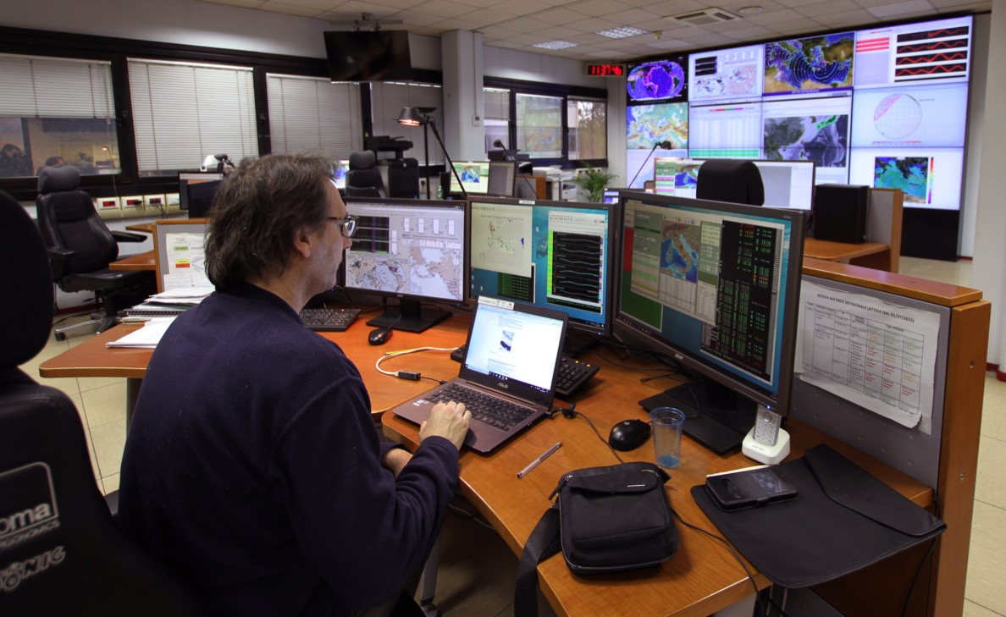
WARNING / CAT-INGV in the monitoring room @ INGV
21 alert messages since 2017
4 Watch
5 Advisory
12 Information
6 messages in 2021 (3 A + 3 I)

Slide 4
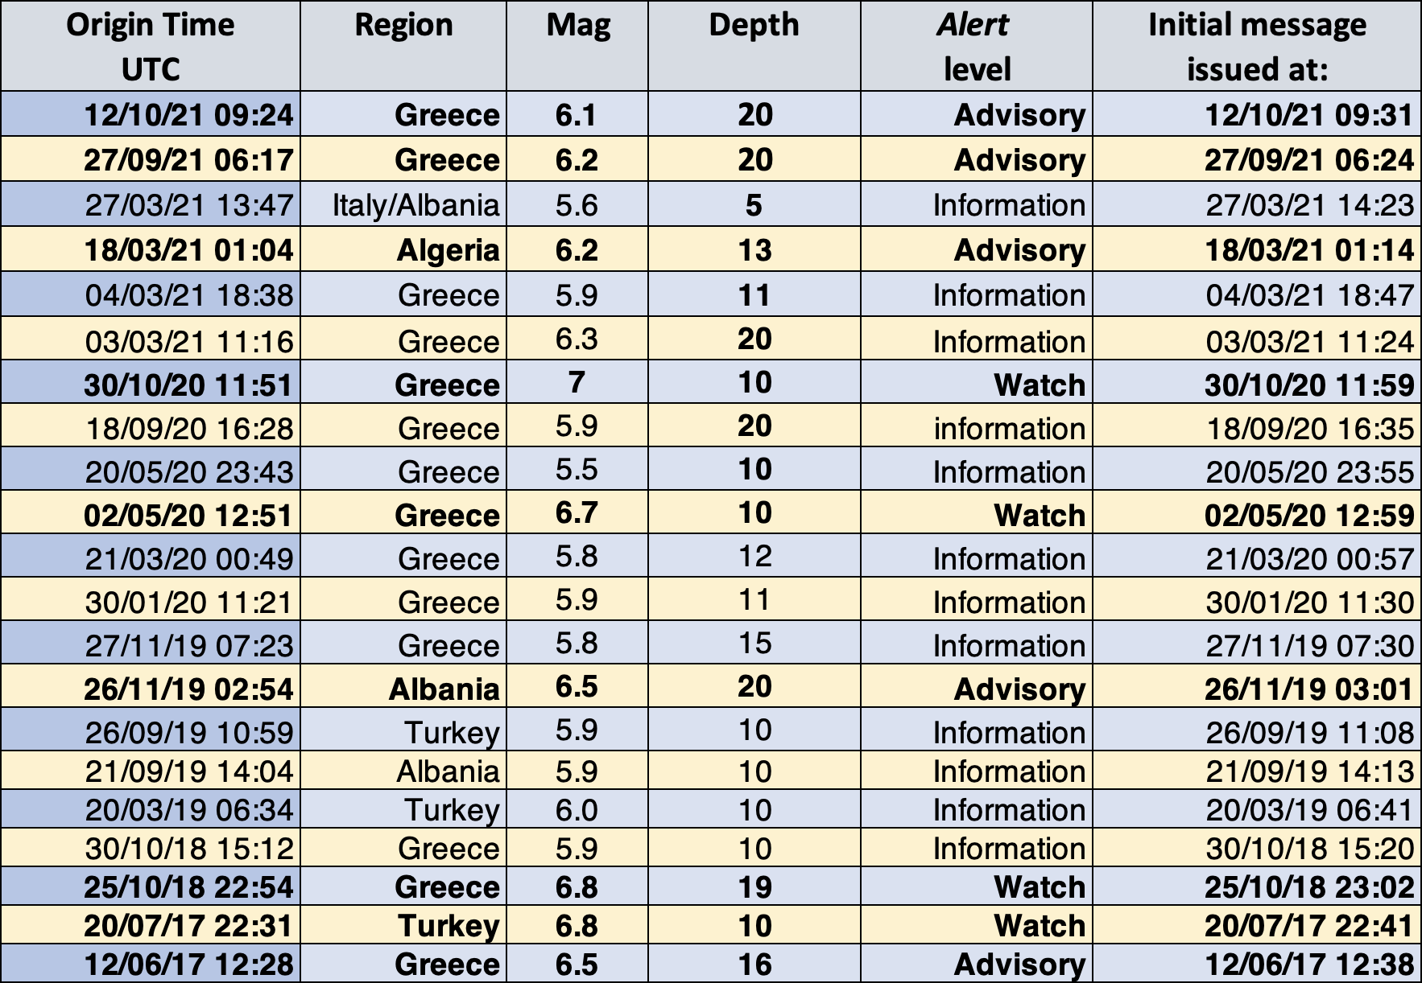

WARNING - Mediterranean events that triggered CAT-INGV

Slide 5
WARNING - Earthquakes and tsunami alerts 2017-2021 (November)
21 CAT-INGV Activations 2017-2021 – 6 in 2021 (3 Info + 3 Advisory)
Mw 5.6 - 7.0 - Messages between 7-10 minutes
Modified from: Amato et al., Seismol. Res. Letters, 2021
Notes:
NEAMTWS Activations

Slide 6
Main results:
- Use Mwp (instead of Mb) even at low magnitude (5.0-5.8)
- Feasibility of using Early-Est solution n.002 instead of 005 (3 minutes in advance)
- Times of alert delivery (2017-2021) shorter than thought (7-10 minutes)
(Amato et al., Seismol. Res. Letters, 2021)
WARNING - Earthquakes and tsunami alerts 2017-2021 (November)
Notes:
NEAMTWS Activations

Slide 7
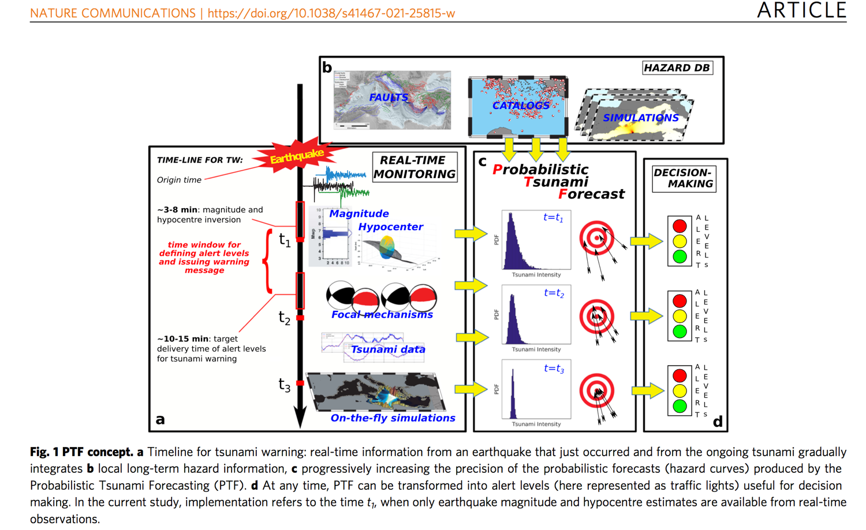
WARNING - Probabilistic Tsunami Forecast (Selva et al., 2021)

Slide 8
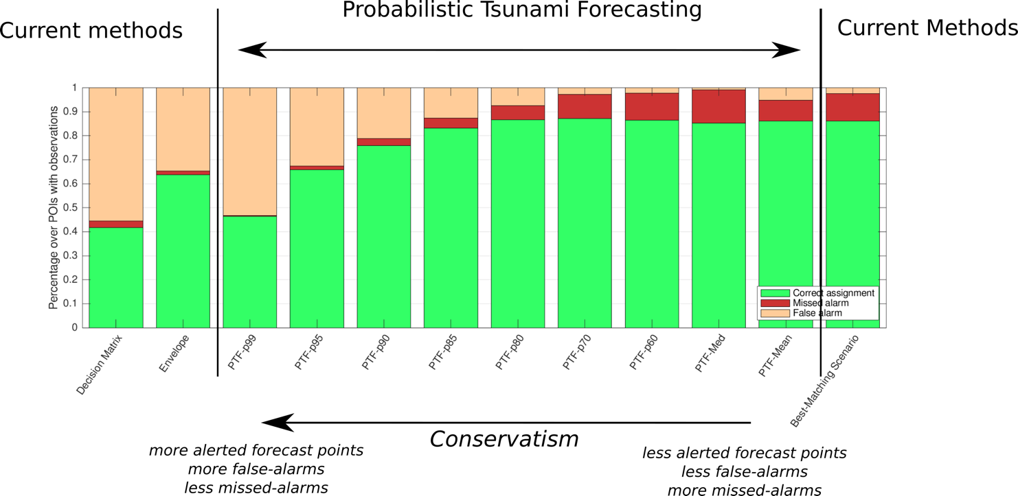
WARNING - Probabilistic Tsunami Forecast (Selva et al., 2021)

Slide 9
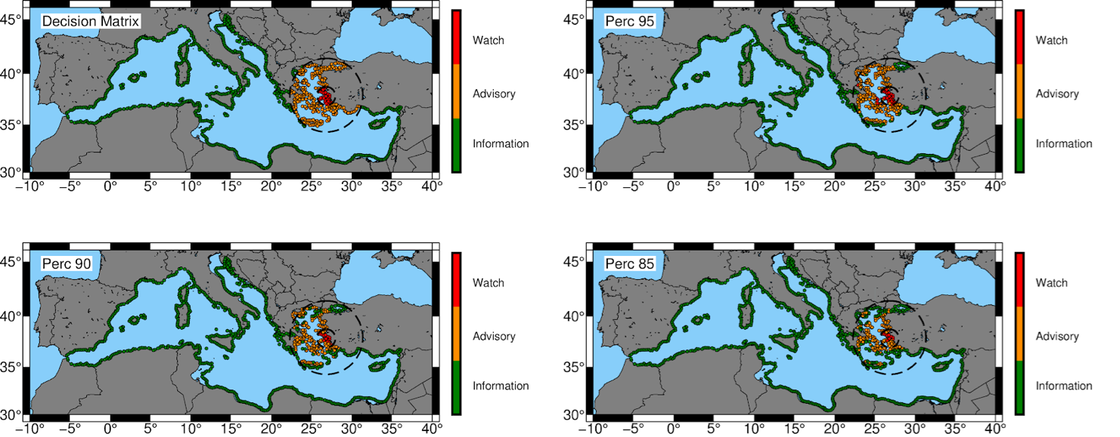
WARNING - Probabilistic Tsunami Forecast (Selva et al., 2021)
Comparison DM – PTF for 2020 Samos event during WTAD

Slide 10
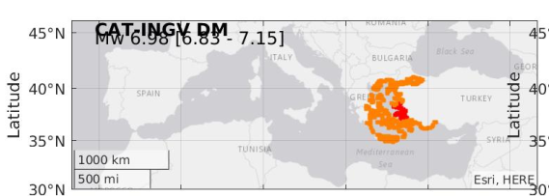
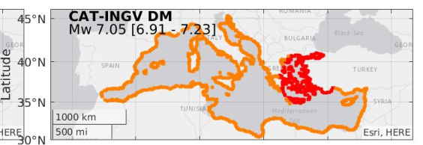
WARNING - Probabilistic Tsunami Forecast (Selva et al., 2021)
Comparison DM – PTF for 2020 Samos event during WTAD

Slide 11
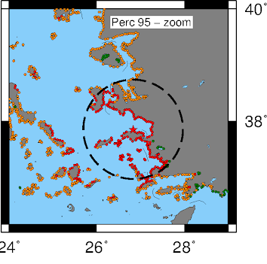
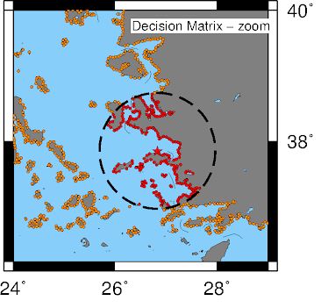
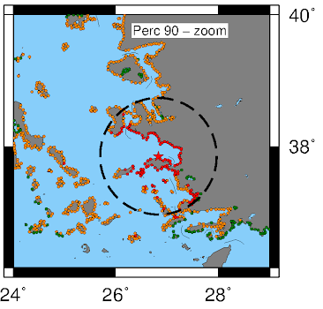
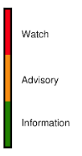
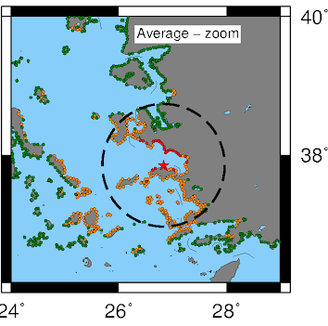
WARNING - Probabilistic Tsunami Forecast (Selva et al., 2021)
Comparison DM – PTF for 2020 Samos event during WTAD
From PTF to Alert Levels
Note the higher resolution of PTF
PTF
Decision Matrix
In the WTAD test, the PTF run time was of ~1 minute (8s for the DM), but there is a good margin for improvement
Model 3

Slide 12

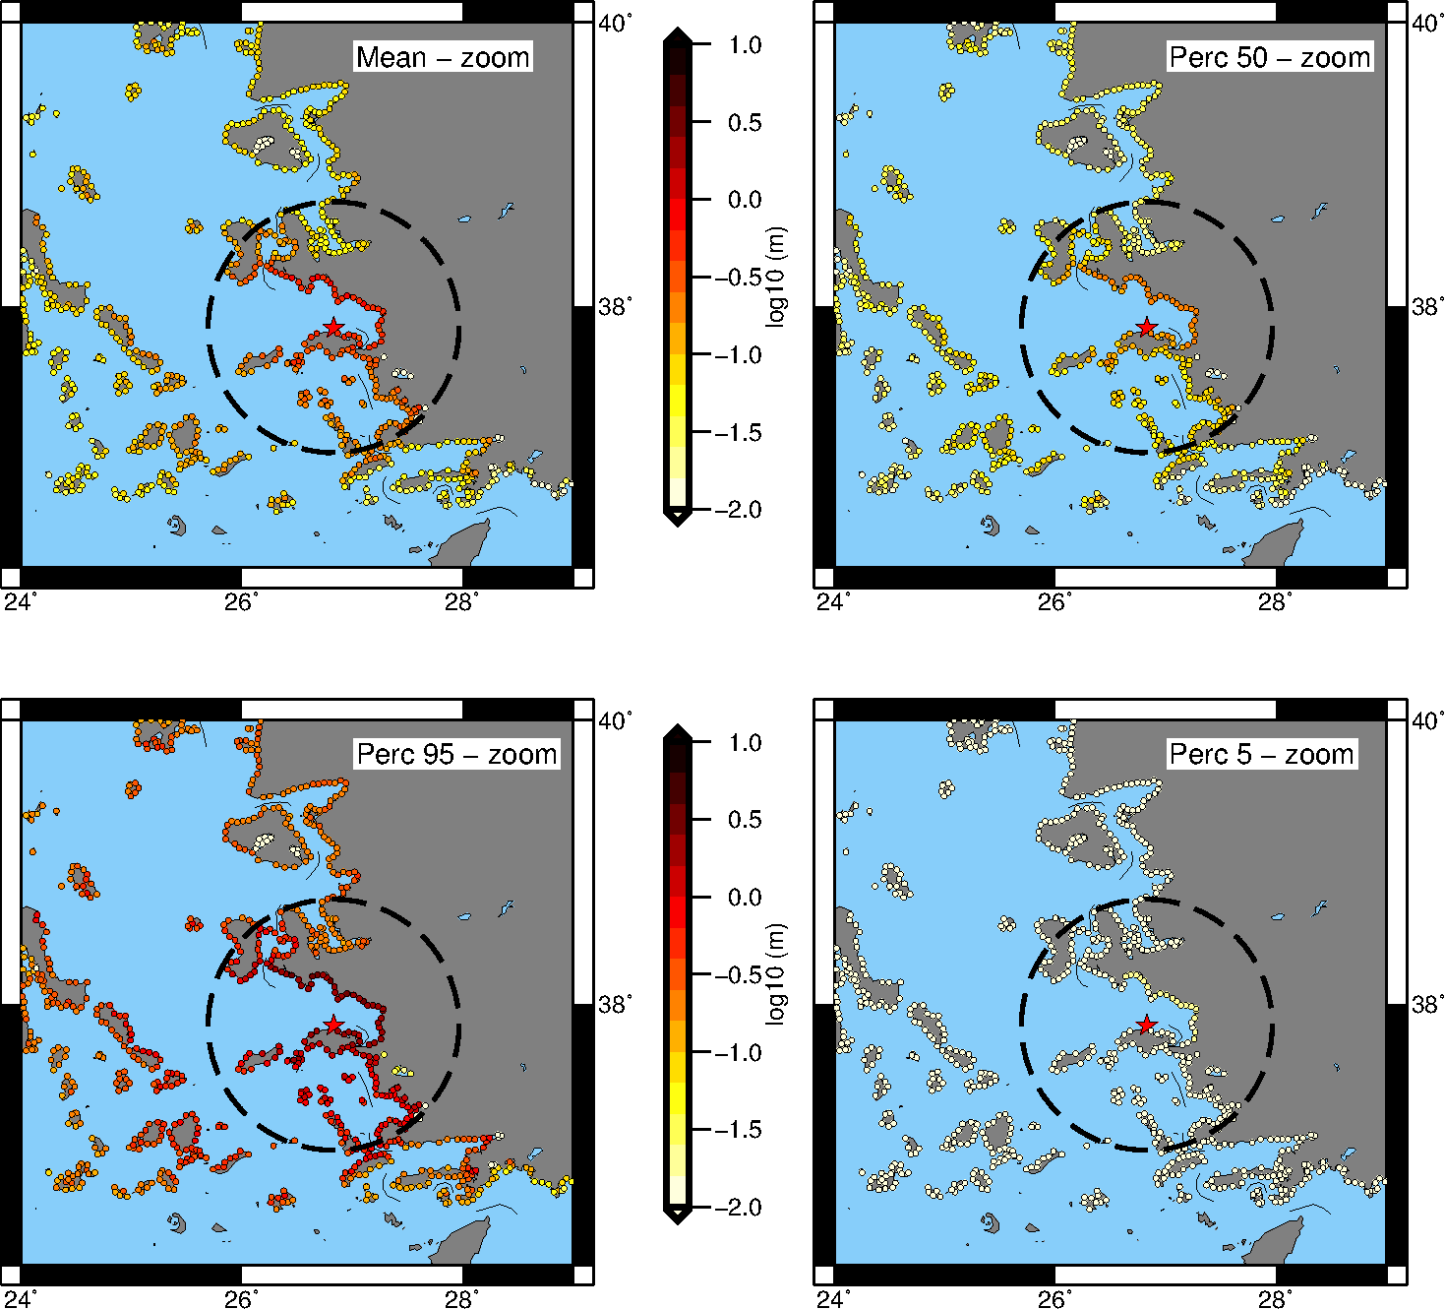
Probabilistic Tsunami Forecast: 2020 Samos Earthquake
Urgent Computing exercise
WTAD – Nov. 5, 2021
On-the-fly SCENARIOS (Urgent Computing)
POST-EVENT ASSESSMENT VERSION
Prototype for applications in ARISTOTLE, event analysis at CAT-INGV.
Simulation ensembles to be run from scratch on large enough HPC clusters in urgent computing mode.
Provides exceedance probabilities for tsunami heights just off the coastline for almost equally spaced points of interest every 2 km in front of the coasts of the Mediterranean Sea (calculated along the 50 m and 10m isobath, then extrapolated at 1 m depth).
Uncertainty exploration up to 2 sigma
~38,000 scenario simulations
Minutes to tens of minutes - optimization ongoing
~800 nodes x 4 V100
on MARCONI100 @CINECA

Slide 13
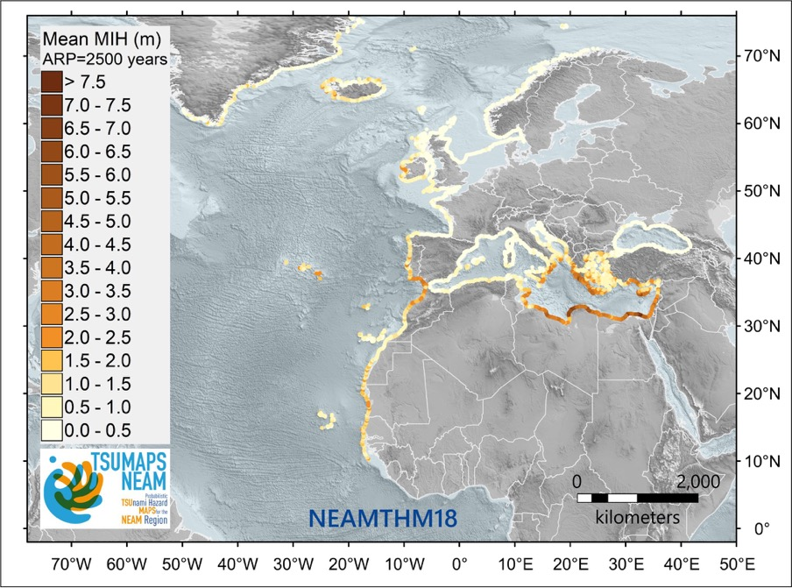

HAZARD modelling and mapping across scales
Basili et al., 2021 – TSUMAPS-NEAM - http://www.tsumaps-neam.eu
Funded by DG-ECHO; NEAMTWS Reference, being used as a basis for homogenous planning and as a driver for the prioritization of local assessments
Notes:
NEAM - Regional scale

Slide 14
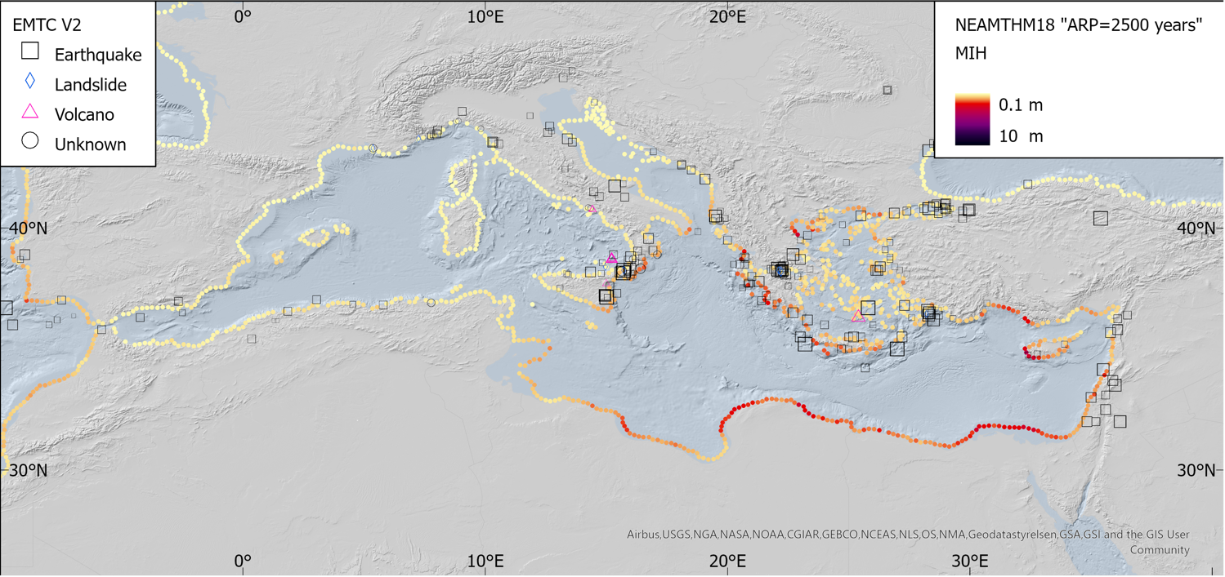

Tsunami Hazard (S- PTHA) in the Mediterranean
http://www.tsumaps-neam.eu

Slide 15
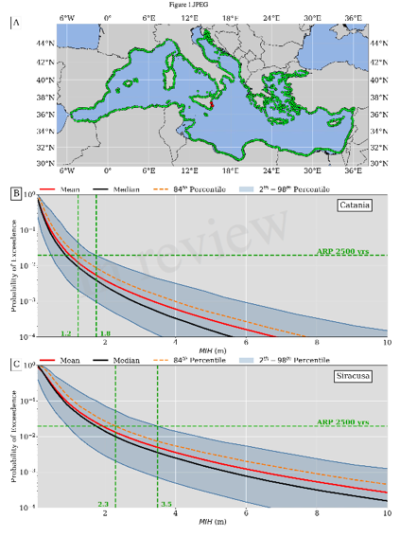

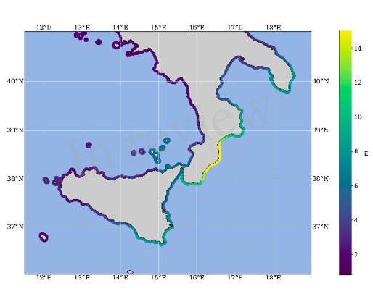
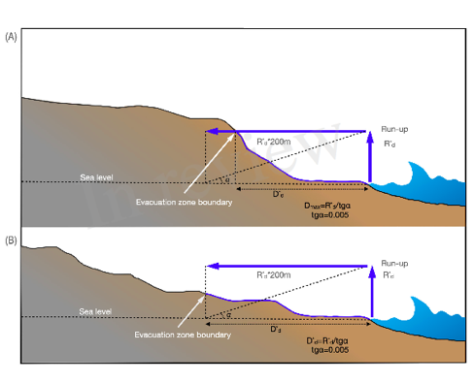
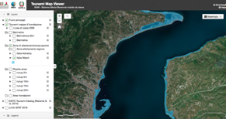
Inundation maps for Coastal Planning (including evacuation)
DirPC SiAM; DPC, 2018
Regional Hazard (NEAMTHM18)
2500 yr ARP + 84th percentile
Safety factors
Coastal dissipation
Notes:
Dealing with / Communicating uncertainty

Slide 16
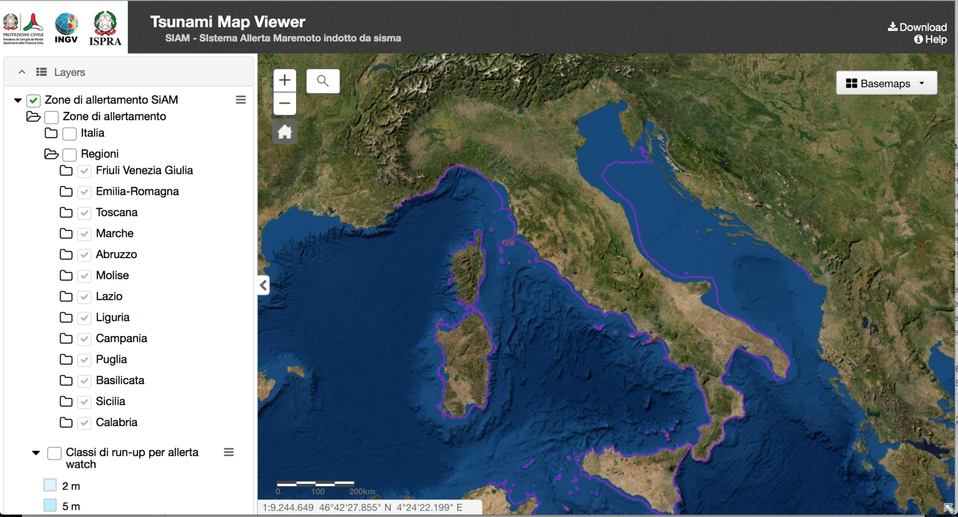
Tsunami Hazard and inundation zones
ISPRA has completed the revision of 13/15 Regions. Veneto and Sardinia by the end of 2021

Slide 17
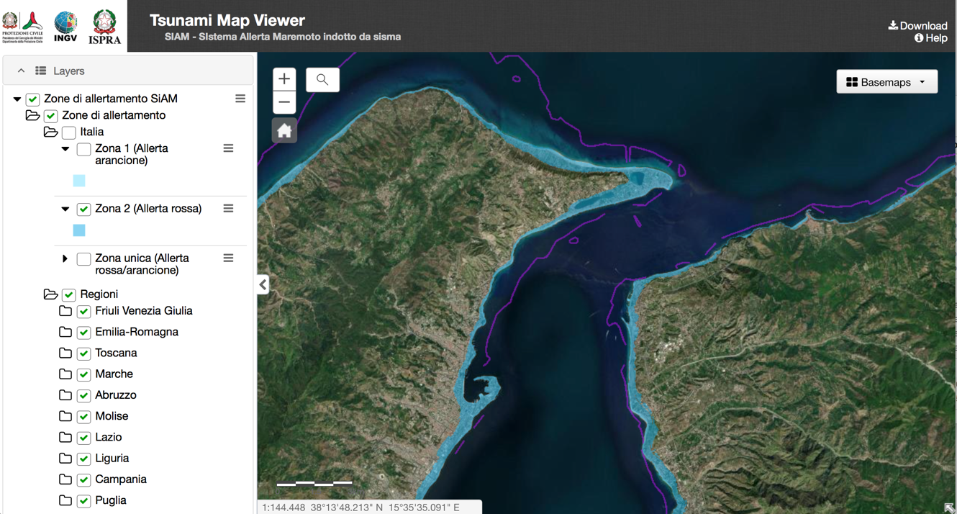
Tsunami Hazard and inundation zones
Zoom on the Messina Straits area with Watch level alert zone (in light blue)

Slide 18
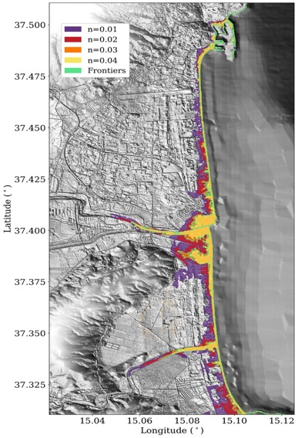
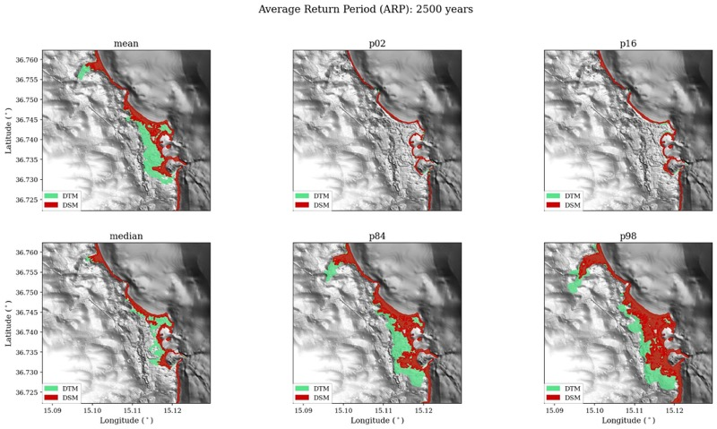
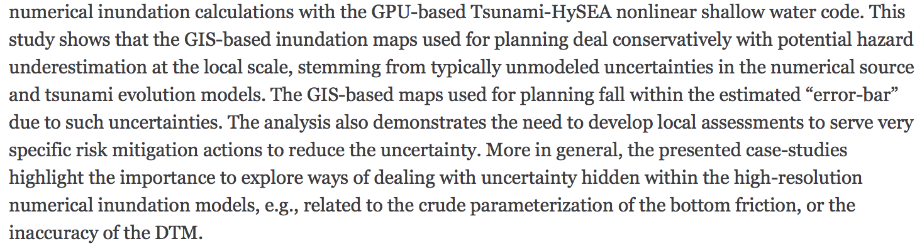
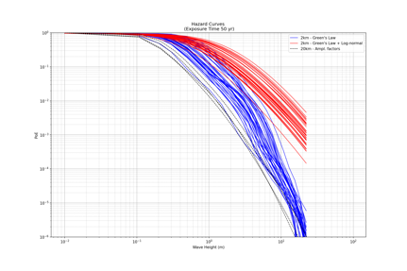
Uncertainty in inundation maps
Tonini et al., 2021
Notes:
Aleatory and Epistemic

Slide 19
Monitoring: new horizons
New generation tide gauges (ISPRA)
Seismomters and pressure sensors below oil/gas platforms
Deep-sea Observatories and SMART cables in the Ionian Sea

Slide 20

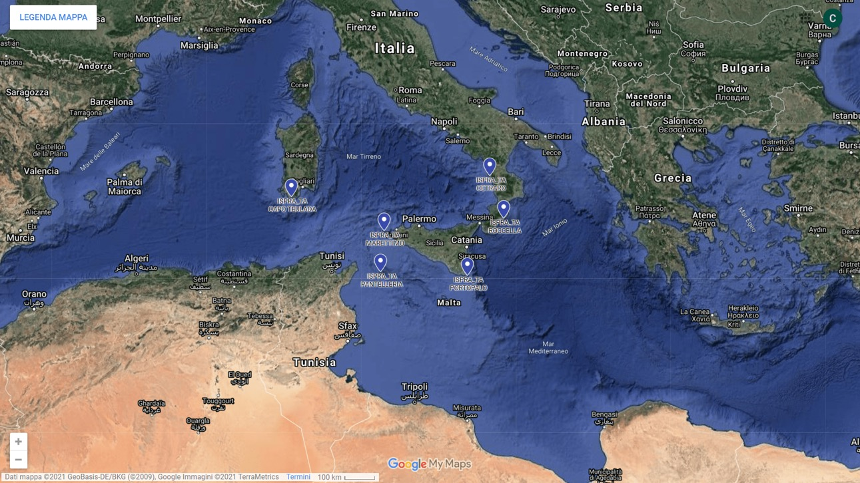
Monitoring: ongoing efforts / 1. New generation tide gauges (ISPRA)
Six new generation sea level stations installed by ISPRA in 2021.
High reliability, high frequency, strong resistance, high accuracy, with webcam.

Slide 21
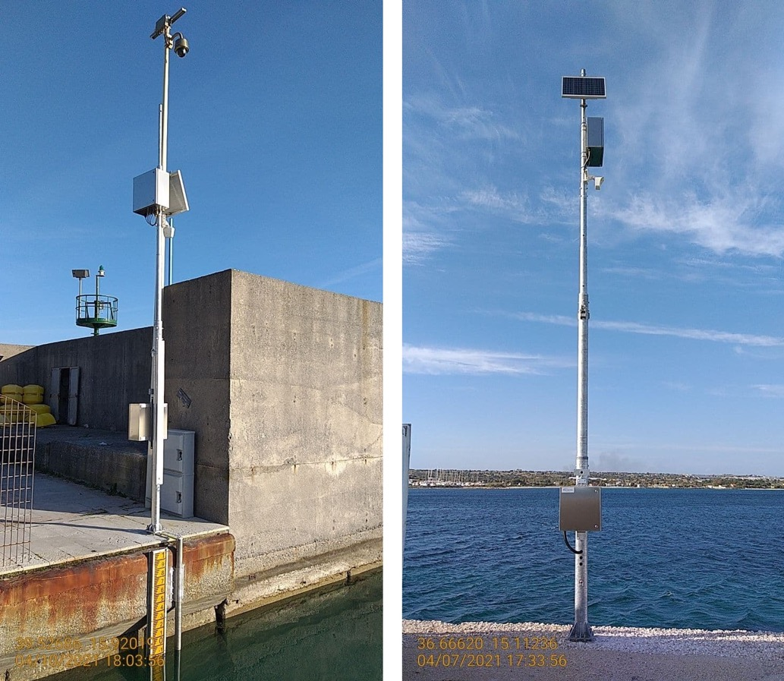
Monitoring: ongoing efforts / 1. New generation tide gauges (ISPRA)
Two examples:
Cetraro (Calabria) and Capo Passero (Sicily)

Slide 22
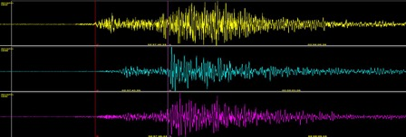
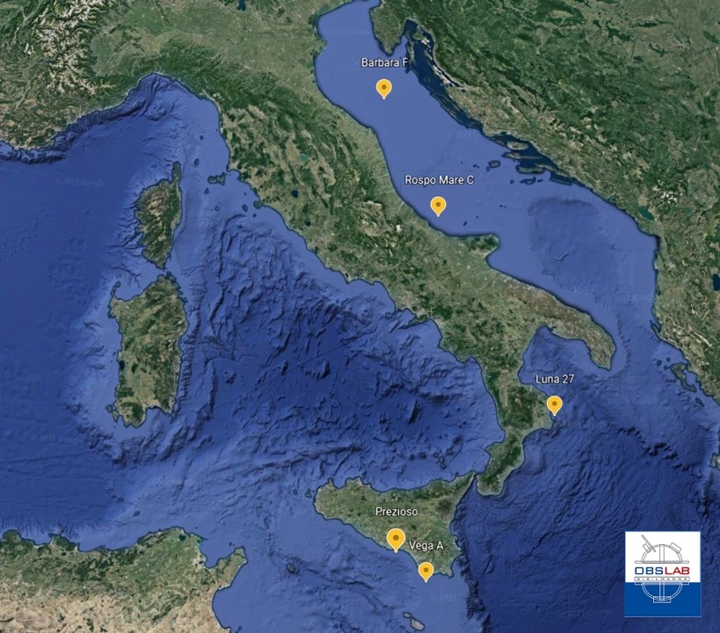
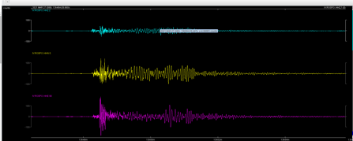
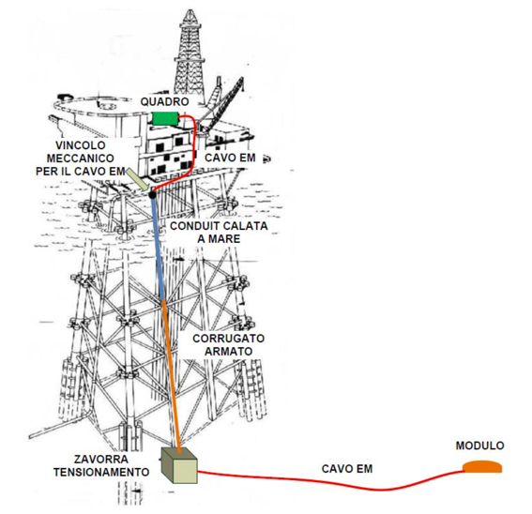
Monitoring: ongoing efforts / 2. gas/oil platforms
Ongoing project: installing seismometers, pressure sensors, and other sea state sensors.
Funded by National Project (PON) InSEA
INGV Lab in Gibilmanna, Sicily.

Slide 23
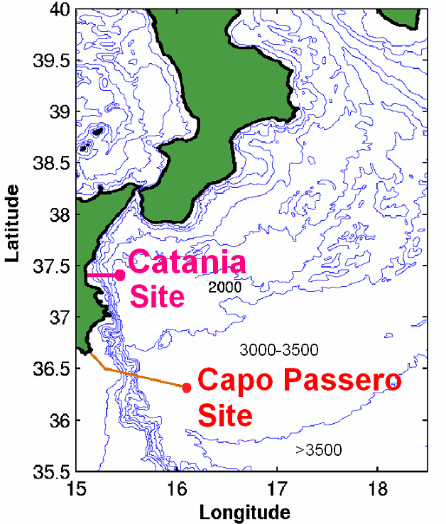
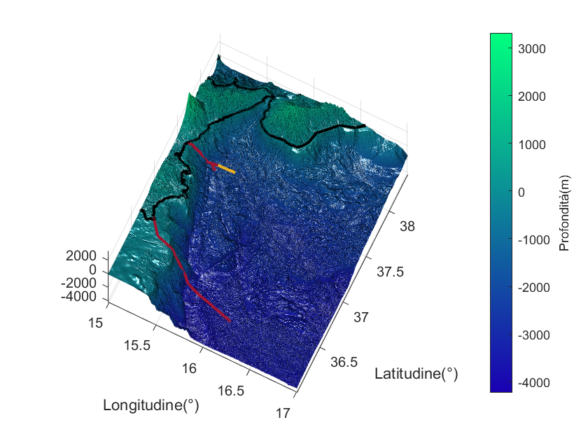
InSEA project: enhancement of Western Ionian Sea
Monitoring: ongoing efforts / 3. Deep-Sea Observatories + Smart Cables
National Operative Programme – Research and Innovation 2014-2020
InSEA: Initiatives in Supporting the consolidation and enhancement of EMSO infrastructure and related Activities
Catania Site:
JB + 2 new multidisciplinary seafloor observatories: CALIPSO and DIONE
shore station enhancement (ICT and power supply 2kVA)
Ionian SMART cable pilot project
Capo Passero Site (3500 m bsl, 100km E/O cable):
JB + 2 new multidisciplinary seafloor observatories: TETI and DORIDE
EMSO data center in Portopalo shore station
CALIPSO & DIONE
37.54765 N, 15.3975 E
SMART CABLE
36.29687 N, 15.97839 E
TETI & DORIDE
G. Marinaro et al., ESC 2021

Slide 24
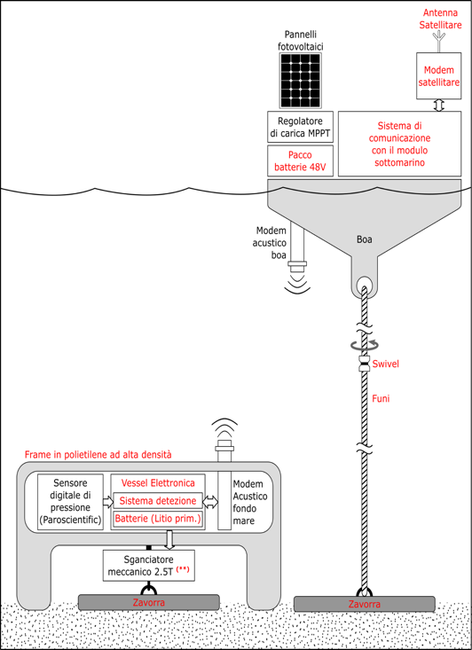
Monitoring: ongoing efforts / 4. a new buoy project in the Ionian
Ongoing project: installing pressure sensor at depth.
More than half is already in the Lab.
Funded by National Project (PON) InSEA
INGV Lab in Gibilmanna, Sicily.

Slide 25
Mitigation and last mile activities
  NEAMWave2020/21
  Tsunami Risk perception studies
  Io Non Rischio campaigns (October 2021)
  Tsunami Ready
  WTAD 2021
  IT-ALERT

Slide 26

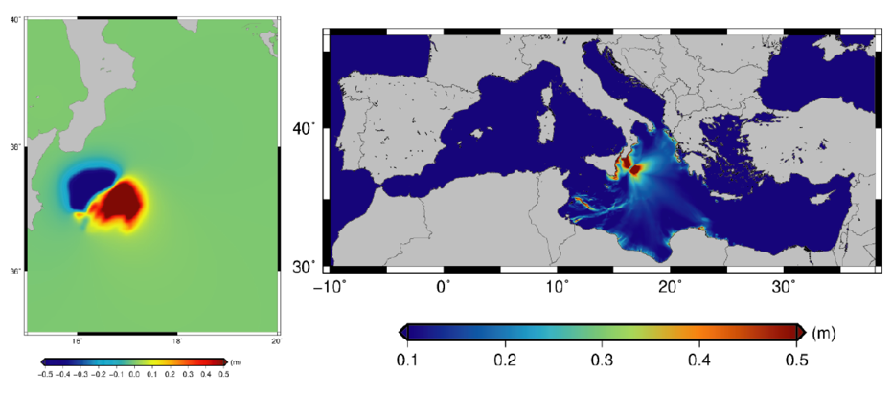
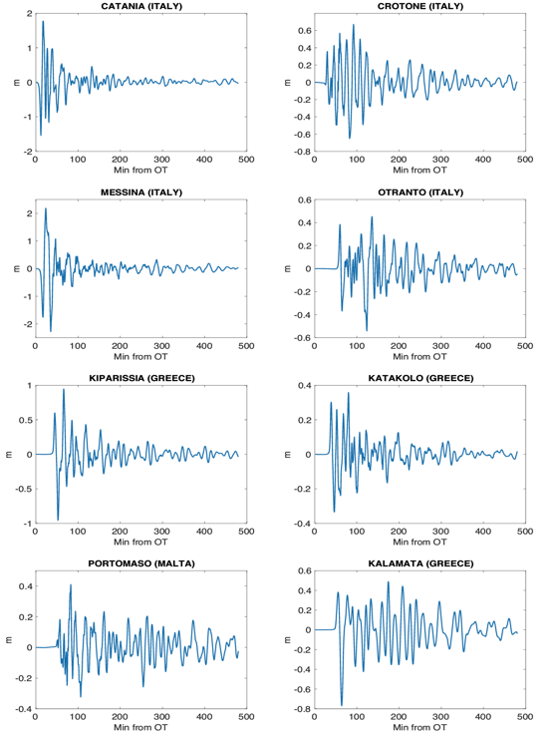
Mitigation and last mile activities/1: NEAMWAVE21
Earthquake parameters
M_{w} | 7.9
Longitude | 16.95 °E
Latitude | 37.12 °N
Depth (km) | 10.0
Rupture Area (km²) | ~11000
Slip (m) | 2.7 (average)
Rigidity (GPa) | ~30
Rake | 90
Played on NEAMWave20 day (March 9, 2021)
Replayed on WTAD for Malta exercise (Nov.5, 2021)

Slide 27
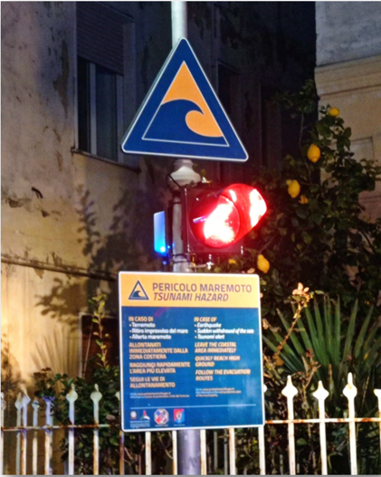

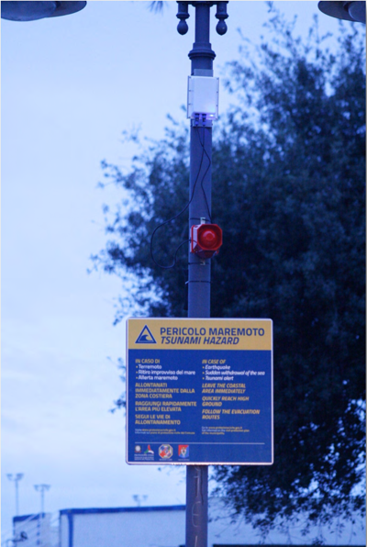
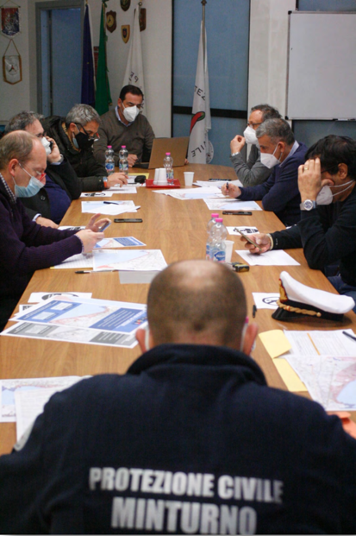
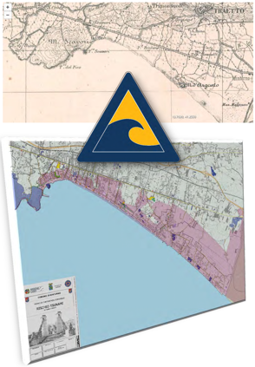
Mitigation and last mile activities/1: NEAMWAVE20 /21
NEAMWave20/21 in Minturno,
one of the Italian municipalities
running for Tsunami Ready

Slide 28
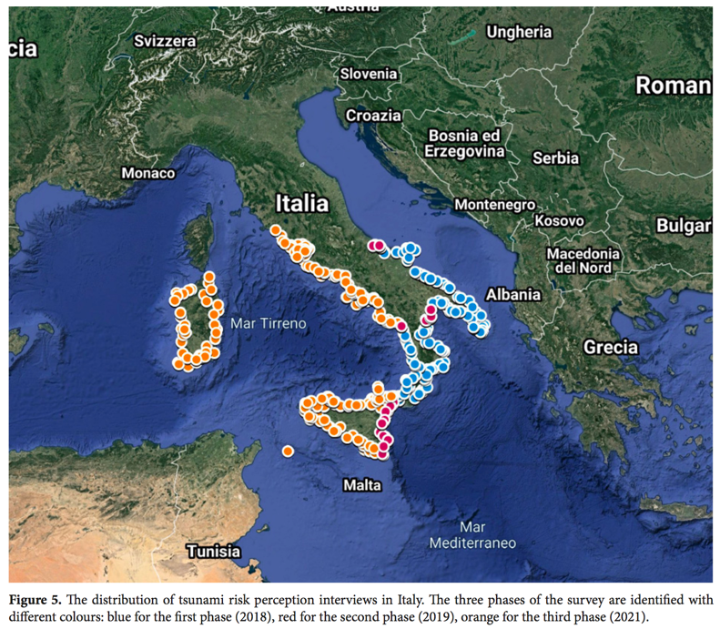
Mitigation and last mile activities: 2. Risk perception study
Total survey coverage in coastal municipalities (CATI) 2018 | 2020 | 2021
Surveyed coastal regions | 53% (8/15)
Surveyed coastal municipalities | 70% – (450/645)
Total respondents | 5.842 representative of about 12mln people (7.342 with Telepanel)
Km of surveyed coastline | 77,9% (6.166km/7.915km)
2021 – Telepanel (General public)
1500 total respondents | Nationwide distributed according to: age, gender, geographic area, educational qualification variables.
(A. Cerase, M. Crescimbene, F. La Longa, A. Amato, NHESS, 2019)
CUGLIARI ET AL. (2021), in progress

Slide 29
Tsunami Risk Perception Surveys – 2018|2020|2021
Is tsunami risk perceived differently by coastal residents compared to the average of the Telepanel(general public)?
Which channels/sources you want to receive tsunami warnings from?

Slide 30
Risk perception: Some indications from the first surveys
Risk perception is affected by memory (Calabria vs. Apulia), even of “old” events (e.g., 1908), by education, and other elements
Media images of big tsunamis affect people’s characterization of risk (underrating small, dangerous events! – more likely)
Different words with the same meaning (maremoto vs. tsunami) sound different for laypeople (language problem)
Broadcast and traditional media are still relevant as information sources and alert dissemination channels (TV, radio, sirens) - more than Internet
Interpersonal sources and social networks are very relevant for some processes and for some categories (elders, people with low education)
People have great expectations from authorities, civil protection and research institutions to face tsunami risk and manage early warning issues

Slide 31

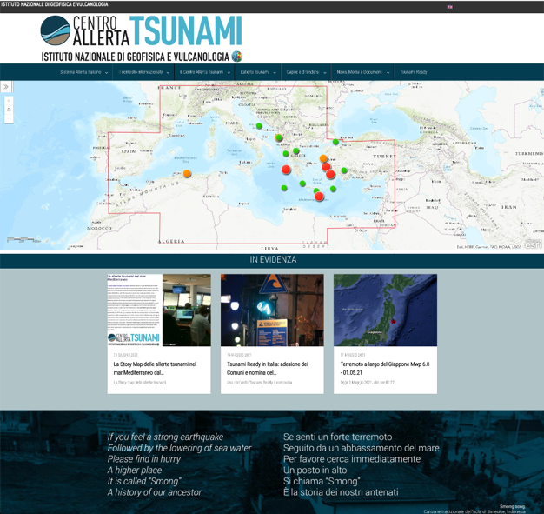

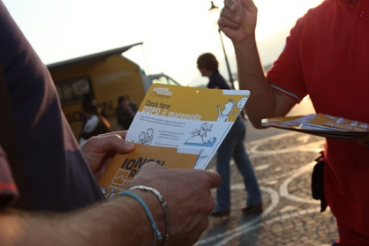
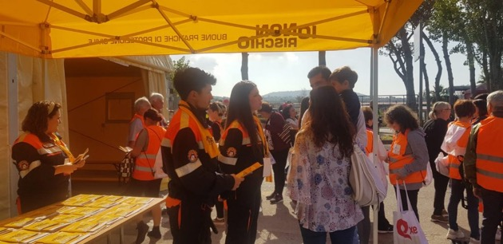
Io Non Rischio yearly campaigns
<-----
CAT web site

Slide 32
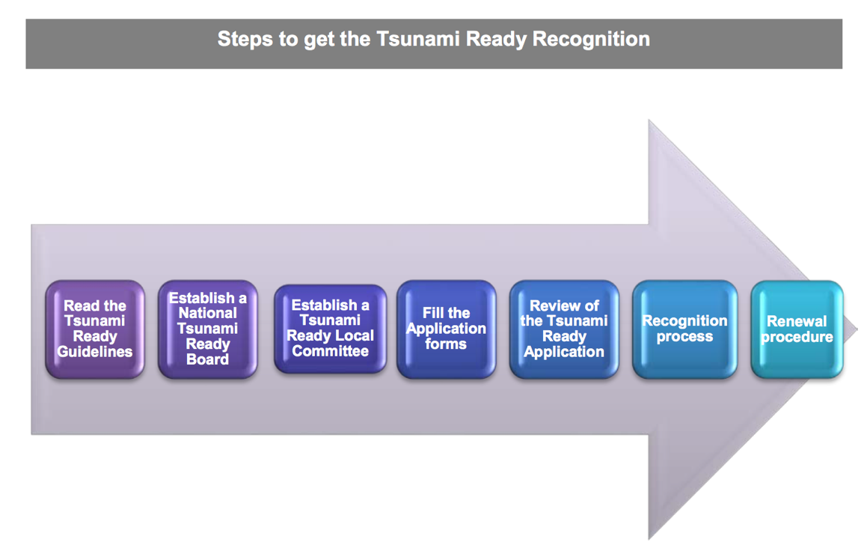



Mitigation and last mile activities/4: Tsunami Ready in Italy
First NTRB in NEAM region
May, 2021

Slide 33
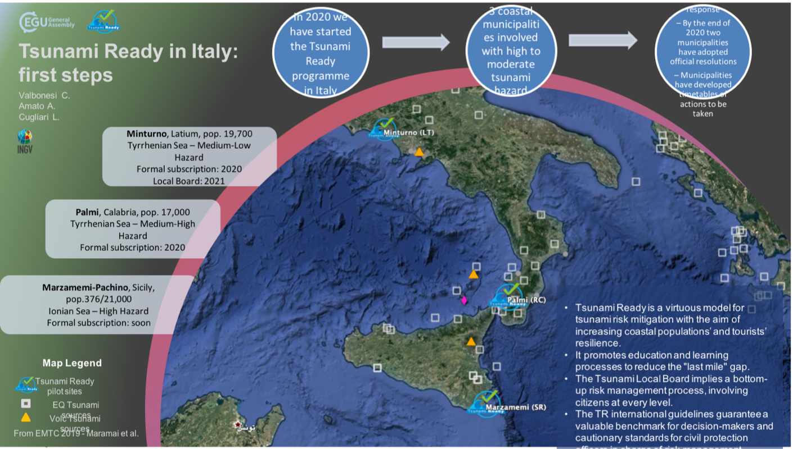
Mitigation and last-mile/4: Tsunami Ready program in Italy
European Geophysical Union, April 2021

Slide 34

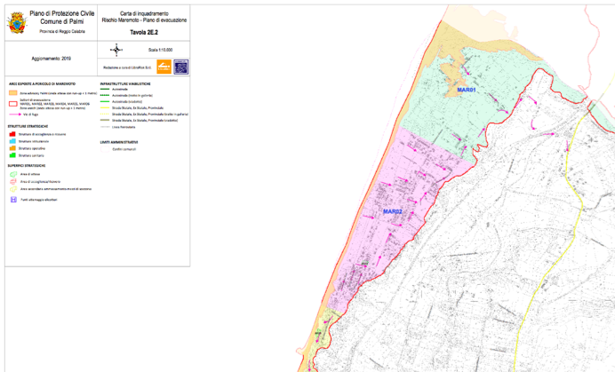
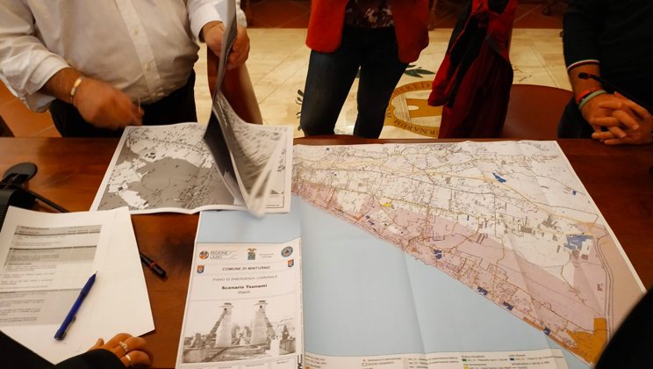
The last-mile/4: Tsunami Ready program in Italy
Examples from Palmi, Calabria, and Minturno, Lazio
From Inundation Maps to Coastal Planning and Evacuation Routes
Notes:
The last-mile

Slide 35

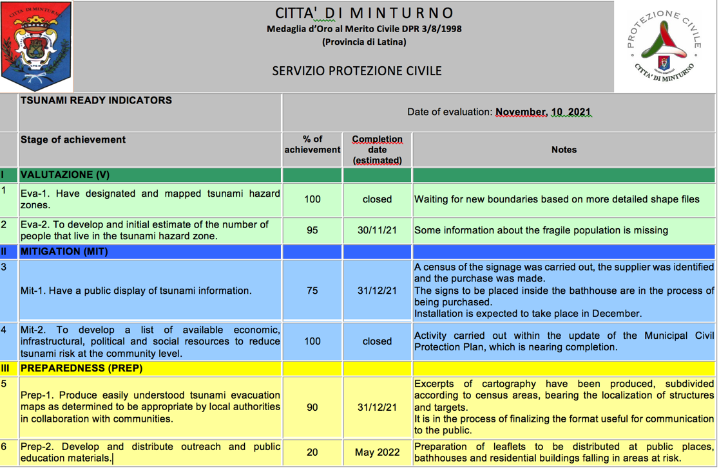
The last-mile/4: Tsunami Ready program in Italy
On November 2021, the National Tsunami Ready Board asked an update to the three municipalities running for TR recognition
Two answered promptly (the third one has just changed the Mayor and the Council and did not answered yet)
More details on WG4 and Tsunami Ready presentations
Notes:
The last-mile

Slide 36
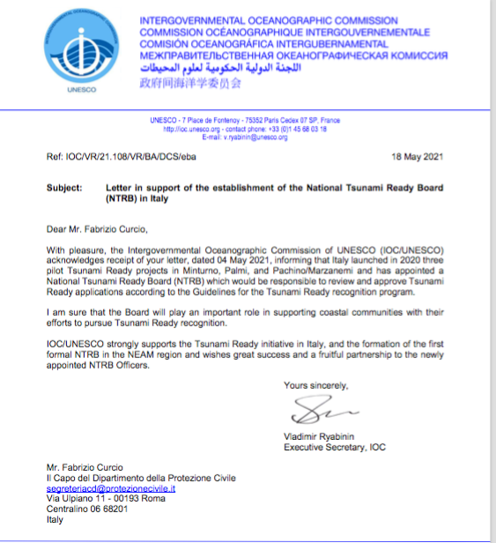
Tsunami Ready Officially Started
Notes:
The last-mile

Slide 37

The last-mile/5: CAT-INGV Website
News on CAT-INGV website (Italian and English)
From May 2020 (site release) | 59 News
Notes:
The last-mile

Slide 38

The last-mile/6: IT-ALERT
Testing phase ongoing…
Notes:
The last-mile

Slide 39
Papers published in 2021 by CAT-INGV and co-authors

Slide 40





Recent papers: 1. Monitoring - Warning
Amato et al., SRL, 2021
Notes:
As testified by this Factsheet, for about 15 years we have been building the NEAMTWS

Slide 41


Recent papers: 2. Probabilistic Tsunami Forecasting

Slide 42




Recent papers: 3. Tsunami Hazard S-PTHA / NEAMTH18
WTAD 2021 / 8 November 2021 – NIOF-EGYPT
Notes:
As testified by this Factsheet, for about 15 years we have been building the NEAMTWS

Slide 43




Recent papers: 4. Tsunami Hazard and Risk / Research Gaps
Behrens et al., FEART, 2021
WTAD 2021 / 8 November 2021 – NIOF-EGYPT
Notes:
As testified by this Factsheet, for about 15 years we have been building the NEAMTWS

Slide 44






Recent papers: 5. Tsunami risk for “atypical” sources
Selva et al., Nuovo Cimento, 2021
WTAD 2021 / 8 November 2021 – NIOF-EGYPT
Notes:
As testified by this Factsheet, for about 15 years we have been building the NEAMTWS

Slide 45

Recent papers: 6. Tsunami Hazard, Warning, Risk reduction
WTAD 2021 / 8 November 2021 – NIOF-EGYPT

Slide 46


Recent papers: 7. The 2/5/2020 Crete earthquake-tsunami
WTAD 2021 / 8 November 2021 – NIOF-EGYPT

Slide 47

Recent papers: 8. Testing tsunami inundation maps

Slide 48



9. Tsunami risk perception (2019)
WTAD 2021 / 8 November 2021 – NIOF-EGYPT

Slide 49
Useful Links
www.ingv.it/cat/en
http://www.tsumaps-neam.eu
https://tsunamiarchive.ingv.it/emtc.2.0/
https://storymaps.arcgis.com/stories/32091c82e42a4d30a2f24b1e7b5955b6
http://sgi2.isprambiente.it/tsunamimap/
https://rischi.protezionecivile.it/it/maremoto-0
WTAD 2021 / 8 November 2021 – NIOF-EGYPT

Slide 50
Thank you for your attention!
WTAD 2021 / 8 November 2021 – NIOF-EGYPT
Notes:
As testified by this Factsheet, for about 15 years we have been building the NEAMTWS

