Slide 1
THE UN OCEAN DECADE SAFE OCEAN OUTCOME AND TSUNAMI EARLY
WARNING SYSTEMS

Slide 2
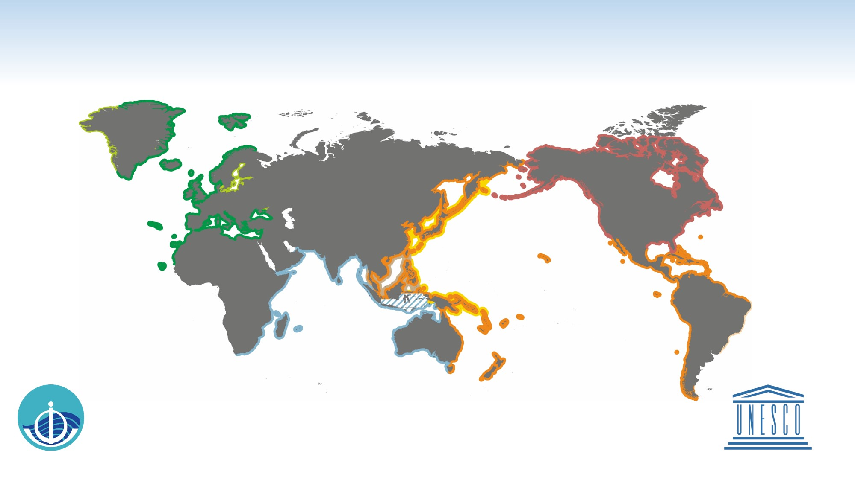
EXISTING SERVICES OF THE GLOBAL TSUNAMI WARNING SYSTEM
Intergovernmental Oceanographic Commission of UNESCO
2021 www.ioc-tsunami.org
The services provided by the
US National Tsunami Warning Center
are outside the framework of the IOC
coordinated tsunami warning systems
NEAMTWS
North Eastern Atlantic, Mediterranean
and connected seas Tsunami Warning and Mitigation System
Accredited TSPs:
CENALT Centre d'Alerte aux Tsunamis
IPMA Instituto Portugues do Mar e da Atmosfera
INGV Istituto Nazionale di Geofisica e Vulcanologia
KOERI Kandilli Observatory and Earthquake Research Institute
NOA National Observatory of Athens
Planned
CARIBE-EWS
Tsunamis and Other Coastal Hazards Warning System for the Caribbean and Adjacent Regions
Service provided by
PTWC Pacific Tsunami Warning Center
Planned
PTWS
Pacic Tsunami Warning and Mitigation System
NWPTAC/JMA
Northwest Pacific Tsunami Advisory Center /
Japan Meteorological Agency
PTWC
Pacific Tsunami Warning Center
SCSTAC/NMEFC
South China Sea Tsunami Advisory Center /
National Marine Environmental Forecasting Center of P. R. China
IOTWMS
Indian Ocean Tsunami Warning and Mitigation System
InaRTSP
Indonesian Regional Tsunami Service Provider
ITEWC
Indian Tsunami Early Warning Centre
JATWC
Joint Australian Tsunami Warning Centre
Service is provided by the
InaTEWS
Indonesian Tsunami Early Warning System at the BMKG, outside the framework of the IOC-coordinated tsunami warning systems
Notes:
In response to the devastating Indian tsunami of December 2004, the IOC UNESCO together with partners from the UN and outside has developed a well-organized and focused the Global Tsunami Warning and Mitigation System. The System covers over close to 1.5 million km of coastline (Lauretta Burke, Yumiko Kura, Ken Kassem, Carmen Revenga, Mark Spalding, and Don McAllister, Pilot Analysis of Global Ecosystems: Coastal Ecosystems, World Resources Institute, Washington D.C. April 2001) in ~150 countries and provides tsunami threat information in direct support of the over 1Billion people that live in low-lying coastal areas (Living in coastal areas « World Ocean Review). The system is made up of four regional intergovernmental systems covering the Pacific, Indian, and Northeastern Atlantic Ocean basins as well as the Mediterranean Sea and Caribbean Sea and adjacent regions, with eleven IOC Member States serving as either basin-wide or regional Tsunami Service Providers. The areas of responsibility of the Tsunami Service Providers are highlighted on the Map in different colors.

Slide 3


Tsunami Programme Proposal

Slide 4
The Thirty-first Session of the Intergovernmental Oceanographic Commission (of UNESCO) Assembly (14-25 June 2021) approved the establishment of the Ocean Decade Tsunami Programme, a Scientific Committee to prepare the Draft 10-Year Research, Development and Implementation Plan and Tsunami Ready Coalition
“...this programme will seek to ensure that a country's ability to prepare for, defend against and recover from the tsunami threat is not dependent on what it can afford.”
Alexander Frolov, Jul 2021

Slide 5

CHALLENGES AND OPPORTUNITIES FOR THE DEVELOPMENT OF THE GLOBAL TSUNAMI WARNING SYSTEM
Improve data exchange:
bathymetry,
seismic,
sea level,
GNSS,
Digital Earth Elevation data
Improve speed of tsunami detection and measurement system on the basis of new technologies (including near-field and non-seismic tsunamis)
Scaling the IOC Tsunami Ready programme
Increase capacities for tsunami warning and mitigation within SIDS/LDS
Ensuring interoperability with other components of a global coastal Multi-Hazard Early Warning System (MHEWS)
Notes:
contribute to improve our understanding of tsunami and other coastal hazards by expanding our knowledge of past or potential tsunami and other coastal hazards sources,
continue to help vulnerable communities around the world meet the guidelines outlined in the UNESCO/IOC Tsunami Ready program

Slide 6
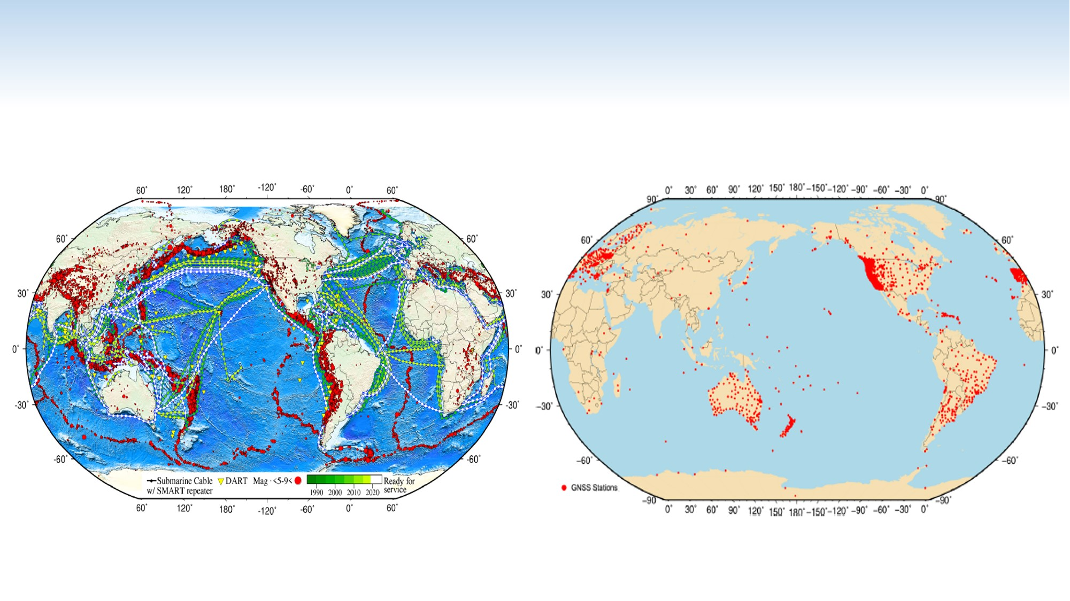
NEW POTENTIAL SOURCES OF SEISMIC OBSERVATIONS FOR TSUNAMI WARNING SYSTEMS
Locations and magnitudes of historical seismic events (red),
DART tsunami buoys (yellow triangles) and current (green)
and planned (white) submarine cables,.
SMART repeaters shown every 300 km
The location of 2,260 real-time GNSS stations from public networks around the world
Angove, M . et. al, 2019
Pacific Northwest Geodetic Array/Central Washington University

Slide 7
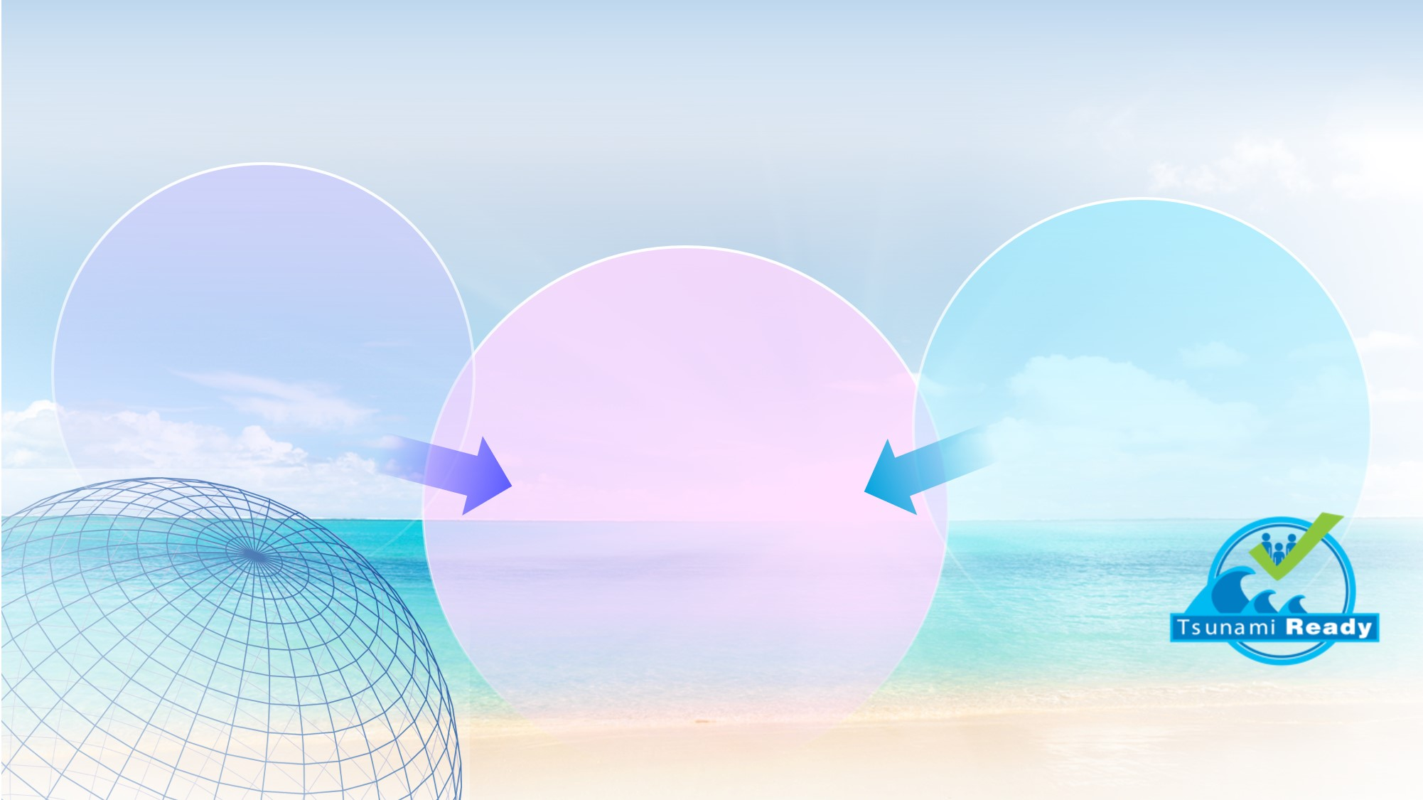
OCEAN DECADE TSUNAMI PROGRAMME:
Seeking Major Advances in SCIENCE and PREPAREDNESS
New observational and analysis technologies to move from a high-uncertainty assumption-based capability to a low-uncertainty dynamic-based capability
Comprehensive institutional & community preparedness and capacity building efforts aimed at achieving IOC Tsunami Ready designation across all socio-economic categories
RESILIENCE!
Communities respond to tsunami threats by combining accurate real-time impact forecasts with deep community preparedness. Tsunami disaster impacts are minimized, enabling rapid restoration of critical infrastructure and services
Notes:
Our vision for advancing the GTWS as a dedicated Tsunami Programme under the UN Decade is based on two over-arching aspects. The first aspect is to fully explore technological and observational advances that will allow us to move from a capability based largely on seismic assumptions and large uncertainties to one based on real-time dynamic assessment and low uncertainties. The second aspect will be to match these capability advancements with improved community preparedness efforts, including striving for 100% Tsunami Ready or comparable recognition of all at-risk coastlines. In this way—by combining scientific and technological advances with unprecedented levels understanding and preparedness—we look to achieve true long-term tsunami resilience where communities have access to accurate real-time tsunami impact forecasts that enable them to minimize impacts and maintain critical infrastructures and services even under extreme circumstances.

Slide 8
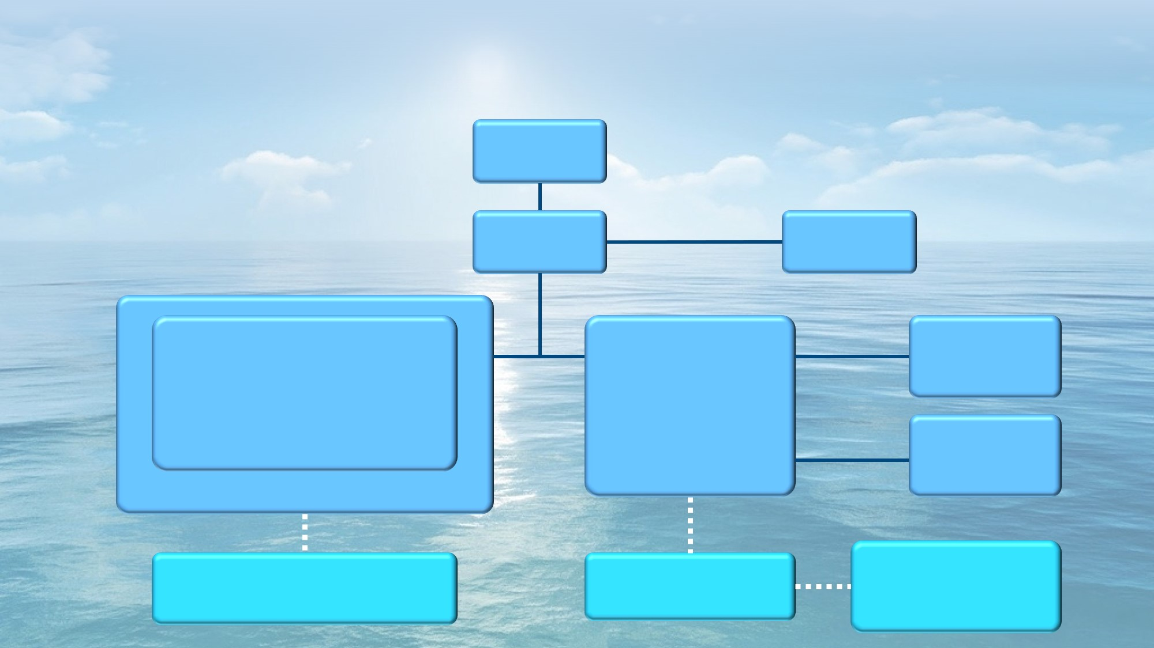
OVERVIEW OF THE OCEAN DECADE TSUNAMI PROGRAMME PLANNINGS
IOC Assembly
IOC Executive Council
IOC Secretariat
Tsunami Unit
ICG/PTWS
ICG/IOTWMS
ICG/CARIBE EWS
ICG/NEAMTWS
Pacific
Indian
Caribbean
NE Atlantic and Mediterranean
TOWS-WG
WG on Tsunamis and Other Hazards Related to Sea-Level Warning and Mitigation System
TT on TWO
Task Team on Tsunami Watch Operation
Standards, Best Practice,
Advisory to IOC Assembly/EC
TT on DMP
Task Team on Disaster Management and Preparedness
Coordination of Regional TWS
Capacity Development
TSUNAMI READY COALITION
A 10-year Research, Development and Implementation Plan
SCIENTIFIC COMMITTEE
Co-design, Partnership, Resources

Slide 9
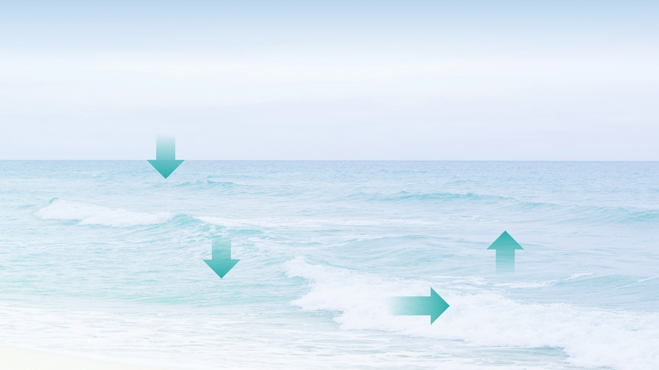
OVERVIEW OF THE OCEAN DECADE TSUNAMI PROGRAMME PLANNINGS (CON’ED)
The TOWS-WG will perform Global Steering Committee functions for the programme
A special Coalition for Tsunami Ready will be established in collaboration with other critical stakeholders across the UN structure and national civil protection agencies
A Scientific Committee with an advisory role for the duration of the programme will be established
The Scientific Committee will be tasked to develop a Draft 10-Year Research, Development and Implementation Plan for the programme for endorsement by the TOWS-WG at its next session
The four ICGs will perform regional Steering Committee functions

Slide 10

OCEAN DECADE TSUNAMI PROGRAMME:
THE MAIN SOCIAL OUTCOME
BY 2030
TO MAKE 100%
OF COMMUNITIES AT RISK OF TSUNAMI PREPARED FOR AND RESILIENT TO TSUNAMIS
10
Notes:
We recognize that there is much room for scientific advances related to the field of tsunami warning. We also recognize that scientific advances are only as important as the societal outcomes they influence. With this in mind, the Tsunami Programme, under the UN Decade of Ocean Science for Sustainable Development, will strive to ensure *all* threatened communities achieve tsunami resilience through a combination of advanced scientific capability and dedicated preparedness efforts by the year 2030. This is a Grand Challenge and one the Global Tsunami Warning and Mitigation System and it’s supporting components eagerly embraces.

