Slide 1
AGITHAR
COST Action CA18109
Accelerating Global Science in
Tsunami Hazard and Risk Analysis
Report to ICG/NEAMTWS-XVII
Jörn Behrens
joern.behrens@uni-hamburg.de

Slide 2
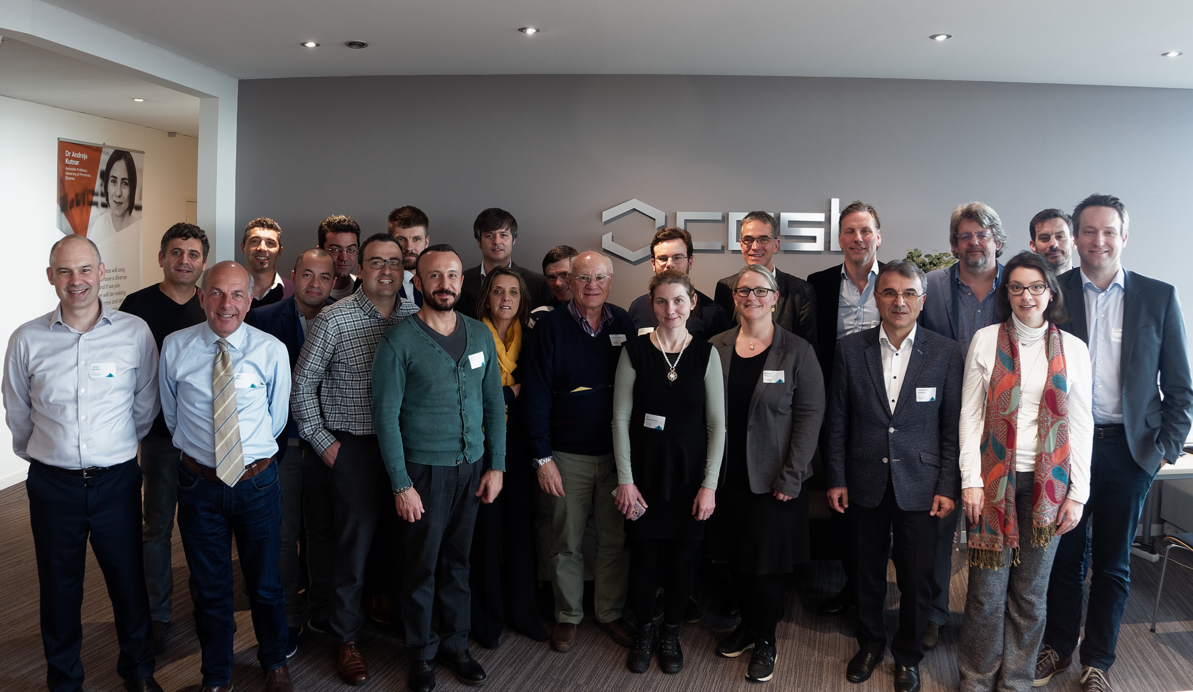
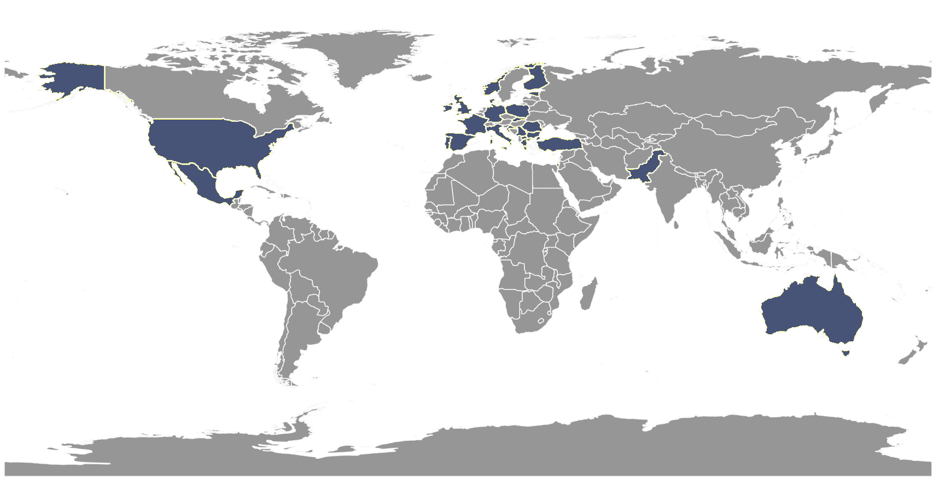
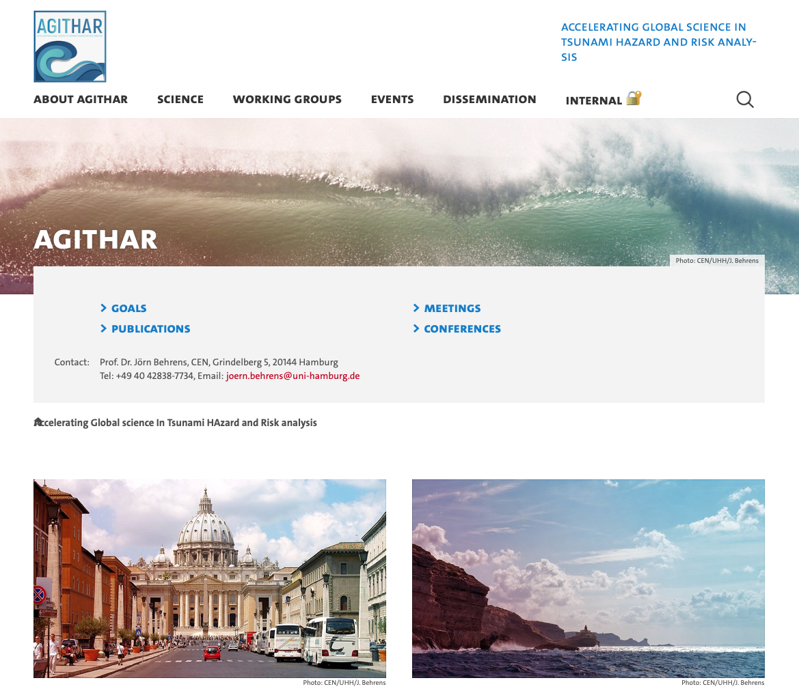
Introduction
Networking Activity
26 COST Countries
14 ITCs (56%)
~5 non-COST Countries
100+ Participants
Meetings
05/19 Brussels
10/19 Malta
01/20 Rome
09/20 Virtual
10/21 Virtual
www.agithar.uni-hamburg.de

Slide 3
Funding
Period | Time | Total Amount
1 | 05/2019-04/2020 | ~110.000 €
2 | 05/2020-10/2021 | ~110.000 €
3 | 11/2021-10/2022 | ~138.000 €
4 | 11/2022-04/2023 | max. 150.000 €

Slide 4
Objectives of AGITHAR
Inventory of PTHA and PTRA approaches
Performance metrics and test cases (benchmarks) for individual components of PTHA and PTRA workflow
Structure for standardized PTHA and PTRA workflows
Quality assurance for PTHA and PTRA
Benchmarking for interdisciplinary quality assessment
Open Access data repositories
Implementation and dissemination of PTHA and PTRA methods to stakeholders and end users

Slide 5
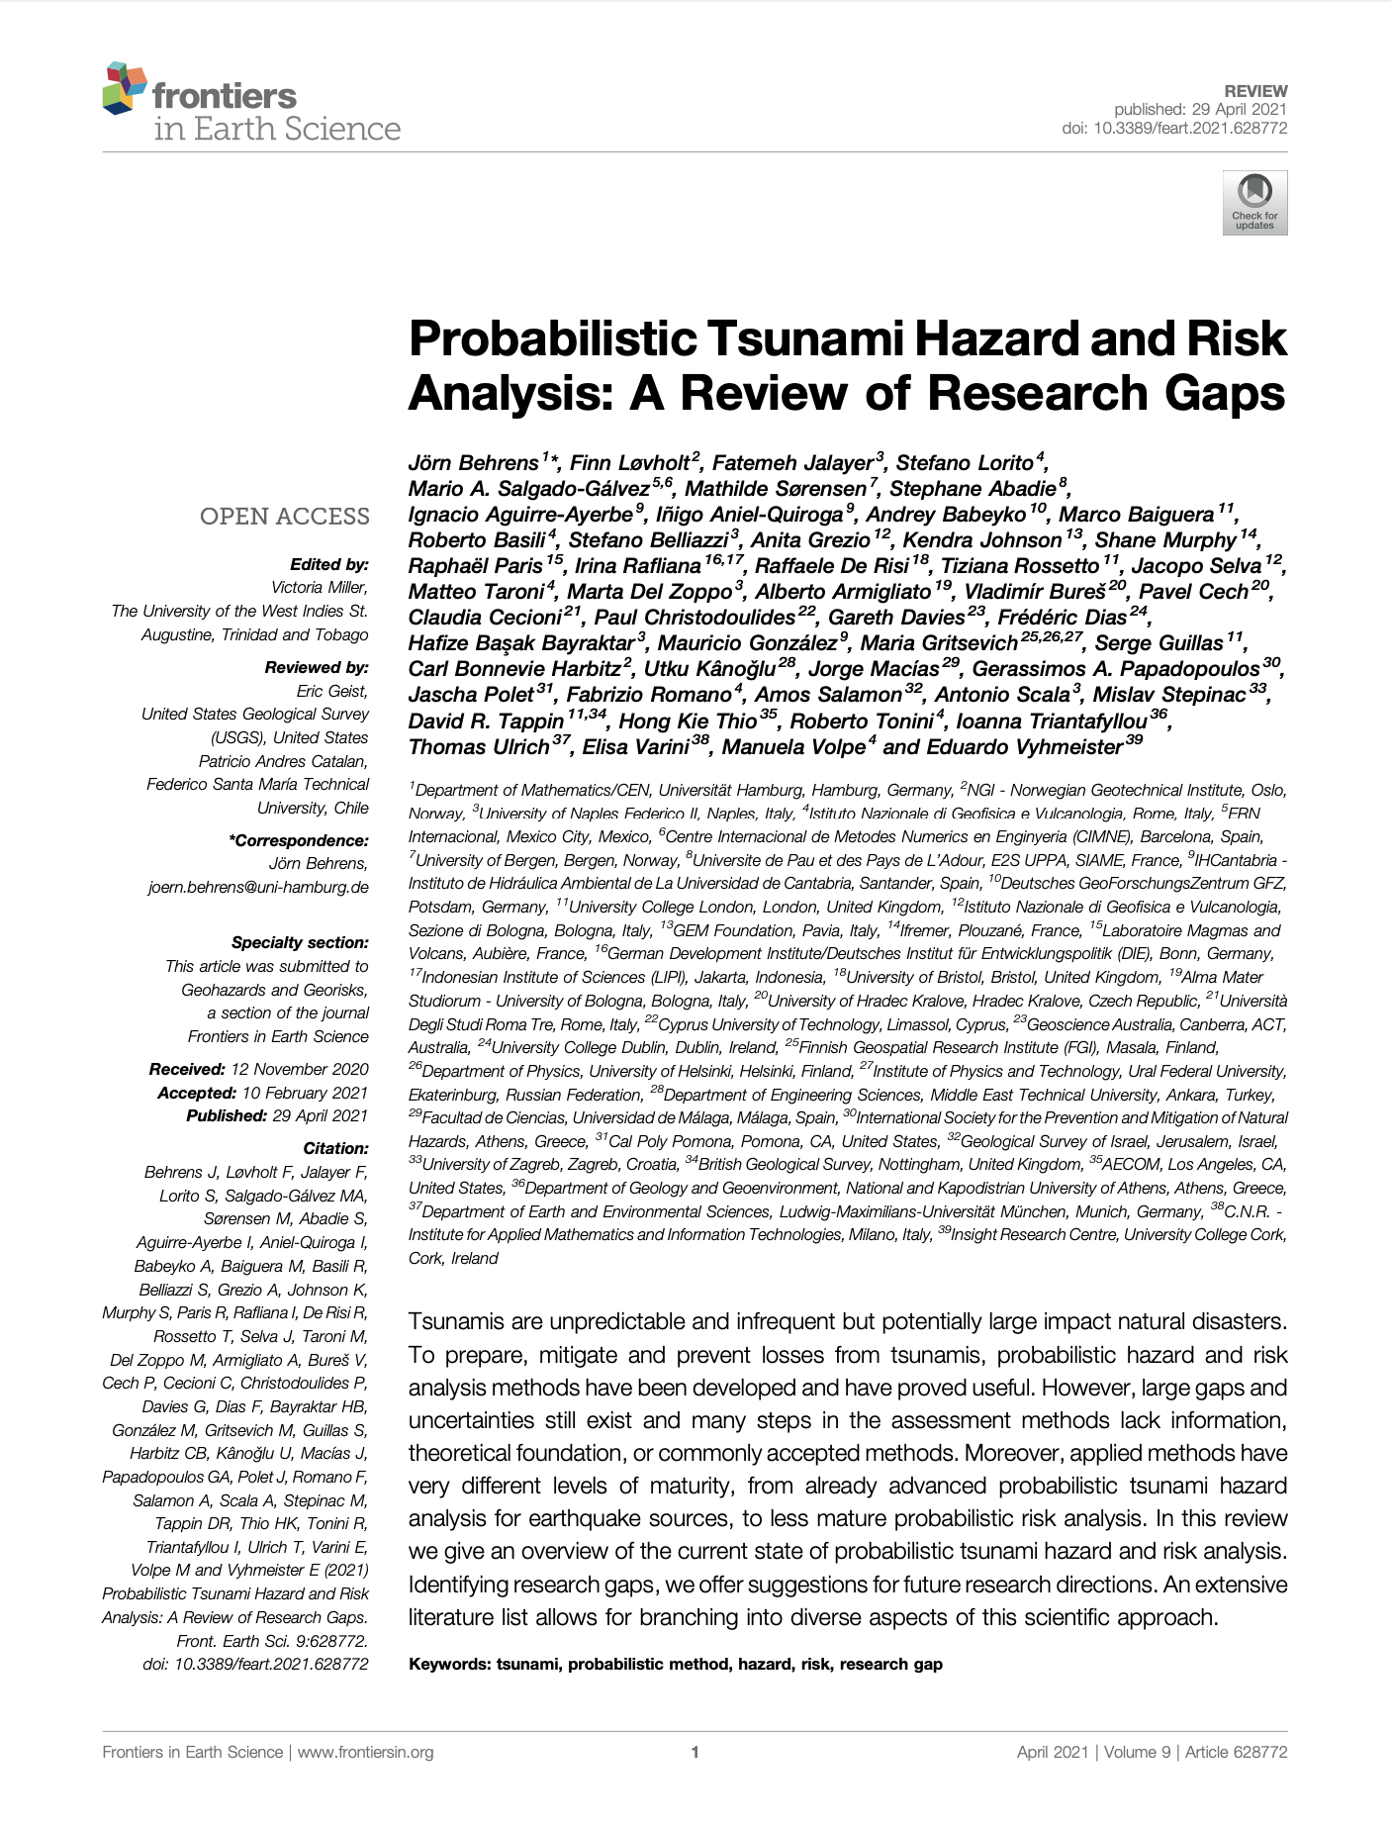
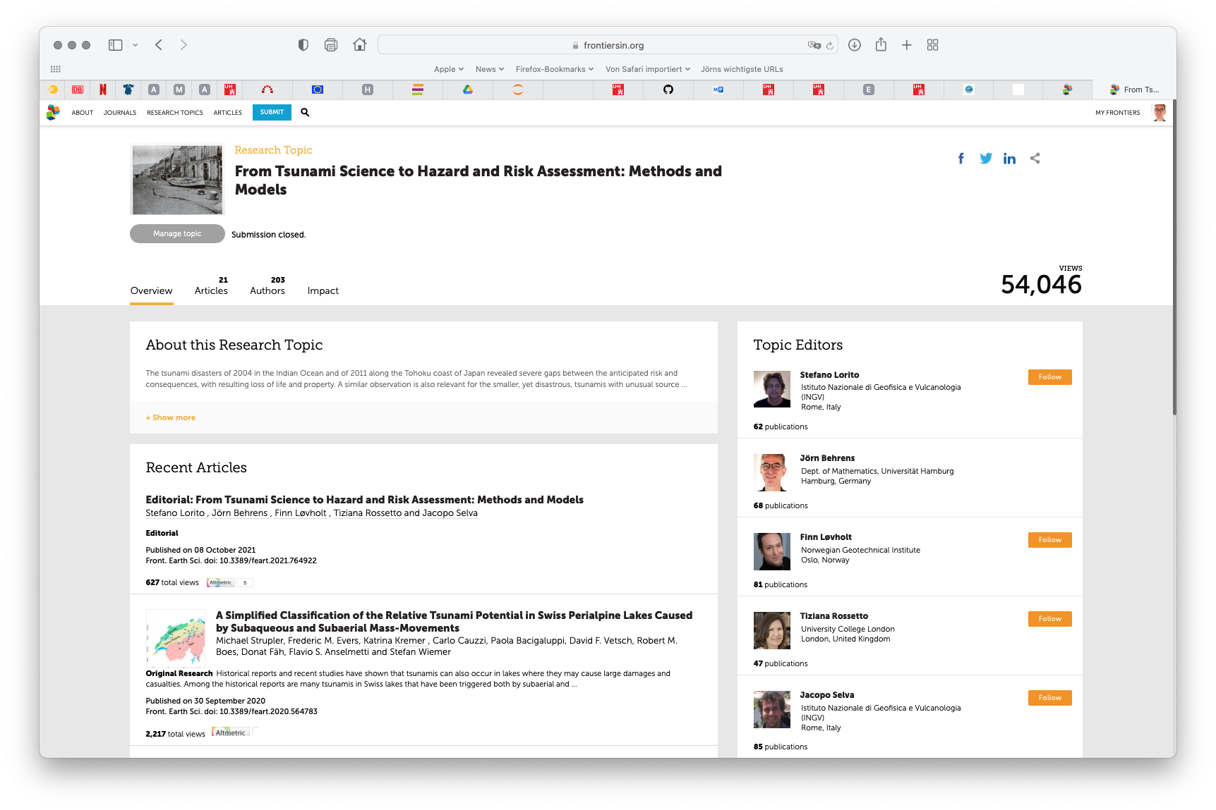
Achievements
Deliverable #1 (DOI:10.3389/feart.2021.628772)
Research Topic on Tsunami Hazard and Risk Assessment (https://www.frontiersin.org/research-topics/13035)
Several funding application initiatives
Notes:
Several

Slide 6
New COST Rules

Slide 7
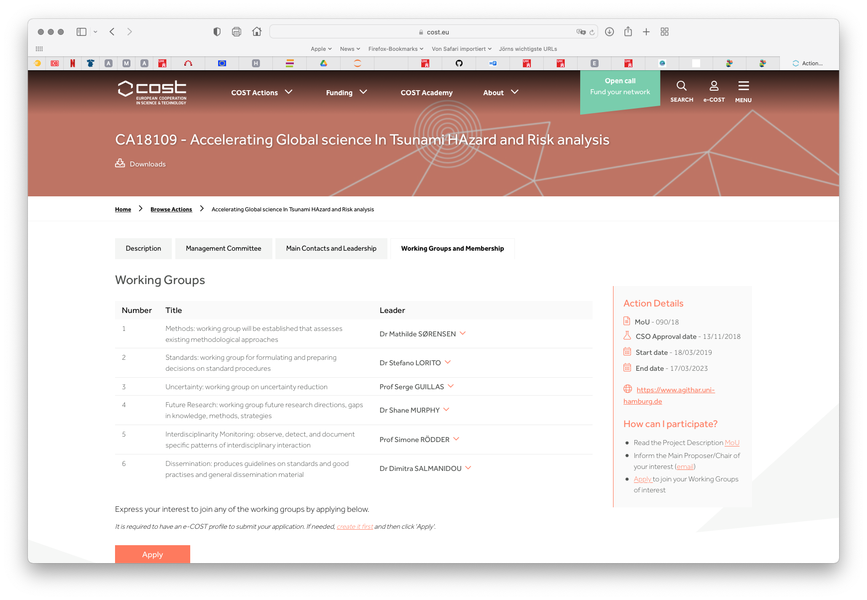
New COST Rules

Slide 8
Future
Advance Knowledge
Develop Probabilistic Approaches
Facilitate/Sustain Community
Platform for Initiatives (EPOS, GTM, EU Proposals, etc.)
Inclusiveness

