Slide 1



4.3 Evaluation of NEAMWave21
Coordinated by Task Team on Tsunami Exercise
(co-chairs: Ceren Ozer Sozdinler (Turkey) - Marinos Charalampakis (Greece))
ICG/NEAMTWS - XVII
Paris, France, 24–26 November 2021

Slide 2
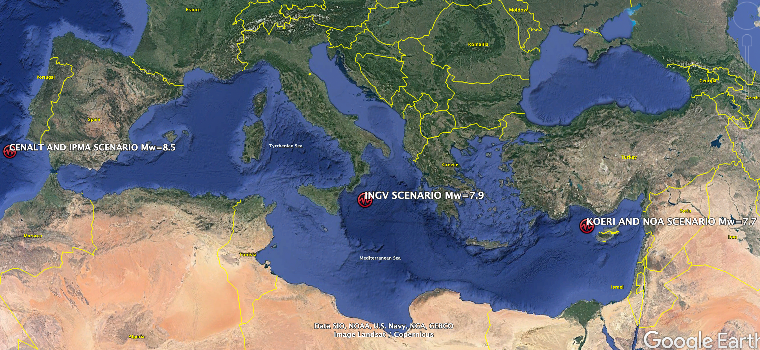
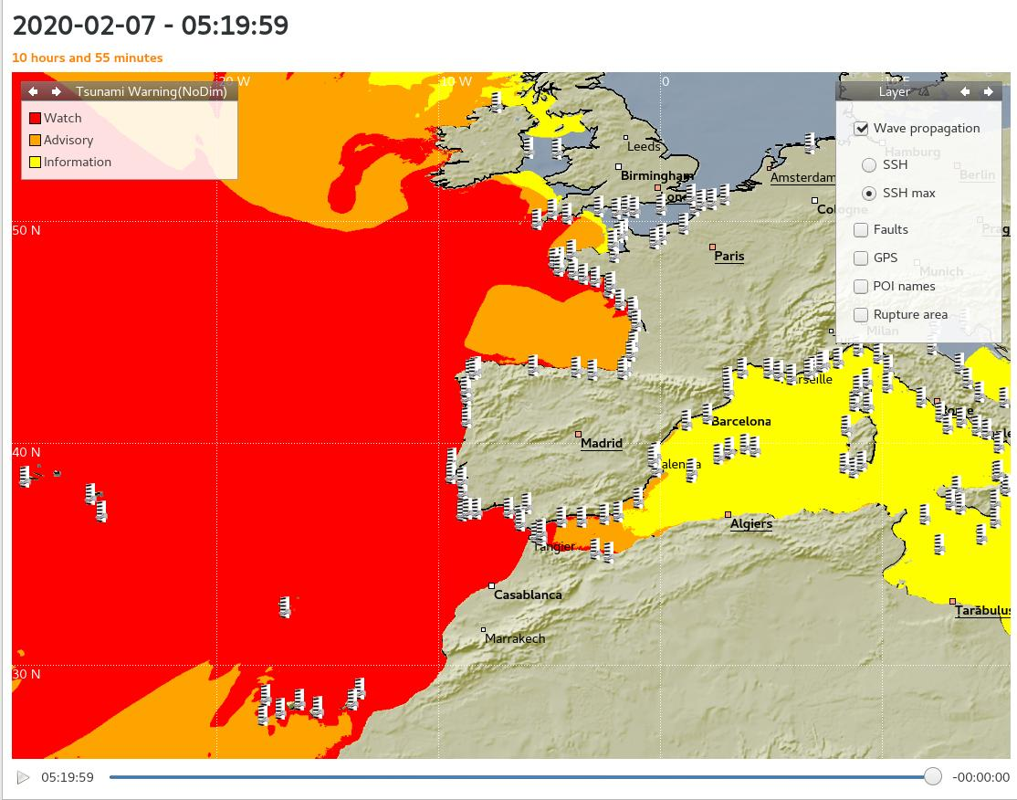
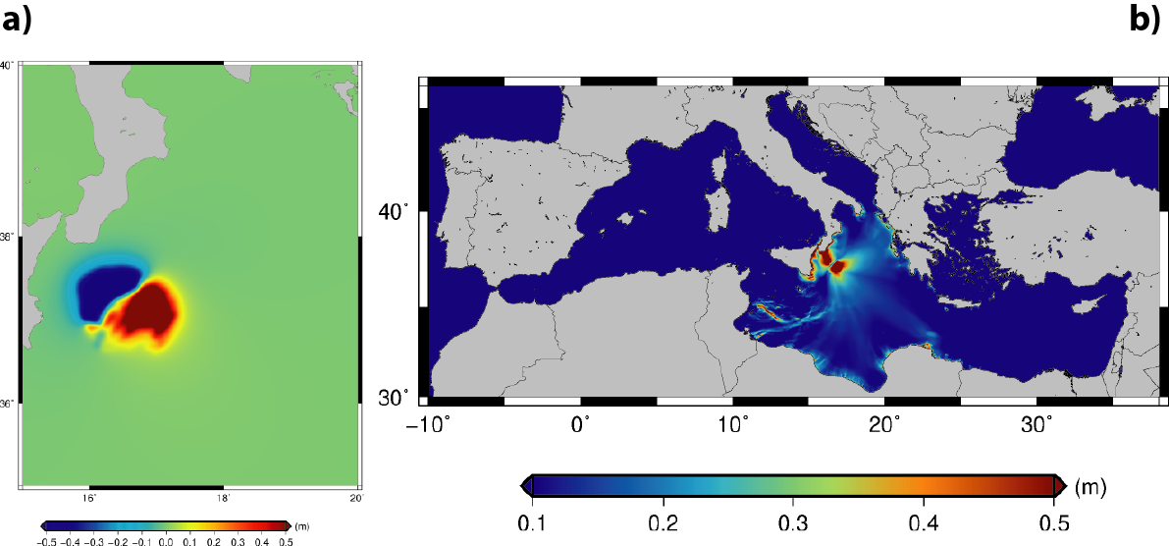
NEAMWave21 Scenarios
North Eastern Atlantic;
Joint scenario (Mw=8.5) by IPMA & CENALT
Central Mediterranean;
Single scenario (Mw=7.9) by INGV
Eastern Mediterranean;
Joint Scenario (Mw=7.7) by NOA & KOERI
ICG/NEAMTWS - XVII
Paris, France, 24–26 November 2021

Slide 3
Dates of NEAMWave21
2 joint scenarios; 1 single scenario!
ICG/NEAMTWS - XVII
Paris, France, 24–26 November 2021

Slide 4
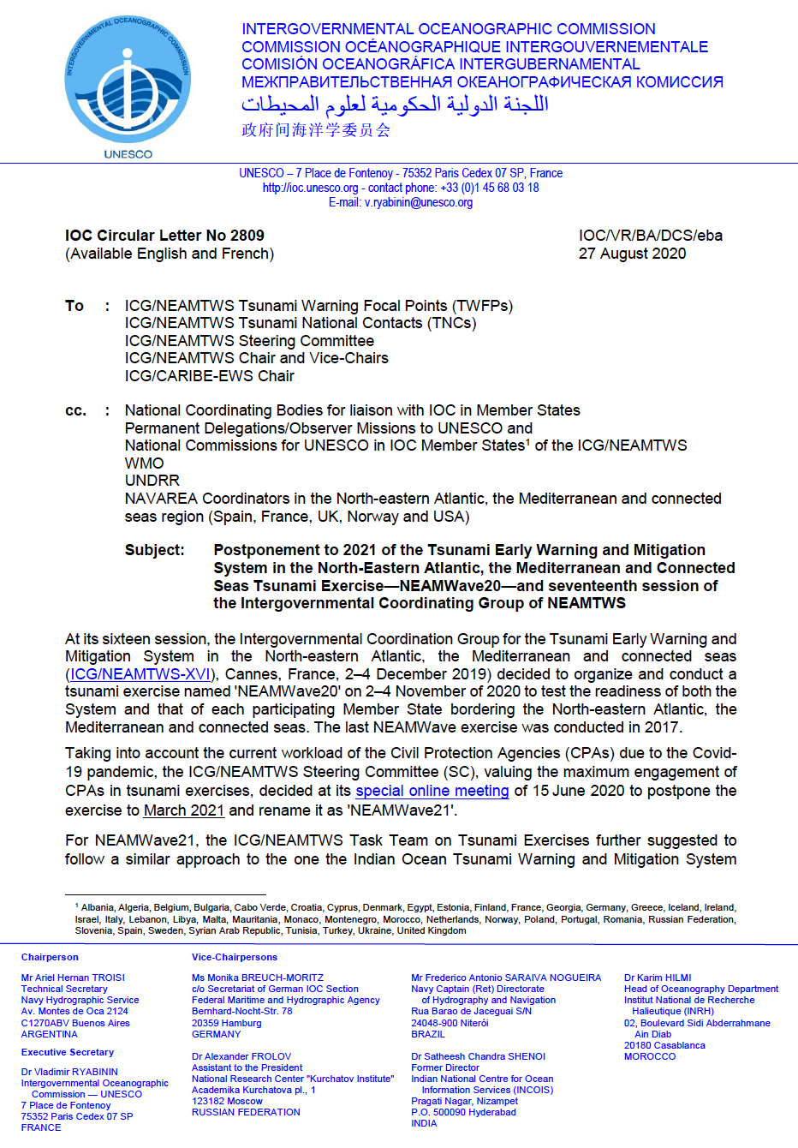
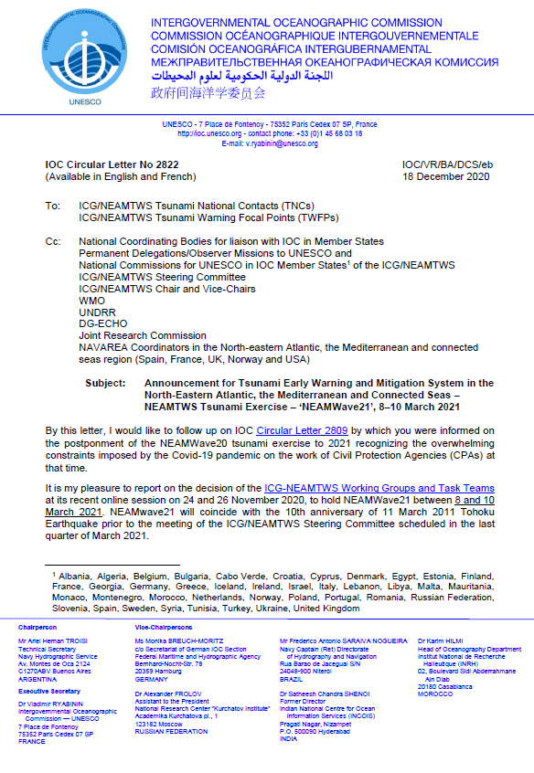
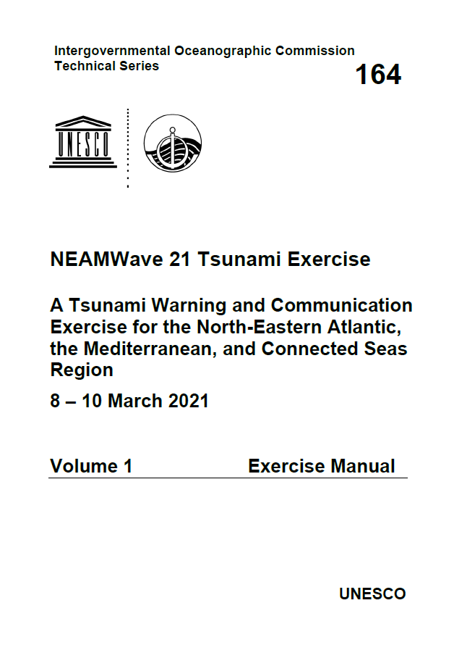
Announcements for NEAMWave21
IOC Circular Letter 2809: 27 August 2020
IOC Circular Letter 2822: 18 December 2020
Exercise Manual – Parts 1 & 2: Distributed to NEAMTWS Member States on 25 January 2021
ICG/NEAMTWS - XVII
Paris, France, 24–26 November 2021

Slide 5
Preparations for NEAMWave21
NEAMWave Tsunami Exercise Manual comprises two parts.
- Part 1 is the Exercise Instructions. It is the generic information part of the NEAMWave Exercise Manual, containing general and extensive information about the overall activities, the general scope, objectives and concepts, the roles of participants, as well as media arrangements.
- Part 2 is the Exercise Supplements. It contains more specific information about the actual exercise that is going to take place. It details the exercise scenarios in NEAMWave, the registration procedures for participation, the contact information of exercise team members, as well as the evaluation procedure of the exercise.
ICG/NEAMTWS - XVII
Paris, France, 24–26 November 2021

Slide 6
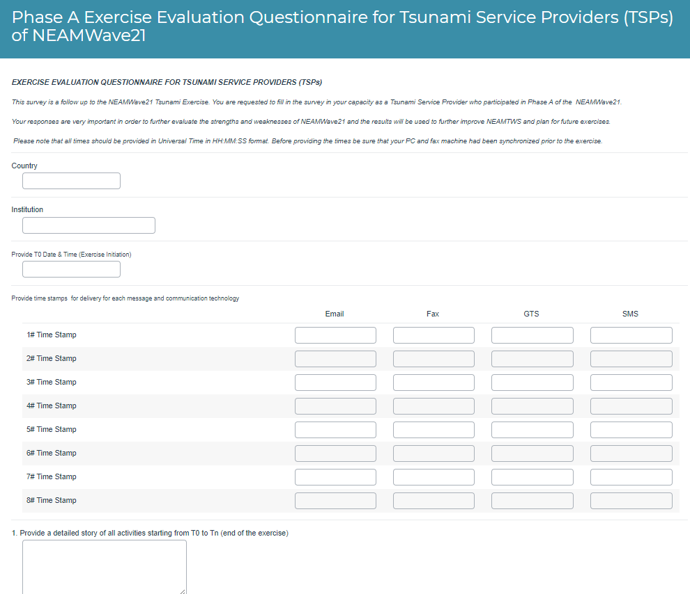
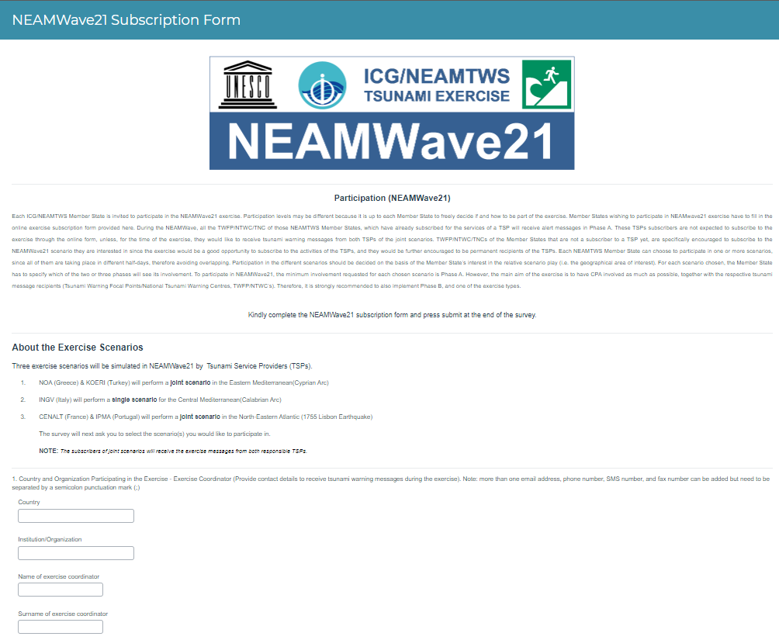
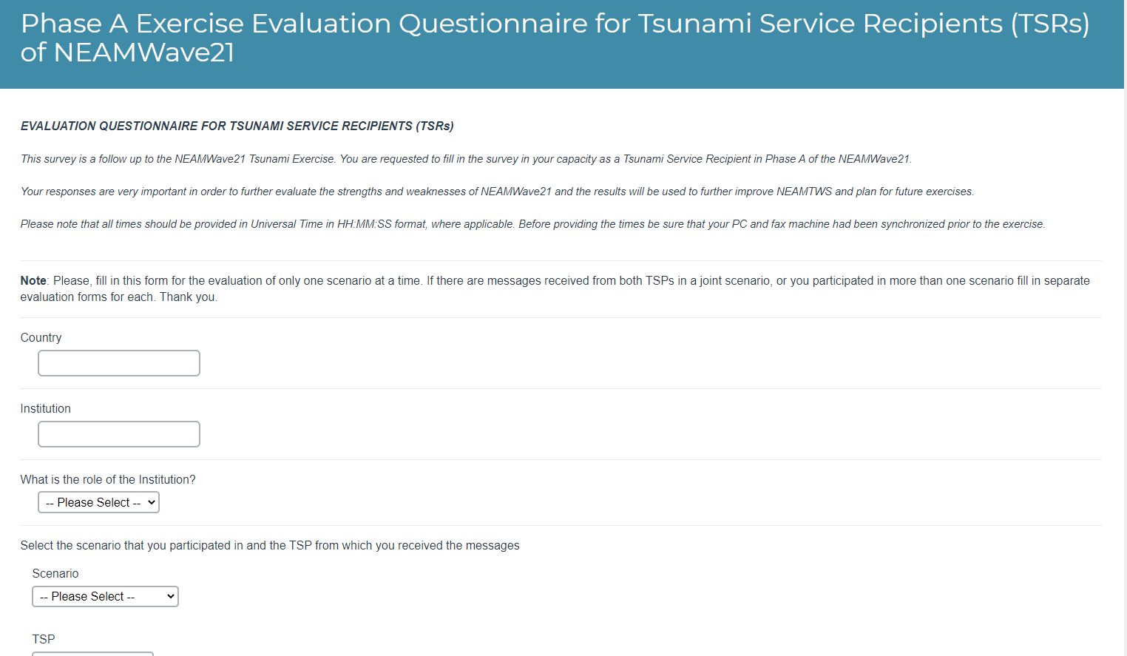
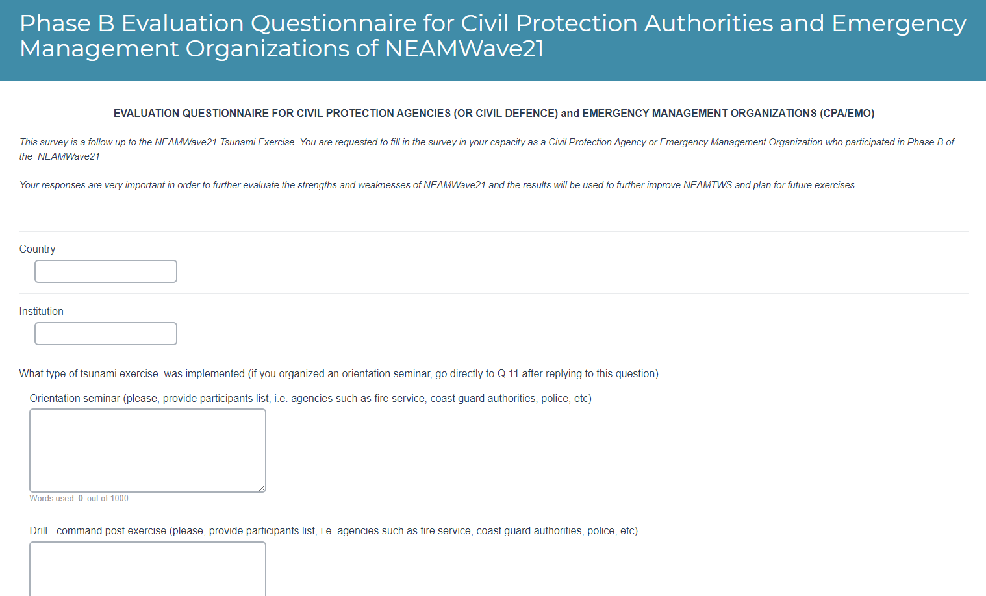
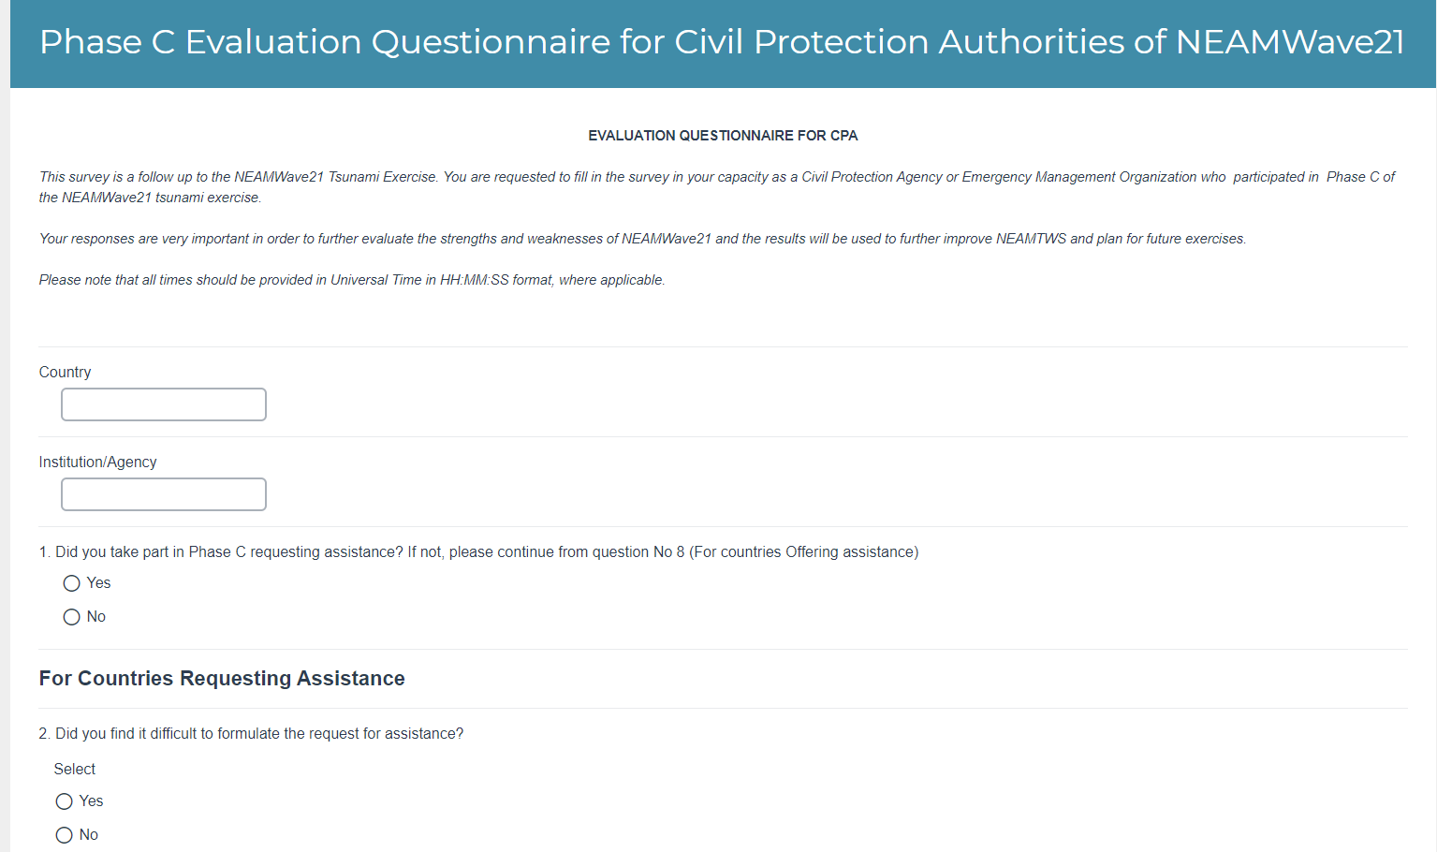
Preparations for NEAMWave21
Online forms for Subscription and Evaluation
Prepared using Alchemer Platform!
ICG/NEAMTWS - XVII
Paris, France, 24–26 November 2021

Slide 7
Preparations for NEAMWave21
14-15 April 2020: A preparatory online TT-TE workshop with the participation of NEAMwave21 exercise team members, TSP representatives and the Secretariat.
17 February 2021: an online meeting hosted by the IOC Secretariat - discussing the “DG-ECHO participation and Phase C implementation”.
19 & 23 February 2021: ERCC online internal training on Tsunamis / NEAMTWS
  Organized by ERCC, supported by IOC and JRC for the preparation of ERCC’s duty officers for Phase C of the exercise.
  The details of Phase C as well as the ways for ERCC to serve as a link between NEAMTWS services and CPAs were discussed.
23 February 2021: Email distribution by TT-TE co-chairs to the TSPs including the participants list of NEAMWave21 taken from online subscription forms.
  Requesting TSPs to contact their subscribers and ask their level of participation; to update the contact list of TNCs and TWFPs circulated by the secretariat.
ICG/NEAMTWS - XVII
Paris, France, 24–26 November 2021

Slide 8
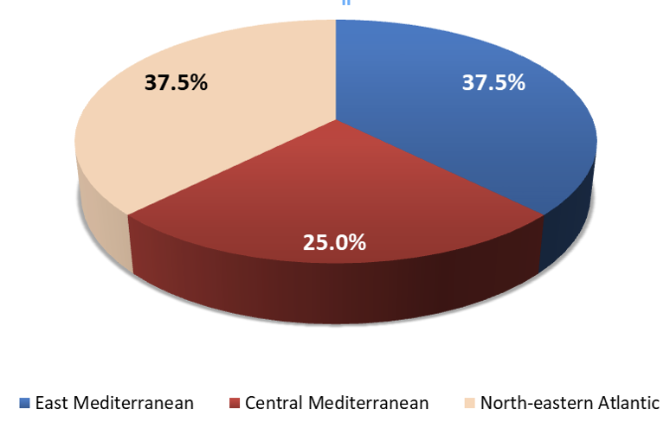
Participation in numbers
ICG/NEAMTWS - XVII
Paris, France, 24–26 November 2021

Slide 9
Participation in numbers
50 Evaluation forms have been received
Phase A (TSP): 4 Member States
Greece (NOA), Italy (INGV), Portugal (IPMA) & Turkey (KOERI)
Phase A (TSR): 10 Member States
Denmark, Finland, Germany, Greece, Ireland, Italy, Lebanon, Portugal, Spain & Turkey
Phase B: 4 Member States
Denmark, Finland, Italy & Turkey
Phase C: 4 Member States
France, Malta, Portugal & Spain
ICG/NEAMTWS - XVII
Paris, France, 24–26 November 2021

Slide 10
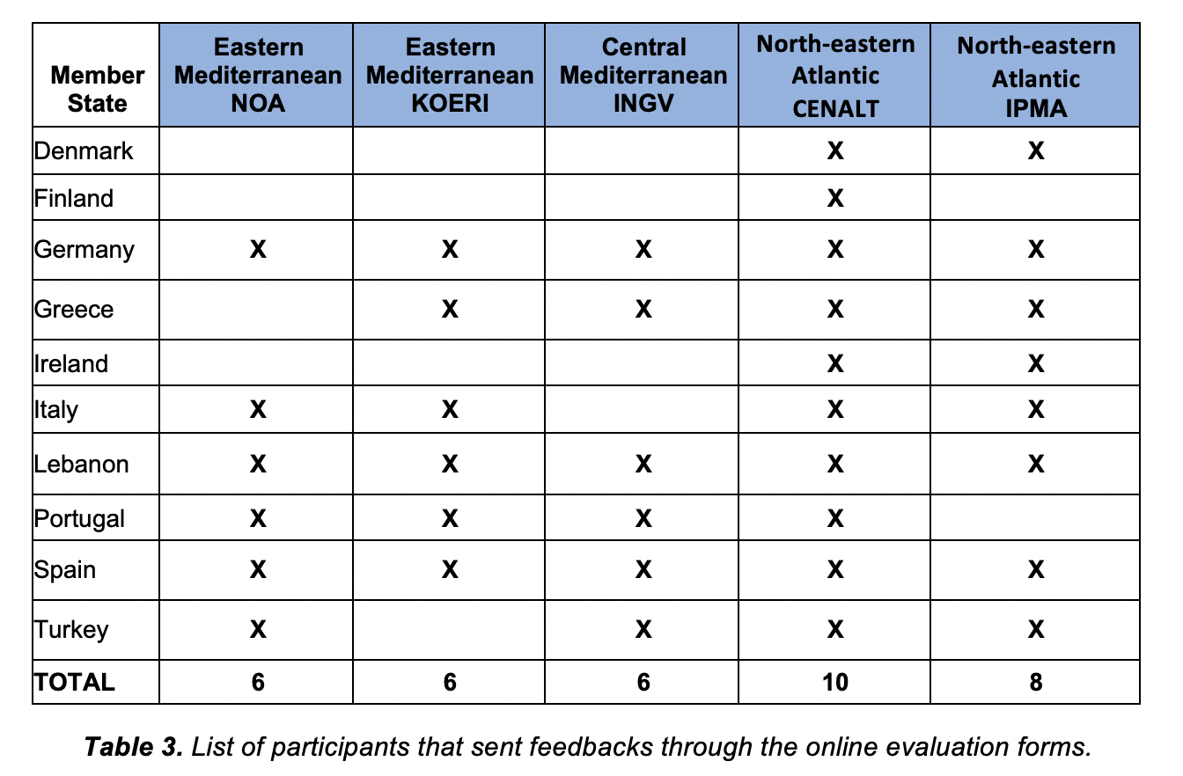
Evaluation of Phase A from TSRs
ICG/NEAMTWS - XVII
Paris, France, 24–26 November 2021

Slide 11
Evaluation of Phase A by TSPs
Restriction measures were applied to most TSPs, due to COVID-19.
Minor communication issues were identified.
The exercise was overall a positive experience.
Gave the chance to test National message dissemination and test in almost real conditions new features in the analysis and reporting procedures.
Delay in distributing the exercise material to the participants.
More frequent Phase A exercises (scenario-based communication tests) could be promoted in order to verify i) operational readiness of TSP- availability of communication links, and ii) message recipient list
Identification of responsible persons for submitting the evaluation, both from the TT-TE and the participants side.
ICG/NEAMTWS - XVII
Paris, France, 24–26 November 2021

Slide 12
Evaluation of Phase A by TWRs
The exercise was useful in Confirmation of communication contacts / Assessing transmission times / Evaluating procedures / Getting used to English text messages in the format of NEAMTWS, identifying the key information in the messages.
Maybe clarify the TSPs messages and rearrange the text within, with close collaboration with the CPAs. Congratulations to KOERI because its dissemination tsunami alert maps are easily and quickly understood in comparison with the standard text messages.
Online submission for both subscription and evaluation was highly appreciated. Suggestion for the responses to be provided to the users.
It would be nice with possibility to get more information from TSP i.e. a password protected website with information about the wave height or run-up.
Chat function between TSP and TWR will be very nice.
From two different MS (TSPs): A triple joint scenario / For the next NEAMWave exercise, we would like to suggest a joint scenario between INGV, KOERI and NOA to mimic the real-life operational activities.
ICG/NEAMTWS - XVII
Paris, France, 24–26 November 2021

Slide 13
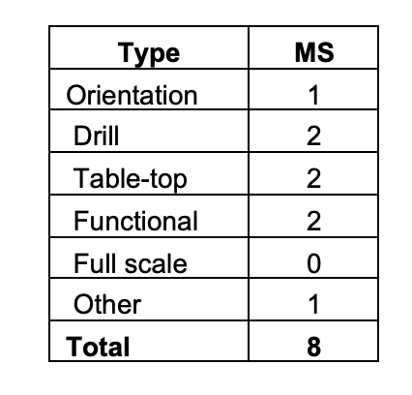
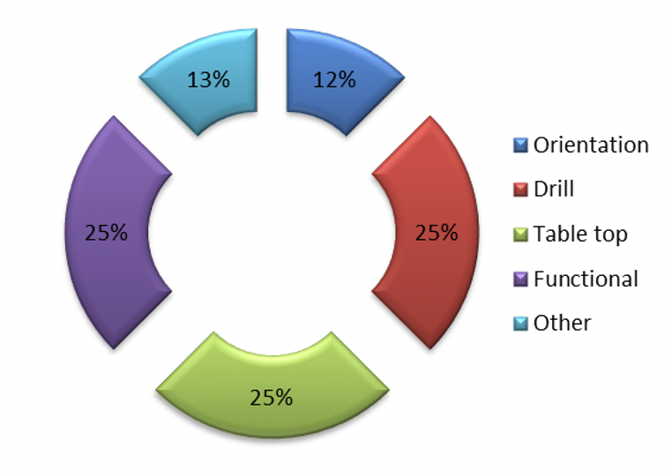
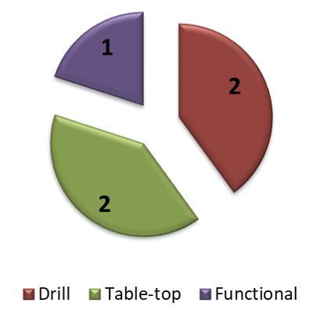
Evaluation of Phase B
Types of Phase B exercises of NEAMWave21, according to the subscription forms of the Member States.
Types of Phase B activities according to the submitted evaluation forms: 2 drill (Finland and Italy), 2 table-top (Denmark (FGS) and Turkey) and 1 functional exercise (Denmark (DMI)).
ICG/NEAMTWS - XVII
Paris, France, 24–26 November 2021

Slide 14
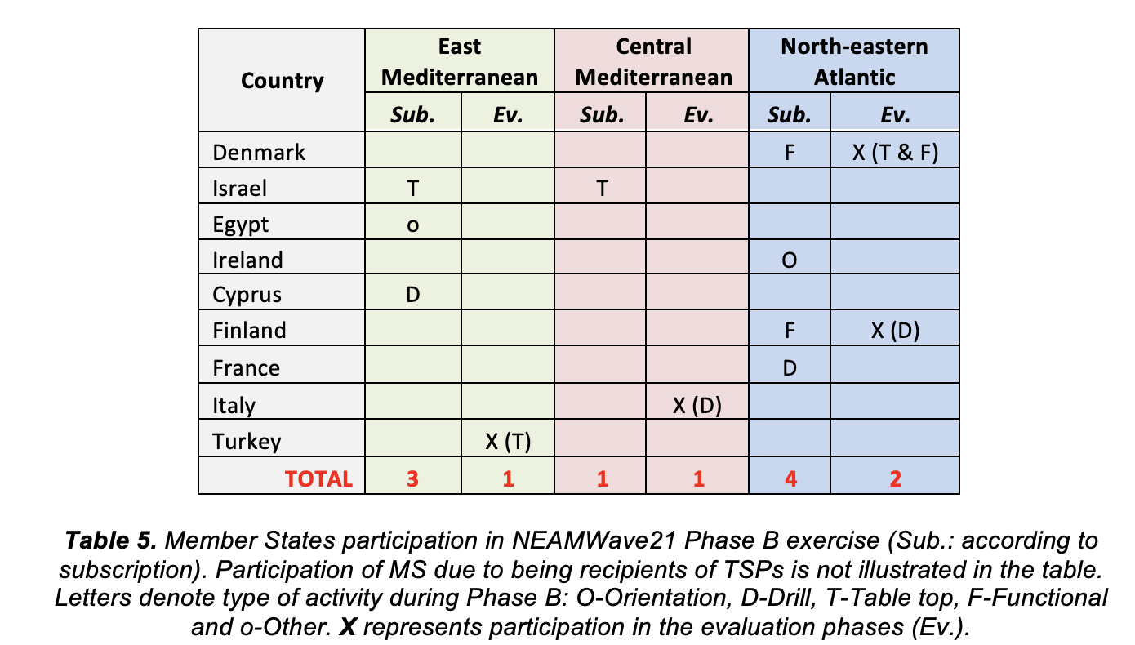
Evaluation of Phase B
ICG/NEAMTWS - XVII
Paris, France, 24–26 November 2021

Slide 15
Evaluation of Phase B
Good to have these exercises if they lead to more preparedness and awareness raising.
Longer messages similar to tsunami-warnings that are issued in the Pacific Ocean
The message should specify when the next message will be issued and where to find additional information. Both about this specific event and general awareness information about tsunamis.
The exercise was useful to test the platform system and the involvement of all the participants.
This kind of exercise can be on an online platform instead of just a warning mail/message. Virtual online communication of the participants.
Review of the incident-based plans on Tsunami, especially updating point of contacts.
ICG/NEAMTWS - XVII
Paris, France, 24–26 November 2021

Slide 16
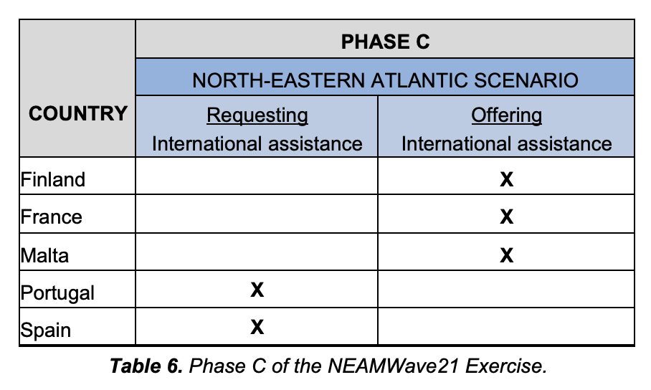
Evaluation of Phase C
ICG/NEAMTWS - XVII
Paris, France, 24–26 November 2021

Slide 17
Evaluation of Phase C
There were some issues to connect to CESIS, so messages were received via emails by ERCC, so there was no update in figures or situation reports.
Suggestion for a mandatory link check 2 days before the exercise between the participants and the organizers.
These type of exercises are very useful as information flow and procedures are tested. Everyone participating has the feeling of getting a bit more in touch with a real potential tsunami and how actions should be taken. The Exercise Manual provides a good sight on how the TXT will be developed, and helps you to prepare the scene at a regional and local level
Repeat the exercise periodically (biannual).
ICG/NEAMTWS - XVII
Paris, France, 24–26 November 2021

Slide 18
Evaluation of Phase C by ERCC
The table-top exercise provided the opportunity to test procedures and communications in case of a major disaster. Internal DG ECHO procedures were tested by the ERCC (DG ECHO.A1) and the Situational Awareness Team (SAT) (DG ECHO.A3) during phase C.
Overall, the exercise was a valuable experience with clear benefits, including identifying lessons to enhance ERCC working processes.
The exercise was challenging and rewarding
The exercise should be replicated in future
Issues were encountered with remote working and information sharing. There is a need for more resilient IT systems and clearly identified back up processes.
Some communication issues occurred (delays, no answers, technical failures) in Union Civil Protection Mechanism (UCPM) but these reflected the expected reality of dynamic emergency management.
Some lessons learnt were identified related to the Common Emergency Communication Information System (CECIS) which is the UCPM communication platform amongst EU MS/PS. MS/PS should ensure that CECIS, and other relevant programs, are part of their business continuity plans to guarantee their ability to coordinate at EU level, especially in pandemic conditions.
ICG/NEAMTWS - XVII
Paris, France, 24–26 November 2021

Slide 19
Contact with the Media
Several countries advertise and inform about NEAMWave21 in the local media with more extensive coverage compared with the previous exercises:
  Italy posted news about NEAMWave21, in several sites. Moreover, Alessandro Amato (Head of CAT-INGV) has been interviewed by a web-journal. The exercise also produced a good local media response. On the 10th anniversary of the 2011 Japan earthquake and tsunami, CAT-INGV organized a webinar closely related to the NEAMWave21 exercise.
  A press release was issued by the Corporate Communication Office of the Boğaziçi University (Turkey). Moreover, a representative of KOERI has participated in a radio program on 12 March 2021.
  Spain reported that they were contacted before the exercise to request their confirmation of participation in the exercise. About phase C, the exercise was mentioned in the local, regional and national press (digital & written), as well as in Twitter.
  Portugal was contacted by the media about the NEAMTWS but more specifically for the North-eastern Atlantic scenario they were performing. Some interviews on local and national radios were also given. About phase C, Portugal made a public information note to the media, regarding the realization of the exercise.
  Denmark posted information on Twitter regarding Phase B and got a good response.
ICG/NEAMTWS - XVII
Paris, France, 24–26 November 2021

Slide 20
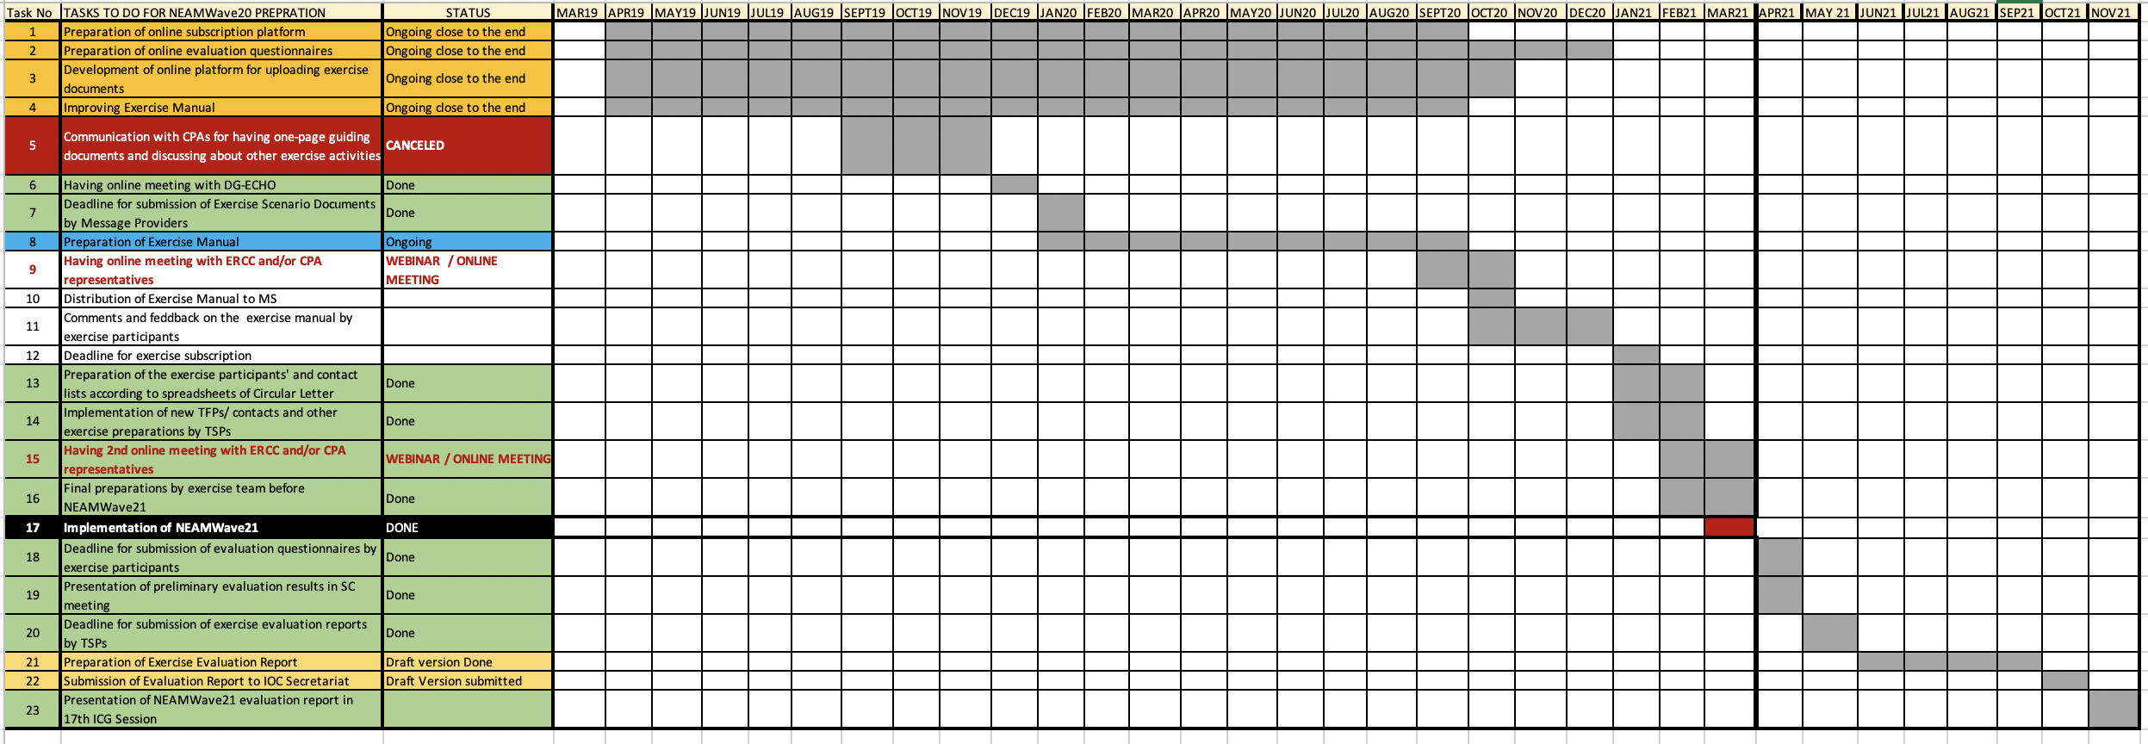
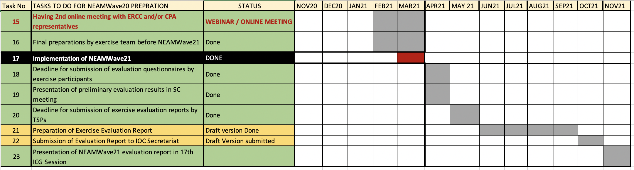
Timeline of NEAMWave21
ICG/NEAMTWS - XVII
Paris, France, 24–26 November 2021

Slide 21
Conclusions and Comments
NEAMWave21 showed the advanced operational level of the TSPs, like the dissemination of messages to CPAs in national languages, as well as the provision of tsunami enhanced products (tsunami travel time and alert level maps).
  Joint scenarios are useful for enhancing close collaboration between the TSPs. Next time, we can go one step further and test a joint scenario of three TSPs.
NEAMWave21 presented a very good opportunity for several countries (e.g. Denmark, Italy, Malta, Portugal, Spain, Turkey) to create new links and strengthen already existing one among actors at national level.
Unfortunately, only Egypt from the North-African Countries expressed their intention to participate in Phase B with an orientation workshop for the Eastern Mediterranean, but no evaluation was received. Morocco was approached by the ERCC for cooperation in the exercise, which was eventually not realized.
ICG/NEAMTWS - XVII
Paris, France, 24–26 November 2021

Slide 22
Conclusions and Comments
The exercise clearly illustrates that there is still a broken link between NEAMTWS parts, i.e. TSPs & TWFP and recipients like NTWCs and especially CPAs.
Although, participation of the Civil Protection Authorities was a key target for NEAMWave21, a strong engagement could not be achieved. The main reasons may be attributed to the COVID-19 pandemic outbreak and the consequent heavy workload of the CPAs dealing with the situation.
No country performed a full-scale evacuation exercise in Phase B during the three days of NEAMWave21. However, Malta performed a full-scale exercise on the 5th of November, with the opportunity of the World Tsunami Awareness Day (WTAD), utilising the Central Mediterranean scenario of NEAMWave21.
ICG/NEAMTWS - XVII
Paris, France, 24–26 November 2021

Slide 23
Conclusions and Comments
Most countries modified the alert messages for national dissemination. The international messages are still not user friendly, as it was also constantly highlighted by several countries in all previous evaluations.
Overall, all the countries agreed that the exercise has been an important opportunity to raise awareness on tsunami risk, but also to test communication channels and emergency procedures between TWFPs and CPAs/EMOs.
There is still room for improvement in internal coordination (among IOC Secretariat, ICG/NEAMTWS Task Team members and TSPs) in regard to the development of TNC/TWFP databases, upgrading of online tools (documents repository, subscription mechanism and evaluation forms) and timely preparation and distribution of the exercise material.
ICG/NEAMTWS - XVII
Paris, France, 24–26 November 2021

Slide 24
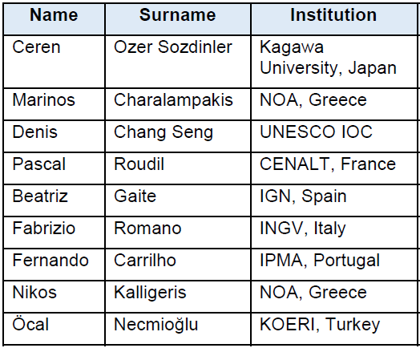
Many thanks for the contributions of all exercise actors!
List of NEAMWave21 Exercise Team Members
ICG/NEAMTWS - XVII
Paris, France, 24–26 November 2021

