Slide 1
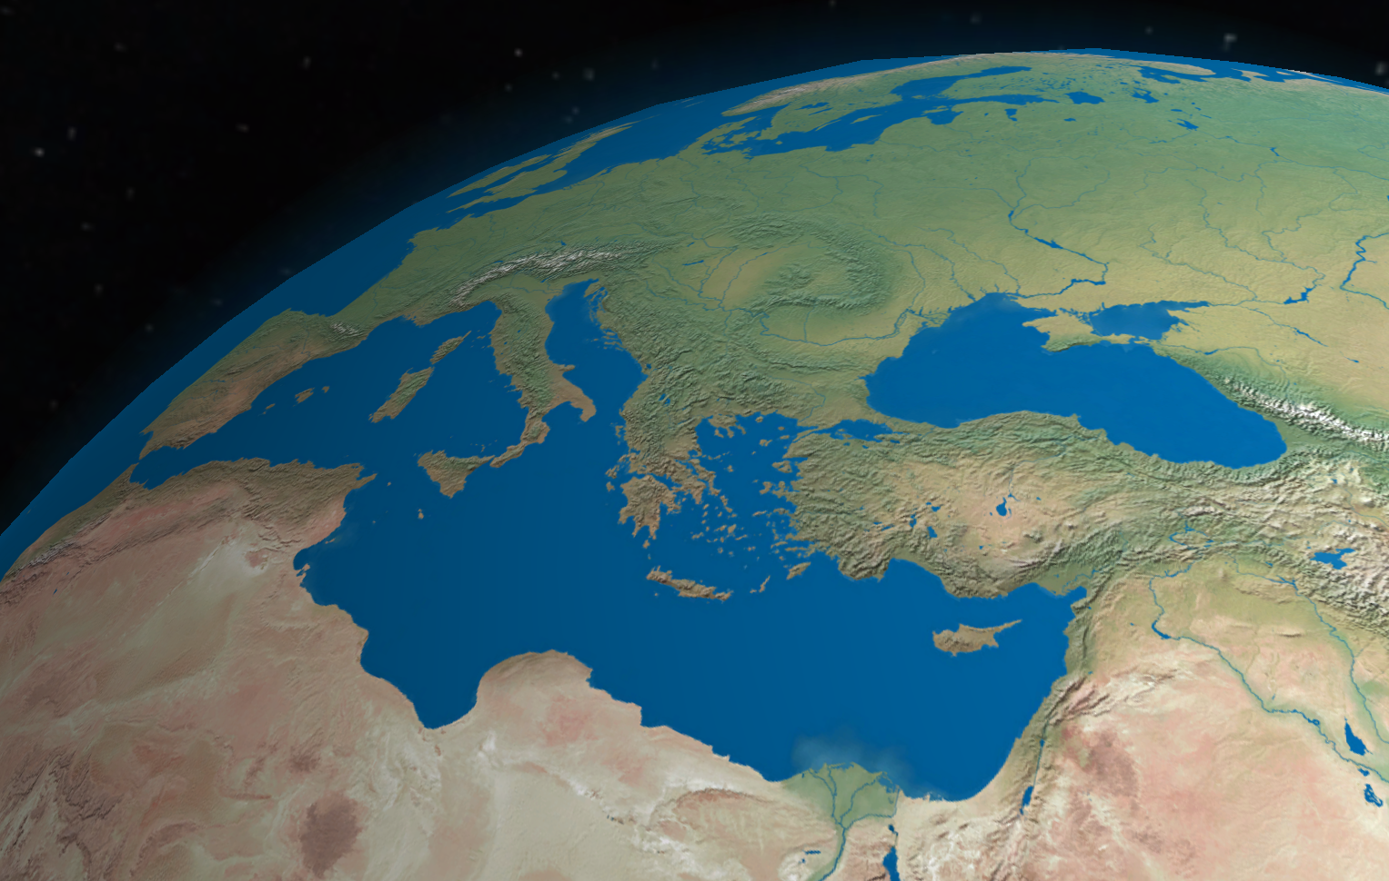
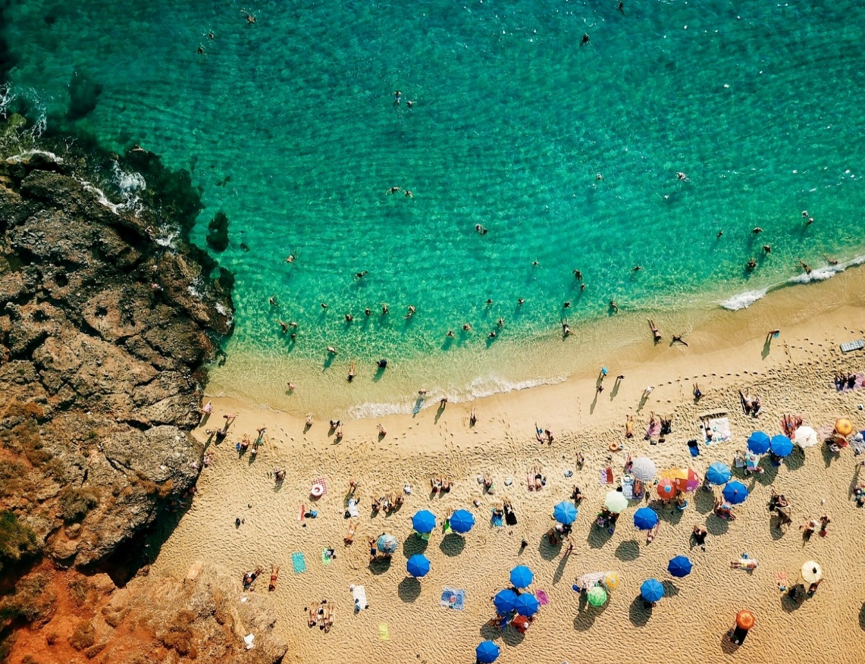



ICG/NEAMTWS XVII Session 24-26 November 2021
Report by the IOC Secretariat
Update on IOC -European Union ECHO NEAMTWS Project
Denis CHANG SENG, PhD Programme Specialist
Tsunami Unit, Technical Secretary (ICG/NEAMTWS) Global Ocean Observing System (GOOS) & IOC Focal point for MHEWS/ IN-MHEWS
IOC of UNESCO

Slide 2
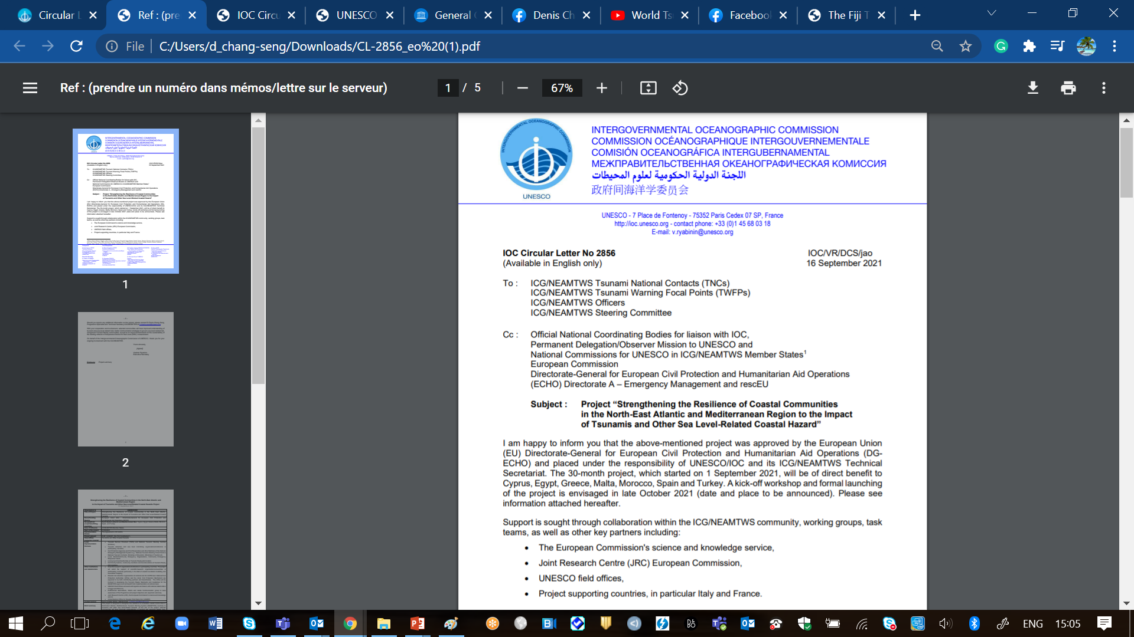


PROJECT
Project “Strengthening the Resilience of Coastal Communities in the North-East Atlantic and Mediterranean Region to the Impact of Tsunamis and Other Sea Level-Related Coastal Hazard”
Approved by the European Union (EU) Directorate-General for European Civil Protection and Humanitarian Aid Operations (DG ECHO)
Geographical scope/benefitting countries | North Eastern Atlantic and Mediterranean Sea: Cyprus, Egypt, Greece, Malta, Morocco, Spain, and Turkey
Technical Advise | France and Italy
Area of influence | 40 NEAMTWS Member States
Period | 01/09/2021 --- 30/03/2024

Slide 3
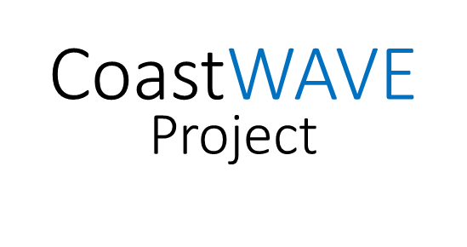
PROJECT GOALS
Tsunami Ready Recognized Communities
Alert Systems
Detection & Monitoring
Risk Communication Strategies
Improved understanding of tsunami and sea-level related risks. Better communication strategies to govern sea-level related risk
Real time detection/ monitoring Improved framework for the sustainability of the existing Inexpensive Device for Sea Level (IDSL) Network
Alert technology to provide early alert/warning
At least seven recognized Tsunami Ready communities by 2023

Slide 4
PROJECT OUTCOMES
Tsunami Ready pilot programmes based on standards and guidelines developed and adopted by the ICG/NEAMTWS
Understanding and communication of tsunami and other sea-level related risk in selected communities enhanced.
Selected coastal communities are better prepared to respond to SL-related hazards
Access to near real time detection and alert technology to provide early warning of rapid onset sea level-related hazards
Longer term sustainability of the Inexpensive Device for Sea Level (IDSL) network to provide early warning of rapid onset sea level-related hazards in NEAMTWS countries enhanced
1
2
3
4
5

Slide 5
PROJECT IMPLEMENTING PARTNERS/STAKEHOLDERS
Local Implementation Partners
TSPs and NTWCs
Tsunami detection and sea level monitoring organisations
CPA and First Responders etc.
Ministries of Education, Ministries of Tourism etc.
Local: District/Community Emergency Organizations, Community Emergency Response Teams
Local government/authorities at Tsunami Ready pilot location.
Community leaders, community members and tourists/visitors at Tsunami Ready pilot locations.
Other institutions and stakeholders
Scientific/research organisations/institutions e.g. universities (coastal inundation modelling and evacuation mapping)
Professional associations, NGOs and media Communication group
UNDRR
Joint Research Commission (JRC)
UNESCO field offices (Egypt and Morocco)

Slide 6
PROJECT Three Tier Partnership and Support
1. Cyprus, 2. Egypt, 3. Morocco : The pilot project will conduct risk perception survey, design, install and commission tsunami detection and alerting systems at selected sites and train operators in their use and maintenance, support the implementation of the full cycle of Tsunami Ready, including mapping, signage, national/local SOPs, supporting the establishment of national Tsunami Ready Board, response plan and evacuation drills/exercises | A
4. Greece, 5. Malta and 6.Turkey: Build up on JRC Last Mile Project. This includes supporting national to community level tsunami awareness and Standard Operating Procedures workshop, establishment of Tsunami Ready Board, signage, national/local SOPs, evacuation drills and exercise May conduct risk perception study in Malta | B
7. Spain: Partnership variation between A and B | C

Slide 7

PROJECT Communication and Visibility Plan
Communication and Visibility (C & V) Plan
Circular Letters
Press and media conferences
Workshops /webinars/ information meetings and briefings
Socialize survey results and focus group discussions
Maps and videos
Website (e.g. NEAMTIC), radio, social media, Snapshot and other articles etc.
ICG/NEAMTWS Steering Committee, Working Groups/ Task Teams and ICG/NEAMTWS sessions
Publications and reports

Slide 8
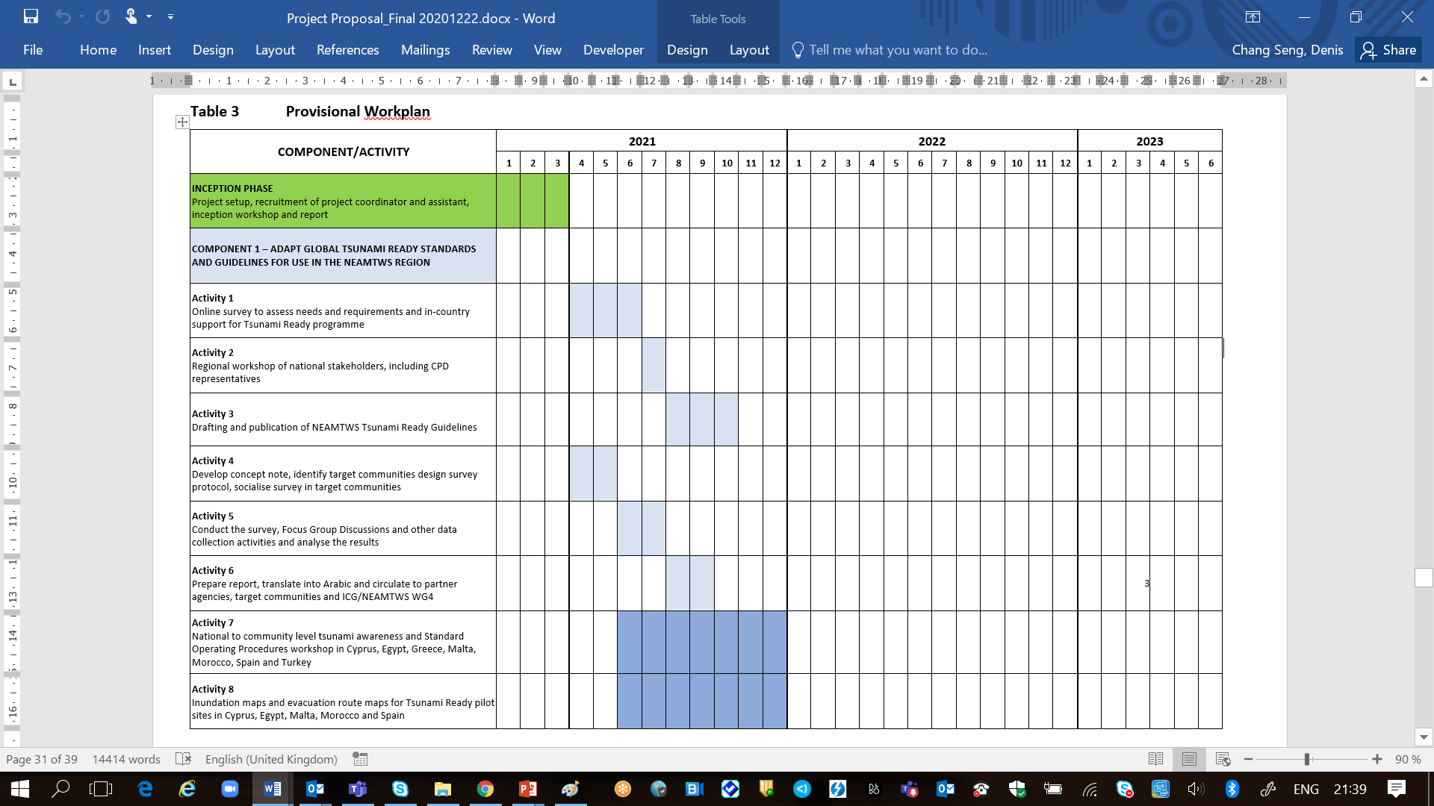
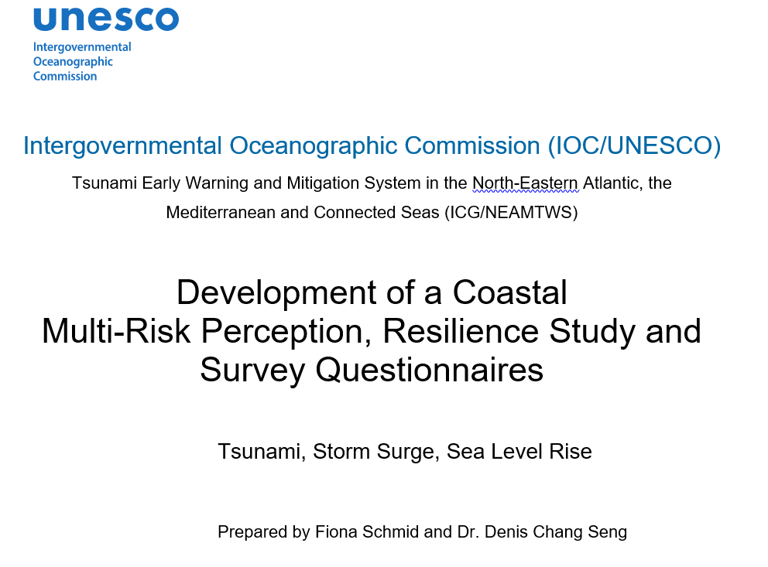

Slide 9
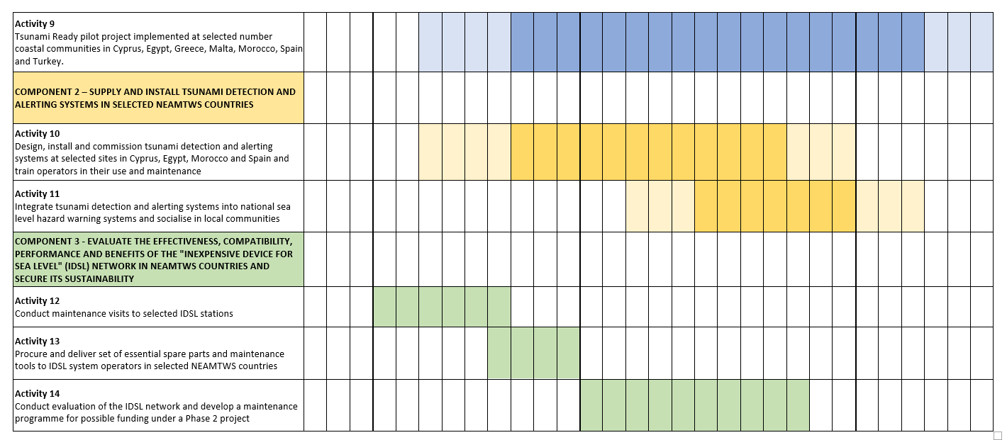

Slide 10
PROJECT Kick-Starting
Inception Phase (3 months)
IOC CL 2856 to ICG/NEAMTWS MS
Letters to target countries: National focal point, TR nomination site, potential stakeholders and partners
Information sharing with project countries and partners
Recruitment of two project staff
Project Assistant (Administration, Finance and Budget)
Associate Project Officer (Project Coordinator)
Planning inception workshop and launching of CoastWAVE project.
Contribute to component 1, outcome 2 of the European Union ECHO project on Strengthening the Resilience of Coastal Communities in the North-Eastern Atlantic and Mediterranean Region to the Impact of Tsunamis and other Sea Level-Related Coastal Hazards
Component 1: Adapt Global Tsunami Ready Standards and Guidelines and pilot Tsunami Ready within the framework of the ICG/NEAMTWS.
Outcome 2: Understanding and communication of tsunami and other sea-level related risk in selected communities in Cyprus, Egypt, Malta and Morocco enhanced

Slide 11
END

