Slide 1
OBPS– OceanPractices Survey WP 8 03 - 12 Nov 2021 https://forms.gle/aofP1Q7Nr5e6hL2d6
WP Co-leads: Johannes and Jay
Contributors / WP8 team members

Slide 2
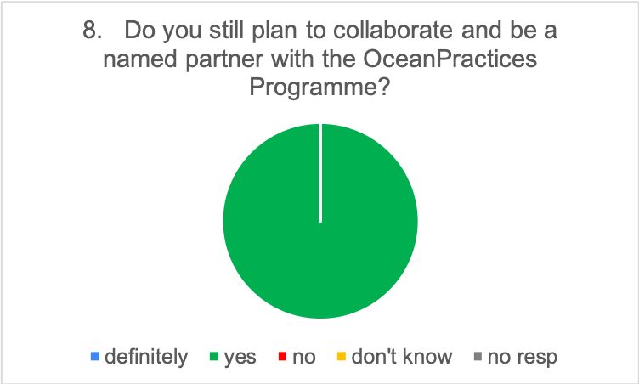
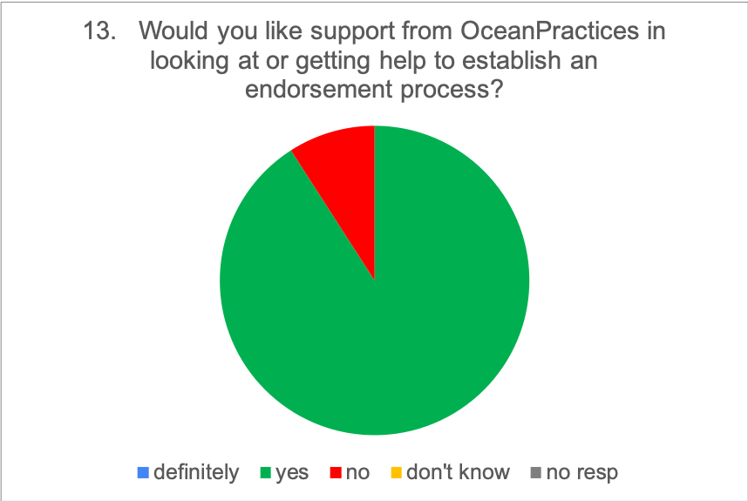
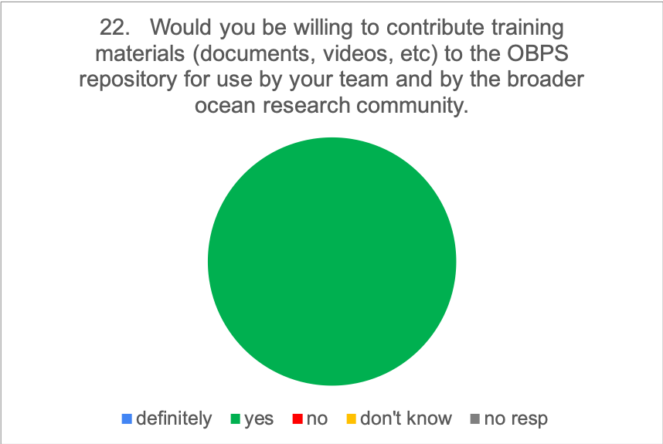
Survey
Sent to partners – received 23 responses from 33 requests
Three major groups of questions:
Collaboration with OceanPractices
Approaches to Best Practices
Training and capacity development

Slide 3
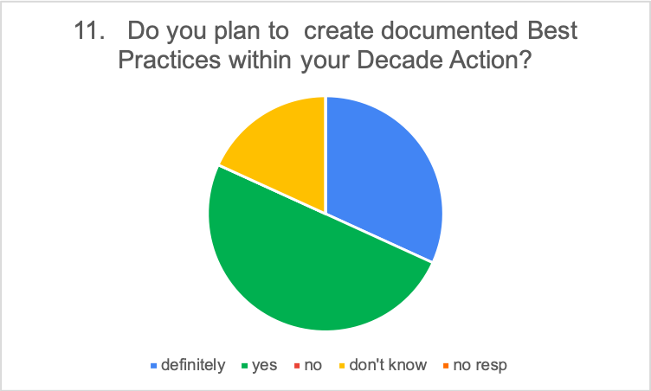
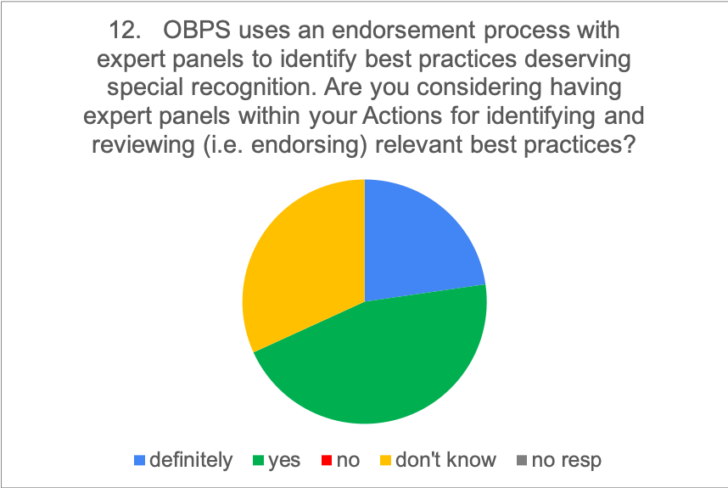
Collaboration with OceanPractices
SunYetSun Univ
Clivar
ICES
Schmidt Ocean
*
SunYetSun Univ
Clivar
DITTO
ICES
OBON
Schmidt Ocean
ICES
IOCCP

Slide 4
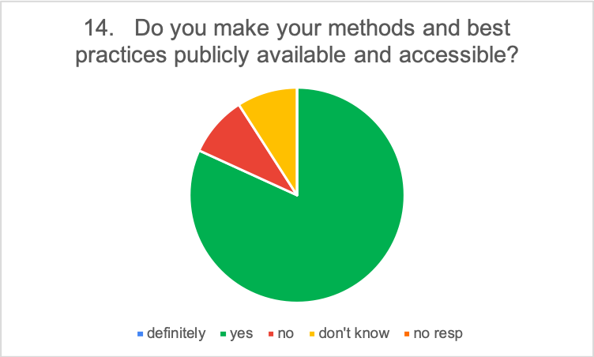
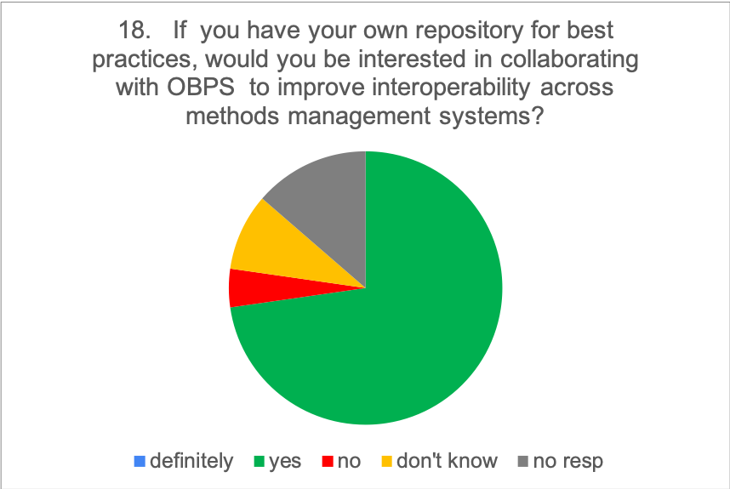
Approaches to Best Practices
Yes: 16; No:1; Don’t know 2; No response: 3

Slide 5
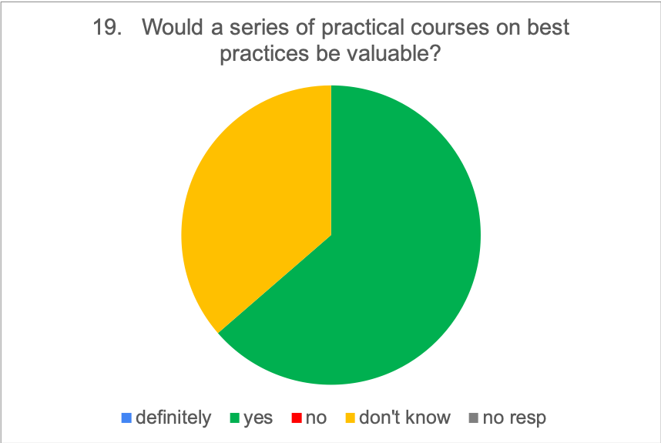
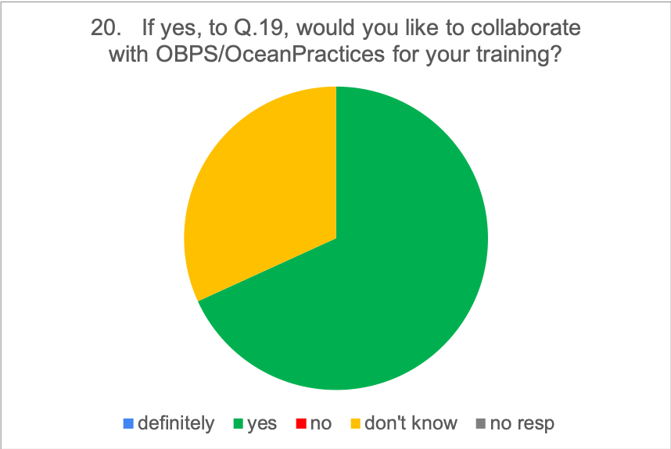
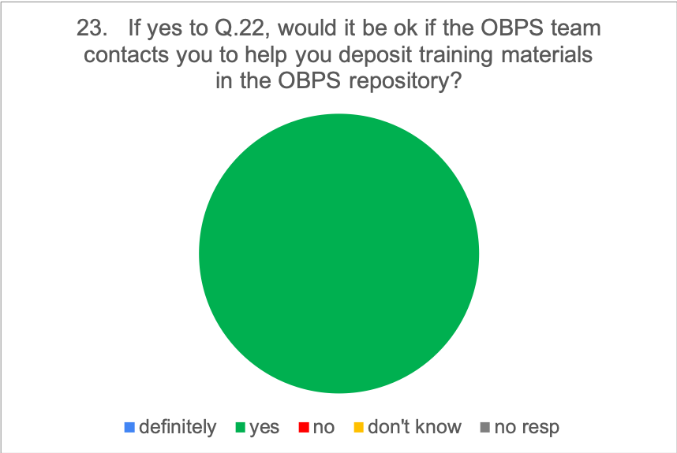
Training and Capacity Development
7

Slide 6
Overview (Key Points)
Significant opportunity in collaboration and expansion of endorsement
Training materials will be available to OBPS. Community encourages collaboration with OBPS.
Plan needed for a sustainable foundation in training

