Slide 1
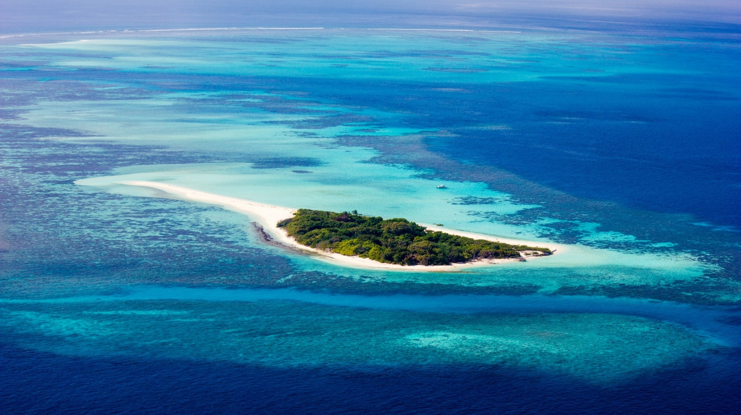





TROPICAL AMERICAS AND THE CARIBBEAN REGION
REGIÓN TROPICAL DE LAS AMÉRICAS Y EL CARIBE
RÉGION DE L’AMÉRIQUE TROPICALE ET DES CARAÏBES
REGIONAL KICK-OFF CONFERENCE FOR THE UN DECADE OF OCEAN SCIENCE FOR SUSTAINABLE DEVELOPMENT 2021–2030 FOR THE TROPICAL AMERICAS AND THE CARIBBEAN REGION
One Planet, One Ocean / Un Planeta, Un Océano / Une planète, un océan
iocaribe.ioc-unesco.org / Ioc.unesco.org / www.oceandecade.org
@Iocaribeocean

Slide 2
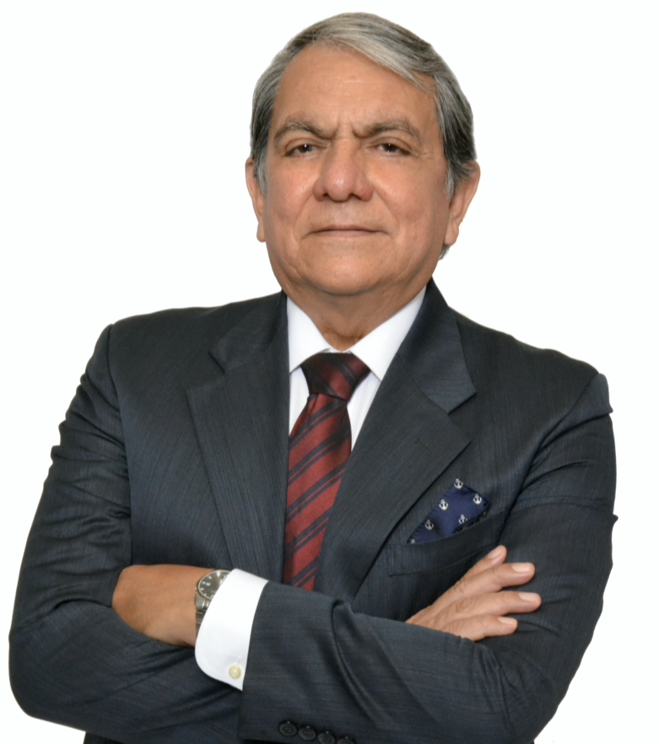
Breakout Session Introduction
Edgard Cabrera
Member Regional Planning Group

Slide 3
Introduction to the Breakout Sessions
Three themed sessions to address the ten Ocean Decade Challenges
Knowledge and Solutions
Essential Infrastructure
Foundational

Slide 4
Introduction to the Breakout Sessions
BoS-1 Knowledge and Solutions
Challenge 1 Understand and beat marine pollution
Challenge 2 Multiple stressors on ecosystems
Challenge 3 Sustainably feed the global population
Challenge 4 Develop a sustainable and equitable ocean economy
Challenge 5 Ocean-climate nexus
Regional Working Groups: Clean Ocean – Healthy Ocean – Productive Ocean

Slide 5
Introduction to the Breakout Sessions
BoS-2. Essential Infrastructure
Challenge 6 Increase community resilience to ocean hazards
Challenge 7 Expand the Global Ocean Observing System
Challenge 8 Create a digital representation of the Ocean
Regional Working Groups: Safe Ocean – Transparent and Accessible Ocean – Predicted Ocean

Slide 6
Introduction to the Breakout Sessions
BoS-3. Foundational
Challenge 9 Skills, knowledge and technology for all
Challenge 10 Change humanity’s relationship with the ocean
Regional Working Groups: Cross cutting – Capacity Development Inspiring Ocean

Slide 7

Breakout Session 1 – Knowledge and Solutions
Objectives: | Clean Ocean | Healthy Ocean | Productive Ocean
Leaders: | Francisco Arias Alejandro Acosta Christopher Corbin
Rapporteur: | Fadilah Ali
Tables: | TAC Pollutants Observatory TAC Understanding multiple stressor effects TAC Fisheries/Tourism/ Sustainable Development

Slide 8
Breakout Session- 2 - Essential Infrastructure
Objectives: | Transparent and Accessible Ocean | Predicted Ocean | Safe Ocean
Leaders: | Christa von Hillebrandt-Andrade Albert Martis Julio Morell | Douglas Wilson Tom Cuff
Rapporteur: | Azra Blythe-Mallett | Carlos Torres Navarrete
Tables: | An Ocean Observing System for the TAC Region Implementation of TAC Regional Modelling and Forecasting Systems Impact based Early Warning Systems and Services for the TAC Region Supporting Data and Information Management, Access and Delivery Systems for TAC / climate Digital Twins for the coastal ocean

Slide 9
Breakout Session– 3 - Foundational
Objectives: | Cross Cutting | Capacity Development |  | Inspiring Ocean
Leaders: | Elva Escobar |  | Arthur Paterson
Rapporteur: | Milena Maltese Zuffo |  | Joseph Naughton
Tables: | Best practices: achieving equal access to data by standardizing local, national, and international data Ocean literacy: changing local communities’ relationship with the ocean by promoting the democratization of access to knowledge in the TAC Region The blue economy: enhancing comprehensive capacity development across all aspects of ocean science and for all stakeholders in the region in the TAC Region Partnership and cooperation: overcoming barriers to reach optimal efficiencies, effectiveness, and impact of capacity development initiatives in the TAC Region

Slide 10
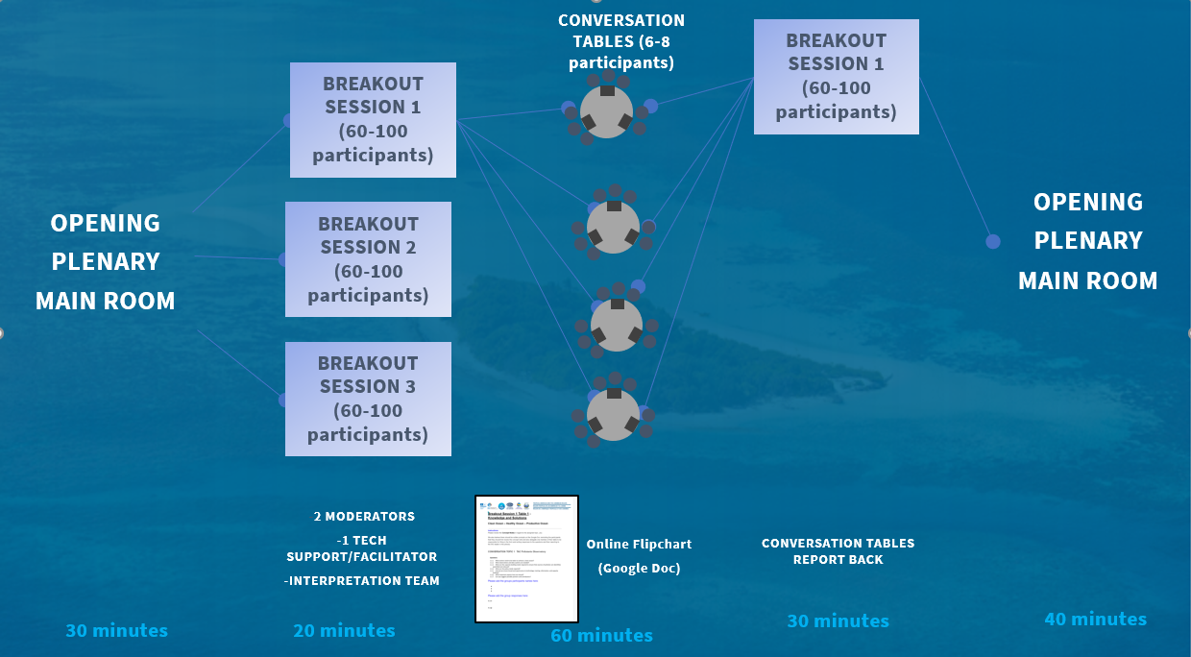
BREAKOUT
SESSION 1
BREAKOUT
SESSION 1
BREAKOUT
SESSION 2
BREAKOUT
SESSION 2
BREAKOUT
SESSION 3
BREAKOUT
SESSION 3

