Slide 1

Contribution of Russian NODCs to the Black Sea Data Management in the framework of the IODE and EC projects
All-Russian Research Institute for Hydrometeorological Information – World Data Center,
Obnininsk
Nikolay Mikhailov, Evgenii Viazilov, Alekhander Mikheev (RIHMI-WDC)

Slide 2
IODE projects:
Ocean Data Portal
Ocean Data and Information System
EU projects:
Sea Data Net
EMODNet – Chemistry
Plan for 2022-2023

Slide 3

IODE ODP definitions
“The ODP is delivering a standards-based infrastructure to build and manage a distributed marine data network basing on:
data and products of the data centers of the IODE, JCOMM and other IOC projects;
resources from other participating systems
and also provide the discovery, evaluation (through visualization and metadata review) and access to data and products.”
IODE Ocean Data Portal concept paper,
42-th EC IOC, XX-th session of IODE Committee Resolutions

Slide 4
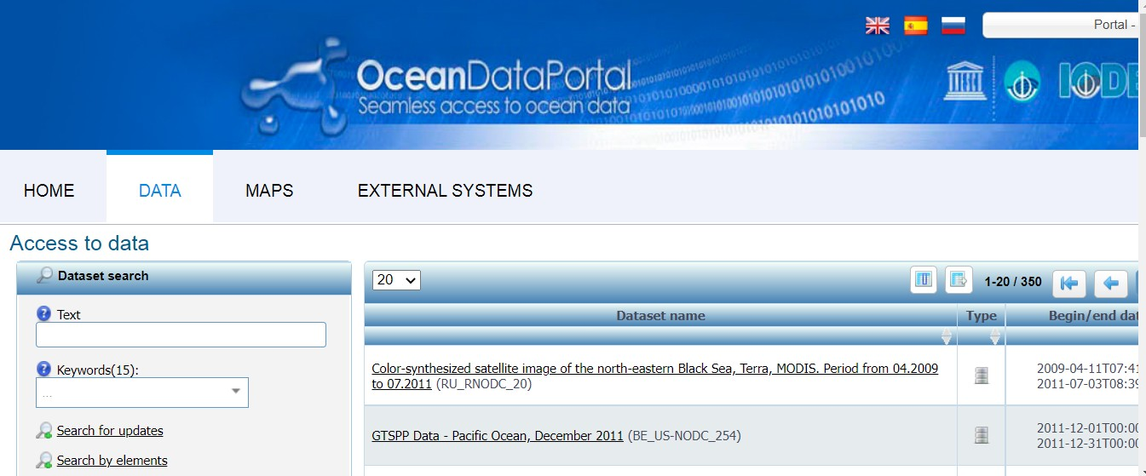
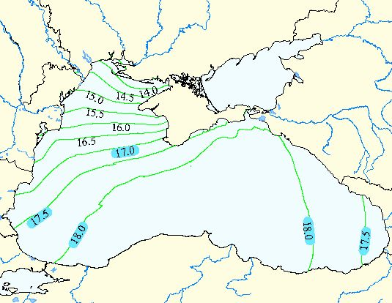
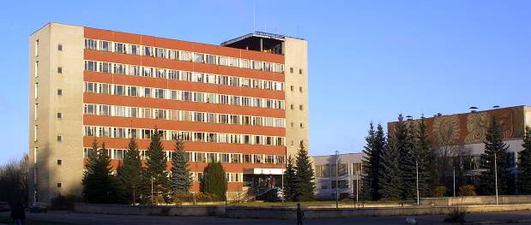
RNODC contribution to ODP BS
Network model, ODP ToolKit and interoperability specifications based on service-oriented architecture and ESIMO technologies
BS ODP node (RF) using ToolKit and operability arrangements http://www.oceandataportal.net/portal/portal/odp2/data
IODE BS distributed data network – 15 resources from Russian Federation. Other BS ODIN partners do not provide data to ODP
ODP governance and support: SG-ODP, Project Manager and Partnership Center
Accreditation and evaluation NODCs and other participants for ODP nodes operation in concern with IODE-QMF requirements

Slide 5
Partnership Centre implementation
support the tools and specifications of the IODE ODP
assist lODE NODCs and other ODP nodes to achieve their bjectives
maintain the ODP training programmes
monitor and report on the IODE ODP tools used by the ODP nodes
provide an infrastructure to develop and test the web-based technologies and tools, generate new ideas and perspectives of the ODP
promote collaboration between relevant experts in IOC programmes and projects, other organisations and systems (e.g. OBIS, WIS, GEOSS).
Notes:
The Ocean Data Portal will not create a new data system. The key principles of the Portal will be interoperability with existing systems and resources. Participating data centres will need to accept and implement a set of agreed interoperable arrangements including the technical specifications and Web-services for the integration and shared use of the metadata and data.
This interoperability will be achieved through the use of internationally endorsed standards such as SOA, ISO and OGC and it will not be required for data centres to change their internal data management systems.

Slide 6
IODE projects:
Ocean Data Portal
Ocean Data and Information System
EU projects:
Sea Data Net
EMODNet – Chemistry
Plan for 2022 - 2023

Slide 7
ODIS definitions
“The IOC Ocean Data and Information System (ODIS) will be an e-environment where users can discover data, data products, data services, information, information products and services provided by Member States, projects and other partners associated with IOC.
IODE will work with existing stakeholders, linked and not linked to the IOC, to improve the accessibility and interoperability of existing data and information, and to contribute to the development of a global ocean data and information system, to be referred to as the IOC Ocean Data and Information System, leveraging established solutions where possible.”
IOC ocean data and information system (ODIS): implementation plan and cost benefit analysis. IOC XXX/2, Annex 7 (2019)

Slide 8
RNODC contribution to ODIS
ODP data and metadata (350 resource units) for ODIS
Interaction between IODE ODP and ODIS for data, меtadata and services submission and presentations (under development)
Partnership Center for ODIS

Slide 9
ODIS Partnership Centre, RIHMI-WDC/RNODC (draft)
  Provide an ODIS software tool that enables ingestion, description (metadata), quality control and transmission (to the Partnership Centre) of data/information held by the stakeholder/provider
  Provide training support as well as documentation for the use of the ODIS software tool
  Provide secondary quality control of data/information received from stakeholders/providers through the ODIS software tool
  Archive and make available online of the data sets received from the stakeholders / providers
  Provide a secure archival/mirror of all stakeholders/providers who cannot ensure/assure the long-term and secure archival of their data/information
  Make all data and information available globally through the ODIS interoperability network
  Coordinate, with their respective secretariats/hosts, the submission of data held by the Partnership to the World Ocean Database (WOD) and Ocean Biodiversity Information System (OBIS)
  Make all data and information available through a mirror site at the IOC Project Office for IODE
  Report on activities to the IODE Management Group.
Notes:
The Ocean Data Portal will not create a new data system. The key principles of the Portal will be interoperability with existing systems and resources. Participating data centres will need to accept and implement a set of agreed interoperable arrangements including the technical specifications and Web-services for the integration and shared use of the metadata and data.
This interoperability will be achieved through the use of internationally endorsed standards such as SOA, ISO and OGC and it will not be required for data centres to change their internal data management systems.

Slide 10
IODE projects:
Ocean Data Portal
Ocean Data and Information System
EU projects:
Sea Data Net
EMODNet – Chemistry
Plan for 2022-2023

Slide 11
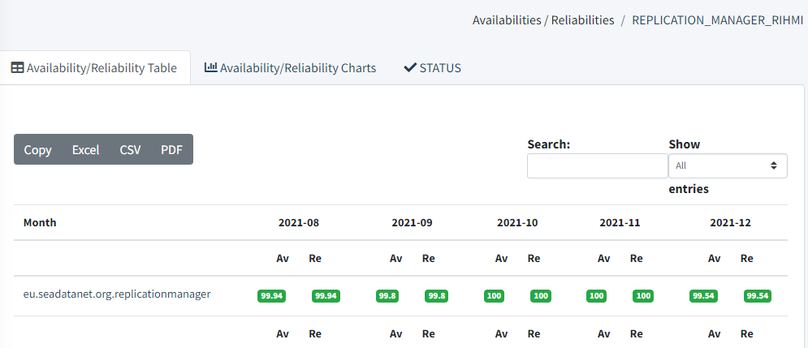
Сontribution to Sea Data Net – RM RNODC
First installation – December 2019, version 1.0.26
Last upgrade - 3.06.21 up to version 1.0.49
Server characteristics: 8 GB of RAM, 50 GB disk storage, java version is 1.8, apache tomcat web server version is 8.5.31
RM Availability and reliability over the last 5 months

Slide 12
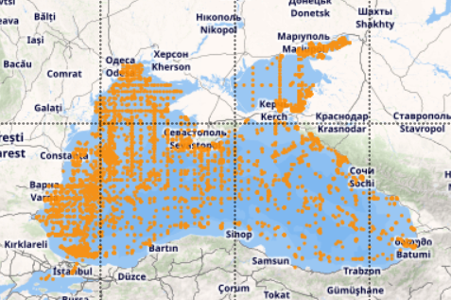
SEADATANET Project
Contribution to Sea Data Net
Period: 2006-2021
Region: Black and Azov seas
Total: 18347 Stations
Historical data: 18230 Stations
After 2000: 117 Stations

Slide 13
Сontribution to Sea Data Net
Data provider (20) | Stations
Donskaya offing station North-Caucasus HMS | 1207
Far Eastern Regional Hydrometeorological Research Institute | 3
Federal State Budgetary Institution of Science, "Federal Research Centre the Southern Scientific Centre of the Russian Academy of Sciences" | 14
Institute of Biology of the Southern Seas, NAS of Ukraine | 59
Kuban offing station, North-Caucasus HMS | 1698
Mariupol Marine Hydrometeorological Station, Ukrainian HMS | 25
Navy Main Administration of Navigation and Oceanography, Ministry of Defence | 259
North-Caucasus Regional Administration of Hydrometeorology of Roshydromet | 8697
Nothern Regional Administration of Hydrometeorology of Roshydromet | 189
Odessa Branch of State Oceanographic Institute | 5221
P.P.Shirshov Institute of Oceanology, RAS | 249
State Oceanographic Institute, Sebastopol Branch | 48
Tuapse Hydrometeorological Bureau, North-Caucasus Centre | 537
Ukrainian Hydrometeorological Institute, Marine Branch | 147
Ukrainian scientific center of Ecology of Sea | 12 18347
Parameters:
Temperature, Salinity

Slide 14
IODE projects:
Ocean Data Portal
Ocean Data and Information System
EU projects:
Sea Data Net
EMODNet – Chemistry
Plan for 2022-2023

Slide 15
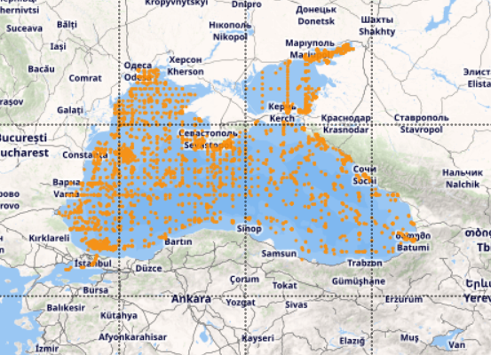
Contribution to EMODNet Chemistry
Period: 2009-2021
Black Sea – 7394 Stations
Azov Sea – 4189 Stations
Total: 11623 Stations
Historical data: 11485 Stations
After 2000: 134 Stations

Slide 16
Contribution to EMODNet Chemistry
Data provider (19) | Stations
Donskaya offing station North-Caucasus HMS( | 657
Federal State Budgetary Institution of Science, "Federal Research Centre the Southern Scientific Centre of the Russian Academy of Sciences" | 15
Institute of Biology of the Southern Seas, NAS of Ukraine | 19
Kuban offing station, North-Caucasus HMS | 225
Mariupol Marine Hydrometeorological Station, Ukrainian HMS | 25
Navy Main Administration of Navigation and Oceanography, Ministry of Defence | 79
North-Caucasus Regional Administration of Hydrometeorology of Roshydromet | 5241
Nothern Regional Administration of Hydrometeorology of Roshydromet | 9
Odessa Branch of State Oceanographic Institute | 3476
P.P.Shirshov Institute of Oceanology, RAS | 177
Specialized Center for Hydrometeorology and Monitoring of Environment of Black and Azov Seas | 16
State Oceanographic Institute | 275
Parameters (15) | Stations
Alkalinity, acidity and pH of the water column | 6655
Ammonium and ammonia concentration parameters | 1195
Concentration of other organic contaminants | 1263
Concentration of polychlorobiphenyls (PCBs) | 373
Concentration of polycyclic aromatic hydrocarbons (PAHs)( | 12
Dissolved metal concentrations | 380
Dissolved oxygen parameters | 10064
Dissolved total and organic nitrogen concentrations | 29
Dissolved total or organic phosphorus concentration | 450
Nitrate concentration parameters | 872
Nitrite concentration parameters | 4131
Particulate total and organic nitrogen concentrations | 20
Pesticide concentrationss | 746
Phosphate concentration parameters | 4755
Silicate concentration parameters | 4290

Slide 17
IODE projects:
Ocean Data Portal
Ocean Data and Information System
EU projects:
Sea Data Net
EMODNet – Chemistry
Plan for 2022-2023

Slide 18
Plan for 2022-2023
ODIS Catalog for BS
ODIN BS web-site

Slide 19
ODIS Catalog for BS
Content: Data sets, data systems, data product, experts. observing systems, codes and voc, education and training, atlases , software enc. (16 entities)
Format: ODIS, GUI, https://catalogue.odis.org/
Participants: all, leader: ?????
Work packages:
Development (mastering IODE documents) specification of collection and presentation of marine sources descriptions via ODISCat
Preparation of materials with marine sources descriptions in NODC s and DNA ODIN BS
Key-enter source descriptions via ODISCAt GUI and access to ODISCat profile from ODIN BS website

Slide 20
ODIN BS Website
Content: DM news, events, experts (link to OceanEpert profile), DM school (link to OceanAcademy), BS Data bases Catalog (link EDMED SDN profile), ODIS Catalog for BS (link to ODISCAt profile), ODP data network (link to ODP profile), etc.
E-environment: LifiRay/SPF
Participants: all, leader: ?????, developer: on a competition basis
Work packages:
Development of technical requirements for ODIN BS website, call and competition
Web-site tools development, development of Manual for management of ODIN BS web-site content
Preparation of content materials and content magagement
ODIN BS web-site launch

Slide 21
Thank you !

Slide 22
BS Marine Data Bases Catalogue
Content: digital data ocean cruise, buoy, coastal stations, sea level observations, pollution, summarized and climatic data, atlases and manuals, etc.
Format: EDMED, XML files
Participants: all, leader: ?????
Work packages:
Development (mastering SDN documents) specification of collection and presentation of marine datasets descriptions in EDMED format
Preparation of materials with marine datasets descriptions in NODC s and DNA ODIN BS
Digitization of dataset descriptions and submission for publication on the ODIN BS website

