Slide 1
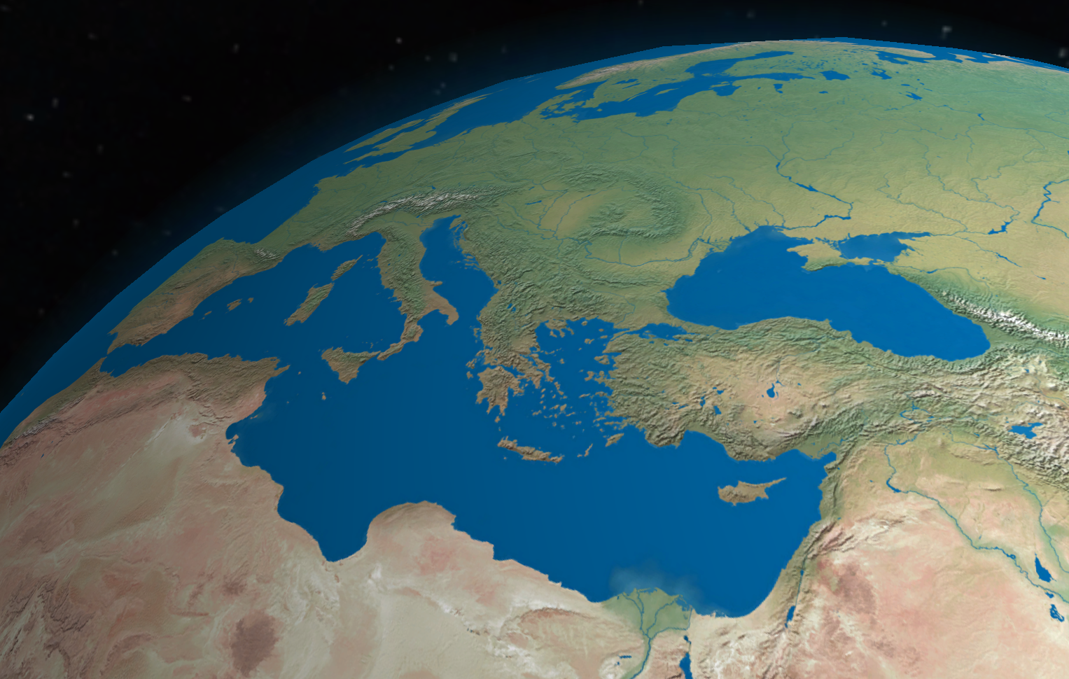
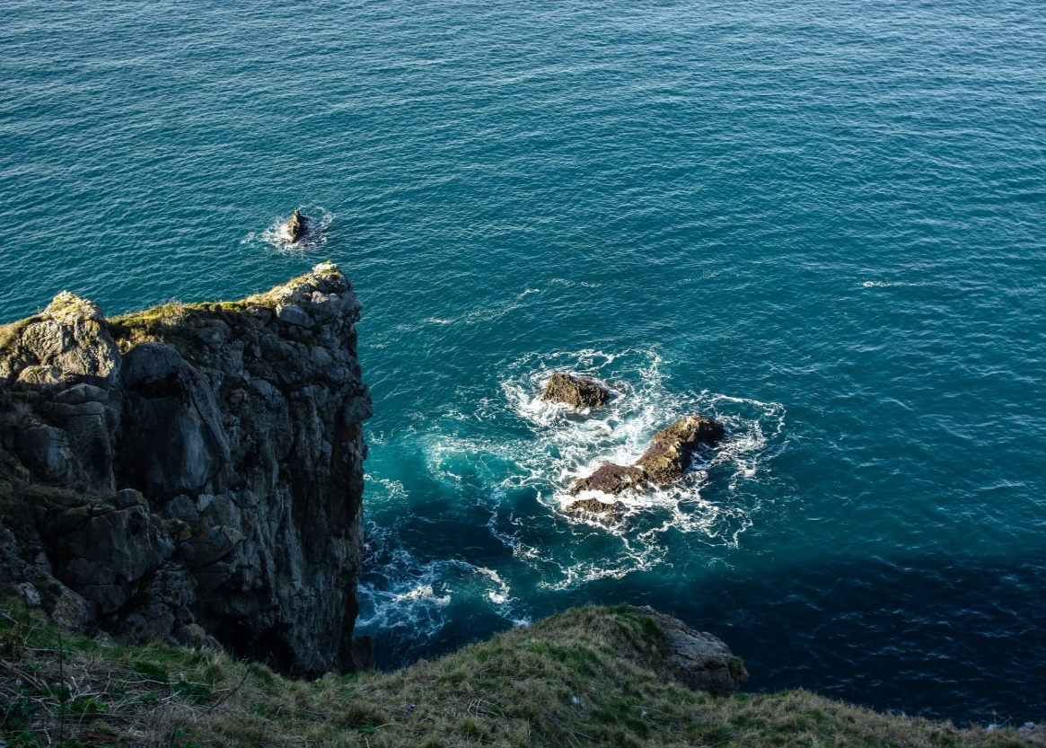
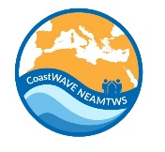


PROJECT
KICK-OFF WORKSHOP
Strengthening the Resilience of Coastal Communities in the North-East Atlantic and Mediterranean Region to the Impact of Tsunamis and Other Sea Level-Related Coastal Hazard
17 & 20 December 2021
IOC EU ECHO NEAMTWS Project
Denis CHANG SENG, PhD
Programme Specialist
Tsunami Unit, Technical Secretary (ICG/NEAMTWS)
Global Ocean Observing System (GOOS)
IOC Expert Focal Point for MHEWS/ IN-MHEWS
IOC Expert Focal Point UNFCCC NWP on Ocean , Coast and Ecosystem
IOC of UNESCO

Slide 2
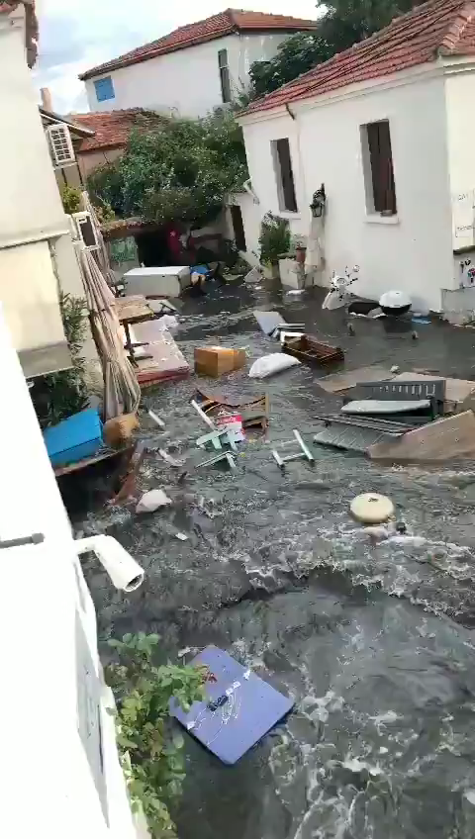
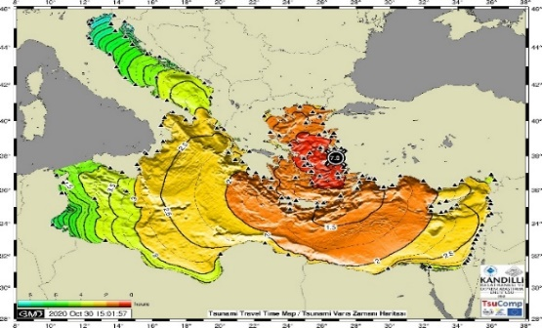
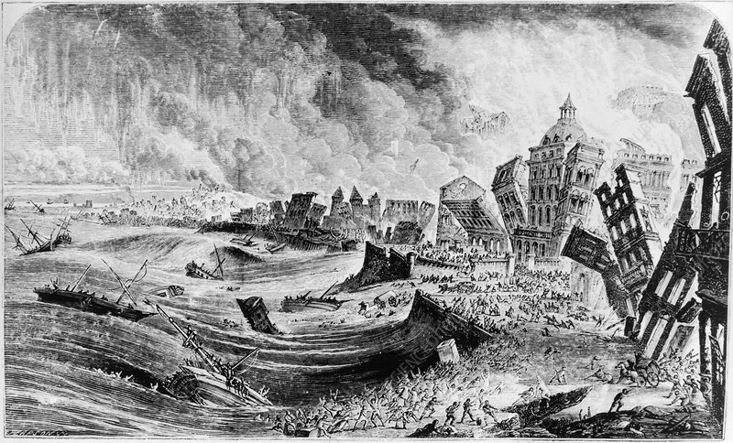
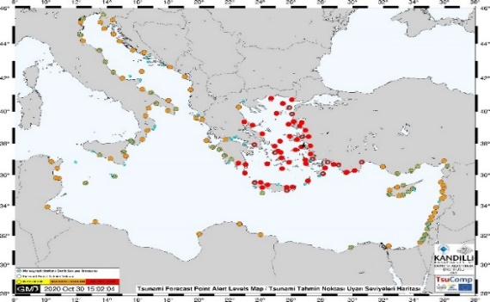
Historical and
Recent Tsunami Events
TSP Alerts: 8-11 min
Tsunami waves: 15-20 min
Official Response/ public: >20 min
Reports of some kind kind of ‘self-organized’ evacuation
THE 1755 EARTH QUAKE & TSUNAMI
-Lisbon was flooded with tsunami waves of 6 m height.
-estimated 60,000 deaths.
-10,000 may have lost their lives in Morocco.
OCT 2020 SAMOS-IZMIR TSUNAMI
source KOERI, Turkey
Tsunami travel time
https://media.sciencephoto.com/image/e3700073/800wm
Forecast point alert (Watch, Advisory and Information) map,
Notes:
NOA (Greece), KOERI (Turkey) and INGV (Italy) TSPs issued earthquake-tsunami bulletins to Member States within 8-11 minutes following the detection of the earthquake.
Greece and Turkey were on Tsunami Watch (highest level of alert), while other countries either on Tsunami Advisory and or Tsunami Information levels.
Eyewitnesses claim the drawback started within 2-5 minutes followed by runup within 15-20 minutes after the Earthquake.
The Civil Protection in Greece activated the emergency to send messages 24 minutes after the earthquake to cellphones.
The event once again highlighted the difficulties of warning with regard to locally generated, rapid onset of tsunami and challenged the ability of local authorities and the communities at risk to take early action.

Slide 3
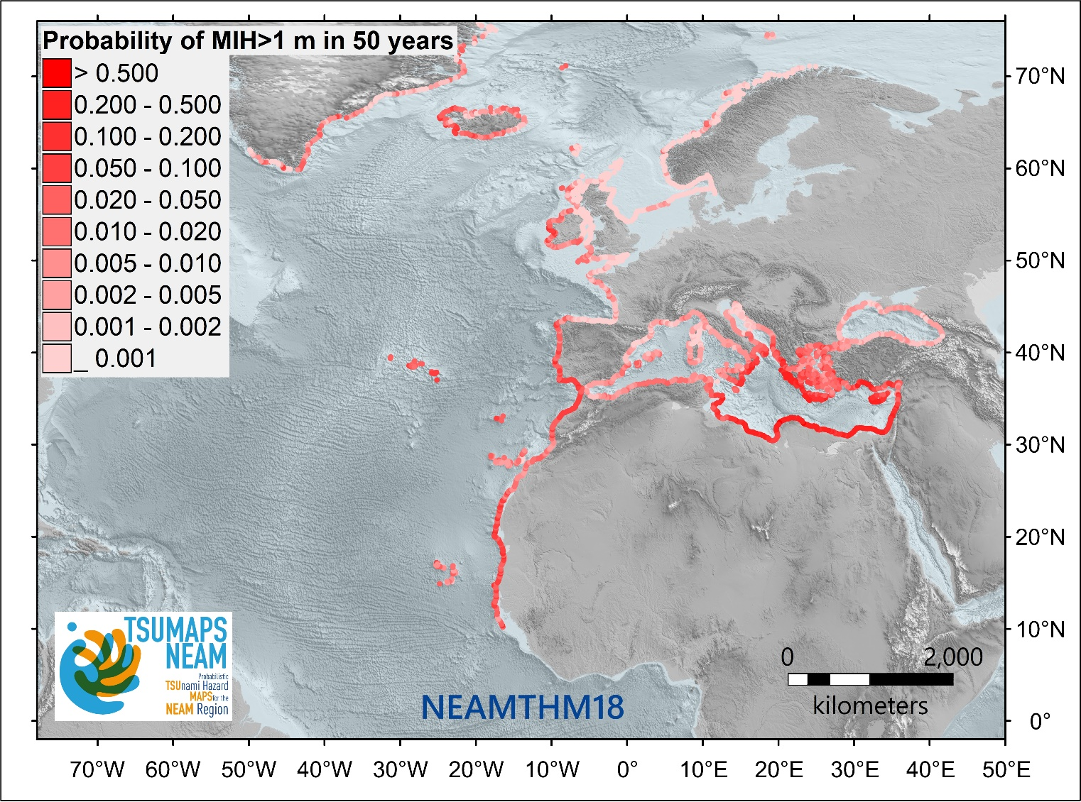
Probability of Tsunami in NEAM Region
In the NEAM region, the probability/likelihood of an earthquake-generated tsunami exceeding a Maximum Inundation Height (MIH) of 1 m in 50 years is illustrated in the Fig.
Note, MIHs greater than 1 meter have been observed during at least three earthquake-generated tsunamis (Samos and Izmir region 2020, Kos-Bodrum in 2017), which caused damage
Probabilistic tsunami hazard assessment of the NEAM region^{[1]}
^{[1]} Probability of an earthquake-generated tsunami exceeding a maximum inundation height (MIH) of 1 m in 50 years evaluated every ~20 km on the NEAM region coastlines. The map was derived from the NEAM Tsunami Hazard Model 2018 (NEAMTHM18; Basili et al., 2021), which is a product of the TSUMAPS-NEAM project funded by the European Civil Protection and Humanitarian Aid Operations (DG-ECHO). For more details of the model, see http://www.tsumaps-neam.eu. The map presented here was produced with the best information available at the time of modelling. The accuracy of these maps is subject to limitations in the accuracy and completeness of available bathymetry and topographic information, and in the current knowledge of the tsunami sources and characteristics. In the last few years, MIHs greater than 1 meter have been observed during at least three earthquake-generated tsunamis (Samos and Izmir region 2020, Kos-Bodrum in 2017), which caused damage.
Source : TSUMAPS-NEAM project

Slide 4
Coastal Exposure
Population Living Below 10 m along Coastlines
Below 10 meters:
116 million & increasing
Excluding dynamic exposure / vulnerability: Seasonal variability in population associated with tourism activities
UNESCO 2020

Slide 5
Building on Current Achievements
Enhancing, Sustaining and Scaling Up

Slide 6
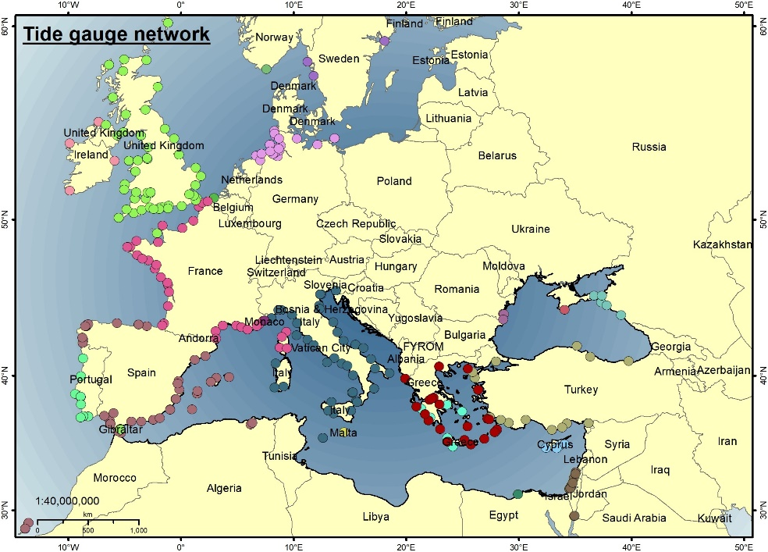
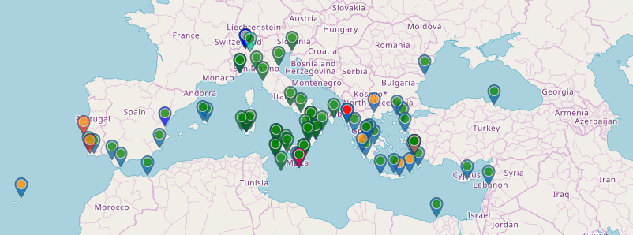
JRC IDSL Network
Testing Inexpensive Device for
Sea-Level Measurement (IDSL) https://webcritech.jrc.ec.europa.eu/tad_server/
Map of sea level networks used by NEAMTWS Tsunami Service Providers
Need to maintain/repair few instruments damaged
Missing coverage of north Africa coasts

Slide 7
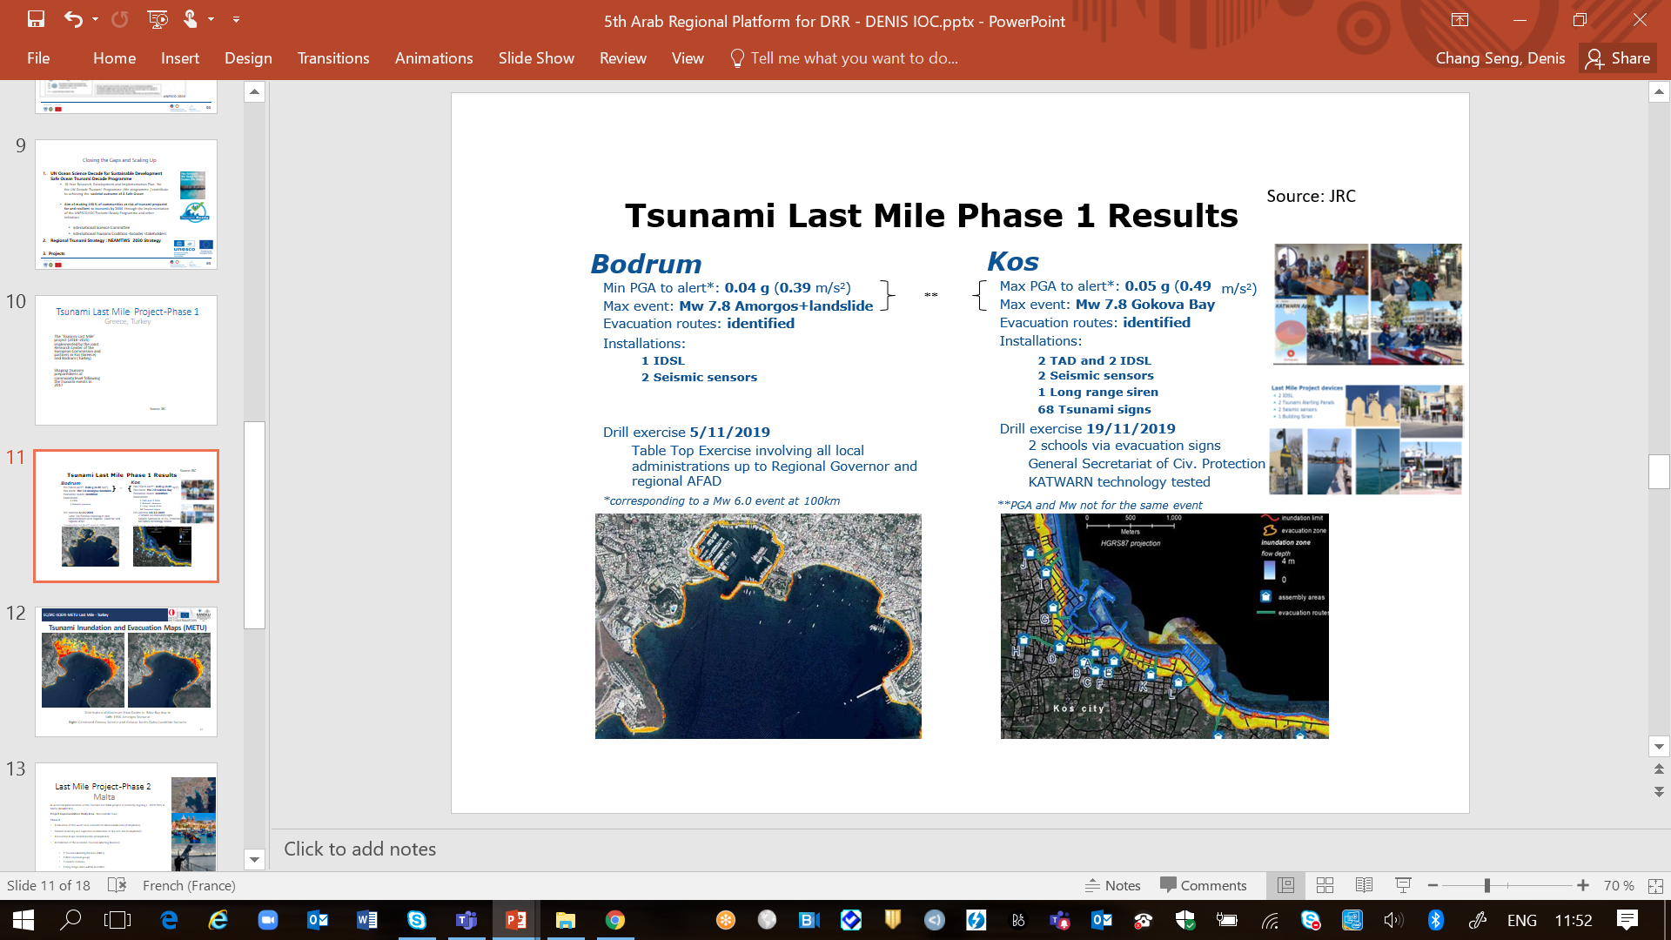
Tsunami Last Mile Project-Phase 1
Greece & Turkey
The 'Tsunami Last Mile' Phase 1 project (2018-2021) was implemented by the JRC and partners in Kos (Greece) and Bodrum (Turkey)
The TLM project has shaped tsunami preparedness at community level following the tsunami events in 2017
Source: JRC

Slide 8
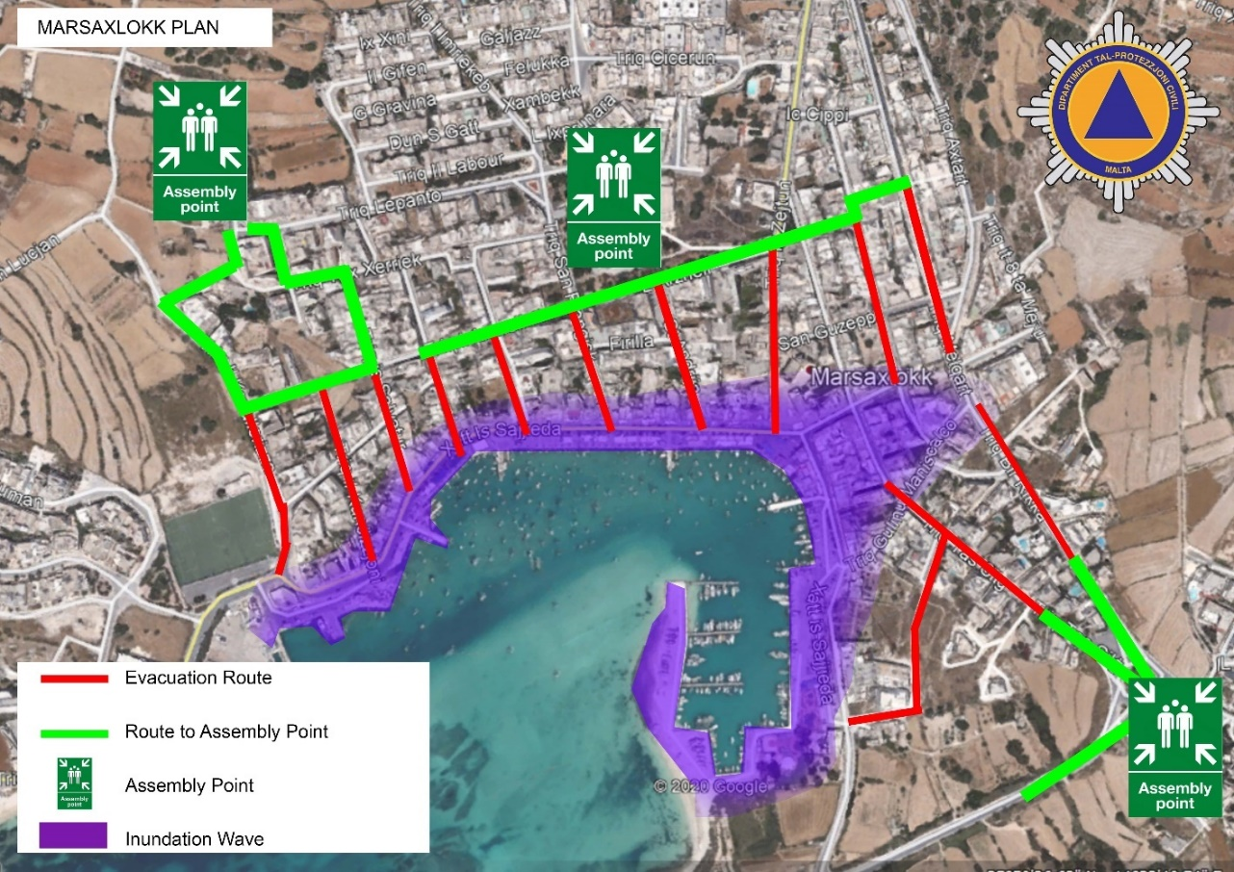
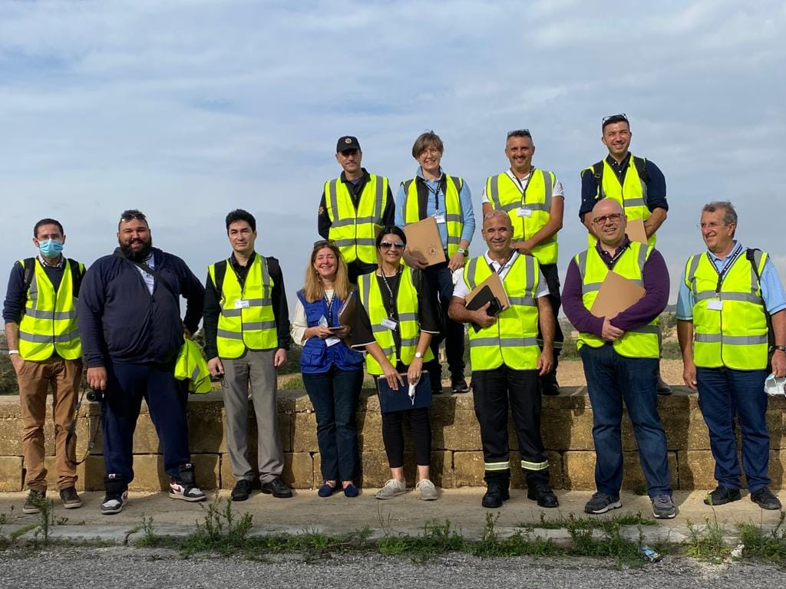
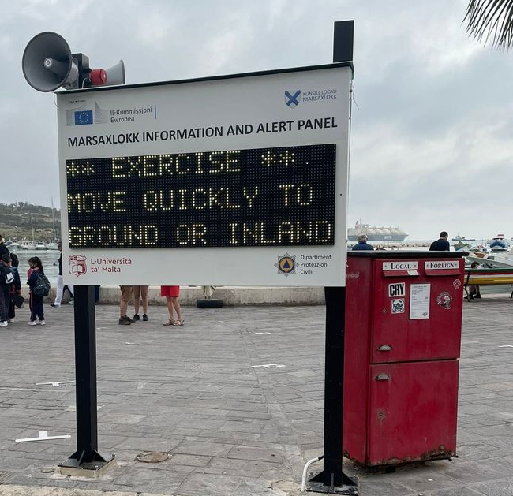
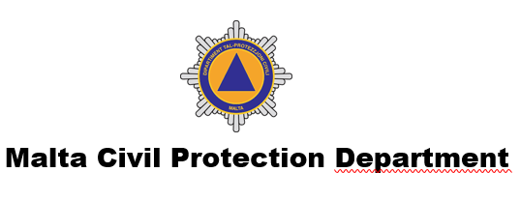
JRC Last Mile Project Phase 2
Malta
First Mission since Feb 2020
Project Implementation Study Area: Marsaxlokk town (Floating Population of 7000)
Malta first end-to-end exercise, 5 Nov 2021
Source
Malta CPD /JRC / M. Santini 2021

Slide 9
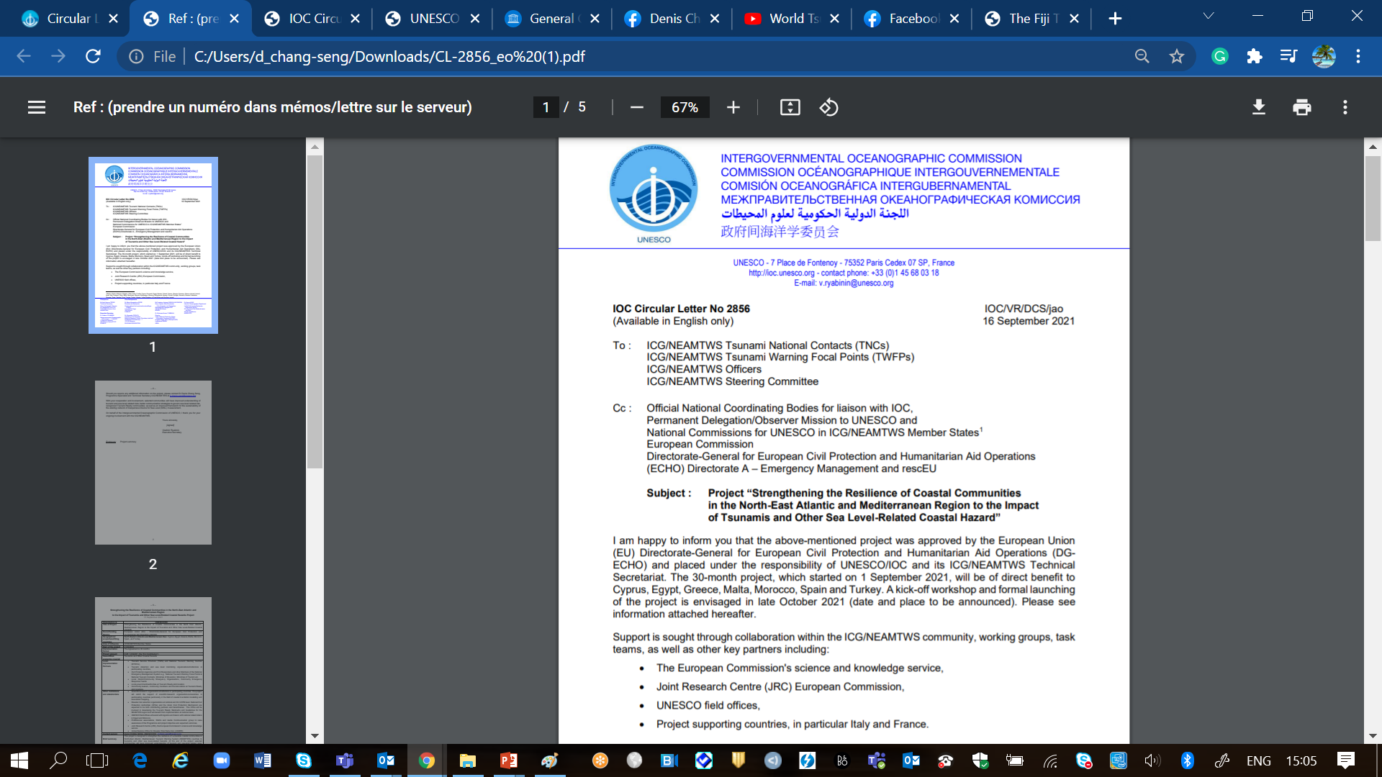


IOC EU ECHO NEAMTWS PROJECT
Project “Strengthening the Resilience of Coastal Communities in the North-East Atlantic and Mediterranean Region to the Impact of Tsunamis and Other Sea Level-Related Coastal Hazard”
Approved by the European Union (EU) Directorate-General for European Civil Protection and Humanitarian Aid Operations (DG ECHO)
Geographical scope/benefitting countries | North Eastern Atlantic and Mediterranean Sea: Cyprus, Egypt, Greece, Malta, Morocco, Spain, and Turkey
Technical Advise | France and Italy
Area of influence | 40 NEAMTWS Member States
Period | 01/09/2021 --- 30/03/2024
Grand Total: 1.2 M Euros

Slide 10
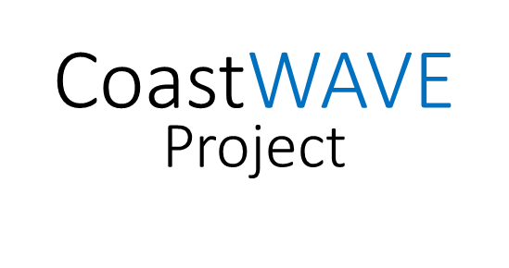
PROJECT GOALS
Project Management, Monitoring etc.
30K EURO
Tsunami Ready Recognized Communities
Alert Systems
Detection & Monitoring
Risk Perception & Communication Strategies
450K
Euros
Improved understanding of tsunami and sea-level related risks.
Better communication strategies to govern sea-level related risk
Enhanced real time detection and monitoring capacities
Improved framework for the sustainability of the existing Inexpensive Device for Sea Level (IDSL) Network
Improved alert/warning capacity
At least seven Tsunami Ready recognized communities by 2023
207 K EURO
16 K
Euros
465 K EURO

Slide 11
PROJECT OUTCOMES
Tsunami Ready pilot programmes based on standards and guidelines developed and adopted by the ICG/NEAMTWS
Understanding and communication of tsunami and other sea-level related risk in selected communities enhanced.
Selected coastal communities are better prepared to respond to SL-related hazards
Access to near real time detection and alert technology to provide early warning of rapid onset sea level-related hazards
Longer term sustainability of the Inexpensive Device for Sea Level (IDSL) network to provide early warning of rapid onset sea level-related hazards in NEAMTWS countries enhanced
1
2
3
4
5

Slide 12
PROJECT
IMPLEMENTING PARTNERS & STAKEHOLDERS
TSPs
Sea Level Monitoring & Tsunami Detection Organizations
Local Government
Community Leaders & members
Ministry of Education (schools)
Scientific organizations , Universities
NGOs
Media
JRC
UNDRR
UNESCO Field Offices
Ministry of Tourism (Hotels)
Community Emergency Organizations & Response Teams
NTWCs

Slide 13
PROJECT Three Tier Partnership and Support
Cyprus, 2. Egypt, 3. Morocco : The pilot project will: Conduct coastal sea level hazard risk perception survey Install tsunami detection and alerting systems at selected sites Train operators in their use and maintenance Support the implementation of the full cycle of Tsunami Ready ( inundation modeling, mapping, signage, national/local SOPs, supporting the establishment of national Tsunami Ready Board, response plan and evacuation drills/exercises ) | A
4. Greece, 5. Malta and 6.Turkey: Build up on JRC Last Mile Project. This includes supporting: national to community level tsunami awareness workshop on SOPs establishment of Tsunami Ready Board signage evacuation drills and exercise *May conduct risk perception study in Malta | B
7. Spain: Partnership variation between A and B *May conduct risk perception study in Spain | C

Slide 14
REVISED WORKPLAN
FLEXIBLE & ADAPTIVE
Situation and Context Specific

Slide 15
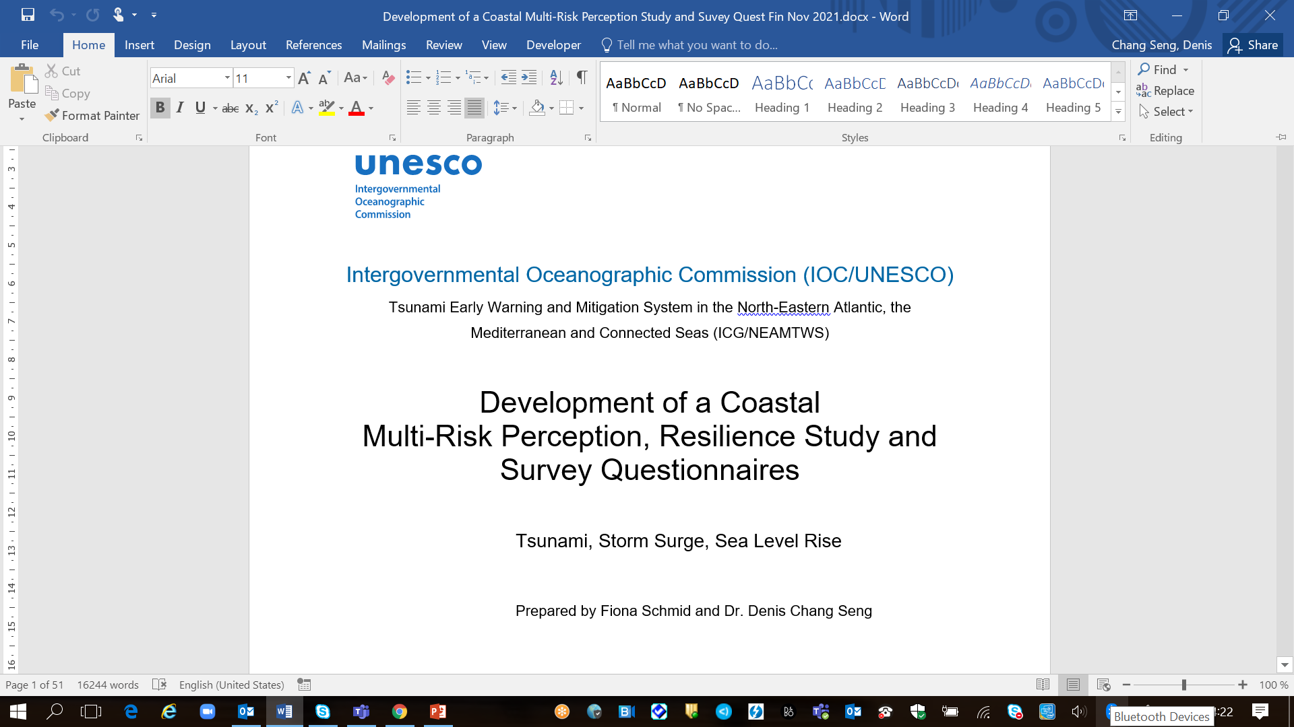
The Project Inception Phase (3 Months)
IOC CL 2856 to ICG/NEAMTWS MS
Letters to target countries: Requesting information concerning project national focal point, TR nomination site, potential stakeholders and partners
Information sharing with project countries and partners
Recruitment of two project staff
  Project Assistant (Administration, Finance and Budget)
  Associate Project Officer (Project Coordinator)
Kick-off project workshop,17 & 20 Dec 2021
Contribute to component 1, outcome 2 of the European Union ECHO project on Strengthening the Resilience of Coastal Communities in the North-Eastern Atlantic and Mediterranean Region to the Impact of Tsunamis and other Sea Level-Related Coastal Hazards
Component 1: Adapt Global Tsunami Ready Standards and Guidelines and pilot Tsunami Ready within the framework of the ICG/NEAMTWS.
Outcome 2: Understanding and communication of tsunami and other sea-level related risk in selected communities in Cyprus, Egypt, Malta and Morocco enhanced

Slide 16
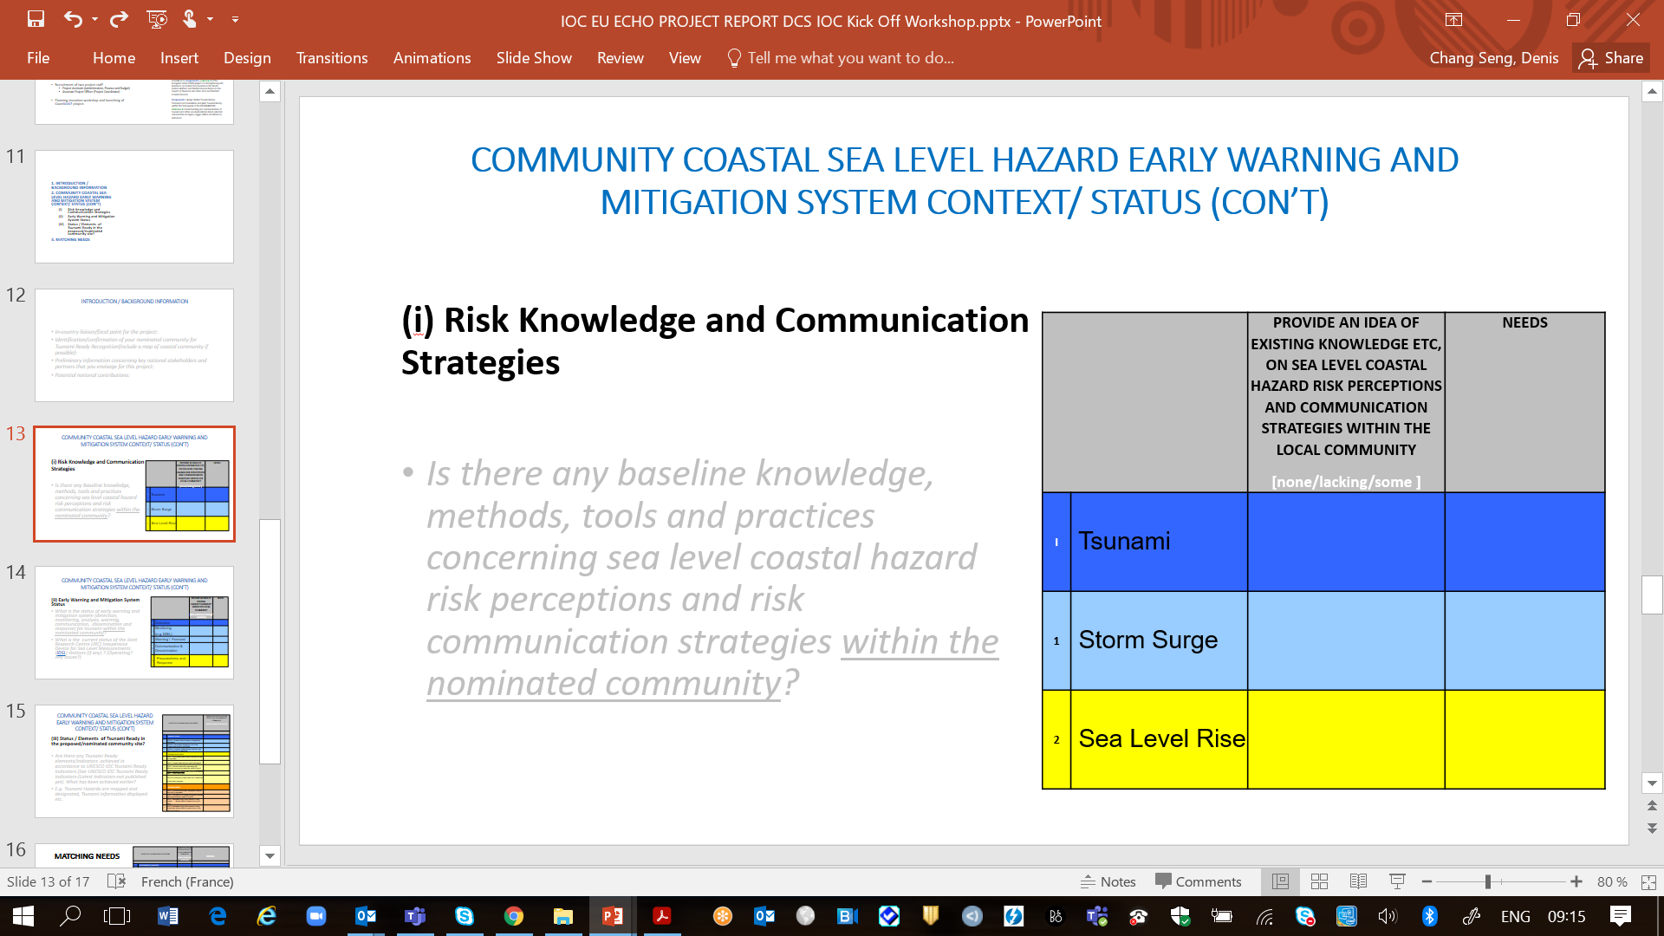
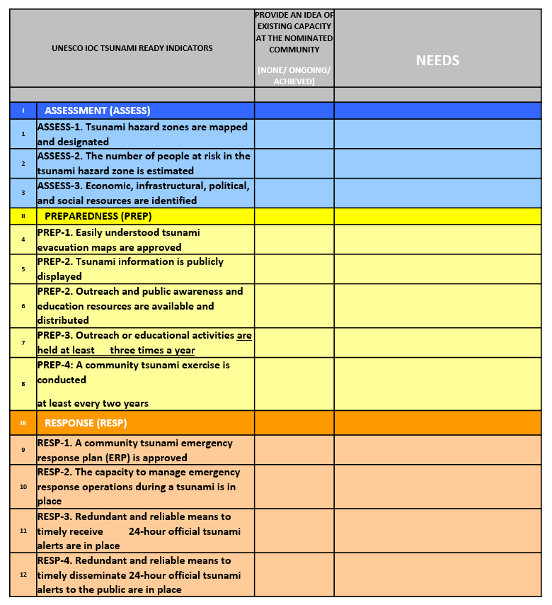
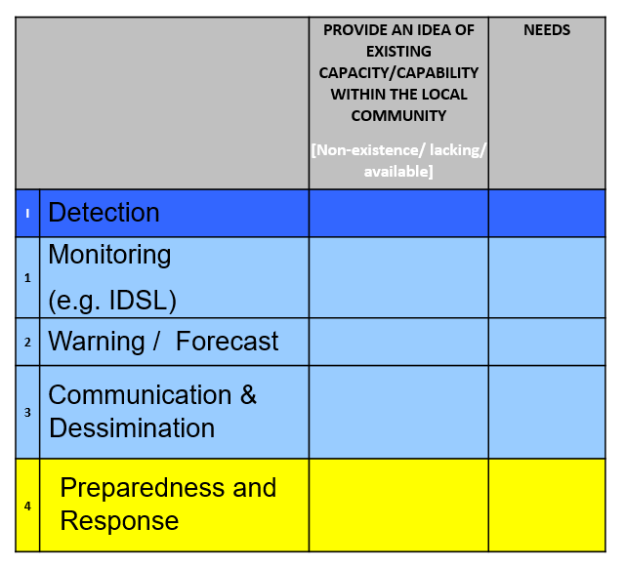
Workshop INTERACTION
Part II
1. INTRODUCTION / BACKGROUND INFORMATION
2. COMMUNITY COASTAL SEA LEVEL HAZARD EARLY WARNING AND MITIGATION SYSTEM CONTEXT/ STATUS (CON’T)
  Risk Knowledge and Communication Strategies
  Early Warning and Mitigation System Status
  Status / Elements of Tsunami Ready in the proposed/nominated community site?
3. MATCHING NEEDS

Slide 17

PROJECT
Communication and Visibility Plan
Communication and Visibility Plan
Circular Letters to inform ICG/NEAMTWS MS
Press and media conferences
Workshops /webinars/ information meetings and briefings
Socialize survey results and focus group discussions
Maps and videos
Website (e.g. NEAMTIC), radio, social media, Snapshot and other articles etc.
ICG/NEAMTWS Steering Committee, Working Groups/ Task Teams and ICG/NEAMTWS sessions
Publications and reports

Slide 18
END

