Slide 1

Project Kick-Off Workshop
IOC EU ECHO NEAMTWS
17 & 20 December 2021
Strengthening the Resilience of Coastal Communities in the North East Atlantic, Mediterranean Region to the Impact of Tsunamis and Other Sea Level-Related Coastal Hazards Project
Pauline Galea/Malta

Slide 2
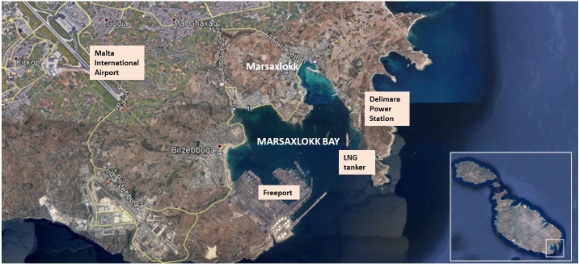
INTRODUCTION / BACKGROUND INFORMATION
In-country liaison/focal point for the project (tentatively):
University of Malta (Department of Geosciences) in coordination with Civil Protection Department
Proposed community: Marsaxlokk village, site of recent Tsunami Last Mile project/exercise.
Potential Stakeholders: M’Xlokk Local Council; Malta Tourism Authority (MTA); Malta Hotels and Restaurants Association (MHRA); Infrastructure Malta (IM)

Slide 3
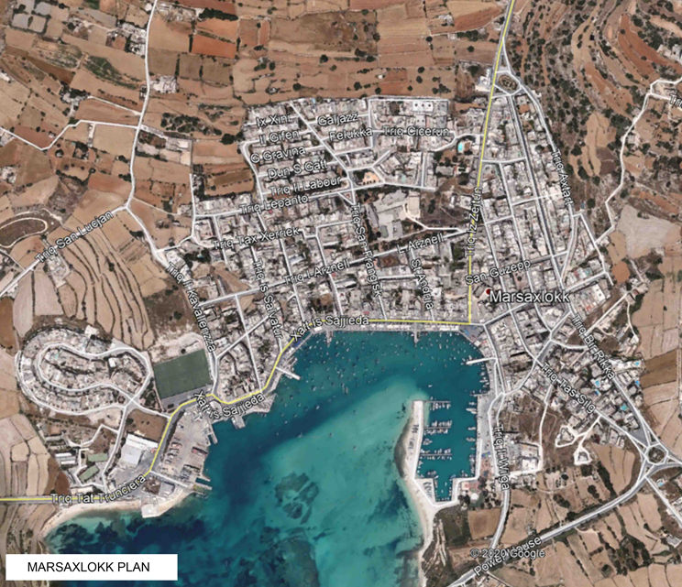
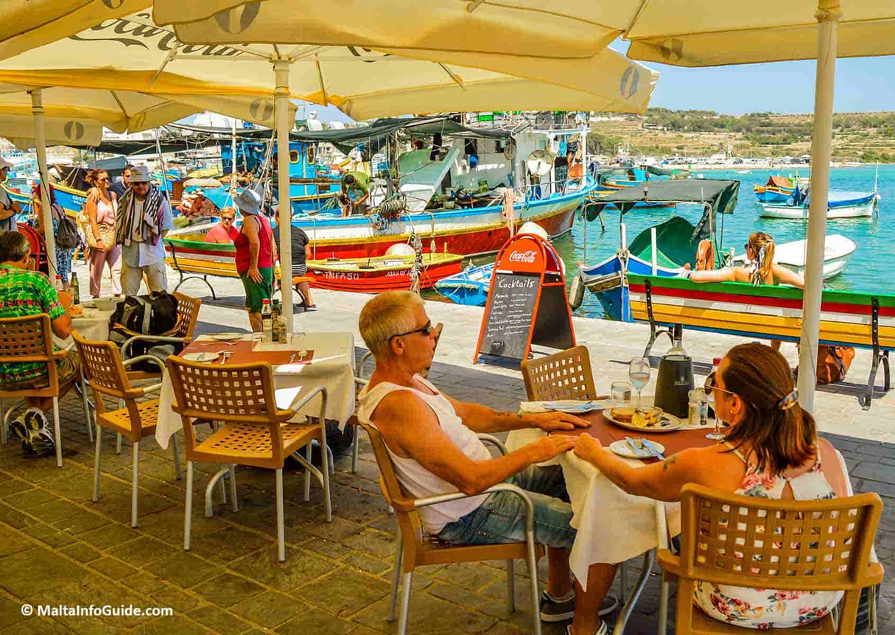
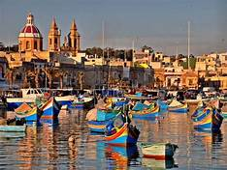
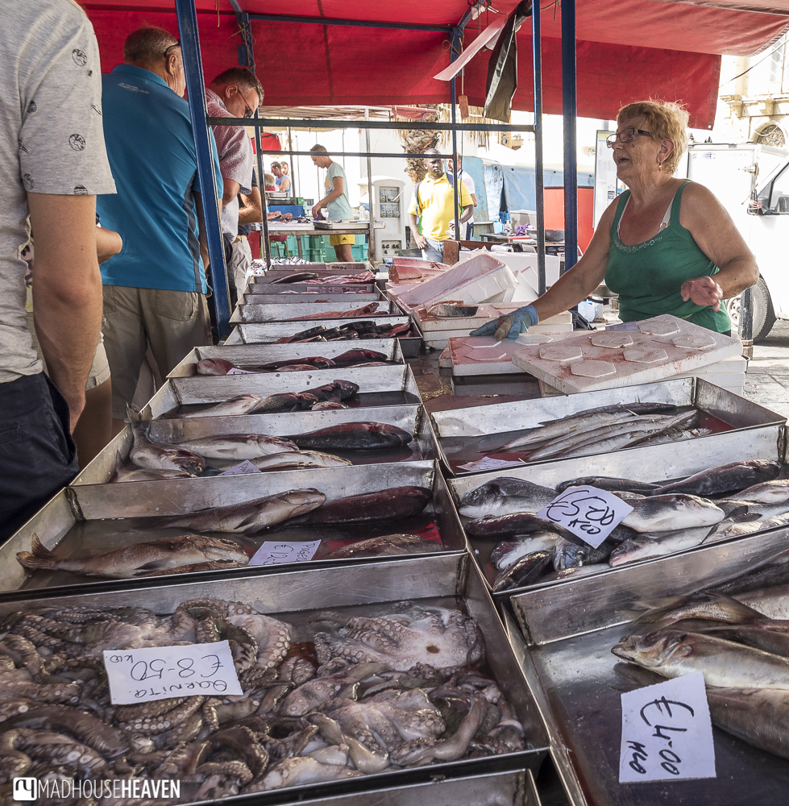
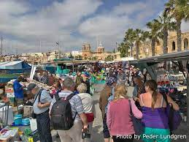
Marsaxlokk Village

Slide 4
COMMUNITY COASTAL SEA LEVEL HAZARD EARLY WARNING AND MITIGATION SYSTEM CONTEXT/ STATUS
Risk Knowledge and Communication Strategies
A public tsunami awareness and information campaign was carried out before the Last Mile project, with public meetings, brochures, media articles, TV programmes, school talks, etc. mostly centred on Marsaxlokk village.
 |  | PROVIDE AN IDEA OF EXISTING KNOWLEDGE ETC, ON SEA LEVEL COASTAL HAZARD RISK PERCEPTIONS AND COMMUNICATION STRATEGIES WITHIN THE LOCAL COMMUNITY [none/lacking/some ] | NEEDS
I | Tsunami | some | the awareness gained during LM project needs to be kept up, especially with schoolchildren.
1 | Storm Surge/ meteotsunami | some (quite frequent occurrence ) | think about using tsunami alert devices to pass on information about these phenomena
2 | Sea Level Rise | probably lacking | more discussion with sea-front restaurant owners and hospitality.

Slide 5
Information Brochures prepared by CPD

Slide 6
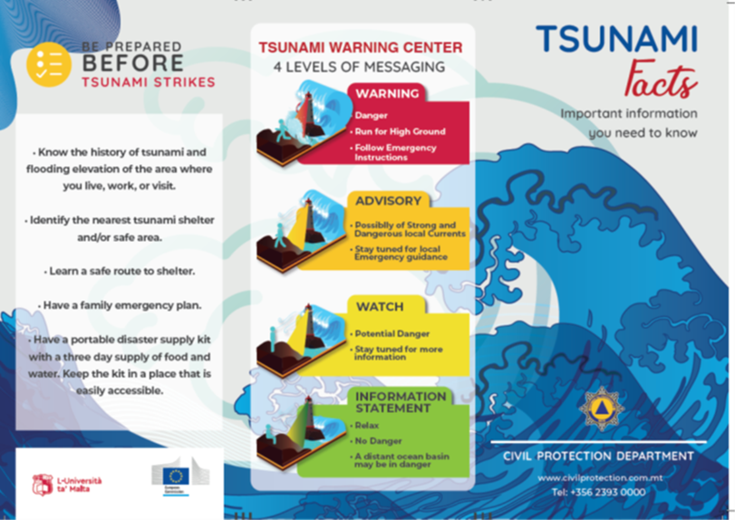
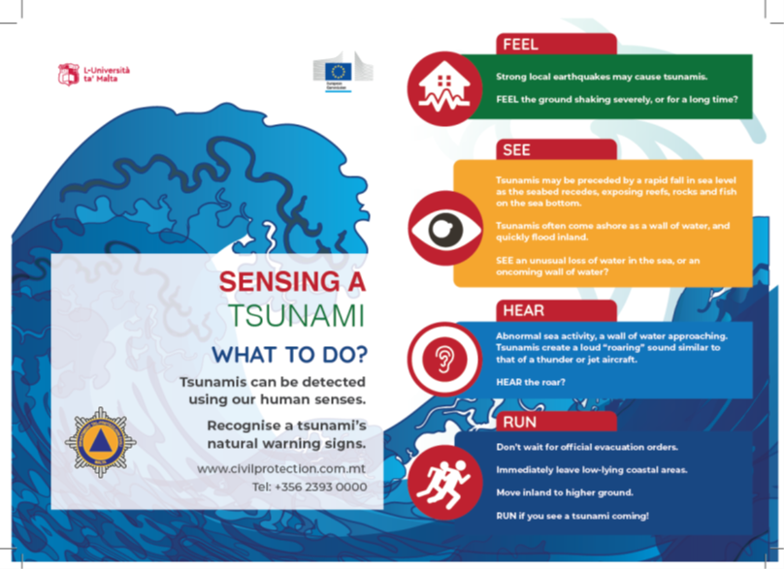
Information Brochures prepared by CPD

Slide 7
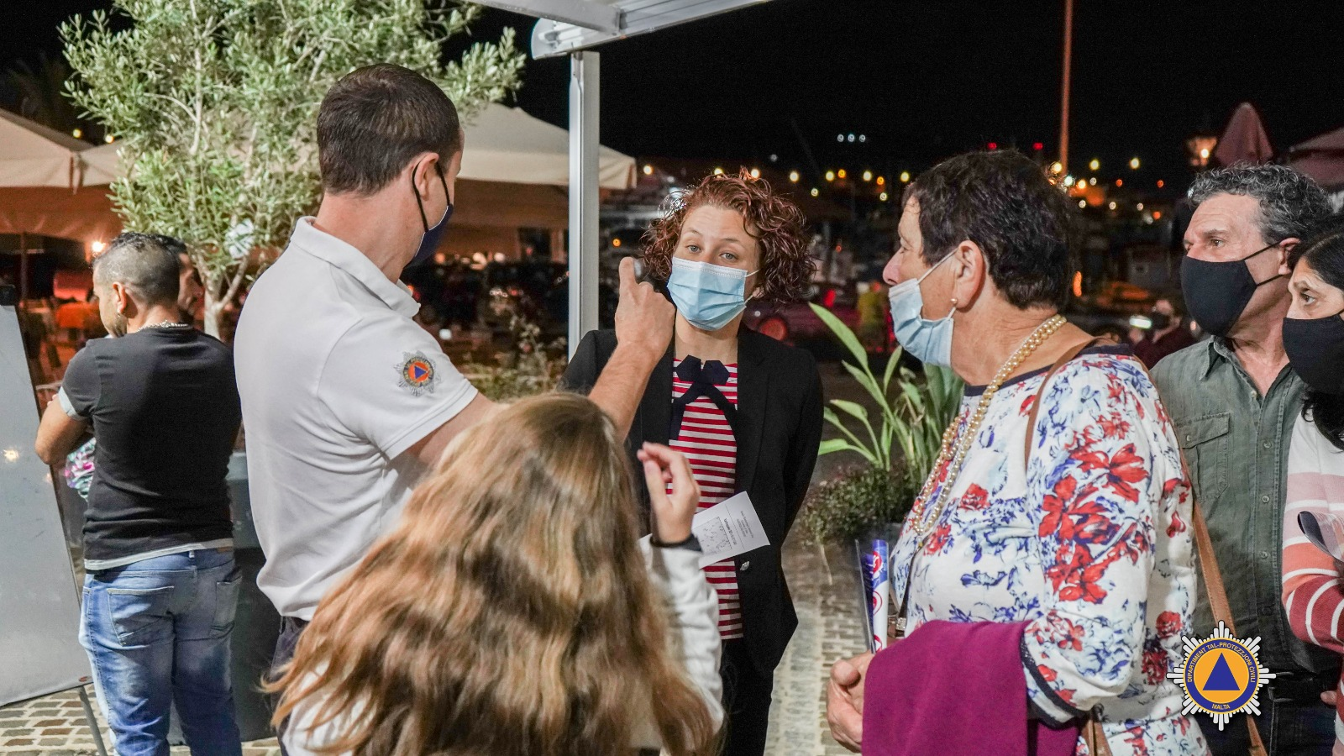
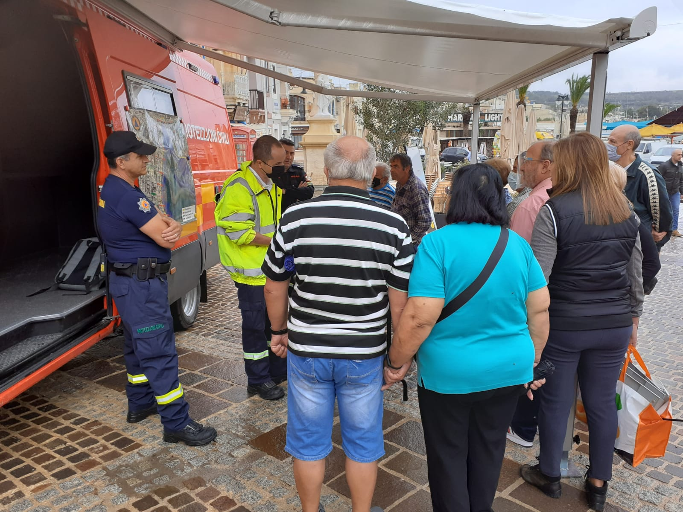
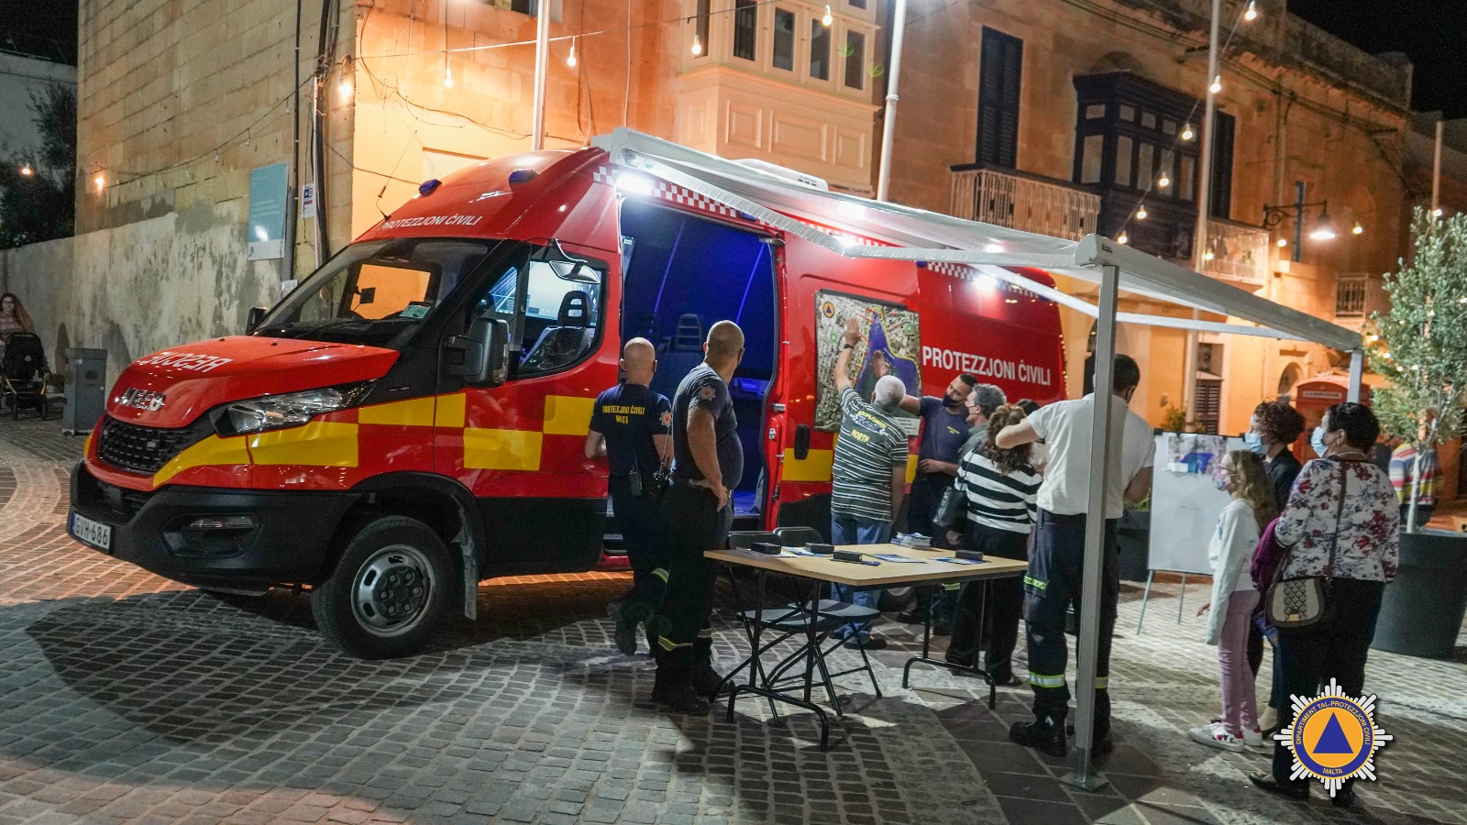
Informing the Public

Slide 8
COMMUNITY COASTAL SEA LEVEL HAZARD EARLY WARNING AND MITIGATION SYSTEM CONTEXT/ STATUS (CON’T)
(ii) Early Warning and Mitigation System Status
UM operates national/regional seismic detection and monitoring system using SeisComP.
SeisComP integrated with tsunami monitoring system TOAST, with automated tsunami simulation and operator verification with SL gauges.
CPD subscribed to INGV-CAT TSP. UM acts as additional advisory input regarding message interpretation, using also its own systems (however with no national mandate to do so).
CPD responsible for dissemination of appropriate message to stakeholders and mobilization of emergency response.
There is currently one JRC IDSL and one RADAC sea level station installed in the bay of Marsaxlokk. Another two IDSL’s are installed in Grand Harbour and in the north of Malta. The devices are generally continuously operating and transmitting.
 |  | PROVIDE AN IDEA OF EXISTING CAPACITY/CAPABILITY WITHIN THE LOCAL COMMUNITY [Non-existence/ lacking/ available] | NEEDS
I | Detection | available
1 | Monitoring (e.g. IDSL) | available
2 | Warning / Forecast | available
3 | Communication & Dessimination | lacking
4 | Preparedness and Response | available (CPD)
Human Resources and overarching national policy lacking. Difficult to maintain systems over long term

Slide 9
Tsunami monitoring and simulation facilities

Slide 10
COMMUNITY COASTAL SEA LEVEL HAZARD EARLY WARNING AND MITIGATION SYSTEM CONTEXT/ STATUS (CON’T)
UNESCO IOC TSUNAMI READY INDICATORS |  | PROVIDE AN IDEA OF EXISTING CAPACITY AT THE NOMINATED COMMUNITY [NONE/ ONGOING/ ACHIEVED]
I | ASSESSMENT (ASSESS)
1 | ASSESS-1. Tsunami hazard zones are mapped and designated | achieved
2 | ASSESS-2. The number of people at risk in the tsunami hazard zone is estimated | achieved
3 | ASSESS-3. Economic, infrastructural, political, and social resources are identified | achieved
II | PREPAREDNESS (PREP)
4 | PREP‑1. Easily understood tsunami evacuation maps are approved | achieved
5 | PREP‑2. Tsunami information is publicly displayed | needs more work
6 | PREP‑2. Outreach and public awareness and education resources are available and distributed | ongoing
7 | PREP‑3. Outreach or educational activities are held at least three times a year | none
8 | PREP‑4: A community tsunami exercise is conducted at least every two years | one exercise conducted November 2021
III | RESPONSE (RESP)
9 | RESP-1. A community tsunami emergency response plan (ERP) is approved | ongoing
10 | RESP-2. The capacity to manage emergency response operations during a tsunami is in place | achieved
11 | RESP-3. Redundant and reliable means to timely receive 24-hour official tsunami alerts are in place | achieved
12 | RESP-4. Redundant and reliable means to timely disseminate 24-hour official tsunami alerts to the public are in place | ongoing
(iii) Status / Elements of Tsunami Ready in the proposed/nominated community site?
Motivated by the Last Mile project, the CPD prepared SOP for tsunami emergency.
Tsunami propagation and inundation scenarios of Marsaxlokk have been prepared by UM.
Evacuation areas and evacuation routes are drawn up, based on inundation models.
Street signs for evacuation and assembly areas were installed
Protocols for contacting stakeholders have been prepared, including all contact information
Information about resident numbers and demographics was collected.
A public awareness campaign was organized.
The SOP was tested through a number of Table Top exercises, and the real tsunami drill, involving all stakeholders.

Slide 11
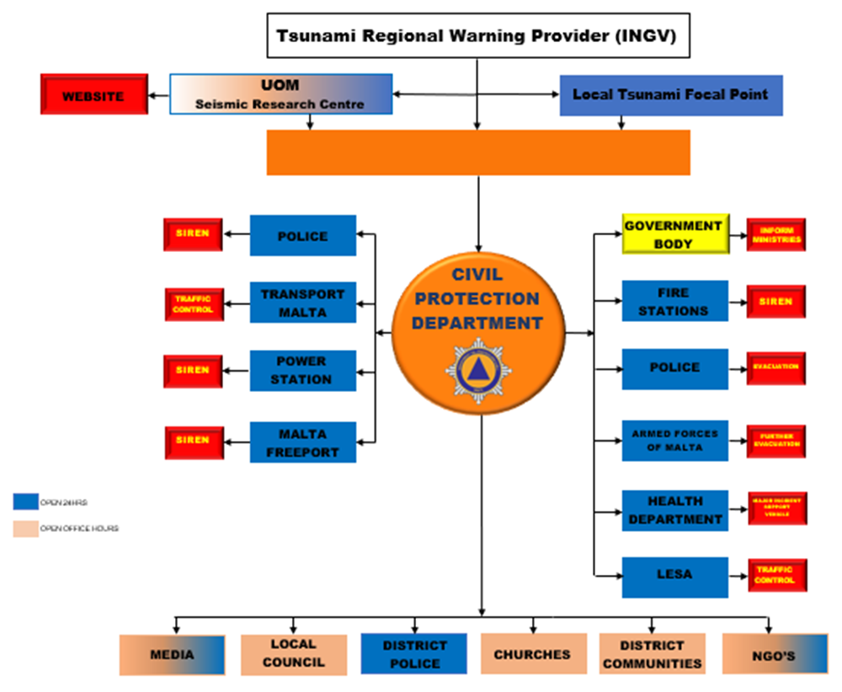
Tsunami Emergency Protocol for Marsaxlokk

Slide 12
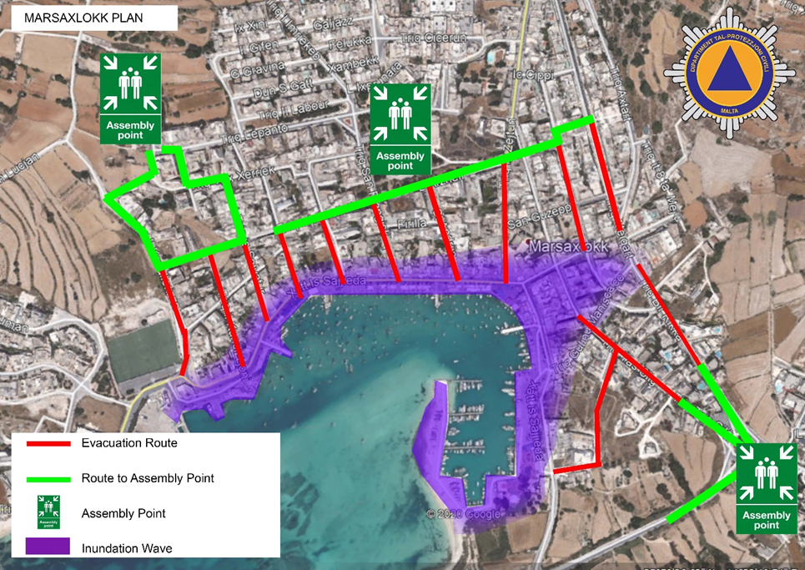
Evacuation plans for Marsaxlokk prepared by CPD

Slide 13
MATCHING NEEDS
UNESCO IOC TSUNAMI READY INDICATORS |  | PROVIDE AN IDEA OF EXISTING CAPACITY AT THE NOMINATED COMMUNITY [NONE/ ONGOING/ ACHIEVED] | NEEDS
I | ASSESSMENT (ASSESS)
1 | ASSESS-1. Tsunami hazard zones are mapped and designated | achieved
2 | ASSESS-2. The number of people at risk in the tsunami hazard zone is estimated | achieved
3 | ASSESS-3. Economic, infrastructural, political, and social resources are identified | achieved
II | PREPAREDNESS (PREP)
4 | PREP‑1. Easily understood tsunami evacuation maps are approved | achieved
5 | PREP‑2. Tsunami information is publicly displayed | needs more work | TAD panels could be better utilized.
6 | PREP‑2. Outreach and public awareness and education resources are available and distributed | ongoing | more meetings with schoolchildren are needed.
7 | PREP‑3. Outreach or educational activities are held at least three times a year | none | more activities in schools
8 | PREP‑4: A community tsunami exercise is conducted at least every two years | one exercise conducted November 2021
III | RESPONSE (RESP)
9 | RESP-1. A community tsunami emergency response plan (ERP) is approved | ongoing
10 | RESP-2. The capacity to manage emergency response operations during a tsunami is in place | achieved
11 | RESP-3. Redundant and reliable means to timely receive 24-hour official tsunami alerts are in place | achieved
12 | RESP-4. Redundant and reliable means to timely disseminate 24-hour official tsunami alerts to the public are in place | ongoing
One exercise is not enough. The community should not rely only on directions by the authorities.
Awareness needs continuous effort.
Schoolchildren of the community need to be drilled regularly
Alert/information panels used in Last Mile project should be utilized efficiently for public education.
Restaurant and market stall owners need to be engaged regularly in awareness activity.

Slide 14
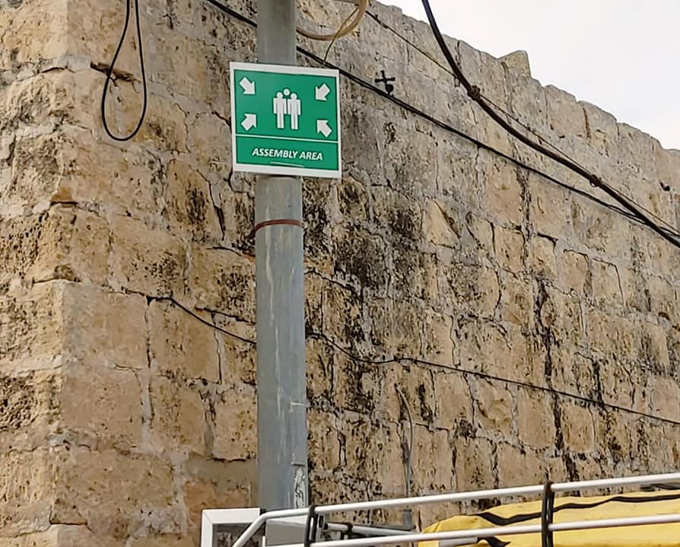
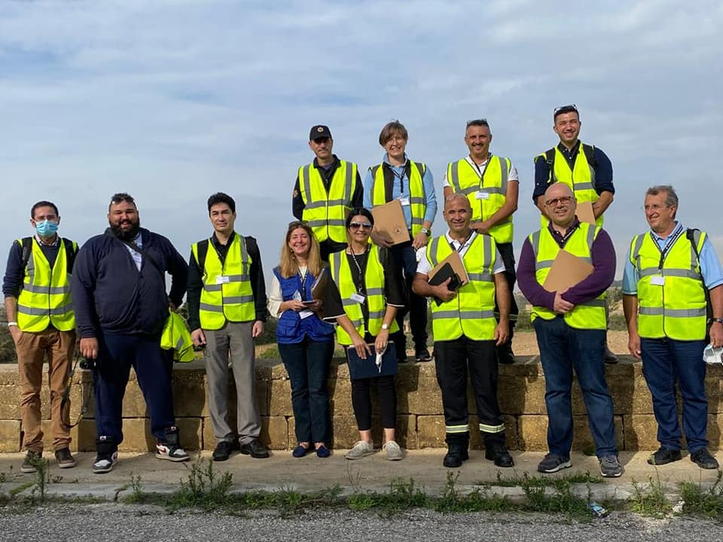
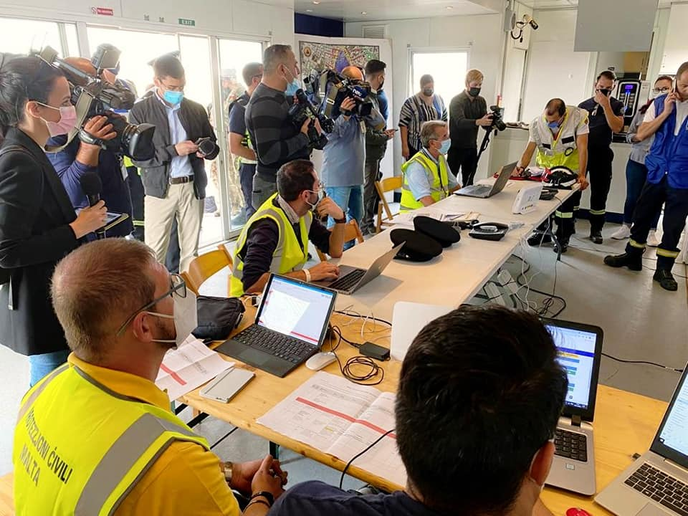
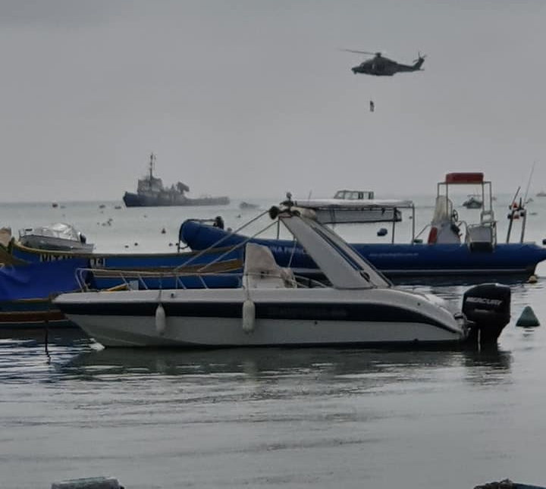
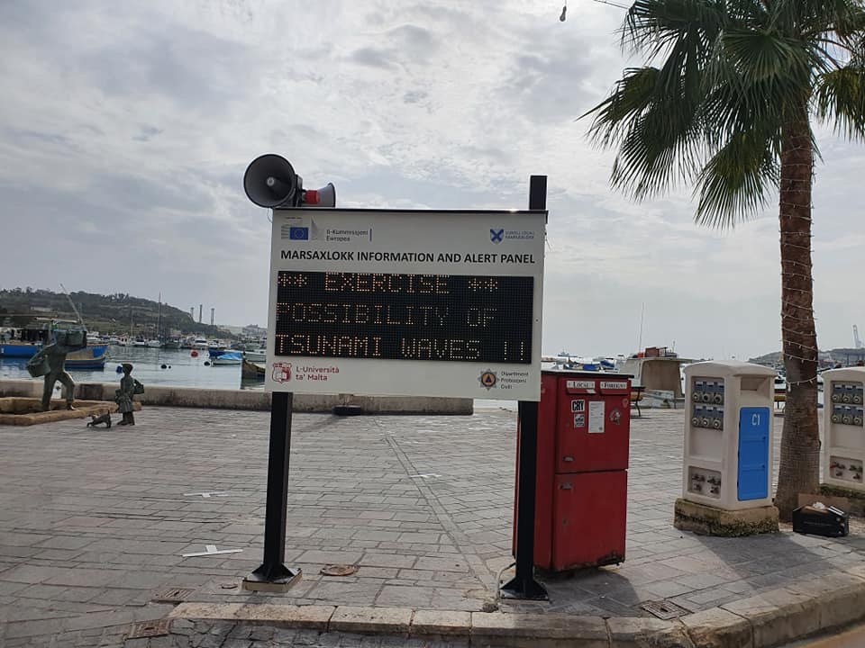
Tsunami Last Mile project
- Marsaxlokk, Malta

Slide 15
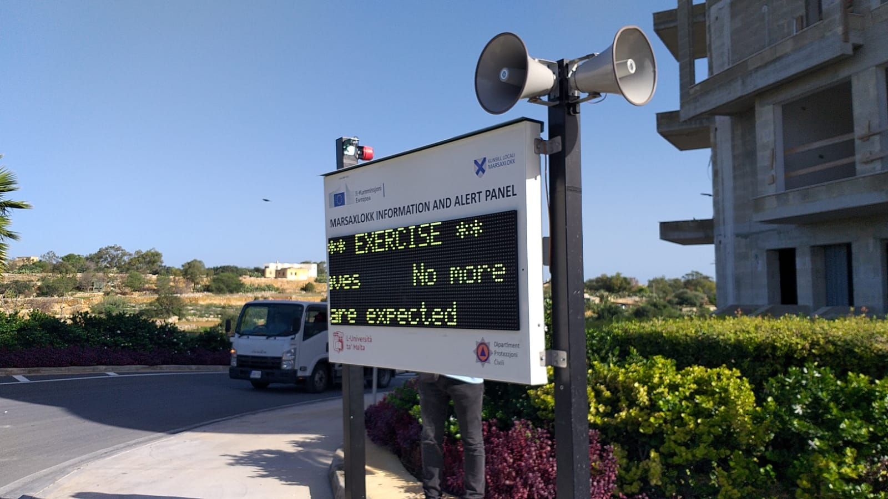
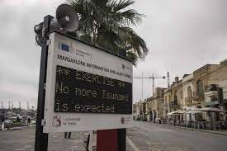
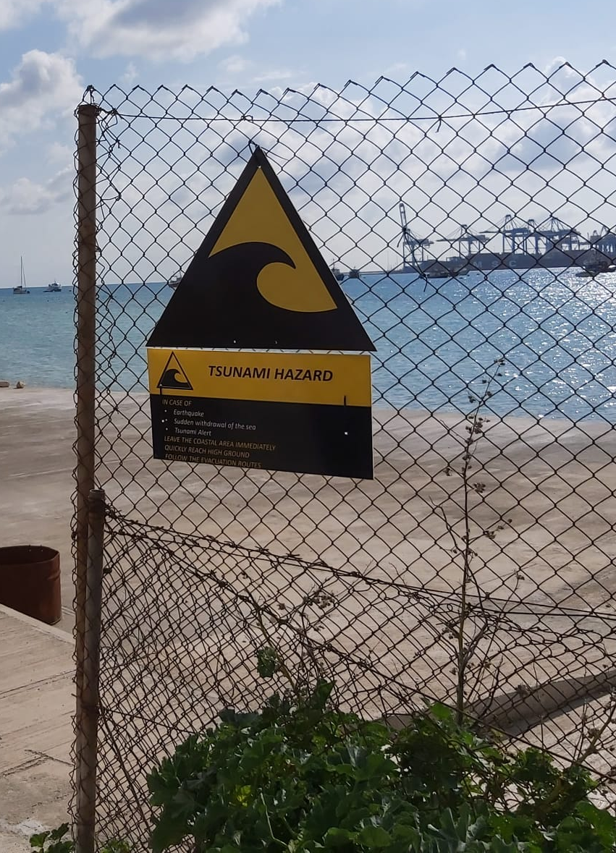
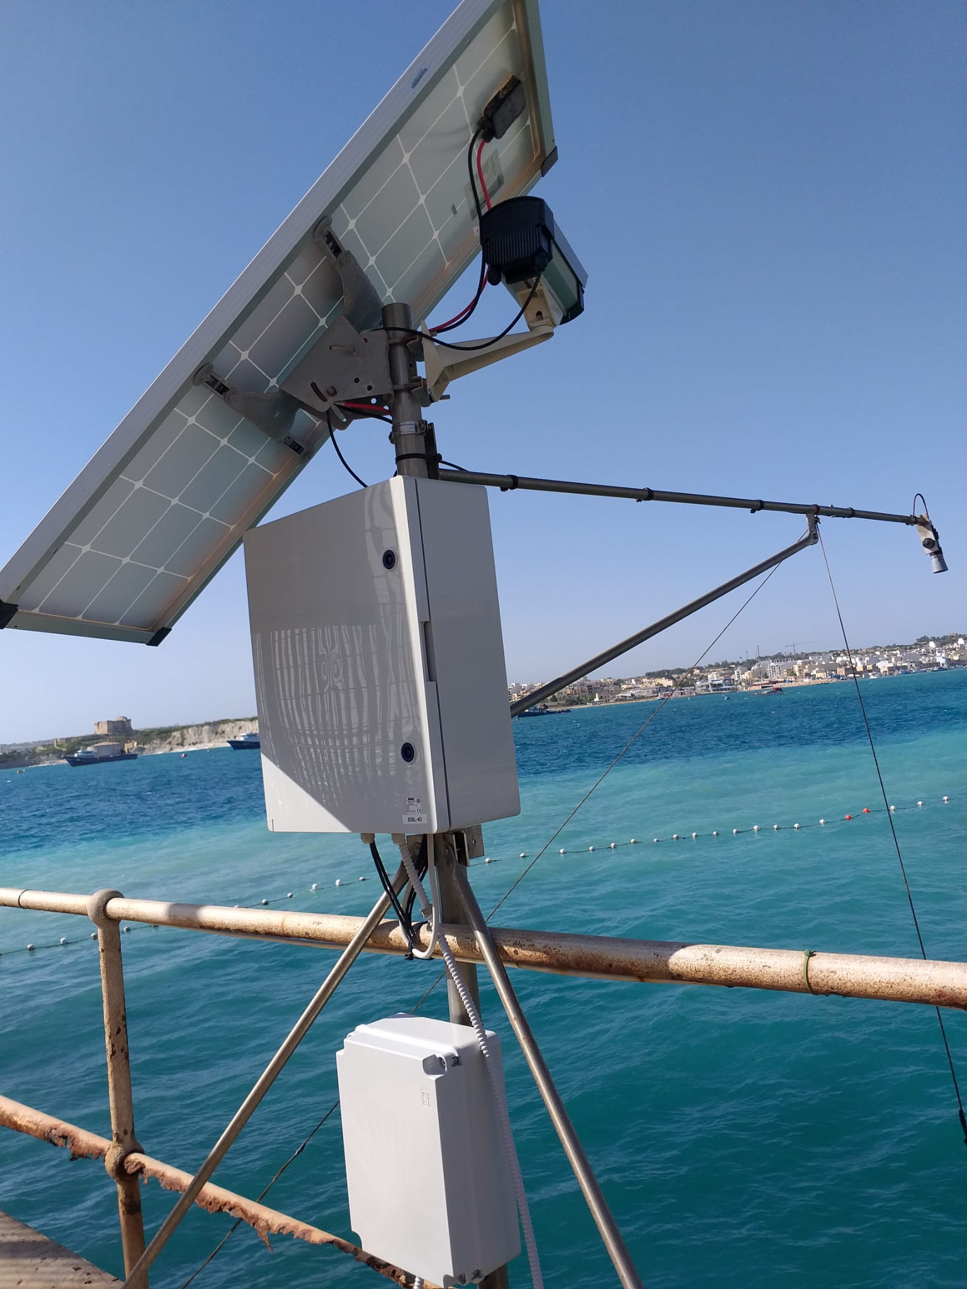
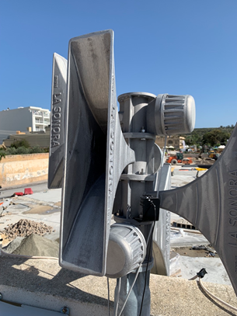
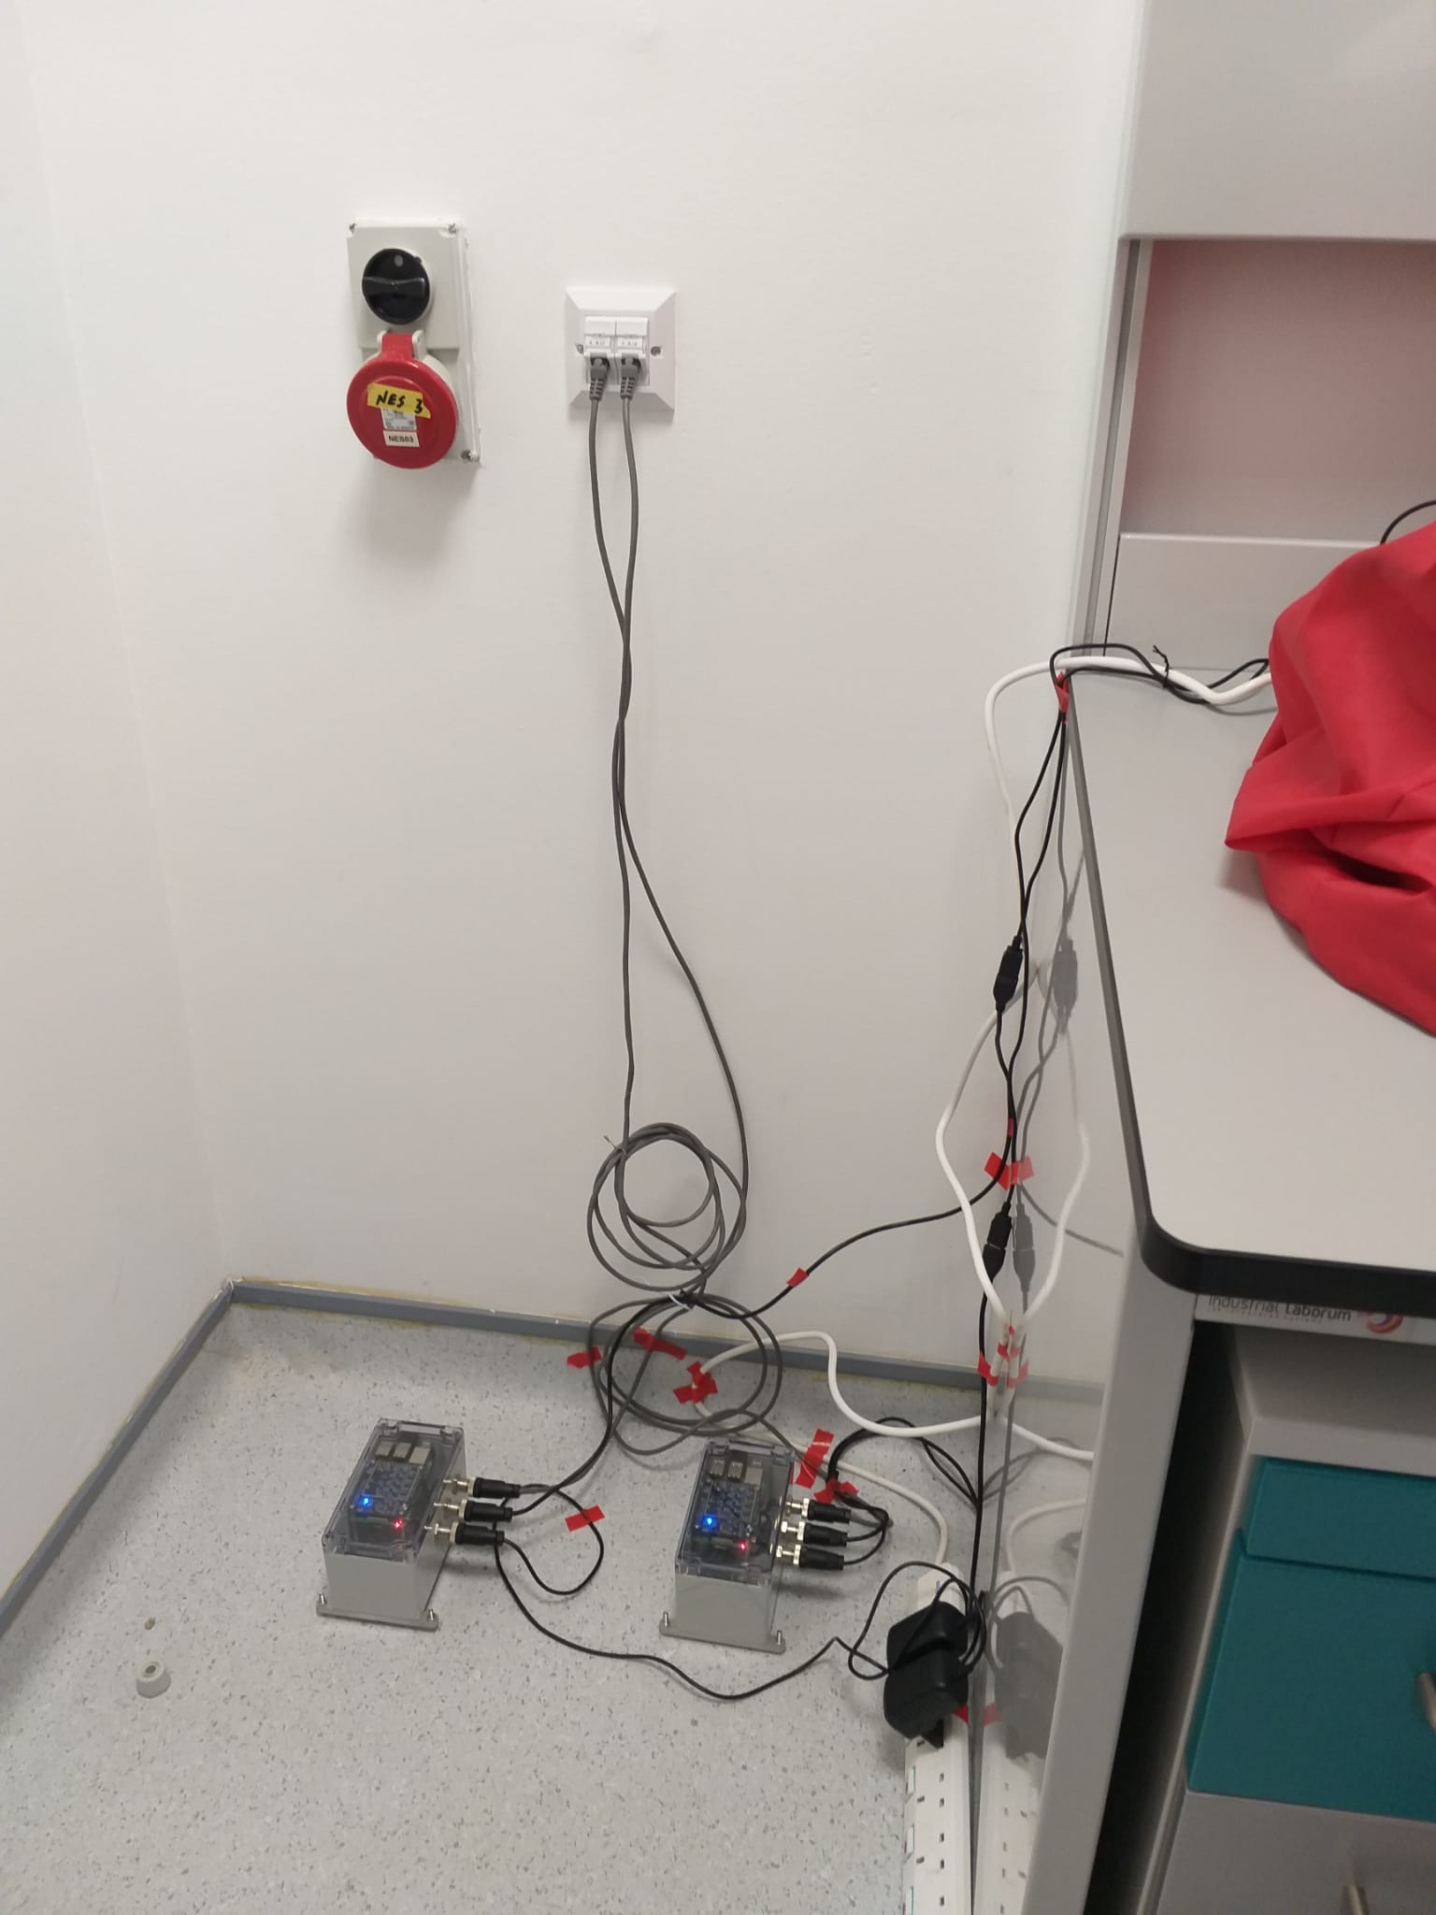
JRC alert and montoring devices installed in Marsaxlokk

Slide 16
Thank You

