Slide 1


Project Kick-Off Workshop
IOC EU ECHO NEAMTWS
17 & 20 December 2021
Strengthening the Resilience of Coastal Communities in the North East Atlantic, Mediterranean Region to the Impact of Tsunamis and Other Sea Level-Related Coastal Hazards Project
CYPRUS
Dr Sylvana Pilidou
Senior Geological Officer (Seismology)
Cyprus Geological Survey Department (Tsunami National Contact)
Representing the NEAMTWS Cyprus National Committee

Slide 2
INTRODUCTION / BACKGROUND INFORMATION
In-country liaison/focal point for the project:
The Tsunami National Contact for Cyprus: The Director of the Geological Survey Department of Cyprus.
Identification/confirmation of your nominated community for Tsunami Ready Recognition(Include a map of coastal community if possible):
Have not chosen a community yet (no previous experience from any tsunami-ready projects), awaiting for more information and advice during the launching of the project to decide which would be the best choice.

Slide 3
INTRODUCTION / BACKGROUND INFORMATION
Preliminary information concerning key national stakeholders and partners that you envisage for this project:
Members and the observers of NEAMTWS Cyprus National Committee:
1. Cyprus Geological Survey Department (GSD), the designated Tsunami National Contact, the technical advisor of the state for all geo-matters. It owns and operates the national seismic network. (Meeting participants: Sylvana Pilidou, Iordanis Dimitriadis)
2. Cyprus Civil Defence (CD), the designated Tsunami Warning Focal Point, the national civil protection entity of the country. (Meeting participants: Nikolas Paris)
3. Cyprus Department of Lands and Surveys (DLS), the national agency and state advisor for cartographic, geodetic and hydrographic issues. It operates the national GNSS and sea-level networks. (Meeting participants: Giorgos Kokosis)
4. Oceanography Centre of the University of Cyprus (UCY), the leading university and the most active research institution in Cyprus. Was involved in NEAMTWS activities in the last 15 years and was a partner in various tsunami-related projects. (Meeting participants: Georgios Georgiou)
Other partners and stakeholders:
5. Cyprus University of Technology (CUT), one of the biggest universities in Cyprus, achieved international research excellence. (Meeting participants: Nicholas Kyriakides)
6. Frederick Research Centre (FRC), one of the leading research centres in Cyprus, with experience in implementing safety, risk and post-disaster management projects. (Meeting participants: Petros Christou)
Potential national partner:
Institute of Geodynamics - National Observatory Athens:
Hellenic National Tsunami Warning Center & Previous experience with tsunami-ready projects.

Slide 4
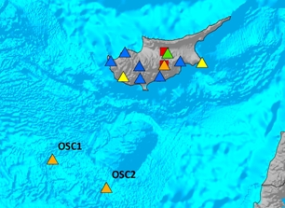
INTRODUCTION / BACKGROUND INFORMATION
  Real-time seismic data sharing
  The national seismic network of Cyprus is streaming data in real-time to the NEAMTWS via the
  Hellenic and Italian National Tsunami Warning Centres.
  Cyprus Civil Defense (24/7)
  National Focal Point of Cyprus receiving tsunami warnings from Greece, Italy and Turkey:

Slide 5
COMMUNITY COASTAL SEA LEVEL HAZARD EARLY WARNING AND MITIGATION SYSTEM CONTEXT/ STATUS (CON’T)
(i) Risk Knowledge and Communication Strategies
Is there any baseline knowledge, methods, tools and practices concerning sea level coastal hazard risk perceptions and risk communication strategies within the nominated community Cyprus?
Since no community is chosen yet, the issues will be addressed for Cyprus in general.
 |  | PROVIDE AN IDEA OF EXISTING KNOWLEDGE ETC, ON SEA LEVEL COASTAL HAZARD RISK PERCEPTIONS AND COMMUNICATION STRATEGIES WITHIN THE LOCAL COMMUNITY [none/lacking/some ] | NEEDS
I | Tsunami | Hazard knowledge: SOME Most Relevant is National Plan for Destructive Earthquakes | Update tsunami hazard information. Update the National Plan of EQ for Tsunami elements.
2 | Storm Surge | NATIONAL PLAN FOR EXTREME WEATHER PHENOMENA
3 | Sea Level Rise | NOT AN IMPORTANT HAZARD FOR CYPRUS

Slide 6
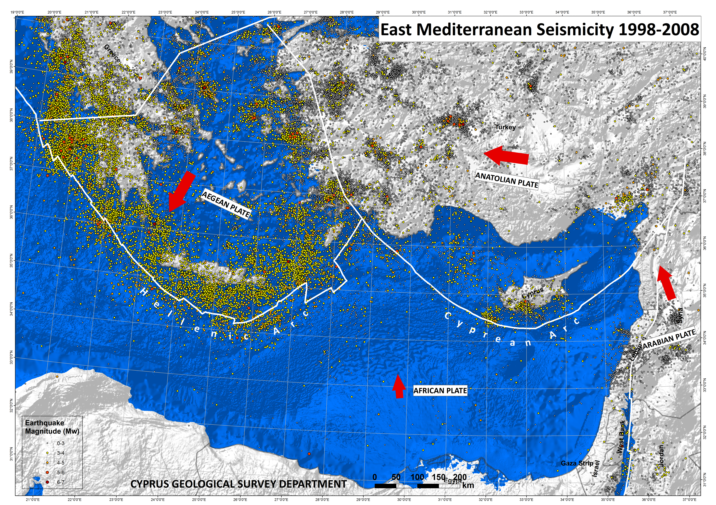

COMMUNITY COASTAL SEA LEVEL HAZARD EARLY WARNING AND MITIGATION SYSTEM CONTEXT/ STATUS (CON’T)
  LOCAL TSUNAMI
  1. Natural Warning Signs:
  Earthquake - tremors
  Quick change (usually drop) of sea-level
  2. Tsunami Warning System
  DISTANT TSUNAMI
  1. Tsunami Warning System
  2. Natural Warning Signs
  (quick change of sea-level)
Statistical analysis of historic data
Tsunami intensity | Wave height (m) | Repeat Period (years)
Moderate | < 1 | 30
Strong | ≥ 1 | 120
Very Strong | ≥ 4 | 375
Tsunami sources affecting Cyprus:
Local, strong, shallow earthquakes.
Submarine landslides at the Levantine coast
Regional, strong, shallow earthquakes.
(Fokaefs & Papadopoulos, 2007)
Notes:
There are 3 tsunami sources that affect Cyprus …
A statistical analysis of historic data shows that in the Cyprus-Levantine area we expect a very strong tsunami every a few hundred ys, a strong every 100 ys and a moderate tsunami, every few decades. However, historic data do not include all tsunami events of Cyprus.

Slide 7
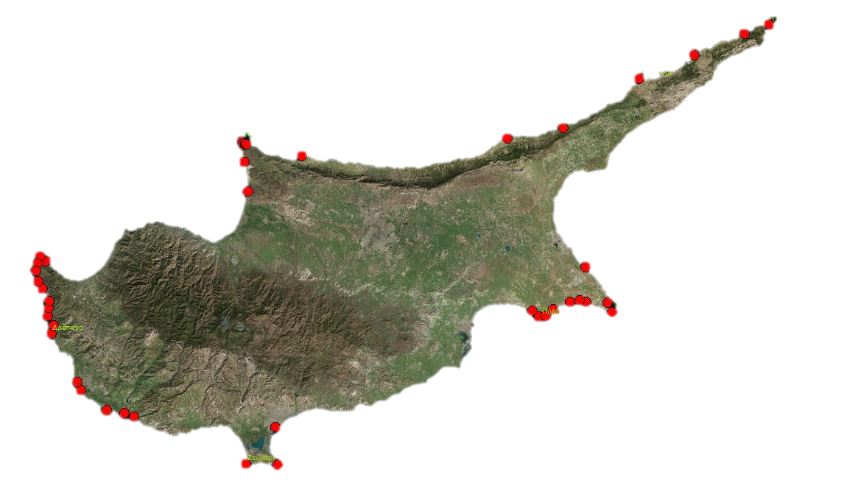
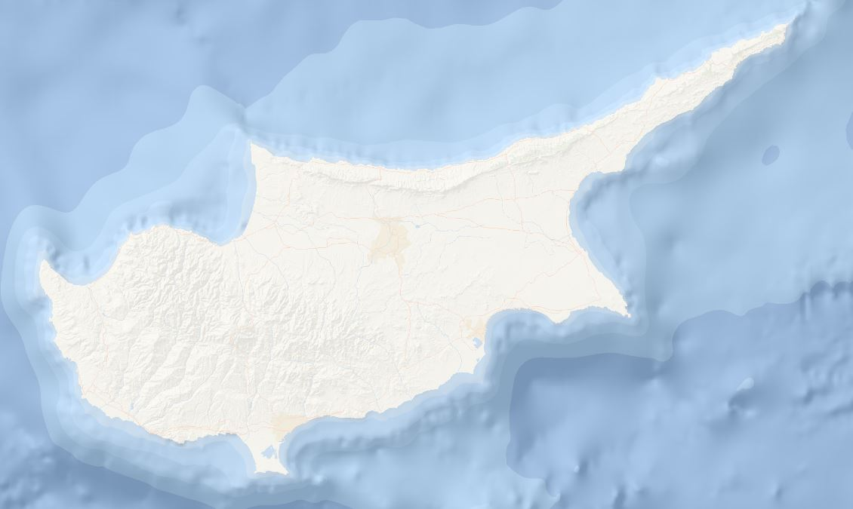
COMMUNITY COASTAL SEA LEVEL HAZARD EARLY WARNING AND MITIGATION SYSTEM CONTEXT/ STATUS (CON’T)
Tsunami evidence in Cyprus from Geomorphology
(Noller et al., 2005, 2011)
Dating of tsunami deposits is pending…
→ more complete assessment of the tsunami hazard
Notes:
For a more complete assessment of the hazard, the tsunami deposits found in Cyprus at the shown locations, must be analyzed and dated.

Slide 8
COMMUNITY COASTAL SEA LEVEL HAZARD EARLY WARNING AND MITIGATION SYSTEM CONTEXT/ STATUS (CON’T)
 |  | PROVIDE AN IDEA OF EXISTING CAPACITY/CAPABILITY WITHIN THE LOCAL COMMUNITY [Non-existence/ lacking/ available] | NEEDS
I | Detection | Non-existent locally in Cyprus
1 | Monitoring (e.g. IDSL) | Available nationally (national sea-level network in operation)
2 | Warning / Forecast | Non-existent locally in Cyprus (TWFP receives warnings from TWCs of NEAMTWS)
3 | Communication & Dissemination | Not available nationally at the moment
4 | Preparedness and Response | Not available nationally at the moment
(ii) Early Warning and Mitigation System Status
What is the status of early warning and mitigation system (detection, monitoring, analysis, warning, communication, dissemination and response) for tsunami within the nominated community in Cyprus?
What is the current status of the Joint Research Centre (JRC) Inexpensive Device for Sea Level Measurements (IDSL) stations (if any) ? (Operating? Any Issues?)
Since no community is chosen yet, the issues will be addressed for Cyprus in general.

Slide 9
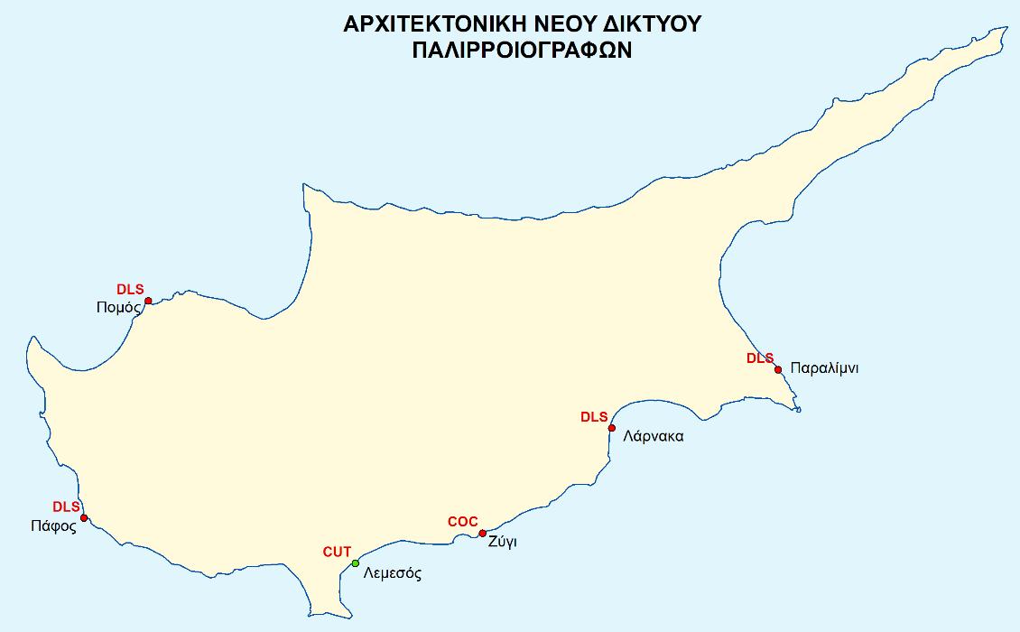
COMMUNITY COASTAL SEA LEVEL HAZARD EARLY WARNING AND MITIGATION SYSTEM CONTEXT/ STATUS (CON’T)
CYPRUS SEA-LEVEL NETWORK
Currently comprised of 6 stations, owned by national stakeholders and partners of this project team.

Slide 10
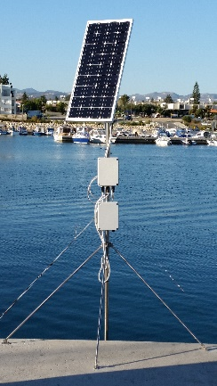
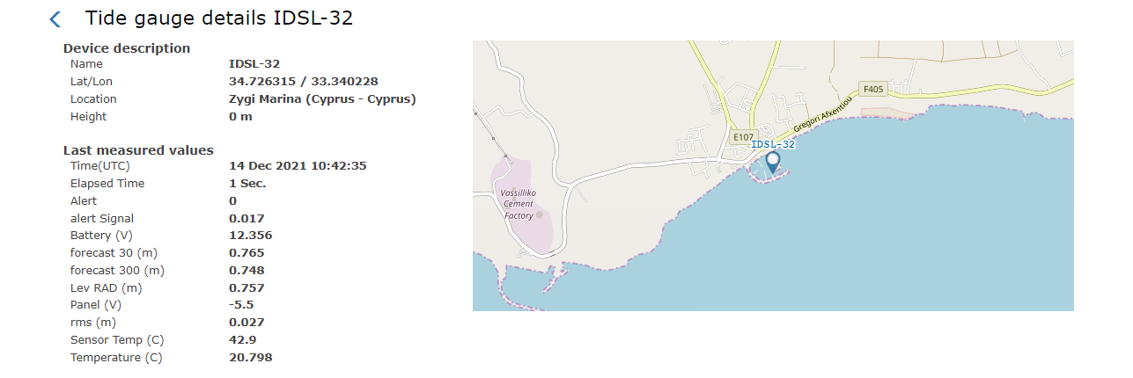
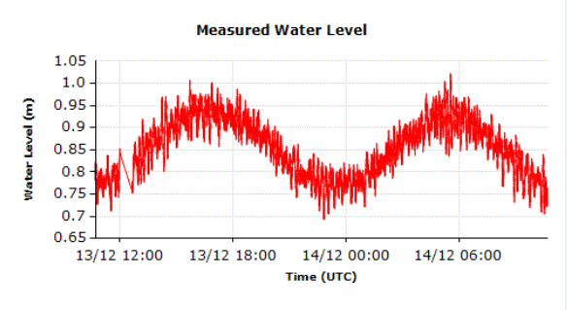
COMMUNITY COASTAL SEA LEVEL HAZARD EARLY WARNING AND MITIGATION SYSTEM CONTEXT/ STATUS (CON’T)
(ii) Early Warning and Mitigation System Status
The University of Cyprus owns and operates an IDSL station in Zygi (south coast), which is functioning without any major issues.
The station is connected to the Early Tsunami Warning System via JRC.
https://webcritech.jrc.ec.europa.eu/TAD_server/Device/130

Slide 11
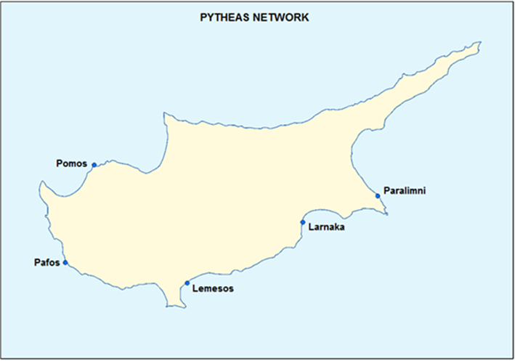
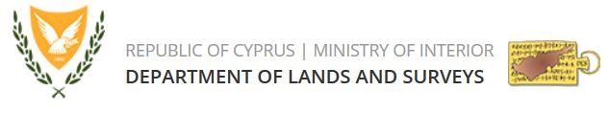
COMMUNITY COASTAL SEA LEVEL HAZARD EARLY WARNING AND MITIGATION SYSTEM CONTEXT/ STATUS (CON’T)
(ii) Early Warning and Mitigation System Status:
The Department of Lands and Surveys (DLS) has recently established a national tide-gauge network (PYTHEAS), to support:
the tsunami warning system, and
the establishment of a Vertical Reference System to support hydrographic activities.
The network is fully operational and consists of five stations, four of which are owned by the DLS and one is owned by CUT. The stations are positioned approximately 40 km apart.

Slide 12
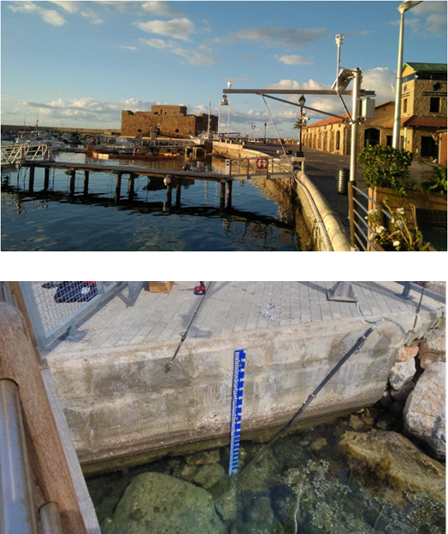
COMMUNITY COASTAL SEA LEVEL HAZARD EARLY WARNING AND MITIGATION SYSTEM CONTEXT/ STATUS (CON’T)
(ii) Early Warning and Mitigation System Status:
The five stations of PYTHEAS are equipped with:
GNSS permanent stations
Sea level sensors
Sea water temperature sensors
Meteorological sensors for wind direction & speed, air temperature, relative humidity, barometric pressure.
The PYTHEAS stations HAVE NOT yet been connected with the Early Tsunami Warning System via JRC.
We hope for implementation through this project.

Slide 13
COMMUNITY COASTAL SEA LEVEL HAZARD EARLY WARNING AND MITIGATION SYSTEM CONTEXT/ STATUS (CON’T)
UNESCO IOC TSUNAMI READY INDICATORS |  | PROVIDE AN IDEA OF EXISTING CAPACITY AT THE NOMINATED COMMUNITY
I | ASSESSMENT (ASSESS)
1 | ASSESS-1. Tsunami hazard zones are mapped and designated | NONE
2 | ASSESS-2. The number of people at risk in the tsunami hazard zone is estimated | NONE
3 | ASSESS-3. Economic, infrastructural, political, and social resources are identified | NONE
II | PREPAREDNESS (PREP)
4 | PREP‑1. Easily understood tsunami evacuation maps are approved | NONE
5 | PREP‑2. Tsunami information is publicly displayed | NONE
6 | PREP‑2. Outreach and public awareness and education resources are available and distributed | ONGOING ACTIVITY (Yearly - Tsunami Awareness Day) Organize events, inform the public via the Media (through interviews, talks, articles, press releases)
7 | PREP‑3. Outreach or educational activities are held at least three times a year | NONE
8 | PREP‑4: A community tsunami exercise is conducted at least every two years | NONE
III | RESPONSE (RESP)
9 | RESP-1. A community tsunami emergency response plan (ERP) is approved | NONE
10 | RESP-2. The capacity to manage emergency response operations during a tsunami is in place | NONE
11 | RESP-3. Redundant and reliable means to timely receive 24-hour official tsunami alerts are in place | NONE
12 | RESP-4. Redundant and reliable means to timely disseminate 24-hour official tsunami alerts to the public are in place | NONE
(iii) Status / Elements of Tsunami Ready in the proposed/nominated community site Cyprus?
Since no community is chosen yet, the issues will be addressed for Cyprus in general.
Are there any Tsunami Ready elements/indicators achieved in accordance to UNESCO IOC Tsunami Ready Indicators (See UNESCO IOC Tsunami Ready Indicators-(Latest Indicators-not published yet). What has been achieved earlier?
E.g. Tsunami Hazards are mapped and designated, Tsunami information displayed etc.

Slide 14
MATCHING NEEDS
UNESCO IOC TSUNAMI READY INDICATORS |  | PROVIDE AN IDEA OF EXISTING CAPACITY AT THE NOMINATED COMMUNITY [NONE/ ONGOING/ ACHIEVED] | NEEDS
I | ASSESSMENT (ASSESS) |  | YES
1 | ASSESS-1. Tsunami hazard zones are mapped and designated | NONE
2 | ASSESS-2. The number of people at risk in the tsunami hazard zone is estimated | NONE
3 | ASSESS-3. Economic, infrastructural, political, and social resources are identified | NONE
II | PREPAREDNESS (PREP)
4 | PREP‑1. Easily understood tsunami evacuation maps are approved | NONE
5 | PREP‑2. Tsunami information is publicly displayed | NONE
6 | PREP‑2. Outreach and public awareness and education resources are available and distributed | ONGOING (Tsunami Awareness Day)
7 | PREP‑3. Outreach or educational activities are held at least three times a year | NONE
8 | PREP‑4: A community tsunami exercise is conducted at least every two years | NONE
III | RESPONSE (RESP)
9 | RESP-1. A community tsunami emergency response plan (ERP) is approved | NONE
10 | RESP-2. The capacity to manage emergency response operations during a tsunami is in place | NONE
11 | RESP-3. Redundant and reliable means to timely receive 24-hour official tsunami alerts are in place | NONE
12 | RESP-4. Redundant and reliable means to timely disseminate 24-hour official tsunami alerts to the public are in place | NONE
What are the needs to establish the full cycle of Tsunami Ready Recognized Community?
Where can we focus and intensify project efforts (in reference to project activities)?
We need a lot of support in all relevant activities!

Slide 15
Project Kick-Off Workshop
IOC EU ECHO NEAMTWS
17 & 20 December 2021
Strengthening the Resilience of Coastal Communities in the North East Atlantic, Mediterranean Region to the Impact of Tsunamis and Other Sea Level-Related Coastal Hazards Project
Thank you!
Cyprus NEAMTWS National Committee,
partners & stakeholders of project

