Slide 1
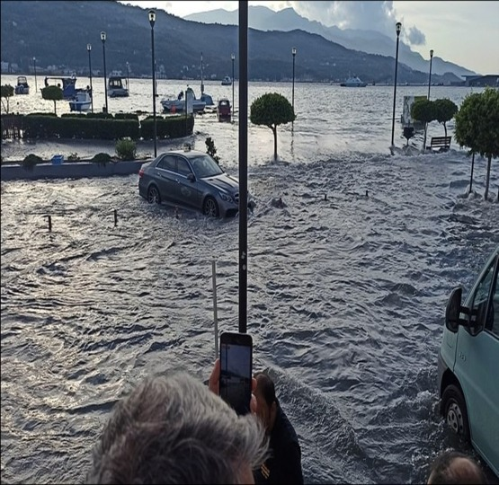


Alessandro Amato
Istituto Nazionale di Geofisica e Vulcanologia, Italy
CAT-INGV
From earthquake monitoring to tsunami warning in the Mediterranean Sea
WTAD 2021 / 8 November 2021 – NIOF-EGYPT

Slide 2

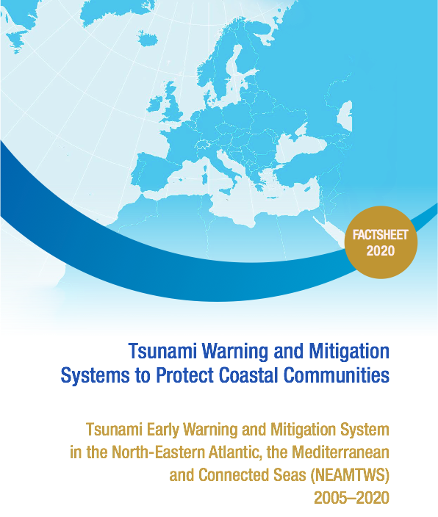
NEAMTWS in a nutshell: from 2005 to 2020
The Intergovernmental Coordination Group for the Tsunami Early Warning and Mitigation System in the North-eastern Atlantic, the Mediterranean and connected seas (ICG/NEAMTWS) was formed in response to the tragic tsunami on 26 December 2004, in which over 250,000 lives were lost around the Indian Ocean region. The Intergovernmental Oceanographic Commission of UNESCO (IOC-UNESCO) received a mandate from the international community to coordinate the establishment of the System.
WTAD 2021 / 8 November 2021 – NIOF-EGYPT
Notes:
for about 15 years we have been building the NEAMTWS

Slide 3
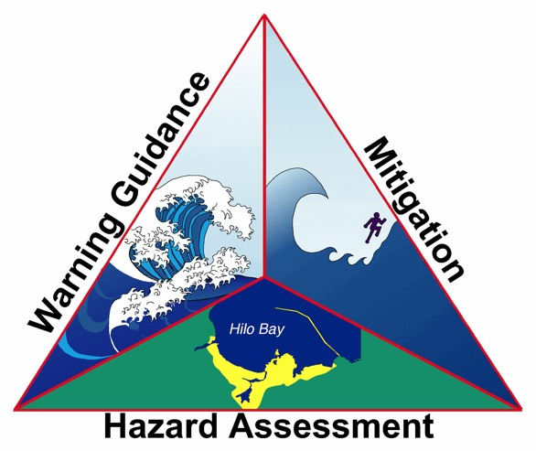
NEAMTWS in a nutshell: from 2005 to 2020
The 3 Faces of Tsunami Early Warning and Mitigation: Early Warning, Risk-informed Coastal Planning, Awareness and Preparedness
WTAD 2021 / 8 November 2021 – NIOF-EGYPT
Notes:
The guiding principles

Slide 4
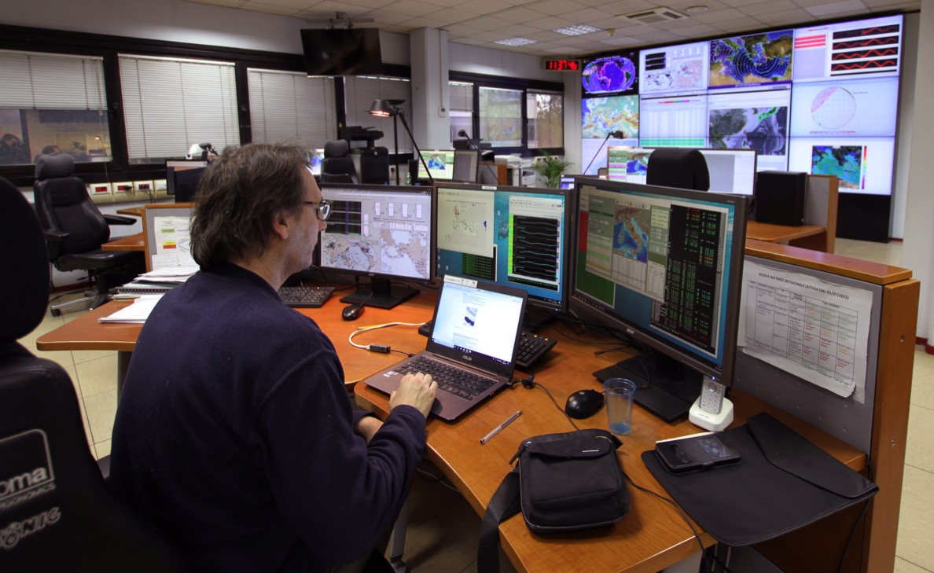
CAT-INGV in the monitoring room @ INGV
- First message in max 14’
- 70 researchers/ IT H24/7
- 7 experts on call

Slide 5
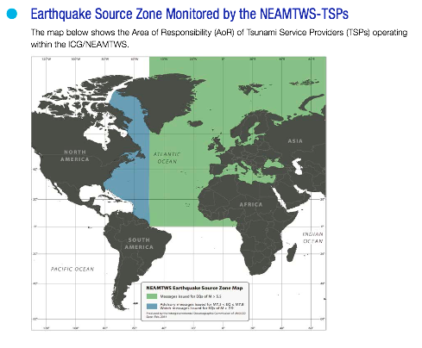
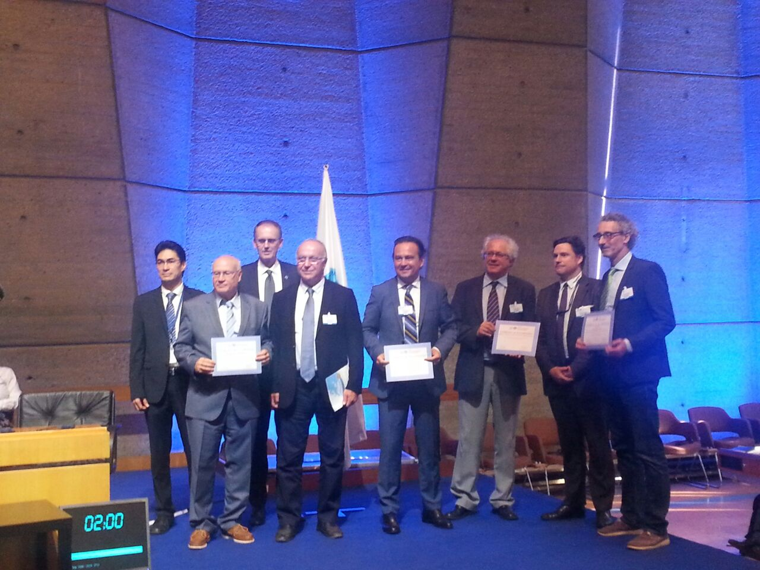
NEAMTWS in a nutshell: from 2005 to 2020
A substantial and successful effort from IOC/UNESCO Member States
(involves infrastructure, legal framework, organizational effort, cutting-edge scientific research, technological development...)
5 Accredited Tsunami Service Providers:
IPMA, Portugal
CENALT, France
INGV, Italy
NOA, Greece
KOERI, Turkey
WTAD 2021 / 8 November 2021 – NIOF-EGYPT
Notes:
The accreditation

Slide 6
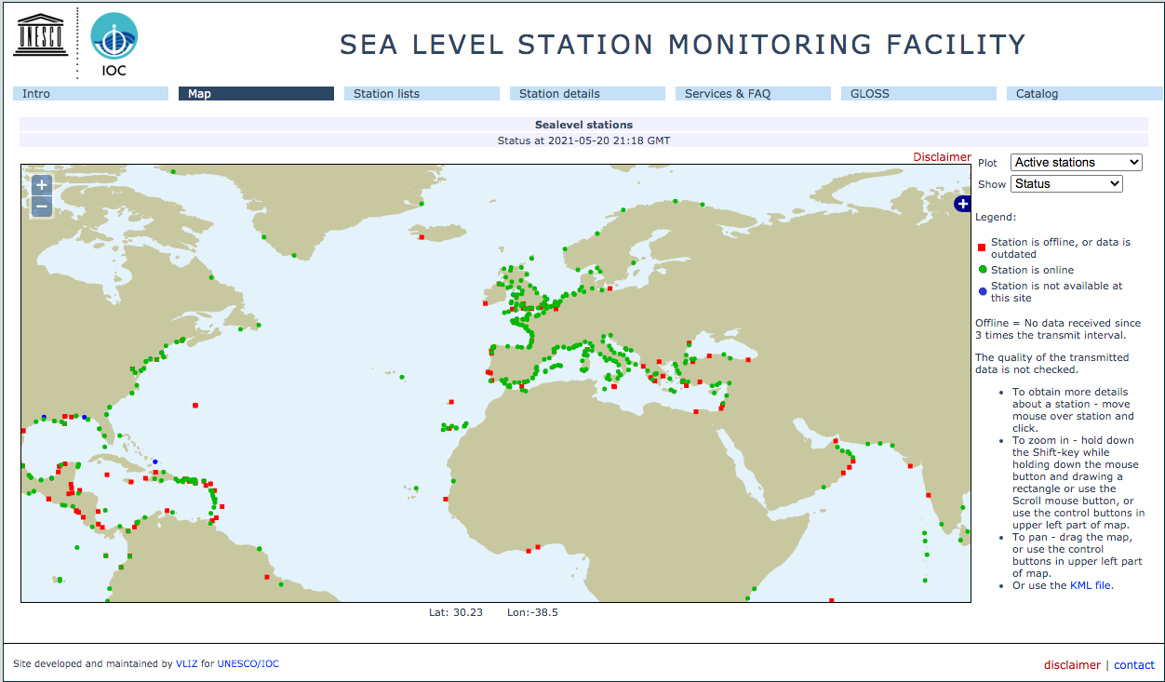
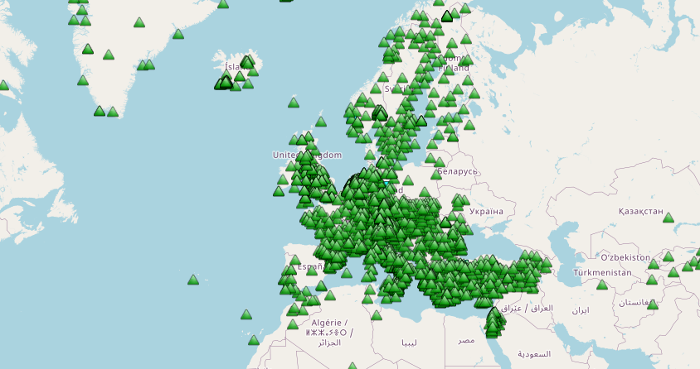

NEAMTWS elements: the upstream warning component
GAPS
There’s a gap in (seismic and sea level) instrumental coverage to the South
Seismometers only: Real time GNSS data are not yet in the system (NOA-INGV network is being integrated)
Coastal gauges only: offshore cabled and deep sea pressure sensors not yet existing or integrated in the system (cabled sensors planned offshore eastern Sicily)
Working towards TSPs Interoperability
The warning is based on Seismic detection and characterization; sea level data used for confirmation/cancellation
WTAD 2021 / 8 November 2021 – NIOF-EGYPT
Notes:
Monitoring

Slide 7
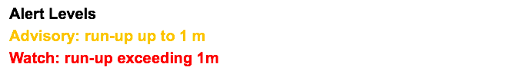
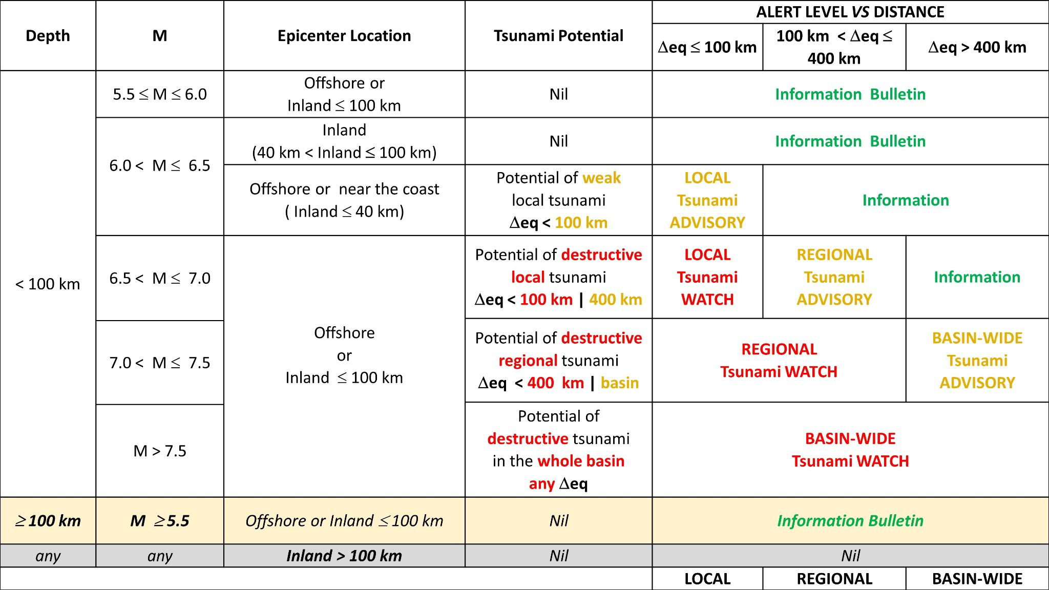
NEAMTWS elements: the upstream warning component
GAPS
Implicit, simplistic and worst-case oriented (prone to false alarms)
Neglects source and bathymetry tsunami directivity effects (missed alarms are still possible!)
Mixes tsunami forecasting with tsunami warning (not a transparent balance and confusion of roles)
Decision Matrix (for M>=5.5):
From earthquake parameters - Magnitude - hypocentral location
--->
Alert levels - Watch (land threat), Advisory (coastal and marine threat)
WTAD 2021 / 8 November 2021 – NIOF-EGYPT
Notes:
Forecasting and Alerting

Slide 8
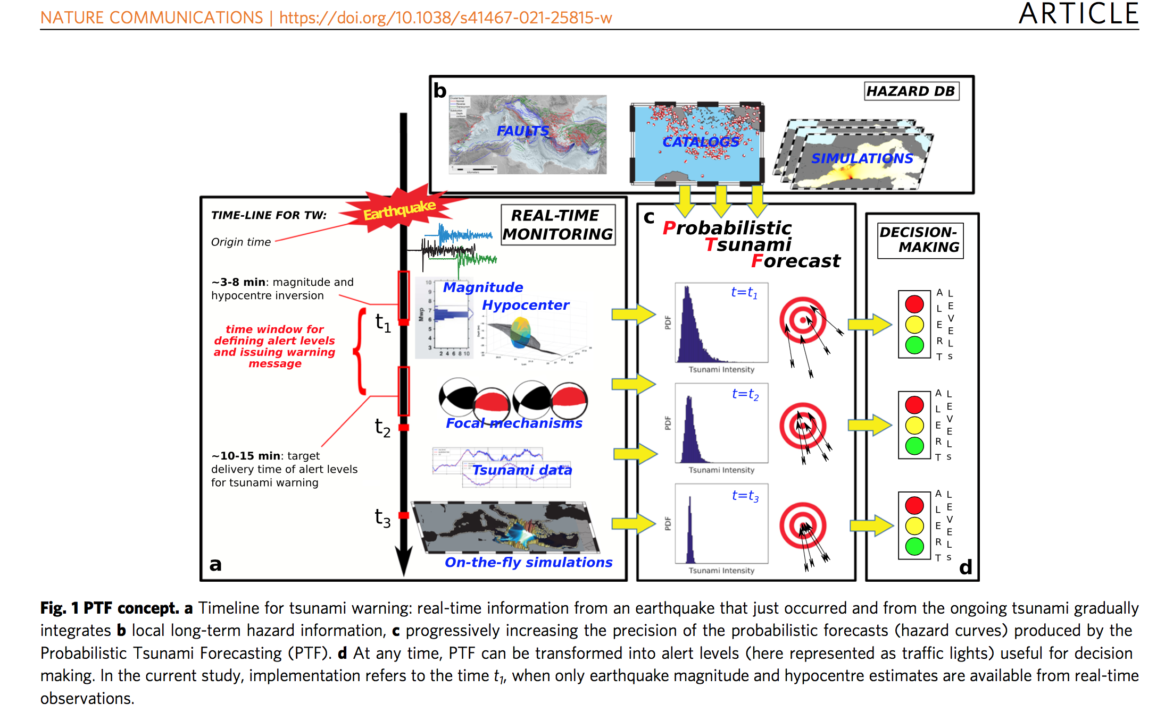
Probabilistic Tsunami Forecast (Selva et al., 2021)

Slide 9
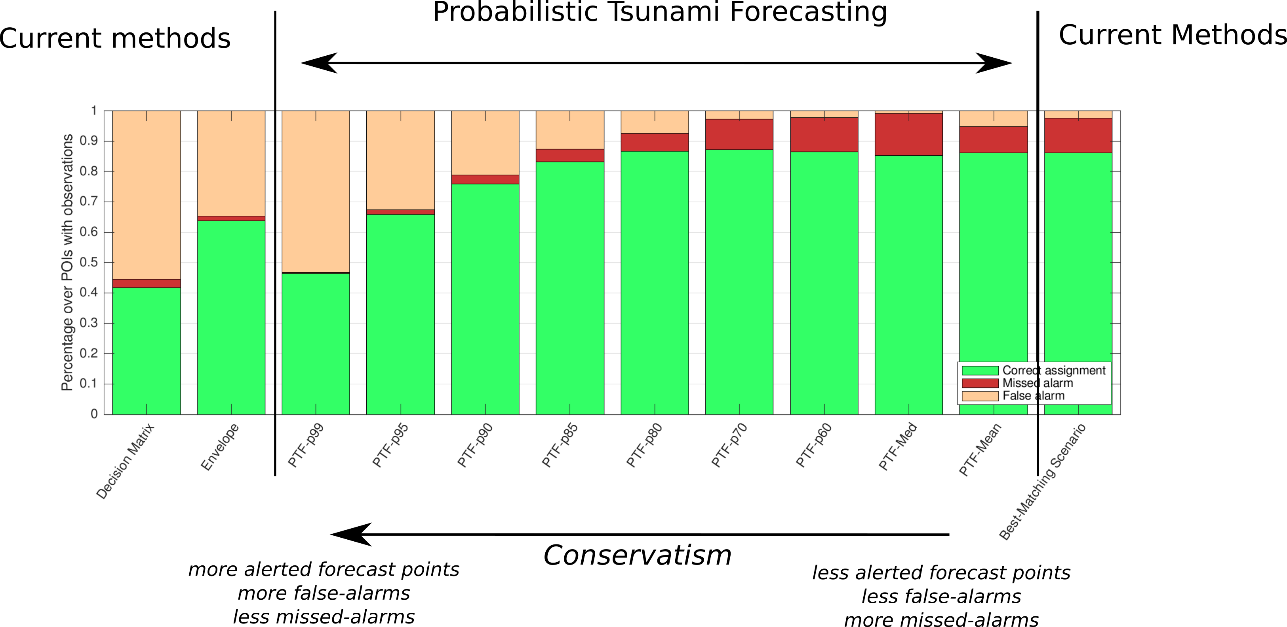
Probabilistic Tsunami Forecast (Selva et al., 2021)

Slide 10
NEAMTWS elements: the upstream warning component
21 CAT-INGV Activations 2017-2021 - Mw between 5.6-7.0 - Messages between 7-10 minutes
Modified from: Amato et al., 2021
WTAD 2021 / 8 November 2021 – NIOF-EGYPT
Notes:
NEAMTWS Activations

Slide 11
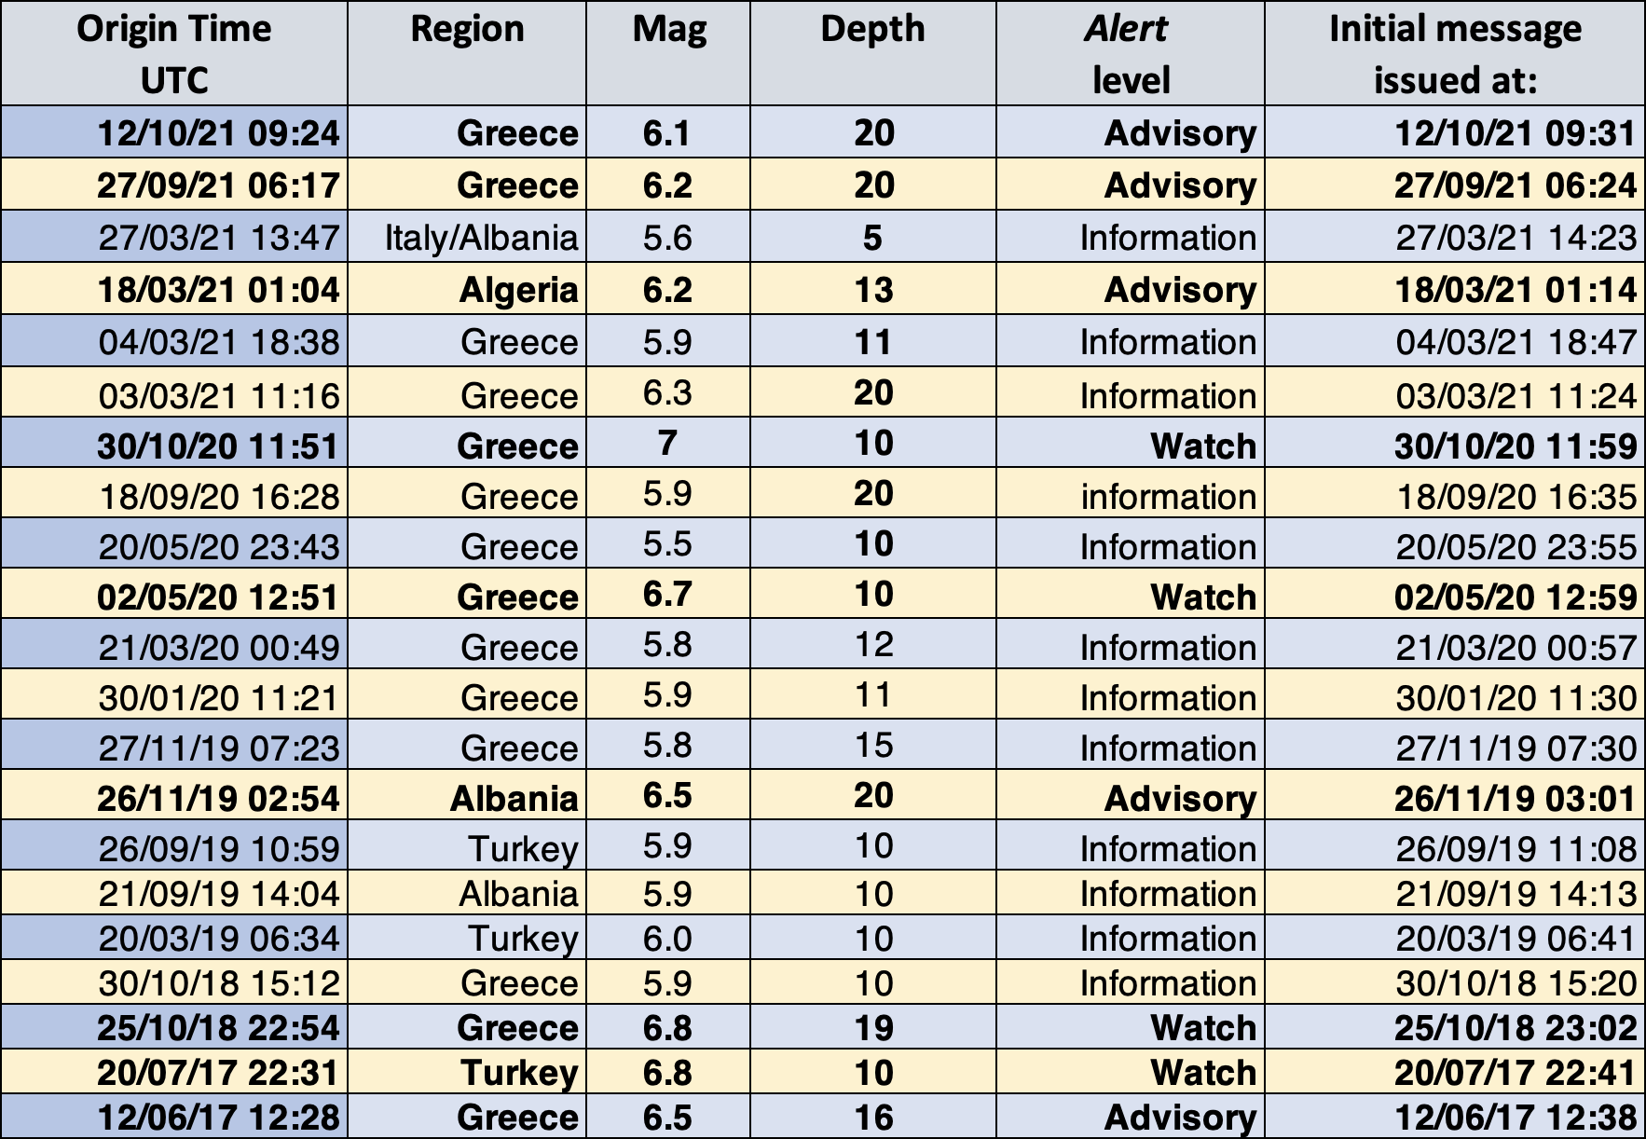
Mediterranean earthquakes that triggered CAT-INGV
WTAD 2021 / 8 November 2021 – NIOF-EGYPT

Slide 12
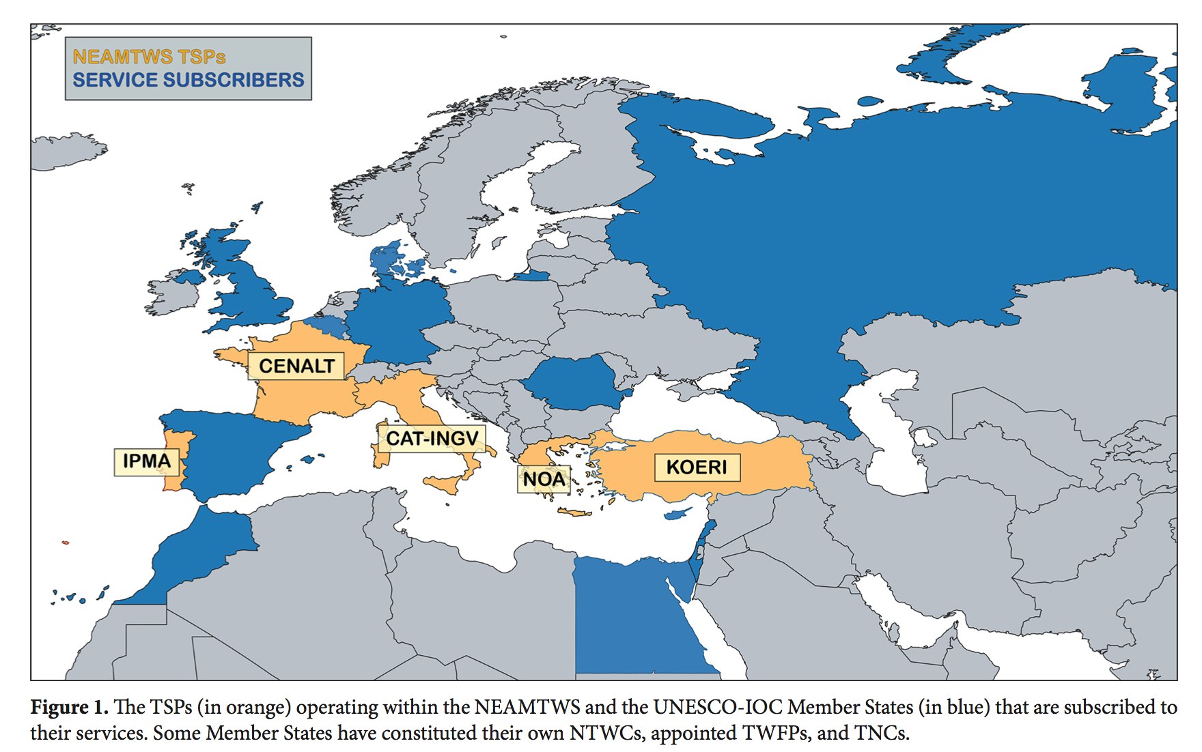
WTAD 2021 / 8 November 2021 – NIOF-EGYPT

Slide 13
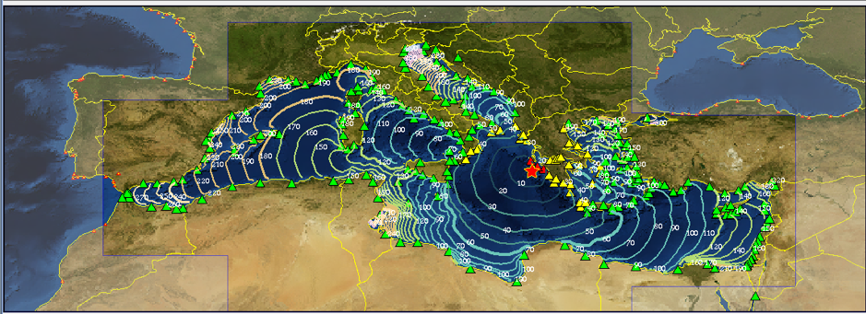
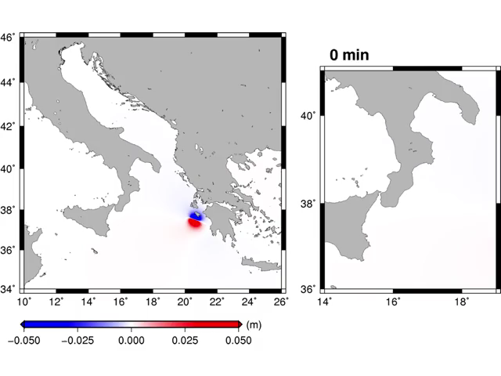
Zakynthos 2018
TSUNAMI MESSAGE NUMBER 001
NEAM INGV IT-NTWC TSUNAMI SERVICE PROVIDER
ISSUED AT 2302Z 25 OCT 2018
... TSUNAMI WATCH ...
THIS ALERT APPLIES TO GREECE
... TSUNAMI ADVISORY ...
THIS ALERT APPLIES TO ALBANIA ... GREECE ... ITALY
... TSUNAMI INFORMATION ...
THIS ALERT APPLIES TO ALBANIA ... ALGERIA ... BOSNIA_HERZEGOVINA ... CROATIA ... CYPRUS ... EGYPT ... FRANCE ... GREECE ... ISRAEL ... ITALY ... LEBANON ... LIBYA ... MALTA ... MONACO ... MONTENEGRO ...
MOROCCO ... SLOVENIA ... SPAIN ... SYRIA ... TUNISIA ... TURKEY ... UK
THIS ALERT IS ADDRESSED TO ALL COUNTRIES AND INSTITUTIONS SUBSCRIBED
TO THE SERVICES OF INGV TSP IN ITS MONITORING AREA
THIS MESSAGE IS ISSUED AS ADVICE TO GOVERNMENT AGENCIES. ONLY
NATIONAL AND LOCAL GOVERNMENT AGENCIES HAVE THE AUTHORITY TO MAKE
DECISIONS REGARDING THE OFFICIAL STATE OF ALERT IN THEIR AREA AND ANY
ACTIONS TO BE TAKEN IN RESPONSE.
AN EARTHQUAKE HAS OCCURRED WITH THESE PRELIMINARY PARAMETERS
ORIGIN TIME - 2254Z 25 OCT 2018
COORDINATES - 37.49 NORTH 20.54 EAST
DEPTH - 19 KM
LOCATION - COSTA_OCCIDENTALE_PELOPONNESO_GRECIA
MAGNITUDE - 6.8
23:02 Primo messaggio di allerta del CAT-INGV
22:54 TERREMOTO M6.8
a ZANTE

Slide 14
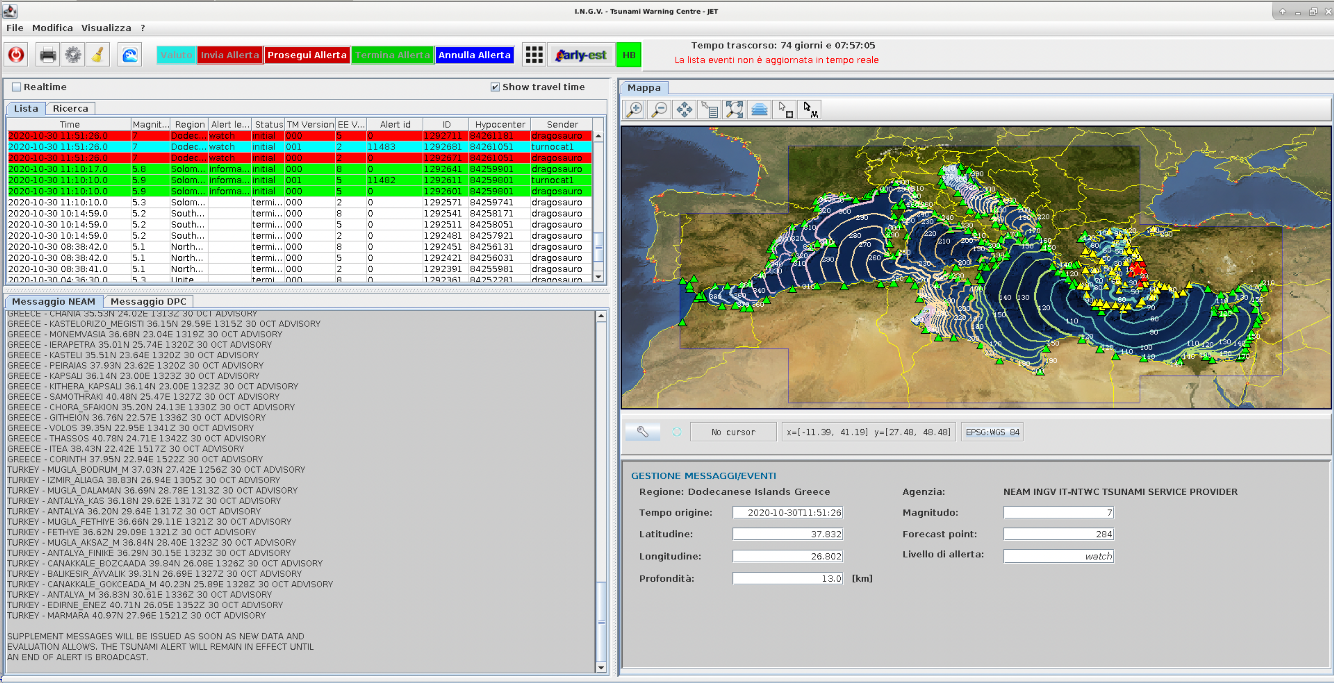
NEAMTWS elements: the upstream warning component
Alert for the 30 October 2020 Samos Earthquake and Tsunami:
Local Watch Alert after 8 minutes; Tsunami exceeded 2 m, (Dogan et al., PAGEOPH, 2021)
WTAD 2021 / 8 November 2021 – NIOF-EGYPT
Notes:
The Samos earthquake

Slide 15
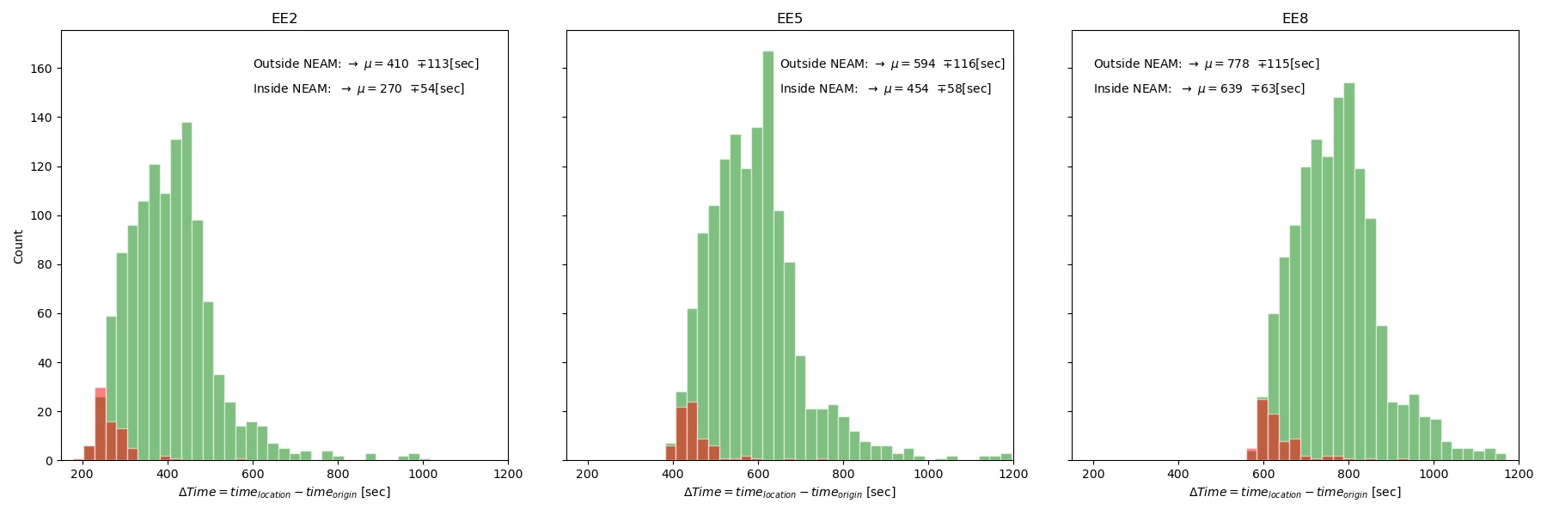
Rapidity vs. Uncertainty
-0.2
+0.2
Magnitude
Location
time
WTAD 2021 / 8 November 2021 – NIOF-EGYPT

Slide 16
Tsunami Hazard and inundation zones
WTAD 2021 / 8 November 2021 – NIOF-EGYPT

Slide 17
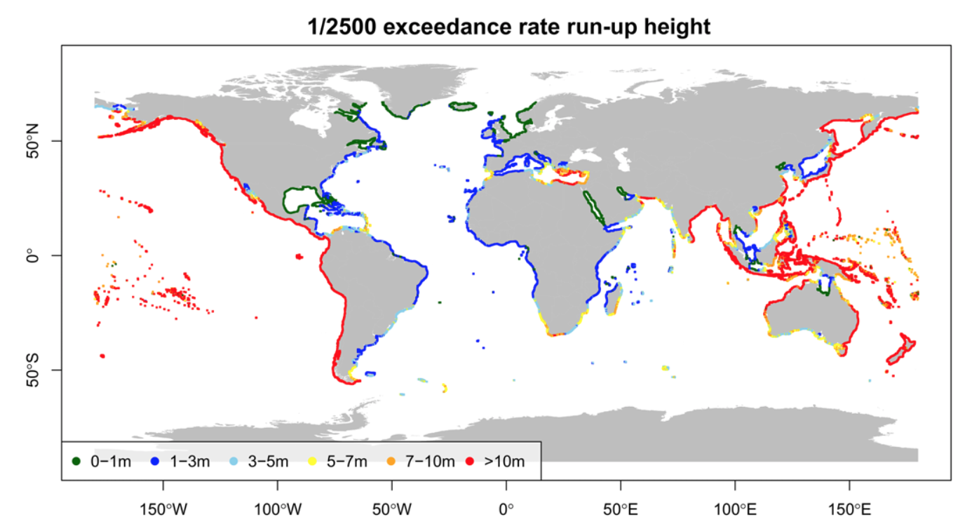
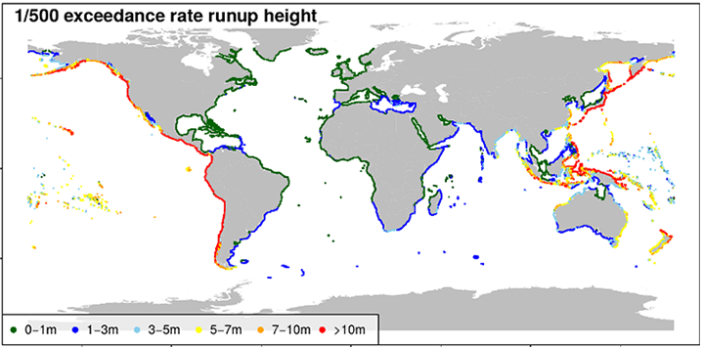
Hazard modelling and mapping across scales
Davies et al., 2018
Included in GAR UNDRR Multi-hazard Risk Assessment
WTAD 2021 / 8 November 2021 – NIOF-EGYPT
Notes:
Global scale

Slide 18
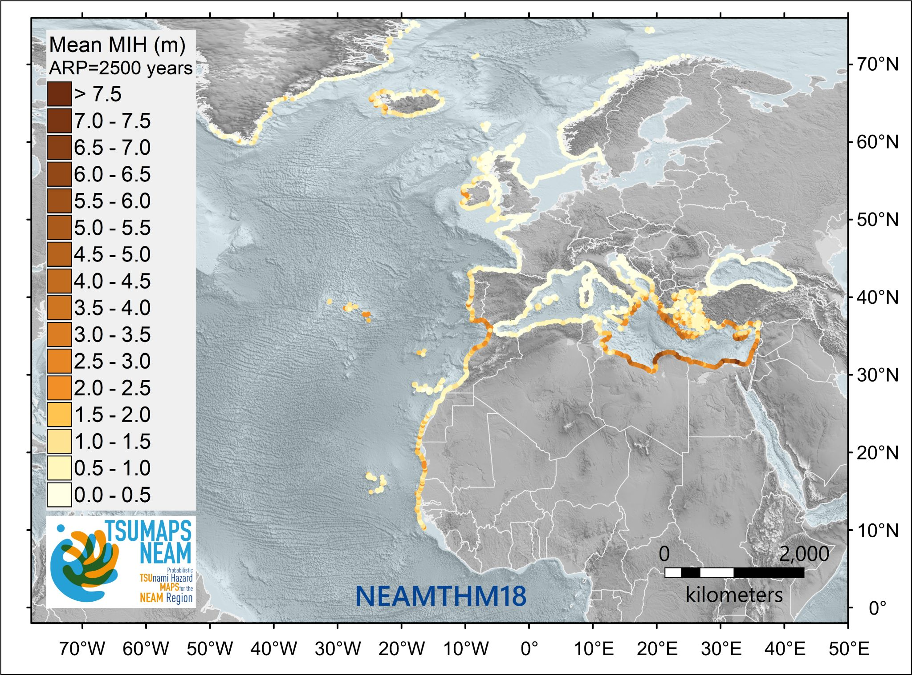
Hazard modelling and mapping across scales
Basili et al., 2019, 2021 – TSUMAPS-NEAM - http://www.tsumaps-neam.eu
Funded by DG-ECHO; NEAMTWS Reference, being used as a basis for homogenous planning and as a driver for the prioritization of local assessments
WTAD 2021 / 8 November 2021 – NIOF-EGYPT
Notes:
NEAM - Regional scale

Slide 19
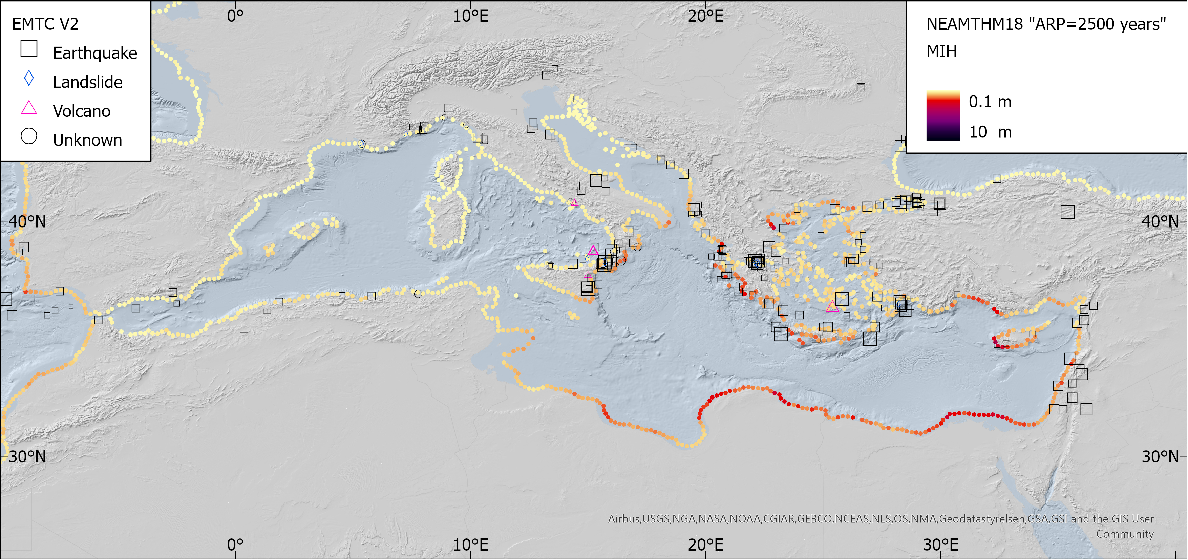
Tsunami Hazard (S- PTHA) in the Mediterranean
http://www.tsumaps-neam.eu
WTAD 2021 / 8 November 2021 – NIOF-EGYPT

Slide 20
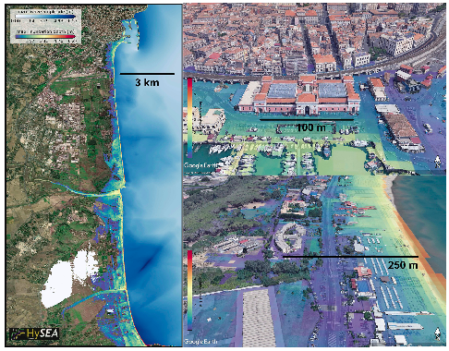

Hazard modelling and mapping across scales
Gibbons et al., 2020
Pilot Demonstrator Workflows in ChEESE,
Center of Excellence for Exascale Supercomputing in the area of Solid Earth
WTAD 2021 / 8 November 2021 – NIOF-EGYPT
Notes:
Local Scale

Slide 21
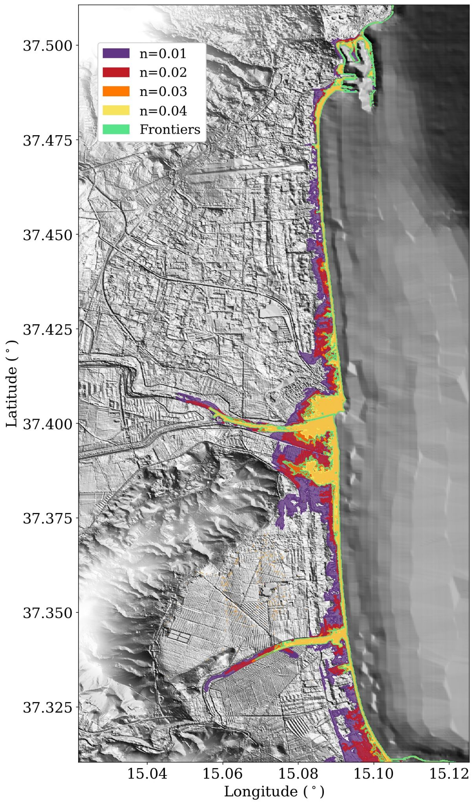
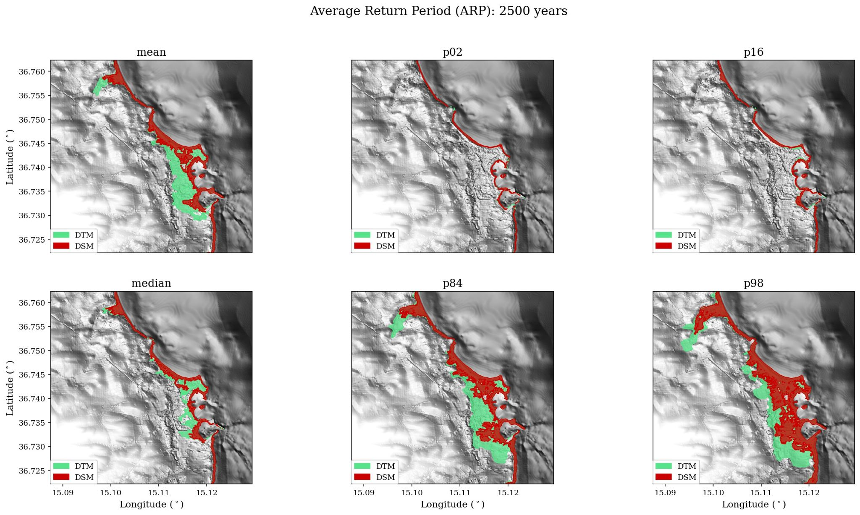
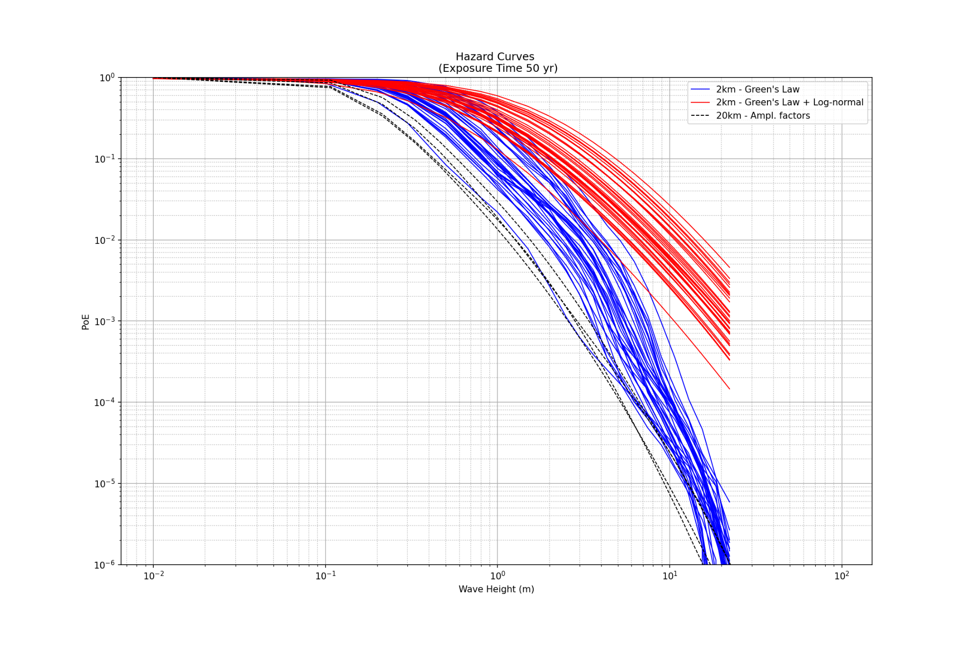
Uncertainty
GAPS
Tsunamis are rare, sparse evidence: rely on source probability from short catalogues
Lack of understanding (e.g. frequency) of tsunami earthquakes and non-seismic sources
High-resolution near-coast bathymetry and topography availability
Computational resources
Uncertainty/Sensitivity of numerical models
WTAD 2021 / 8 November 2021 – NIOF-EGYPT
Notes:
Aleatory and Epistemic

Slide 22
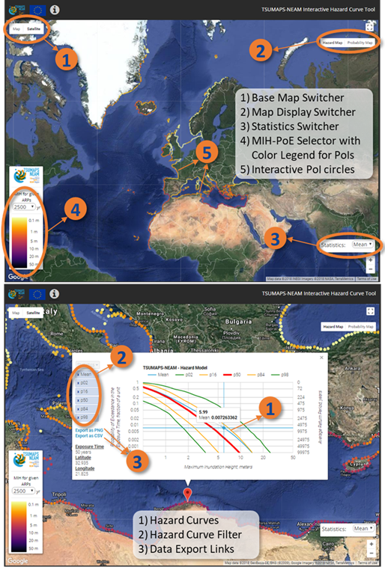
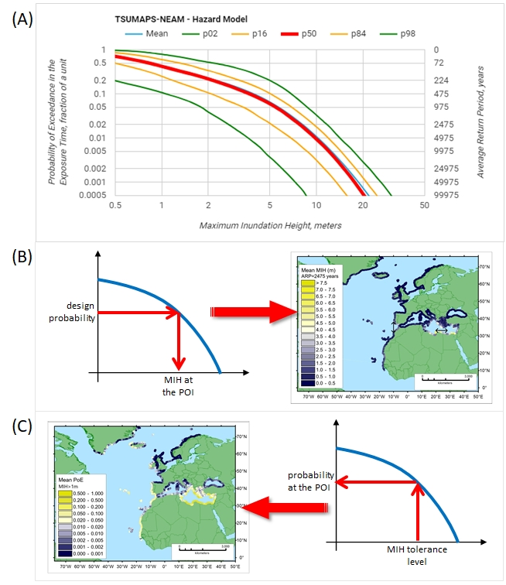
Hazard Curves
NEAMTHM18
WTAD 2021 / 8 November 2021 – NIOF-EGYPT
Notes:
What are they?

Slide 23
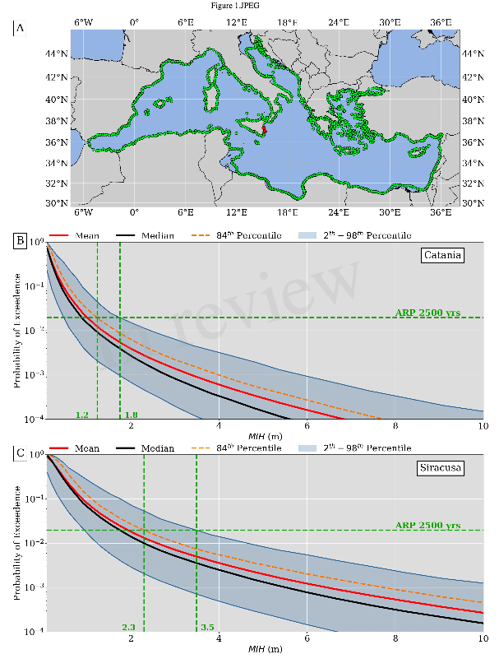

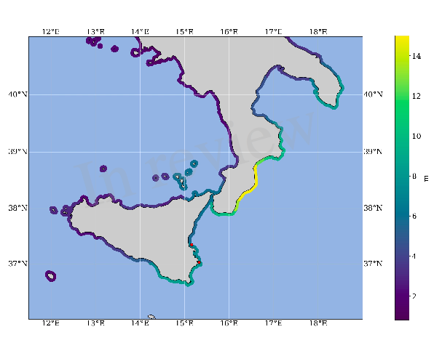
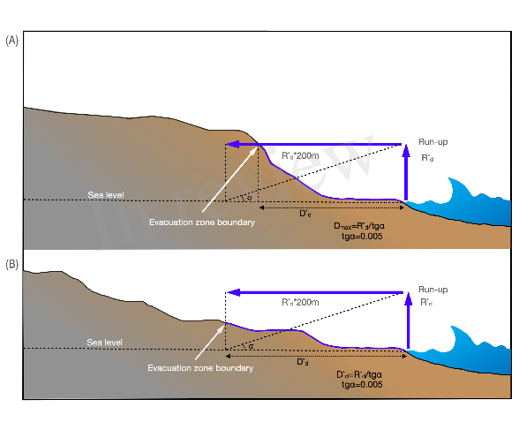
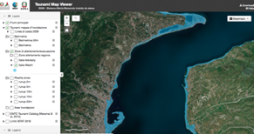
Inundation maps for Coastal Planning (including evacuation)
DirPC SiAM; DPC, 2018
Regional Hazard (NEAMTHM18)
2500 yr ARP + 84th percentile
Safety factors
Coastal dissipation
WTAD 2021 / 8 November 2021 – NIOF-EGYPT
Notes:
Dealing with / Communicating uncertainty

Slide 24
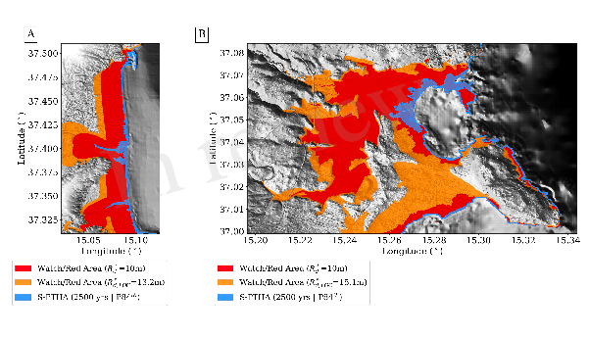
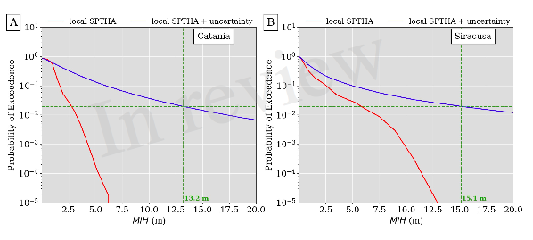
Inundation maps for Coastal Planning (including evacuation)
Tonini et al., 2020
Testing tsunami inundation maps
WTAD 2021 / 8 November 2021 – NIOF-EGYPT
Notes:
Double-checking

Slide 25
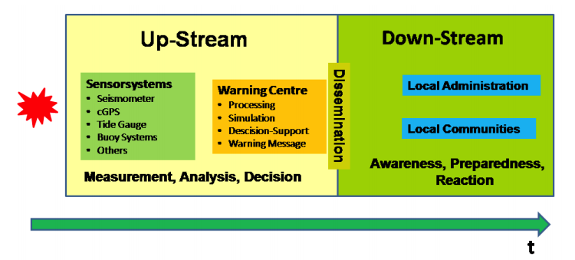
WTAD 2021 / 8 November 2021 – NIOF-EGYPT

Slide 26
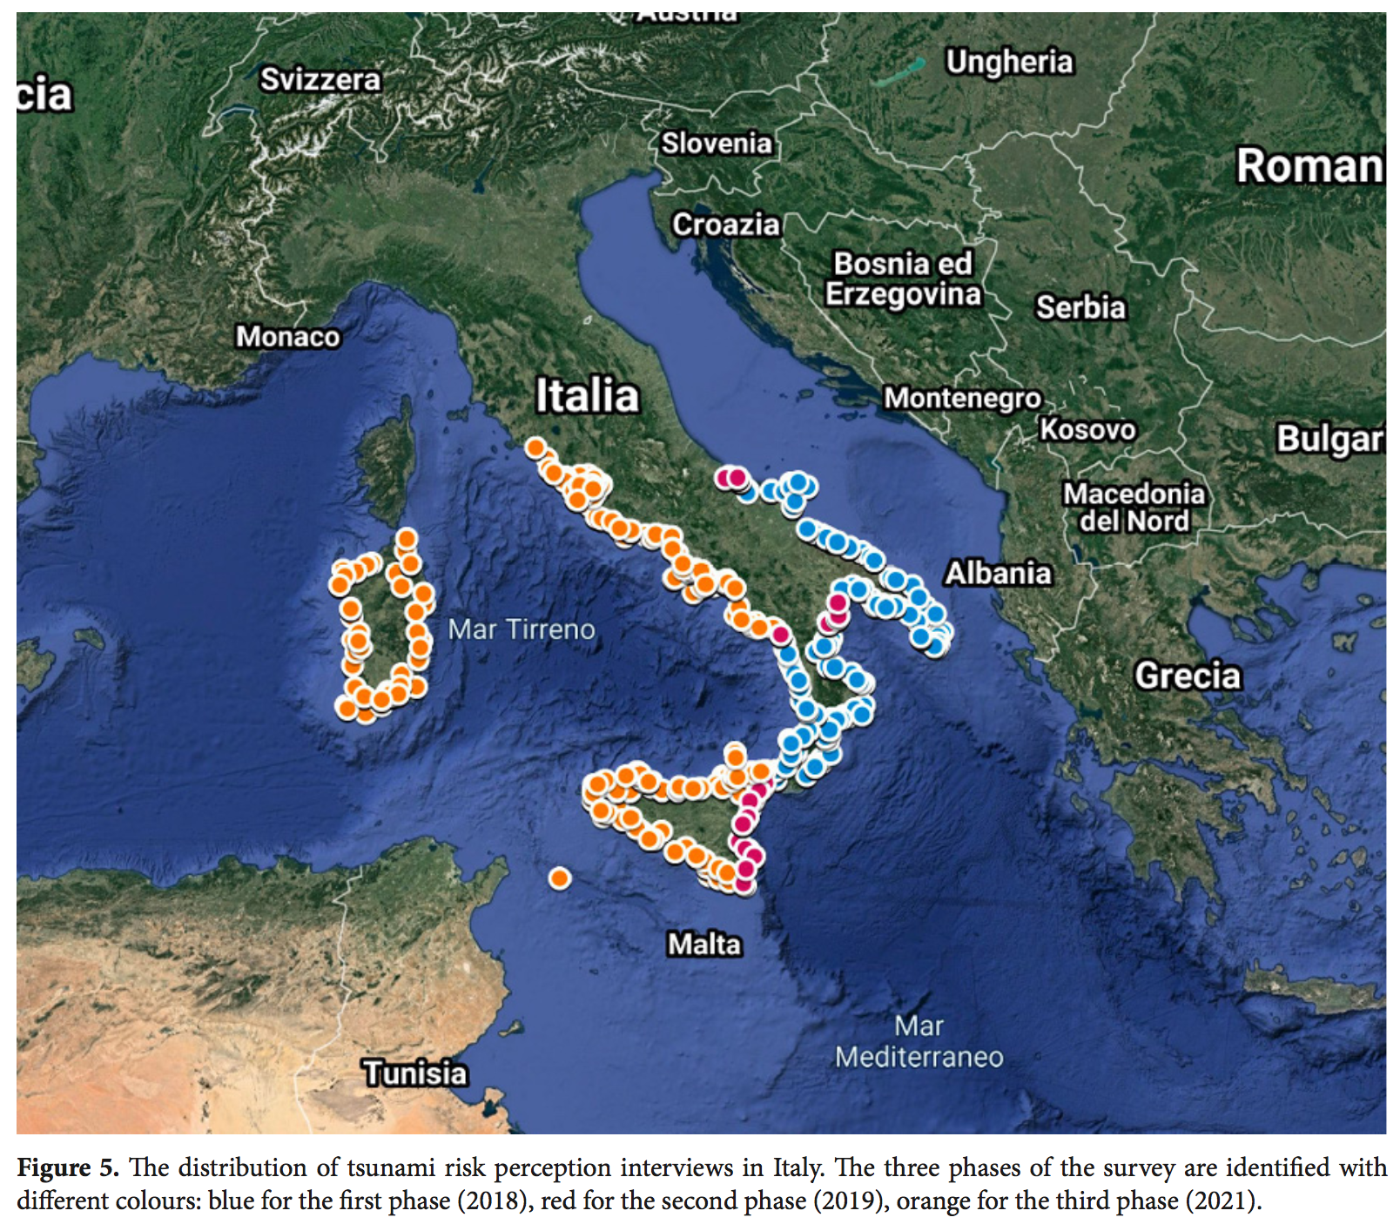
A social study on tsunami risk perception
3 phases: 2018-2019-2021
CaTi (Computer assisted Telephone interviewing)
1021 intervistati in 183 comuni costieri
Campione stratificato (rappr. ~3 miloini)
2019-2020: Sicilia est + Molise + Basilicata
2020-2021: Sicilia-Sardegna-Campania-Lazio
(A. Cerase, M. Crescimbene, F. La Longa, A. Amato, NHESS, 2019)
WTAD 2021 / 8 November 2021 – NIOF-EGYPT

Slide 27
Risk perception: Some indications from the first surveys
Risk perception is affected by memory (Calabria vs. Apulia), even of “old” events (e.g., 1908), by education, and other elements
Media images of big tsunamis affect people’s characterization of risk (underrating small, dangerous events! – more likely)
Different words with the same meaning (maremoto vs. tsunami) sound different for laypeople (language problem)
Broadcast and traditional media are still relevant as information sources and alert dissemination channels (TV, radio, sirens) - more than Internet
Interpersonal sources and social networks are very relevant for some processes and for some categories (elders, people with low education)
People have great expectations from authorities, civil protection and research institutions to face tsunami risk and manage early warning issues
WTAD 2021 / 8 November 2021 – NIOF-EGYPT

Slide 28
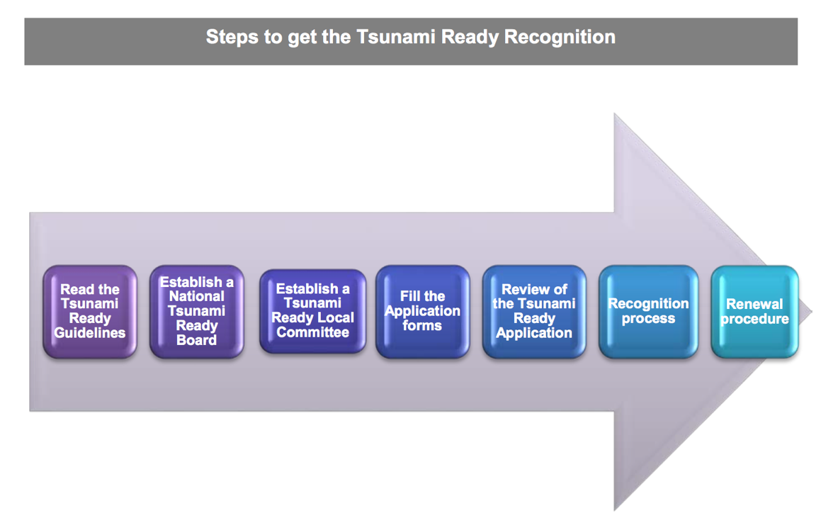



Mitigation and last mile activities/4: Tsunami Ready in Italy
- Italy nominated the first NTRB in NEAM region, May 2021
- Three Local TR Boards in 2021
WTAD 2021 / 8 November 2021 – NIOF-EGYPT

Slide 29

Tsunami Ready
 | TSUNAMI READY INDICATORS
 | Stage of achievement
I | ASSESSMENT (ASSESS)
1 | ASSESS-1. Tsunami hazard zones are mapped and designated
2 | ASSESS-2. The number of people at risk in the tsunami hazard zone is estimated
3 | ASSESS-3. Available economic, infrastructural, political, and social resources are identified
II | PREPAREDNESS (PREP)
4 | PREP‑1. Easily understood tsunami evacuation maps are approved.
5 | PREP‑2. Tsunami information including signage is publicly displayed.
6 | PREP‑3. Outreach and public awareness and education resources are available and distributed.
7 | PREP‑4. Outreach or educational activities are held at least 3 times a year.
8 | PREP‑5: A Tsunami community exercise is conducted at least every two years
III | RESPONSE (RESP)
9 | RESP-1. A community tsunami emergency response plan is approved.
10 | RESP-2. The capacity to manage emergency response operations during a tsunami are established.
11 | RESP-3. Redundant and reliable means to timely receive 24-hour official tsunami alerts are in place.
12 | RESP-4. Redundant and reliable means to timely disseminate 24-hour official tsunami alerts to the public are in place.
WTAD 2021 / 8 November 2021 – NIOF-EGYPT

Slide 30
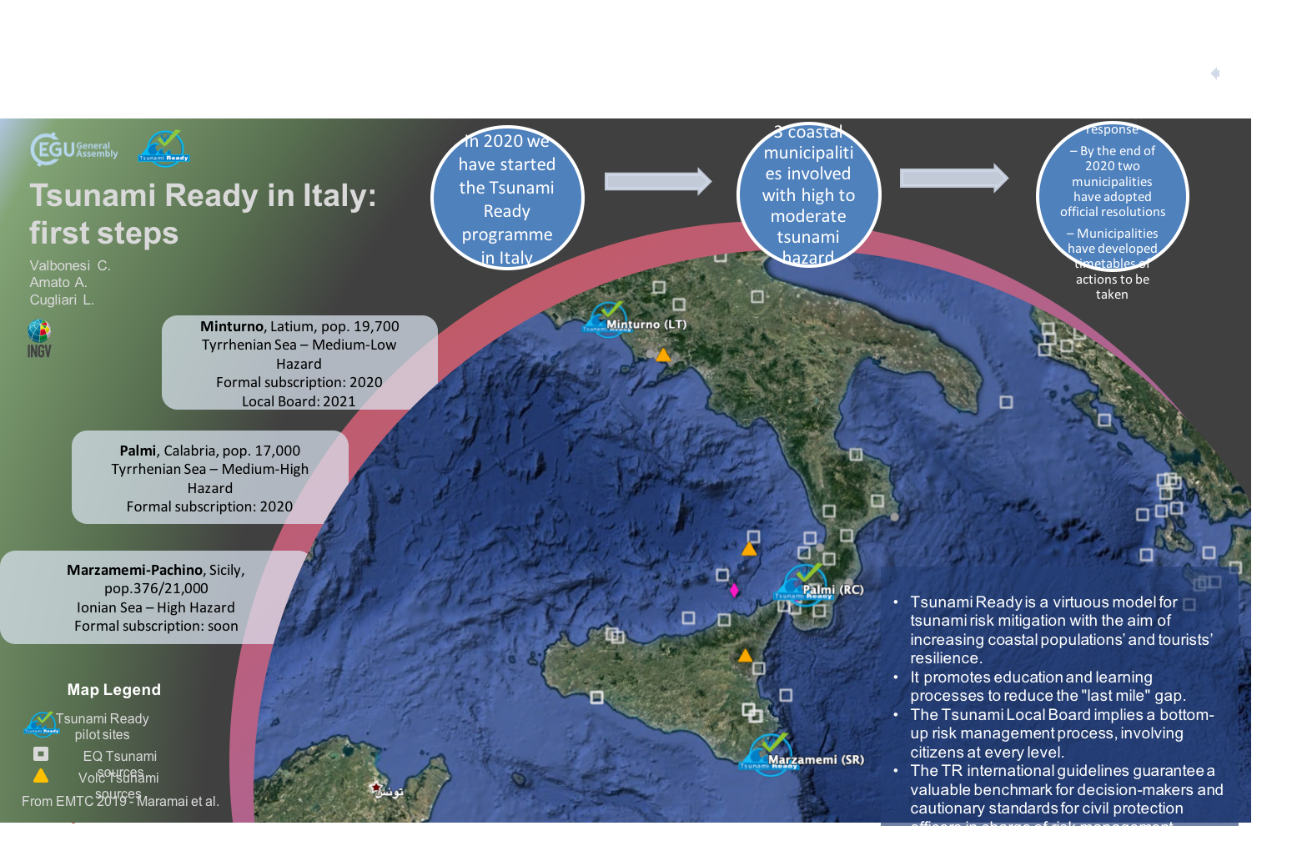
Tsunami Ready in Italy
WTAD 2021 / 8 November 2021 – NIOF-EGYPT

Slide 31
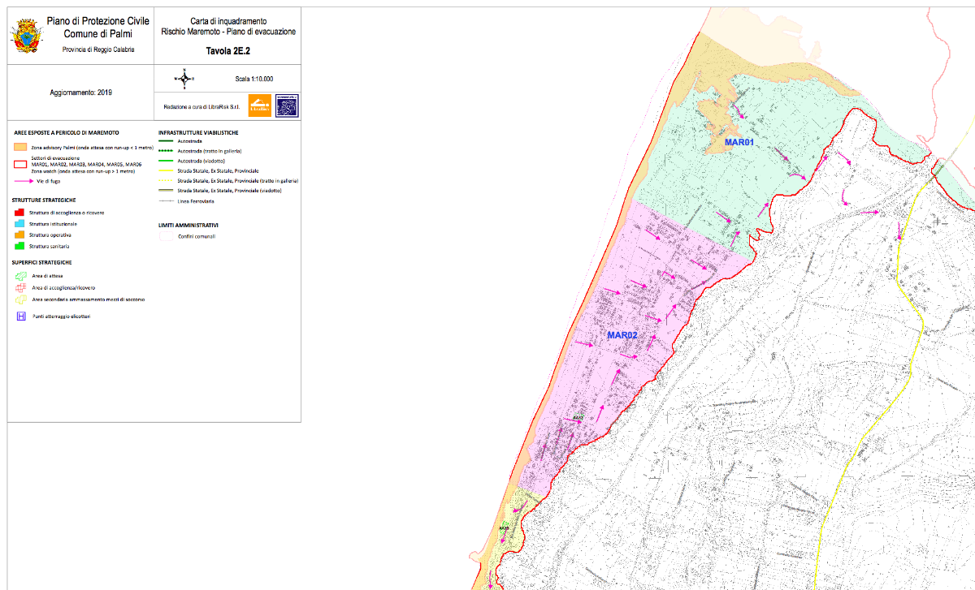
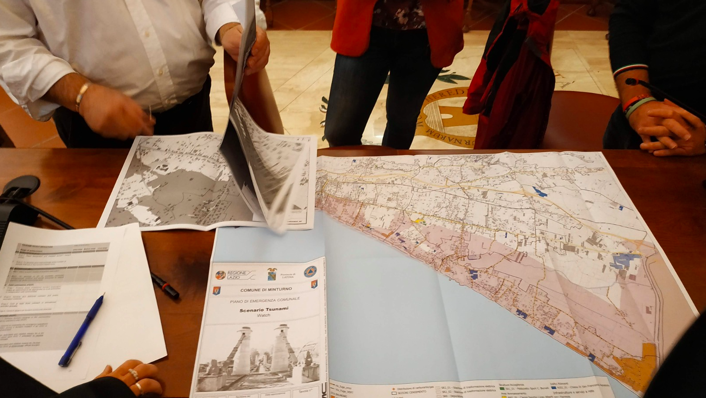
The last-mile: Tsunami Ready program
Examples from Palmi, Calabria, and Minturno, Lazio
From Inundation Maps to Coastal Planning and Evacuation Routes
WTAD 2021 / 8 November 2021 – NIOF-EGYPT
Notes:
The last-mile

Slide 32
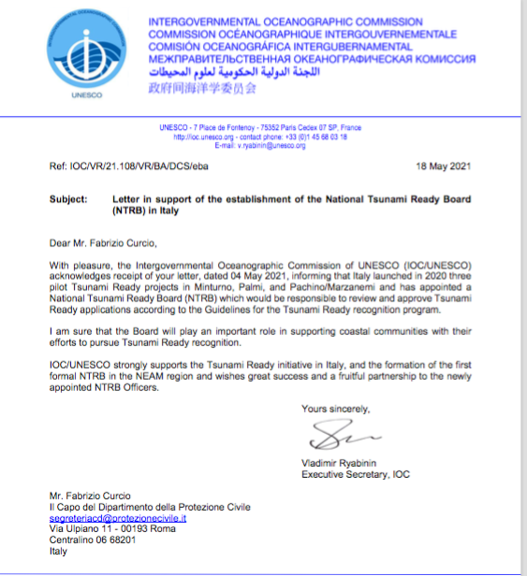
Tsunami Ready Officially Started
WTAD 2021 / 8 November 2021 – NIOF-EGYPT
Notes:
The last-mile

Slide 33
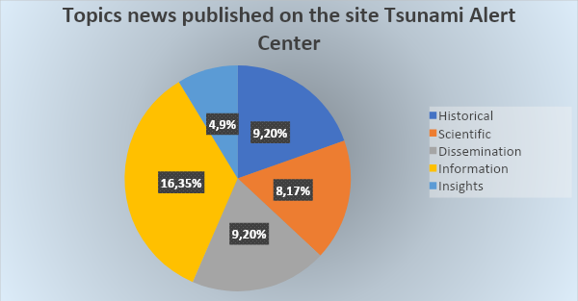
Awareness Raising
News on CAT-INGV website (Italian and English)
From May 2020 (site release) | 59 News
WTAD 2021 / 8 November 2021 – NIOF-EGYPT
Notes:
The last-mile

Slide 34
Concluding Remarks - End to end System - Last-mile
Dissemination of alert messages presently mostly only to authorities/civil protection system over the national territory (cell broadcasting and local dissemination ongoing)
Generally the Civil Protection plans have not been updated yet - the process has started, responding to the 2018 National Directive
Limited awareness and preparadness to respond to both Tsunami Alert Messages and to Natural Signs (shaking, sea level anomalies, ...) - Awareness Raising initiatives ongoing (IoNonRischio, Tsunami Ready)
Planning is based on single-hazard assessment (Research projects ongoing)
Risk assessment (people, buildings, CI) is ongoing or planned
Lack of long-term sustainability planning for the end to end system?
WTAD 2021 / 8 November 2021 – NIOF-EGYPT
Notes:
Last Mile Gaps

Slide 35
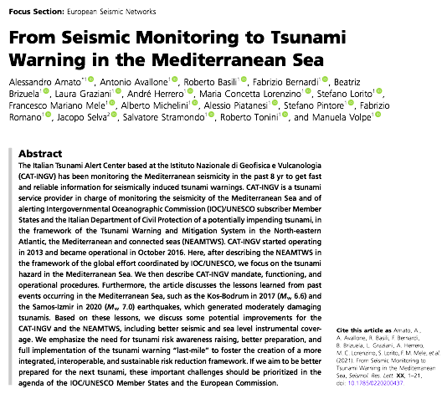
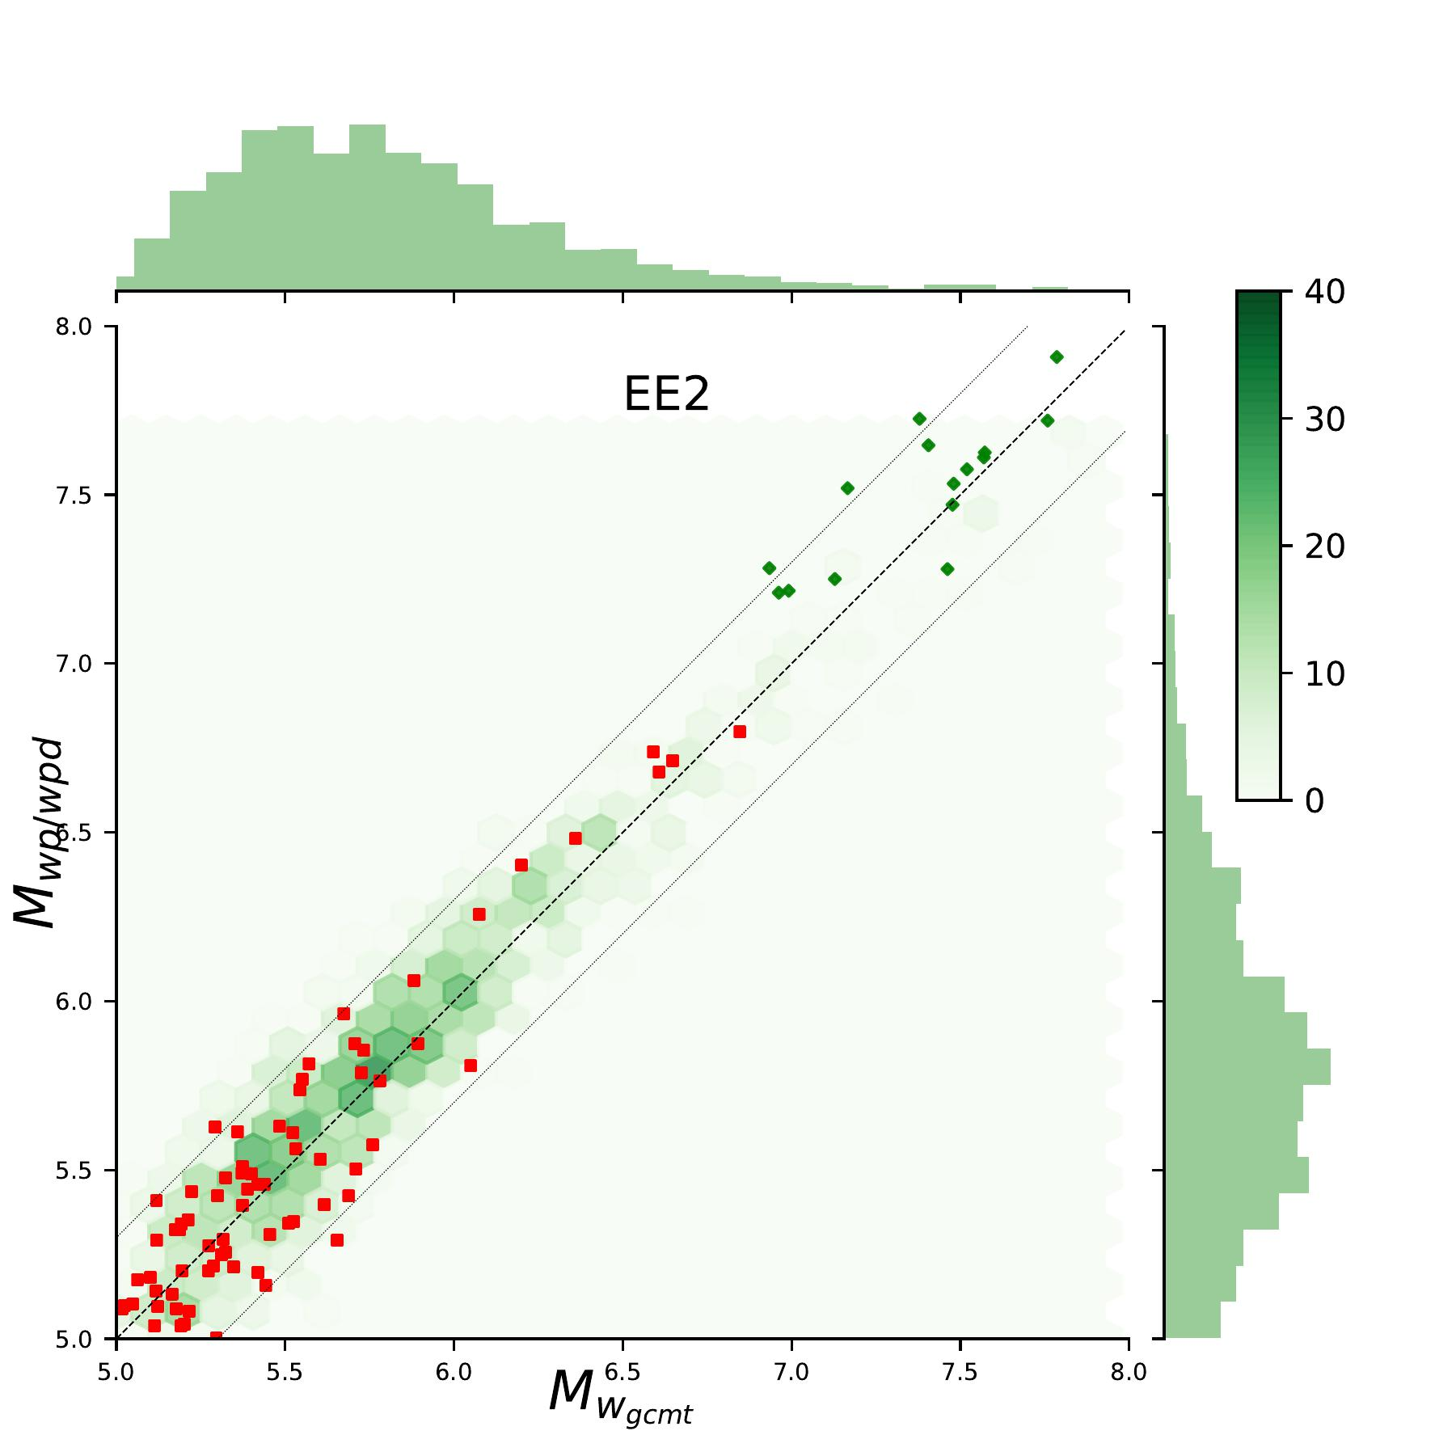
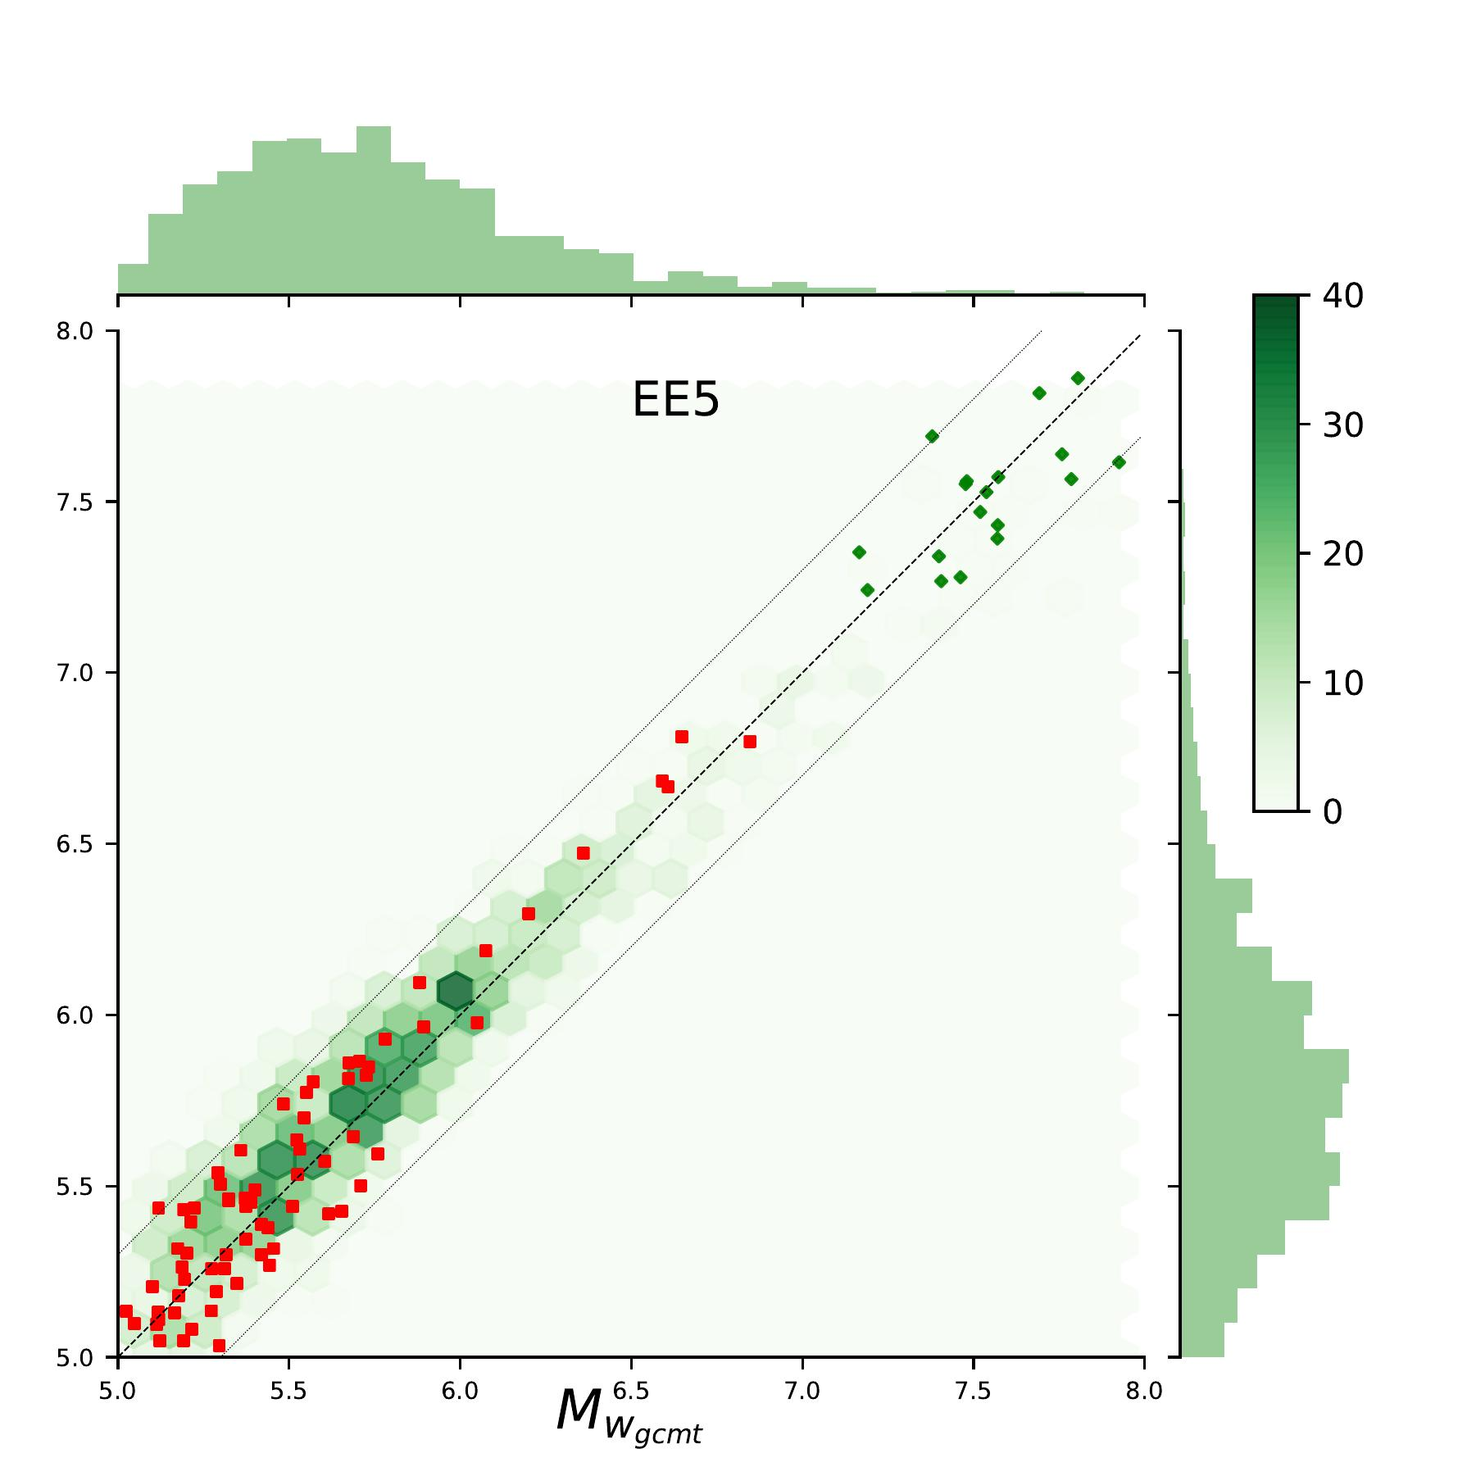

Further readings about progress and gaps
Amato et al., SRL, 2021
WTAD 2021 / 8 November 2021 – NIOF-EGYPT
Notes:
As testified by this Factsheet, for about 15 years we have been building the NEAMTWS

Slide 36

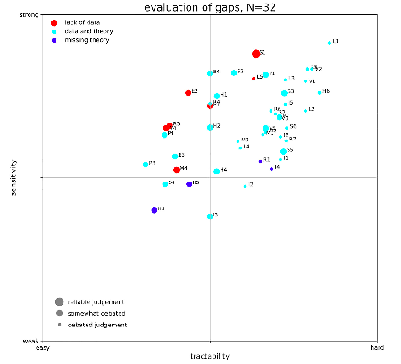
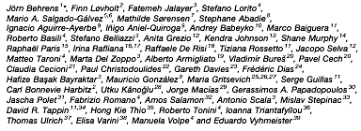
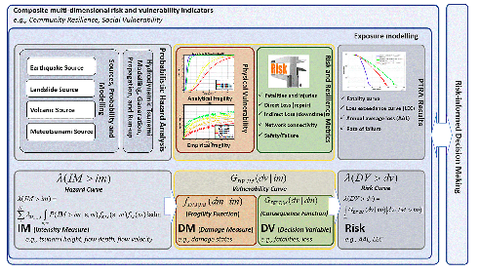
Further readings about progress and gaps
Behrens et al., FEART, 2021
WTAD 2021 / 8 November 2021 – NIOF-EGYPT
Notes:
As testified by this Factsheet, for about 15 years we have been building the NEAMTWS

Slide 37
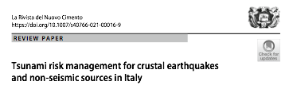
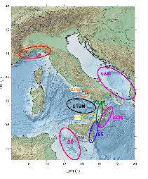




Further readings about progress and gaps
Selva et al., Nuovo Cimento, 2021
WTAD 2021 / 8 November 2021 – NIOF-EGYPT
Notes:
As testified by this Factsheet, for about 15 years we have been building the NEAMTWS

Slide 38

Further readings about progress and gaps
WTAD 2021 / 8 November 2021 – NIOF-EGYPT

Slide 39

Further readings about progress and gaps
WTAD 2021 / 8 November 2021 – NIOF-EGYPT

Slide 40

Further readings about progress and gaps
WTAD 2021 / 8 November 2021 – NIOF-EGYPT

Slide 41
Useful Links
www.ingv.it/cat/en
http://www.tsumaps-neam.eu
https://tsunamiarchive.ingv.it/emtc.2.0/
https://storymaps.arcgis.com/stories/32091c82e42a4d30a2f24b1e7b5955b6
http://sgi2.isprambiente.it/tsunamimap/
https://rischi.protezionecivile.it/it/maremoto-0
WTAD 2021 / 8 November 2021 – NIOF-EGYPT

Slide 42
Thank you for your attention!
WTAD 2021 / 8 November 2021 – NIOF-EGYPT
Notes:
As testified by this Factsheet, for about 15 years we have been building the NEAMTWS

