Slide 1
Task Team on Operations - Report -
Alessio Piatanesi & Fernando Carrilho
(co-chairs)
Online meeting, 24-26 November 2021

Slide 2
Plan of Actions
1) Explore and discuss how to include near real-time tsunami information on NEAMTIC-Dedicated Webpages (Password protected).
2) Organize meeting/consultation on the adoption of the threat level. Explore contributions and views of social scientist on tsunami threat levels.
3) Harmonization of Tsunami Warning Forecast Points, Evaluation of local EWS, how to address non-instrumental observations, and social media in TEWS.
4) Harmonization and standardization of enhanced tsunami products in NEAM region.
5) Request NEAM TSPs and NTWCs to make public tsunami warnings available in the Common Alerting Protocol (CAP) format as an addition to their current messages, as applicable.
6) Consultation with TSPs on Tsunami Alert to Maritime Community
7) Cooperation with other Working Groups and Task Teams (inter -ICG-TOWS TTTWO included) as needed and requested
8) Conduct a TT meeting in mid 2021

Slide 3
Actions performed
Participation to TOWS–WG Inter ICG Task Team Tsunami Watch Operations (Feb 2021)
Organization of a Task-Team meeting (April 2021)
Participation to the SC of ICG/NEAMTWS (April 2021)
- SC prepared a list of ACTIONS for WGs and TTs
- TT on Operations is involved in 7 of those ACTIONS (more details in the following slides)
Organization of 2 Task-Team meetings (July and November 2021)

Slide 4
ACTIONS where the TT on Operations is involved
from the “Summary Report of the ICGNEAMTWS Steering Committee, 8-9 April 2021”)
ACTION 4: TT on Operations to develop a mechanism that will provide a clear status of the seismic network
Leading role (NO PROGRESS)
ACTION 8: TT on Documentation to prepare/update the ICG/NEAMTWS Operational User Guide
Contributing role (NO REQUEST OF CONTRIBUTION UP TO NOW)
ACTION 9: WG 4 and TT on Operations to organize a meeting on adopting a Tsunami Threat Level in NEAM region
Leading role (STALLING ISSUE, difficulties in implementing current Threat Levels)

Slide 5
List continues:
These 4 ACTIONS are strictly interconnected and mainly driven by the need for NEAM TSPs to be more inter-operable
ACTION 10: TT on Operations and TSPs to prepare a list of Tsunami Forecast Point for all TSPs.
Leading role (MADE SOME PROGRESS)
ACTION 11: Encourage TSPs to use Unique Identifiers (basin specific); show most critical information at the beginning of the tsunami message
Leading role (DISCUSSION STARTED)
ACTION 12: TT on Operations to promote collaboration among all NEAM TSPs to start developing the Tsunami Service Provider Inter-Operability Tool (TSP-IOT)
Leading role (DISCUSSION STARTED, concept presented)
ACTION 14: To consider implementing an inter-operable map for the whole NEAMTWS gathering all earthquake-tsunami events on a single platform
Leading role (DISCUSSION STARTED)

Slide 6
Collaboration among all NEAM TSPs to start developing the Tsunami Service Provider Inter-Operability Tool (TSP-IOT)
- All TSPs communicated their own list providing the following information:
- FP coordinates on grid
- spatial resolution of the grid used for travel time calculation
- depth at the FP grid point
- Sensor Location at FP
Repository and interactive web page are in progress
Standard format for tsunami messages: agree on CAPTSU, but specific discussion is needed

Slide 7
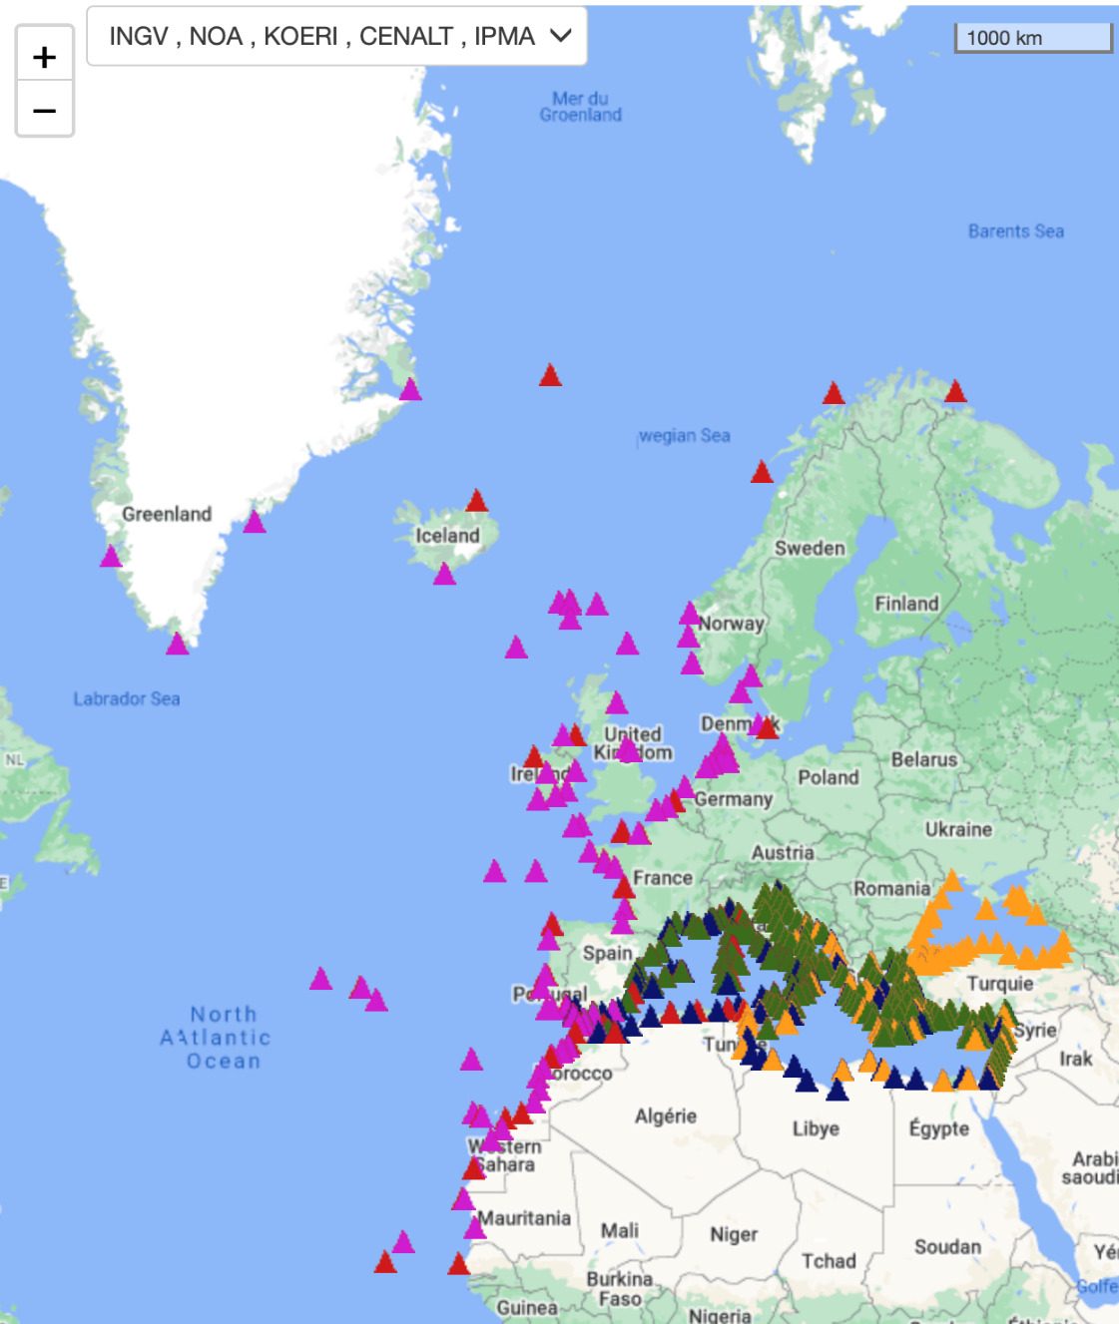
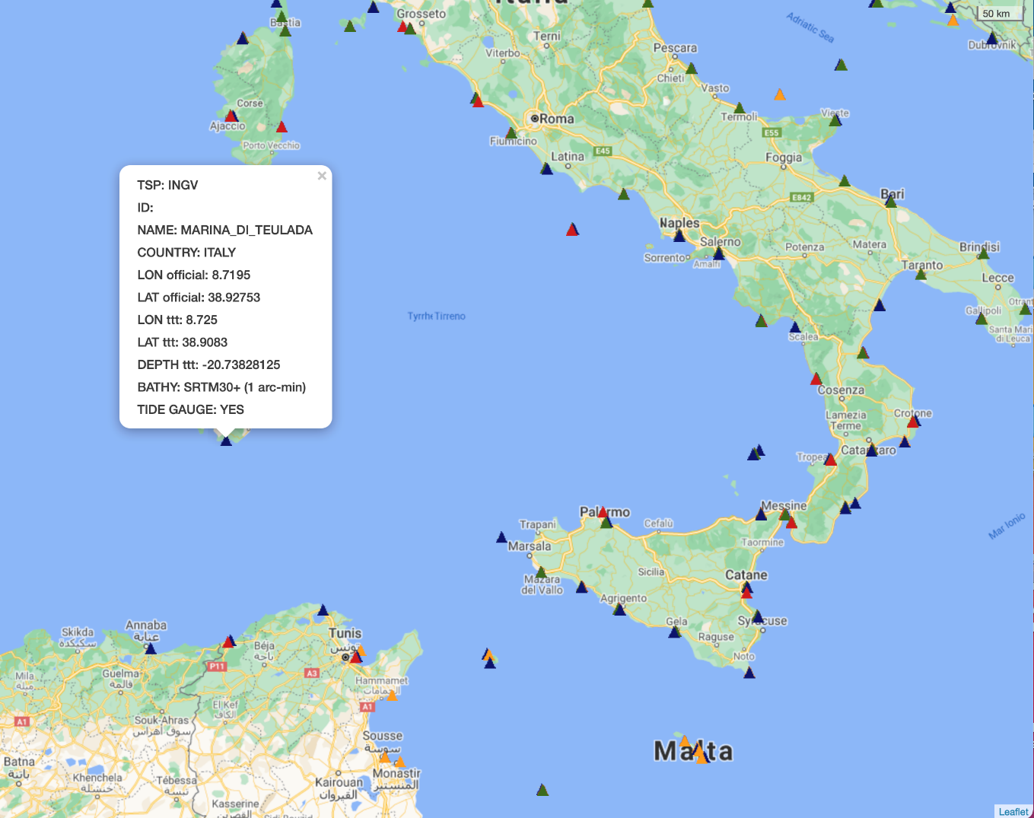
TSP-IOT: interactive web page
Forecast Points

Slide 8
Next steps for TT on Operations
- Contribute to draft a list of Decisions & Recommendations at this ICG/NEAMTWS Meeting
- Prepare the Plan of Actions for 2022

Slide 9
THANK YOU

