Slide 1
3.4 Report by the
Task Teams on Tsunami Exercise
co-chairs:
Ceren Ozer Sozdinler (Turkey) - Marinos Charalampakis (Greece)
ICG/NEAMTWS - XVII Paris, France, 24–26 November 2021

Slide 2
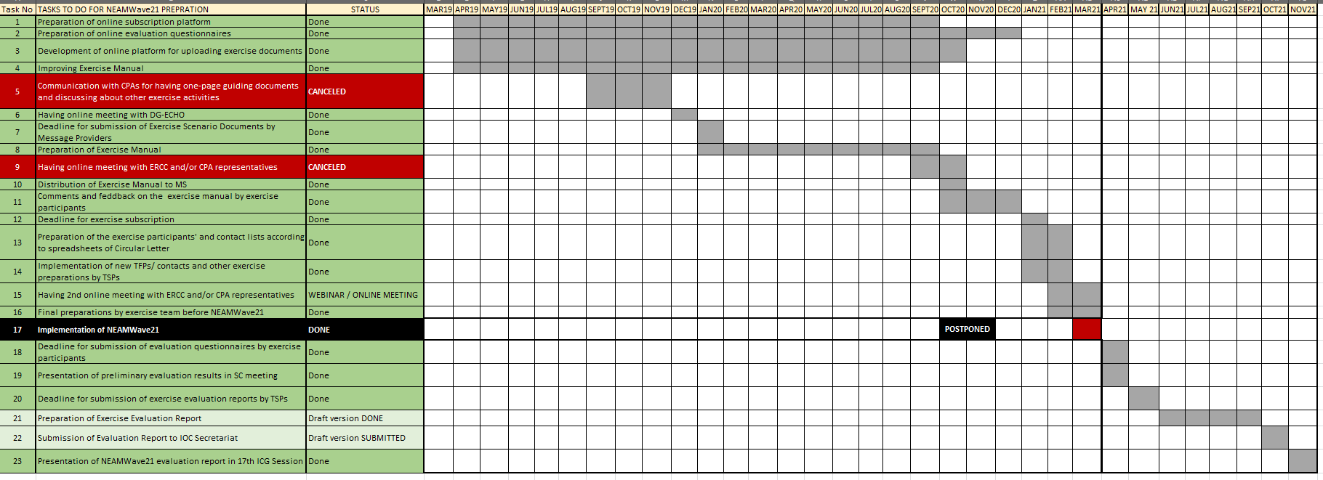
Timeline of NEAMWave21
ICG/NEAMTWS - XVII Paris, France, 24–26 November 2021

Slide 3
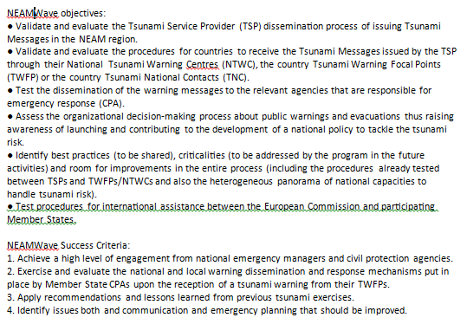
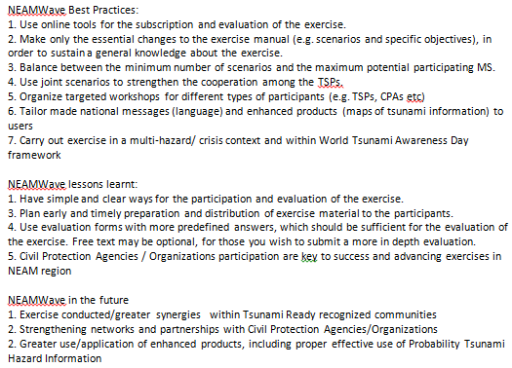
WAVE exercise
ICG/NEAMTWS - XVII Paris, France, 24–26 November 2021

Slide 4
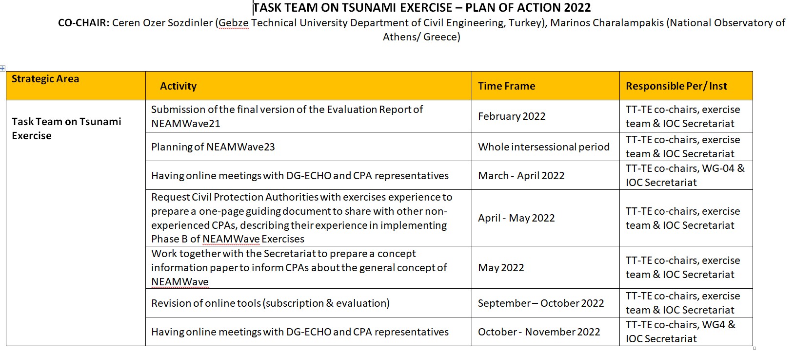
Plan of Actions 2022
ICG/NEAMTWS - XVII Paris, France, 24–26 November 2021

