Slide 1
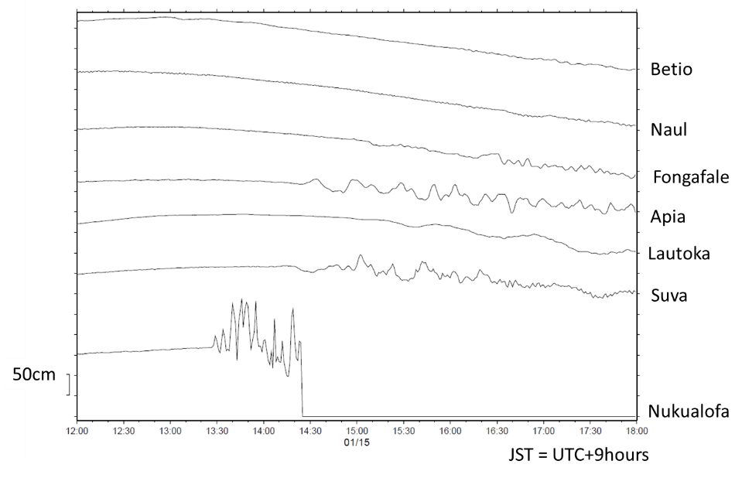
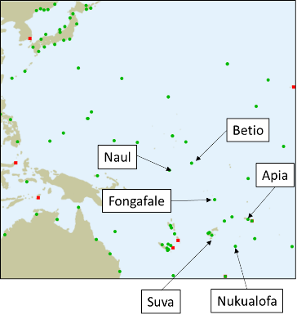
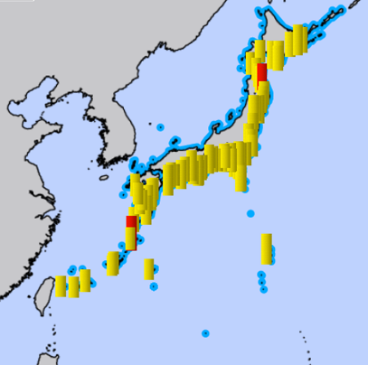
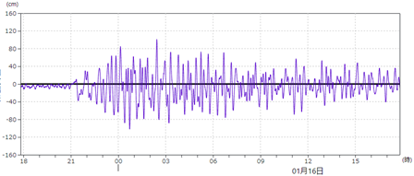
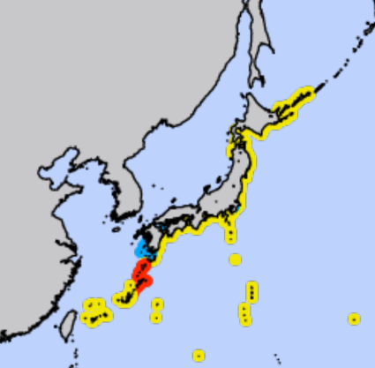
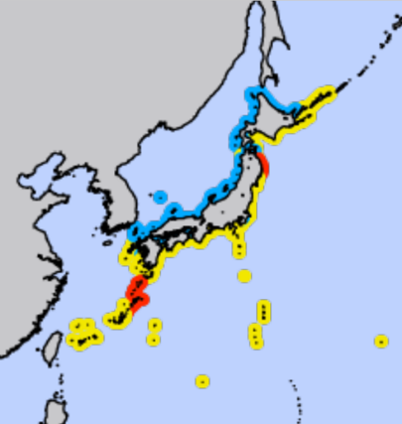
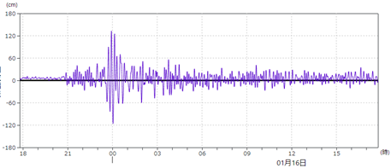
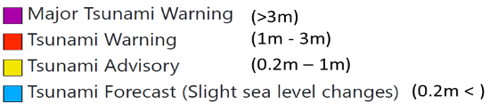
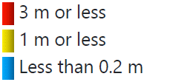
Satellite image of eruption by JMA’S Meteorological Satellite (Himawari) , as of January 15th 14:00 JST = UTC+9hours
JMA’s operations against sea level changes caused by Hunga-Tonga Hunga-Ha'apai Eruption
Sea level changes of overseas gauges
Warning/Advisory issued by JMA
Maximum observed height, as of 14:00 JST Jan. 16
Issued at 00:15 JST Jan. 16
Issued at 02:54 JST Jan. 16
18
21
00
03
06
09
12
15
(JST)
15 Jan.
16 Jan.
18
21
00
03
06
09
12
15
(JST)
15 Jan.
16 Jan.
Notes:
ひまわり
ウェリントンVAACによる情報で噴火を覚知
海外検潮所（ヌクアロファ）で津波の発生も覚知

Slide 2
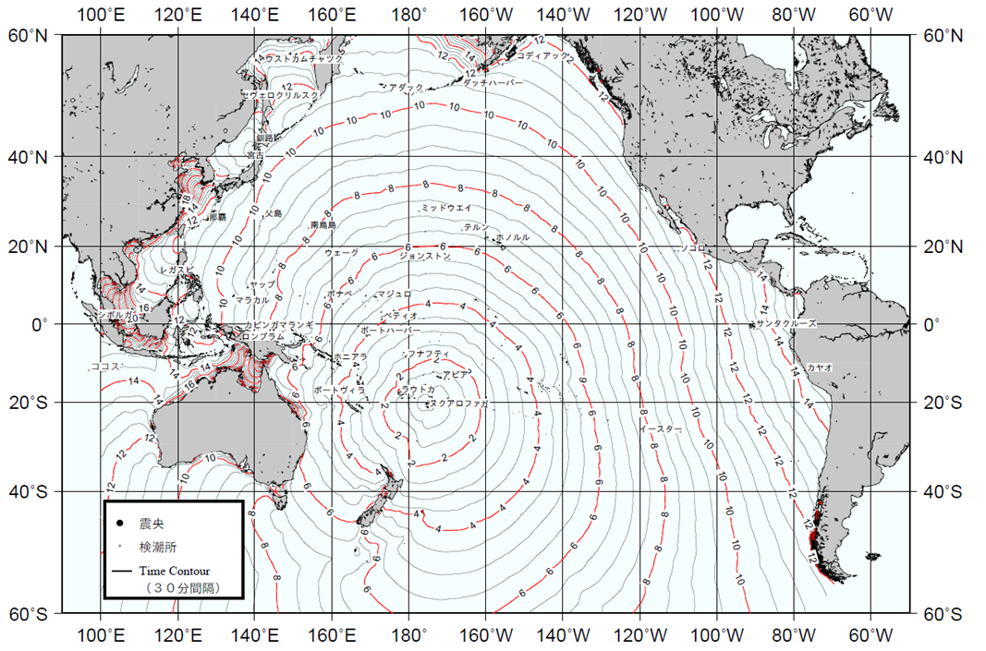
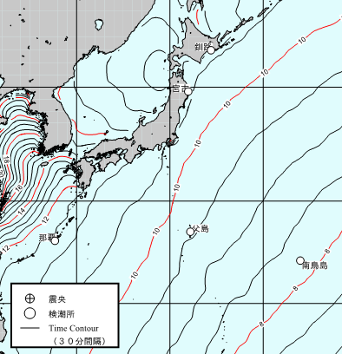
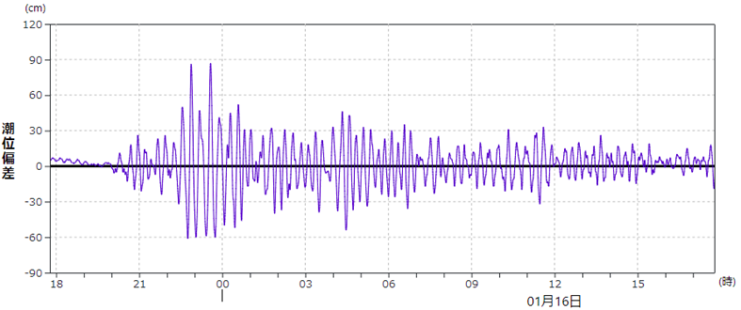
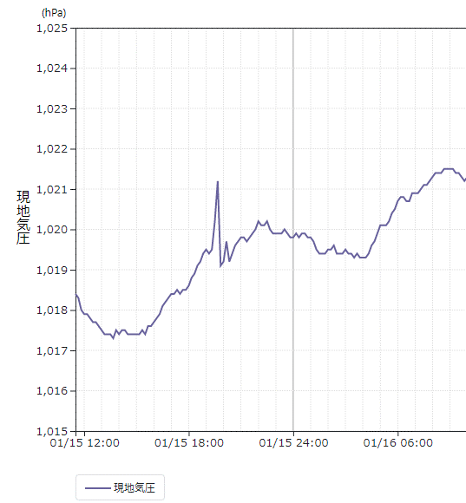
Estimated tsunami arrival to Japan and atmospheric pressure changes
Tsunami travel time map
Chichijima
23 JST
22 JST
21 JST
Sea level changes at Chichijima
Atmospheric pressure changes at Chichijima
Peak time at 19:40 JST
18
21
00
03
06
09
12
15
(JST)
Estimated arrival at Chichijima based on tsunami travel time map
(JST)

