Slide 1
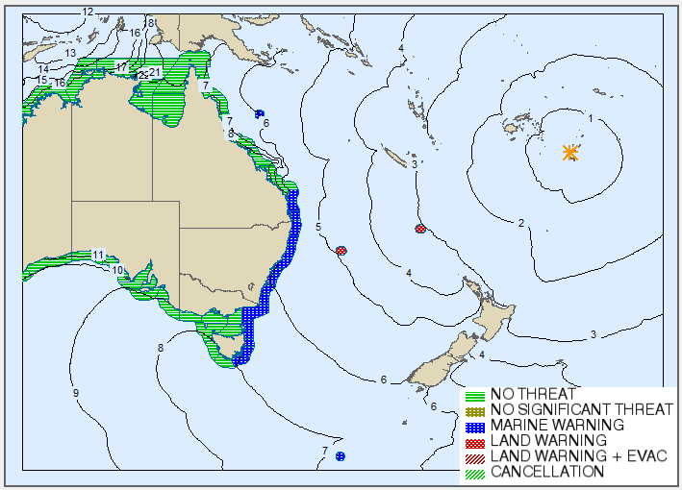
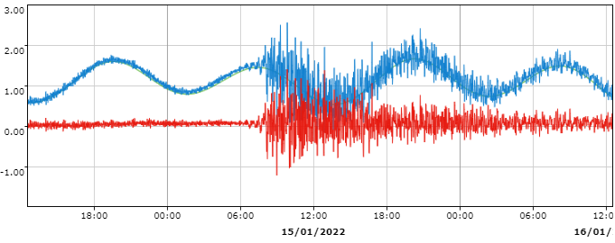
TSUNAMI – HUNGA TONGA-HUNGA HA'APAI VOLCANO
JATWC Tsunami Threat Assessment – Within 7 Hours Travel Time
Time (AEDT) | Elapsed Time (hh:mm) | Key Event: 15 January 2021
15:10 | 00:00 | Explosive volcanic eruption of the Hunga Tonga-Hunga Ha'apai volcano (Tonga)
15:30 | 00:20 | Observations confirm a tsunami was generated at 3:30 PM AEDT at Nuku Alofa.
16:58 | 01:48 | No Threat Bulletin issued with additional text to advise that a tsunami had been generated and that the JATWC would continue to monitor observations. Initial assessment based on 3 hours travel time.
19:36 | 04:26 | Marine Warning for Norfolk Island issued after 50 cm wave observed at the tide gauge.
20:00 | 04:50 | Marine Warning issued for Lord Howe Island based on tide gauge measurements increasing at Norfolk Island.
20:37 | 05:27 | Significant observations in NSW and QLD: (40cm at Twofold Bay at 8:10 PM AEDT; 25 cm at Gold Coast at 7:40 PM AEDT) prompts the issuing of Marine Warnings.
20:58 | 05:48 | Norfolk Island Warning upgraded to Land Threat after wave observations exceed 1.0 m at the tide gauge.
21:00 | 05:50 | Marine Warnings extended to Victoria, Tasmania and Macquarie Island using a 7 hours travel time threat assessment.
21:18 | 06:08 | Lord Howe Island Warning upgraded to Land Threat with evacuation order issued at 10:12 PM AEDT.
10:09 +1 | 18:59 | Land warnings for Norfolk Island and Lord Howe Island downgraded to marine.
10:30 to 11:50 +1 | 19:20 to 20:40 | QLD, Macquarie Island, Victoria and Tasmanian marine warnings cancelled.
19:56 to 21:59 +1 | 28:46 to 30:49 | Lord Howe Island, Norfolk Island and NSW warnings cancelled.
Gold Coast
Norfolk Island
Lord Howe Island
0.05m
0.06m
Macquarie Island
0.11m
0.38m
Norfolk Island – 1.27 m
0.03m
0.56m
0.15m
0.17m
0.29m
Gold Coast – 0.82 m
0.01m
Key Challenges
Initial detection of the volcanic eruption / tsunami and scale of eruption.
Lack of event-specific tsunami modelling.
Lack of a unified sea-level observing tool.

