Slide 1


UN Ocean Decade Tsunami Programme
Scientific Committee (ODTP-SC)
Outcome of the First Meeting held on 17 Feb 2022
Srinivasa Kumar Tummala
Chair, ODTP-SC
TOWS WG and TT Meetings
February 21 – 22 & 24 – 25, 2022

Slide 2
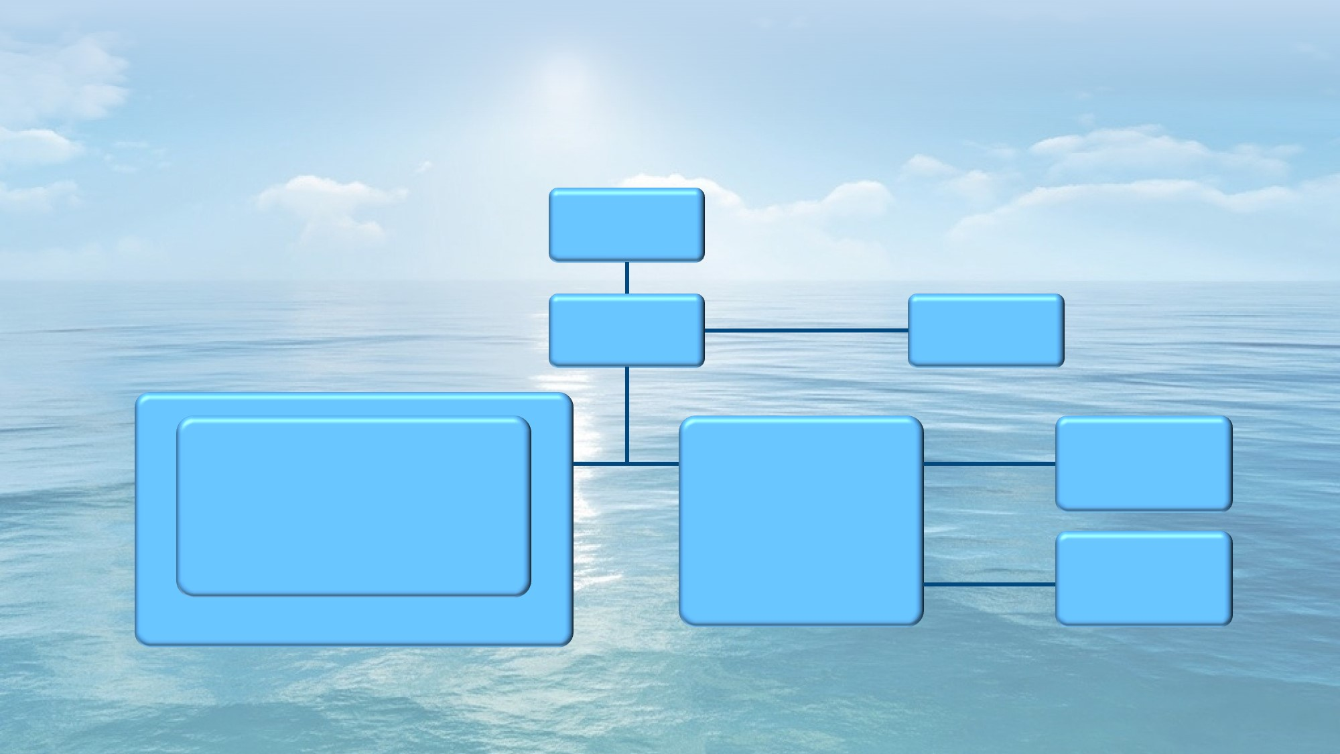
IOC Tsunami Programme and UN Ocean Decade
UN Ocean Decade (2021-30)
Once-in-a-generation opportunity to address gaps in tsunami warning , enhance community preparedness and contribute to “A Safe Ocean”
IOC Assembly 31 (Dec. A-31/3.4.1) established the Ocean Decade Tsunami Programme + Scientific Committee to Develop Research, Development & Implementation Plan
  Technological & Observational Advances to reduce uncertainties
  100 % at risk communities prepared & resilient to tsunamis by 2030 (Tsunami Ready, etc.)
ODTP-SC established by the IOC through CL 2876 dt 24 Jan 2022
Governance
TOWS-WG & ICGs: Global & Regional Steering Committee
Scientific Committee: Advisory Role
Special coalition for Tsunami Ready
IOC Assembly
IOC Executive
Council
IOC Secretariat
Tsunami Unit
ICG/PTWS
ICG/IOTWMS
ICG/CARIBE EWS
ICG/NEAMTWS
Pacific
Indian
Caribbean and Adjacent Regions
NE Atlantic
and Mediterranean
TOWS-WG
WG on Tsunamis and Other Hazards Related to Sea-Level Warning and Mitigation System
TT on TWO
Task Team on Tsunami Watch Operation
ODTP Science Committee
Standards,
Best Practice, Advisory to IOC Governing bodies
TT on DMP
Task Team on Disaster Management and Preparedness
Coordination of Regional TWS
Capacity Development
Protecting Communities from the World's Most Dangerous Waves: A Framework for Action under the UN Decade of Ocean Science for Sustainable Development
Notes:
Services associated with the Global Tsunami Warning System are governed by the 4 ICGs, and advocated for by the Inter-ICG Working Group on Tsunamis and Other Hazards Related to Sea-Level Warning and Mitigation System (TOWS WG). TOWS-WG is informed by two standing task teams made up of ICG representatives on Tsunami Warning Operation and Disaster Management and Preparedness. The Chair of the TOWS WG ensures development and delivery of recommendations to the IOC Executive Council and General Assembly.
TOWS-WG is composed with Chairs of the 4 ICGs, GOOS, IODE and JCOM, plus High-level representatives invited from the key TOWS-WG stakeholders (CTBTO, FSDN, UNDRR, WMO and now IUGG TC!).

Slide 3





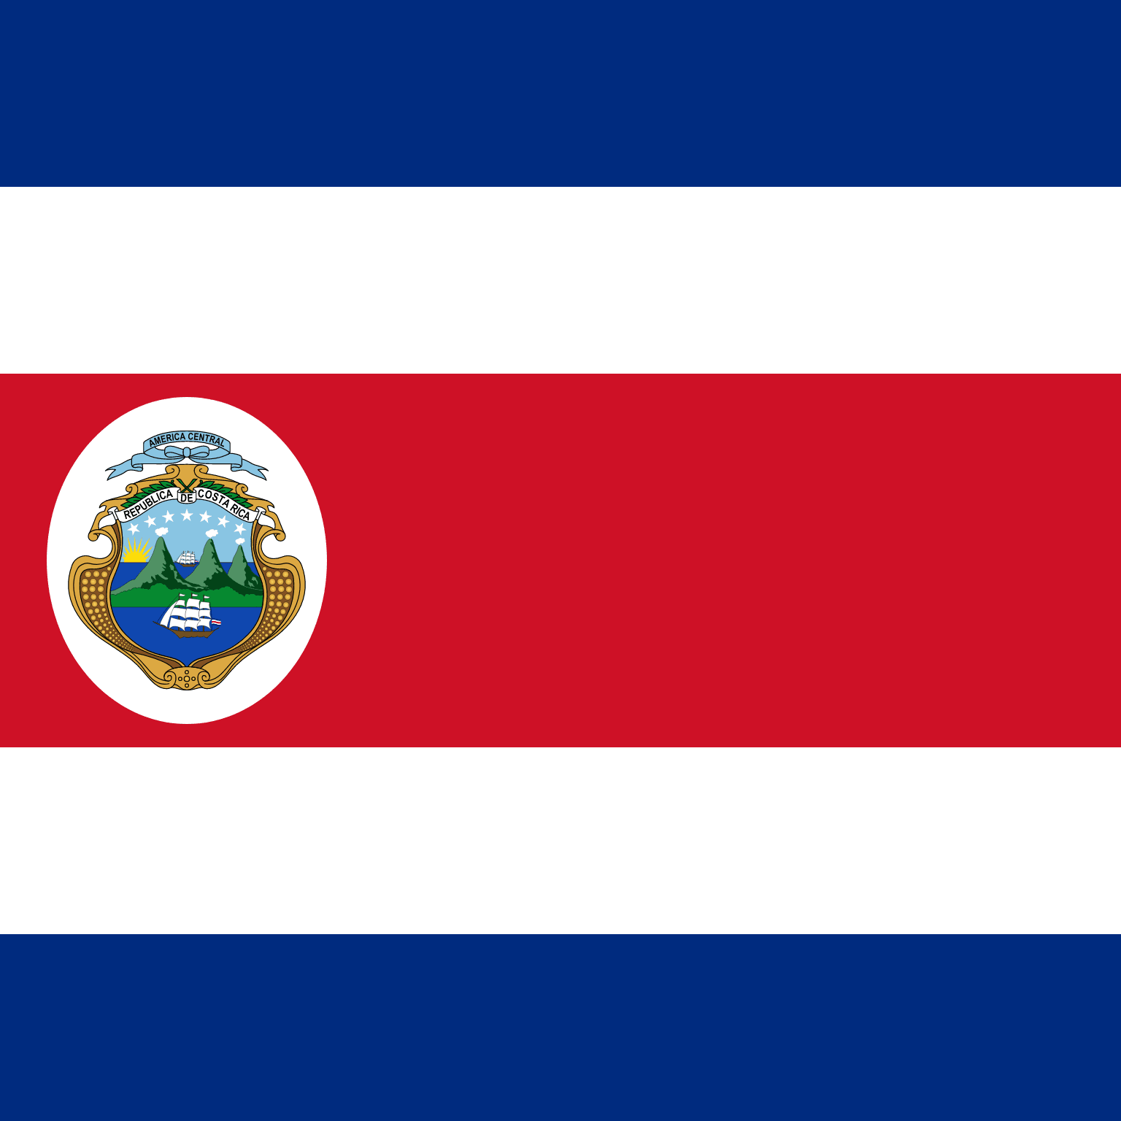



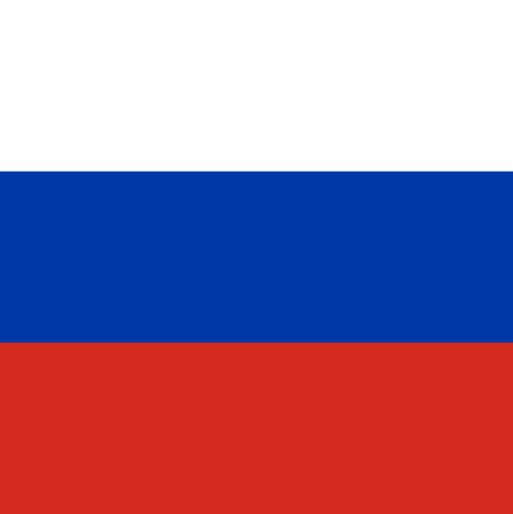
UN Ocean Decade Tsunami Programme Scientific Committee - Membership
Annex to Dec. A-31/3.4.1
Membership:
• Four (4) members nominated by the each of the TOWS-WG Task Teams;
• Three (3) members nominated by the TOWS-WG on the basis of their scientific expertise;
Annex to Dec. A-31/3.4.1 (cont.)
• All members will serve for a period of two years and would be eligible for renewal once.
• In selecting Expert Members, due consideration will be given to geographic, generational and gender balance.
2022-2023
Srinivasa Kumar Tummala
Chairperson
Christa von Hillebrandt
Amir Yahav
Harkunti Pertiwi Rahayu
David Coetzee
Silvia Chacon
Srinivasa Kumar Tummala
François Schindele
Yutaka Hayashi
Michael Angove
Sergio Barrientos
Alexander Rabinovich
BRIAN WILLIAMS
Manager

Slide 4
UN Ocean Decade Tsunami Programme Scientific Committee - ToR
1. Develop a Draft 10-Year Research, Development and Implementation Plan for the Ocean Decade Tsunami Programme based on the concept paper “Protecting Communities from the World's Most Dangerous Waves: A Framework for Action under the UN Decade of Ocean Science for Sustainable Development”;
2. Identify and address gaps in global tsunami hazard assessment as follows:
    a. comprehensive assessment to include all potential tsunamis, anywhere in the world, regardless of their source,
    b. strategies to validate historical tsunami sources, through the application of paleotsunami techniques and historical seismology
3. Identify gaps in tsunami detection, measurement, forecasting, with a special emphasis on tsunamis generated close to populated coastlines;
4. Propose to enhance sensing and analysis strategies to enable the rapid characterization of tsunami sources through the combined use of land-based seismic and geodetic sensors, GNSS terminals, coastal sea level gauges, deep-ocean tsunameters, SMART repeaters on deep-ocean fiber-optic cables and satellite-based observations;

Slide 5
UN Ocean Decade Tsunami Programme Scientific Committee - ToR
5. Propose a roadmap for collaboration with the ITU/WMO/IOC SMART Joint Task Force cable initiative to fully explore the feasibility of widespread deployment of scientific instrumentation on deep-ocean fiber-optic cables to improve capability to rapidly detect and characterize tsunami sources as well as propagating tsunami wave fields;
6. Consider and propose strategies, programmes and content to enhance societal resilience for tsunami and other ocean hazards;
    a. build the framework needed to ensure the training and development of the next generation of technical-scientific expertise,
    b. identify strategies that allow to characterize structural and social vulnerability in tsunami hazard zones
7. Overview the consolidation of inputs received to IOC Circular Letter 2825 on Inventory of actions being considered under the United Nations Decade of Ocean Science for Sustainable Development (2021–2030) in the field of Tsunamis and Other Sea-Level Related Hazards warning and mitigation;
8. Submit a Draft 10-Year Research, Development and Implementation Plan for endorsement by the TOWS-WG at its 15th meeting.

Slide 6
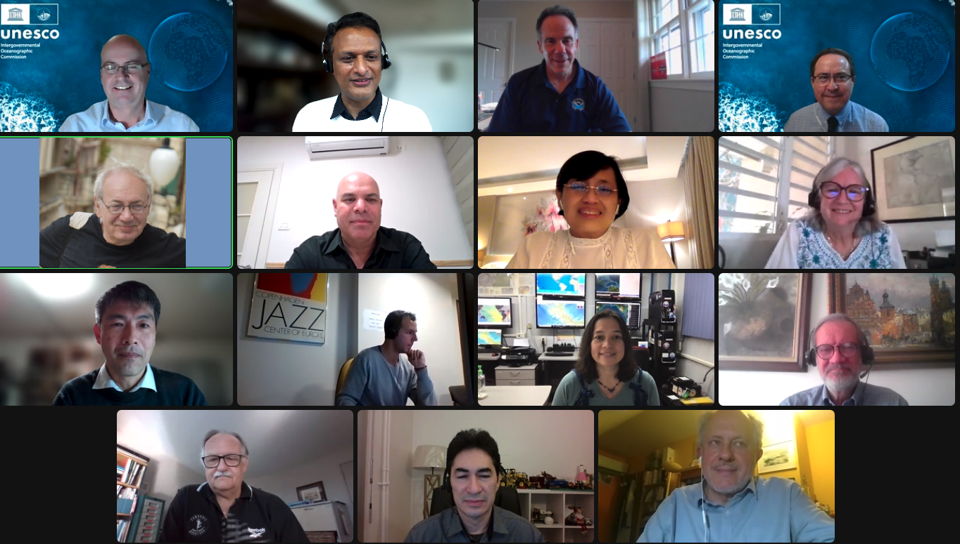
UN Ocean Decade Tsunami Programme Scientific Committee – Outcome of First Meeting on 17 Feb 2022
Introductions by Members:
  Acknowledged the wide expertise within the group. Suggestion to post brief CVs + Picture of SC Members on website for ready reference.
ToRs discussed and acknowledged:
  Tsunami Ready Programme is an integral part of our work in the context of the Decade. Suggestion to include wording under ToR # 6
Timeline of actions:
  Agreed on the broad timeline of actions. Tsunami Symposium (PTWS/IOTWMS) to be added to the timeline and perhaps combined with 3rd SC in person meeting
  Acknowledged resource issues for participation in in-person meetings
Consultant Support:
  2 to 3 consultants to assist the SC in drafting the important chapters
  ToRs to be defined by SC
Other important suggestions:
Important link for UN Ocean Decade with SDG 11 through mainstreaming DRR (tsunami preparedness) in urban planning.
Integration of Tsunami with other ocean hazard warning systems.
Useful to work in smaller groups within the SC to address specific topics, with a provision to invite other experts outside the SC membership, as needed.

Slide 7
UN Ocean Decade Tsunami Programme Scientific Committee – Timeline of action
Goal=Draft a 10-Year Research, Development and Implementation Plan for the Ocean Decade Tsunami Programme
Consultants to draft chapters
Consultations with TSU community (TTs/ICGS)
Consult/contributions Member States (CL)
17 Feb 2022
24-25 Feb 2022
5-7 April 2022
13-17 June 2022
Nov-Dec 2022
23-24 Feb 2023
SC 1st meeting
(online)
TOWS-WG-XV
Safe Oceans
Lab
IOC -EC 55
2nd IOC Tsunami Symposium #
IOC Governing body .
to examine lessons learnt from past events & recent efforts in further developing TWMS
Laboratories are innovative formats that function as self-sustaining events. They act as a creative platform to link diverse stakeholders and topics to trigger collaborative efforts regarding the UN Ocean Decade.
TOWS WG XVI
The purpose of this meeting is to first and foremost meet (virtually) and present each other, but also to broadly discuss the terms of reference and agree on a timeline for delivering the 10-year plan
TOWS-WG is a standard setting and advisory body to the IOC on tsunami and other coastal hazards. This session will discuss among other matters, SMART Cable, Tsunami Ready & UN Decade
Endorsement of the 10-Year Research, Development and Implementation Plan for the Ocean Decade Tsunami Programme
2nd SC meeting
(in person)
3rd SC meeting (in person)
Final version of the Draft 10-Year Research, Development and Implementation Plan for the Ocean Decade Tsunami Programme.
Opportunity for an in-person SC meeting – 1st Draft of the 10-Year Plan
Draft TORs consultancies
1st Draft by email
# Timing subject to decision by the TOWS-WG

Slide 8
Recommendation to the TOWS-WG
The Group noted the establishment of the Scientific Committee (SC) for the Ocean Decade Tsunami Programme; and accepted the Workplan of the SC to develop the Draft 10-Year Research, Development, and Implementation Plan for consideration by the TOWS-WG at its XVI Meeting in February 2023. The Group endorsed the modification of the ToRs of the SC as in Appendix 3:
6. Consider and propose strategies, programmes and content to enhance societal resilience for tsunami and other ocean hazards;
    a. build the framework needed to ensure the training and development of the next generation of technical-scientific expertise,
    b. identify strategies that allow to characterize structural and social vulnerability in tsunami hazard zones
    c. propose strategies for promoting implementation of community preparedness initiatives such as IOC Tsunami Ready to ensure 100 % at risk communities are prepared & resilient to tsunamis by 2030

Slide 9
Thank you

